Slide 1
Measles and Rubella Serosurveys
Accelerating Progress Towards Measles and Rubella Elimination
23 June 2016
Geneva, Switzerland
Minal K. Patel WHO HQ IVB/EPI

Slide 2
Background
Growing demand for periodic cross-sectional surveys to identify population immunity gaps
Purpose
  Provide information to guide on who/where to vaccinate
  Monitor population immunity over time (serosurveillance)
  Provide evidence for verification of elimination
  Assess impact of campaign (pre/post)
Guidelines currently being developed on MR serosurveys
  Provide standards
  Assist EPI managers, epidemiologists, laboratory staff in obtaining accurate, reliable, and usable data
NOT A REPLACEMENT FOR SURVEILLANCE
Notes:
Purpose
Provide information to guidance on who/where to vaccinate
High risk areas
Changes to immunization schedule
Decision making regarding the need for SIAs
Monitor population immunity over time (serosurveillance)
Provide evidence for verification of elimination
Close remaining immunity gaps to sustain elimination
Assess impact of campaign (pre/post)

Slide 3
Topics Covered by Guidelines
Survey planning and implementation
  Identifying stakeholders
  Defining survey objectives
    Important to stress that this will not ‘validate’ coverage
  Survey design/sample size
    Subnational vs national
    Piggybacking onto another serosurvey
    Banked samples
    Age group targeted
  Budget/Timeline
    ~1 year, expensive (100K-1+million USD)
  Ethics
Notes:
Subnational vs national
Piggybacking onto another serosurvey
Banked samples
Age group targeted

Slide 4
Topics Covered by Guidelines
Survey Implementation
  Stressing randomness and ensuring representativeness
Laboratory
  Specimen type (serum vs DBS vs oral fluid)
  Assay (different assays give different results)
Survey Analysis
Notes:
Engaging local authorities
Selection, training, supervision of field/lab teams
Sampling in the field (stressing randomness)
Data collection/management
seroprevalence ≠ protection
Specimen collection/transport
Specimen type choice (serum vs DBS vs oral fluid)
Assay (different assays give different results)
QC testing
Safety

Slide 5
Why are these Needed?
Need standards
  Each decision made in the study planning, implementation, analysis affects interpretability and use of data for action
  Misinterpretation can be costly for MR elimination
    Not vaccinate the right population
    False reassurance that no immunity gap
Notes:
Do you need this slide?
This is rationale and should be before topics

Slide 6
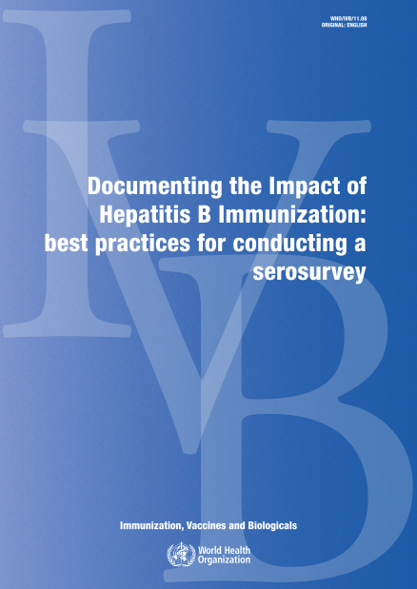
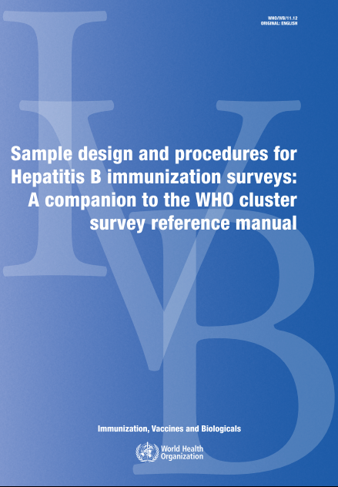
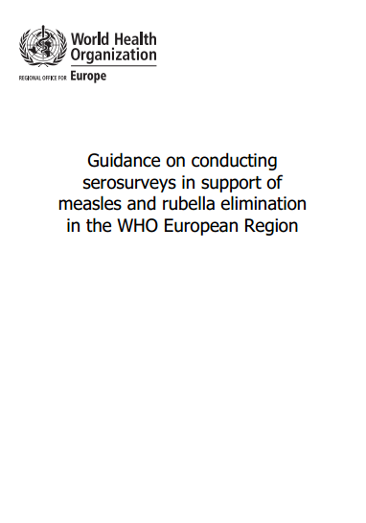
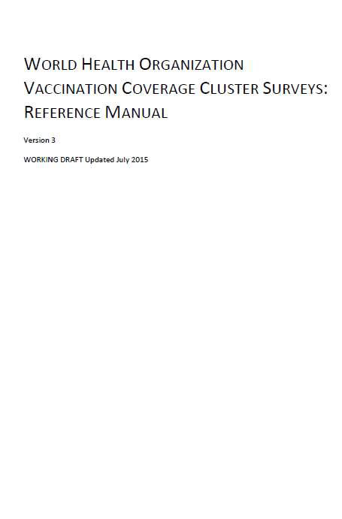
Guidance
http://apps.who.int/iris/bitstream/10665/70808/1/WHO_IVB_11.08_eng.pdf
http://apps.who.int/iris/bitstream/10665/70876/1/WHO_IVB_11.12_eng.pdf
http://www.euro.who.int/__data/assets/pdf_file/0011/236648/Guidance-on-conducting-serosurveys-in-support-of-measles-and-rubella-elimination-in-the-WHO-European-Region.pdf
http://www.who.int/immunization/monitoring_surveillance/Vaccination_coverage_cluster_survey_with_annexes.pdf

Slide 7
Integration Opportunities
EPI
  Coverage survey
  Polio: Lebanon, Jordan
  Hepatitis B serosurveys
    Must be done to show achievement of control goals
Other public health programs
  Lymphatic Filariasis Transmission Assessment Surveys (TAS)
  Dengue?
  Demographic and Health Survey (DHS), Multiple Indicator Cluster Survey (MICS), National Health and Nutrition Examination Survey (NHANES)-like surveys
Notes:
Must give results back
Hepb: Defined by serosurveys in <5 (AFR, EMR), ≥5 (WPR), ‘vaccinated cohorts’ (EUR)
Must give results back
Other public health programs
Lymphatic filariasis Transmission Assessment Surveys (TAS)
School based if ≥75%
Only children 6-7 yrs of age

Slide 8
Country Examples and Lessons

Slide 9
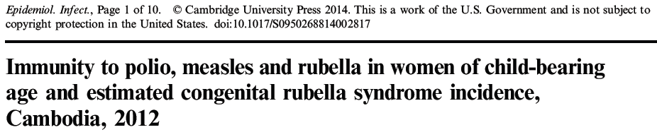
Cambodia: Integrated VPD Serosurvey
Nationwide HH survey in 2012, 15-39y WCBA
  Primary purpose tetanus
  Added on polio, M, R, NTDs, Malaria, Arbovirus, Waterborne pathogens
  Optimized new lab methodology (MBA)
Results: Rubella 73%, Measles: 96%
  15-19y 60% immune to rubella!
Recommendation: close immunity gap→MR SIA 9m-14y

Slide 10
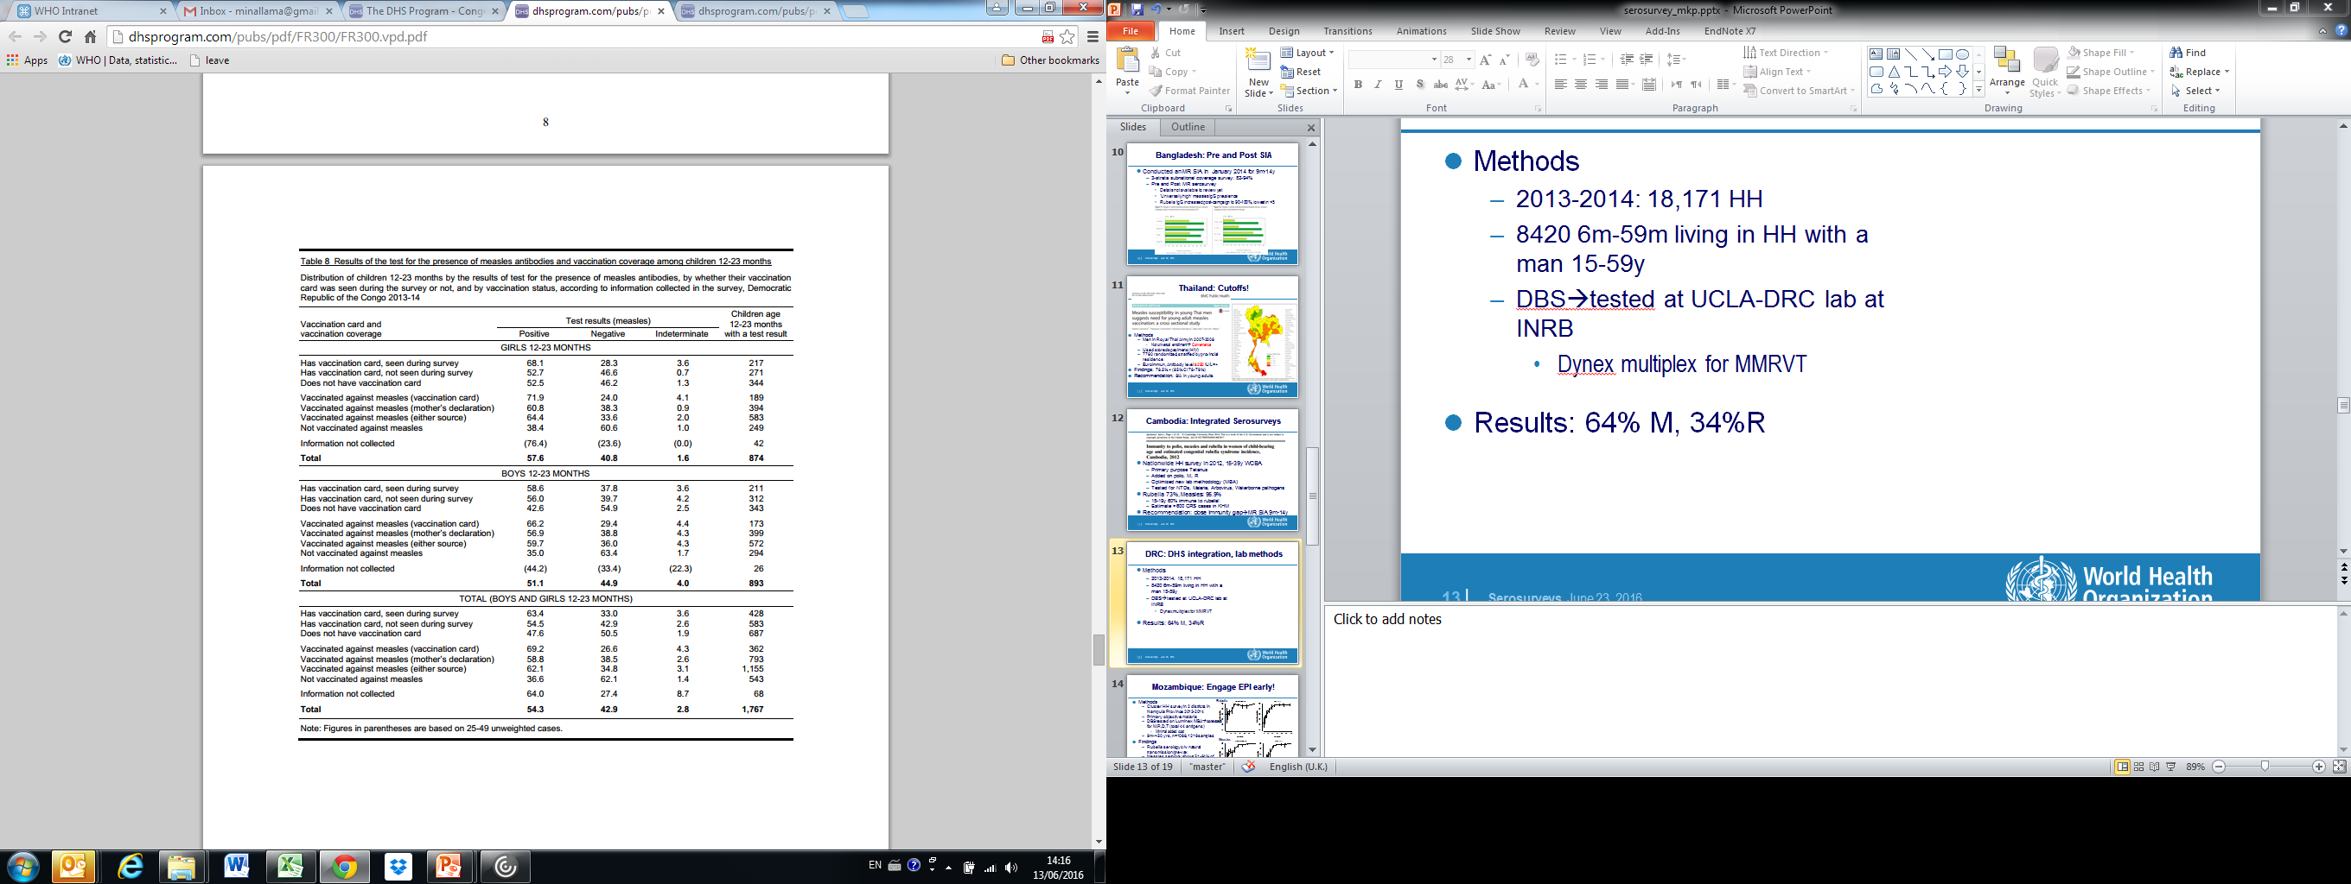
DRC: DHS integration, lab methods
Methods
  2013-2014
  8420 6m-59m
  DBS→tested at UCLA-DRC lab at INRB
    Dynex multiplex for MMRVT
Results: 64% M, 34%R
Limitations
  Small sample size for some subanalyses
  Representativeness of children?
  Unclear if Dynex multiplex performing well→further testing being done to clarify

Slide 11

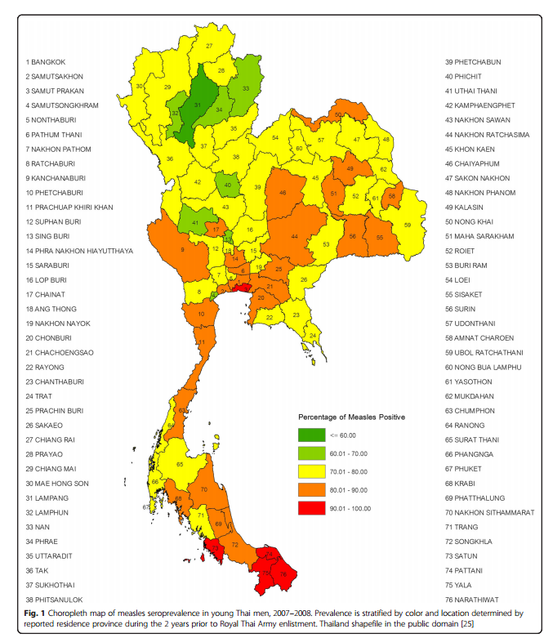
Thailand: Cut-offs
Methods
  7760 Men in Royal Thai Army in 2007-2008
  Used stored specimens (HIV)
  Euroimmun, Antibody level ≥250 IU/L=+
Findings: 78.5% M IgG+
Recommendation: SIA in young adults
Notes:
7760 randomized, stratified by provincial residence
Convenience
Measles remains a major public health concern in Thailand despite the introduction of vaccination since 1984. Similar to other countries, Thailand has experienced numerous measles outbreaks including adult communities such as university student dormitories, prisons, refugee camps, and military recruit camps. These outbreaks raise questions on the seroprotective antibody level in Thai adults.
Methods
(most 21 yrs of age) To better understand measles susceptibility in young Thai adults, a retrospective measles seroprevalence study on repository serum specimens obtained with informed consent from young Thai men entering the Royal Thai Army (RTA) during 2007–2008 was conducted. A total of 7760 stratified randomized samples were chosen by residence province. Measles IgG titer was measured using a commercial IgG quantitative ELISA kit following the manufacturer’s instructions. An antibody level ≥ 250 International Units per Liter (IU/L) was interpreted as seropositive.
Results
The overall measles seroprevalence was 78.5 % (95 % Confidence Interval: 77.6–79.4 %) with geometric mean titer of 738 IU/L (95 % Confidence Interval: 716–760 IU/L). The measles seroprevalence by province ranged from 59.6 % to 93.1 %. A trend of decreasing seroprevalence in the younger cohorts despite increasing immunization coverage was found. Lower seroprevalence than vaccination coverage was observed in the youngest age group.
Conclusions
To achieve long term measles control and elimination, an integrated two doses vaccination strategy has been implemented in children in Thailand. This nationwide measles seroprevalence study in young adult RTA recruits found a measles seroprevalence lower than WHO’s recommendation for measles outbreak prevention and elimination. These results raise concerns for measles control in Thailand. Supplementary immunization in young adults is essential especially in high-risk and densely populated communities to establish herd immunity for outbreak prevention and elimination.

Slide 12
Mozambique: Engage EPI early
Methods
  2013-2014
  Cluster HH survey in 2 districts
  Primary objective: malaria
  DBS tested on Luminex MBA→cotested for M,R,D,T (total 44 antigens)
    Minimal added cost
  2284 9m->50 yrs
Findings
  Rubella serology c/w natural transmission/pre-vax
  Measles: 51-64% of <15yrs IgG+
Recommendations
  Close immunity gap—EPI not interested
  National serosurvey samples pending
Rubella
Measles

Slide 13
Nepal
Objective: Evaluate immunity gap remaining post-2012 MR SIA
Methods
  HH, 9m-14y
  Research question: Oral fluid sens/spec
  Multiple questionnaires
  Siemens, 10% RRL for confirmation→ Error in worksheet
Findings
  Measles 93%, Rubella 94%
Lessons Learnt
  On-site assessment of laboratory
  Need to train lab to handle specimens/ data
Notes:
Lessons learnt
Training laboratory staff on management of large numbers of specimens and data
Many samples at the same time
Bar coder, hook-up between computer and ELISA reader would help but often are not available
On-site assessment of laboratory
No request for nominations rather specific invitations for training to ensure the persons doing the testing are actually being trained
Appoint full-time local coordinator during entire study and analysis phase

Slide 14
Other Problems
Staying true to methodology
  Country X had surveyors only collect blood from children in EPI registers→ over-estimate immunity!
  How to reach adults?
Messaging
  NOT effectiveness of vaccination campaign
  NOT coverage
Integration
  Added complexity→ return results for HBsAg/HCV/HIV
  Added confusion in field?
  Data might not be useful→ what do you do with MR data in 5 year olds only?
    Countries requesting, and on MBA minimal cost, but utility questionable

Slide 15
Summary
MR serosurveys are a tool to complement surveillance
  NOT TO REPLACE
Objectives need to be well defined
  All stakeholders need to understand what can/can’t be evaluated
    CANNOT correlate coverage with immunity
Needs to be well thought out—findings could be uninterpretable
Needs to involve laboratory early and throughout process
Opportunity to evaluate multiple diseases at once
  New technology makes it easier to do this
  Cheaper to implement one comprehensive than multiple 1-disease focused serosurveys

Slide 16
Thank You

