Slide 1
Serosurveillance
Department Immunesurveillance
Centre for Infectious Disease Control
RIVM
Netherlands
Fiona van der Klis
1

Slide 2
Monitoring Vaccination Programme
Clinical surveillance notifications, lab reports, hospital admissions, deaths
Vaccination coverage registration vaccine uptake, indicator for effectiveness
Immune surveillance immunity of population, subpopulations at risk, herd immunity
Pathogen surveillance antigenic drift, genotypic characteristics
Safety of vaccines adverse events monitoring

Slide 3
Role serosurveillance
In era of elimination
  Clinical surveillance limited
Role of serological surveillance more important
  Subgroups at risk
  Monitor dynamics in population composition, migrants
  Waning immunity
  Immunological fit with vaccine strains
  Monitor for vaccine uptake

Slide 4
Design of sero-surveillance studies
Questionnaire
Bloodsample
Laboratory methods have moved forward
  Simultaneous measurements antibodies NIP
  Less material needed
    Dried blood spots can be used
      No freezers, transport easy
      Feasible for use in regions where logistics might be problem

Slide 5
How do you get the sera?
Residual material
  Hospital, diagnostics
Active collection
Cheap, continuous
Representative? Bias?
Additional data?
Unbiased, representative
Many information with serum
expensive

Slide 6
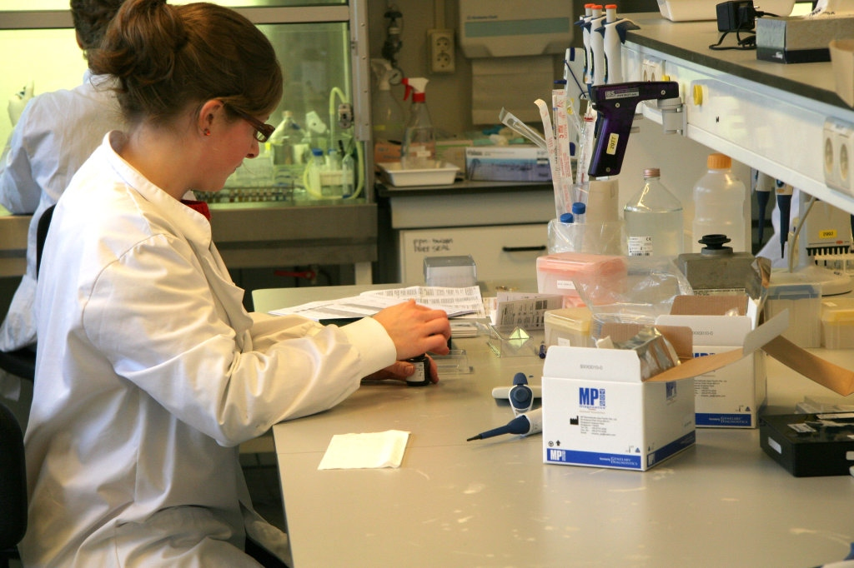
Serological analyses (Multiplexed)
In most (EU) vaccination schemes
  Tetanus
  Diphtheria
  Pertussis (4 components)
  Hepatitis B
  Meningococci type C (A, W, Y)
  Hib
  Pneumococci (13-25 serotypes)
  Polio type 1,2 and 3
  Mumps
  Measles
  Rubella
  HPV (7-9 serotypes)
others
  Toxoplasma
  Q fever
  Influenza A and B
  Varicella
  Toxocara and Ascaris
  Salmonella and campylobacter
  Allergy antigens
  Hepatitis A, C and E
  CMV
  Chlamydia
  Echinococcus
Plans
  EBV
  Rota
  RSV

Slide 7
In the meantime… at the lab
Existing methods
  ELISA, NT
  SBA
    Widely applied and accepted
    Gold standard, however labour intense
    separate assays required, available serum volume limited
High throughput serology method needed
    Expanding immunisation programmes
    Good correlation with historical data
    Good correlation with golden standard
    Low volume required

Slide 8
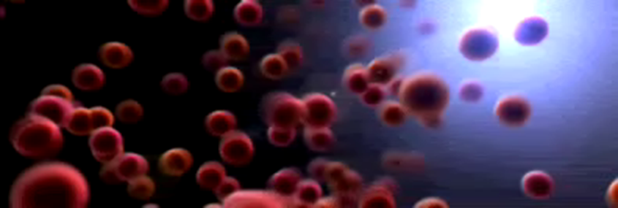

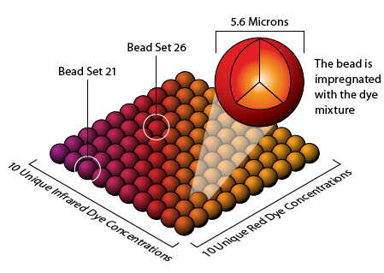
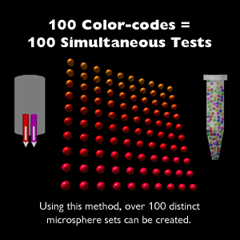
Luminex xMAP technology
100 bead regions

Slide 9
Multiplex immunoassay (MIA)
sample dilutions in assay specific buffer
96-well filter plate
beads/region/well
specific antibody binds to coupled antigen
R-PE conjugated anti-human IgG binds to specific antibody
Notes:
9

Slide 10
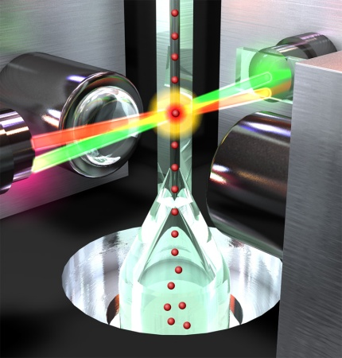
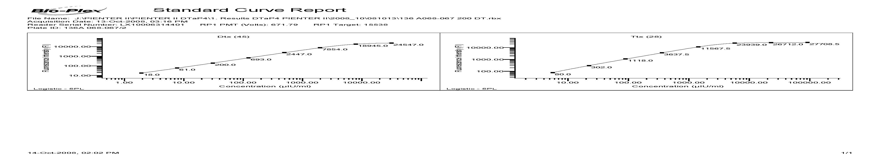
Multiplex immunoassay detection
Red laser reads the bead internal dye fluorescence
Green laser detects the amount of antibody bound in MFI (median fluorescent intensity)
Quantification in IU/ml or µg/ml by interpolation in a 5PL fit of the standard curve
10

Slide 11
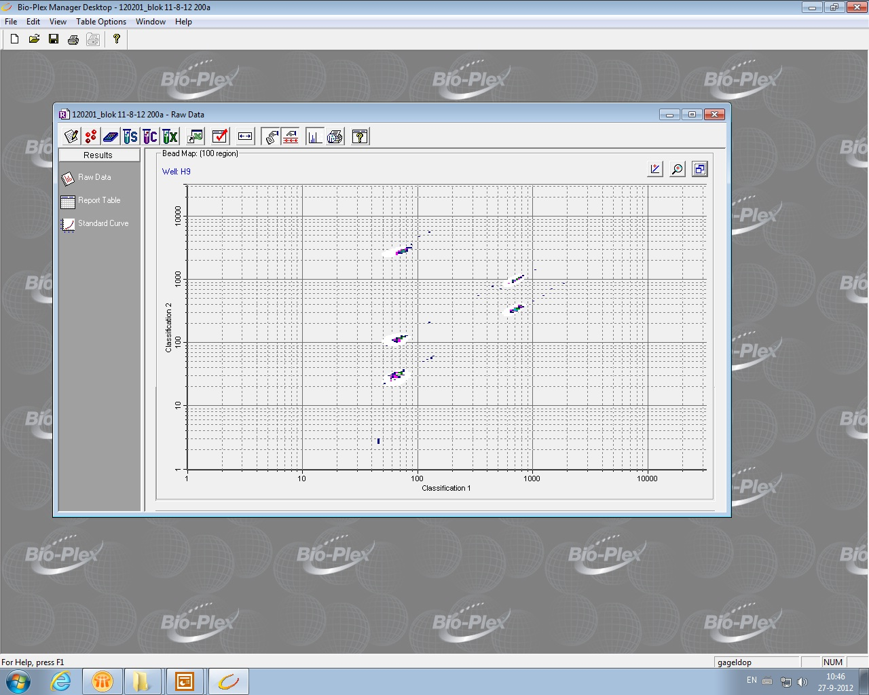
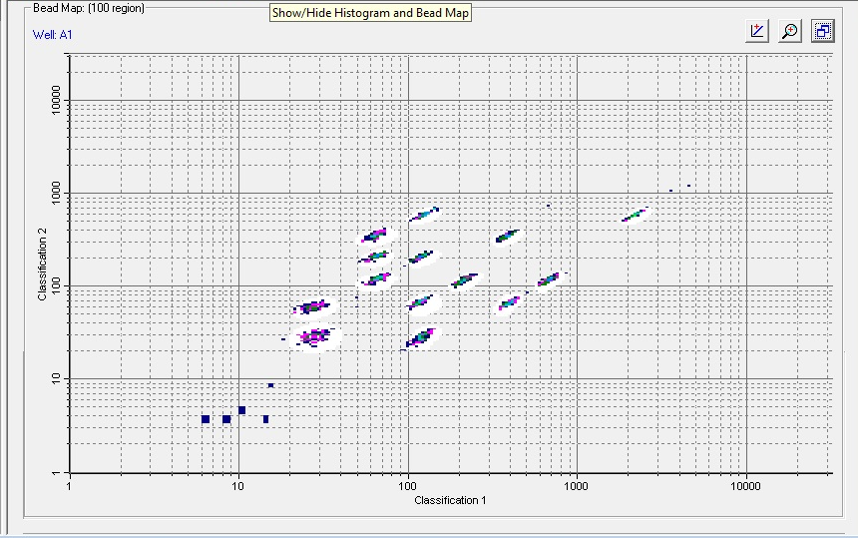
Bead regions
DTaP 5-plex, region 2-11-28-45-60
Pneumo 13-plex, region 1-3-5-7-9-11-13-15-17-18-27-33-38

Slide 12
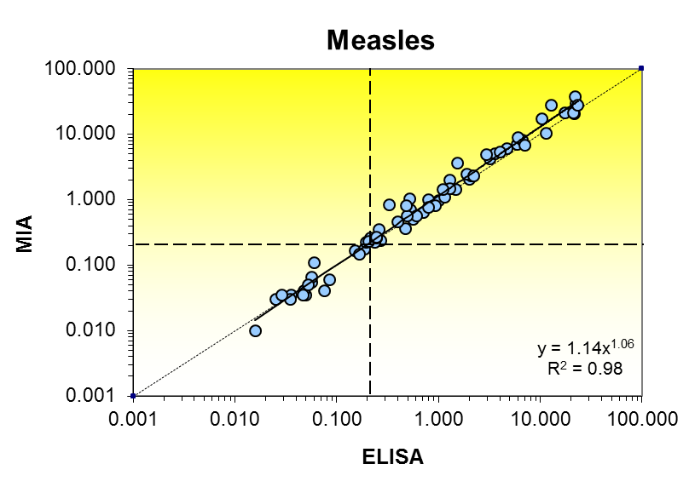
Development of MMRV MIA
Antigen
  Edmonston measles culture on Verocells
  purified by ultracentifugation
  freeze dried and stored in ampuls
  Also commercial antigen possible
  Panel sera open population

Slide 13
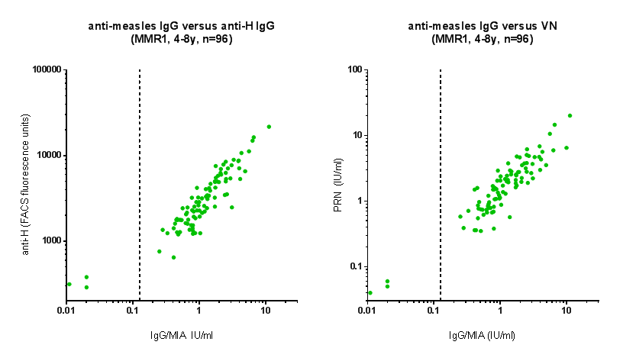
Correlation ELISA and anti-H and VN
Provided by Rob van Binnendijk and Rik de Swart
Notes:
Presera (n=96) van de kinderen (4-8 jaar) van scholen uit de Biblebelt (2013); 1x MMR gevaccineerd, vóór expositie aan mazelen (1e afname).
1. Correlatie IgG(MIA) tegen anti-H (test van Rik, = FACS-Elisa met MEL/J cellen die mazelen-H expresseren)
2. Correlatie IgG (MIA) tegen virus neutralisatie (VN): klassieke PRN test, tegen edmonston (conform 24 culture WHO protocol, 3rd WHO serum standard)

Slide 14
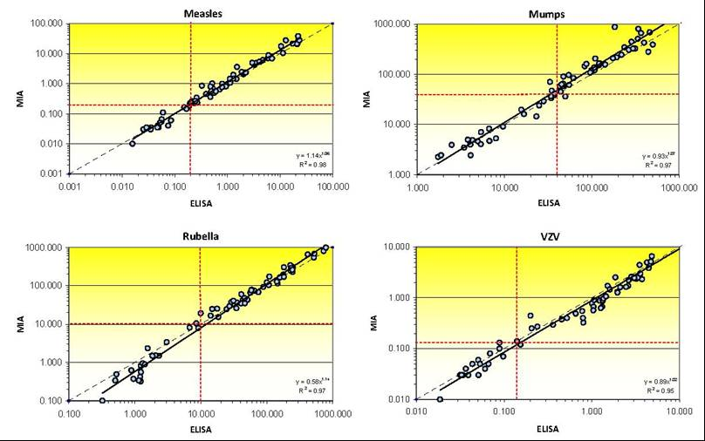
Comparison of results obtained by the MIA with results from the in-house measles, mumps and rubella ELISAs and the varicella zoster ELISA kit. Cut-off levels are indicated by the dashed red lines and the ideal line is represented by the black dashed line.

Slide 15
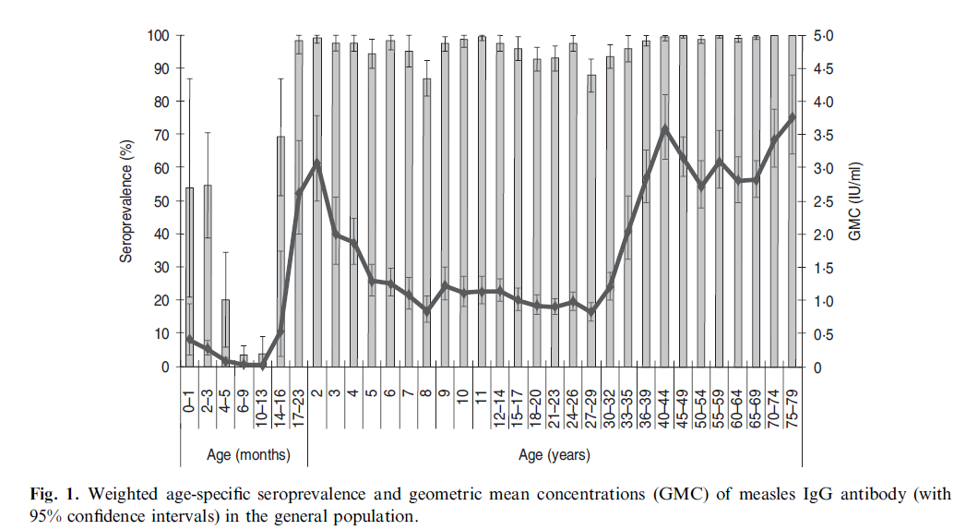
Seroprevalence studies with the MIA
Mollema et al, epidemiol infect 2014
Notes:
Ik heb zelf geen plaatje van mazelen Pienter2, dit is wat liesbeth gepubliceerd heeft.

Slide 16
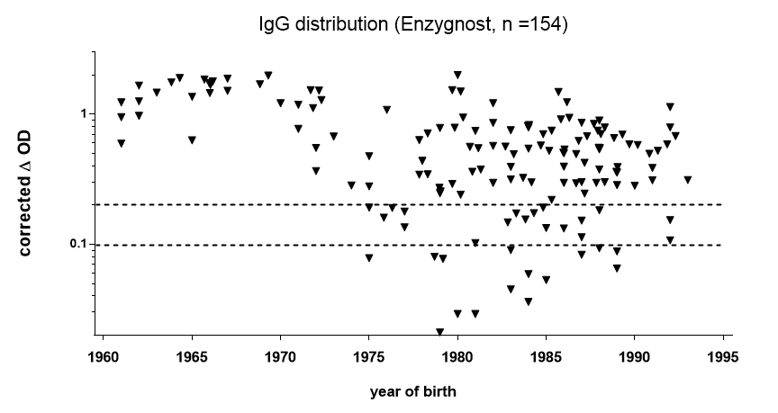
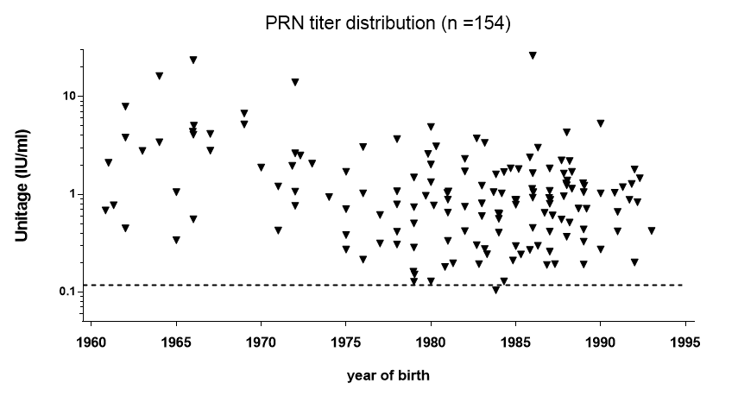
Immune status HCWs
(hospital survey)
Commercial EIAs versus PRN
Vaccinated birth cohorts
10..20% seronegative/indeterminate
different EIA tests, similar outcome
< 1% seronegative with PRN
Dorigo et al. 2015
Notes:
JMV paper 2015; selectie van 154 HCWs, geb. jaren 1960-1995
EIA testen; Siemens/Enzygnost (wereldwijd meest gebruikt), en nog 2 klinische testen (Liaisson, Vidas, hier niet weergegeven)
PRN: klassieke PRN test, tegen edmonston (conform 24 culture WHO protocol, 3rd WHO serum standard)

Slide 17
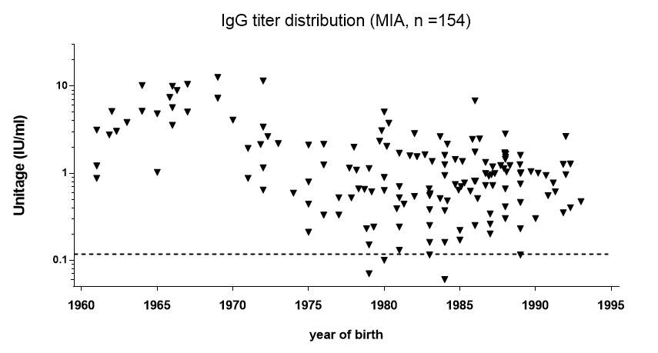
Immune status HCWs
(hospital survey)
IgG (MIA) versus PRN
< 5% seronegative with MIA
< 1% seronegative with PRN
Dorigo et al. 2015
Notes:
JMV paper 2015; selectie van 154 HCWs, geb. jaren 1960-1995
EIA teste: Luminex/MIA
PRN: klassieke PRN test, tegen edmonston (conform 24 culture WHO protocol, 3rd WHO serum standard)

Slide 18
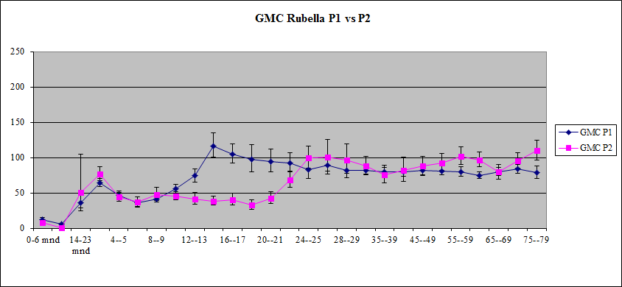
Rubella antibody concentration 1995 vs 2006
Smits et al, Vaccine 2014

Slide 19
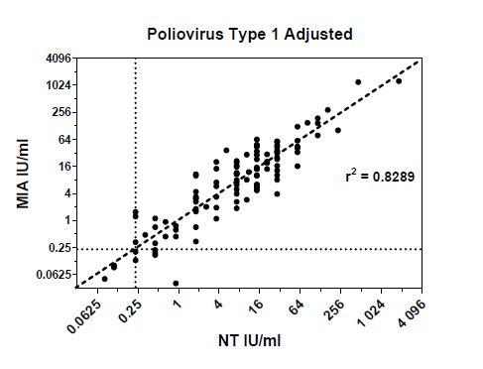
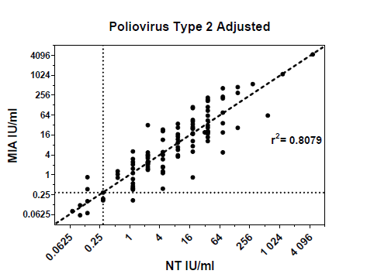
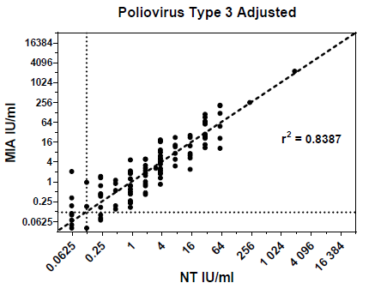
Polio multiplexed serology
Use of polio virus restricted
Need for lab assays independent on live virus
Schepp et al, submitted

Slide 20
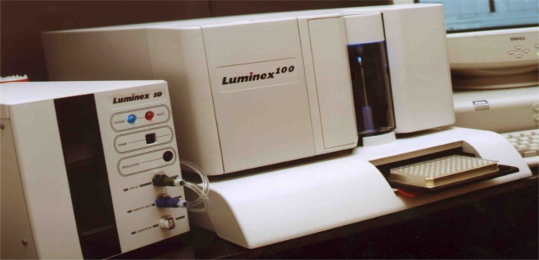

MIA implementation experience
Specific, sensitive and high reproducibility
Sample and antigen saving
Reduced labor by multiplexing
High throughput
Good correlation with ELISA
Cost-effective vs ELISA from 3-plex
Research tools:
Subclass (IgG, IgM, IgA)
Isotyping (IgG1-4, IgA1-2)
Avidity (isothiocyanate)
Sample source:
Serum / plasma
Saliva and cervical secretion
Filter paper dried blood spots
20
Notes:
20

Slide 21
Multiplex immunoassays developed by RIVM
Multiplex immunoassays for different combinations of vaccine components of the NIP
MIA | Vaccine components
DTaP4 6-plex | DT toxin and pertussis vaccine antigens PT, FHA, Prn and Fim2/3
MMRV 4-plex | mumps, measles, rubella and varicella virus
Men-Hib 5-plex | N. meningitidis PS serogroup A, C, W, Y and Hib
Pneumo 13-plex | PnPS serogroup 1, 3, 4, 5, 6A, 6B, 7F, 9V, 14, 18C, 19A, 19F, 23F
HPV 7-plex | VLP types 16, 18, 31, 33, 45, 52, 58
Polio | Type 1, 2 and 3
future plans: Multiplex for Hepatitis B, CMV, EBV, Rota and RSV Further combinations: Pneumo-Men-Hib 18 plex, DTaP-MMRV 10-plex
Notes:
21

Slide 22
Summary
Expanding EPI; need for multiplexed serology
  Low volume sera, dried blood spots
MIA is tool with numerous applications
Used in sero-survey in Dutch cohots, population for monitoring EPI
MIA is sensitive, good correlation with historical (gold) assays
Polio in transition phase, need for assays not using live virus
  Opportunity to take others VPD in same flow?
Role for MIA in EPI surveillance programme?

Slide 23
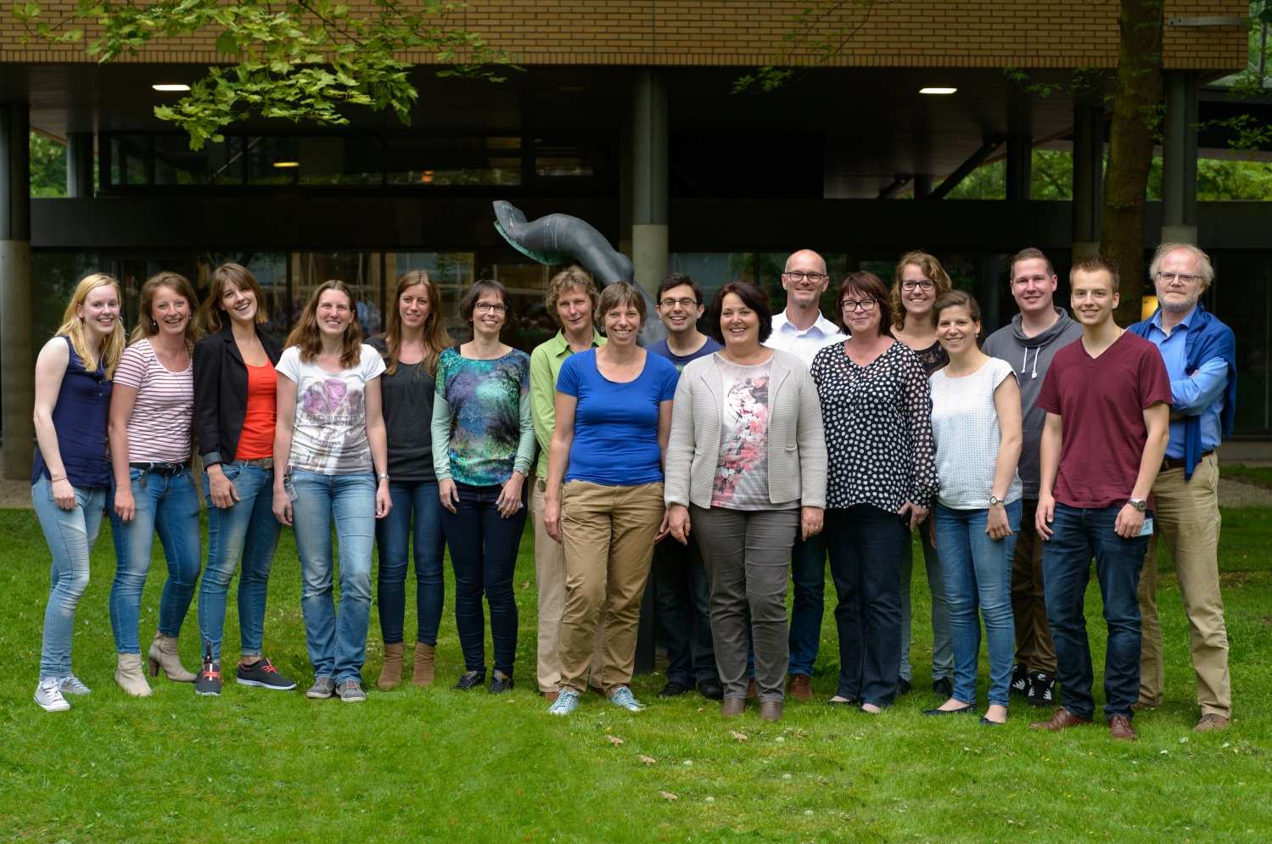
Department
Immunesurveillance
Rob van Binnendijk

