Slide 1

LDS Participation in the Measles Initiative

Slide 2

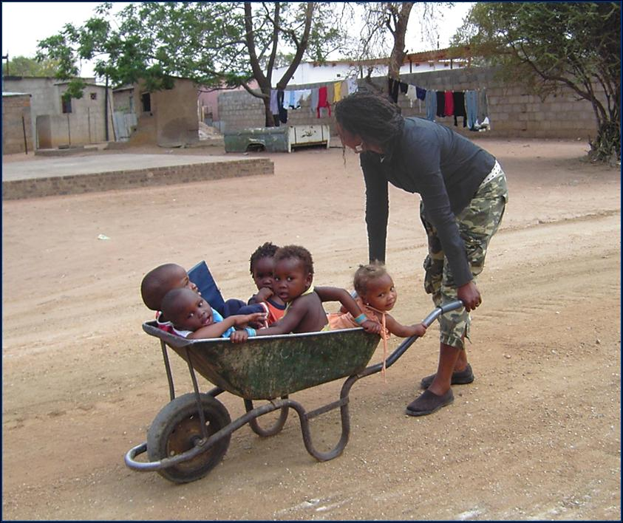
History
LDS began involvement in 2003
2003-2011: LDS Church has contributed $14.6 million
Notes:
As of Sept. 2, 2011

Slide 3
LDS Participation
2003-2011
Approximately 59,000 volunteers have provided 750,000 hours of service in 34 countries
Notes:
As of Jan 2011

Slide 4
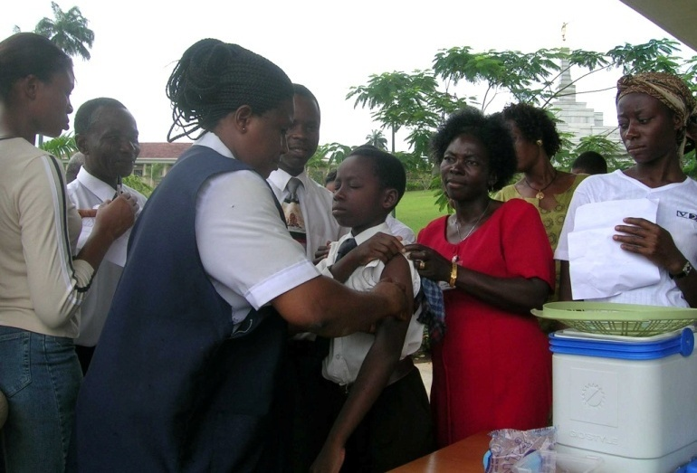
Objectives
Assist the Measles Initiative in saving children’s lives
Teach members of the church and others to be “true volunteers” by serving without expecting compensation
Help build sustainability of local health systems

Slide 5

Social Mobilization
Madagascar
Social Mobilization support
25-29 October 2010
929 member volunteers
4,891 volunteer hours
200,000 flyers distributed
93% vaccination

Slide 6
2011 Campaigns
Country | Status
Mozambique | May 25-29
Benin | September 19-25
Haiti | Postponed
Notes:
Ashley’s Notes: UPDATE and change these numbers

Slide 7
Future
Improve campaign coordination between NGO’s to reduce overlap/duplication in resources and costs
Continued support needed to achieve Measles eradication
2012: commit $1.9 million for immunization initiative
  $1 million to the Measles Initiative
  $900,000 for Social Mobilization

Slide 8
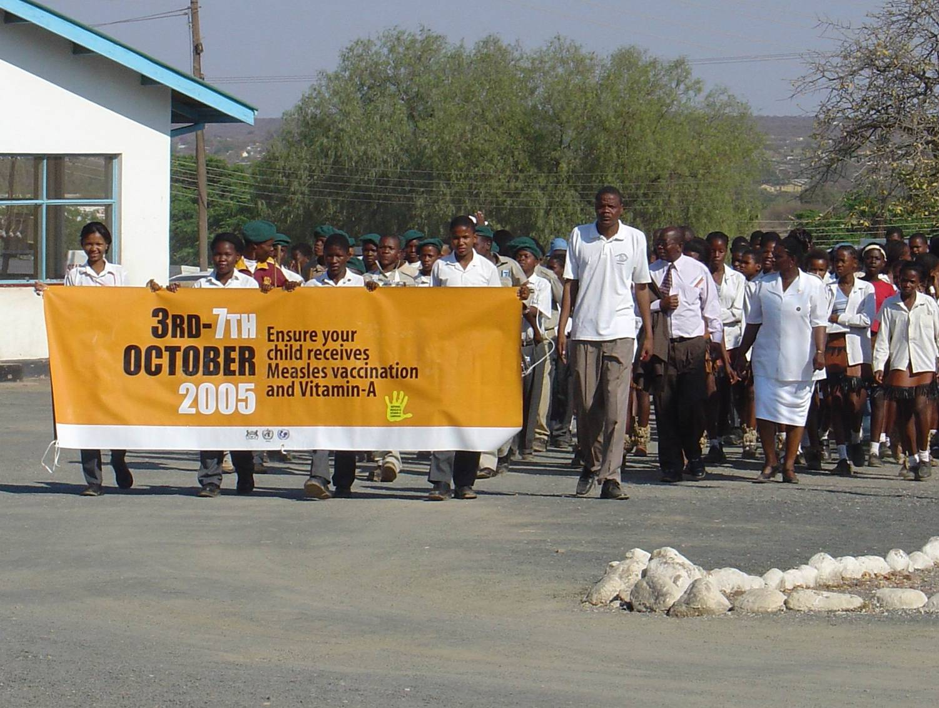

Slide 9
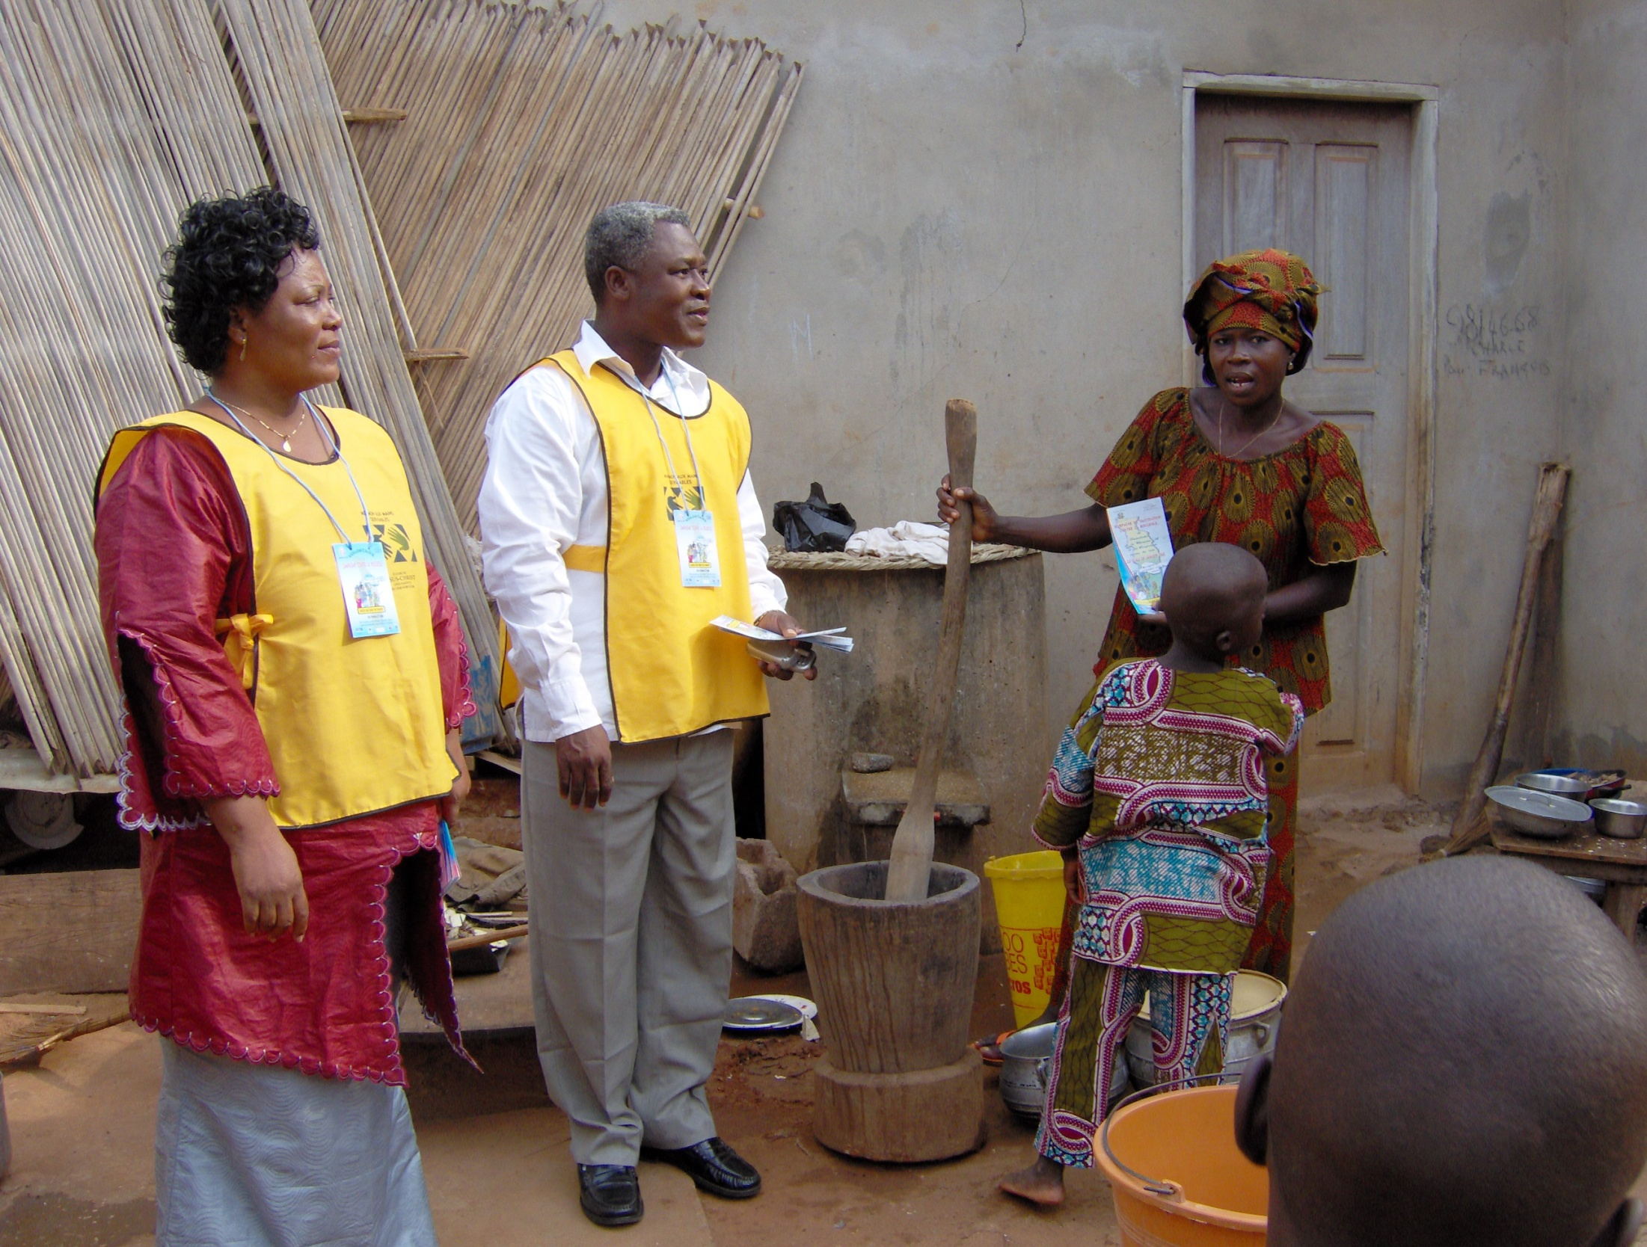

Slide 10
