Slide 1
Economic Analysis of Measles Mortality Reduction and Eradication
Ann Levin, Colleen Burgess, Lou Garrison, Chris Bauch, and Joseph Babigumira
Measles Initiative Meeting
Washington, D.C.
September 13, 2011
Notes:
I’m going to present the results of our team’s economic analysis of measles eradication. Other members of our team include Colleen Burgess, Lou Garrison, Chris Bauch and Joseph Babigumira.

Slide 2
Overview
Background
Costing methods and results
Disease transmission modelling methods and results
Findings on study questions
Conclusions
Notes:
This slides gives an outline of what we will cover in our presentation. First we will present the methods that we used for costing and modeling of disease transmission for six countries where data were collected Then we will present the findings on key study questions, and then we will give our conclusions.

Slide 3
Background
Have achieved goal of 90% mortality reduction in most countries
  Would it be cost-effective to reduce measles mortality further?
Useful to evaluate the cost-effectiveness of various measles reduction goals: current goal of 95% mortality reduction and eradication by 2020
  Compared to costs and effectiveness of earlier goal of measles mortality reduction of 90% by 2000

Slide 4
Costing Method
Collected costs and measles incidence data in six low and middle-income countries
  Countries were chosen based on a number of criteria, including MCV1 level and per capita income
Country | Ethiopia | Uganda | Bangladesh | Tajikistan | Brazil | Colombia
GDP per capita | $345 | $481 | $551 | $716 | $8,070 | $4,950
MCV1 | 63% | 68% | 85% | 86% | 94% | 95%

Slide 5
Study Methods
Estimated cost of achieving measles reduction goals during 2010-2030 and 2010-2050
  Routine measles immunization
  Campaigns
  Outbreak response
  Surveillance

Slide 6
Data Collection
Cost categories
  Recurrent- Personnel, Vaccines, Injection supplies, Transport, Cold Chain, Maintenance, Social mobilization, Surveillance
  Capital Costs - Cold Chain Equipment, Vehicles and other transport
Assumed that cost per dose increases for routine immunization as coverage improves

Slide 7
Epidemiological Data
Collected historical data on incidence of measles by country
  WHO databases
  Studies of measles transmission

Slide 8
Scaling Up Vaccination Coverage
For costs of increasing measles coverage through routine services
  Conducted interviews with program managers
    Additional activities required to:
      Raise coverage by 5%, Raise coverage by 10%, Improve surveillance
  Additional resource requirements:
    More personnel time for vaccination, monitoring and evaluation, more outreach sessions, improvements in cold chain and transport, training
Campaigns/outreach
  Collected Cost data from last two to three campaigns in country
Notes:
Because very little data is available on the costs of scaling up vaccination coverage, we had to make some assumptions about these. First, for routine coverage, we interviewed program managers about the additional resources that would be needed to increase coverage in their countries. Then we developed a spreadsheet model—what could be called a “planning model”--of average resource requirements to implement the additional activities and calculated an average increase in the cost per dose. We also calculated the additional costs of increasing coverage for SIAs.

Slide 9
Cost Results
Total costs 2010-2050 by country and strategy, discounted (2010 USD millions)
Country | Baseline | 95% RM | 2020 E
Bangladesh | $340 | $655 | $388
Brazil | $1,527 | $1,492* | $1,107
Colombia | $925 | $918* | $833
Ethiopia | $254 | $405 | $533
Tajikistan | $30 | $61 | $41
Uganda | $229 | $578 | $630
*Reduction in Cost is due to assumption that other countries have reached the goal of 95% RM → ↓case importation
Notes:
In this slide, we show the estimates of total costs of achieving four vaccination goals in the six countries. The costs differ for countries that have not achieved measles elimination and those that have. For the four countries that have not achieved elimination, the costs increase as the program ramps up its activities to achieve 95% mortality reduction and 98% mortality reduction. In some of the countries, Ethiopia and Uganda, it is costlier to reach the 98% elimination goal. For the others, there are cost savings from not having to do outbreak response as case importation declines. Total costs decline for reaching eradication by 2020 from the 98% mortality reduction goal due to cost savings from discontinuing measles campagins after 2023. For the two countries that have eliminated measles, Brazil and Colombia, it is assumed that the countries would receive some benefit from other countries working towards mortality elimination goals and that case importation would be reduced. Thus, the costs in these countries are reduced for reaching the three vaccination goals from the baseline.

Slide 10
Cost Analysis Findings
In low income countries, costs increase to achieve 95% reduction in mortality
For countries that have already achieved elimination, total costs are reduced for all scenarios over the baseline
  Reduction in case importation
Notes:
To summarize our findings, we found that in countries that have not eliminated measles, specifically the low-income countries, costs per dose increase required to reach 95% or 98% reduction in mortality as measles vaccination services are ramped up. The total costs of reaching eradication by 2020 are lower than those for 95%/98% reduction in mortality. This is due to cost savings from having no campaigns from 2020-2050. Costs were different for countries that had already achieved eradication. Because we were assuming that other countries were already reaching the global goals, there was lower case importation, and fewer outbreak responses were needed. Thus, costs were lower for each of these scenarios than for the baseline.

Slide 11
Disease Modeling Results
Total cases 2010-2050 by country and strategy, discounted
Country | Baseline | 95% RM | E2020
Bangladesh | 17,638,000 | 9,368,000 | 2,353,000
Brazil | 2,000 | 1,000* | 500
Colombia | 4,000 | 3,000* | 900
Ethiopia | 6,390,000 | 3,490,000 | 751,000
Tajikistan | 69,000 | 26,000 | 8,000
Uganda | 413,000 | 244,000 | 27,000
* Reduction in cases based on assumption that reaching global goals of 95%RM and E2020 →↓case importation

Slide 12
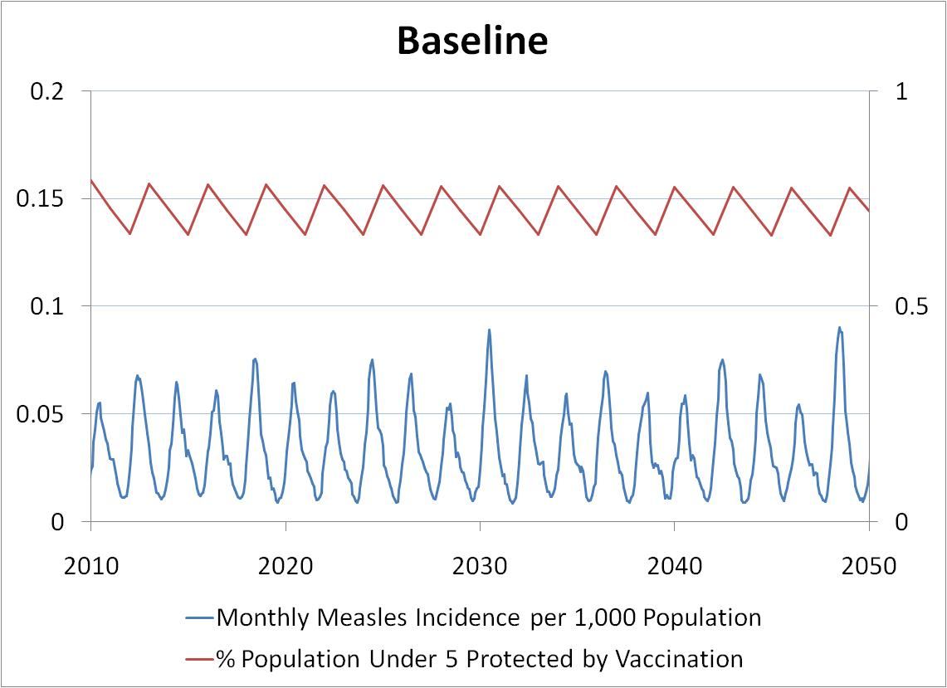
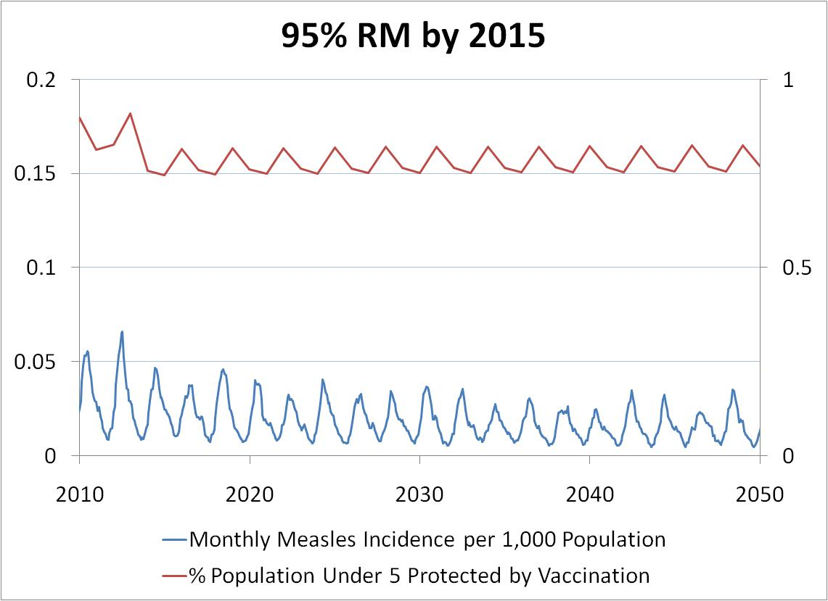
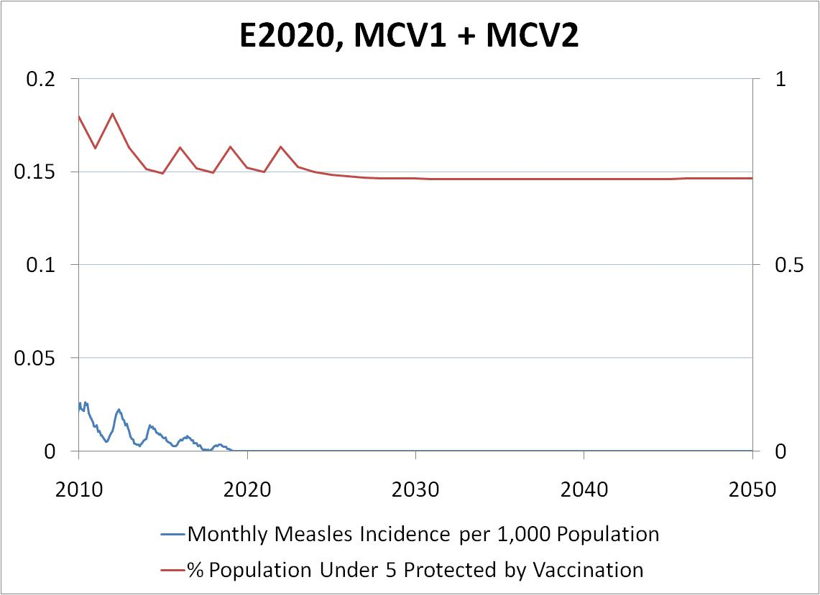
Disease Transmission Results - Uganda

Slide 13
Transmission Model Findings
Level of case importation greatly affects within-country transmission
    Countries with local elimination
    Countries with endemic transmission
Campaigns (SIA, OR) more effective than routine vaccination at decreasing mortality quickly

Slide 14
Comparison of Cost-effectiveness of 95% Mortality Reduction and E2020
 | Cost per DALY averted (95% MR) | Cost per DALY averted (E2020) | GDP per capita
Bangladesh | $259 | $16 | $551
Ethiopia | $190 | $134 | $345
Tajikistan | $7,319 | $1,355 | $716
Uganda | $1,102 | $804 | $481
Brazil | Cost/life saving | Cost/life saving | $8,070
Colombia | Cost/life saving | Cost/life saving | $4,950

Slide 15
Global Findings on Cost-Effectiveness of E2020
Income Group by Elimination Status | # Countries | Deaths Averted | $ per DALY Averted (2010 USD) | GDP per Capita
Measles not eliminated by 2010
Low | 42 | 1,045,000 | $4 | $503
Low-Mid | 41 | 9,408,000 | Cost /life saving | $2,310
Upper-Mid | 24 | 504,000 | $4 | $7,523
High | 39 | 50,000 | $5,273 | $38,134
Measles eliminated by 2010
Low-Mid | 16 | 66,000 | Cost /life saving | $2,310
Upper-Mid | 19 | 81,000 | Cost /life saving | $7,523
High | 12 | 2,000 | Cost /life saving | $38,134
TOTAL | 193 | 11,156,000 | N/A | N/A
Notes:
This slide shows the cost-effectiveness by global income group and elimination status. For the top categories of countries that have not eliminated measles, three of four of the groups are considered cost-effective, while eradication in lower-middle income countries is considered cost and life saving. For countries that have already eliminated, all three income groups had both cost and life savings.

Slide 16
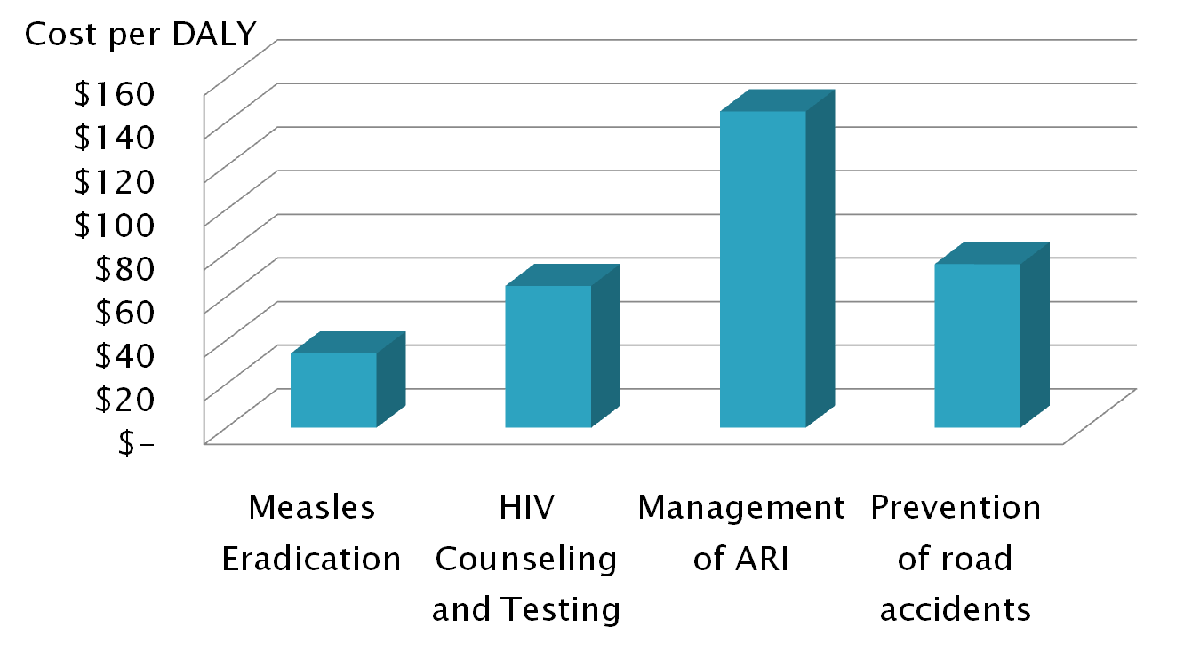
Comparison of Measles Eradication w/ Other Low Cost Interventions
Source: Laximanaryan et al. 2006
16

Slide 17
Conclusions
Attaining the goals of 95% MR or E2020 is cost-effective
  Cost saving and life saving in countries that have already eliminated measles
Key drivers of the results are:
  Cost of increasing routine and campaign coverage
  Number of imported cases
CE analysis is one step towards a decision
  Also need to assess broader economic impact, social, political and ethical factors prior to making a decision on eradication
Notes:
In conclusion, we found that reaching eradication by 2020 is more cost-effective than either of the intermediate goals of 95% RM or 98% RM. In addition, E2020 is projected to be both cost saving and life saving in countries that have already eliminated measles. Some key drivers of the results are estimates of the cost of increasing routine and campaign coverage, the impact of routine vs campaign measles vaccination on morbidity and mortality, and the role of case importation. It should be noted, however, that the analysis does not include the potential impact of post-E2020 re-introduction, which might necessitate further SIAs following eradication.

Slide 18
Backup slides

Slide 19
Key unit costs
Cost per Dose (2010) | Mode of Delivery
 | MCV1 | SIAs | Cost of Increasing
Bangladesh | $1.46 | $0.52 | $0.07 until 90%; $0.15
Brazil | $3.91 | $1.27 | N/A
Colombia | $9.14 | $2.87 | N/A
Ethiopia | $1.35 | $0.64 | $0.055 until 80%; $0.11
Tajikistan | $1.68 | $0.62 | $0.07 until 90%; $0.15
Uganda | $2.35 | $1.24 | $0.04 until 80%; $0.08

Slide 20
Case Fatality Rates
Country | CFR
Bangladesh | 1.7%
Brazil | 0.05%
Colombia | 0.05%
Ethiopia | 3.0%
Tajikistan | 1.0%
Uganda | 6.0%

