Slide 1

Measles Vaccination in Emergency Setting
11th Annual Meeting
The Measles Initiative
Washington, DC
18-19th September, 2012

Slide 2
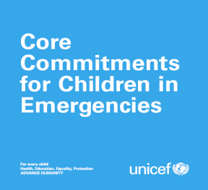

“Immunization of children against measles is probably the single most important (and cost - effective) preventive measure in emergency – affected populations, especially those living in camps”
M Toole and R Waldman Annual Rev Public Health 1997;18-283-312
Vaccinate all children between 6 months and 14 years of age against measles
Provide vitamin A supplementation
Provide vaccines and critical inputs such as cold-chain equipment, training and social mobilization expertise
Provide other emergency supplies such as blankets, tarpaulins and cooking sets.
Introduce nutritional monitoring and surveillance
Support the establishment of essential health-care services
Provide essential drugs, emergency health kits

Slide 3
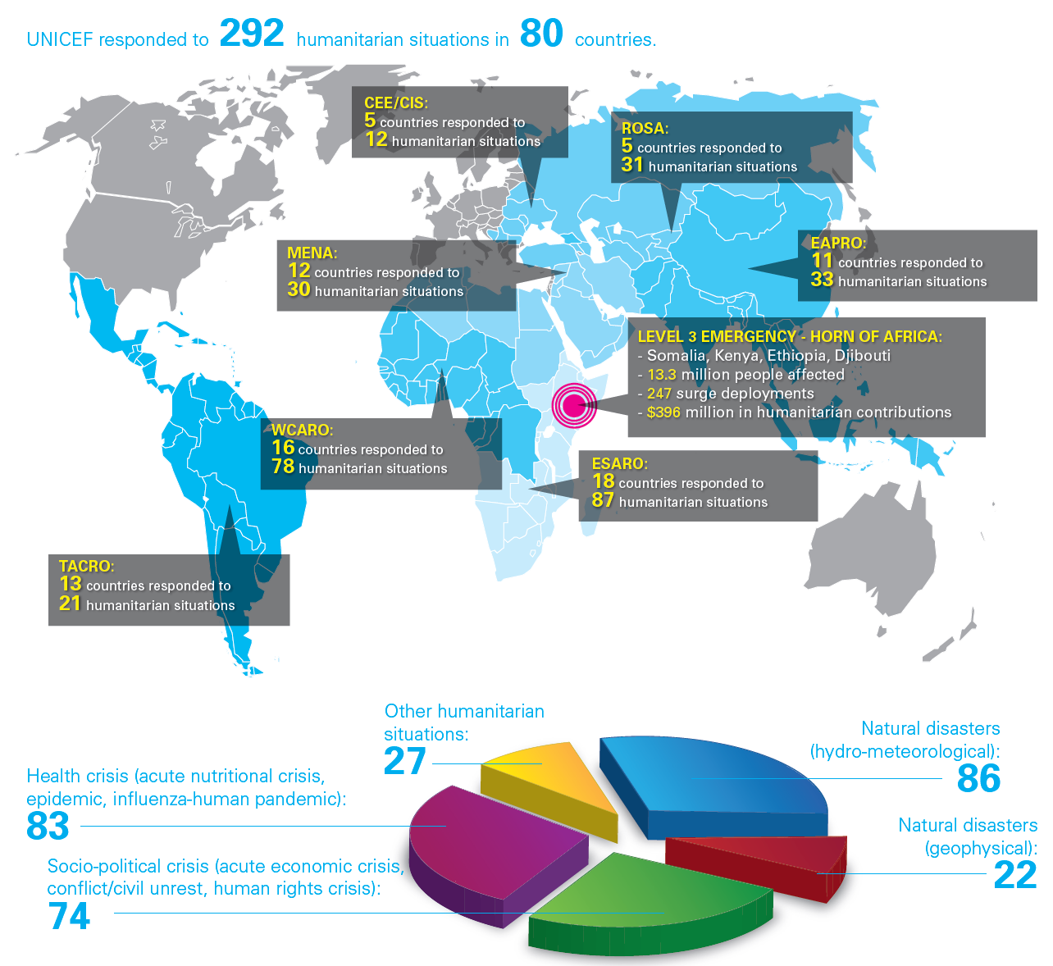
2011
Specific UNICEF SD MCV for Emergencies: Libya; DR Congo; Burkina Faso; Kenya
Guinea; South Sudan; Tunisia; Mauritania Ethiopia; Cote d’Ivoire; Pakistan

Slide 4
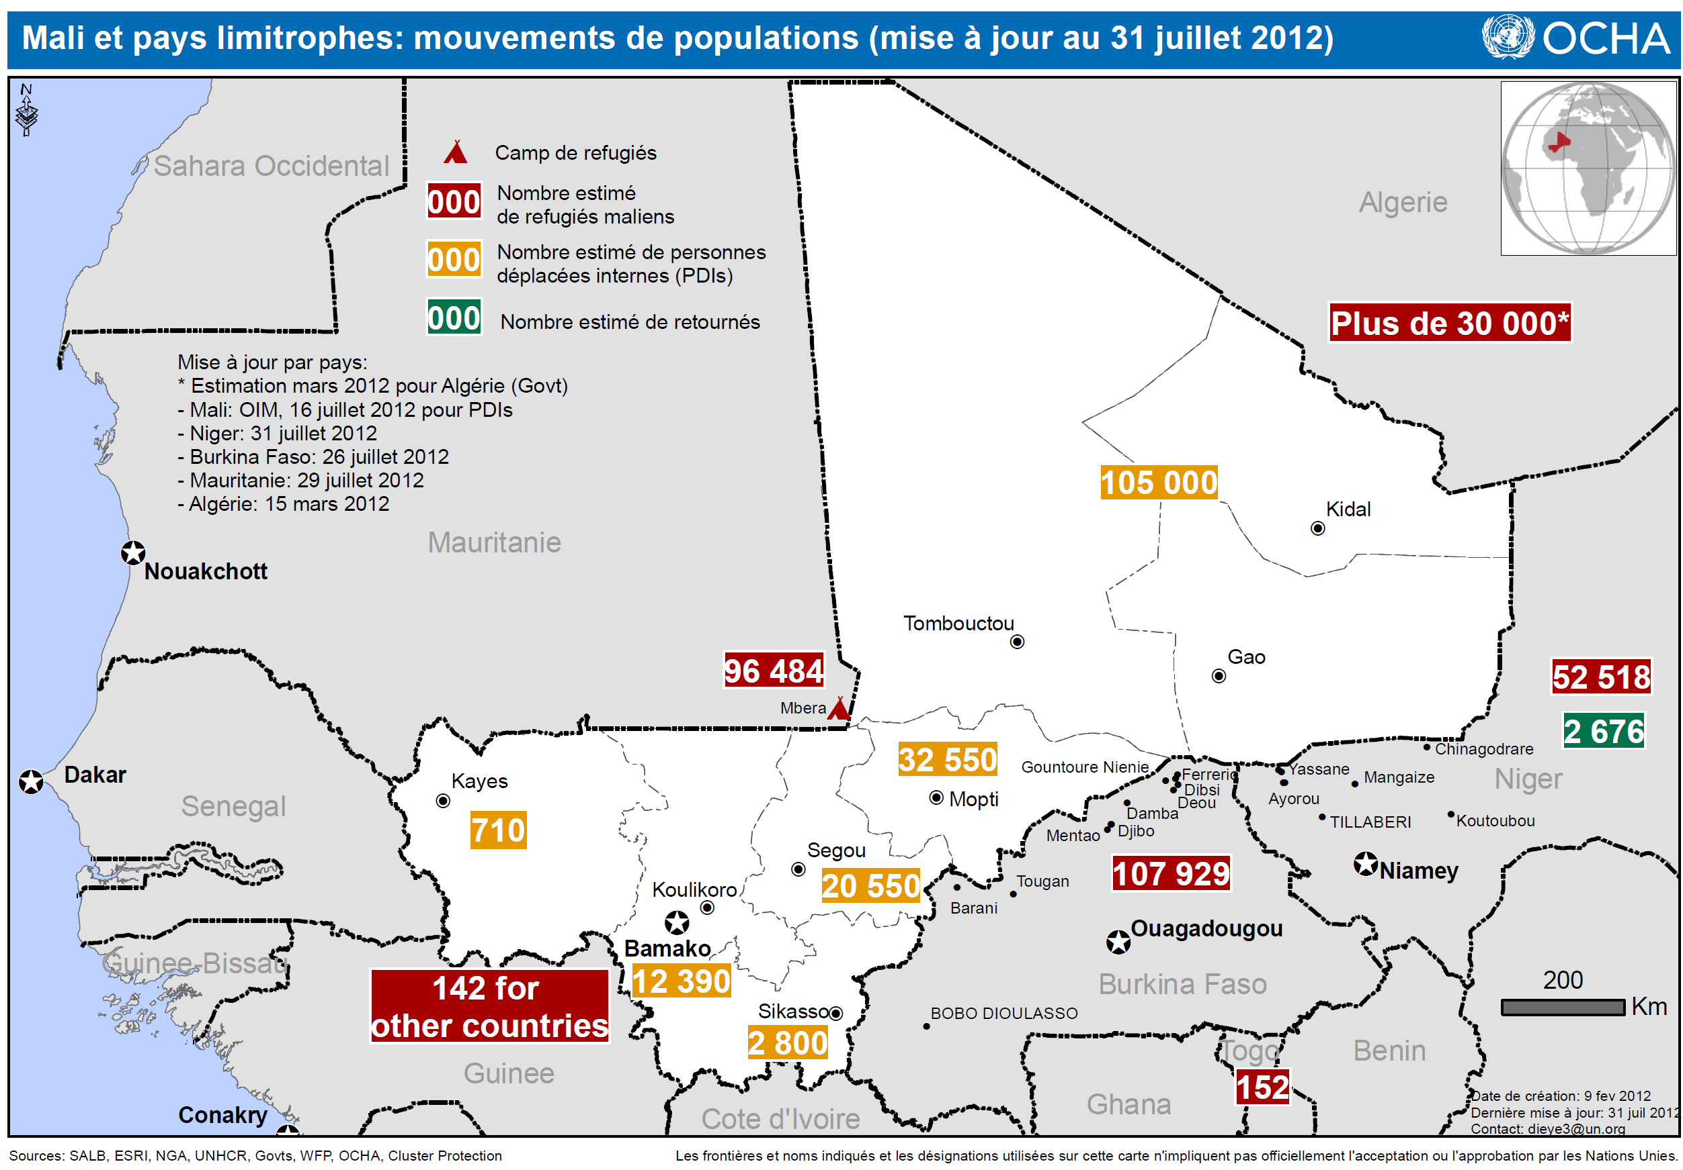

Slide 5
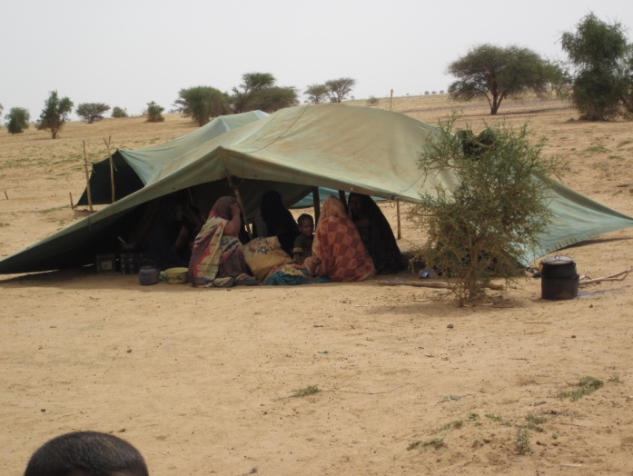
Mali -highlights
Mali routine MCV1 Coverage & SIAs

Slide 6
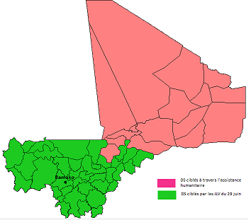
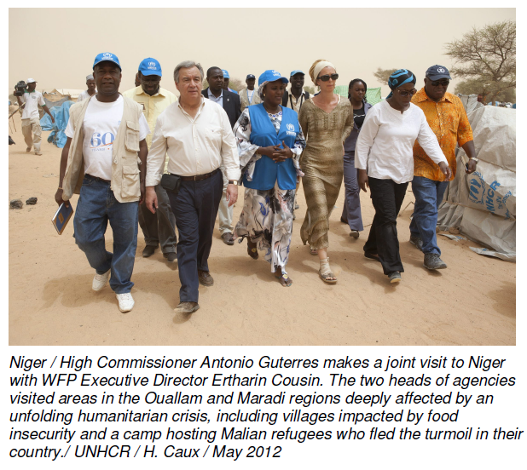
Mali -highlights
3 regions (Gao, Kidal & Tombouctou), occupied by separatist rebels.
Displaced populations
Disrupted health services.
Missed 3 rounds Polio

Slide 7
Decision process
Activation of the health cluster under WHO lead
Sent a field assessment team; identified partners capable to work in the context.
  Timbuctu with Group Pivot Sante (GPS) and ALIMA
  Kidal with Medecin du Monde Belgique
  Gao with FENASCOM.

Slide 8
Planning and preparation
Service contract (PCA) between UNICEF and the NGOs in collaboration with MOH.(activities, strategies & budget)
Endorsement of the PCA by the health cluster.
Coordination committee: (MOH, NGOs, UNICEF, WHO)
Cold chain rehabilitation; Supply vaccines and other items
Training of vaccinators and supervisors.

Slide 9
Implementation
Target measles: 278,076
Duration: From June 25th onwards
Socio mobilization
41 teams of 4 vaccinators in Timbuktu & Kidal
Supervision: national, regional and districts supervisors
Data collection, analysis and reporting
Waste management
Strong support from local authorities/community leaders
No security problems for vaccinators
No case of severe AEFI notified

Slide 10
Dire campaign with ALIMA (25 April-4May;)
Kidal campaign with MDM-B (25 June-18 July Partial results)

Slide 11
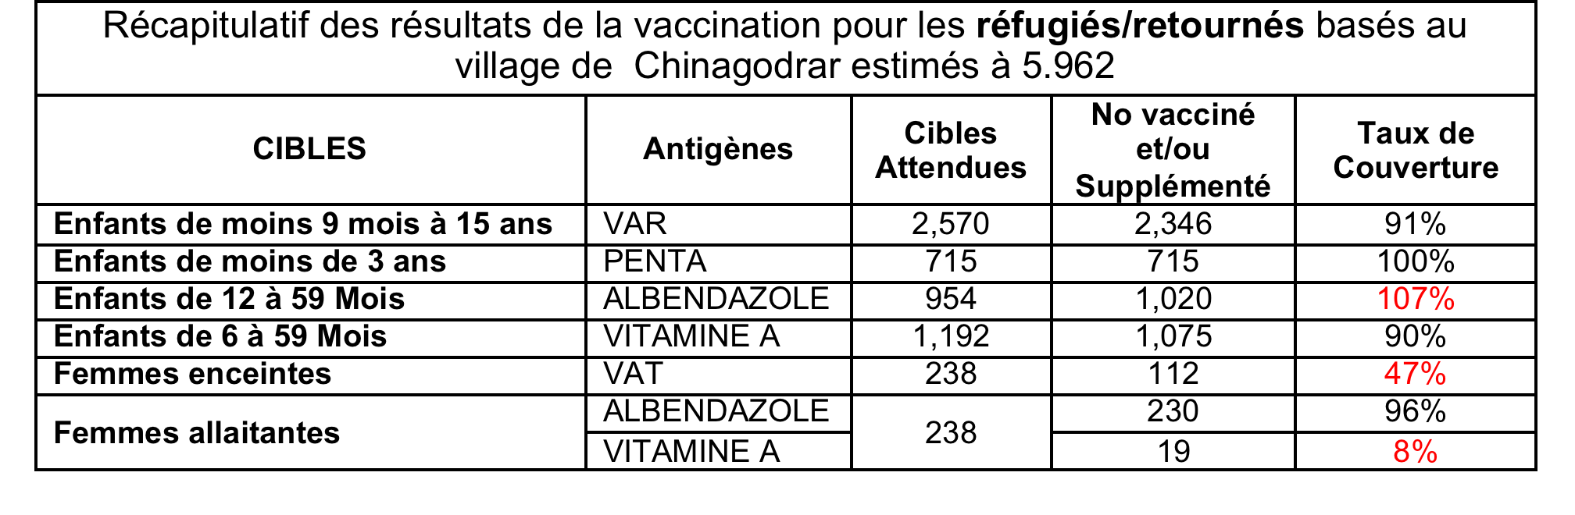
RESULTATS VACCINATION, SUPPLEMENTATION, DEPARASITAGE & DEPISTAGE ACTIF DE LA MALNUTRITION CHINAGODRAR
27 au 29 février 2012

Slide 12
Outcome
Successful integrated measles campaign in the Islamist stronghold region of Timbuktu and later Kidal and Gao paved the way for more humanitarian interventions in the future;
Many health centers revitalized and can provide routine immunization on a regular basis
Vaccine supply to the north region subsequently easier
More local staff trained on immunization and may be utilized for upcoming polio and MNTE campaign. Upcoming SIAs (Particularly Polio) will be feasible in the northern regions
Reinforcement of collaboration and coordination among partners

Slide 13
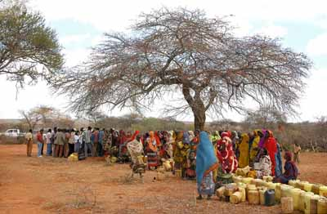
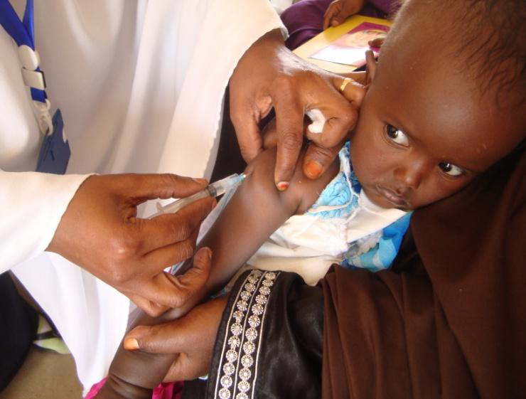
Measles Control during the 2011 Horn of Africa Emergency

Slide 14
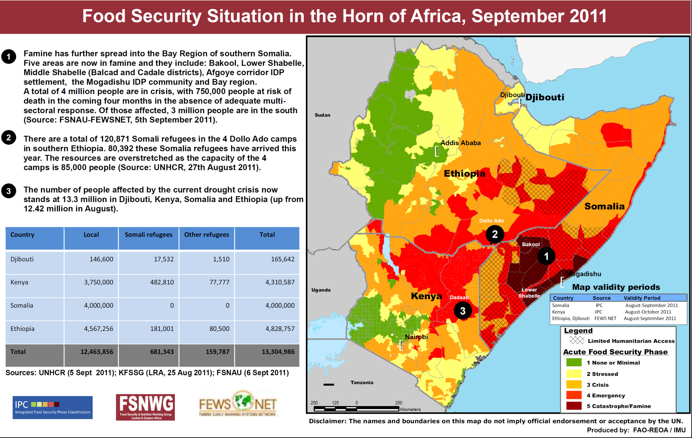

Slide 15
The context situation/crisis
2011: severe drought in the Horn of Africa, and the conflict in Somalia precipitated a crisis.
Early July 2011: hundreds of thousands of people on the move, fleeing famine and conflict, into neighboring countries.
13.3 million needed humanitarian support in Somalia, Kenya, Ethiopia and Djibouti, including 700,000 Somali refugees. 1.5 million displaced people inside Somalia. Half of those in need were children.
More than 320,000 severely malnourished children in the four countries;

Slide 16
Context: Measles situation
2010- 2011: 16,135 reported measles cases in Somalia. 78% were children <5yrs. Most from South and Central Zone (SCZ).
SCZ of Somalia was totally inaccessible for Child Health Days (CHDs) or routine EPI for more than 2yrs due to armed conflict.
2010-2011: Ethiopia: 9,756 cases; Kenya: 2,566 cases with wide age distribution.

Slide 17
Coordination Mechanism For Health Response
At Regional Level:
At the regional level the WHO-AFRO and UNICEF-ESARO set up a HOA emergency Health Group with key partners in health.
The HOA emergency health group (UNICEF, WHO, UNHCR, CDC, UNFPA, OFDA and other NGOs) met every week.
At the Country Level:
Somalia UNICEF and WHO reactivated the Health Cluster (SACOB) to coordinate the health response: developed a joint plan for Measles SIAs.
Kenya and Ethiopia: health response coordinated by government. WHO and UNICEF worked with the government at the national and sub-national levels to support the emergency response.

Slide 18
Resource mobilization/allocation
HoA drought since late 2010; funding needs built into the 2011 inter-agency CAP for Somalia and Kenya.
Ethiopia and Djibouti: funding needs included in the UNICEF’s Humanitarian Action for Children (HAC) appeal.
Escalation of crisis triggered scale up UNICEF’s response. UNICEF issued a revised appeal in July 2011
  The Exec. Director Anthony Lake visited regions of Turkana in Kenya
  The ED activated UNICEF’s procedures for a Level 3 Corporate Emergency
  Key UNICEF allies joined efforts to draw international attention to the crisis
UNICEF secured US$ 405.7 million (96%) of the total appeal.
NB. Somalia had in stock 5 million doses of MCV in Nairobi

Slide 19
UNICEF secured US$405.7 million, 96% of the total requirement for the 2011 HOA Crisis Response
Source of Contribution for the 2011 HOA Crisis through UNICEF

Slide 20
Planning and preparations
Somalia
Consultative group (country, regional and global) organized through regular conference calls.
CDC staff assigned to UNICEF Somalia.
UNICEF provided cold chain equipment, vaccines, devices, other supplies and technical
Kenya
Nursing students and tutors were mobilized to fill the HR gap during the vaccination campaign.

Slide 21
Emergency Response Measles Immunization
Somalia:
1,074,331 children aged 6 months to 15 years received measles vaccination out of the 2.9 million targeted
1,009,401 children received vitamin A supplementation out of the 1.3 million targeted
Over 426,354 received de-worming medication out of the 1.1 million targeted.
465,505 children under 5 years received Oral Polio Vaccine
210,611 women of child bearing age vaccinated against tetanus toxoid.
  Central and South Zones missed due to insecurity.

Slide 22
Emergency Response Measles SIAs
Kenya:
Integrated measles vaccination conducted in Dadaab refugee camp and the host communities in August 2011.
  170,800 children 6 to 59 mo vaccinated with Measles (107%).
  189,000 children received OPV
  167,900 children received Vit A
Additional measles campaign conducted in the three Dadaab refugee camps targeting those aged 15-30yrs and reached 79,078 people ( 86%)
Support to routine immunization - allocation of cold chain equipment and other supplies. Coverage reported at 100% in the camps and all new arrivals.

Slide 23
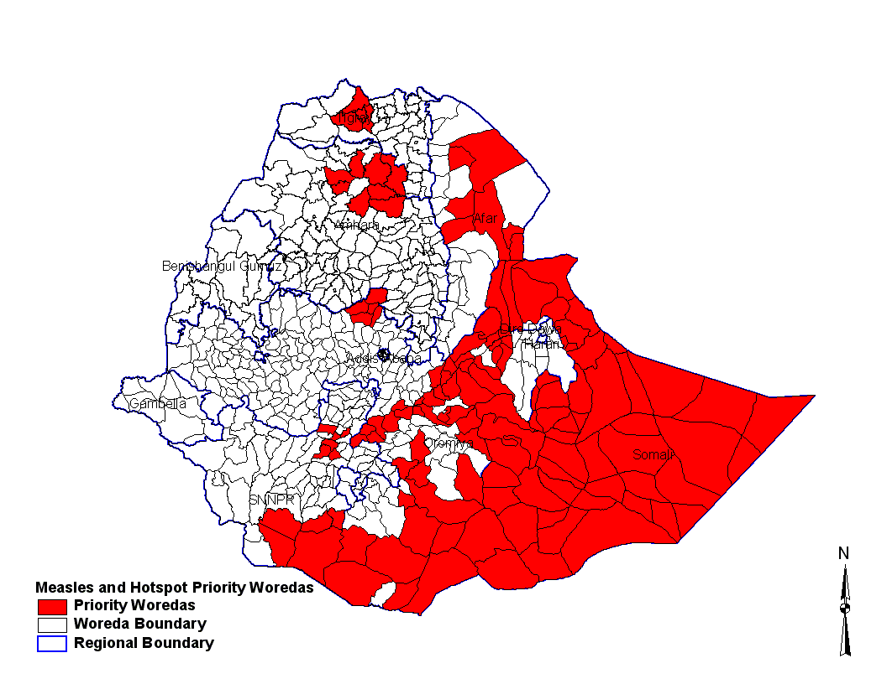
Emergency Response Measles Immunization Activities
Ethiopia
Measles SIA Prioritized Woredas
151 districts selected based on nutritional status and risk for measles outbreaks
7 million children age 6mo to 15yrs vaccinated against measles (96% coverage)
3 million kids received OPV

Slide 24
Observations
The regional level inter-agency HOA health emergency group created a forum to discuss technical issues around disease control, prioritize activities and facilitate cross border coordination.
The technical consultations for measles through emergency teleconference facilitated the decision making in Somalia.
UNICEF played a significant role through leadership of the humanitarian clusters for Nutrition, Water, Sanitation and Hygiene and Education sectors. Collaboration between UNICEF & WHO to provide technical assistance to the affected countries
The use of the polio network in Somalia for early warning and disease control.
UNICEF mobilized 248 personnel from ESA countries and global level to support the four countries and the regional office

Slide 25
Observations
Challenge remains accessing South and Central Zone of Somalia
The mass displacement meant that planning and managing interventions with scarce / fluid data on population movements, made it difficult to determine coverage nor impact of interventions
Lack of clear guidance and differentiation for preventive mass measles vaccination campaign in emergencies and outbreak response measles vaccination campaign

Slide 26
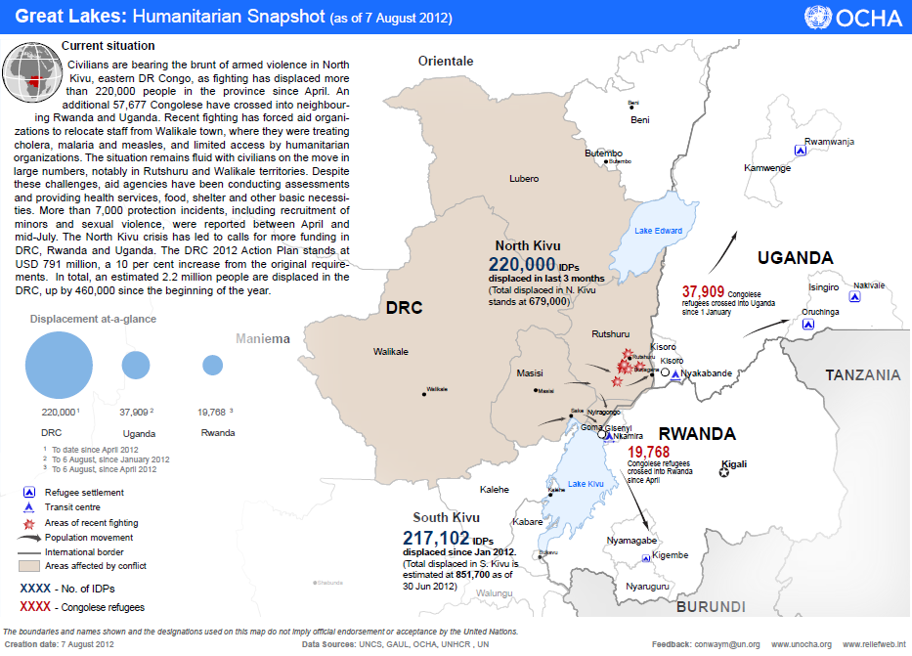

Slide 27
DRC outbreak Response vaccination activities:
Province Orientale : Outbreak response SIAs postponed because of the outbreak of epidemic hemorrhagic fever.
Equateur:: ORI being organised. Launch done on Sept 11, 2012.
For the provinces of Bas-Congo, Bandundu, Kasaï-Oriental and Kinshasa: 1,000,000 doses MCV received, and to be distributed to the provinces starting 11 Sept 2012. However, a gap of USD 568,778 Ops costs.
Katanga: Response SIAs 22- 26 Aug - with 997,940 children reached in 10 ZS as of day 5 – 98% of target. Data completeness almost 100% except for two districts.
Kasaï-Occidental: ORI launch on 22 Aug in all districts reaching a total of 348176 (104%) of target in 5 ZS.
Nord-Kivu: 175,467 children reached in 1 ZS (103% of target).
Maniema: A total of 81,247 children reached in 2 ZS (96% of target).

Slide 28
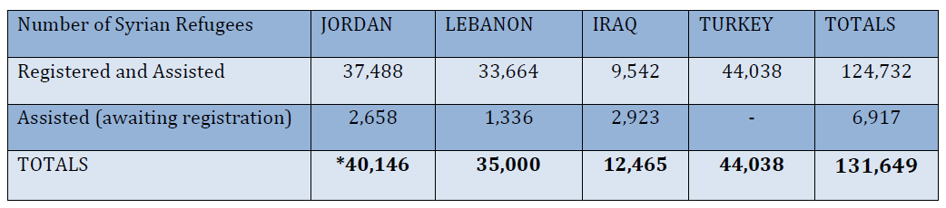
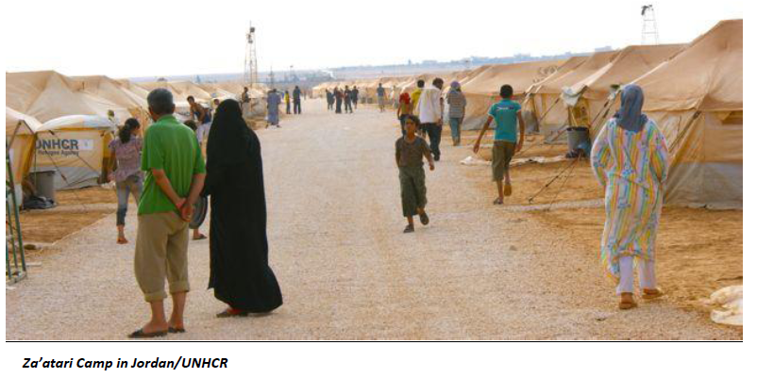
Syria crisis – refugee popln. various countries Aug 12

Slide 29
Conclusion
Measles vaccination in emergencies is occurring under UNICEF’s CCC and in collaboration with various actors: Govts, NGOs on the ground, UNHCR, WHO.
Global documentation is sub-optimal and probably difficult to capture.
Small scale activities take place over time with the trickle of displaced persons using local resources.
Resource mobilisation for emergency measles vaccination is “probably easier – especially with high level visits to highlight the urgency and plight of children.
There are grey areas between outbreak response and preventive SIAs.

