Slide 1
Measles elimination in the African Region- Regional updates
Dr Balcha MASRESHA
IVD/AFRO
Annual MRI Partners’ Meeting
Washington DC
10 – 11 September 2013
Notes:
T

Slide 2
Regional measles elimination targets for 2020
> 95% measles immunization coverage at national level and in all districts;
> 95% SIAs coverage in all scheduled measles SIAs, and in outbreak response immunization activities;
measles incidence of <1: 1,000,000 population at national level;
> 80% of districts investigating > 1 suspected measles cases within a year, and a non measles febrile rash illness rate of > 2 per 100000 population at national level.

Slide 3
Routine Immunisation

Slide 4
MCV1 coverage WHO UNICEF estimates. AFR. 2000 – 2012.

Slide 5
MCV1 coverage WHO UNICEF estimates in AFR countries. 2008 – 2012.

Slide 6
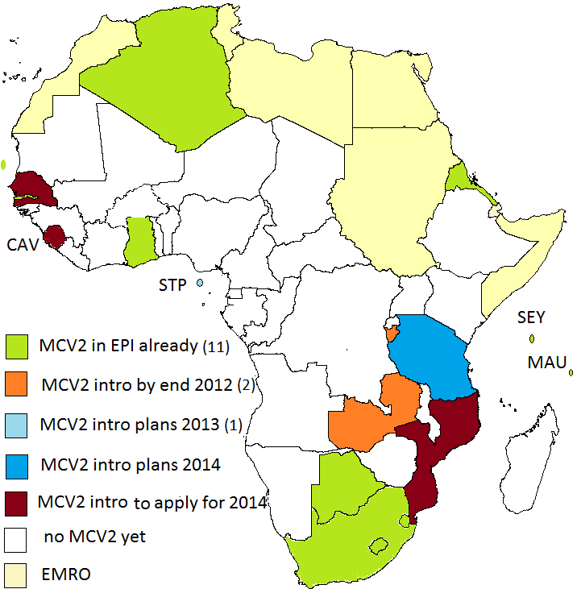
MCV2 introduction in AFR
(as of August 2013)
MCV2 in routine services in 20 countries by end 2014
MCV2 in ~ 25 countries by the end of 2015.

Slide 7
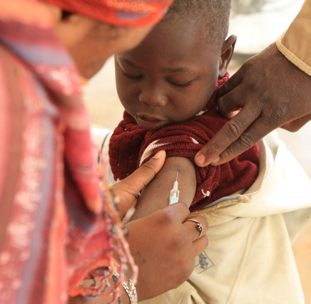
Supplemental Immunisation activities

Slide 8
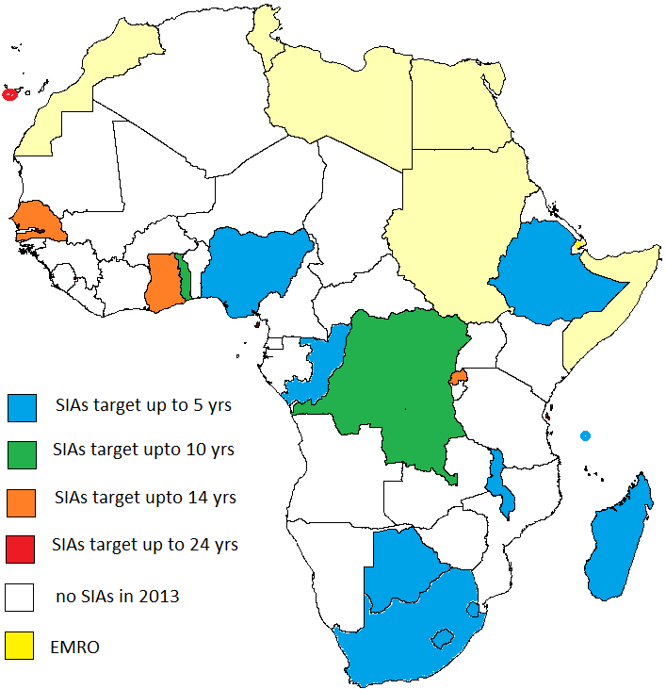
Measles SIAs in 2013
16 countries doing SIAs
  MR SIAs in 4 countries
A total of 88.9 million targeted
  16,118,351 reached in 3 countries,
  awaiting results from 2 more countries
  11 countries doing SIAs in the last quarter
MR used in 4 of the 16 SIAs

Slide 9
Measles SIAs national and district level coverage. 2012 – August 2013. AFR.

Slide 10
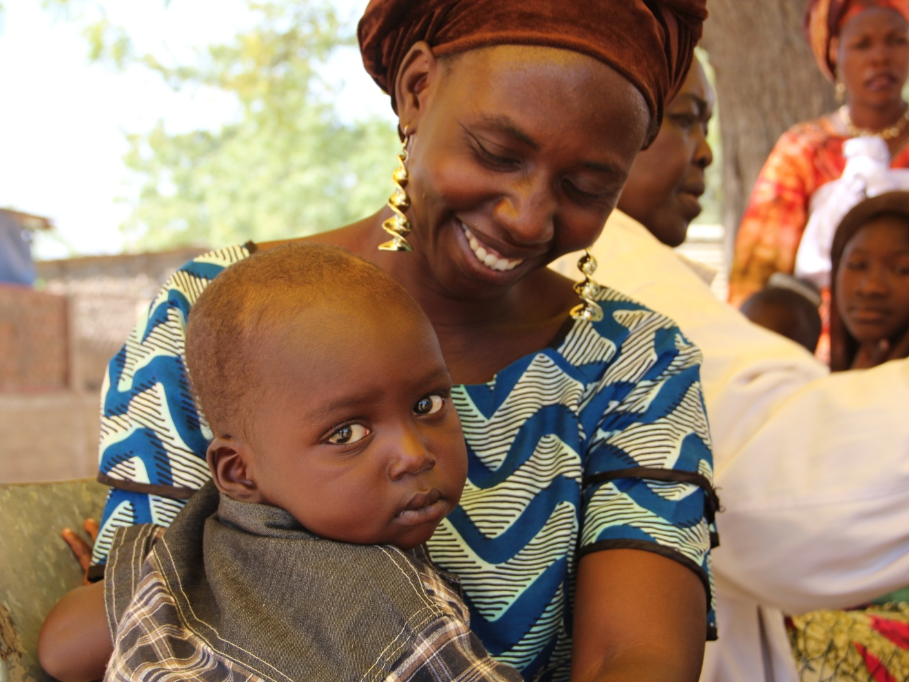
Case based surveillance

Slide 11
Key Measles Surveillance Performance Indicators, African Region 2010 – end July 2013.
PERFORMANCE INDICATORS | 2010 | 2011 | 2012 | 2013
Number of suspected measles cases reported | 163,575 | 74,896 | 55,717 | 58,657
Number of confirmed measles cases | 127,422 | 32,323 | 20,935 | 35,558
Non-measles febrile rash illness (target >2/ 100,000 population ) | 3.7 | 4.4 | 3.7 | 2.9
% districts reporting at least 1 case with blood sample (target >80%) | 84% | 81% | 84% | 77%
Incidence of confirmed measles per million population | 165 | 42 | 27 | 41

Slide 12
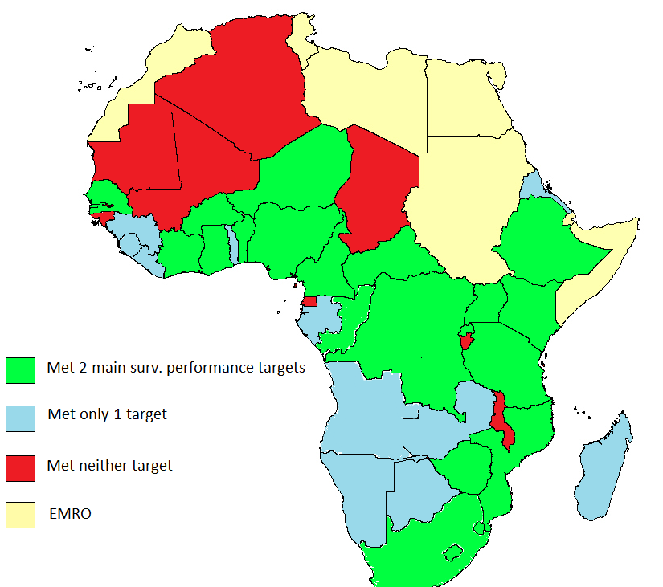
Measles case based surveillance performance. AFR. 2012.

Slide 13
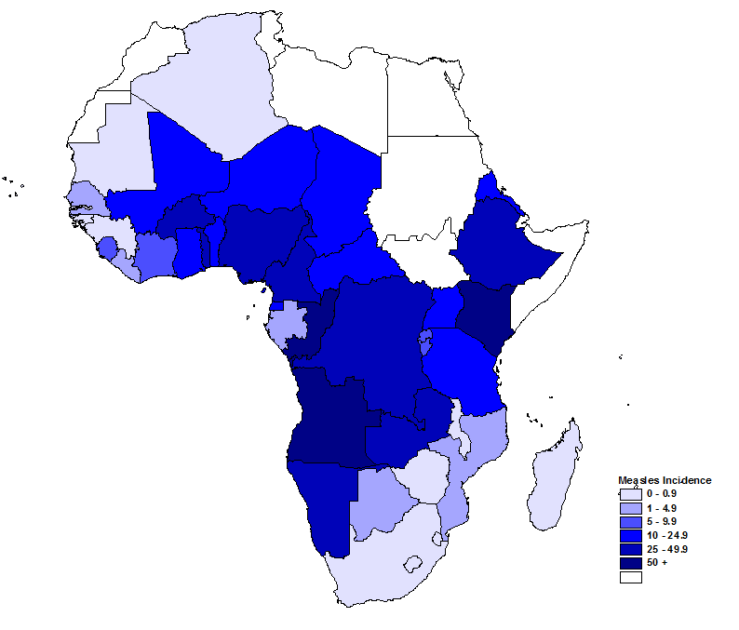
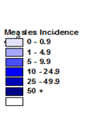
Measles Incidence rate per million population. AFR. 2012

Slide 14
Measles case reports & MCV1 coverage (WHO-UNICEF estimates). AFR. 1980 - 2012
Follow up SIAs
Catch up SIAs
64% of case reports in 2010 = from Malawi
69% and 68% of case reports in 2011 and 2012= from DR Congo

Slide 15
Performance against the 2020 measles elimination targets (as of Dec 2012)
> 90% MCV1 coverage nationally (WHO UNICEF estimates)
  15 countries (2012)
> 95% coverage during measles SIAs in every district.
  3/12 countries (2012)
incidence < 1 confirmed measles /1,000,000 pop’n /year
  16 countries
NMFRI rate of > 2:100,000
  25 countries
> 80% districts reporting per year
  25 countries

Slide 16
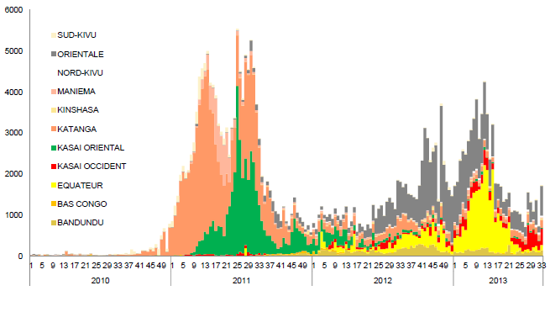
Weekly trends of measles reporting in DR Congo by province. 2010 – week 33, 2013

Slide 17
Measles Resurgence in AFR; Key factors
Gaps in routine coverage
Delays and gaps in SIAs coverage
Resistant groups
Shift in epidemiological susceptibility

Slide 18
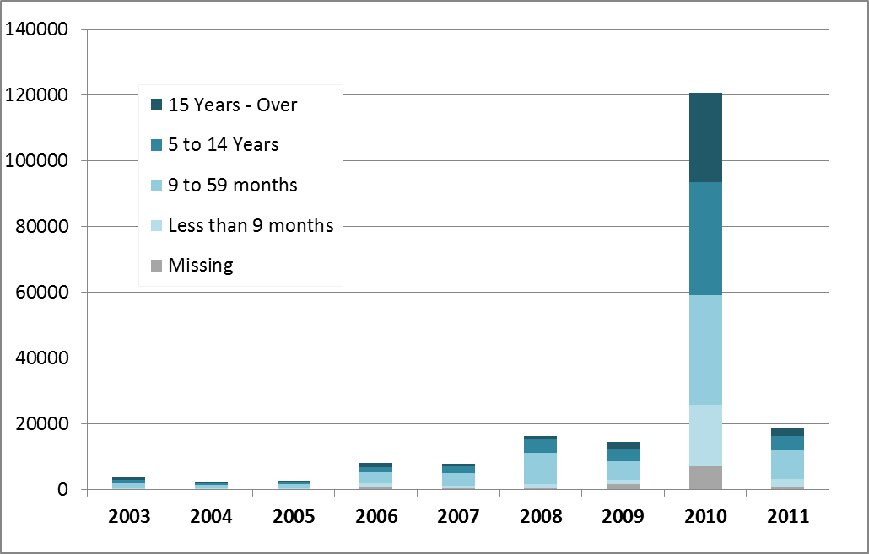
Confirmed measles. Case based surveillance data. AFR. 2003 – July 2011

Slide 19
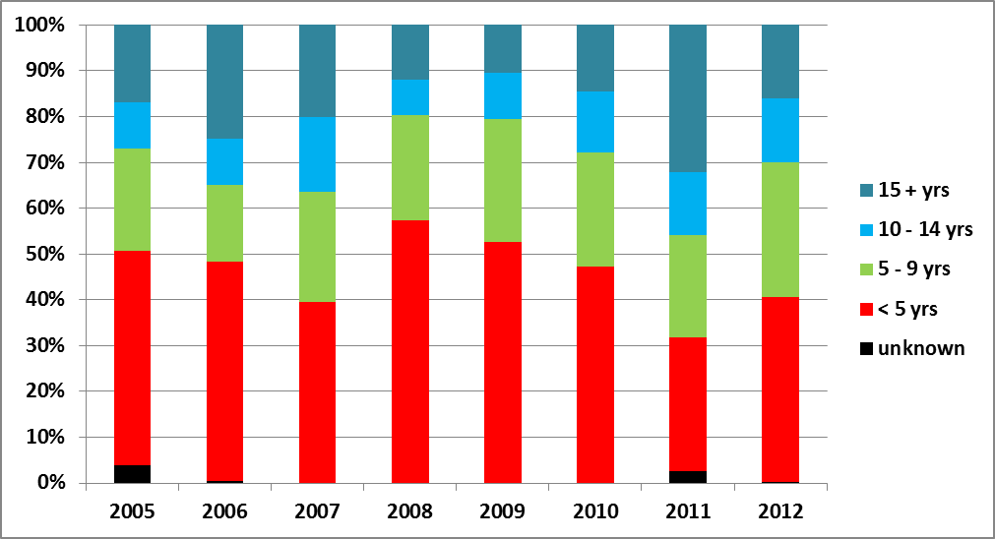
Age breakdown of confirmed measles cases. Ethiopia. 2005 – 2012.

Slide 20
Attempts to address the resurgence: Routine immunisation program
Ongoing efforts to strengthen immunisation systems
  The opportunity of new vaccine introduction
  “RED approach”
Ministerial conference on implementing GVAP – early 2014
MCV2 introduction and Post introduction evaluations
Linking GAVI HSS support to immunisation outcomes
Using SIAs as an opportunity to support strengthening routine immunisation

Slide 21
Attempts to address the resurgence: SIAs
Planning and budgeting for SIAs in the context of national strategic plans & cMYPs
  Timely mobilisation of local and partner resources for SIAs
  Timely conduct of scheduled SIAs
Emphasising on high quality SIAs ( > 95% coverage in every district)
SIAs targeting age groups as determined by the epi. picture:
  Zambia, Niger in 2012
  Togo, 2 provinces in DRC in 2013

Slide 22
Age breakdown of measles cases in selected provinces in DRC. 2005 – 2012.
Equateur province, DRC.
Orientale province, DRC.

Slide 23
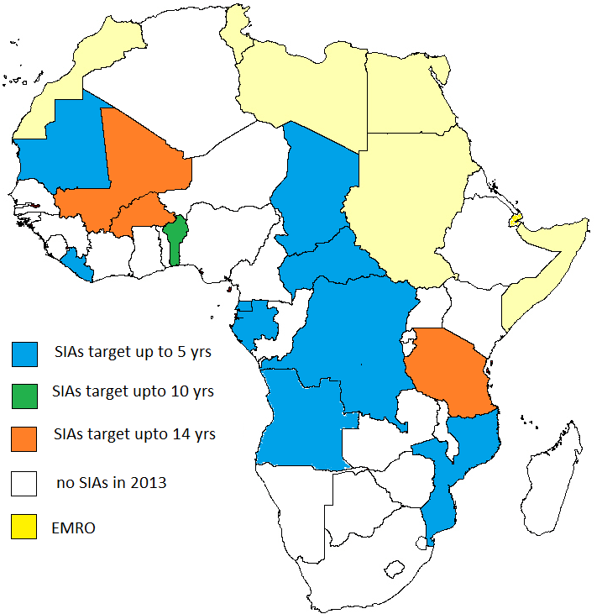
Measles SIAs in 2014
14 countries (incl. S Sudan)*
A total of 78.6 million to be targeted
  MR SIAs in 2 countries
  GAVI support for CHA, DRC, BUR, TAN
  3 non GAVI eligible
MRI support = 5 countries with 11.6 million to target:
  ~ USD 13.1 million for BV, ½ ops costs, surveillance and TA
* CAR and MOZ = SIAs in 2013???

Slide 24
Technical support needs in 2014
SIAs:
  Mostly francophone countries
  Angola
  S Sudan!
Areas for MRI support:
  SIAs:
    Logistics
    Planning and coordination of coverage survey
    Advocacy with non-GAVI eligible countries
  MCV-2 Post-Introduction Evaluation
  Surveillance reviews:

Slide 25
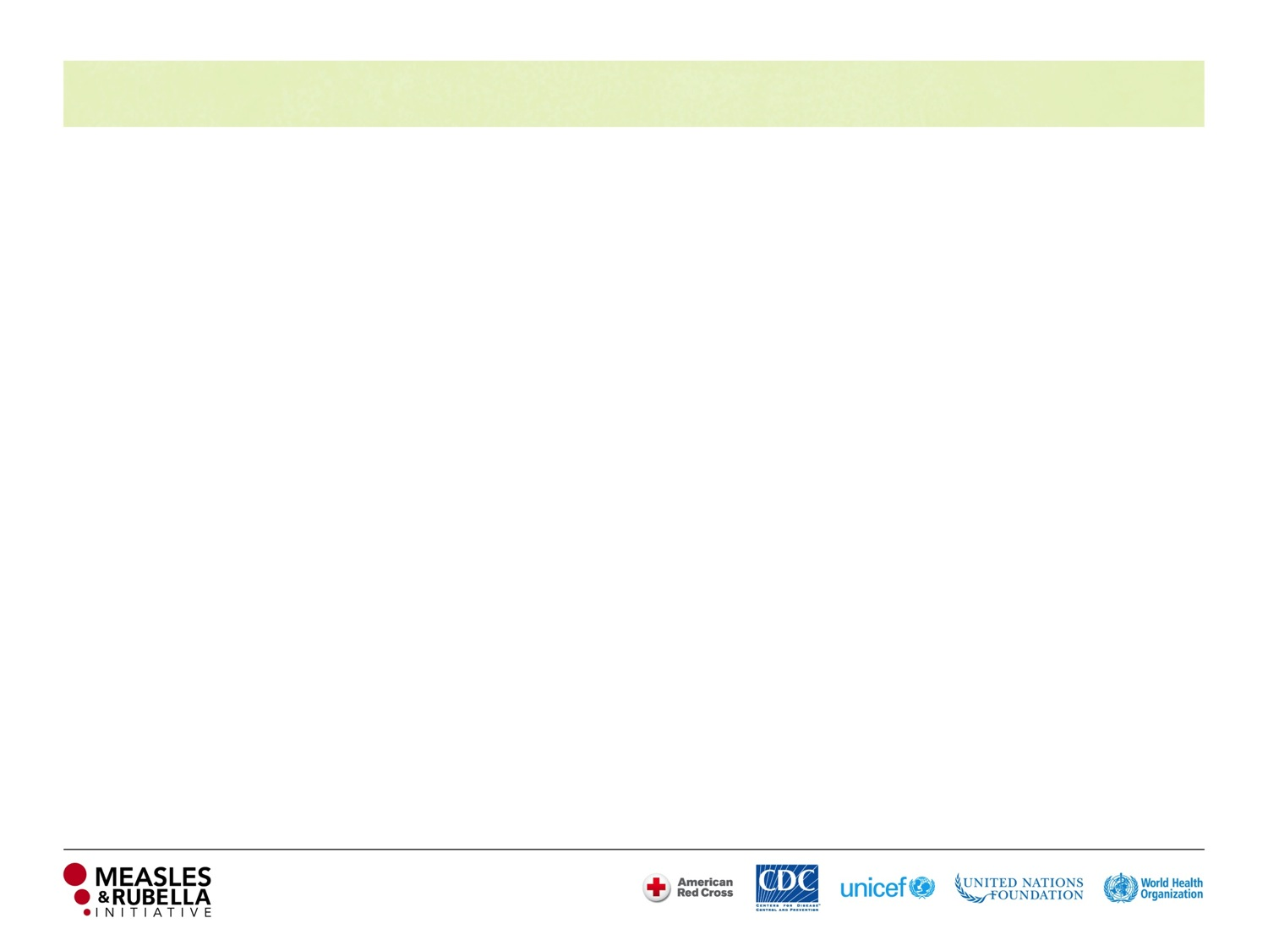


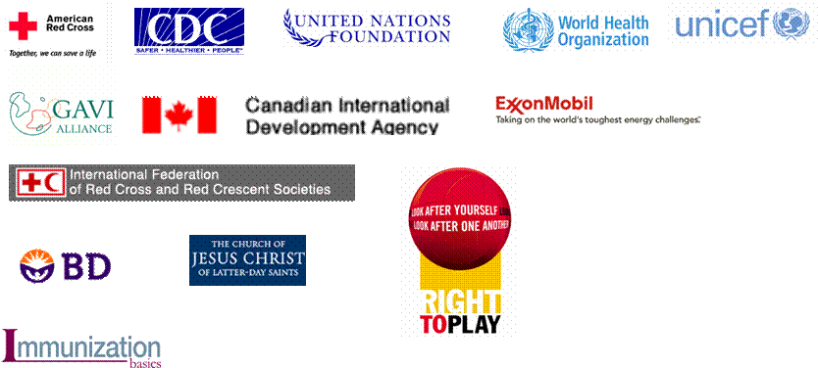
















Thank you
Anne Ray Charitable Trust

