Slide 1
Update on the Epidemiological Situation of Measles in the Americas: Challenges and Response
Dr Jarbas Barbosa
Assistant Director
PAHO/WHO Washington DC

Slide 2
Outline
Measles epidemiological situation in the Americas
Factors contributing to measles outbreaks
Outbreak response
Challenges to sustain the elimination

Slide 3

History of Measles and Rubella Elimination
The Americas 1980-2019
CATCH UP CAMPAIGNS TO ELIMINATE MEASLES
SPEED UP CAMPAIGNS TO ELIMINATE RUBELLA
Confirmed measles cases
FOLLOW- UP CAMPAIGNS FOR MEASLES AND RUBELLA
% Vaccination coverage
LAST ENDEMIC MEASLES CASE
ULTIMO CASO ENDEMICO DE RUBEOLA
LAST ENDEMIC RUBELLA CASE
Source: PAHO-WHO/UNICEF 2019 joint reporting form (JRF) on immunization (2018 data).
Notes:
The Americas is the only region which has been certified as measles free since September 2016, accomplishing one of the most important goals in public health at the global level in the new millennium.
Although two countries have reestablished the endemic transmission in 2018 and 2019, one fundamental fact is that 33 of 35 Member States have sustained the measles elimination during the last 17 years and most of them since 28 years ago (English Speaking Caribbean countries).

Slide 4
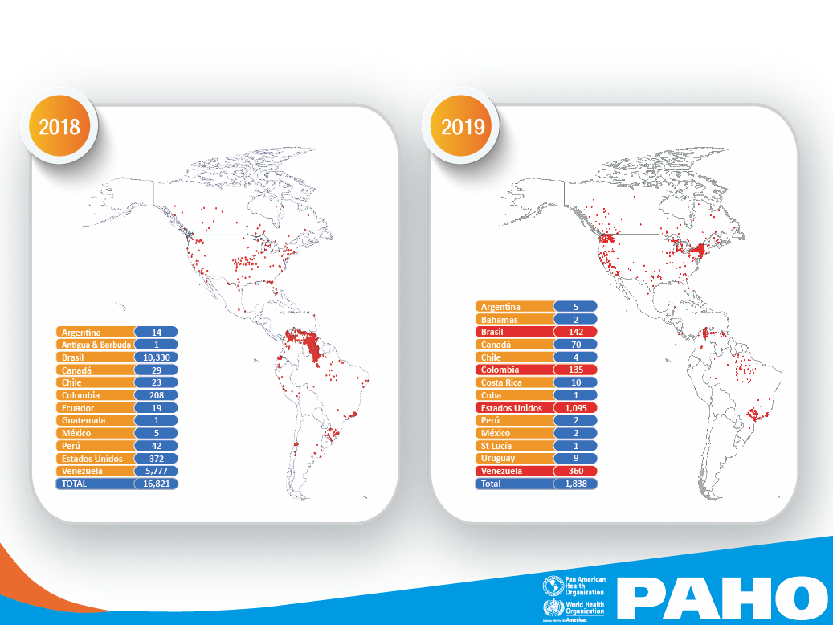
Distribution of Confirmed Measles Cases by Countries
The Americas 2018 and 2019*
Argentina=5
Bahamas=2
Brazil=2,561 (4 deaths)
Canada=107
Chile=5
Colombia= 189
Costa Rica=10
Cuba = 1
EUA= 1,215
Peru=2
Mexico= 11
St Lucia=1
Uruguay = 9
Venezuela=446
Total= 4,564
Argentina=14
Antigua & Barbuda=1
Brazil=10,330
Canada=29
Chile=23
Colombia=208
Ecuador=19
EUA=372
Guatemala=1
Mexico =5
Peru=42
Venezuela=5,778
TOTAL=16,822
Source: ISIS, MESS, country reports to FPL-IM/PAHO., and Measles Epidemiological Alert. PAHO.
*Data as of August 31 2019.
Notes:
In these maps for 2018 and 2019 years, we have summarized the measles cases for each country in the Americas. In 2018 a total od 16,822 cases were reported, with the largest outbreaks in Brazil (10,330 cases) and Venezuela (5,778 cases).
Between 1 January and 31 August 2019, a total of 4,564 measles confirmed cases, have been reported in 14 countries and territories of the Region of the Americas: Argentina, the Bahamas, Brazil, Canada, Chile, Colombia, Costa Rica, Cuba, Curaçao, Mexico, Peru, the United States of America, Uruguay, and the Bolivarian Republic of Venezuela. Three deaths have been reported as well (two deaths in Brazil and one in Colombia).
In 2019, most confirmed cases have been reported from Brazil (n=2561-56%) and the United States (n=1,215-27%). The total cases in both countries represents 83% of total cases. The remaining countries have done a rapid response and have achieved the interruption of virus in a fast way. This deserve the recognition of such efforts in countries

Slide 5
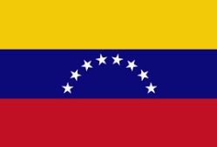
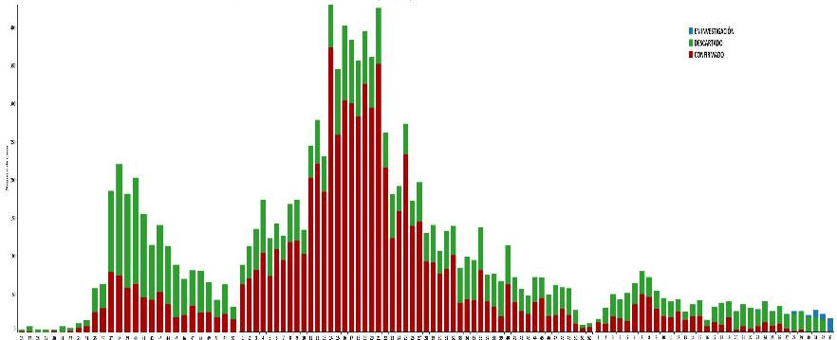
Distribution of Notified Measles Cases by Epidemiological Week and Final Classification Venezuela 2017 – 2019*
10.329 reported cases
6.952
confirmed cases:
727 in 2017; 2 deaths
5,779 in 2018 and 77 deaths
446 in 2019; zero deaths
45 cases under investigation in 2019
National cumulative incidence rate: 218 cases per million habitants
Re-establishment of endemic transmission:
30 June 2018
(EW-27, 2018)
Date of rash onset of the last case: 7 August, 2019 in Mara, Zulia.
Number of cases
2017
2018
2019
Confirmed
Discarded
Source: Ministry of Health of Venezuela Reports to PAHO/WHO Venezuela |
* Data up to EW 34, 2019
Under investigation
Notes:
Venezuela has the longest measles outbreak of two years (since July 2017 to August 2019) with around 7 thousand cases and have had a national virus spreading (all 24 the states).
The reestablishment of endemic transmission was in June 30th 2018, after 12 months with active virus circulation with the same genotype D8.
Thanks to a catch-up campaign aimed to children from 6 months to 15 years of age the transmission has been declining and in 2019 there are 446 confirmed cases reported until now.
The last confirmed cases were reported in August in Zulia, in border with Colombia.

Slide 6
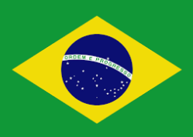
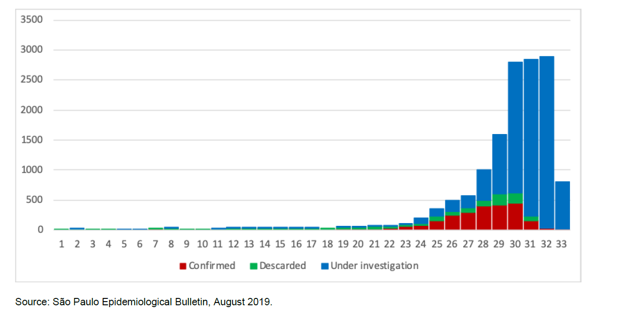
Distribution of Confirmed Measles Cases by Month. Brazil, 2018-2019*
Distribution of reported cases by epidemiological week of rash onset. São Paulo, Brazil, 2019*
Re-establishment of endemic transmission: February 19, 2019
N= 2,299 cases (98% of 2019 cases)
2018
2019
10.330 cases
2,561 cases
N= 12,891 cases in
2018-2019
Source: Ministry of Health of Brazil | CGPNI/DEIDT/SVS/MS * Preliminary data as of epidemiological week 33 of 2019
Notes:
Brazil has the largest measles outbreaks during 2018 and 2019, with a total of more than 12 thousand cases
These outbreak have been focused in three states; Amazonas and Roraima in 2018; and Sao Paulo in 2019, as you can see in this epidemiological curve in two peaks for both years.
The reestablishment of endemic transmission was in February 19th 2019, after 12 months with active virus circulation with the same genotype D8.
Thanks to a Follow-up campaign aimed to children from 1 to 4 years of age the transmission declined in 2018 but in 2019 has been increase again in the state of Sao Paulo with a different genotype D* than reported in 2018.
By 2019 there are 2, 561 confirmed cases reported until now, and Sao Paulo has the 98% of this total of cases.

Slide 7

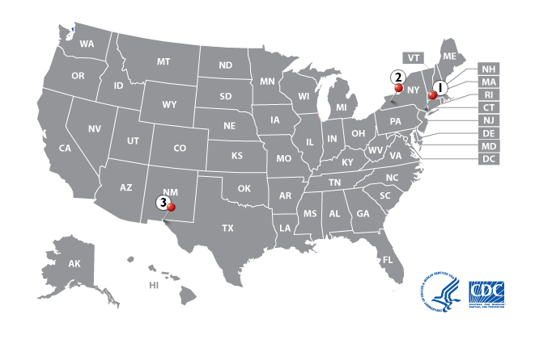
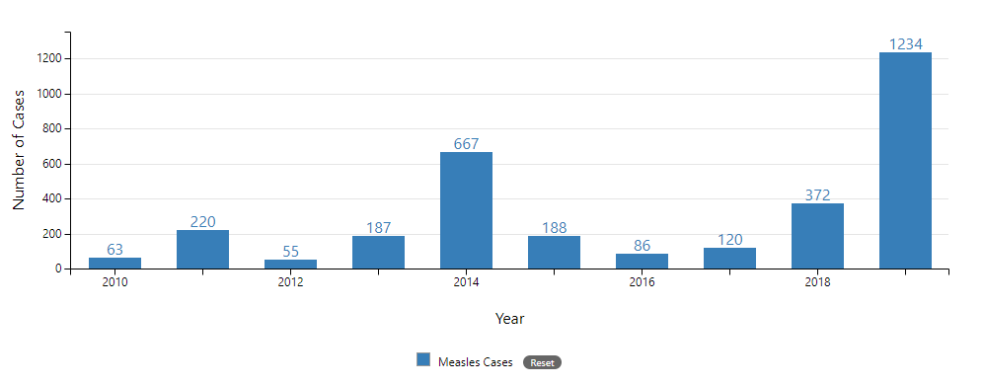
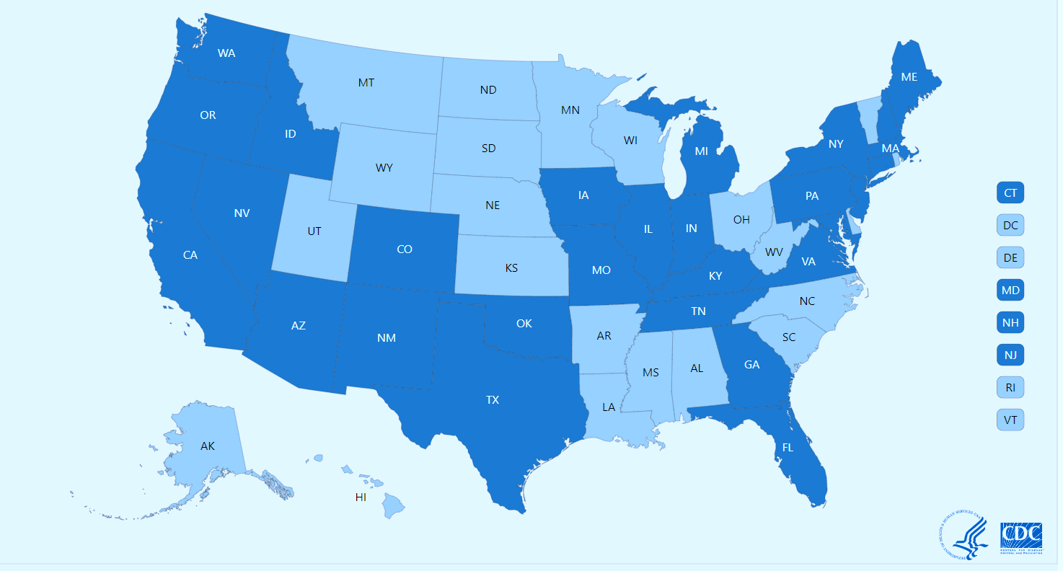
Distribution of Confirmed Measles Cases by Epidemiological Week
United States of the America, 2019*
N=1,234
Number of cases
Epidemiological weeks
Geographic location of Confirmed Measles Cases
by State, 2019*
Measles outbreaks in USA are linked to travelers who brought measles back from other countries such as Israel, Ukraine, and the Philippines, where large measles outbreaks are occurring.
Reported cases
No reported cases
Source: Centers for Disease Control and Prevention. Provisional data as of 6/22/2019
https://www.cdc.gov/measles/cases-outbreaks.html
Notes:
From January 1 to August 29, 2019, 1,234** individual cases of measles have been confirmed in 31 states. Longest measles outbreak in more than 25 years threatens U.S. measles elimination status, first established in 2000
More than 75% of the cases this year are linked to outbreaks in New York. Measles is more likely to spread and cause outbreaks in U.S. communities where groups of people are unvaccinated.
Measles outbreaks in USA are linked to travelers who brought measles back from other countries such as Israel, Ukraine, and the Philippines, where large measles outbreaks are occurring.
On September 3, health officials declared that the measles outbreak in New York City has ended (because 6 weeks without notified cases).
The majority of cases are among people who were not vaccinated against measles. As of August 29, 2019, 125 of the people who got measles this year were hospitalized, and 65 reported having complications, including pneumonia and encephalitis. All measles cases this year have been caused by measles wild-type D8 or B3.

Slide 8
Outline
Measles epidemiological situation in the Americas
Factors contributing to measles outbreaks
Outbreak response
Challenges to sustain the elimination

Slide 9
Factors contributing to measles outbreaks:
Community factors:
Susceptible population:
Epidemiological surveillance and outbreak response:
Notes:
As Dr Katrina Kretsinger from WHO has mentioned before in her Global overview of progress and challenges, in 2019 there is an increase of cases at the global level of three times higher than the same period in 2018.
This epidemiological measles situation is the worse since 2006 and as a result, the countries of the Americas are permanently at high risk of measles virus importations from other regions of the world.
We have identified as main risk factors the following (among others that could be specific in each country):
Community factors:
High migration from areas with virus circulation (Venezuela) into the Region
Residents traveling internationally to other regions with virus circulation
Easy virus spreading in no vaccinated indigenous communities
Easy virus spreading in communities with pockets of unvaccinated people
Under vaccination:
Non geographical access to vaccination (rural indigenous communities);
Philosophical or religious beliefs (urban areas);
Vaccine hesitancy and other community-specific issues (urban areas);
Susceptible population in older age groups (adolescents and young adults)
Epidemiological and response:
Weak surveillance at some municipalities
Delayed response for vaccination in adolescent and young adults
Overload of field outbreak investigation in a high migration settings
Nosocomial transmission at hospital and health services

Slide 10
Children 1 year of age vaccinated in Venezuela and Brazil, 2010 - 2018
Coverage Trends with MMR1 and MMR2
Venezuela, 2010-2018
Coverage Trends with MMR1 and MMR2
Brazil, 2010-2018
Source: PAHO HQ : Country reports through the PAHO-WHO/UNICEF Joint Reporting Form (JRF), 2019

Slide 11
Outline
Measles epidemiological situation in the Americas
Factors contributing to measles outbreaks
Outbreak response
Challenges to sustain the elimination
Notes:
The epidemiological situation has been updated until August 31, 2019.

Slide 12
Outbreak Response
Actions for rapid increase population immunity at country and regional level:
High vaccine coverage and/or rapid public health response (mop-up activities)
Follow-up campaigns (Argentina, Brazil, Costa Rica, Panama, Guatemala, Haiti) and Catch-up campaigns in Venezuela and Peru;
Addressing barriers to access immunization
Addressing vaccine hesitancy in close-knit communities

Slide 13
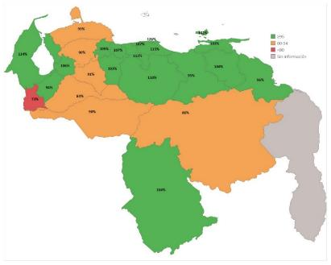
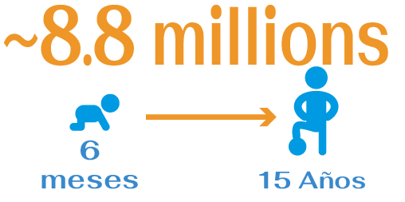
National Campaigns 2018
MR/MMR Coverage by State During the Catch-Up Vaccination Campaign for measles and Dhipteriae
Venezuela, April-December of 2018
MMR Coverage by State During the Follow-Up Vaccination Campaign for measles and Polio.
Brazil, August – September 2018
>95
80-94
<80
No data
Source: Ministry of Health of Brazil sipni.datasus.gov.br. Dados finais 2019.
98% goal
97.8% goal
10.9 million
6 m – 15 years old
1 – 4 years old
Notes:
BRAZIL:
Between August and September of 2018, the follow-up vaccination campaign against measles was carried out in the 27 Federated Units, with a population goal of 1 to 4 years of 11, 2 million, reaching a coverage of 97.8%, (10.9 million children vaccinated). All the Federated Units achieved coverage> 95%, including the Federal District (90.32%) and Piauí (92.23%). In the state of Roraima and the municipality of Manaus-Amazonas, the campaign was anticipated as a result of measles fever and vaccination of the population between 06 and 11 months of age was included in the goal.

Slide 14




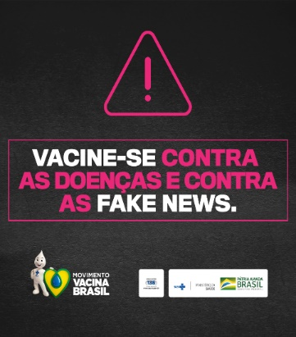

Outbreak Response in Brazil, 2019

Slide 15
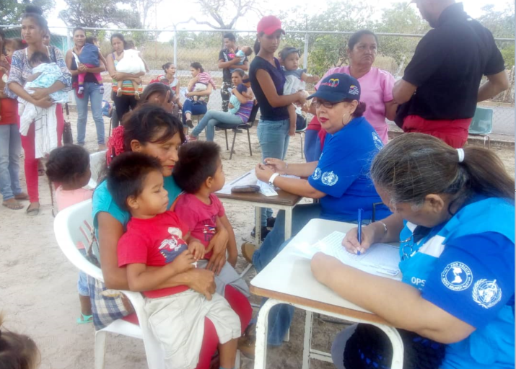
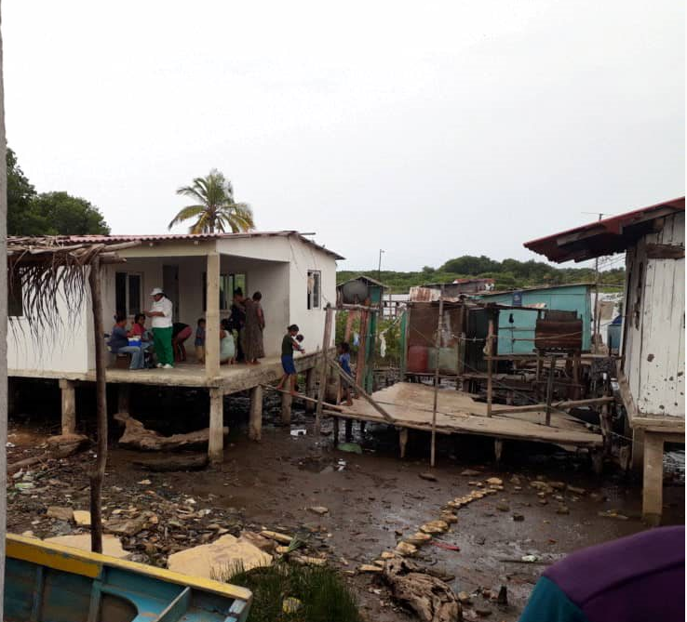
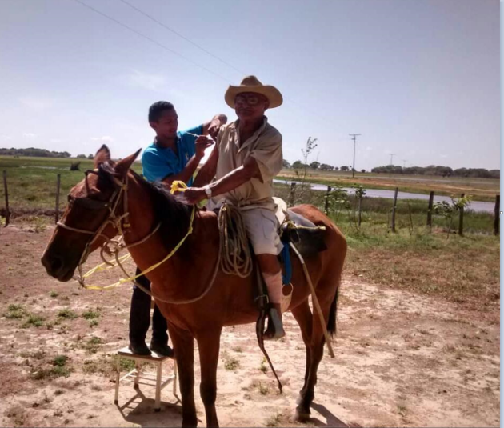
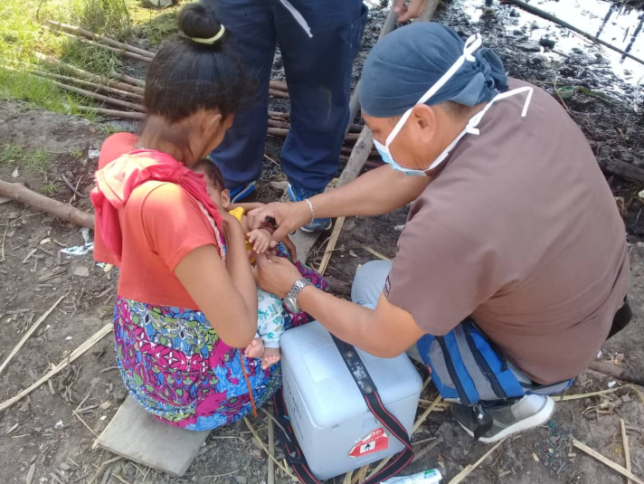
Outbreak Response in Venezuela 2018 - 2019

Slide 16
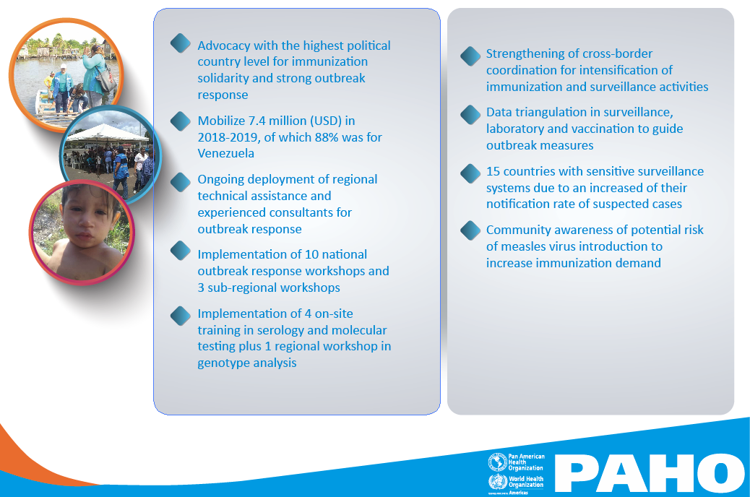
PAHO’s Technical Assistance in Outbreak Control, 2018-2019

Slide 17



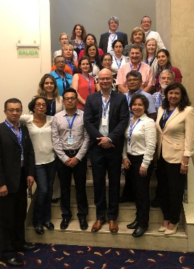
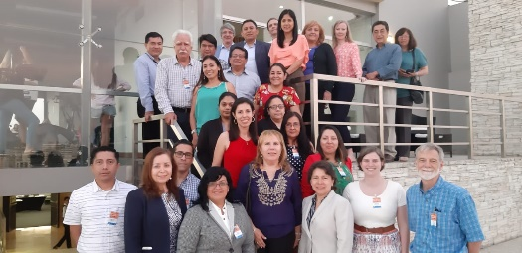


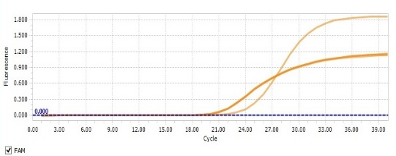
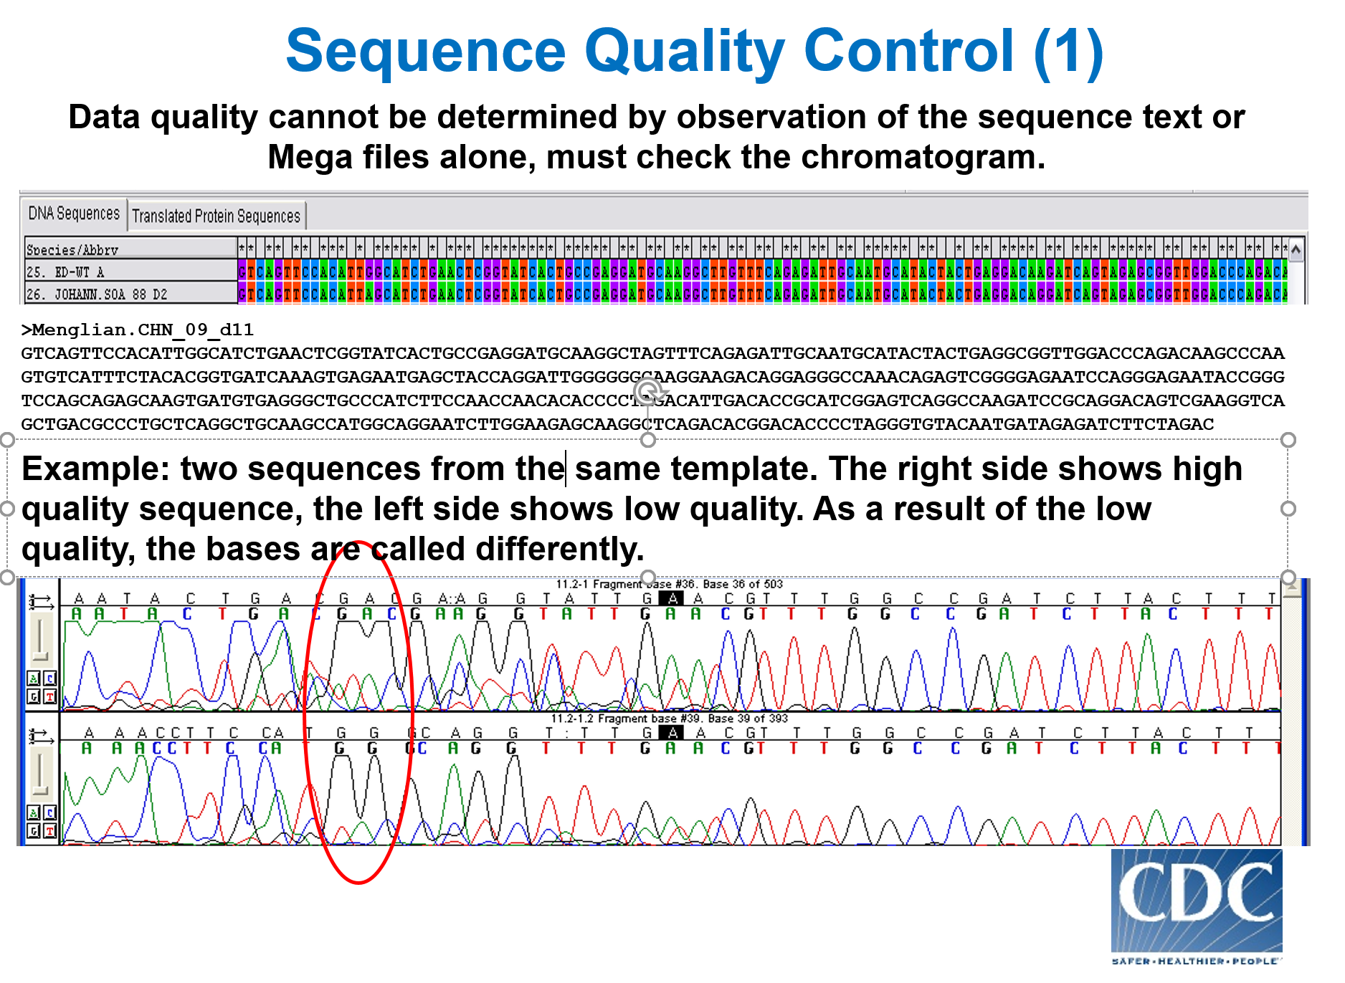




PAHO Supporting and Strengthening the capacities of national MR laboratories, 2018-2019*
Regional meetings
Kits IgM, IgG, RNA extraction, enzymes
Support to 18 countries and the Caribbean Subregion
Custom and International Courier costs
Buenos Aires, April 2019
Lima, April 2019
Trainings / Workshops
Support to 12 countries
RNP
Accreditation visit to laboratories
Positive (Ct 21)
On-site trainings
Ecuador, April 2018
Guyana, September 2018
Panama, November 2018
Guatemala, August 2019
Workshop
Participants of 8 countries
Buenos Aires, April 2019

Slide 18
Distribution of measles sequences reported to MeaNS by epi-week and genotype. Region of Americas, 2018-2019*
2018
2019
N = 1.276 (2018 = 501; 2019 = 775)
Source: MeaNS (http://www.who-measles.org) by 6 Sep 2019

Slide 19
Outline
Measles epidemiological situation in the Americas
Factors contributing to measles outbreaks
Outbreak response
Challenges to sustain the elimination
Notes:
The epidemiological situation has been updated until August 31, 2019.

Slide 20
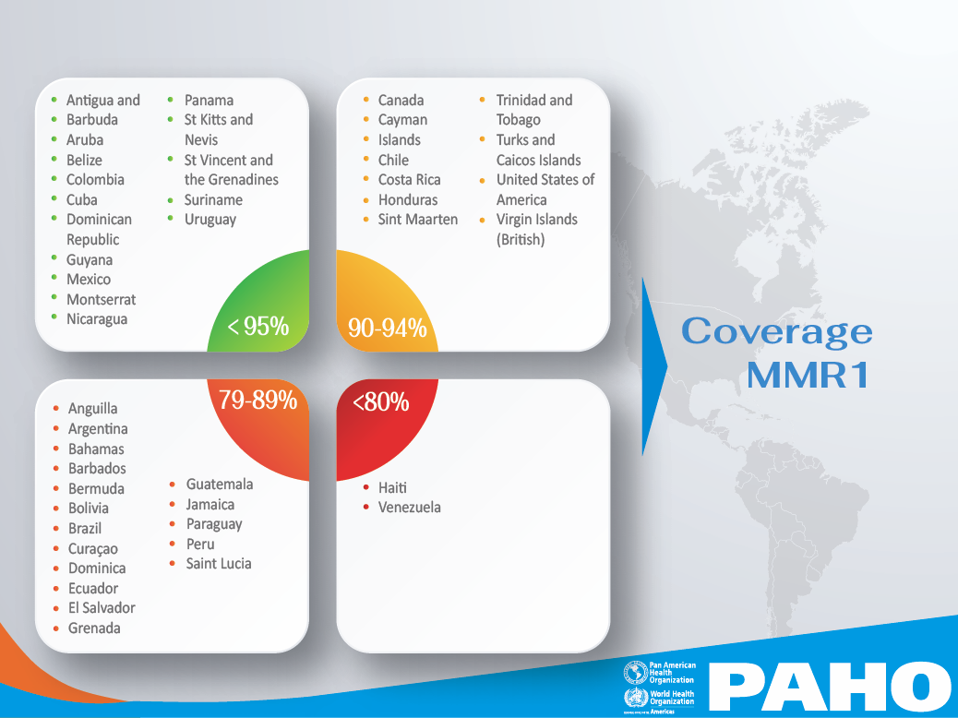
MMR1 Routine Vaccination Coverage by Countries and Coverage Range Groups
The Americas, 2018*
Source: Country reports through the PAHO-WHO/UNICEF Joint Reporting Form (JRF), 2019.

Slide 21
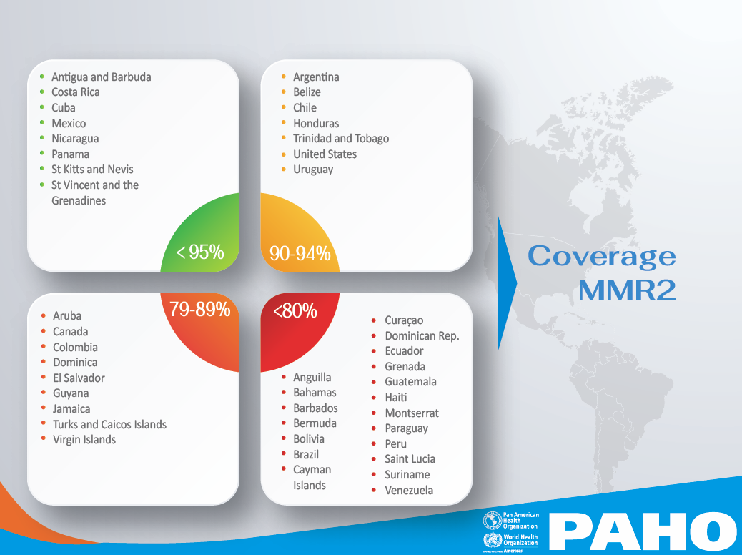
MMR2 Routine Vaccination Coverage by Countries and Coverage Range Groups
The Americas, 2018*
Source: Country reports through the PAHO-WHO/UNICEF Joint Reporting Form (JRF), 2019.

Slide 22

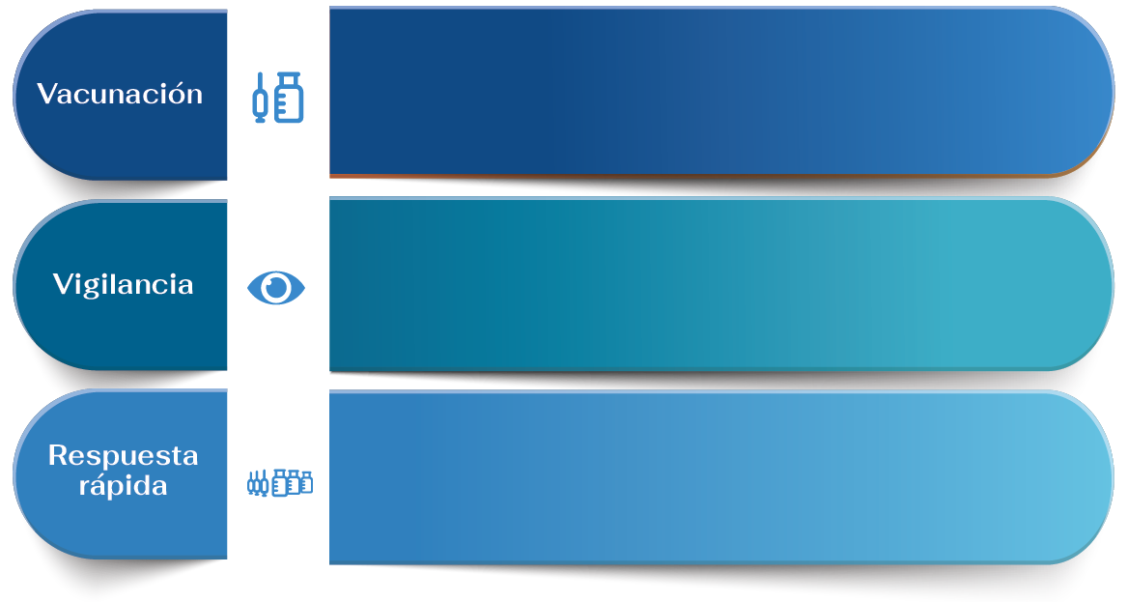
Key Strategies to Sustain Measles & Rubella Elimination
  Vaccinate with equity reaching 95% by municipality with MMR1 and MMR2;
  Vaccinate high-risk populations (e.g. health workers, tourism, migrants, etc.);
  Implement high quality follow-up campaigns when appropriate, according to the country's susceptibility analysis;
  Comply with TAG recommendation of lowering the age of vaccination of MMR2 to 18 months.
  Timely detection of suspected cases in public and private facilities;
  Strengthen epidemiological surveillance in border areas;
  In explosive or extensive outbreaks, classify suspected cases by epidemiological link or clinical compatible symptoms;
  Implement follow-up of contacts and active case finding;
  Obtain specimens for case confirmation and viral detection
  Activate trained rapid response teams to implement immediate actions for outbreak control and interrupt transmission;
  Establish adequate intrahospital management of cases with reference flow of patients and isolation rooms, to avoid nosocomial transmission.

Slide 23
