Slide 1
The Measles & Rubella Initiative:
Preparing for the Next Decade
Lisa Cairns, MD, MPH
Sept 18, 2012
Washington, DC
Notes:
Good morning.
I;ve been asked to talk to you today aboutt he measles and rubella initiative -- both about how it operaties now, and, more importantly, how it is preparing for the next decade.

Slide 2
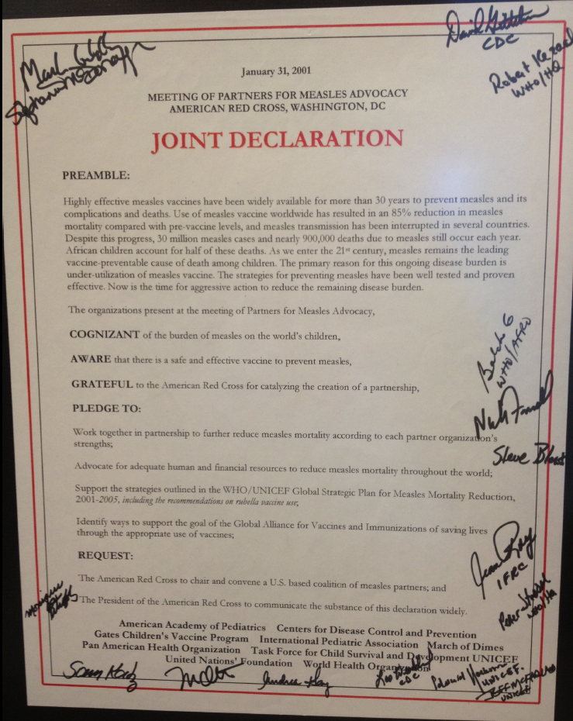
Measles Initiative, Joint Declaration, Jan 31 2001
Founding Partners: UNICEF, UN Foundation (UNF), World Health Organization (WHO), American Red Cross (ARC), Centers for Disease Control and Prevention (CDC)
Notes:
This is a picture of the declaration by the Measles Initiative’s 5 founding partners to work jointly to reduce measles mortality. This declaration was signed in 2001, almost 12 years ago now. The five founding partners were the UN Foundation, The World Health Organiszation, UNICEF, an dthe Centenrs for Disease control and Prevention. For the first 11 years of our existence, we were known as the Measles Initiative, or MI. We’ve recently changed our name to the Measels Rubella Iniatiive; during this talk I will explain how that happened.

Slide 3
2000 – 2010 Progress
Estimated measles deaths down by 74%,
(9.6 million deaths prevented)
26%
26%
79%
78%
85%
76%
74%
** Simons E et al. Assessment of the 2010 global measles mortality reduction goal: results from a model of surveillance data. Lancet 2012; 379(9832):2173-8
Notes:
The Measles Initiative has been very successful in reducing measels mortality over the years since it was was founded. Recently published work estimates that, from 2000 to 2010 , global measles mortality was reduced by 74%, and 9.6 million deaths were prevented,

Slide 4
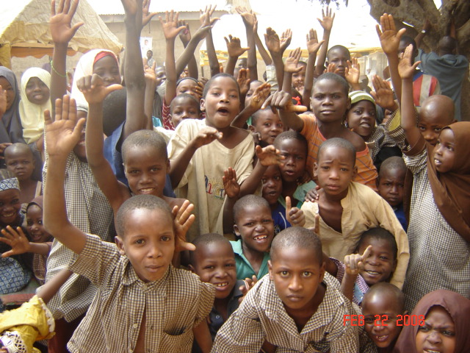
Foundations of Success
Partnerships and collaboration
Donations
  US $934,959,993 (2001- 2012)
Operating procedures
Notes:
These successes can, I think, be attributed to seveal things.
First, the parternaships and collaborations that have developed with Ministries of Health, donors, and other technical agencies. These partnerships are what allos us to develop a vision, and move from this to a strategic plan and to actual implementation.
Second, the generous donations that we have received – just iunder a billion dollars to date -- have been critical. In this context, I would particularly like to acknowledge the recent generosity of the Anne Ray Charitable Trust to the Measles Rubella Iniative.
Finally, the way in which we operate has also contributed to our successes.
In preparing this talk, it struck me that some of you might not know how the Measles Rubella Iniatiive works, and so I thought I would briefly review that here.

Slide 5
How We Work:
Country Prioritization and Planning
Annual country plans prepared with WHO/UNICEF
  Countries mandated to pay 50% operational costs
  Approved by ICC, submitted through WHO
  Plans consolidated regionally and globally
Plans reviewed by founding partners
  Existing resources
  Disease burden
  Immunization profile in-country
  Country’s ability to self-fund and to implement
Notes:
The process begins at country level, where countries are asked to draft annual plans to reach measles goals. This plans are prepared in conjunction with WHO and UNIVCEF. Countries are mandated to pay 50% of the operational costs associated with supplementary immunixation actitvigties or SIA. Plans are then approved by the ICC, and submitted to the Initiviat through the country WHO office. Plans are then consolidated regionally, and, eventually, globally.
Plans and requests for funding are then reviewed by the founding partners. In amking decisions about funding, a number of things are taken in to account. These include the Iniatitiaves existing resources, the disease burden in the counrty, the immunization profile of the country , and the country’s ability to self fund and implement an SIA.

Slide 6
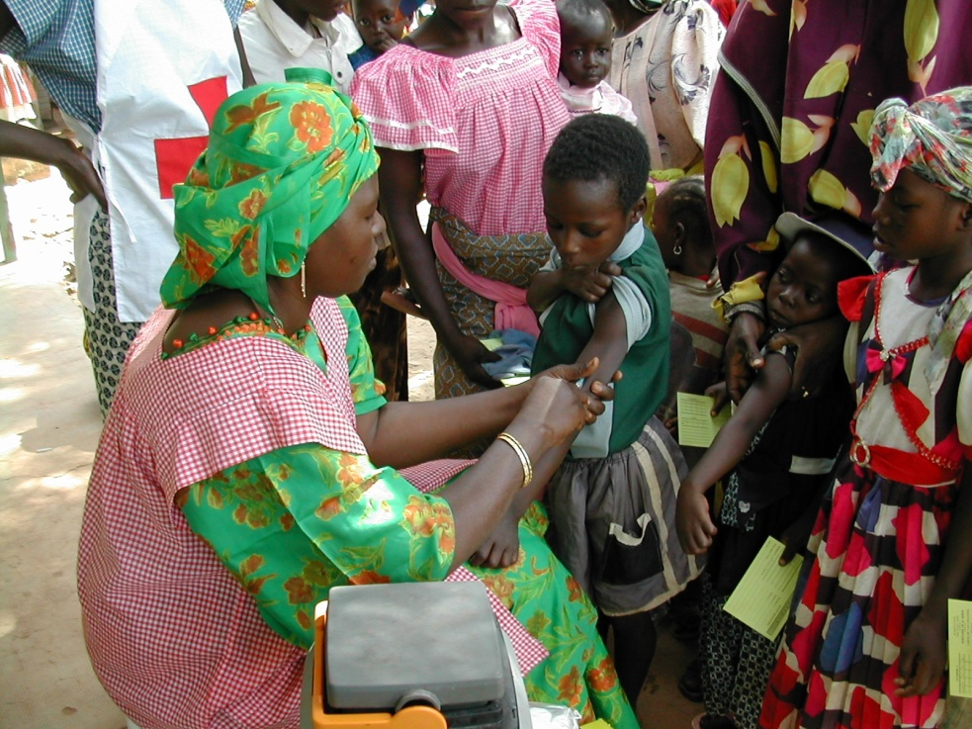
How We Work:
Implementation and Reporting
Partners support implementation of
plan of action
  Technical (campaign planning,
  implementation, evaluation…)
  Advocacy, social mobilization, surveillance
Technical implementation report submitted
  One for each country
  Consolidated annually by WHO and UNICEF into a single report
  Provided to donors
UNICEF SD reports
  # vaccine doses and devices procured
Notes:
Measels and Rubella Iniatiive partners support the implementation of country plans of action. This is done through tachnical assistance in terms of campaign planning, implementaiton and evaluation, and in terms of advocacy , social mobilization, and the whole complex process of conductin g surveillance.
Once activities have been completed, a technical implmentation report is submitted. One report is prepared by each country; these are then consolidated annually by WHO and UNICEF into asingle report which is shared with donors.
UNICEF supply division also reports annually the number of vaccine doses and deviices which have been procured to support these actcivities.

Slide 7
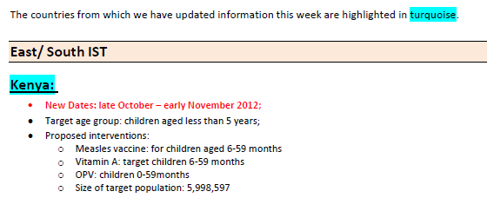
How We Work:
Coordination
Teleconferences provide
updates
  AFR: weekly
  SEAR and EMR: monthly
  Participants
    Regional offices: Outbreaks, surveillance findings, country plans of action, measles SIAs, country resources
    Civil societies: In-country activities
    UNICEF SD: Orders placed
Annual meetings (Washington, GMMM, Lab Network)
Ad hoc meetings of core partners
Notes:
ACTIVITIES ARE ROUTINELY COORDINATED THROUGH REGULAR TELECONFERENCES. These occur WEEKLY FOR AFRO, AND MONTHLY FOR THE SOUTH EAST ASIAN AND EASTERN MED REGIONS. THERE IS A WIDE VARIETY OF PARTICIPATION ON THE CALLS. WHO REGIONAL OFFICES PROVIDE INFORMATION ON OUTBREAKS, SURVEILLANCE FINDINGS, COUNTRY PLANS OF ACTION, PLANNED SIAS, AND COUNTRY RESOURCES. FOR THE AFRO CALLS, THE REGIONAL WHO OFFICE PREPARES A WEEKLY BULLETIN WHICH IT SHARES WITH THE CALL PARTICIPATNS PRIOR TO THE CALL. This PHOTO IS AN EXAMPLE OF ONE OF THESE BULLETINS. THE BULLETINS PROVIDE A WEALTH OF INFORMATION, FROM STATUS OF SECOND DOSE MEASLES INTRODUCTION THROUGH ROUTINE IMMUNIZATION SERVICES THROUGH RECENTE SURVEILLANCE RESULTS. CIVIL SOCIETIE GIVE UPDATES ON IN-COUINTRY ACTIVITIES, WHILE THE UNICEF SUPPLY DIVISION UPDATES US ON ORDERS PLACED FOR VACCINES AND DEVICES.
THE INITIATIVE ORGANIZES THREE MEETINGS A YEAR. THERE IS THIS ONE, ROUTINELY HOSTED BY THE AMERICAN RED CROSS AND HELD AROUND THE SUMMER. THERE IS THE ANNUAL GLOBAL MEASLES MANAGEMENT MEETING, HELD ANNUALLY IN EARLY SPRING IN GENEVA. This meeting provides opportunities for regions and countries to share experiences, such as how to use door to door registration for a campaign identify children being missed during routine immunizations. FINALLY, THERE IS THE GLBOAL LAB NETWORK MEETING, ALSO HELD IN GENEVA, USUALLY IN LATE SPRING. THIS IS WHERE MUCH OF THE SURVEILLANCE WORK, WHICH IS SO critical to determining disease burden and program impact is discussed .

Slide 8
How We Work:
Monitoring and Evaluation
Monthly and annual tracking of
established indicators:
Number of doses of measles vaccine administered, by delivery strategy, 2000-2010
Progress toward 2015 goals and regional elimination goals
Impact of activities on measles deaths and CRS cases
Introduction of MCV2
Introduction of RCV
Additional child health interventions
Country provision of costs
RI and surveillance strengthening activities, including surveillance reviews
Notes:
Finally, the MRI conducts monthly and annual tracking of established incidcators.
ON the left you can see a graph of number of dosease of measels vaccine according to delivery strategy, drawn from data tracked by the MRI.
Indicators include progress torward the 2015 goals and regional elimination goals that Peter has just mentioned, as well as impact of activiites on measles deaths – and now on congenital rubella syndrome (or CRS) cases, introduction of second dose of measels through routine , introduction of rubella containing vaccine, the addition of other child health interventions – such as deworming or administering vitamin A – to vaccination services, country provision of costs, and activities to strengthen routine immunization and surveillance.

Slide 9

New Opportunities
2011-2012
Notes:
After the successes of the first decade of the Iniatiives existence, the second decade has been ushered in with a bang as we have been given a host of new opportunities.

Slide 10
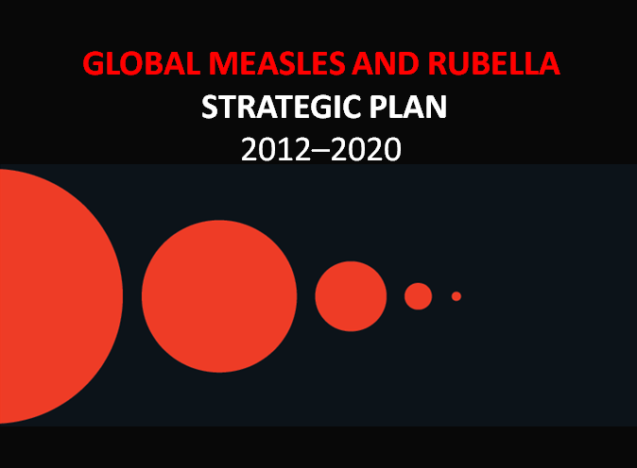
Global Measles and Rubella
Strategic Plan
2012- 2020
Notes:
First, in early 2012 we published the Global Measles and Rubella Strategic Plan, which really puts forward an ambitious vision for measles and rubella through 2020.

Slide 11
2011 WHO Rubella Vaccine Position Paper
  “In light of the remaining global burden of CRS and proven efficacy and safety of RCVs,
  WHO recommends that
  countries take the
  opportunity offered by
  control and elimination
  activities to introduce
  RCVs."
Notes:
Second , a critical WHO position paper was published in 2011. In this paper, WHO recommended that countries take the opportunity offered by measles control and elimination activities to introduce rubella containing vaccines. Prior to this positon paper, we expected that it would be years before rubella vaccine was widely introduced, but this postion paper threw the door to rubella vaccine use wide open.

Slide 12
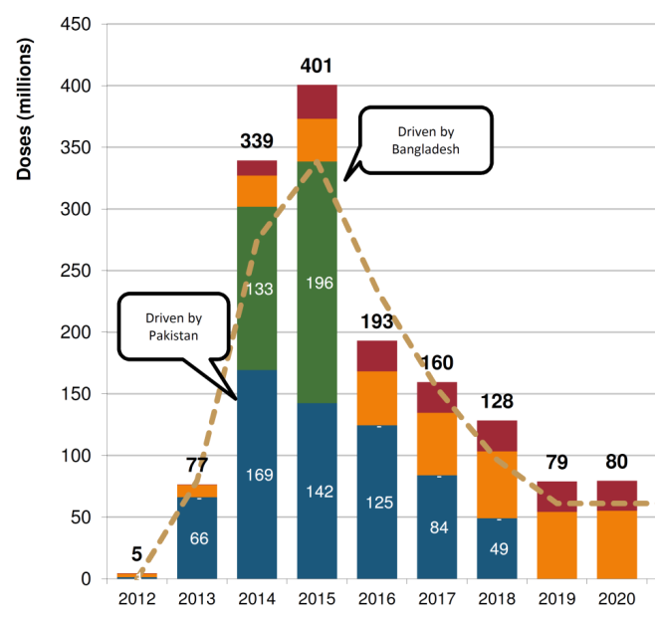
GAVI Support for Measles and Rubella -
>$750 Million through 2018
Rubella introduction:
  MR catch-up SIA (9m-14y)
Performance-based funding for 1st dose measles coverage
Continue support for grants to introduce MCV2 in routine
Support for measles follow-up SIAs in 6 large countries
Support for measles outbreak response immunization ($55 million) -- through MRI
Demand for MR vaccine
Notes:
This was followed by a decision from GAVI to offer more than 750 million dollars for measles and rubella vaccination activities through 2018. This includes funidng for rubella introduction through wide-scale MR catch up campaigns, performance based funding for first dose measles coverage, grants to introduce second dose measles through routine, support for measles follow up SIAs in six large countries, and support for measles outbreak respo nse immunization.
The graphn the right shows the projected demand for MR vaccine over the next several years.
12

Slide 13
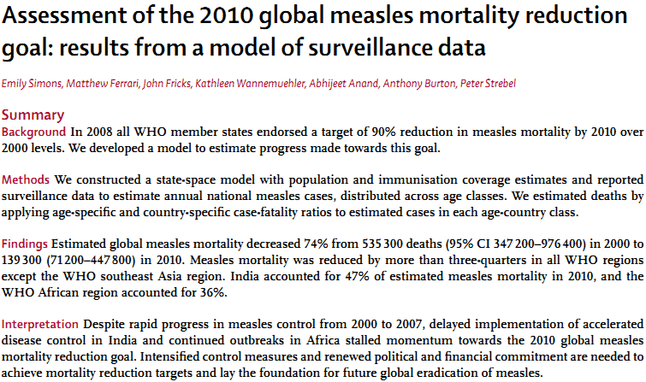
New Measles Mortality Estimates and Methodology
Notes:
In addition, we were able to collaborate with disease modeellers from Penn State University to develop much more sophisticated methodology to estimated measles mortality. This model does a mcuh better job at integrating the results of surveillance and the effects of herd immunity into a disease model than previous measles models had done, and we feel does a much better job at his estimating both existing death due to measles and deaths averted through vaccination. The results of this modeling were published in Lancet earlier this year, showing the 74% decrease in measles deaths from 2000 through 2010, and the estimated 9.6 million measles deaths averted through vaccination.

Slide 14




Welcoming New Partners
GAVI
  Rubella vaccine introduction
  Six countries at high risk for measles
  outbreaks
  Outbreak fund
International Pediatric Association and
American Academy of Pediatrics
  New approach to social mobilization and
  fund raising
Sabin Vaccine Institute
  Parliamentarians sensitized to the value of vaccine
European CDC
  Increased focus on measles and rubella in Europe
Notes:
.

Slide 15

Preparing for the Next Decade
Notes:
So, with all of these changes, we decided it was time to stand back, take stock of where we were, and see how to proactively strengthen the Iniative to ensure that it was positioned to deliver the work that needs to be done over the next decade. With this in mind, the founding partners held a retreat at the end of July. In the next slides, I’m going to introduce the conclusions of our discussions, and summarize next steps.

Slide 16

Name Change and New Logo
Measles Initiative
Notes:
First, wth the sudden rise t prominence of rubella vaccine, we realized that our mission had moved beyond preventin g measles to also preventing rubella and congenital rubella syndrome, or CRS. In recognition of this, we changed our name from the Measles Initiative to the Measles and Rubella Intiative. WE also developed a new logo, whi ch incorporates the new name and shows the spots common to both diseases fading away.

Slide 17
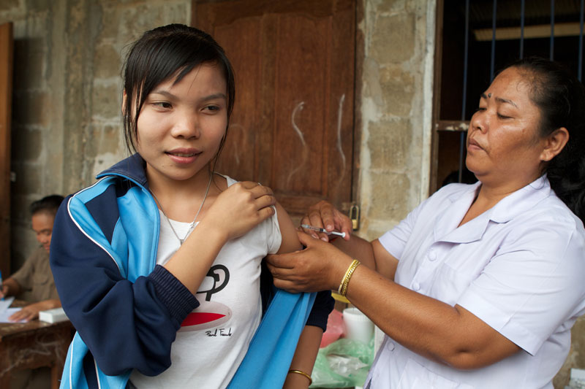
Charter
Develop a charter outlining:
Legal foundation
Governance structure
Roles and relationships of founding partners
Executive Team membership and decision-making process
Notes:
We also decided to develop a charter for the organization. This would build on and formalize the legal foundation, governance structure, roles and relationship s of foudning partners, exectuive team (which I’ll talk about shortly) membership, and decsion making processes.
This charter will build upon our existing operational procedures document. In deciding to develop it, we were mindful of the fact that many of the individuals originally involved with the Measles Initiative are likely to retire in the next dec ade, and we felt that this step would assist with the sustainability of the Iniatiiative.

Slide 18
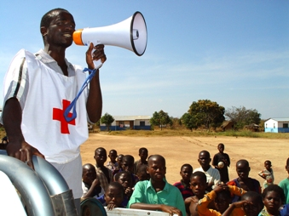
Strategic
Communications Plan
Positioning the MRI
  Strengthening the brand
  Segmenting our audiences
  Consistent, timely information
  Our successes and challenges
  Where we are going
  What we need to get there
Presentation Sept. 19, 1:30 – 2:00 pm
Notes:
We have also decided that it is time to focus on the area of communications, an area which seems to become more important with every passing year!
To this end, the MRI is developing a strategic communications plan which will look at how best to position ourselves in the global health arena for the next decade. It will also look at how to strengthen the MRI brand, how to segment our audiences to reach each of them better. We aim to make consistent and timely informaition available, and make our successes and challenges more widely known. We want people to know we are going, and what we need to get there.
A detailed presentation on the strategic communications plan will be given on Sept 19 from 1:30 – 2:00 om as part of this conference.

Slide 19
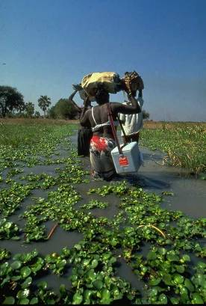
Administrative Structure
Establish an Executive Team
Representatives of 5 founding
partners
Decision making through a
consensus building process, with
input from stakeholders
Quarterly and ad-hoc
teleconferences
Notes:
Although we have had a de facto Executive Team of leaders with in the MRI from its inception, we have felt that we would increase the transparency of our decision making processes by formally acknowledging this leadereship group, and establishing a formal “Executive Team”. Each founding partner has one representatiave on the executive team. Decision making is done through a consensu building process, with input from stakeholders. Quarterly and, when necessary, ad hoc telecconferences are held.

Slide 20
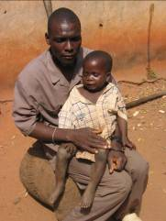
Dedicated Staff
Create 3 MRI staff positions housed within founding partners’ agencies
Executive Secretary
Fundraiser
Communications specialist
Notes:
In the past, we have operated by having staff from each agency devote some time to MRI activities. However, we have each had other, very substantial responsibilities.
Recognizing the increased workload and complexity of interactions associiated with the many measles and rubella activities planned over the next decade, we have decided to create 3 MRI staff positions dedicated to supporting the MRI. These include an executive secretary who would ensure coordination of actciviteis, a fundraiser, and a communications specialist. Despite the very generous funds coming to measles and rubella activities, there still remain many under funded mandates – for example surveillance and expansion of the laboratory network, as well as funding to ensure that all opportunities for SIAS to strengthen routine services be fully taken advantage of .
We are still discussing how best to assure sustainable funding for these positions, where they will be housed, and whether they will be grouped in a single agency or not.

Slide 21
Opportunities for Partner and Country Input
Coordination calls remain open, as always
Create MRI Global Partners Group (MGPG)
  Rotating Chair - non-founding partner - selected by MGPG
  Meet in conjunction with annual meetings
  Assure
    Country representation
    Inclusion of partners
Notes:
We would like to increase opportunities of r partner and country input to the MRI.
Coordination calls will remain open, as they have always been.
In addition, we plan to create an MRI Global Partners Group, made up of reoresentatives from countries in which the MRI works, as well as representatives from the non-foudning parnters. We would propose that this group have a rotating chair selected by the group, and would meet in conjunciton with the MRI annual meetings. The idea here is to assure adequate country representation, and inclusion of partners.

Slide 22
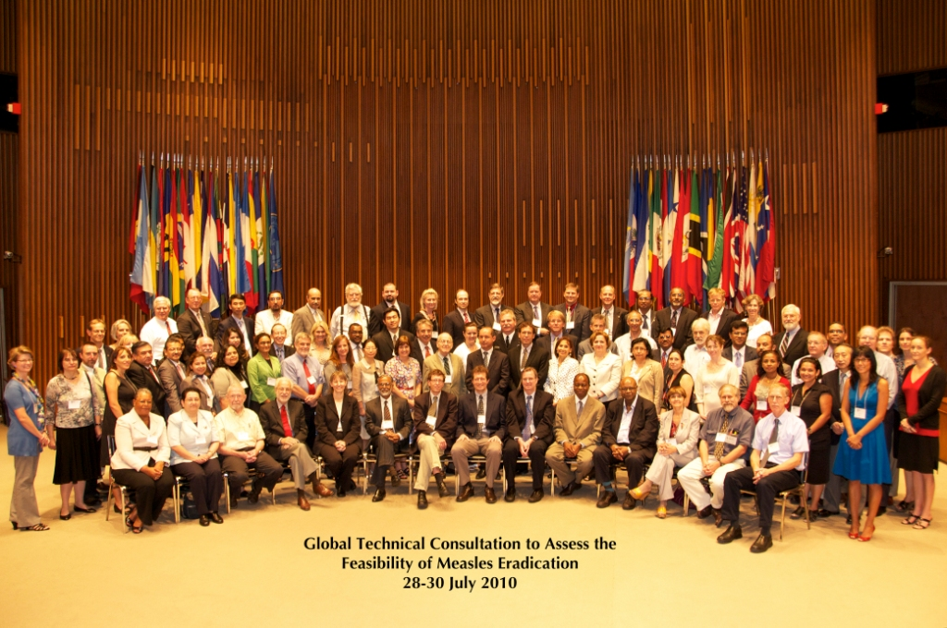
External Evaluation
External evaluation of MRI and its recent changes
Are we prepared for coming challenges? What can be done better?
Evaluation team
  Expert
    Public health
    management
    Global health
  Objective
  Representing North/South
Notes:
Finally, we are requesting and external evaluation of the MRI, including review of these chanages which I have just discussed with you. We want to ask if we are prepared for the coming challenges, and ask for guidance on what could be done better.
We are hoping to assemble an evaluation team made up of experts in public health managemetn and global health who are broadly familiar with the immunization landscape but are objective, and represent both North and South. I am currently drafting the terms of reference for this evaluation , and we hope to have a report completed by this time next year.
This summarizes the major changes that we are envisioning.

Slide 23


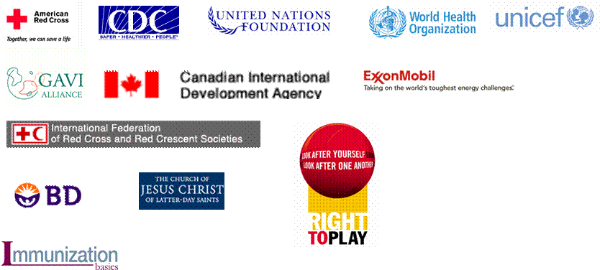










Anne Ray Charitable Trust
Notes:
I Always love showing this slide, as it really highlights the importance of partnership to the Iniatiative. Her e are the logos of our many partners – some of whom are donors, amnh of whom are technical partners.

Slide 24
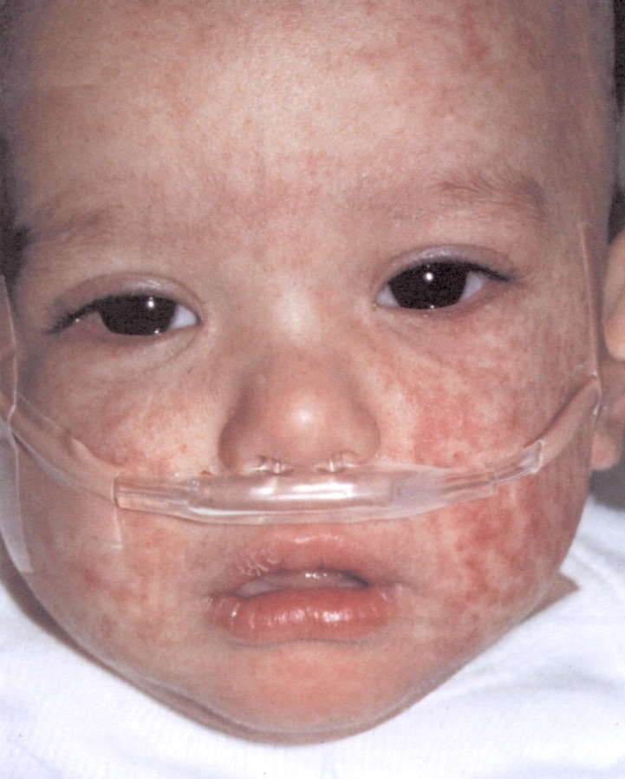
Thank You

Slide 25
Extra Slides

Slide 26
Funding Flow

