Slide 1

Promoting vaccination demand
M&RI Partners Meeting, Sept 12
Robb Butler @RobbButler2
© UNICEF/UN074437/omino

Slide 2

The Challenge
In spite of substantial supply-side investments overall coverage is flat……time to re-focus?
In some regions with higher # of MICS immunization programmes are struggling to maintain coverage

Slide 3







Routine Immunization System
GLOBAL
GLOBAL
GLOBAL
GLOBAL
GLOBAL
GLOBAL
GLOBAL
NATIONAL
NATIONAL
NATIONAL
NATIONAL
NATIONAL
NATIONAL
NATIONAL
LOCAL
LOCAL
LOCAL
LOCAL
LOCAL
LOCAL
LOCAL
POINT OF VACCINATION
POINT OF VACCINATION
POINT OF VACCINATION
POINT OF VACCINATION
POINT OF VACCINATION
POINT OF VACCINATION
Inventory management
POINT OF VACCINATION
Inventory management
Inventory management
Inventory management
Inventory management
Inventory management
Inventory management
Sufficient supplies at health posts
Sufficient supplies at health posts
Sufficient supplies at health posts
Sufficient supplies at health posts
Sufficient supplies at health posts
Sufficient supplies at health posts
Sufficient supplies at health posts
Community engagement & demand creation
Community engagement & demand creation
Community engagement & demand creation
Community engagement & demand creation
Community engagement & demand creation
Community engagement & demand creation
Supply planning
Community engagement & demand creation
Community engagement
Supply planning
Supply planning
Supply planning
Supply planning
Supply planning
Supply planning
Individual
Individual
Individual
Individual
Individual
Individual
Supply chain & logistics
Supplies
Individual
Supplies
Supplies
Supplies
Supplies
Supplies
Supplies
Manufacturing
Manufacturing
Manufacturing
Manufacturing
Manufacturing
Manufacturing
Manufacturing
Storage and distribution
Storage and distribution
Storage and distribution
Storage and distribution
Storage and distribution
Storage and distribution
Storage and distribution
Health worker
Health worker
Health worker
Health worker
Health worker
Health worker
Health worker
Supervisors & FLWs
Supervisors & FLWs
Supervisors & FLWs
Supervisors & FLWs
Supervisors & FLWs
Supervisors & FLWs
Supervisors & FLWs
Procurement & distribution
Human resources for health
Procurement & distribution
Procurement & distribution
Procurement & distribution
Procurement & distribution
Procurement & distribution
Procurement & distribution
Motivation
Motivation
Motivation
Motivation
Motivation
Motivation
Motivation
National & sub-national program managers
National & sub-national program managers
National & sub-national program managers
National & sub-national program managers
National & sub-national program managers
National & sub-national program managers
National & sub-national program managers
Training & mentorship
Training & mentorship
Training & mentorship
Training & mentorship
Training & mentorship
Training & mentorship
Collection & use of data
Training & mentorship
Collection & use of data
Collection & use of data
Collection & use of data
Collection & use of data
Collection & use of data
Collection & use of data
-------------------- Supply chain data -------------------
-------------------- Supply chain data -------------------
-------------------- Supply chain data -------------------
-------------------- Supply chain data -------------------
-------------------- Supply chain data -------------------
-------------------- Supply chain data -------------------
-------------------- Supply chain data -------------------
Monitoring & use of data
National training / professional programs and supervision
National training / professional programs and supervision
National training / professional programs and supervision
National training / professional programs and supervision
National training / professional programs and supervision
National training / professional programs and supervision
Data to guide national decision making
National training / professional programs and supervision
Data to guide national decision making
Data to guide national decision making
Data to guide national decision making
Data to guide national decision making
Data to guide national decision making
Data to guide national decision making
National motivation
National motivation
National motivation
National motivation
National motivation
National motivation
National motivation
Performance management, training, leadership
Global indicators
Global indicators
Global indicators
Global indicators
Global indicators
Global indicators
Global indicators
Global guidelines
Global guidelines
Global guidelines
Global guidelines
Global guidelines
Global guidelines
Global guidelines
Political commitment
Financing and pricing
Enabling partner environment
POLITICAL COMMITMENT
POLITICAL COMMITMENT
POLITICAL COMMITMENT
POLITICAL COMMITMENT
POLITICAL COMMITMENT
POLITICAL COMMITMENT
POLITICAL COMMITMENT
FINANCING & PRICING
FINANCING & PRICING
FINANCING & PRICING
FINANCING & PRICING
FINANCING & PRICING
FINANCING & PRICING
FINANCING & PRICING
ENABLING PARTNER ENVIRONMENT
ENABLING PARTNER ENVIRONMENT
ENABLING PARTNER ENVIRONMENT
ENABLING PARTNER ENVIRONMENT
ENABLING PARTNER ENVIRONMENT
ENABLING PARTNER ENVIRONMENT
FINANCING & PRICING
ENABLING PARTNER ENVIRONMENT
POLITICAL COMMITMENT
ENABLING PARTNER ENVIRONMENT
Governance, stability, and national infrastructure essential to vaccination systems but out of scope here.
Courtesy of BMGF
System components

Slide 4
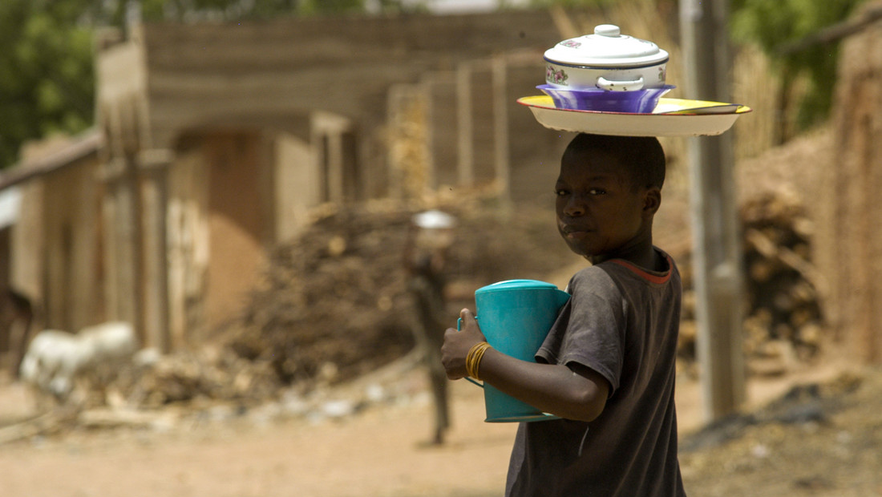
Demand Challenges:
Case: Nigeria
Reasons for under-vaccination
Demand reasons
Supply reasons
Source: McKinsey analysis of data from the 2016/2017 MICS/NICS

Slide 5
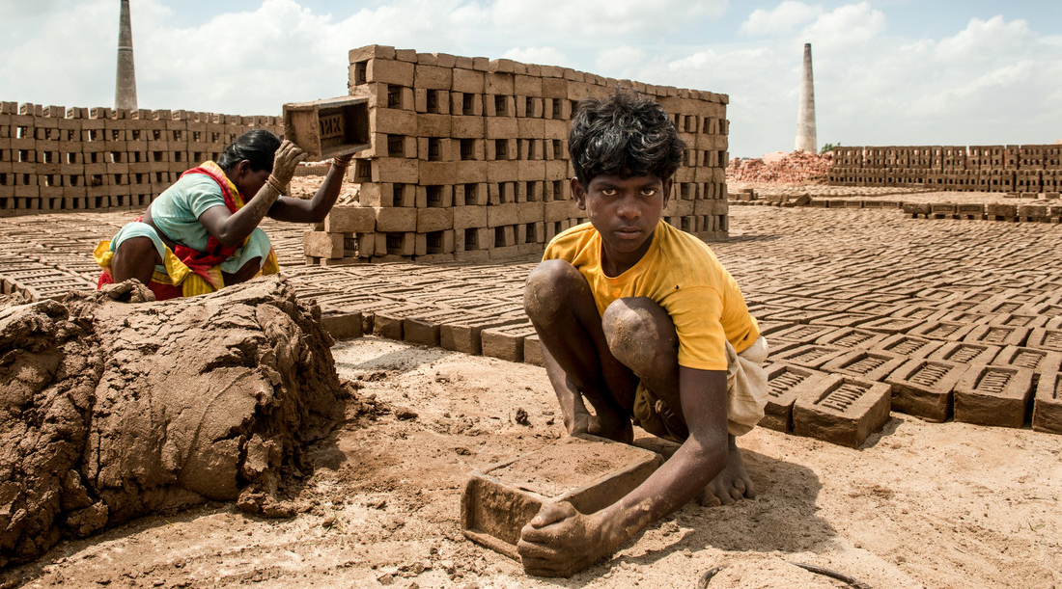
Demand challenges
Case: India
Service delivery
Other
12%
Child travelling
10%
13%
Mistrust or fear
33%
32%
Lack of knowledge
Reasons for under-vaccination
Concurrent Routine Immunisation monitoring data – Jan to Dec 2015

Slide 6
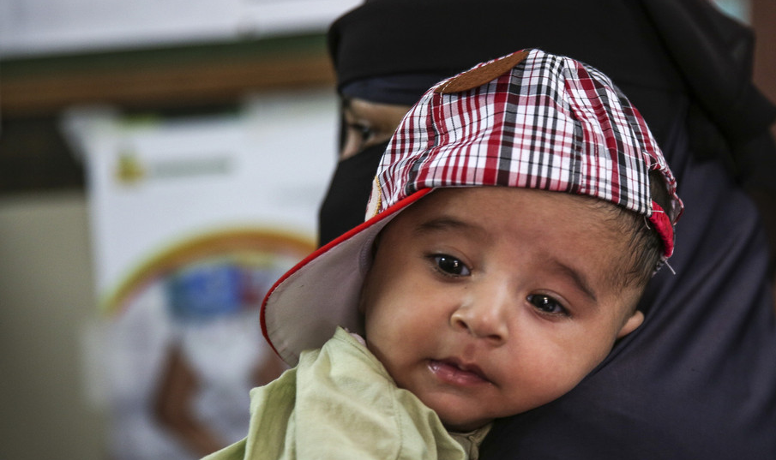


Demand Challenges
Case: Pakistan
… and in India
UNVACCINATED
Demand reasons
Service delivery
Other
12%
Child travelling
10%
13%
Supply reasons
Mistrust or fear
33%
More systematic collection and analysis of ‘reasons for missed children’ and other demand data needed to guide interventions
UNDERVACCINATED
Demand reasons
Lack of knowledge
Reasons for under-vaccination
Supply reasons
Concurrent Routine Immunisation monitoring data – Jan to Dec 2015
Reasons for non-vaccination and under vaccination among children in Pakistan, Riaz et al , Vaccine, 2018

Slide 7
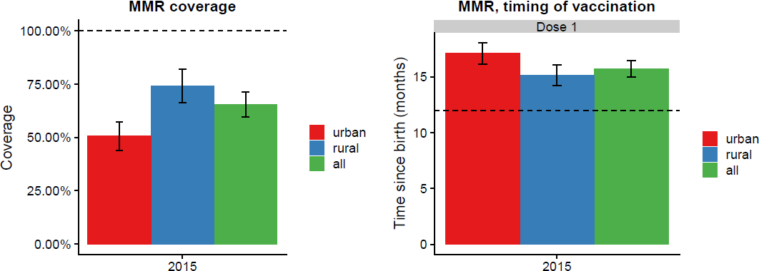
Fed. Bosnia and Herzegovina
Challenge:
Low and rapidly declining coverage: MCV1 and Polio3 63% in 2016
(total population est. 3.5 million)
Photo credits: Malin Bing/WHO all rights reservied

Slide 8
Fed. Bosnia and Herzegovina
Reasons for low uptake: (WHO/EURO, TIP 2018)
Urban parents, well informed but likely to want alternative medicine and not trust vaccination safety and authorities
No system for monitoring, recording un-/under-/delayed vaccination
No system for call/reminders
Roma, low-education and lack of trust of authority
Confusion among health workers regarding laws and provisions related to vaccination
Mandatory vaccination not being implemented – an empty threat
Low knowledge (vaccination, VPD, vaccine safety) among some health workers
Sentiment among health workers of being left alone and unsupported by health system
8
8
Notes:
Most (if not all) of these factors are demand-related factors.

Slide 9

Australia, NSW
Challenge:
Low coverage: 38% of 1-year-olds not fully immunized in East-West Maitland, New South Wales, Australia
Photo credit:Kinda Kapers

Slide 10
Australia, NSW
Reasons for low uptake: (NSW Health & WHO/EURO, TIP 2016-17)
Parents were not opposed to immunization or ‘hesitant’
Parents experienced socio-economic disadvantage, poor mental health, addiction, poverty, homelessness and domestic violence
Some parents didn’t trust health services and rarely used them
Some parents experienced service access barriers (cost, location, transportation and appointment availability)
A more supportive, family centred primary health care approach was suggested as an effective way to reach out to parents in the target group
Better use of data from the register, including sharing with relevant stakeholders and monitoring trends was recommneded as many had been unaware of the problem in Maitland
Sentiment among health workers of being left alone and unsupported by health system
Notes:
Most (if not all) of these factors are demand-related factors.

Slide 11
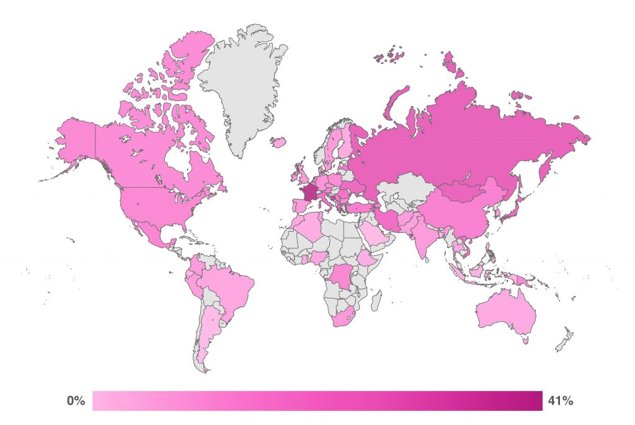
Percent Disagreeing with the Statement, “Overall I think vaccines are safe”
MIC&HIC particularly affected by vaccination confidence.
The State of Vaccine Confidence Report, 2016, LSHTM
Notes:
Highest recorded value was 41%, gradient has been scaled to maximise visibility within this range.
This map represents percentage disagreement with the statement, “Overall I think vaccines are safe,” by combining the two disagree responses (Tend to Disagree and Strongly Disagree) and dividing by the total number of responses, including Don’t Know/No Response as well as the two Agree options. Countries in grey were not included in this survey

Slide 12
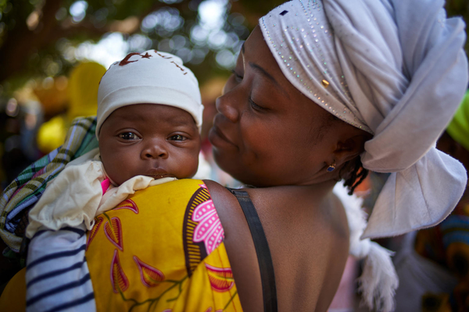
The journey…

Slide 13
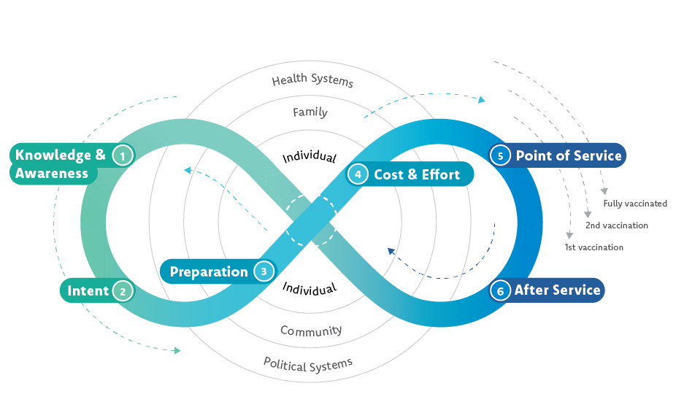
The journey to immunization – what are the barriers?
Financial, occupational and social costs as well as lack of convenience
Health centre convenience:
client satisfaction, interpersonal communication, missed opportunities to vaccinate
Lack of awareness or understanding of the value of immunisation, of service (when/where)
Challenging logistics– remembering dates and times, finding transport, childcare, competing priorities
Negative attitude or fear of immunisation, immunisation not a a social norm, or lack of decision making power/ perceived behavioural control
After service: feedback, next steps, side effects, cues to action, reinforcement of vaccination as a social norm
UNICEF Journey to Immunization, Social Data Workshop, Amman 2017
Notes:
Meeting of SAGE, conclusions and recommendations, October 2017. Published in the World Epidemiological Report, 1 Dec 2017: http://apps.who.int/iris/bitstream/10665/259533/1/WER9248.pdf

Slide 14

and a (collective) need to move beyond a deficit model
Knowledge
Leask, J. (2011). Target the fence-sitters. Nature, 473(7348), 443-445.
Notes:
One misconception in the process of maintaining and increasing vaccine acceptance is based on the idea that all we have to do is provide the facts and knowledge. This approach is called the information deficit model. But simply presenting correct information and evidence in order to inform the public as described by the information deficit model is said to be hugely ineffective (CLICK) when it comes to correcting misconceptions and it ignores the importance of tailored messages and the corporation with all necessary parties (CLICK). Leask described the important factors in her Nature article about targeting the fence-sitters. This reveals that we can and have to do way more in order to maintain and increase vaccine acceptance.
One very important factor is the involvement of health professionals or health care workers. They themselves are a special group science has focused on … (NEXT SLIDE)

Slide 15
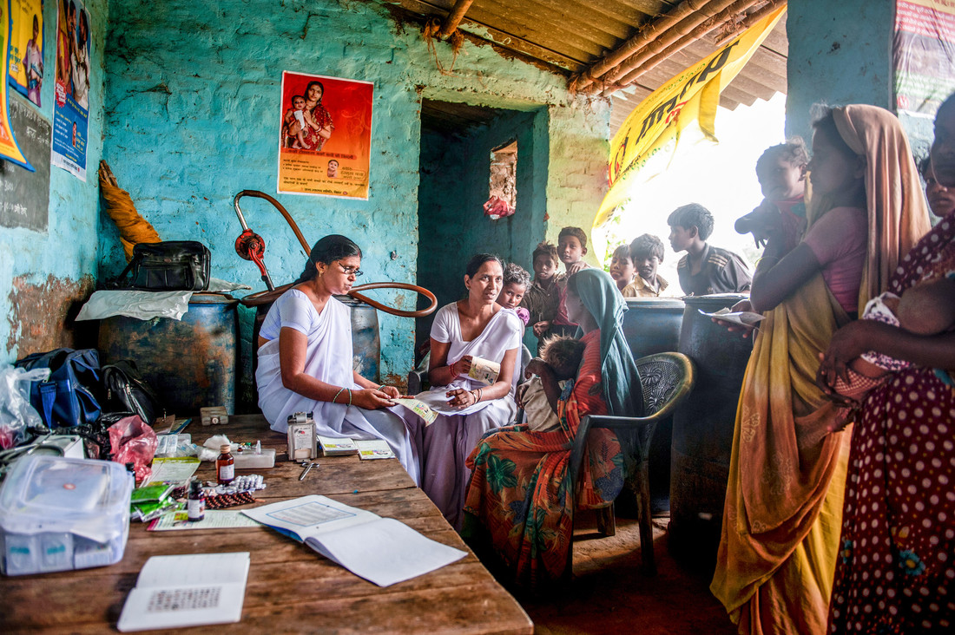
Generating demand requires more than communication
Make the desired action the easiest action
Reduce Barriers
Cultivate and sustain public trust in vaccines and services
Build Trust
Activate Intentions
Use nudges to overcome the gap between intentions and actions
Involve communities to improve the quality and accountability of services
Tailor Services
Notes:
But before we look at vaccination demand and how we are best advised to promote it, let’s consider the whole continuum of vaccination behaviour, and unpack different standpoints, considering vaccination behavioural determinants, barriers and enablers in each case.

Slide 16
The vaccination behavior continuum
Vaccination hesitancy:
Accept some, delay some, refuse some
Resilient
Demand
Passive
Acceptance
Refuse
all vaccines
Source: GVAP Strategic Objective 2 Working Group
Notes:
Explain what you see on the slide.
In addition,
The continuum is not representative of the proportions of any population. That said, the majority of most countries’ population is on the greener shaded part of the continuum i.e. they demand or accept vaccination and vaccinate their children or themselves according to the national immunization schedule, at the correct time.

Slide 17
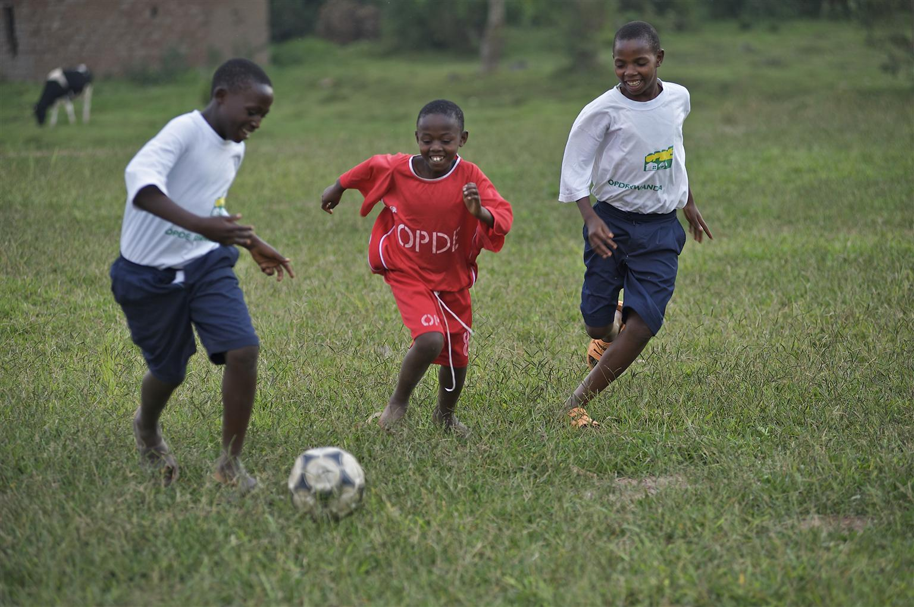
Country experiences

