Slide 1
Disappearance of measles genotypes
Kevin Brown
Virus Reference Department
National Infection Service
23 June 2016

Slide 2
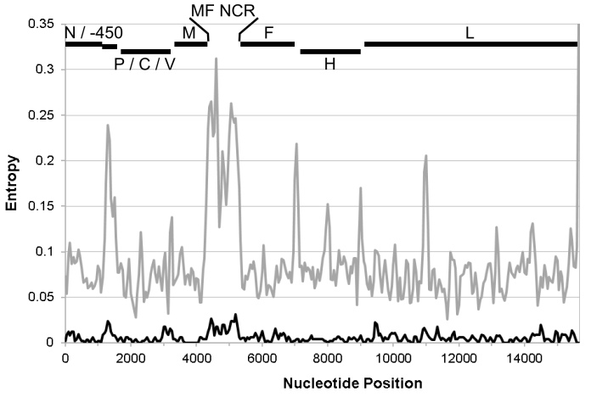
Measles Virus
    Measles serologically monotypic

Slide 3
Measles Virus Genotyping
    N and H genes: ~ 7% variability
    450bp COOH-terminus of N 12% variation
    Estimate of 1.8x10⁻³ substitions/site/year
1) Amplify and sequence 450 nt. encoding hypervariable COOH-terminal 150 amino acids of N protein
1 PCR product -
2) Amplify and sequence entire coding region H gene (for new genotypes)
Sequences are compared to sequences of WHO reference strains to make a genotype assignment
N
P/C/V
M
F
H
L
2%
Standardisation of the nomenclature for describing genetic characterisation of wild type measles viruses. WER 1998:73; 265-72

Slide 4
Measles Virus Genotypes
Montreal.CAN/89 D4
Victoria.AUS/12.99 D9
Palau.BLA/93 D5
Bangkok.THA/93/1 D5
8 clades:
A – H
23 genotypes:
A, B1-B3, C1-C2,
D1-D10, E, F, G1-G3, H1-H2
D11 added in 2010
Illinois.USA/89/1 D3
Manchester.UNK/30/94 D8
Illinois.USA/50.99 D7
Victoria.AUS/16.85 D7
Bristol.UNK/74 D1
Johannesburg.SOA/88/1 D2
NewJersey.USA/94/1 D6
MVi/Mpigi.UGA/18.00 D10
MVs/Madrid.SPA/94 F
Erlangen.DEU/90 C2
Tokyo.JPN/84/K C1
Maryland.USA/77 C2
Goettingen.DEU/71 E
Edmonston-wt.USA/54 A
Libreville.GAB/84 B2
Yaounde.CAE/12.83 B1
NewYork.USA/94 B3.2
Ibadan.Nie/97/1 B3.1
Hunan.CHN/93/7 H1
Beijing.CHN/94/1 H2
Berkely.USA/83 G1
Amsterdam.NET/49.97 G2
Gresik.INO/18.02 G3
0.01

Slide 5
WHO Reference Sequences and Accession Numbers
WER March 2012
Genotype | Last Observed* | Reference Strain | GenBank H | Genbank N
A | 2008 | MVi/Edmonston-wt.USA/0.54 | U03669 | U01987
B1 | 1983 | MVi/Yaounde.CAE/12.83 | AF079552 | U01998
B2 | 2011 | MVi/Libreville.GASB/0.84 | L46753 | U01994
B3 | 2011 | MVi/New York.USA/0.94 | L46752 | L46753
 |  | MVi/Ibadan.NIE/0.97/1 | AJ239133 | AJ232203
C1 | 1992 | MVi/Tokyo.JPN/0.84 | AY047365 | AY043459
C2 | 2007 | MVi/Maryland.USA/0.77 | M81898 | M89921
 |  | MVi/Erlangen.DEU/0.90 | Z80808 | X84872
D1 | 1986 | MVi/Bristol.UNK/0.74 | Z80805 | D01005
D2 | 2005 | MVi/Johannesburg.SOA/0.88/1 | AF085498 | U64582
D3 | 2004 | MVi/Illinois.USA/0.89/1 | M81895 | U01977
D4 | 2011 | MVi/Montreal.CAN/0.89 | AF079554 | U01976
D5 | 2010 | MVi/Palau.BLA/0.93 | L46757 | L46758
 |  | MVi/Bangkok.THA/0.93/1 | AF009575 | AF07955
D6 | 2007 | MVi/New Jersey.USA/0.94/1 | L46749 | L46750
D7 | 2007 | MVi/Victoria.AUS/16.85 | AF247202 | AF243450
 |  | MVi/Illinois.USA/50.99 | AY043461 | AY037020
D8 | 2011 | MVi/Manchester.UNK/30.94 | U29285 | AF280803
D9 | 2011 | MVi/MViVictoria.AUS/12.99 | AY127853 | AF481485
D10 | 2005 | MVi/Kampala.UGA/51.01/1 | AY923213 | Ay923185
D11 | 2011 | MVi/Menglian.Yunnan.CHN/47.09 | GU440576 | GU440571
E | 1987 | MVi/Goettingen.DEU/0.71 | Z80797 | X84879
F | 1994 | MVs/Madrid.SPA/0.94 [SSPE] | Z80830 | X84865
G1 | 1983 | MVi/Berkeley.USA/0.83 | AF079553 | U01974
G2 | 2004 | MVi/Amsterdam.NET/49.97 | AF171231 | AF171232
G3 | 2011 | MVi/Gresik.INO/17.02 | AY184218 | AY184217
H1 | 2011 | MVi/Hunan/CHN/0.93/7 | AF045201 | AF045212
H2 | 2003 | MVi/Beijing.CHN/0.94/1 | AF045203 | AF045217

Slide 6
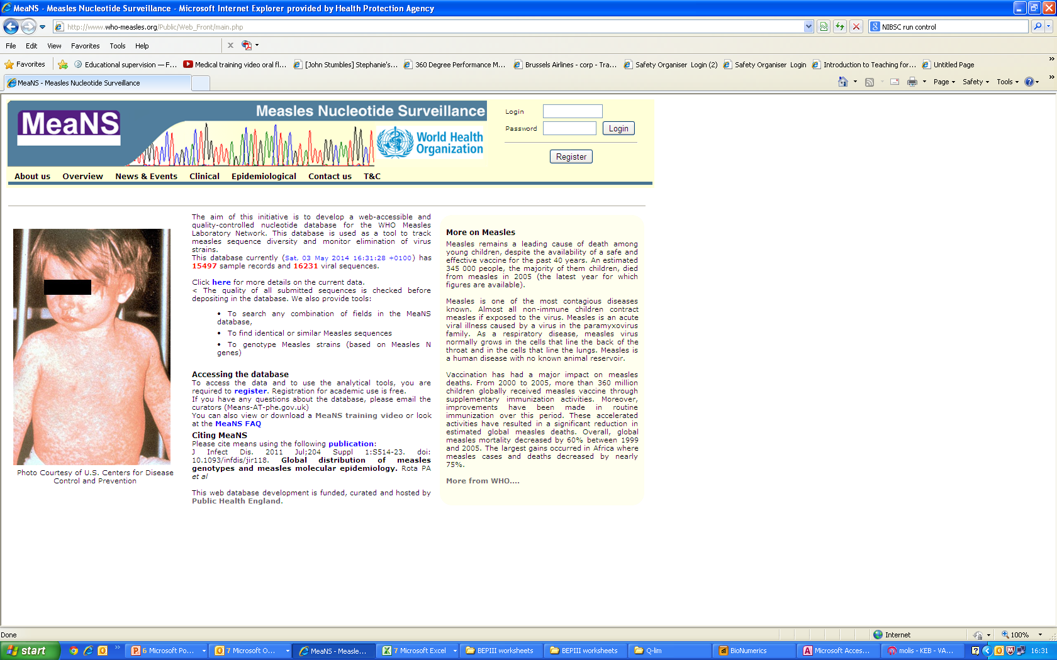
MeaNS database
Measles Nucelotide Surveillance database
(www.who-measles.org)
Database for storing measles sequences
Started in 2006
Seeded with data from ELSM study in Europe/UK data/Genbank data
Hosted by HPA Colindale (now PHE)
Tools for:
Genotyping
Comparison/phylogeny with viruses in other countries
Finding identical ‘strains’ (N450)
Reporting ability to WHO (regional offices and HQ)
Ability to upload to GenBank

Slide 7
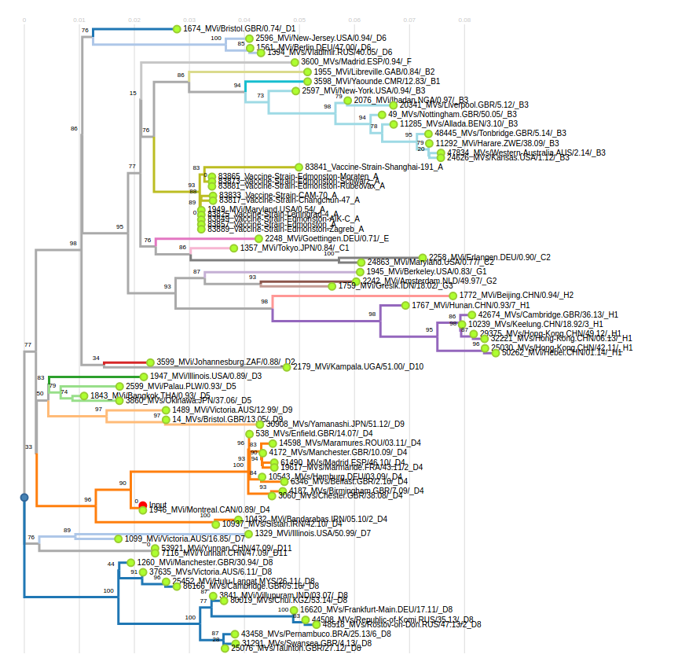
Named and reference sequences

Slide 8
MeaNS Submissions

Slide 9
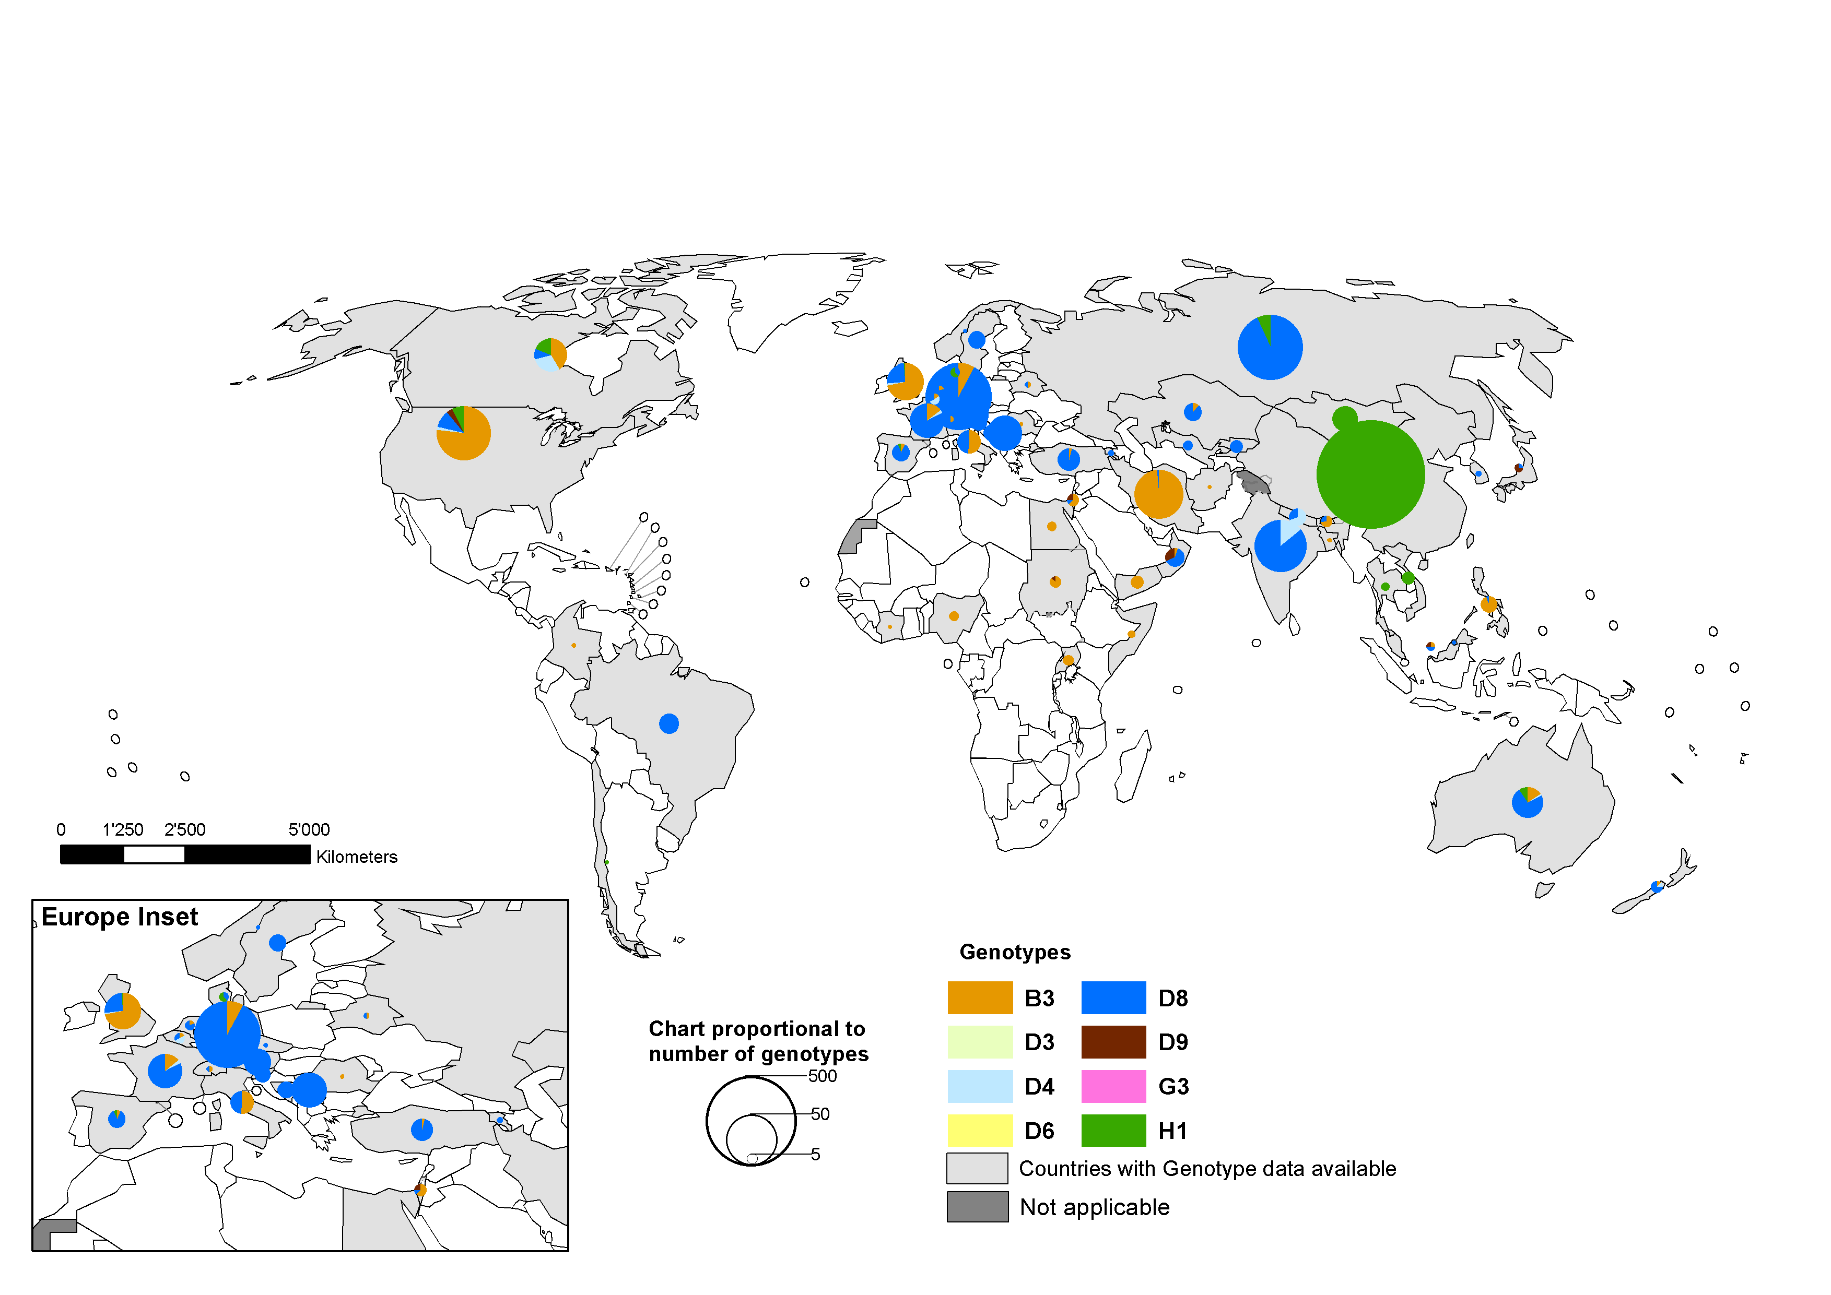

Distribution of measles genotypes
year 2015
Data in HQ as of 7 March 2016
Note: Pie chart proportional to the number of sequenced viruses:
China data has been adjusted by size (total genotyped = 2862).

Slide 10
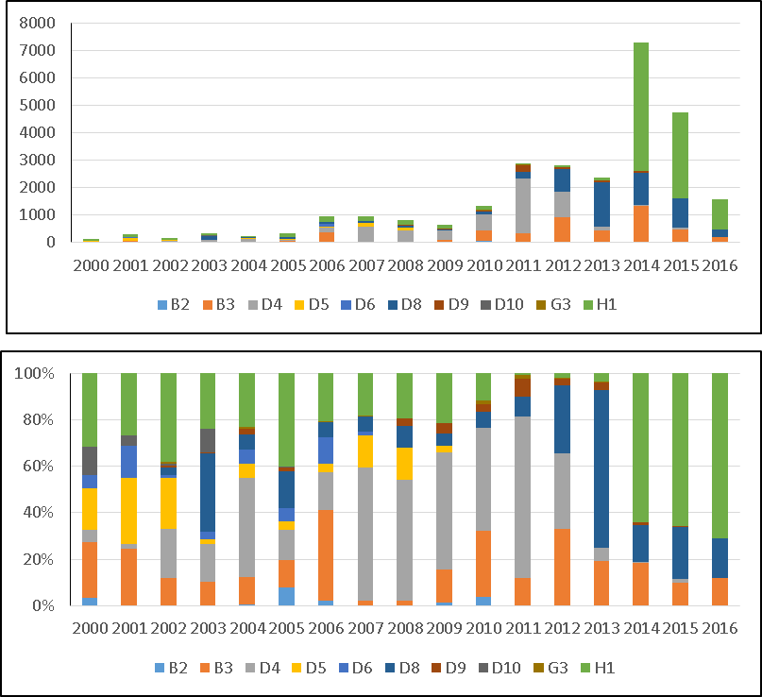
MeaNS by genotype
10
Manual for the laboratory diagnosis of measles and rubella virus infection
WHO – EPI, WHO/IVB/07.01: 2nd edition 2007

Slide 11
Genotype disappearance?
 | 2005 | 2006 | 2007 | 2008 | 2009 | 2010 | 2011 | 2012 | 2013 | 2014 | 2015 | 2016
B2 | 27 | 21 | 0 | 1 | 10 | 52 | 7 | 0 | 0 | 0 | 0 | 0
B3 | 42 | 369 | 20 | 15 | 93 | 385 | 331 | 934 | 458 | 1337 | 478 | 163
D4 | 45 | 153 | 550 | 423 | 329 | 599 | 2003 | 914 | 131 | 37 | 61 | 4
D5 | 12 | 34 | 133 | 114 | 17 | 0 | 0 | 0 | 0 | 0 | 0 | 0
D6 | 20 | 108 | 18 | 0 | 0 | 0 | 0 | 0 | 0 | 0 | 0 | 0
D7 | 0 | 0 | 1 | 0 | 0 | 0 | 0 | 0 | 0 | 0 | 0 | 0
D8 | 56 | 60 | 59 | 76 | 37 | 95 | 241 | 820 | 1604 | 1148 | 1058 | 245
D9 | 5 | 3 | 1 | 26 | 28 | 41 | 225 | 91 | 73 | 90 | 21 | 1
D10 | 2 | 0 | 0 | 0 | 0 | 0 | 0 | 0 | 0 | 0 | 0 | 0
G3 | 0 | 3 | 4 | 0 | 0 | 25 | 51 | 1 | 15 | 4 | 0 | 0
H1 | 140 | 194 | 175 | 157 | 140 | 156 | 15 | 59 | 81 | 4670 | 3015 | 21

Slide 12
Caveats about interpreting MeaNS data
 | Measles cases | Lab confirmed | # in MeaNS | Percent Lab confirmed | Percent measles cases
AFRO | 45327 | 6830 | 27 | 0.40% | 0.06%
AMRO | 210 | 210 | 240 | 114.29% | 114.29%
EMRO | 14053 | 8955 | 170 | 1.90% | 1.21%
EURO | 6623 | 4510 | 960 | 21.29% | 14.49%
SEARO | 90817 | 2361 | 179 | 7.58% | 0.20%
WPRO | 67510 | 44589 | 3185 | 7.14% | 4.72%
Total | 224540 | 67455 | 4639 | 6.88% | 2.07%
Data for 2015

Slide 13
MeaNS submission by region
13
Manual for the laboratory diagnosis of measles and rubella virus infection
WHO – EPI, WHO/IVB/07.01: 2nd edition 2007

Slide 14
MeaNS Genotype Diversity
14
Manual for the laboratory diagnosis of measles and rubella virus infection
WHO – EPI, WHO/IVB/07.01: 2nd edition 2007

Slide 15
MeaNS Genotype Diversity
15
Manual for the laboratory diagnosis of measles and rubella virus infection
WHO – EPI, WHO/IVB/07.01: 2nd edition 2007

Slide 16
B3 by region

Slide 17
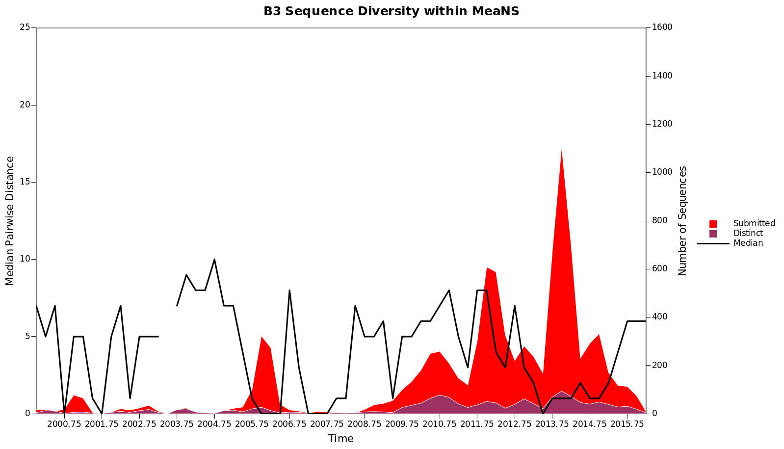
B3 diversity

Slide 18
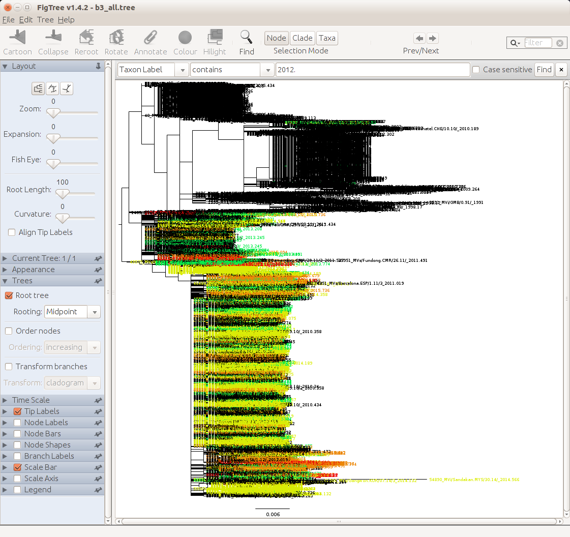
B3 genetic diversity
4772 sequences
Harare dominates over the last 5 years
Possibly not in 2016
2016
2015
2014
2013
2012

Slide 19
D4 genotypes

Slide 20
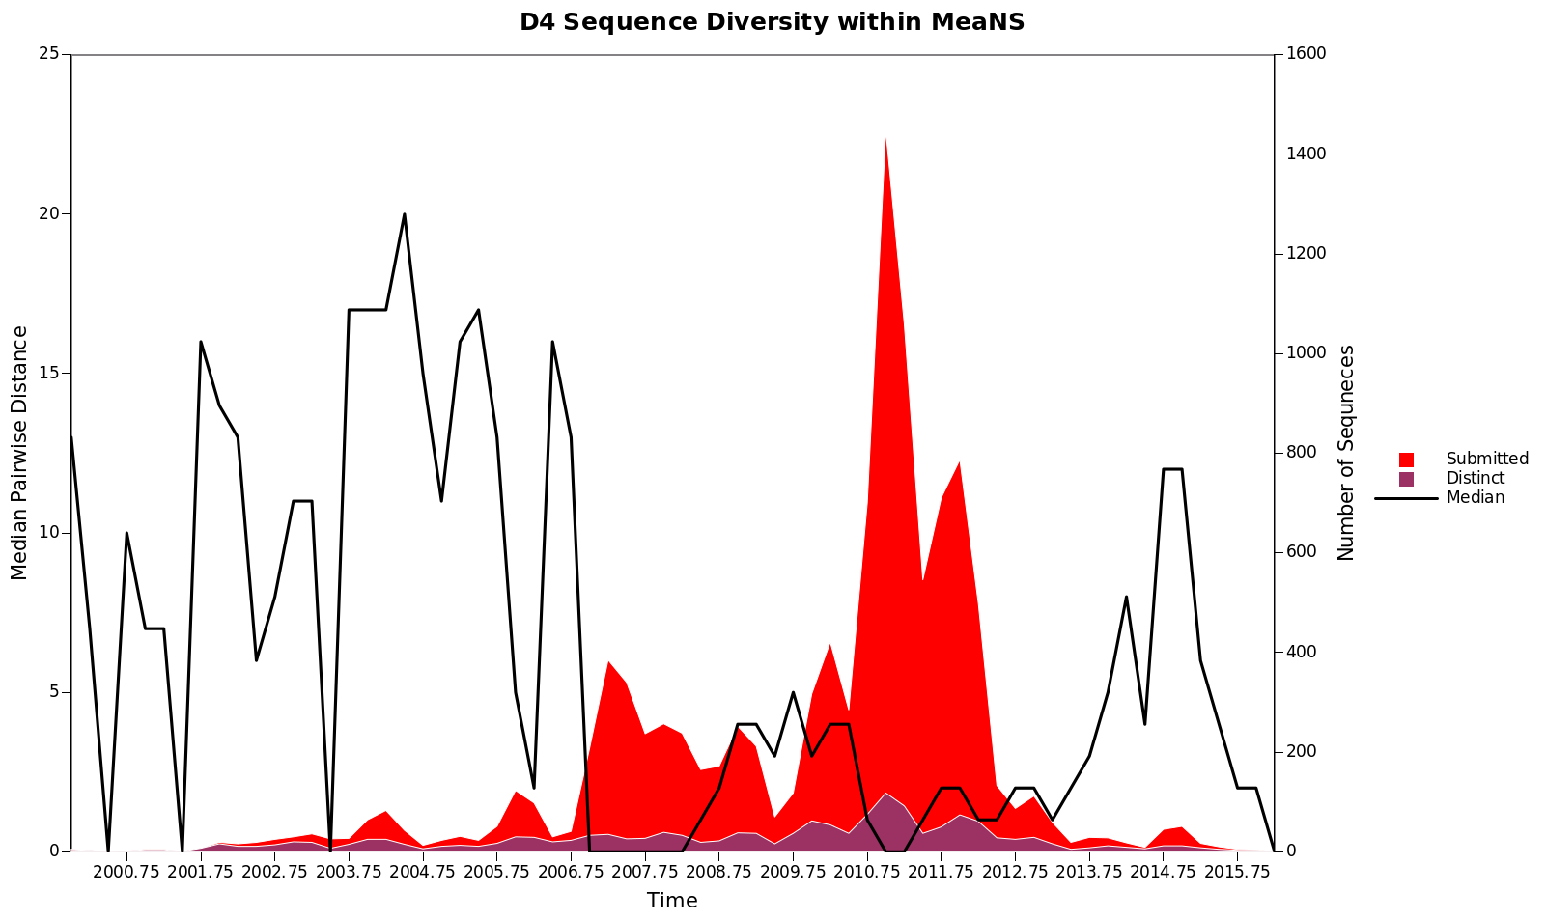
D4 sequence diversity

Slide 21
D8 genotypes

Slide 22
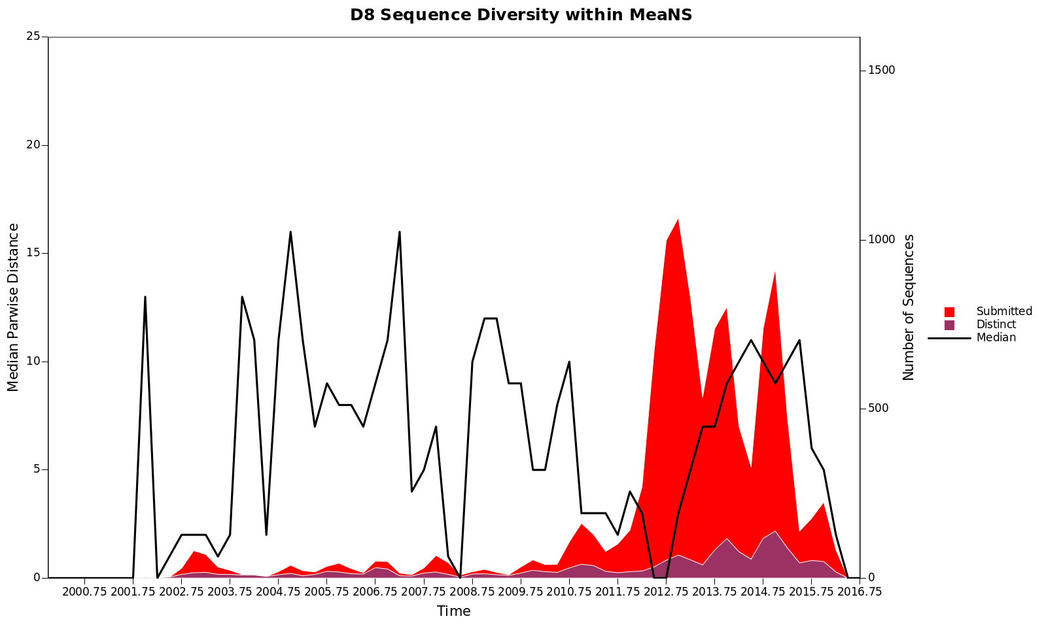
D8 diversity

Slide 23
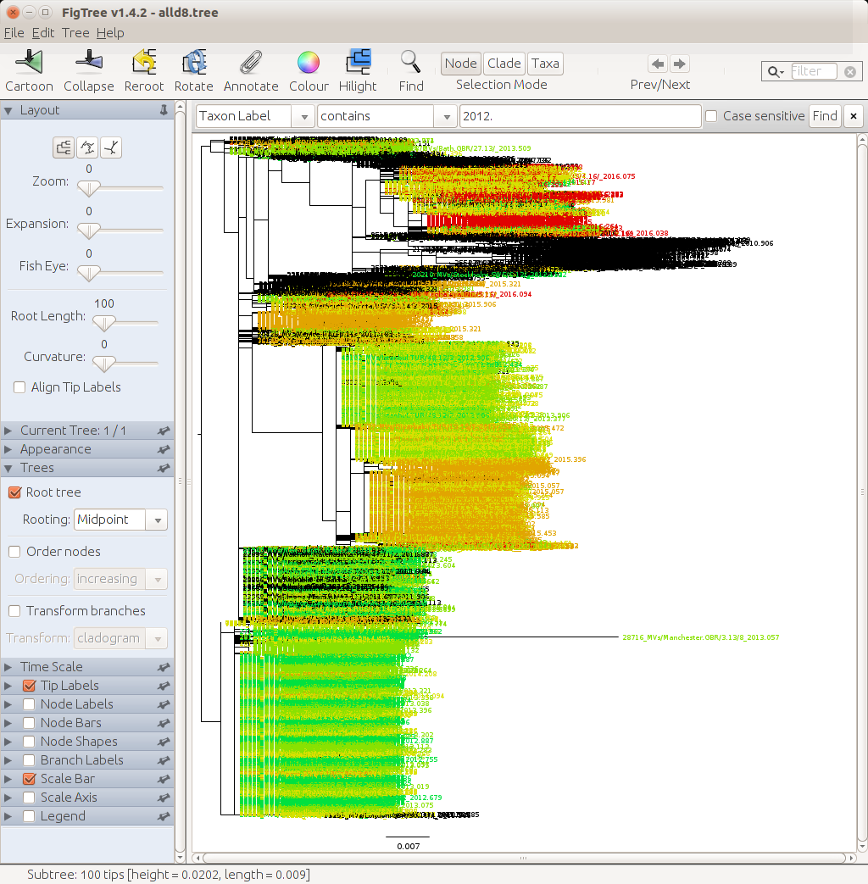
D8 diversity
Cambridge.GBR/5.16
Frankfurt Main.DEU 17.11
5600 sequences
2016
2015
2014
2013
2012
Taunton.GBR/27.12

Slide 24
MeaNS Genotype Diversity
Genotype data in MeaNS appears to show a reduction in the number of genotypes
Is this simply sampling bias?
Interpreting diversity in sequences maybe counter-intuitive
In outbreaks get less diversity
Multiple importations – greater diversity
May be useful at a regional or country level
Need more sequences/sampling in most regions for monitoring diversity to be useful at a global level
24
Manual for the laboratory diagnosis of measles and rubella virus infection
WHO – EPI, WHO/IVB/07.01: 2nd edition 2007
MeaNS RubeNS Update 2015

Slide 25

Acknowledgment

