Slide 1
Next generation and Extended sequencing Working group (NEW) for measles and rubella and the NEW working group
Accelerating Progress towards Measles and Rubella Elimination, WHO Geneva, June 21-23, 2016
Alberto Severini
National Microbiology Laboratory
Public Health Agency of Canada
alberto.severini@phac-aspc.gc.ca

Slide 2
Background
Genotyping of measles by the WHO recommended target N450 is the mainstay of measles outbreak investigation and transmission documentation
However, as we are getting closer to the elimination of measles and rubella the diversity of their genomes diminishes
Standardised genotyping targets are often insufficient to distinguish repeated importations from local transmission
Higher resolution genotyping methods are needed for outbreak investigation

Slide 3
Are cases of measles linked by a chain of transmission or are they independently imported?
Is it endemic circulation of repeat importation?

Slide 4
Increasing the window for sequencing
Sequencing a longer stretch of the genome increases the probability of detecting genetic diversity
Identifying hypervariable regions maximises the ratio mutation/nucleotide sequenced
Whole genome sequencing (WGS)
Hypervariable intergenic non-coding region MF-NCR

Slide 5
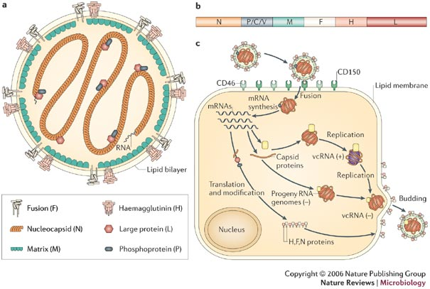
Measles genome
WHO genotyping N target 450 nt
MF-NCR target
1018 nt
Alternate genotyping target:
H ORF, 1854 nt
Moss & Griffin, 2006
WGS-t
15,875 nt

Slide 6
2011 Outbreak in the Canadian province of Quebec
776 reported cases in Quebec
19 distinct importations, mostly from France
  all but 2 are D4 “Manchester”
One importation produced 20 secondary cases
One importation resulted in a 26 week outbreak of 678 cases
118 D4 (Manchester) samples genotyped
Unrelated D4 importations from Europe produced cases in Ontario and British Columbia
De Serres et al (2013) JID. 207:990.
© H. Schulz
6

Slide 7
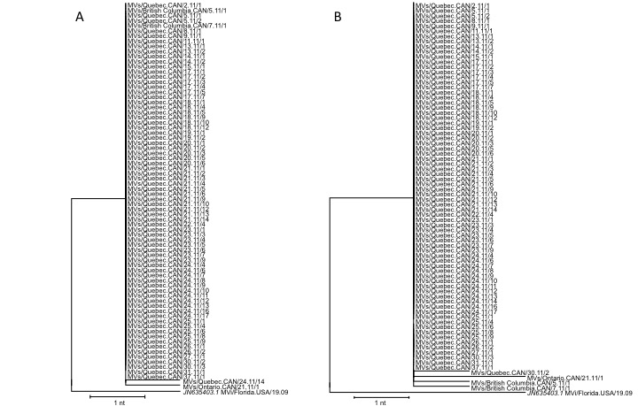
Identical N450 and H gene target sequences

Slide 8
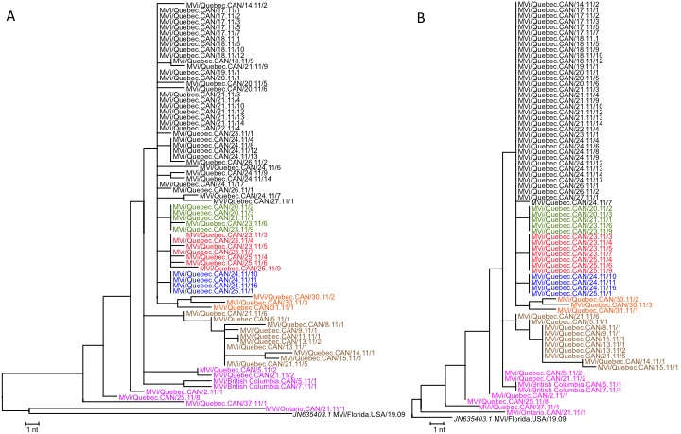
The MF-NCR offers a resolution comparable to WGS
Epi week range
17-27
WGS
MF UTR
20-23
23-25
24-25
30-31
5-13

Slide 9
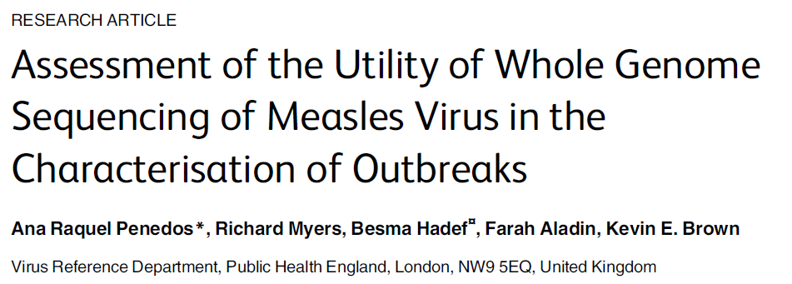
PLoS ONE 2015;10:e0143081

Slide 10
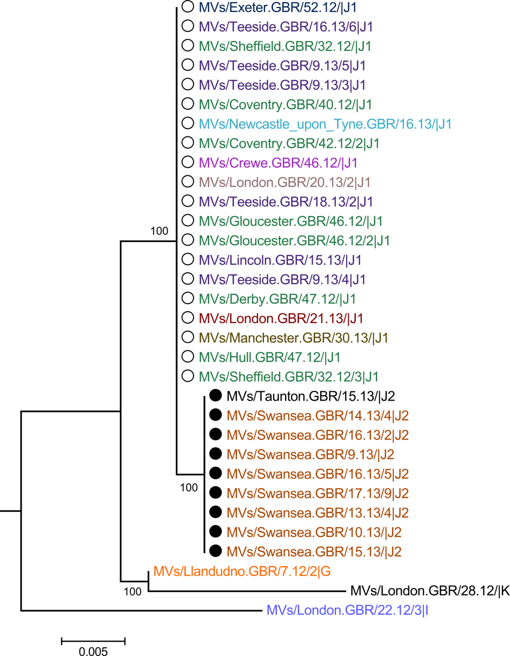
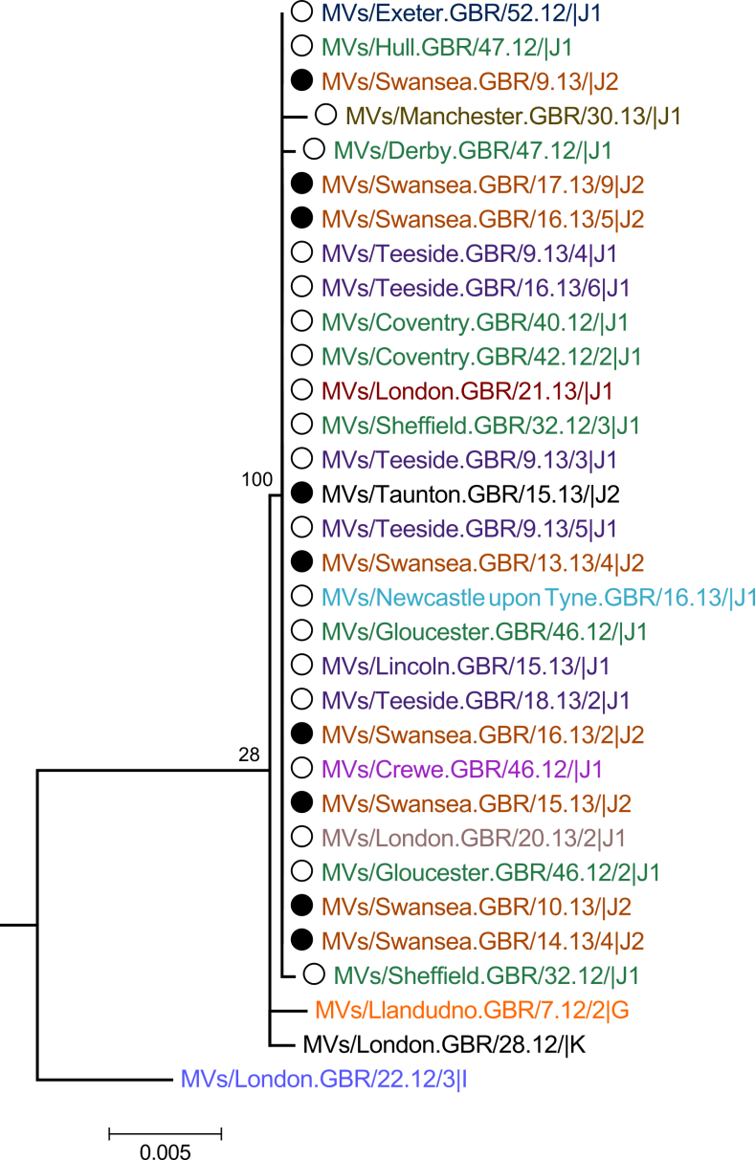
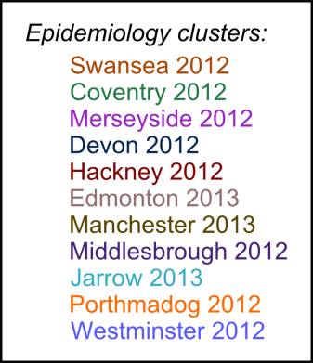
MVs/Taunton.GBR/27.12/
MVs/Swansea.GBR/4.13/
N-450 (456 nt)
H (1854 nt)

Slide 11
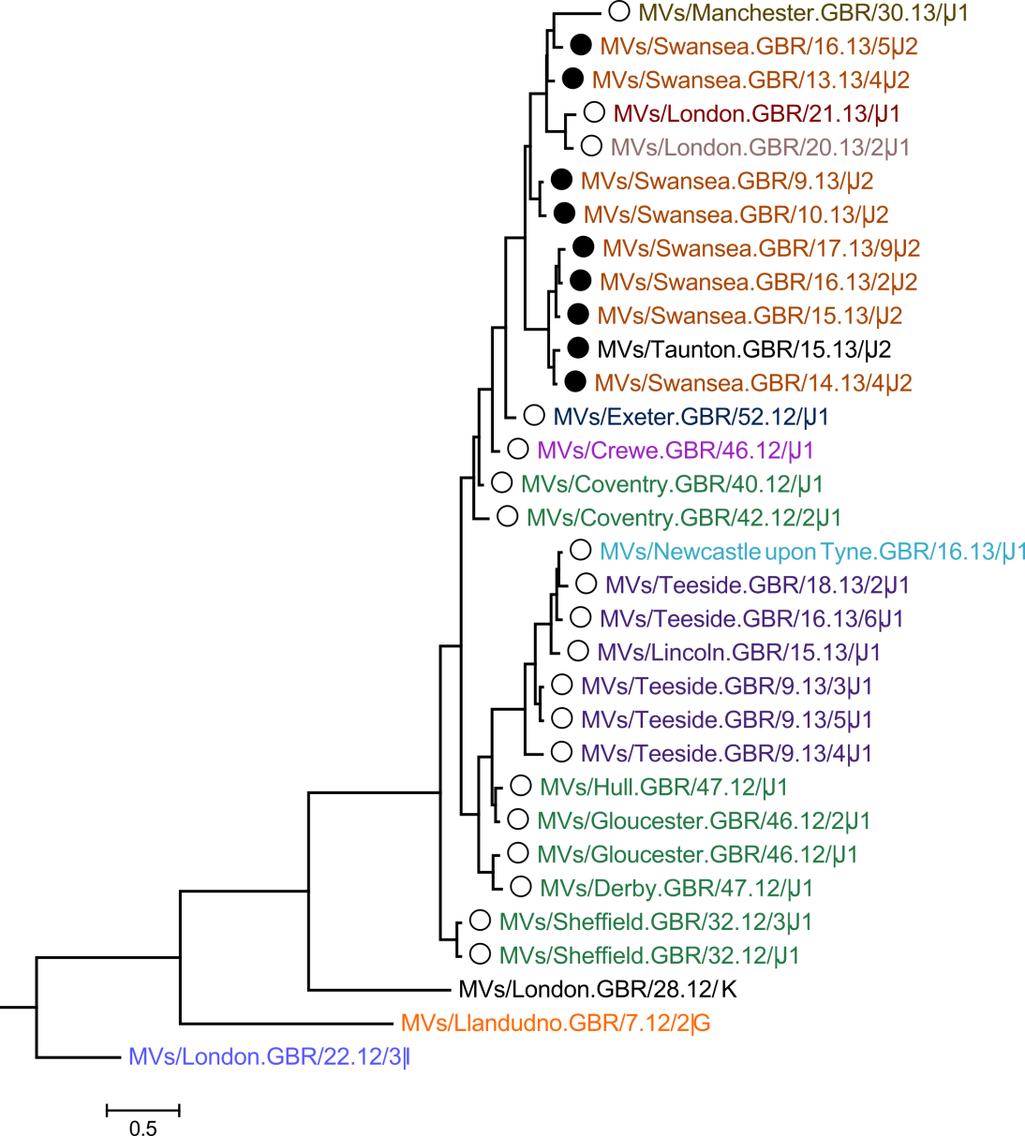
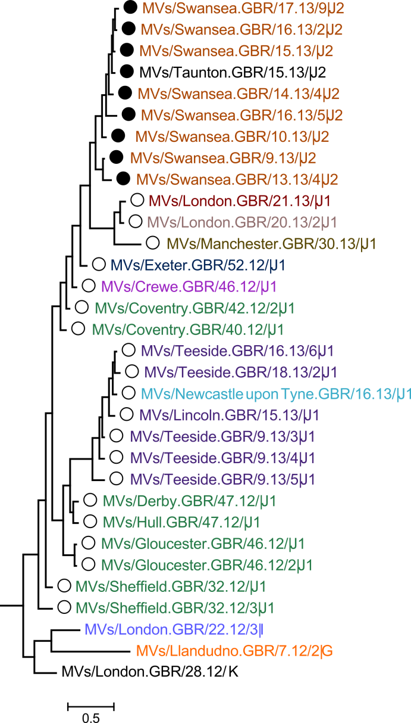
BEAST analyses
Taunton
Swansea
M/F NCR (1012 nt)
WGS-t (15678 nt)

Slide 12
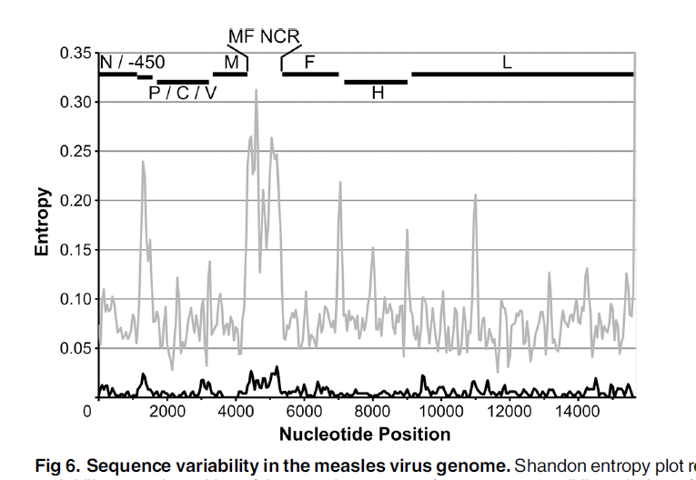
Most of the sequence variability is in the MF NCR region

Slide 13
Conclusions – Quebec and England outbreaks
Whole genome sequencing resolves the chain of transmission of this outbreak
Sequencing of the MF –NCR region is a good surrogate for WGS

Slide 14
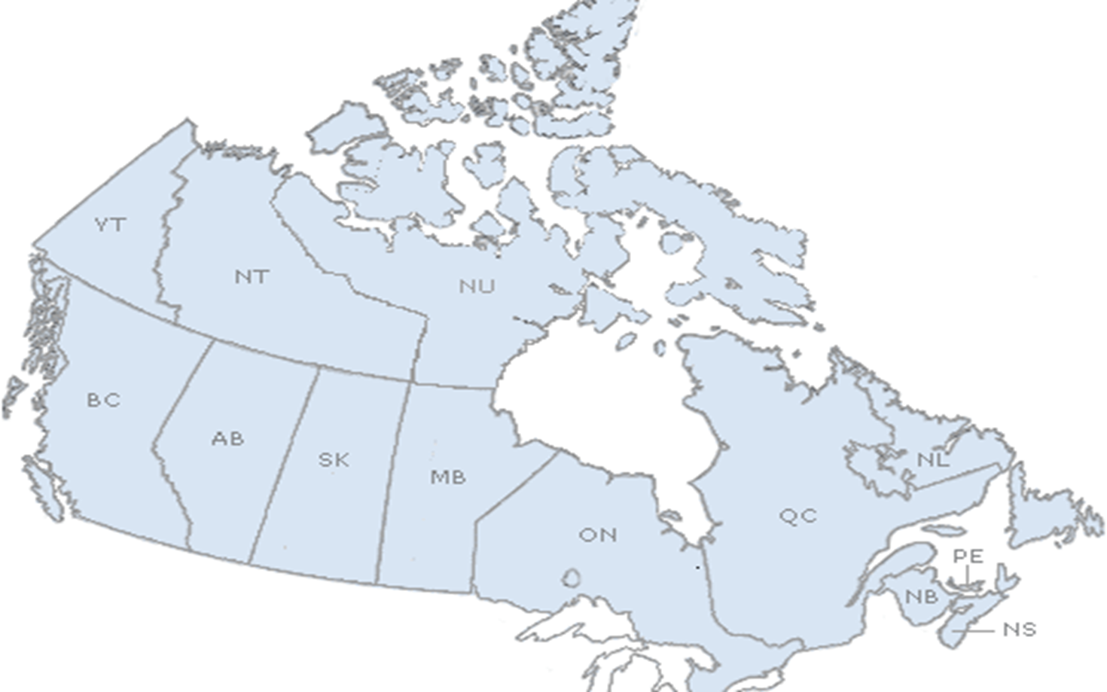
Multiprovince D8 “Frankfurt” outbreak (weeks 22 – 26, 2013)
PEI:
2 cases
Index traveled to Europe
Ontario:
5 cases
Index cases traveled to BC
British Columbia:
3 cases
Index traveled to New York
Notes:
All 3 index cases (BC, ON & PEI) travelled on the same date.
BC & ON index cases were at the same airport at the same time (the BC case was travelling to New York)
The BC cluster possibly led to a case in the US

Slide 15
4nt difference is enough to exclude direct transmission
WGS (15,894 nt)
(variable sites only)
British Columbia
6
TTGTGGCCA
4
Vancouver airport
7
TTGCGGCCA
Ontario
TTGCGGCCA
1
5
2
10
TTGCGGCCA
Toronto airport
3
Prince Edward Island
9
8
CCGCAGCAA
Mvi/München.DEU/19.13 D8
TTACGCTCG

Slide 16
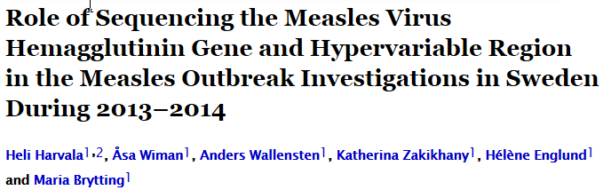

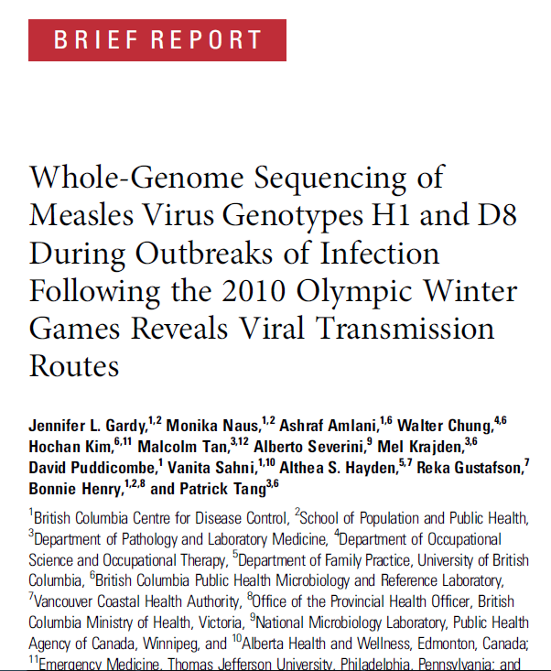
JID 2016;213:592

Slide 17
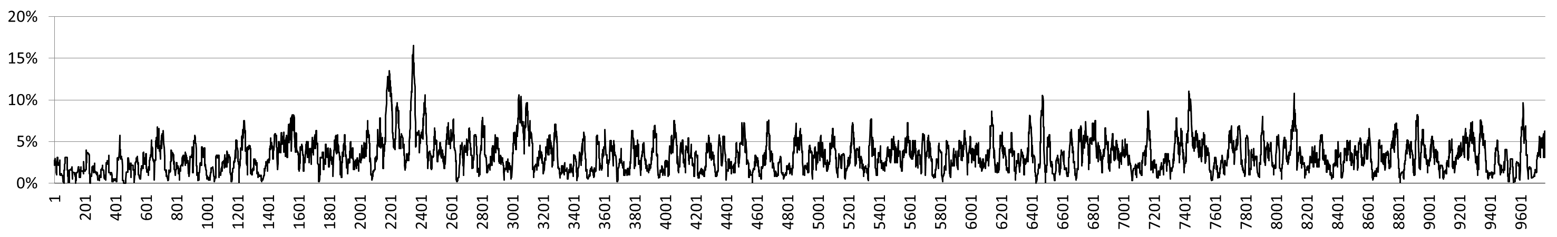
Rubella whole genome and extended sequencing
Nucleotide heterogeneity along the entire genome
NSP SP
p150
p90
C E2 E1
3’
Hypervariable region
Genotyping
window
Nucleotide variability
20-nt sliding window; 48 complete RV genomes
Overall genetic distance: 0.057
Hypervariable region (HVR): 0.115
Genotyping window for wild type rubella virus: 8731 – 9469 (p-distance = 0.061)

Slide 18
Evidence for Association between Rubella and Granulomas in Children with PID
Previous study
RA27/3 RV vaccine strain was the only virus sequence found in granuloma biopsies by NGS
(Bodemera C. et al, Clin Microbiol Infect, 2014)
Current study
7 out of 14 PID cases were positive for RV antigen by IHC
RV positive PIDs were largely T cell defects
(Perelygina, Plotkin, Russo, Hautala, Bonilla, Ochs, Joshi, Routes, Patel, Wehr, Icenogle, and Sullivan. Rubella Persistence in epidermal keratinocytes and M2 macrophages in patients with primary immunodeficiencies. The Journal of Allergy and Clinical Immunology, In Press)
Sequence done by classic methods, but comparison with rubella virus sequences from other persistent infections, recently derived by NGS, was possible.

Slide 19
The Next generation and Extended sequencing Working group (NEW) for measles and rubella
NEW met in Berlin on March 16-17, 2016
We discussed the available data and their utility in measles and rubella outbreak investigation
We developed a set of recommendations for GRMLN
We developed a set of standards for obtaining and depositing measles sequences

Slide 20
NEW current membership
WHO Mick Mulders
US CDC Bettina Benkamp
Min-hsin Chen
Joe Icenogle
Paul Rota
Public Health England Kevin Brown
Ana Penedos
Luxemburg Institute of Health Judith Huebschen
Claude Muller
RKI Germany Annette Mankertz
Sabine Santibanez
GIE - Russian Federation Sergey Shulga
NML Canada Joanne Hiebert
Alberto Severini

Slide 21
Utility
Extended and WGS are not meant to replace standard genotyping by N-450 for measles and 739 from the E1 gene for rubella
WGS or sequencing of the MF-NCR region of measles has proven its utility in low incidence setting, when standard genotyping fails
Extensive and uniform sampling of outbreaks, plus a prior knowledge of related sequences, are needed to make the results interpretable
It is recommended to obtain as many measles and rubella genomic sequences as possible to develop a database that will aid in outbreak investigations

Slide 22
Collaborations and data collection
It is recommended to obtain as many measles and rubella genomic sequences as possible to develop a database that will aid in outbreak investigations.
  NLs are encouraged to collect and store specimens (suited for culture isolation, if possible) for extended sequencing and to collaborate with GSLs and RRLs that have capacity for whole genome and/or extended sequencing.
MeaNS and RubeNS eventually be able accept measles and rubella whole genome sequences and measles MF-NCR sequences.

Slide 23
Next steps
We need a practical method for whole genome sequencing
We need a precise algorithm to distinguish chains of transmissions form independent importations
We need more whole genome sequences for measles and rubella from outbreaks around the world

Slide 24
Acknowledgements
NEW working group
Ana Penedos measles WGS
Kevin Brown
Min-hsin Chen rubella WGS
Joe Icenogle
And all the members
NML Canada
Helene Schulz
Robyn Thorington
Shaun Tyler DNA core

