Slide 1
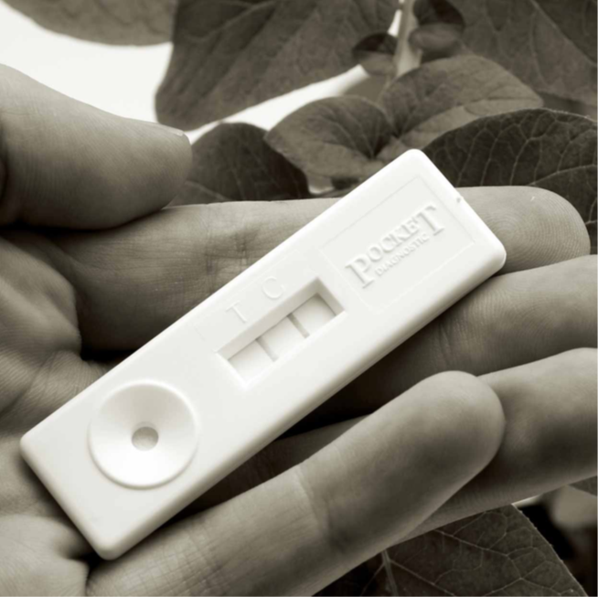
Developing point of care tests for Measles surveillance : An update.
Dr David Brown, PHE, Fiocruz
.
1 Serology and public health, july 2016

Slide 2
AIM: To describe a Gates Foundation project : Rapid immunity assessment tools for tetanus and measles
  Rapid, inexpensive and sustainably produced measles and tetanus IgG tests that provide unambiguous results at the point of collection using OF, DBS.
  To reliably transfer results in real time to remote regional/national centres .
  To allow immunisation coverage levels to be monitored more reliably than current systems. Tetanus toxoid antibody only found after vaccination
  POCT for measles IgM for Case confirmation in OF , Capillary blood and serum.

Slide 3
Components of PHE Project
VRD,PHE
Project Coordination
Develop Rapid Tests
Qiagen, Lake Constance, Germany
Maddison Product Design, Chichester, UK
Rapid Test reader Development
Design new Oral fluid collection device
Uganda Virus Research Institute (UVRI), PHE and Ex WHO consultant
Abingdon Health, UK
FIELD STUDIES, New Device approval, Ethical approvals,
Manufacture
Rapid Tests
Carclo technical plastics, Surrey
Manufacture Oral fluid collection device

Slide 4
New tools developed for the project
Oralight™ - new oral fluid collection device
Lateral Flow tests for use on serum, capillary blood and oral fluid.
    Tetanus toxoid specific IgG antibody.
    Measles specific IgG antibody.
    Measles specific IgM antibody.
ESEQuant lateral flow reader/ mobile phone

Slide 5
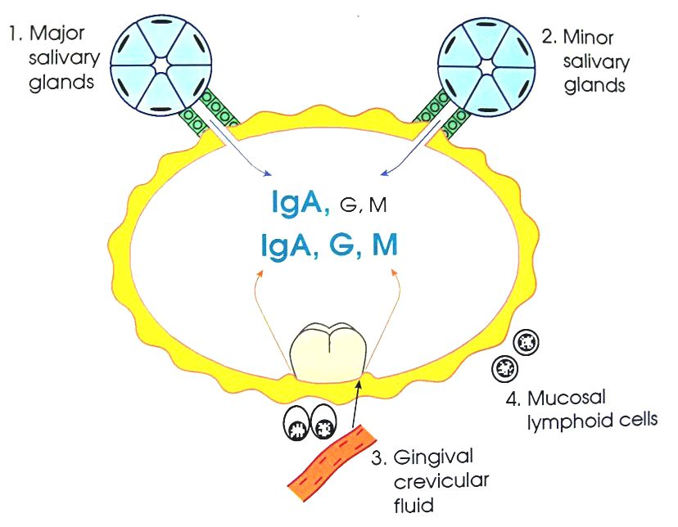
Oral fluid for antibody detection: Key issues
Gingival crevicular fluid: pattern of antibody identical to that in blood
Antibody levels increase with age and reflect serum levels
Variable sample
Non invasive to collect
Safe
Immunoglobulin concentrations (mg/100ml)
in serum and saliva
 | IgG | IgM
Serum | 1250 | 80
Whole saliva Parotid saliva Gingival Crevicular Fluid | 1.4 0.04 350 | 0.2 0.04 25
Serum: Saliva ratio | 900:1 | 400:1

Slide 6
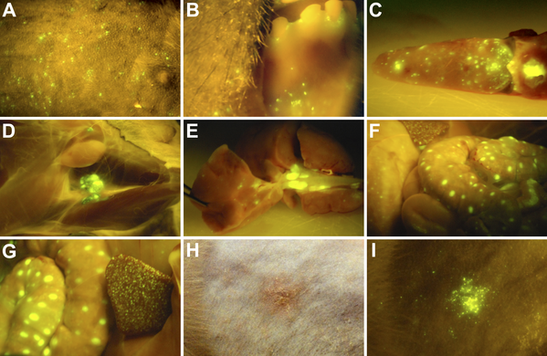
Oral Fluid for Virus detection and characterisation.
Jin L, Vyse A, Brown DWG. The role of RT-PCR assay
of oral fluid for diagnosis and surveillance of measles,
mumps and rubella. Bull WHO (2002)
Cynomolgus macaque #C3 on day 9: MV infection in the
tongue and tonsils (C ).Rik de Swart, Plos 2006.
Many studies now show that Throat swab and OF optimum
samples for virus detection by RT-PCR (T/S for culture)
in acute samples .

Slide 7
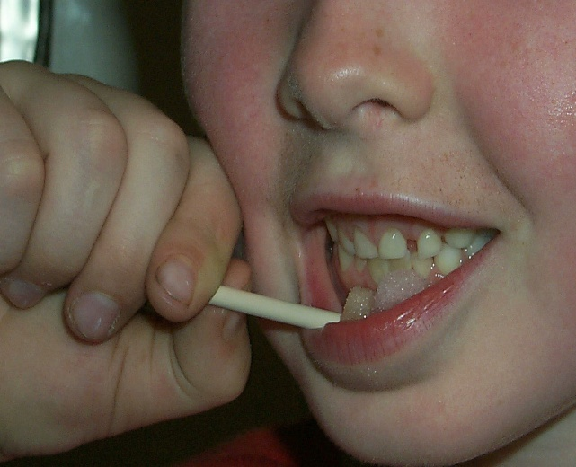
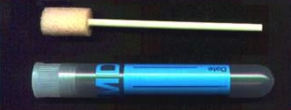
Oral fluid collection: Oracol
Oracol™ device (Malvern Medical Developments) successfully used for 20 years in UK
Limitation: Requirement for sending to laboratory for extraction and testing

Slide 8
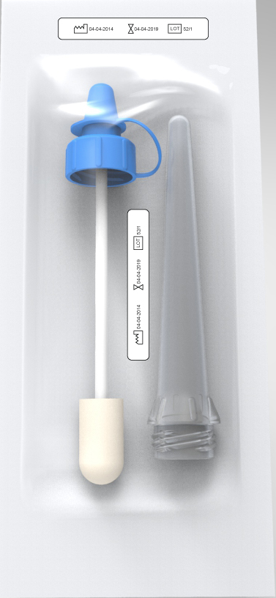
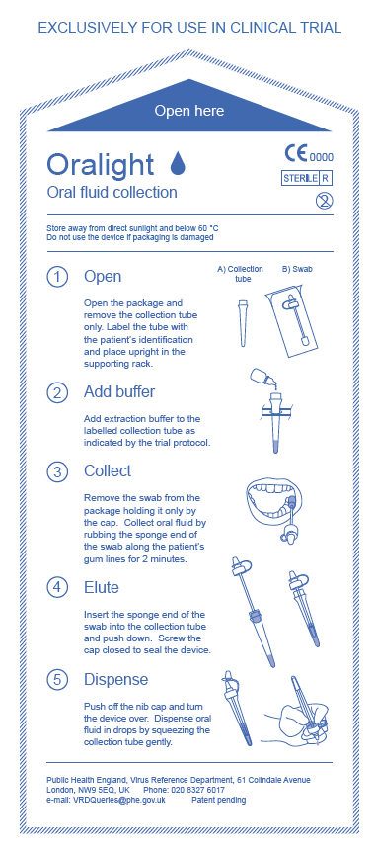
Oralight: Packaged for use

Slide 9
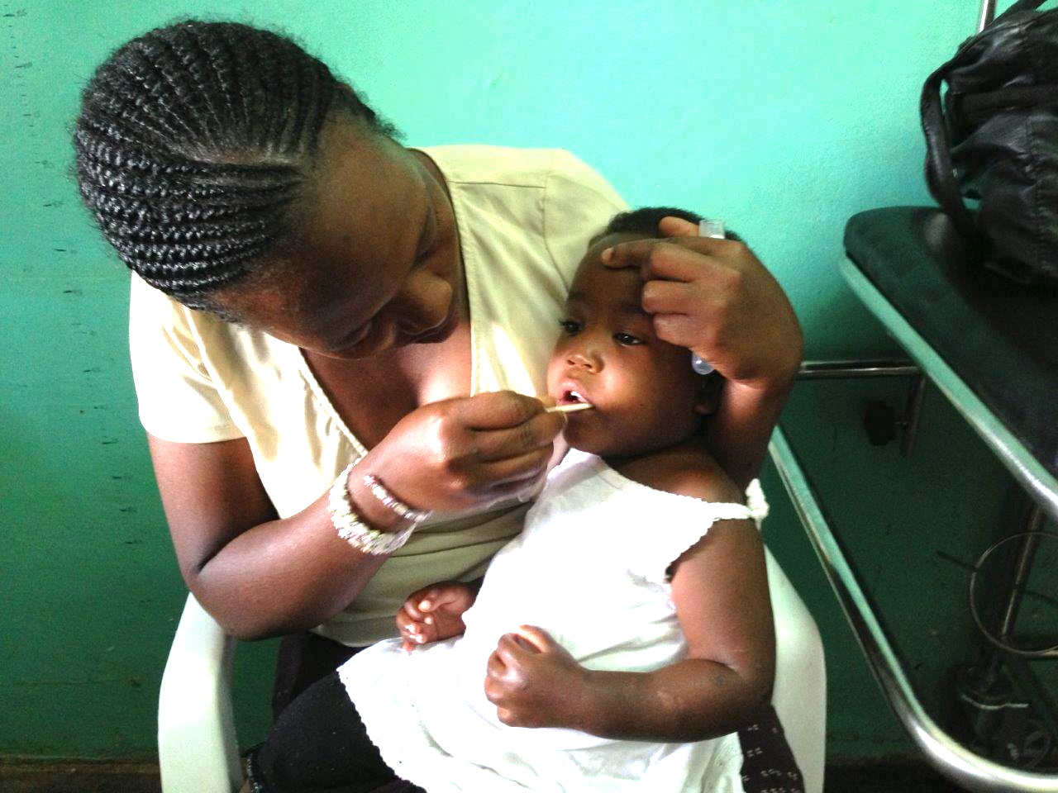
Oral Fluid Collection Using Oralight

Slide 10
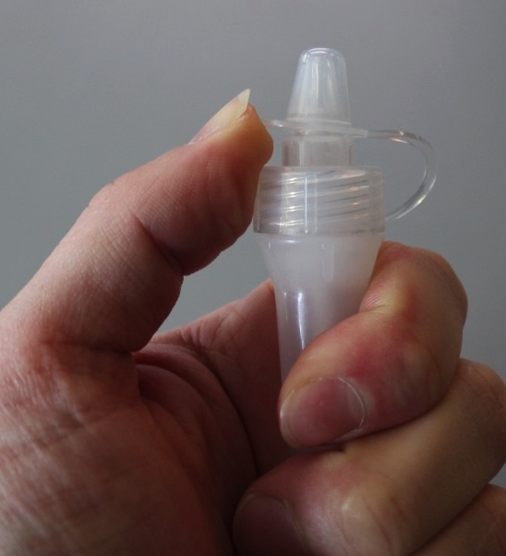
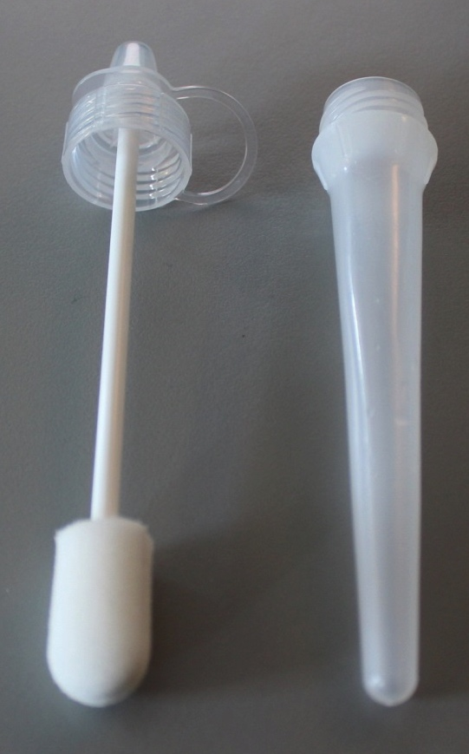
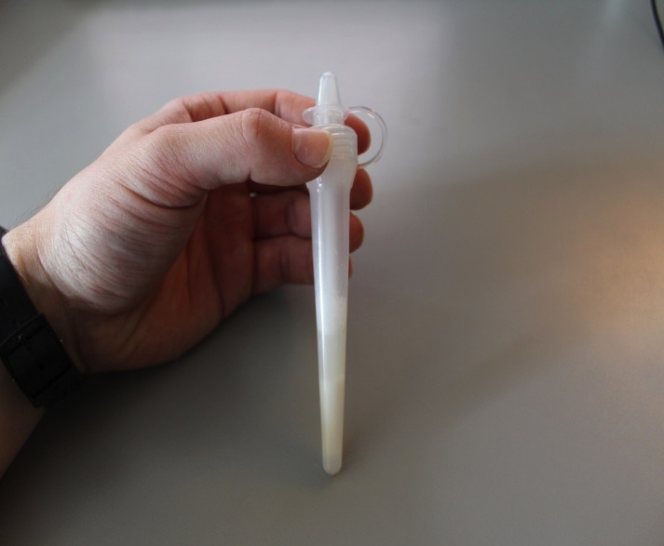
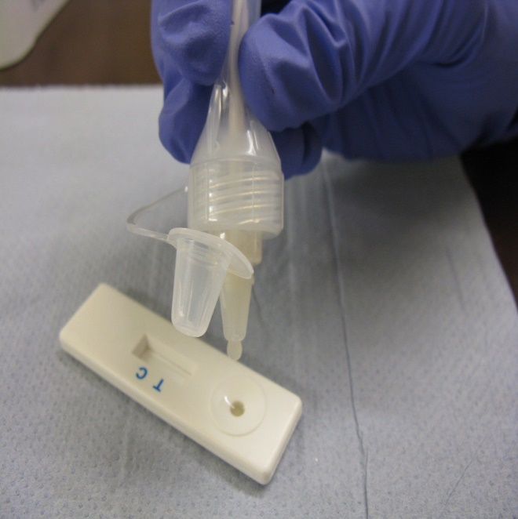
Extracting oral fluid from the Oralight™
1. Device
3. Flip open primary lid
2. Add extraction buffer (1ml). Push down swab and tighten screw cap to squeeze OF into tube
4. Invert and dispense OF into test device or for storage
3.
1.
2.
15 Serology and public health, june 1st 2016
4.

Slide 11
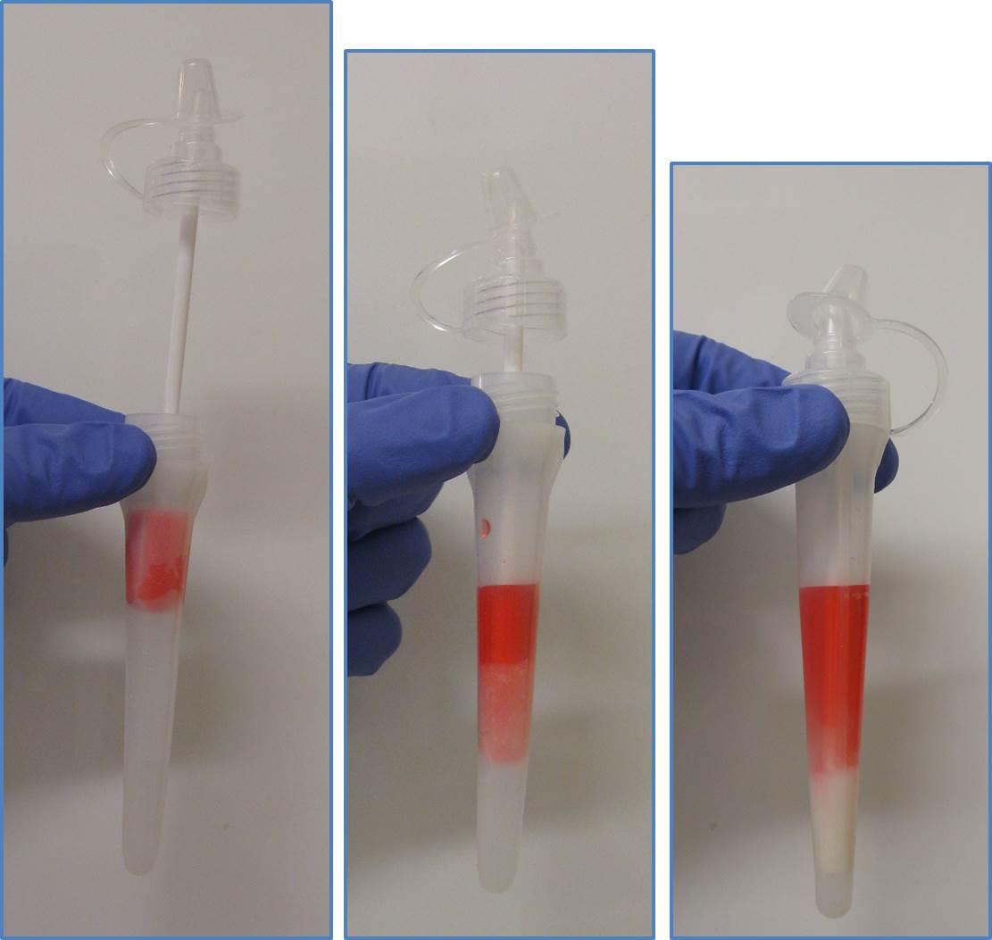
Elution of dyed liquid from sponge swab.
1mL elution fluid added into Oralight tube, before inserting sponge swab. (1)
Sponge swab soaked in dyed liquid for two minutes. (2)
Sponge swab inserted into Oralight tube. (3)
Dropper cap tightened to fully constrict swab and elute dyed liquid. (4)
Liquid dye in sponge (2)
Dye has been eluted from the sponge
(4)
Dye being eluted from sponge
(3)
Elution buffer (1)
Sponge, mostly devoid of dye

Slide 12
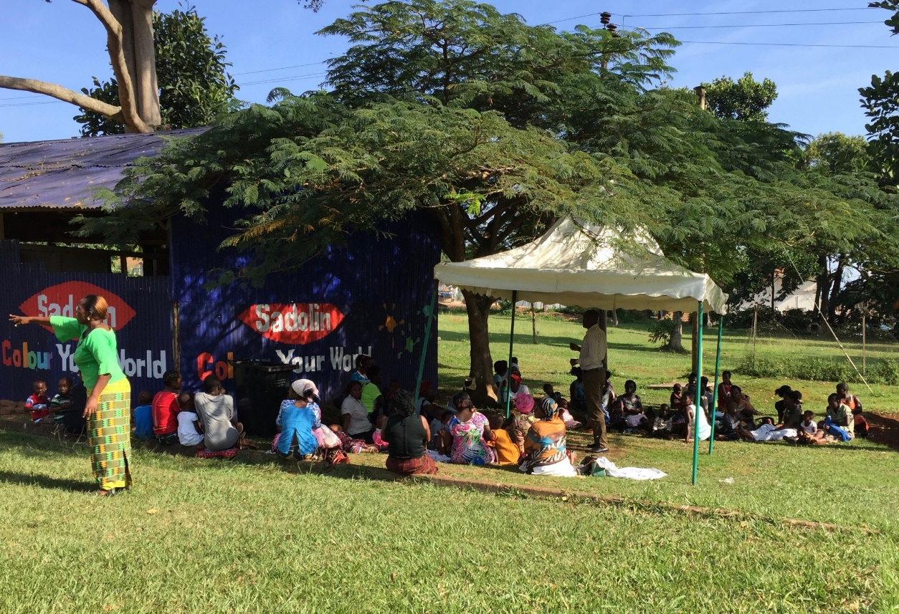
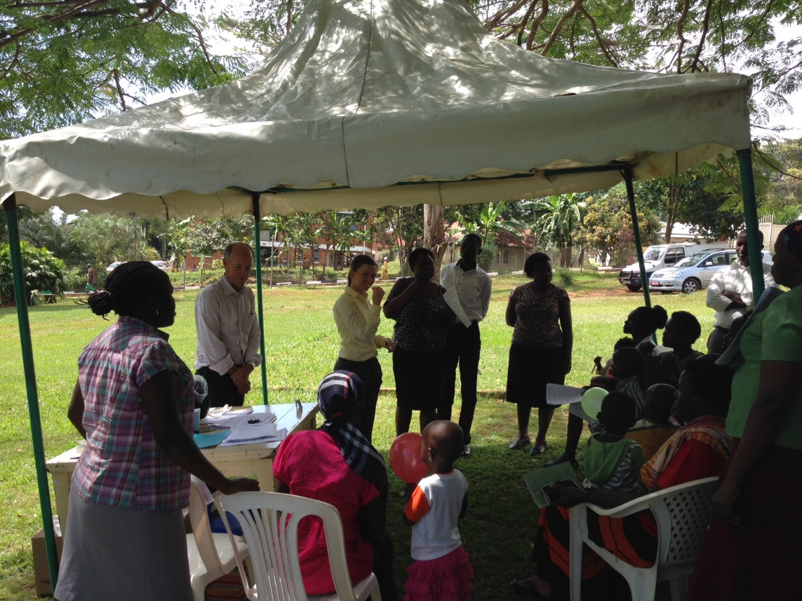
Oralight assessment study, Entebbe Hospital tempory OPD.
March 2016

Slide 13
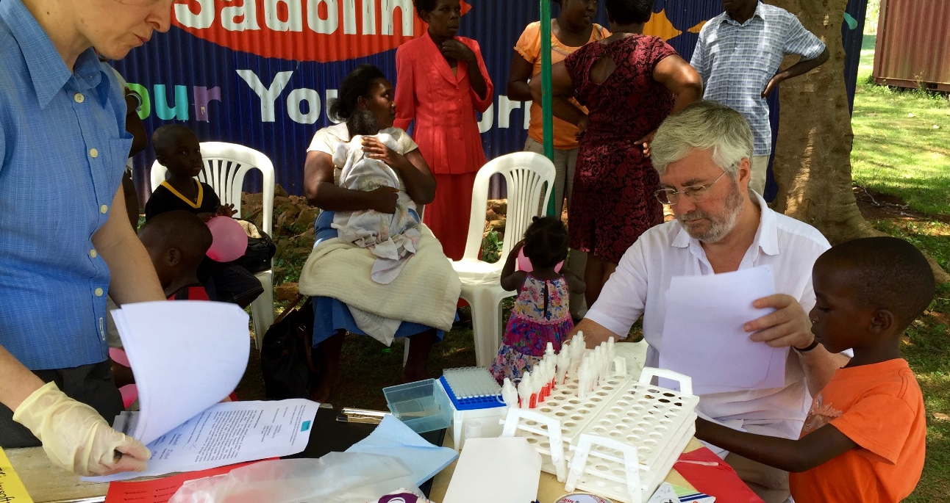
  To compare the usability, safety and sample quality of OF samples collected using Oracol and Oralight in children aged 9-60 months
Recruit and consent children.
Complete questionnaire of demographics, vaccine history.
Check current health of child, height, weight.
Collect 2 OF samples from children. (one with each device, each 2 mins!)
Study conducted in Entebbe Hospital OPD, Uganda, Feb-March 2016
137 Serology and public health, june 1st 2016

Slide 14
Oralight and Oracol Collection device sample adequacy in head to head trial- Entebbe, Uganda
Collection device used first | N | Device | Mean volume | Range Min-max vol
Overall | 154 | Oralight | 0.9 | 0.35-1.92
 |  | Oracol | 0.79 | 0.34-1.94
Oralight | 69 | Oralight | 0.92 | 0.41-1.75
 |  | Oracol | 0.75 | 0.34-1.82
Oracol | 85 | Oralight | 0.88 | 0.35-1.92
 |  | Oracol | 0.83 | 0.35-1.94

Slide 15
Oralight and Oracol Collection device sample Total IgG concentrations in head to head trial: Entebbe, Uganda, Mar 2016
Collection device used first | N | Device | Mean* Total IgG conc | Range Min-max conc
Overall | 154 | Oralight | 12.32 | 0.24 - >25
 |  | Oracol | 12.12 | 0.54 - >25
Oralight | 69 | Oralight | 13.01 | 0.24 - >25
 |  | Oracol | 11.92 | 0.19 - >25
Oracol | 85 | Oralight | 11.65 | 0.53 - > 25
 |  | Oracol | 12.02 | 0.54 - >25
* Upper limit of assay is 25. Values of >25 IgG (N=14 Oracol and N=14 Oralight) were considered as 25 for determining mean values

Slide 16
Usability and Safety
Usability: No problem in using either but some preference for Oracol due to need to hold cap of Oralight
Oralight initially felt drier in the mouth than Oracol
Extracted Oralight fluid contained more particulate material than processed Oracol sample
Safety: Blood contamination in 4.5% of Oracol and 7% in Oralight
No evidence of discomfort or bleeding after 5 mins and 30 mins
Contributing factors: Status of teeth/oral hygiene, over vigorous rubbing of gums with device

Slide 17
New Device, Oralight
We have shown the Oralight is:
      Is safe
      Is acceptable to patients
      Is easy to use
      Can replace Oracol™
      Specimen is compatible with serological tests
      CE marking application is in progress

Slide 18
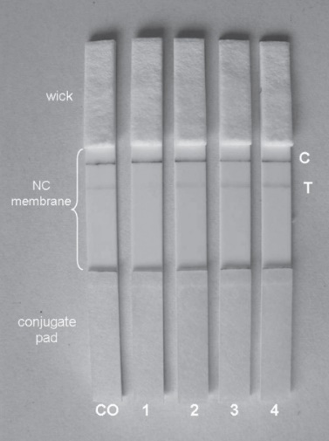
A point-of-care test for measles diagnosis: detection of measles-specific IgM antibodies and viral nucleic acid
- Warrener et al: Bull World Health Organ 2011
Main findings:
With serum POCT showed a sensitivity and specificity of 90.8% (69/76) and 93.6% (88/94), respectively.
With oral fluids, sensitivity and specificity were 90.0% (63/70) and 96.2% (200/208), respectively.
Both H and N genes were reliably detected in POCT
strips and the N genes could be sequenced for genotyping.
Measles virus genes could be recovered from POCT strips after storage for 5 weeks at 20–25 °C.
Components of the point-of care test (POCT) and examples of signal intensities obtained
during POCT testing of sera from four patients and of the cut-off control serum

Slide 19
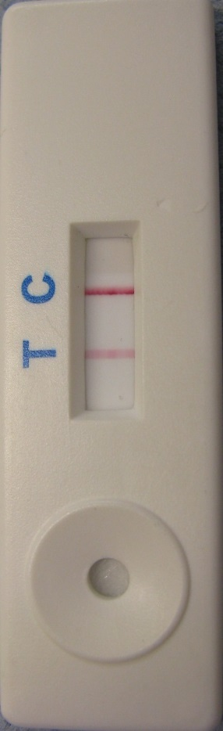
Capture format lateral flow assay
gold-labelled antigen and anti-human IgM test line
Direction of reagent flow
Add sample
OF/ blood
Labelled microbial
antigen
Test line :
anti-human IgM
Control line:
Antibody: anti- microbial antigen
Blood separation pad
Nitrocellulose
membrane
Plastic backing card
Cotton linter paper wick
Conjugate release pad
Notes:
Control lines:
Specific antibodies to microbial antigens/toxins
Test Line: single anti-human IgG, Fc fragment specific
Gold: 40nm gold colloid
Conjugates: directly conjugated microbial antigens/toxins
Complexed SA-gold-bTT

Slide 20
Measles specific IgM
Prototypes of measles IgM POCT produced.
Evaluation with UK and Zimbabwe OF samples
Microimmune EIA result on oral fluid | LFD results on Zimbabwe and UK oral fluids POS NEG |  | TOTAL
POS | 54 | 4 | 58
NEG | 1 | 64 | 65
EQV | - | 2 | 2
TOTAL | 55 | 70 | 125
Sensitivity: 93.1%
Specificity: 98.5%
28 Serology and public health, june 1st 2016

Slide 21
Status of Measles IgM POCT studies.
Oral fluid- Evaluation vs Siemens IgM test on serum within Ethiopian surveillance system, await clearance, planned start Oct .
Capillary blood…

Slide 22
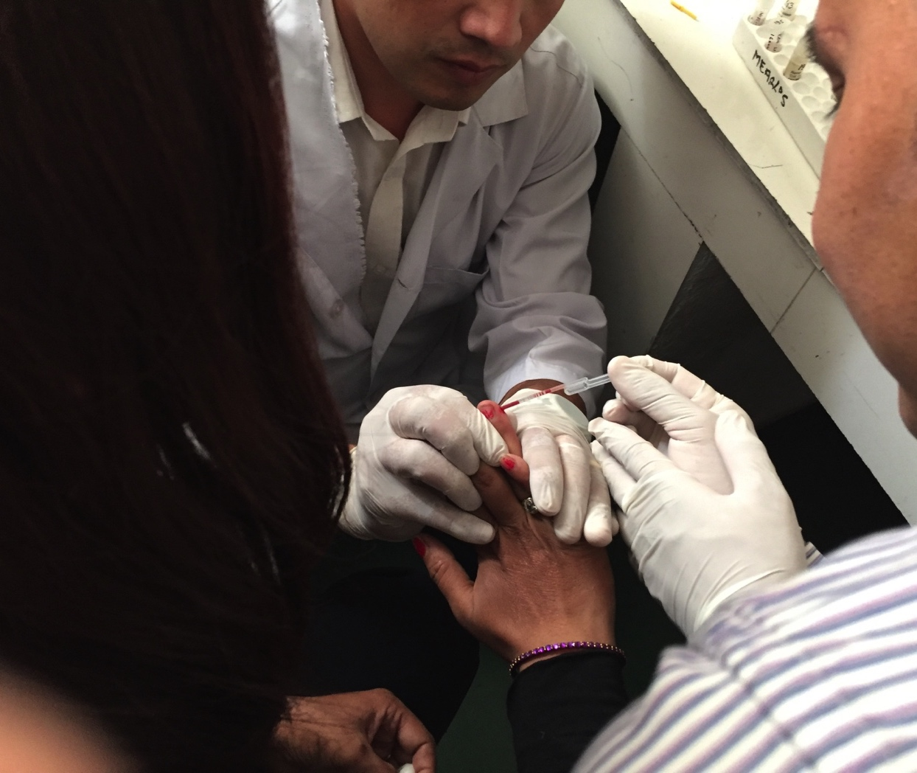
Using capillary blood

Slide 23
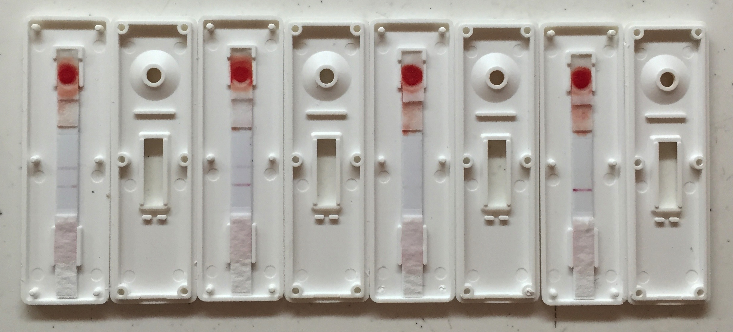
Opened POCT cassettes showing filtration of RBCs

Slide 24
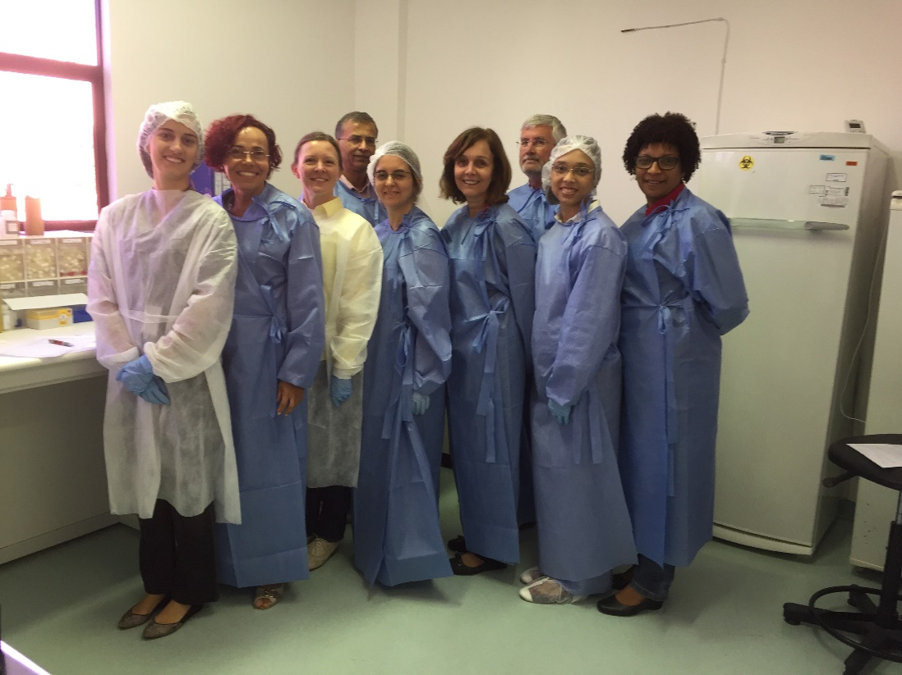
Measles IgM POCT evaluation in Rio
125 sera from Brazilian surveillance system
Positive and negative for measles IgM, 28 dengue IgM positives.
Tested in POCT, read using WHO scoring scheme 0-4 by 3 independent blinded readers.
All POCTs read in ESEQuant reader
Sensitivity and specificity defined, consistency of reading assessed.
29 Serology and public health, june 1st 2016

Slide 25
Measles IgM evaluation Rio: Comparison of Siemens IgM ELISA results with POCT visual test line score consensus
-Visual scoring of ≥2 being interpreted as positive for measles IgM in the POCT
-Control line consensus visual scoring ≥2 being considered as valid.
Siemen’s IgM EIA result | Visual Test line score consensus |  |  |  |  | Total
 | 4 | 3 | 2 | 1 | 0
Positive | 7 | 44 | 23 | 2 | 1 | 77
Equivocal |  |  | 1 |  | 1 | 2
Negative |  |  |  | 1 | 45 | 46
Total | 7 | 44 | 24 | 3 | 47 | 125
Sensitivity: 96.1% (74/77)
Specificity: 100% (46/46), Concordance: 96.0% (120/125)
325 Serology and public health, june 1st 2016
Notes:
Comparison of Siemens IgM ELISA results with PoCT visual test line score consensus, using a visual scoring of ≥2 being interpreted as positive for measles IgM in the PoCT and a control line consensus visual scoring ≥2 being considered as valid.
Sensitivity: 96.1% (74/77)
Specificity: 100% (46/46)
Concordance: 96.0% (120/125)

Slide 26
Accuracy of visual reading: Measles IgM POCT
Agreement with consensus
Reader | Results | Agreement | Kappa | Serror | Kappa_95% CI
AL_TL | 92 | 84.8% | 0.79 | 0.06 | 0.72-0.85
BR_TL | 68 | 91.2% | 0.87 | 0.08 | 0.79-0.95
CR_TL | 96 | 88.5% | 0.84 | 0.06 | 0.78-0.9
JA_TL | 28 | 82.1% | 0.74 | 0.11 | 0.63-0.86
RO_TL | 9 | 88.9% | 0.71 | 0.20 | 0.51-0.91
XE_TL | 82 | 95.1% | 0.93 | 0.07 | 0.86-1
Reader average |  | 88.4% | 0.81
 | Test Line Consensus
AL_TL* | 0 | 1 | 2 | 3 | 4 | Total
0 | 31 | 0 | 0 | 0 | 0 | 31
1 | 0 | 2 | 0 | 0 | 0 | 2
2 | 0 | 1 | 15 | 6 | 0 | 22
3 | 0 | 0 | 3 | 26 | 1 | 30
4 | 0 | 0 | 0 | 3 | 4 | 7
Total | 31 | 3 | 18 | 35 | 5 | 92
* TL = Test Line
The high kappa scores indicate that only two readers are required.
The good correlation with the eseQuant suggest the POCT’s are usable without the reader if necessary.

Slide 27
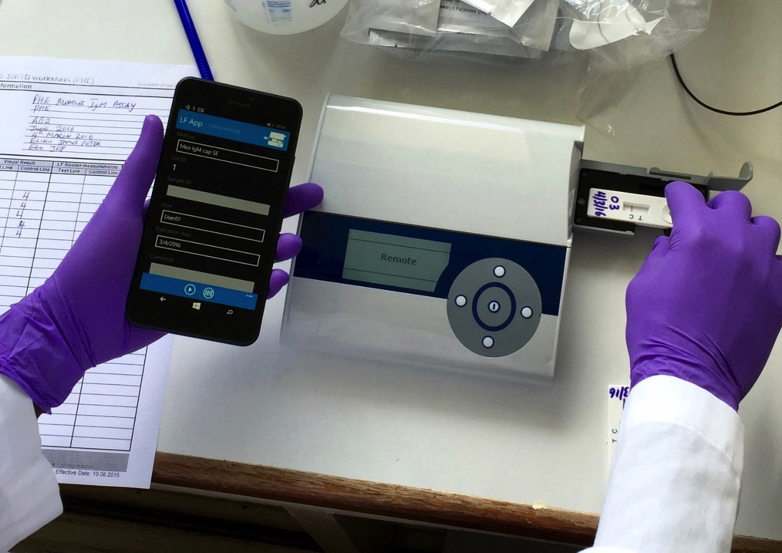
Transferring results in real time using the
EZEquant POCT reader and smart phone

Slide 28
Timing: Collection to Results
Procedure | Serum - EIA | Oralight - POCT
Collection | 5 mins | 5 mins
Extraction | 10 mins | 2 mins
Packaging and Shipping Prep | 20 mins | nil
Shipping | 3 days | nil
Testing and reporting | 4.5 hrs | 15 mins
Turnaround time | 3 -7 days | immediate
TOTAL | 7-11 days | 22 mins

Slide 29
Inexpensive:
Approximate cost comparison of serum and oral fluid collection and testing for Measles IgM. Single sample:
Procedure | Serum - EIA Vaccutainer | Oral fluid - POCT Oralight
Collection device and process | $3.50 | $3.61
Extraction process | $0.94 | $0.05
Assay – single sample | $15.76 | $3.64
Total single sample ELISA | $20.20 | $7.30
Total (per sample in full ELISA strip) | $7.59 | $7.30
Transportation | Serum EIA | POCT
Shipment to lab | $10-150 | NIL

Slide 30
Summary and Discussion
New Oralight OF collector designed and evaluated.
A POCT developed with high sensitivity and specificity for measles IgM detection using serum. Cap blood, OF awaiting trial.
POCT Can be used for molecular epidemiology studies, by PCR and sequencing of POCT strip.
EseQuant reader / mobile phone available to QC results and transmit results to programme in real time.
Overall project aim is to collect and extract OF samples and test in POCT in the clinic. Field studies still required to compare Capillary blood and OF with serum based / DBS before introduction. IgG assay at similar stage

Slide 31
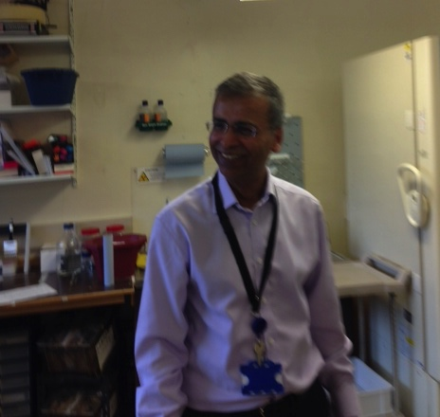
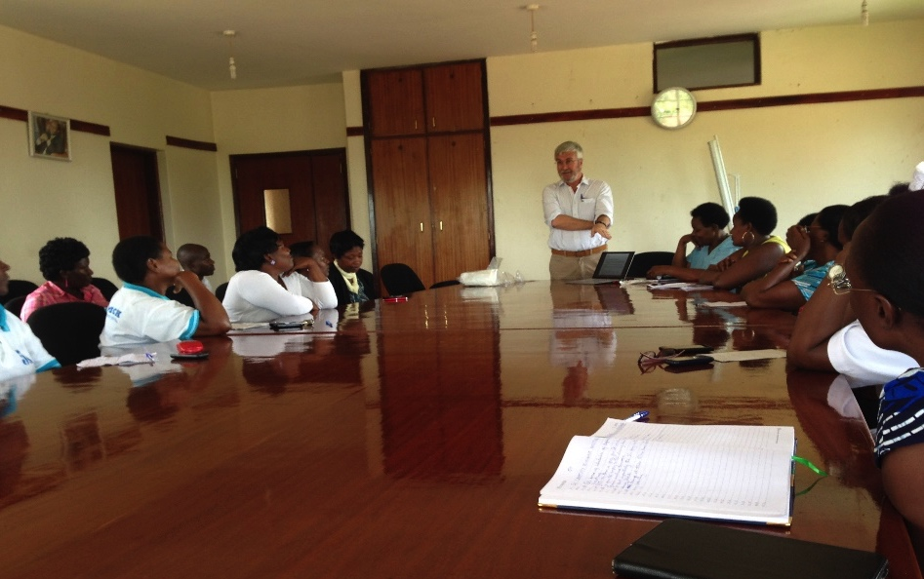
Acknowledgements:
BMGF
David Brown
Dhan Samuel
Lenesha Warrener
David Featherstone
Ben Childs –Maddison designs,
CARCLO –swab manufacture
Keith Perry
Kevin Brown
Field Studies:
Josephine Bwogi, Marilda Siqueira
Anatoli Kamali Berhane Beyene
Theopista Kabaliisa
Henry Bukenya
Peter Eliku

