Slide 1
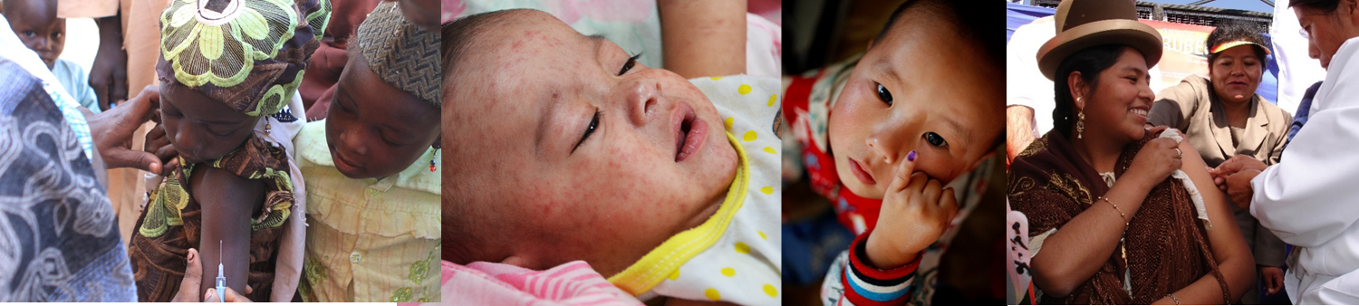
Accelerating Progress towards Measles and Rubella Elimination
Hotel Royal, Geneva, Switzerland, 21-23 June 2016
Paul Rota,
Measles, Mumps, Rubella, Herpesviruses Laboratory Branch, CDC par1@cdc.gov
Mircroneedle patches: An emerging vaccine delivery technology to achieve high coverage for measles and rubella vaccines
National Center for Immunization & Respiratory Diseases
Measles, Mumps, Rubella, and Herpes Laboratory Division

Slide 2
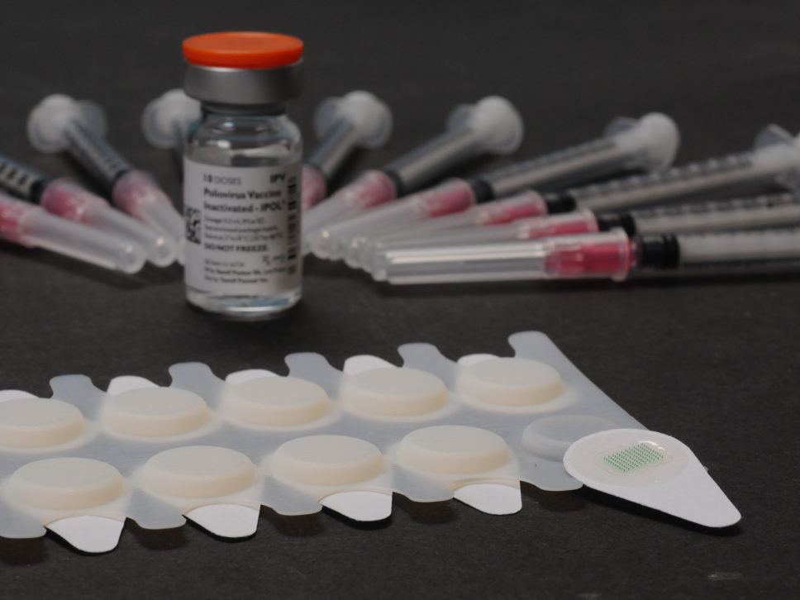
Collaboration between CDC and the Georgia Institute of Technology
Mark Prausnitz, GT
Web address: http://drugdelivery.chbe.gatech.edu/
Jessica Joyce, GT
Marcus Collins, CDC, MMRHLB
Melissa Coughlin, CDC, MMRHLB
Min-hsin Chen, CDC, MMRHLB
James Goodson, CDC, GID
Mark Papania, CDC, GID

Slide 3
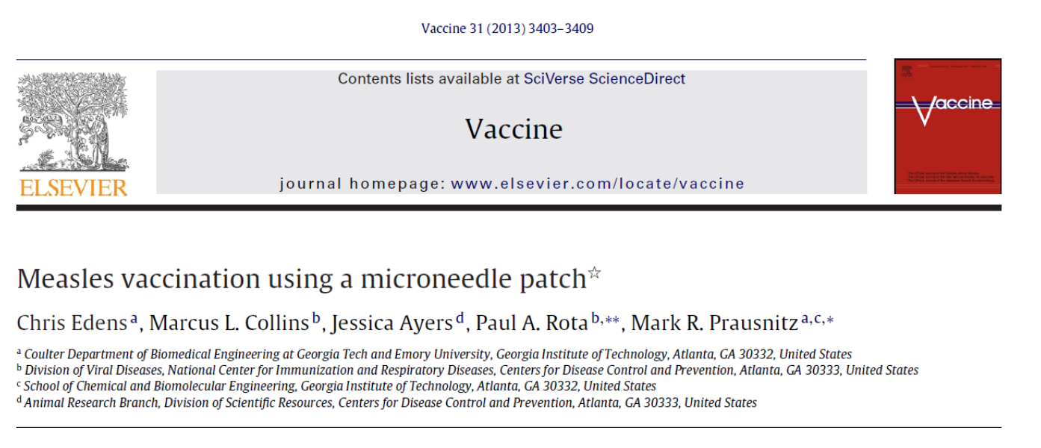
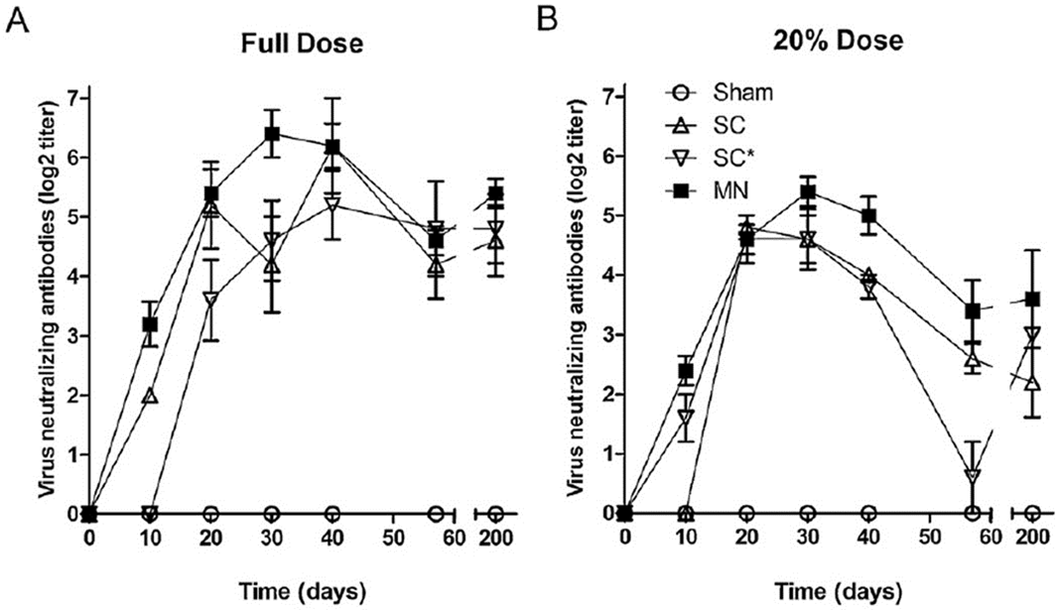

Slide 4
Advantages of Vaccination Using an Intradermal Microneedle Patch for MR Vaccination
Thermostability
  reduced or no cold chain requirement
Single-dose presentation
  no reconstitution, minimal wastage, reduces missed opportunities
Administration by minimally-trained personnel
  enables house-to-house campaigns
No sharps waste
  no sharps disposal, no sharps injuries
Small package size
  single-dose, simplified storage, transportation and disposal
Increased immunogenicity
  potential dose-sparing
Cost-effective manufacturing
  cost similar to that of lyophilized vials

Slide 5
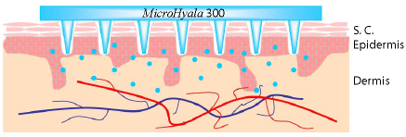

Slide 6
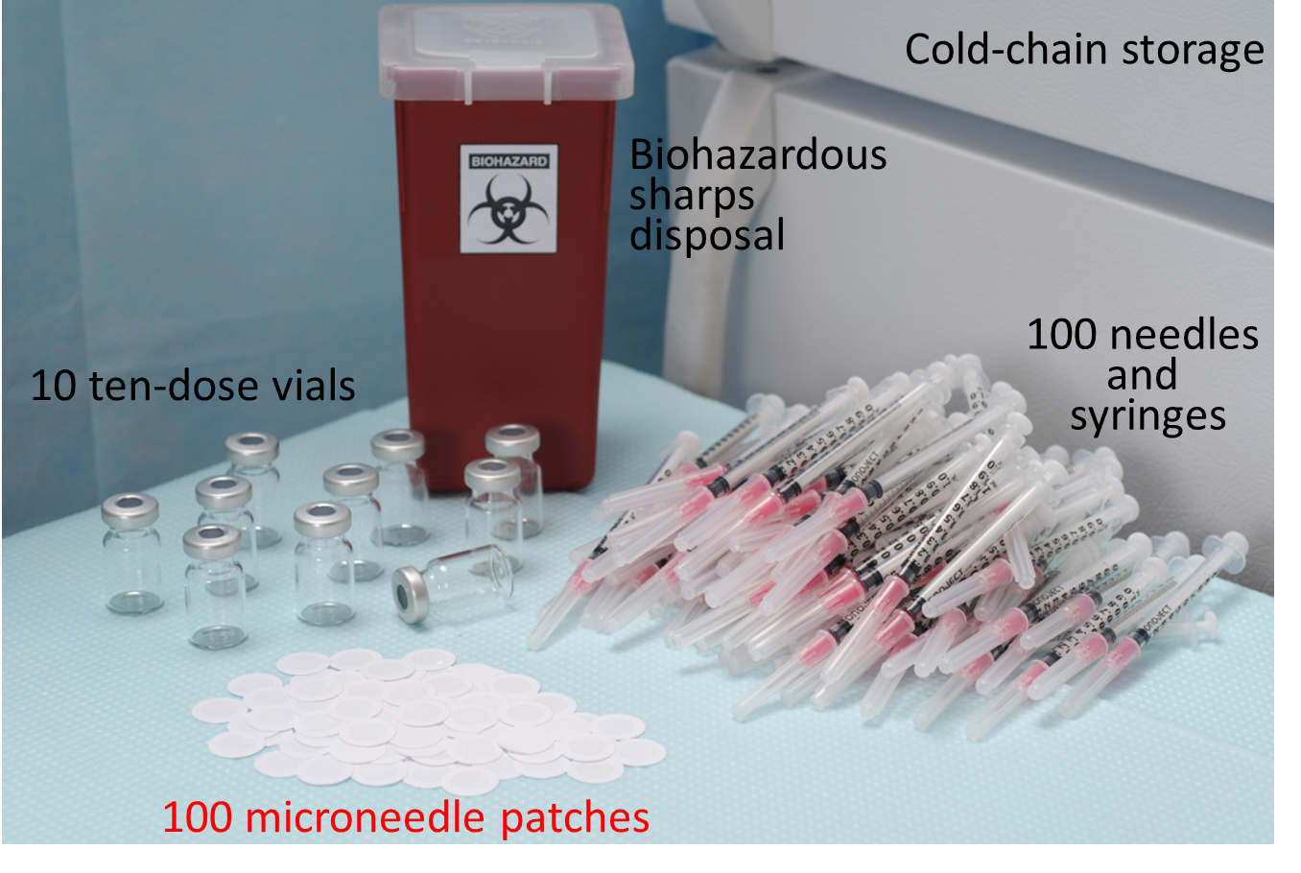
Innovations – Intradermal Patch Vaccination
Microneedle Patch for MR Vaccination: Improved Logistics
Rationale
Georgia Tech and CDC
Notes:
The most common rate limiting step in conducting measles vaccination is the number of qualified vaccinators. If vaccination could be made easier – for example like applying a band aid to the skin – it could be delivered by volunteers. Research is ongoing at CDC and Georgia Tech to develop an intradermal patch vaccine. This slide shows the advantages of such an approach which would not only be able to be given by volunteers but also get rid of bulky syringes, the need for vaccine reconstitution before administration and the risk of needle stick injury which requires careful disposal of sharps.

Slide 7
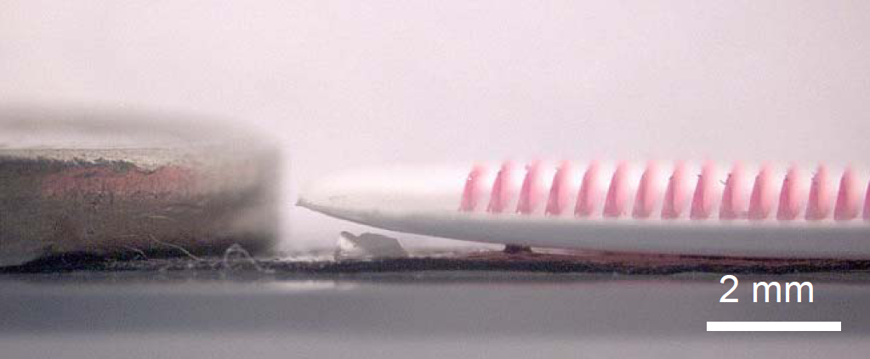
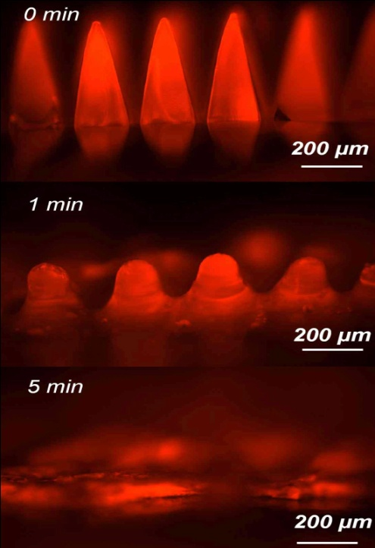
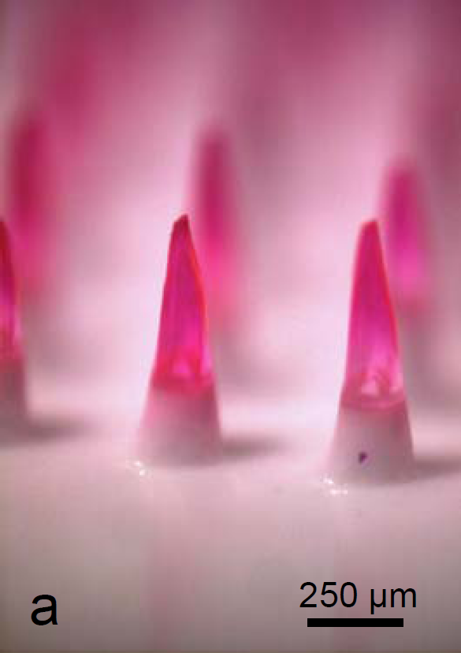
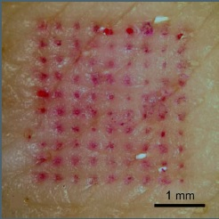
Microneedles Deliver Vaccine to the Skin
Using a Simple Patch
Microneedle Patch for MR Vaccination: No Sharps Hazard

Slide 8
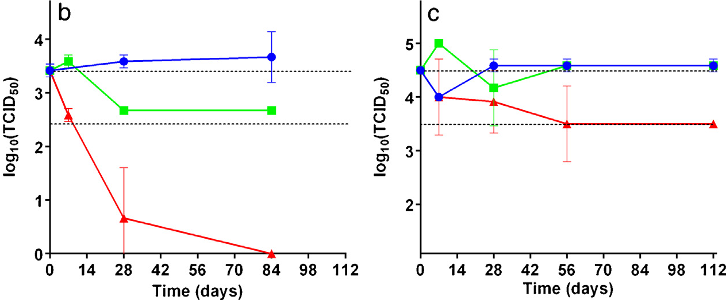
Thermostability Results
Microneedle Patch for MR Vaccination: Thermostability
No loss of potency after 6 months at 25°C
< 1 log loss of potency after 2 month at 45°C
Microneedle patch maintained full potency for almost 4 months at 25◦C, and < 10-fold decrease in potency after almost 4 months at 40◦C.
Reconstituted liquid vaccine
Microneedle
5 C
25 C
40 C
The dashed line represents the range between 100% titer retention and a 10-fold loss of titer
Reference: Chris Edens, Marcus L. Collins, James L. Goodson, Paul A. Rota, Mark R. Prausnitz. Measles vaccination of non-human primates using a microneedle patch. Vaccine. 2015; doi:10.1016/j.vaccine.2015.02.074.

Slide 9





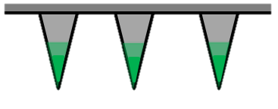
Microneedle Patch: Outline of Formulation
Vaccine + excipients solution
Fill molds with vaccine
Dry vaccine
Fill molds with bulking polymer
Molds are filled by pulling vacuum through the bottom of the PDMS mold
Dry bulking polymer
Remove patches and package

Slide 10
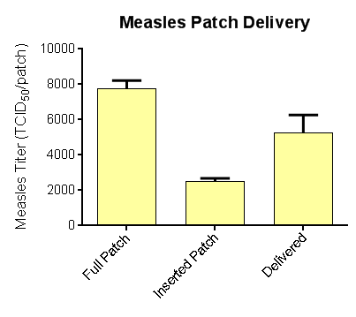
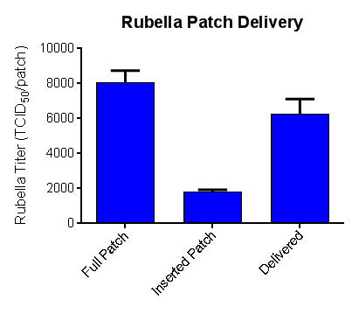
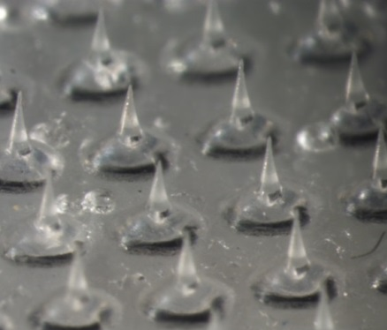
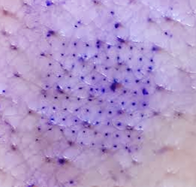
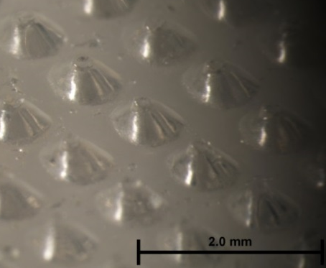
Delivery of a Standard Dose (10³ TCID₅₀/dose)
Patches were inserted into ex vivo pig skin
Vaccine titer was measured before and after patch insertion
70%
78%

Slide 11
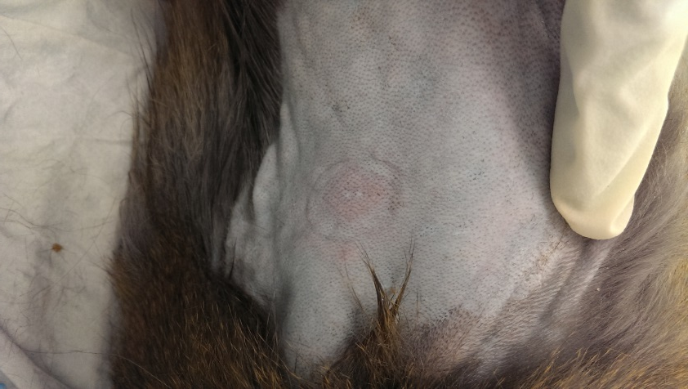
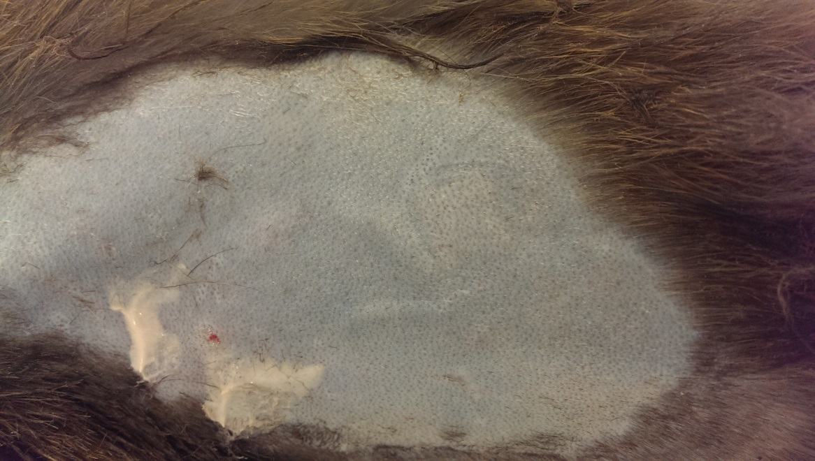
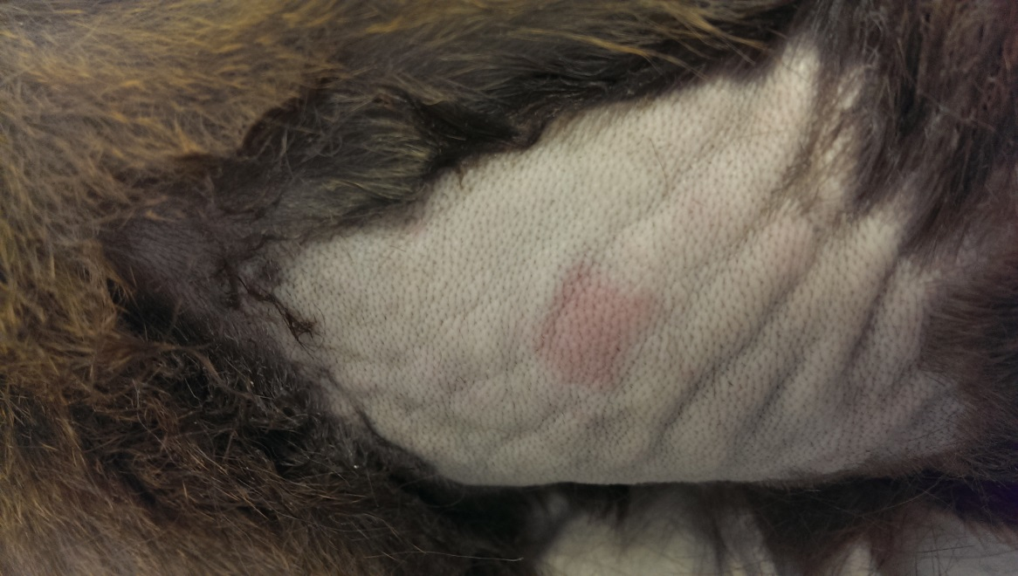
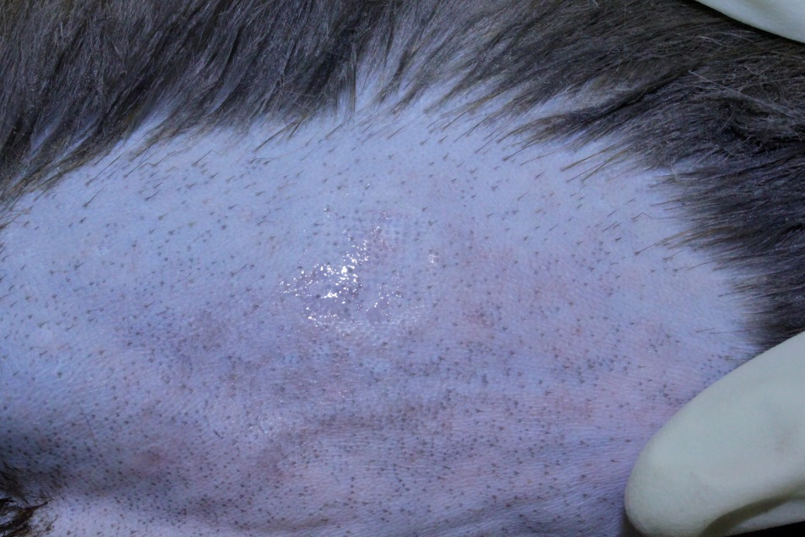
Vaccination of Rhesus Macaques
Patch
Nair
Notes:
Saw minimal redness immediately after patch was removed

Slide 12
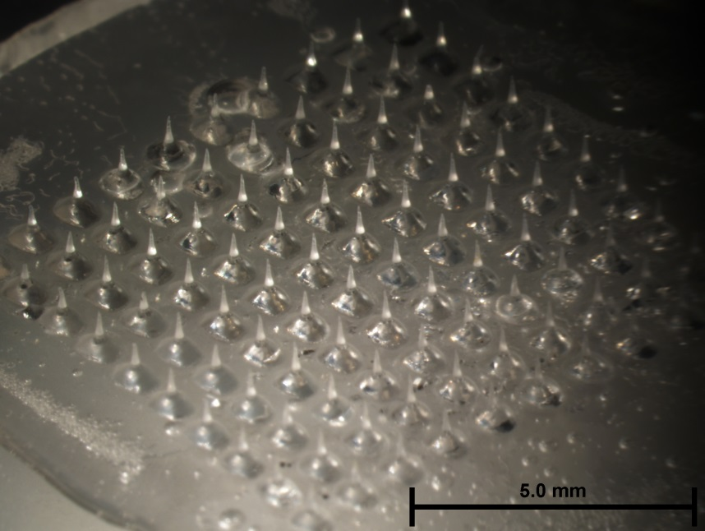
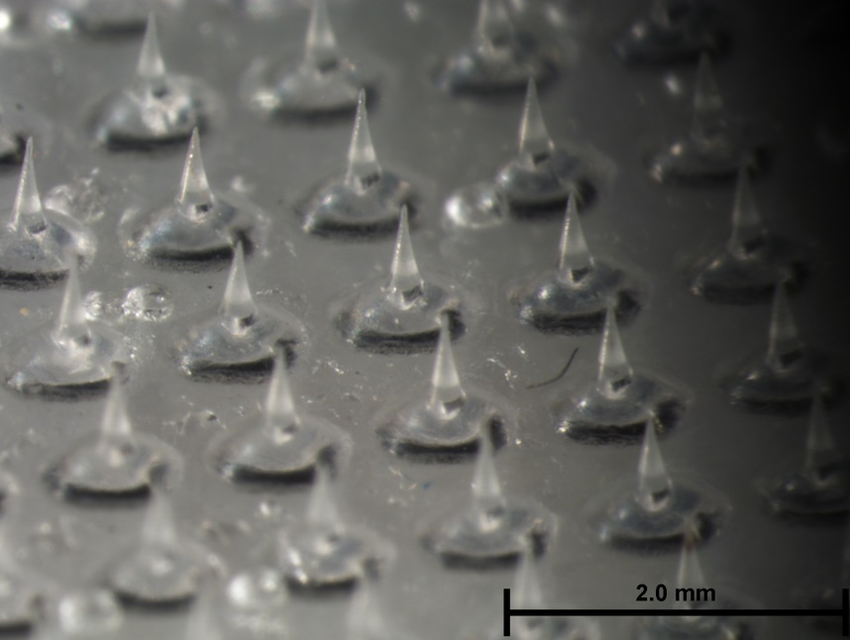
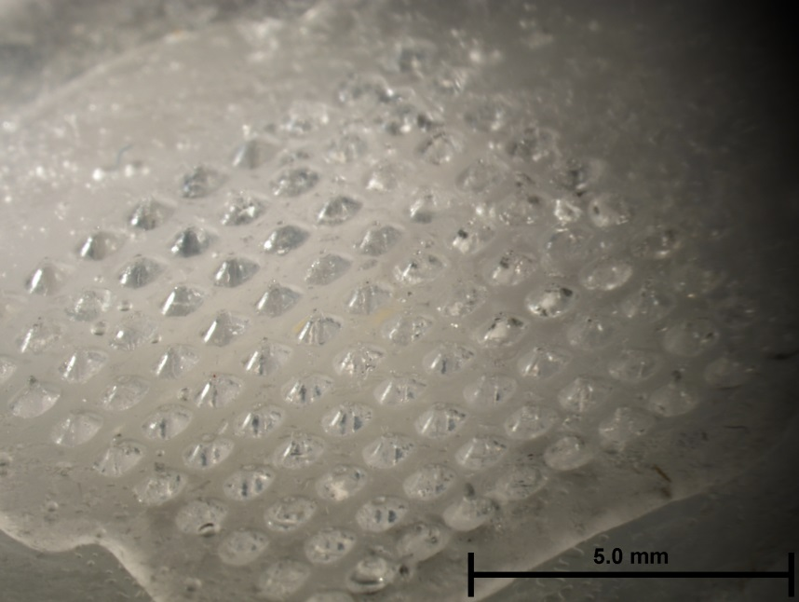
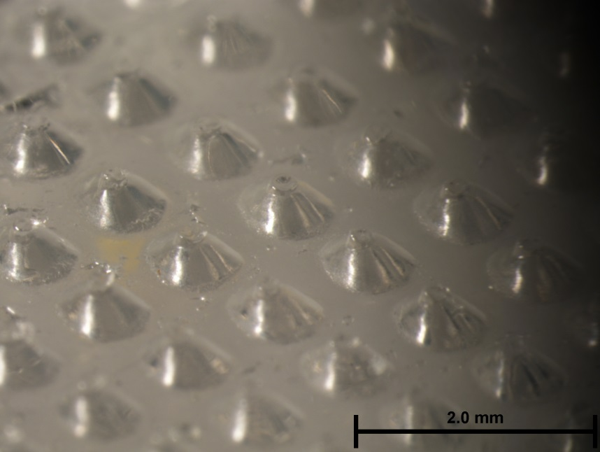
MR patches before (top) and after (bottom) insertion
Notes:
These patches were created and stored in desiccant at room temp for one week.
The patches shown here were taken to the CDC but not inserted into the monkey backs.

Slide 13
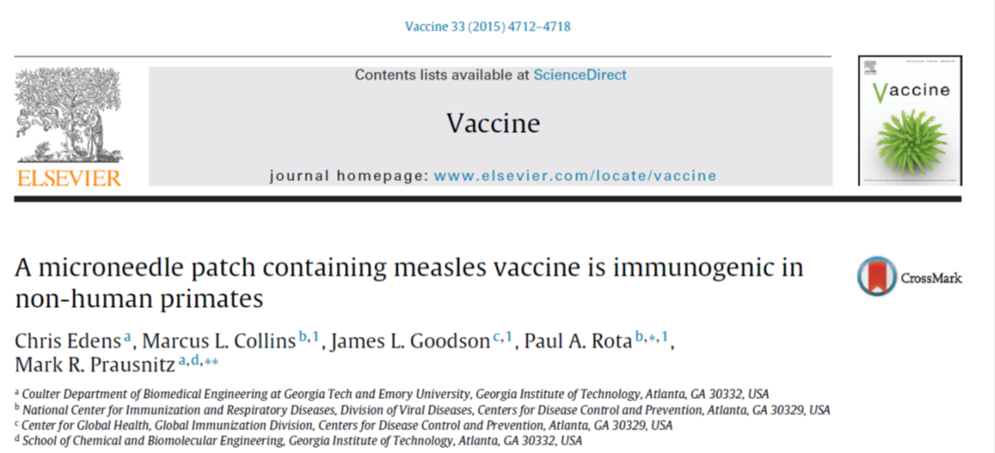
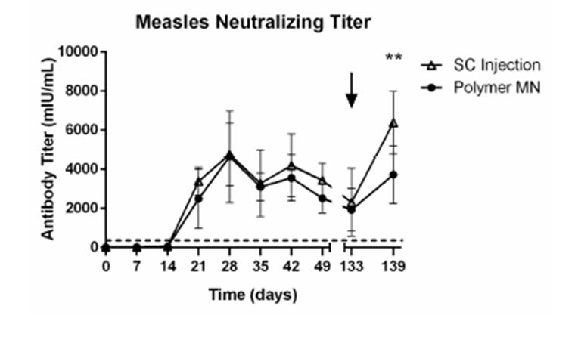

Slide 14
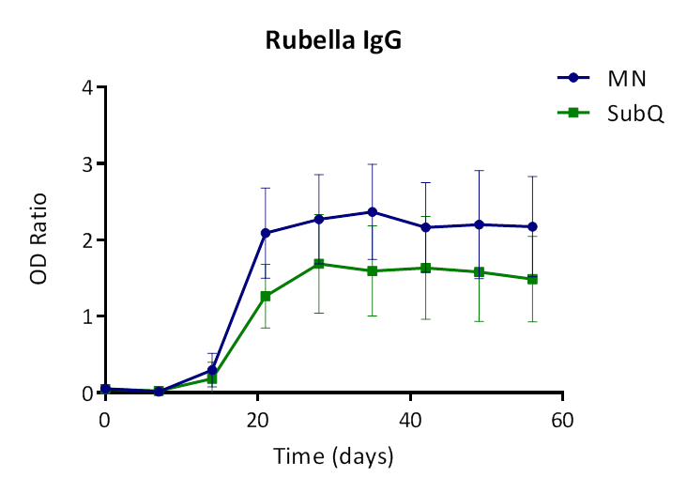
MR Microneedle Patch:
Antibody Response to Measles and Rubella is Comparable between MN and SQ

Slide 15
Evaluation of Cellular Immune Response:
Measles Microneedle Vaccination Study
CMI for measles is being measured using a monkey specific IFN-g ELISPOT assay
Comparable IFN-g response between MN and SQ groups at time points tested thus far
Normalized data suggest that MN may have higher sustained measles specific response at later time points
Currently CMI of MR microneedle immunized monkeys is being evaluated

Slide 16
Conclusions
MR microneedle patches are immunogenic in rhesus macaques (both humoral and cellular immunity detected)
  One experiment with M
  Two experiments with MR (including infant rhesus)
Antibody titers in response to MN vaccination are at least equivalent to those of SQ
MN patches are thermostable and may require less stringent cold chain requirements than current, injectable vaccine

Slide 17
Ongoing and Next Steps
Continue development of MN microneedle patch formulation with a bulk preparation of a licensed commercial vaccine
  Long term stability studies, potency retention
  Immunogenicity in rhesus macaques
Develop new assays to measure immunity in rhesus
  Cellular immunity
  Microbead assay for IgG (rhesus specific Luminex)
Infant vaccine study (in progress)
  PRN titers
  Challenge with wt MeV
Address regulatory issues
Develop plan for clinical trials in humans
Commercial partner; Micron Biomedical: http://micronbiomedical.com/

