Slide 1
Regional Progress Towards Measles and Rubella Elimination
WHO European Region
Tenth Annual Measles Initiative Meeting
September 13-14, 2011 Washington, DC
Sergei Deshevoi

Slide 2
Presentation outline
Regional goal and strategy
Progress towards goal
Challenges in reaching the goal in 2015
Accelerated actions required to reach the goal
Estimated costs 2011-2015 and needs at the WHO European Region

Slide 3
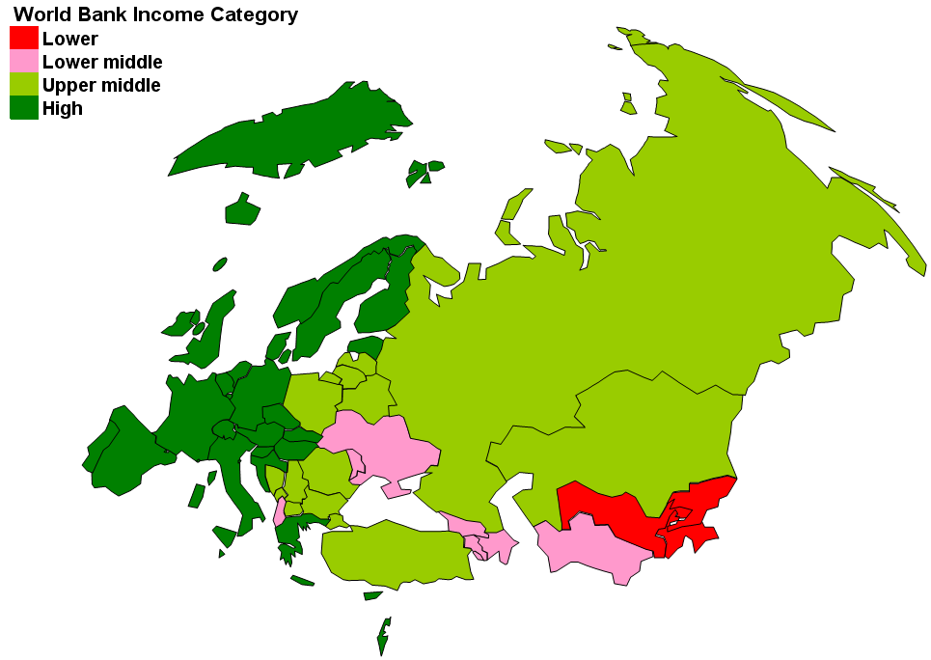
WHO European Region:
53 Member States (~890 million)
Primary partners:
  UNICEF
  US CDC
  ECDC
  GAVI
  USAID
  WHO Collaborating Centers

Slide 4
Regional Measles and Rubella
Elimination Goals
Resolution EUR/RC55/R7
    Original target: 2010
Resolution EUR/RC60/R12
European Region Strategic Plan
  New target: 2015

Slide 5
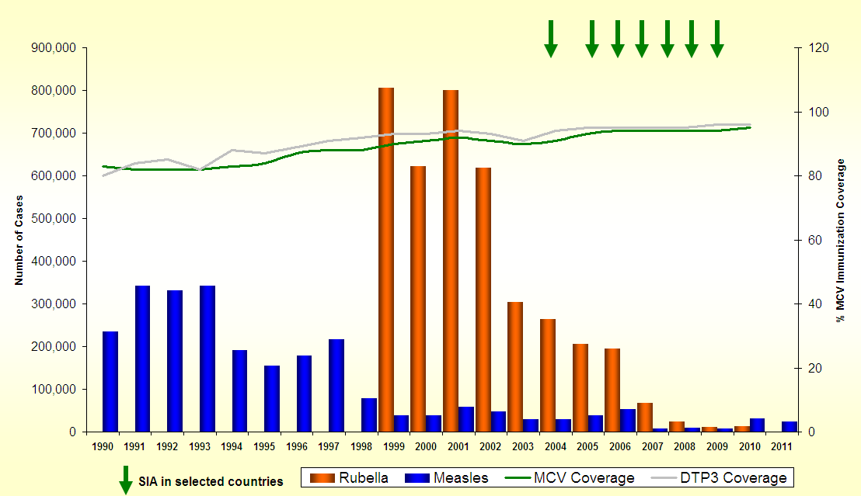
Progress in implementing Strategic Plan to eliminate measles and rubella in the
WHO European Region, 1990-2011*
96% reduction in measles
97% reduction in rubella
Catch-up SIAs
Measles elimination goal
Rubella elimination goal
Data Source: 1990-2010: WHO-UNICEF Joint reporting Form ; 2008-2011*: data from Monthly MR surveillance (data as of 1 Sep 2011)

Slide 6
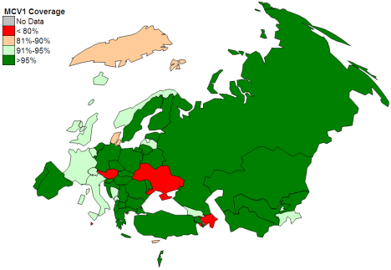
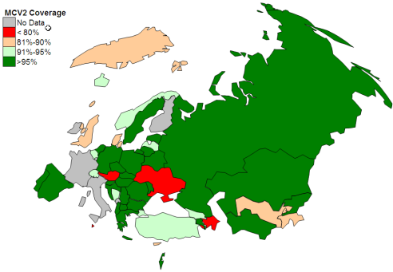
Strategy 1. Ensuring high coverage (>95%) with 2 doses of measles vaccine and 1 dose of rubella vaccine through high-quality services
Vaccine coverage (%) for measles
containing vaccine (MCV)1
and MCV2,
WHO European Region, 2010
MCV1
No data
<80%
80-89.99%
90-94.99%
>95%
MCV2
Source: MCV1 WHO/UNICEF Coverage Estimates (except Ukraine) ; MCV2: WHO/UNICEF JRF for year for 2010

Slide 7
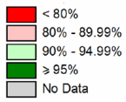
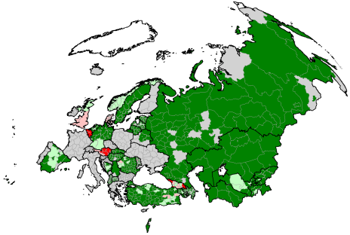
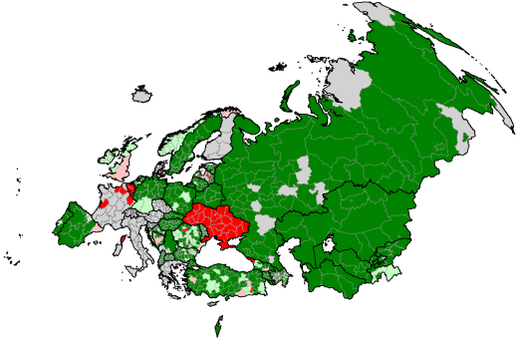
Pockets of low coverage and missing data
MCV1 coverage at sub-national level, WHO European Region,
2009 2010
Source: Sub national level admin MCV1 coverage reported in WHO UNICEF JRF for year 2009 and 2010
7

Slide 8
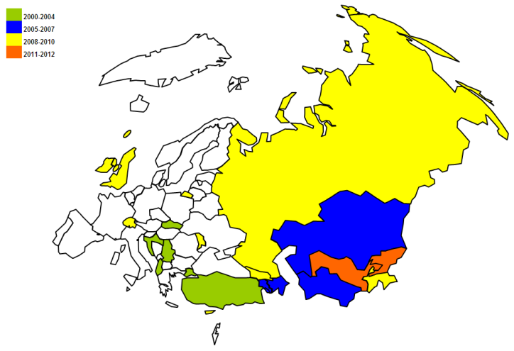
Strategy 2: Providing a second opportunity for measles and rubella immunization through supplemental immunization activities in susceptible populations
Country | Year(s) | Coverage (%)
Albania – c/u | 2000, 2002, 2003 | 98, 97, 74
Armenia – c/u | 2007, 2013 | 97
Azerbaijan – m/u, c/u | 2004, 2006 | 92, 94, 95
Georgia – c/u | 2004, 2005, 2008, 2013 | 92, 94, 50
Kazakhstan – c/u | 2005 | 99
Kyrgyzstan – c/u | 2001, 2002, 2012 | 99, 99
Republic of Moldova – c/u | 2002 | 93
Russian Federation – c/u | 2004, 2005, 2008 | 20, 51, 101
Serbia – c/u, m/u | 2003, 2005 | 99, 83
Tajikistan – c/u | 2004, 2009, 2015 | 98, 97
Turkey – c/u | 2003, 2004, 2005, 2007 | 97, 79, 96
Turkmenistan – c/u | 2007 | 97
Ukraine – c/u | 2008, ??? | 4
Uzebekistan – c/u | 2007, 2011 | 99
Period of MR SIA
Measles and rubella supplementary
immunization activities,
WHO European Region, 2000-2010
57 million vaccinated
coverage (50%-99%)

Slide 9
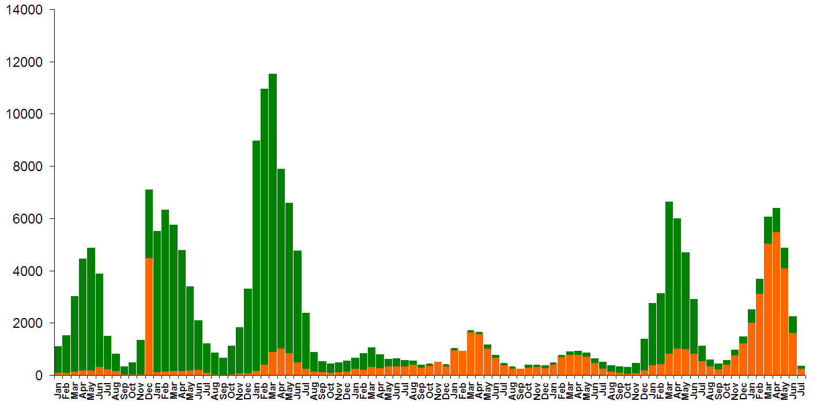
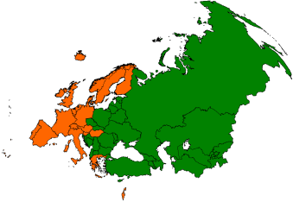
Strategy 3. Strengthening measles, rubella, and congenital rubella syndrome surveillance
Ukraine
Romania
Bulgaria
France
Measles cases
2004
2005
2006
2007
2008
2009
2010`
2011`
Month and year
Data Source: Monthly Measles Rubella Surveillance data, CDS/WHO/EURO
Data as of Sep 2011

Slide 10
Measles case-based surveillance reporting,
WHO European Region, 2010

Slide 11
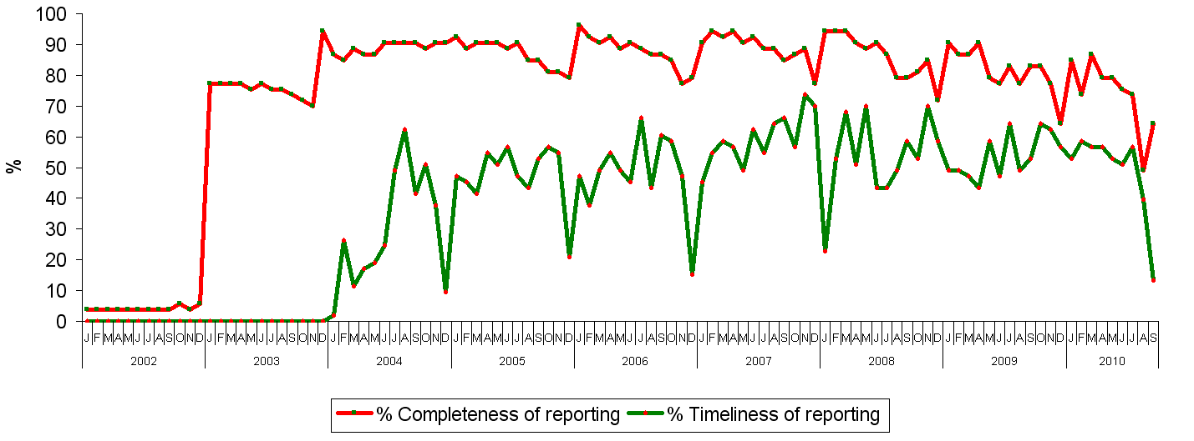
Timeliness and completeness of monthly measles reporting to WHO European Region, 2002-2010
target >80%
Source: WHO UNICEF JRF and WHO/UNICEF Official Coverage Estimates
Notes:
Communicable Diseases Unit, WHO Regional Office for Europe
13 September 2011
11
Report to WHO is due on every 25 of the next month, Timeliness of
reporting is important to plan rapid response

Slide 12
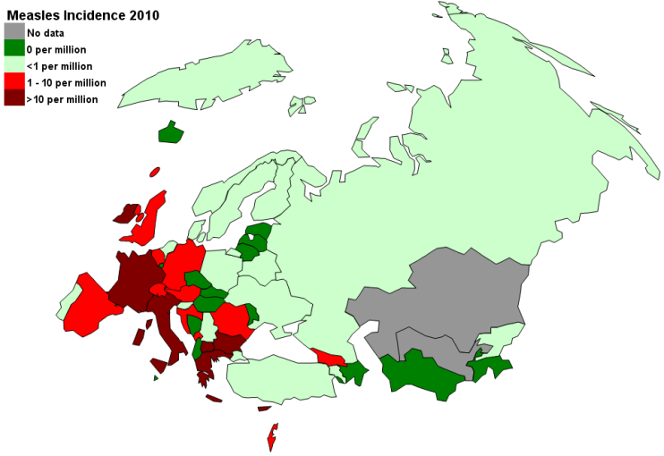
Measles outbreaks,
WHO European Region, 2010-2011*
Measles outbreaks in 2010
Measles outbreaks in 2011
?
*2011: as of 05 May 2011

Slide 13
Characteristics of measles outbreaks in 2010-2011
Outbreaks emerging all over the Region with circulation of endemic virus (over the border)
Few cases to ~24000
Different age groups and NOT IMMUNIZED
  Beginning in young adults and children in the age for routine immunization
  Spreading to children <1year of age
In some countries starting in specific subpopulation, but later spread into general population (nosocomial)
Exportation to other Regions (measles free PAHO)

Slide 14

Strategy 4. Improving information on benefits and
risks of immunization: European Immunization Week
Platform for:
  providing information on vaccine
  benefits and safety
  increasing demand for vaccines
  advocating for political support and
  financial commitment
2011: ”Shared solutions to common threats”
  WHO/Europe round table and press release on measles
  52 Member States participated (47 Member States participated in 2010)

Slide 15
WHO Vaccine Communications Activities
1. TIPPS (Tailoring Immunization Programmes to Profile Susceptibles)
(pilots in Armenia (Oct) & Bosnia & Herzegovina (Dec)
  a. Formative Research Tool (under development)
  b. Behavioural and Communications Profiling Framework (model developed, testing underway)
  c. Compendium of global best practices (Jan 2012)
3. Outbreak and crisis communications response support to Member States
5. Publications and PR materials (Monthly Epi Brief, Immunization Highlights (anual), Euro Immunization Monitor (quarterly))
6. EURO Vaccine Communications Working Group (October, Istanbul)
7. Vaccine Safety Communications Manual
8. Social media platform development, blogger mapping and outreach strategy

Slide 16
Vaccine Related Events
– Managing the Communications Response
Manual for MS – testing in BiH today
To avoid erosion of trust in immunization programmes
Anticipating safety ‘event’ impact on public confidence in immunization programme
Determining appropriate responses – active versus passive, precautionary versus comprehensive
Templates and tools to enable vaccine safety event communication strategy development by MS
Scenarios and case studies on different communication responses
Manual is applicable to other Regions

Slide 17
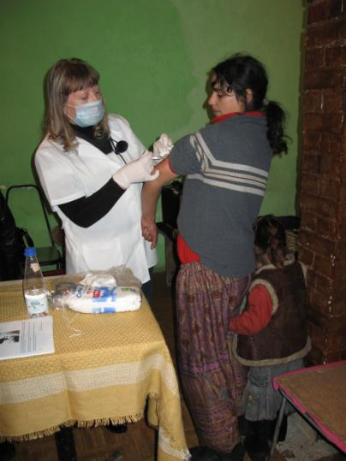
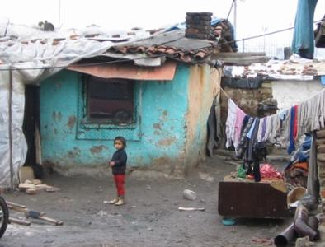
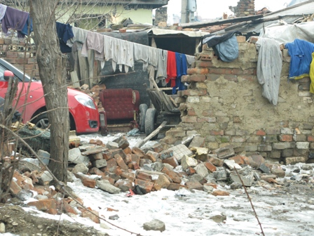
Outbreaks in vulnerable populations: pockets of unimmunized/under immunized

Slide 18
Measles and rubella elimination verification planned activities, WHO European Region
Jan-Dec ‘10 | Dec’ 10 | Jan-Oct ‘11 | Nov‘11 | Dec‘11
Meeting on feasibility and feed back from internal consult Analysis of funding requirements and advocacy | Consultation with country technical experts to finalize framework and address gaps Work on guidelines and reporting forms | Guidelines finalized Form regional verification commission Finalize 2011-2015 Strategic Plan for the Region | First meeting of MRRVC Meeting with European inter-governmental council | Preliminary feedback to countries Form national verification committees

Slide 19
Estimated Costs (US$) 2012
European Region
 | SIA vaccine + ops | Surveillance | Technical support | Total
Kyrgyzstan | 1,457,150 | 90,000 | 25,000 | 1,572,150
Tajikistan |  | 40,000 | 33,000 | 73,000
Ukraine |  | 60,000 | 80,000 | 140,000
EURO |  | 100,000 | 50,000 | 150,000
Total needs (GAP) | 1,457,150 | 290,000 | 188,000 | 1,935,150

Slide 20
Estimated SIA Costs (US$) 2013-2015
WHO European Region
 | Country | Activity | MR SIA Costs (Vaccine and Ops)
2013 | Georgia | MR Catch-up < 20 years | $ 527,000
2013 | Armenia | MR Follow-up < 5 years | $ 300,000
2015 | Tajikistan | MR Follow-up < 5 years | $ 1,600,000
Total SIA Support 2013-2015 (GAP) |  |  | $ 2,424,000

Slide 21
Estimated costs for surveillance and laboratory support (US $) by type of country:
2012-2015, European Region
 | Lab | Surveillance
High income (N=26) | 29,127,000 | 3,693,035
Upper middle income (N=14) | 449,000 | 2,513,244
Low-middle income/low income (N=13) Potential GAP | 668,000 | 844,000

Slide 22
Operational research needs
Demand creation for immunization
  Use of social marketing and mobilization
Advocacy mechanisms with civil society organizations and sub-national levels
Knowledge, attitudes, practices and behaviour
  mothers, health care professionals
Spectrum of anti-vaccine movement
Innovations to follow children (e.g., UK)
How to reach and estimate size of vulnerable populations
Economic analyses (outbreaks, CRS cases, equity)

Slide 23
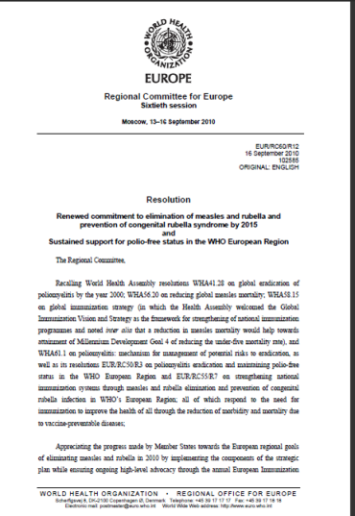
Renewed commitment to MR elimination by 2015 and sustained support for polio-free status
Member States:
Commit and give goals high priority
Ensure required resources
Strengthen routine immunization
  Focus on pockets with low coverage and mobilize
  European Immunization Week
Strengthen health system components
Strengthen surveillance systems in line with IHR
  polio, measles and rubella

Slide 24
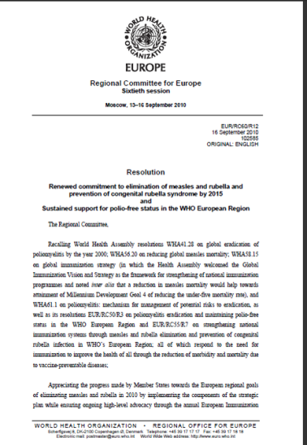
Renewed commitment to MR elimination by 2015 and sustained support for polio-free status
WHO European Regional Office:
  Provide leadership and strategic direction-Strategic Plan 2011-2015
  Provide technical guidance to Member States
  Work with Member States on addressing :
    vulnerable groups
    increasing demand for immunization

Slide 25
Acknowledgements
Member States of the WHO European Region
All partners
European Technical Advisory Group of Experts on Immunization (ETAGE)
ECDC/EUVAC.NET

Slide 26
Thank you

