Slide 1
Measles 2nd Dose (MCV2) Introduction
10th Annual Measles Initiative Meeting
September 13-14, 2011
Washington
Tracey Goodman, WHO (EPI+/IVB)

Slide 2
WHO Recommendation* - Recap
All children should receive two doses of measles vaccine
Minimum interval of one month between doses
MCV1 at 9 or 12 months
When MCV1 > 80% for 3 years then add MCV2 at:
  15-18 months (if country has ongoing measles transmission)
  school entry (option if near elimination)
Very high coverage (>90%) is needed with both doses
  Mortality reduction: >90% national, >80% in every district
  Elimination: >95% in every district
School entry screening for vaccination status
*WHO Measles Vaccine Position Paper, WER Aug 2009 (http://www.who.int/wer/2009/wer8435.pdf)

Slide 3
139 Countries with 2 Doses of Measles Vaccine in National Immunization Schedule (2010)
No (54 countries or 28%)
Yes (139 countries or 72%)
Source: WHO/IVB database, 193 WHO Member States. Data as of July 2011
Date of slide: 30 August 2011

Slide 4
Percentage of countries in each region with MCV2 dose in schedule (2010)
Total | EMRO | WPRO | SEARO | EURO | AMRO | AFRO | Region
73 % (139/193) | 86% (18/21) | 85 % (23/27) | 64 % (7*/11) | 100% (53/53) | 86 % (30/35) | 15 % (7/46) | Percent (number of countries)
* Plus India partially

Slide 5
Age of Administration MCV2, 2010
139/193 WHO Member States have 2 doses of measles in their routine immunization schedule
1-2 Years ( 38 countries or 20%)
1-2 Years part of the country ( 1 countries or 1%)
3-7 Years (88 countries or 46%)
The boundaries and names shown and the designations used on this map do not imply the expression of any opinion whatsoever on the part of the World Health Organization concerning the legal status of any country, territory, city or area or of its authorities, or concerning the delimitation of its frontiers or boundaries. Dotted lines on maps represent approximate border lines for which there may not yet be full agreement.
© WHO 2010. All rights reserved
Source: WHO/IVB Database as of August 2011
193 WHO Member States. Date of slide:9 September 2011
> 7 Years (12 countries or 6%)
No Applicable (54 countries or 28%)

Slide 6
Reported Coverage MCV2, 2010
<50% (6 countries or 3%)
139/193 WHO Member States have 2 doses of measles in their routine immunization schedule
50-79% (12 countries or 6%)
80-89% (17 countries or 9%)
>=90% (67 countries or 35%)
The boundaries and names shown and the designations used on this map do not imply the expression of any opinion whatsoever on the part of the World Health Organization concerning the legal status of any country, territory, city or area or of its authorities, or concerning the delimitation of its frontiers or boundaries. Dotted lines on maps represent approximate border lines for which there may not yet be full agreement.
© WHO 2010. All rights reserved
Source: WHO/IVB Database as of August 2011
193 WHO Member States. Date of slide:9 September 2011
No Coverage data available (37 countries or 19%)
No Applicable (54 countries or 28%)

Slide 7
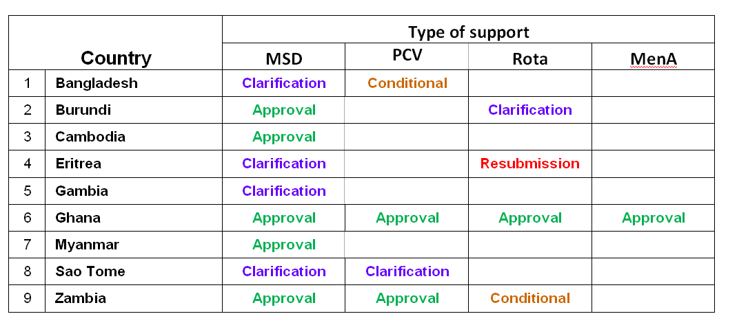
GAVI IRC recommendations – July 2011
(Total MSD ~ $20 million)
* Plus DPRK and Vietnam approved in 2008

Slide 8
GAVI MSD Support
Up to 5 years vaccine and injection safety materials cash "in kind"
Freight and insurance charges covered
No co-payment required
Min $100,000 for start-up costs ($0.30/infant birth cohort in the year of introduction)
Burkina Faso, Kenya, Malawi, Nicaragua, Nepal, Rwanda, and Tanzania* should think about applying soon. (Botswana, Guatamala, Honduras not GAVI eligible)
Other 35 countries to focus on getting MCV1 coverage UP!
* If additional AFRO surveillance criteria met

Slide 9
Pre-Review of GAVI Applications
REMEMBER TO INCLUDE:
  Proof of WHO endorsement and MCV1 coverage x 3yrs
  National decision-making process (NITAG)
  Schedule for MSD (age of contact); any integration & boosters
  Multiple (individual) introduction plans vs one for all new vaccines
  Revision of materials/cards/recording systems
  Post-introduction evaluation (PIE) (6-12 months after)
  School entry screening of measles vaccination status
  Communication strategy for immunization beyond 12 months

Slide 10
Vaccine Presentation & Cold Chain
Evaluate choice between 5 and 10-dose vial
5-dose vial up to 40% reduction in wastage expected
Because less wastage – the overall burden on the cold chain is reduced (25% space savings)

Slide 11
Planning
Measles Strategic Planning (MSP) Tool to do analysis of different strategies (http://www.technet21.org/index.php/tools/view-document-details/1131-measles-strategic-planning-tool-v.2.0.html)
If possible, synchronize MSD introduction immediately after SIA
If other new vaccines being introduced combine policy change of EPI schedule, advocacy, training, revision of cards
Plan a PIE! 6-12 months later to "trouble shoot problems"
Assess costs

Slide 12
Reaching an Older Age Group
15-18 months/school age > usual EPI target group
  Communication with parents/caregivers (willing to bring?)
  Adapt strategies/approaches
  Human resource/logistics implications (more work)
Opportunity to link interventions or add boosters (VitA, DTP, etc)
Not enough to get the same children – bigger impact when MCV2 actually reaches zero dose kids
Chance to catch up missed/delayed doses of primary series (typically lost to EPI system when unvaccinated child is >12 months – policy implications)

Slide 13
Recording/M&E
Requires revision of cards, forms, wall monitoring charts, database systems
Calculating target population
Definition of fully vaccinated child (FIC) shifting
Recording MCV1 & 2 in campaigns (not "SIAs" then!)
Include MCV2 in EPI coverage survey, MICS, and DHS
Challenges of producing a Global WHO/UNICEF Estimate of MCV2 coverage (when many different ages)

Slide 14
Looking Forward….1+1 >2
MCV2 introduction is critical for control/elimination of measles
Many with 2-dose schedule need to raise MCV2 coverage – requires commitment, resources, and innovation
Directly related to immunization systems strengthening
Success through "learning by doing", evaluation, and sharing experiences – EPI Managers Meeting, etc.
Short-term opportunity with GAVI window – encourage eligible countries to apply sooner rather than later! (But must not forget the non-GAVI countries either)

