Slide 1
Monitoring the impact of vaccination on rubella and CRS
Susan E. Reef, MD
11th Annual Meeting
The Measles and Rubella Initiative
Sept. 19, 2012

Slide 2
Goal of rubella vaccination program
Prevention of congenital rubella infection
  Miscarriages
  Stillbirths/Fetal deaths
  Congenital Rubella Infection Only
  Congenital Rubella Syndrome (CRS)

Slide 3
Rationale
  To document the impact of the vaccination program
  If needed to make modifications to the vaccination strategy
  Needed to document elimination of rubella and CRS

Slide 4
Field and laboratory surveillance*
Should be fully integrated with measles in a single surveillance system
Need to document the impact of rubella vaccination:
  laboratory-supported surveillance for rubella and CRS surveillance
  molecular epidemiology
  monitoring of vaccine coverage
  monitoring population immunity using seroprevalence surveys where appropriate.
*2011 WHO rubella vaccine position paper

Slide 5
Rationale for CRS Surveillance
Need to measure the impact of the vaccination program on the program’s goal
Up to 50% of mothers who give birth to infants with CRS present without rash illness, or asymptomatic/subclinical and would not be identified as rubella cases

Slide 6
CRS surveillance
Two entry points
  Integrated measles-rubella surveillance
    Pregnancy registry – following the outcomes of pregnant women who are infected or suspected of rubella infection
  Infants with congenital defects

Slide 7
Impact of Rubella Vaccination Strategies: England and Wales 1970-2001
Selective strategy 1970-1988
  1970 Monovalent rubella vaccine
  School girls 11-13y 78-86%
  Non-immune WCBA (postpartum 5-80%)
Universal strategy
  1988 - 1 dose MMR
    1993 outbreak among young adult males
  1994 MR campaign, 5-16 year olds
    1996 outbreak males in military and universities
  1996 2nd dose MMR at school-entry
    School girls program discontinued
  Coverage
    1992-1997 ->90%
    1998-<90% (2003-2005 – 80-82%)
    2007- ~86%
Selective
Universal
1d MMR
MR campaign
2nd MMR
Source: Epidemiol Rev 2002, Vyse et al.
* Annual average number

Slide 8

Reported Rubella and CRS—United States, 1966-2009
1969 - > 12 months to puberty
1977 – adolescent and adults females,
high risk groups (Health care
workers, college, teachers,
military)
2004 – Expert panel concludes that
rubella virus is no longer
endemic
Notes:
This curve shows the decline in rubella and CRS from 1966 when rubella became reportable. On the X axis is the years and the left Y axis shows the number of rubella cases and the 2nd Y shows the number of CRS cases. Because of the signficiant decline in cases, te graph on the upper Left hand corner… shows the number of cases since 1985.

Slide 9
Molecular Epidemiology
To determine the endemic strain in each country
To determine the origin of virus in rubella and CRS cases (e.g., imported cases)
To document the interruption of endemic rubella virus

Slide 10
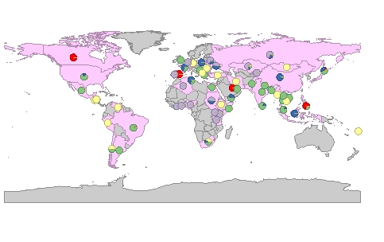
Global Distribution of rubella genotypes, 2000-2012
< 700 virus entries in the WHO rubella virus
genotype database for viruses found from 1966 through June
2010
2B
1E
1j
1G/h
Others

Slide 11
Summary
Establishing or enhancing surveillance systems to monitor the impact of the vaccination program
  Including the documentation of elimination
Some components will be integrated/part of the measles surveillance system
CRS surveillance is an integral component to monitoring the success of the rubella program
Emphasis should be placed on collection of specimens for genotyping

Slide 12
Epidemiological Surveillance to Monitor Impact of Rubella Control Program, 1991-2007, Singapore*
Community-wide rubella outbreak in 1969
  8.5 CRS cases/100,000 deliveries
  Post-outbreak susceptibility in WCBA – 40-50%
Rubella Vaccination
  Goal – prevent congenital rubella infection (CRS)
  1976 – 11-12 yo females
  1982 – 1998 11-12 yo males/females and military recruits; replaced by 2nd dose of MMR – primary 6 children
  1990 – routine vaccination – 1 yo
  1998 – mass campaign (MMR) 12-18 yo
Mathematical modeling
  Eliminated rubella/CRS with vaccine coverage 90%
*Ann Acad Med Singapore. 2010 Feb;39(2):95-101.

Slide 13
Rubella Incidence and RCV Coverage, by Year, Singapore 1991-2007

