Slide 1



Moving the Needle on Capitol Hill: Grassroots Advocacy

Slide 2
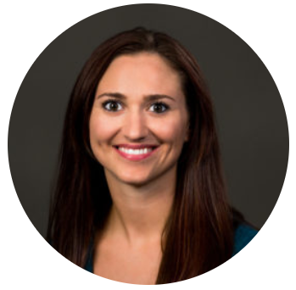
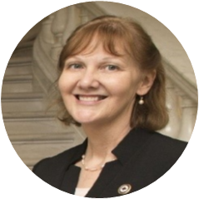
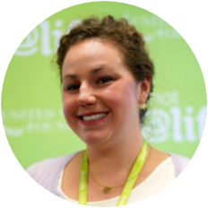
Rebecca Maxie
Grassroots Strategist,
United Nations Foundation
Linda MacIntyre
Chief Nurse,
American Red Cross
Ashley Daigle
Champion Leader,
Shot@Life Campaign

Slide 3
Introducing
Linda MacIntyre
Chief Nurse, American Red Cross

Slide 4
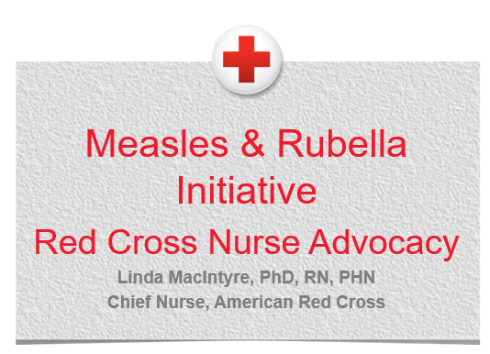

Slide 5
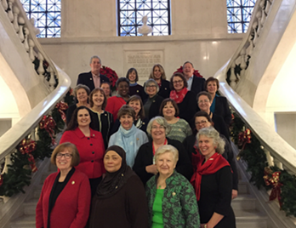
Background
Notes:
Quick Facts:
§Volunteers comprise 90% of the American Red Cross Workforce
§There are about 20,000 Red Cross Health Professional Volunteers
§Most Red Cross nurses are volunteers
§About 60 volunteer nurse leaders support the Chief Nurse in Volunteer Services in delivering the Red Cross mission
Additionally:
•Senior Nurse Consultants and the National Nursing Committee support the Chief Nurse and provide guidance and input.
•They work to integrate health professionals throughout the organization and in the community to further the Red Cross mission.
•
•All Red Cross nurses, employees and volunteers, are part of the Nursing Network
•Nursing Pins: RNs, LVNs and LPNs earn pins after 20 hours; nursing students after 10 hours
•Filling Regional Nurse Leader positions is critical to health professional recruitment & engagement. These positions will be required at the end of FY19.
•Nursing Network Division Nurse Leaders partner with Division Volunteer Services Executives
•Nursing Network Regional Nurse Leaders partner with RVSOs
•Associate Division Nurse Leaders work on Division Nurse Leader teams & support Regional Nurse Leaders
•They can fill open RNL positions on an interim basis and lead Academic Service Learning

Slide 6


M&RI Nurse Advocacy Program
Notes:
Who/Where?
Red Cross Nurse Leaders received virtual training to visit U.S. Senators in their home towns
Why?
To educate members of the Senate HELP Committee about M&RI and promote CDC partner funding
When?
During World Immunization Week (April 24-30)

Slide 7
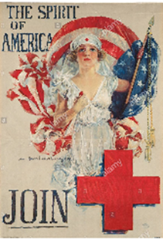
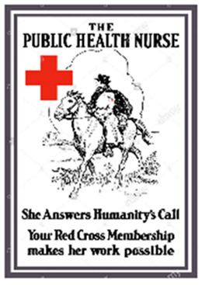

Why nurses?
Notes:
For the 17th year in a row, nurses top Gallup’s poll of most trusted profession: https://www.aha.org/news/insights-and-analysis/2019-01-09-17th-year-row-nurses-top-gallups-poll-most-trusted-profession
Nurses are advocates
Many associate the American Red Cross with nurses and iconic nurse images.

Slide 8
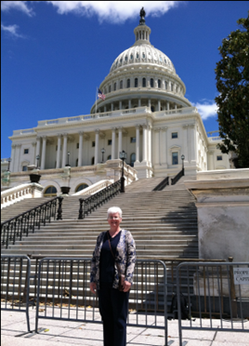
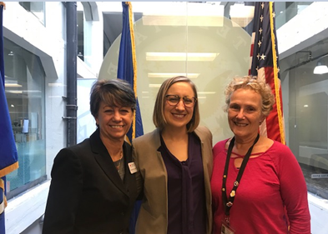
A Typical Congressional Meeting
Notes:
Questions Addressed by Nurse Advocates During Senate Office Visits
What is the Measles & Rubella Initiative (M&RI)?
What is the impact of measles and rubella?
Who are the M&RI partners and what is the American Red Cross role?
What is the CDC’s Role in the M&RI?
Why should we focus on eliminating diseases abroad when we have issues here at home?
What does it cost?
Does the American Red Cross have a stance on vaccination hesitancy and/or the anti-vaccination movement?
What can Congress do to help?

Slide 9
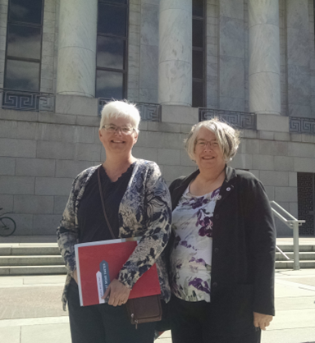
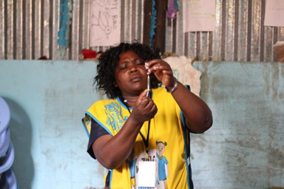
Additional Initiatives & Activities
Notes:
Red Cross Chief Nurse Initiatives:
Support the Measles & Rubella Initiative (MR&I) community education program
Promote volunteer engagement and support Congressional awareness of the MR&I
Other Red Cross Nurse M&RI Activities:
Annual M&RI presentations at the National Black Nurses Association
M&RI presentations for the National Student Nurse Association
Community presentations
American Red Cross nurse leaders educated their legislators and advocated for CDC funding for the Measles and Rubella Initiative this year.

Slide 10
Nurse Advocacy Impact
[Senator’s legislative aide] “was very surprised to learn about the virulence of measles, as well as the effects of rubella…”
[Senator’s legislative aide] “called me after the meeting to inform me that he reviewed the information with the Senator, who fully supports the funding request.”

Slide 11
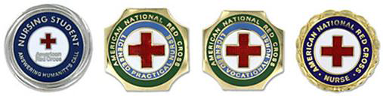

Thank You for Our Partnership
Notes:
ARC nurses make a difference for the M&RI. We want to take this time to publicly thank them.

Slide 12
Introducing
Ashley Daigle
Champion Leader,
Shot@Life Campaign

Slide 13
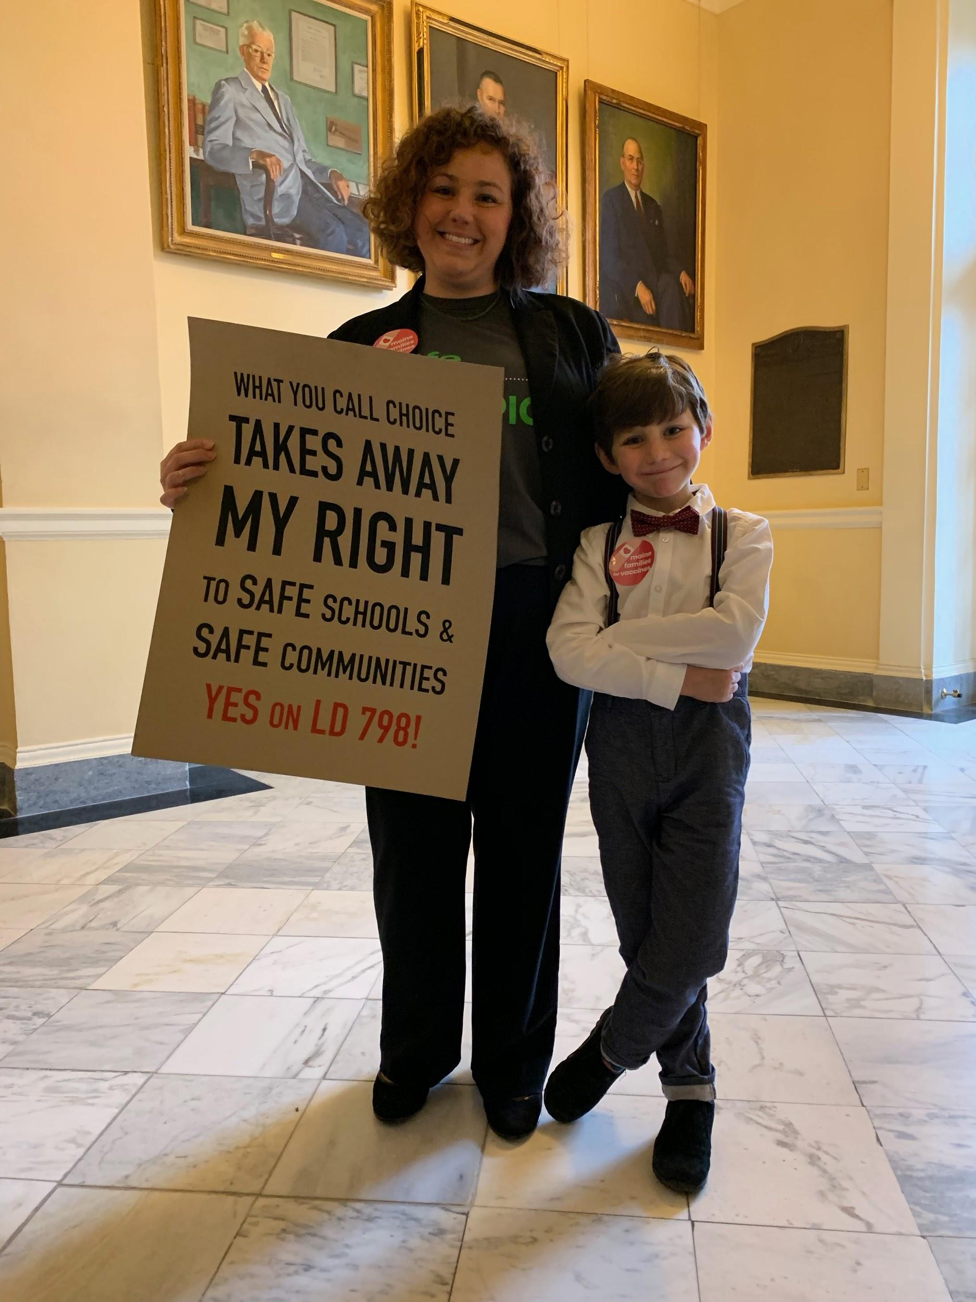
Why are we here?

Slide 14
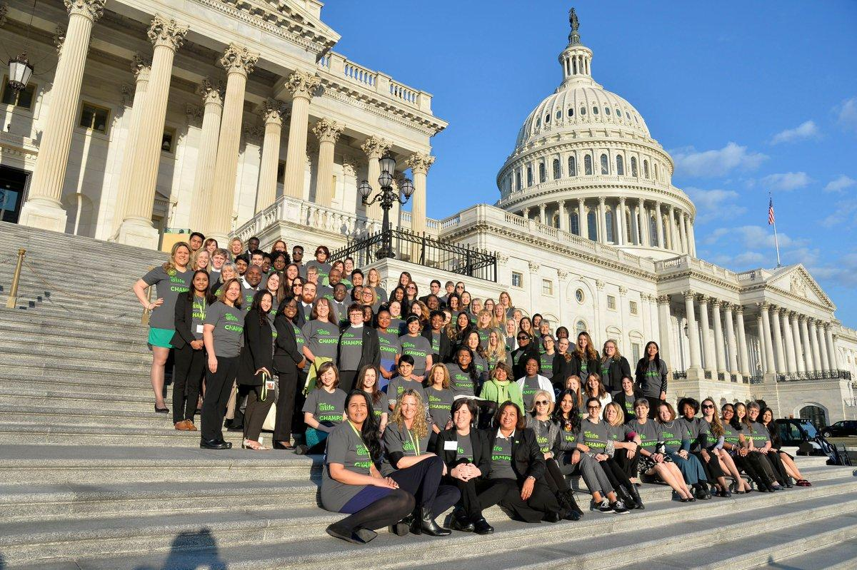
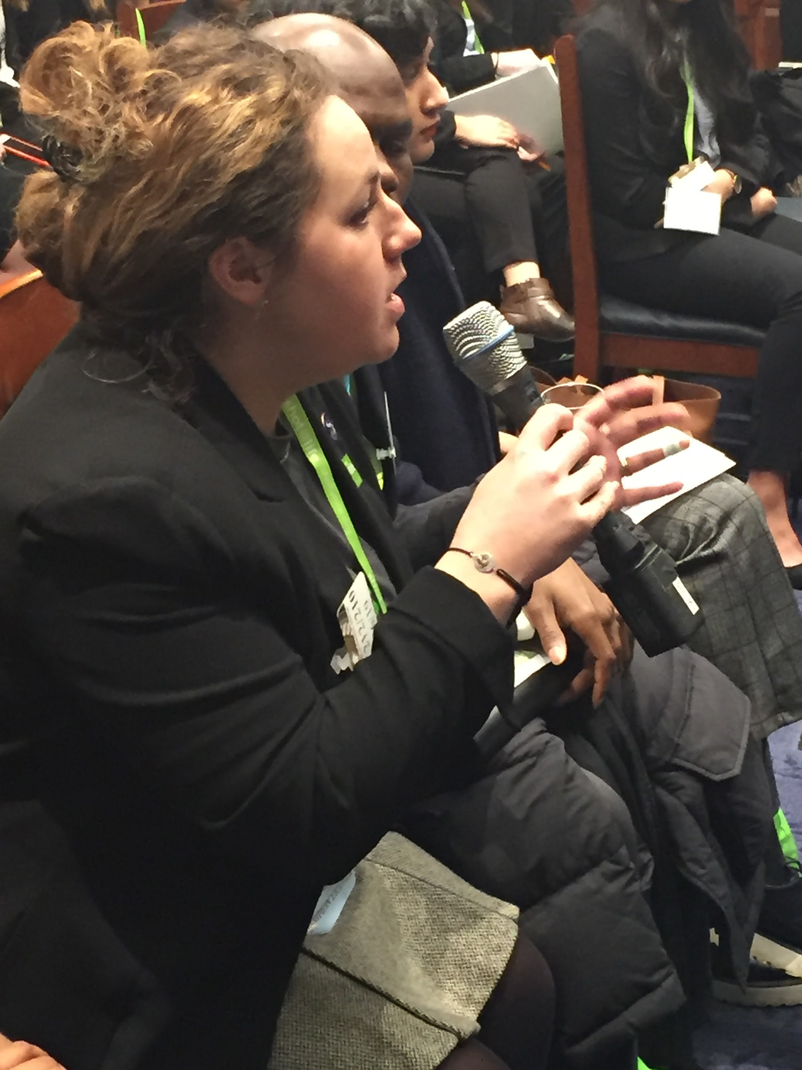
What do I do?

Slide 15
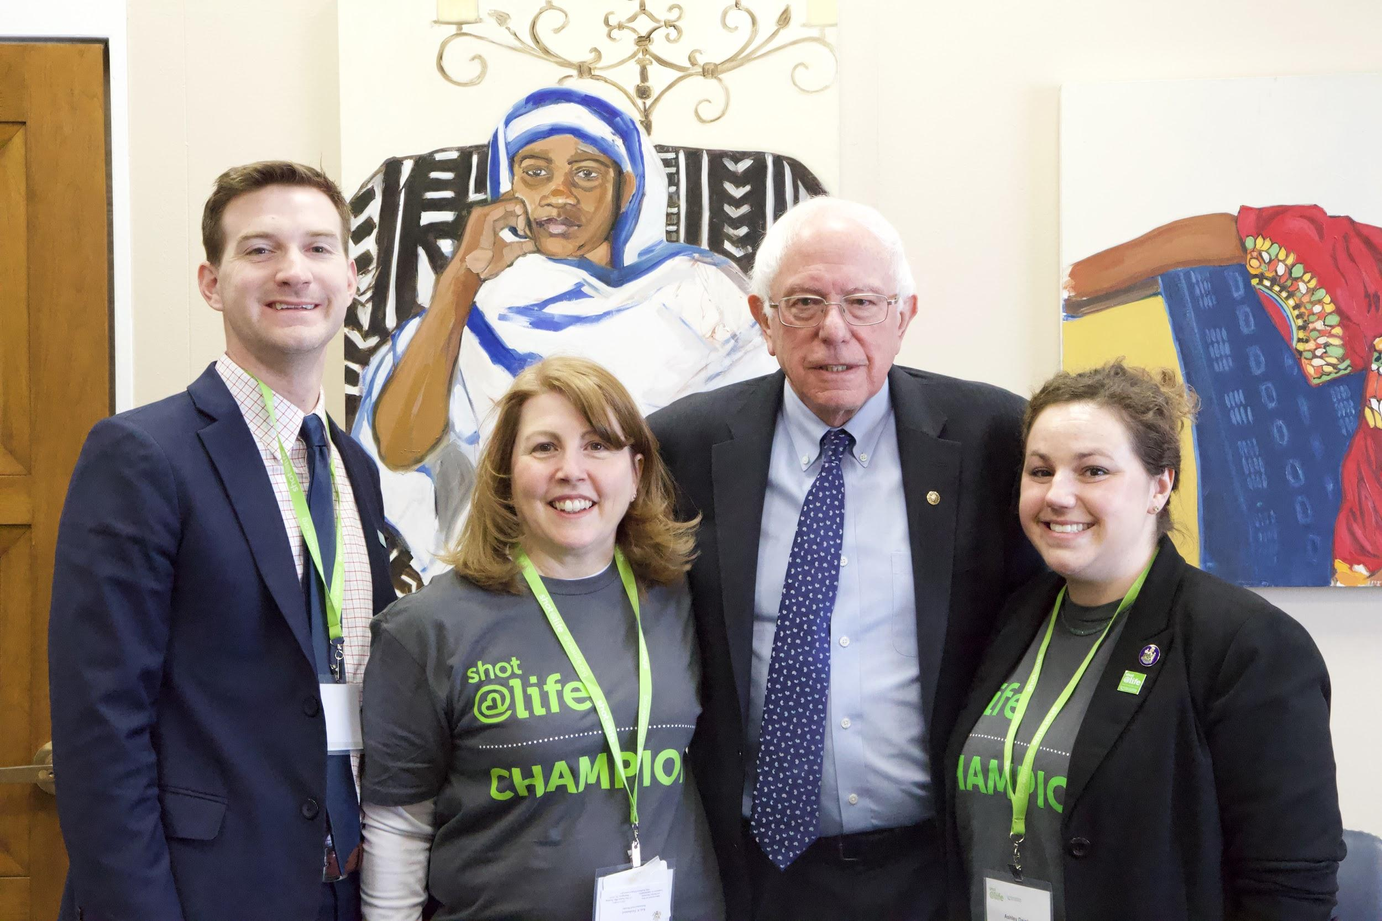
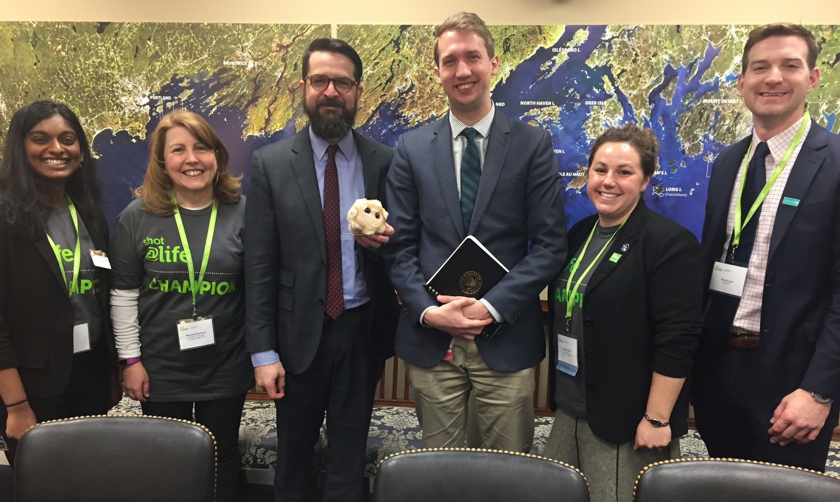
Congressional Meetings

Slide 16

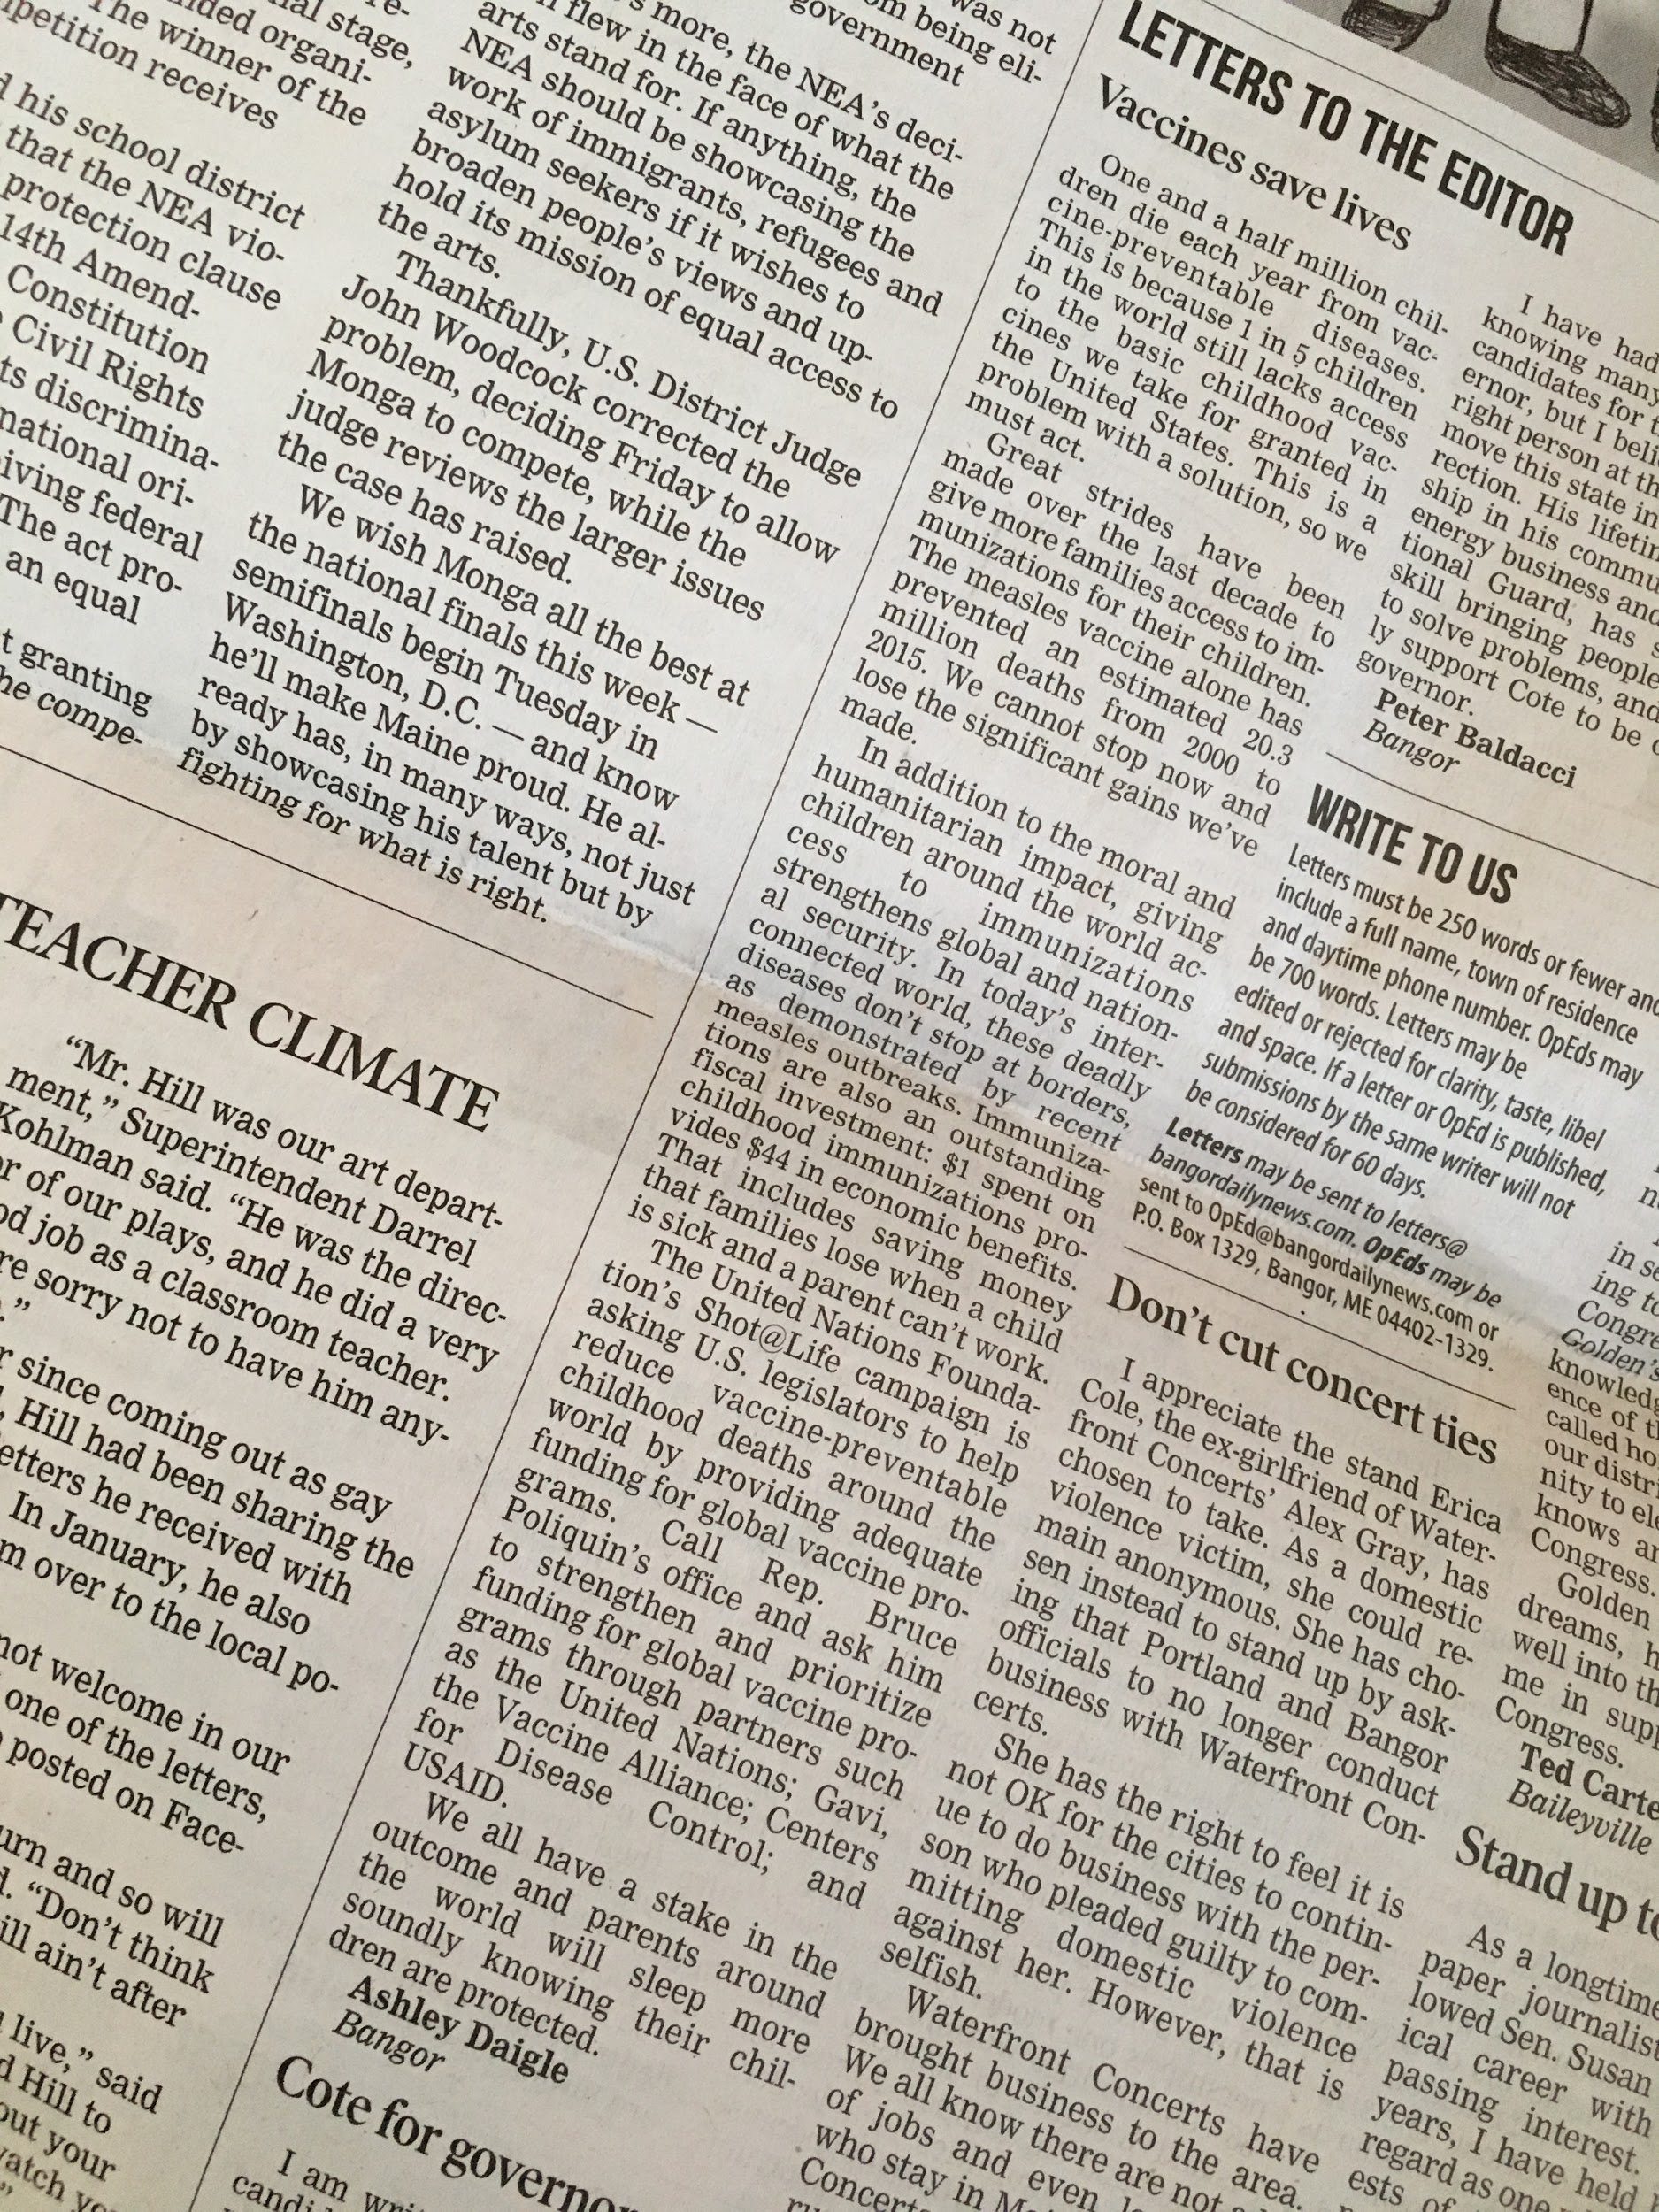
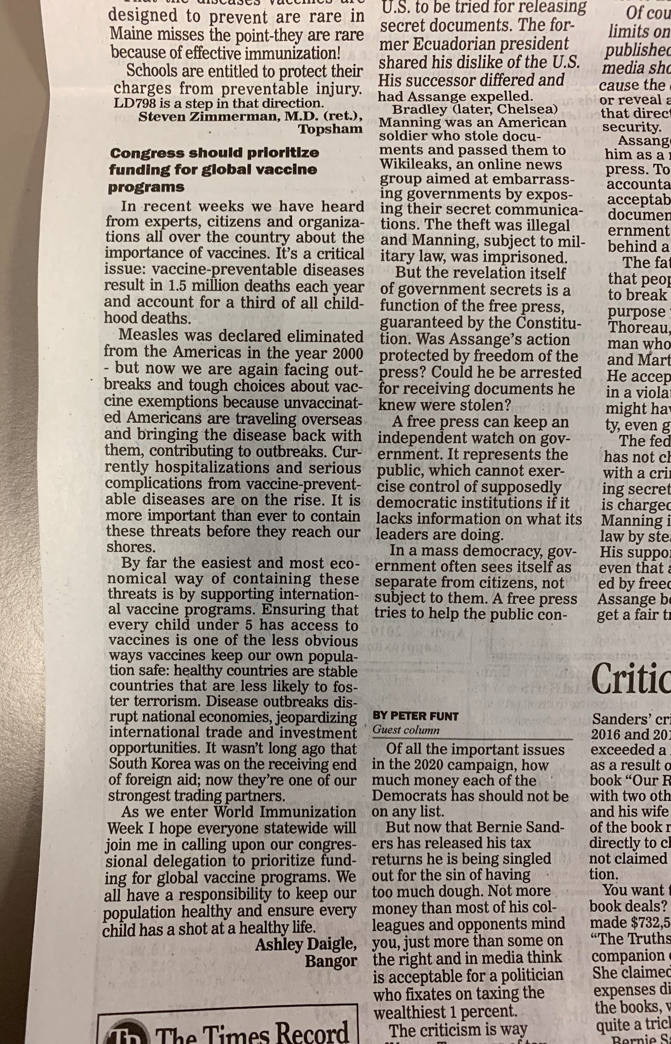


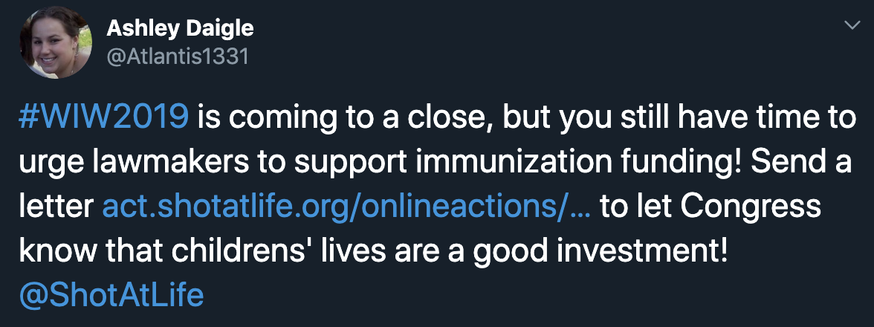
Communications & Outreach

Slide 17
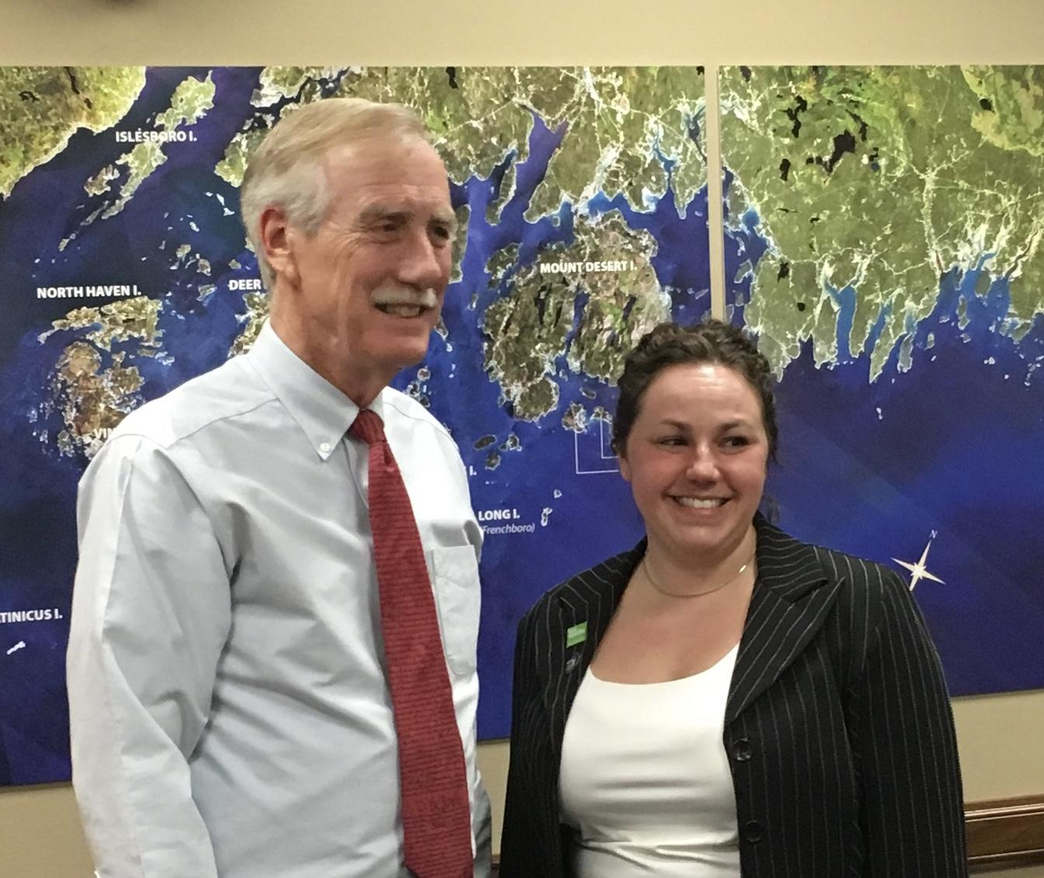
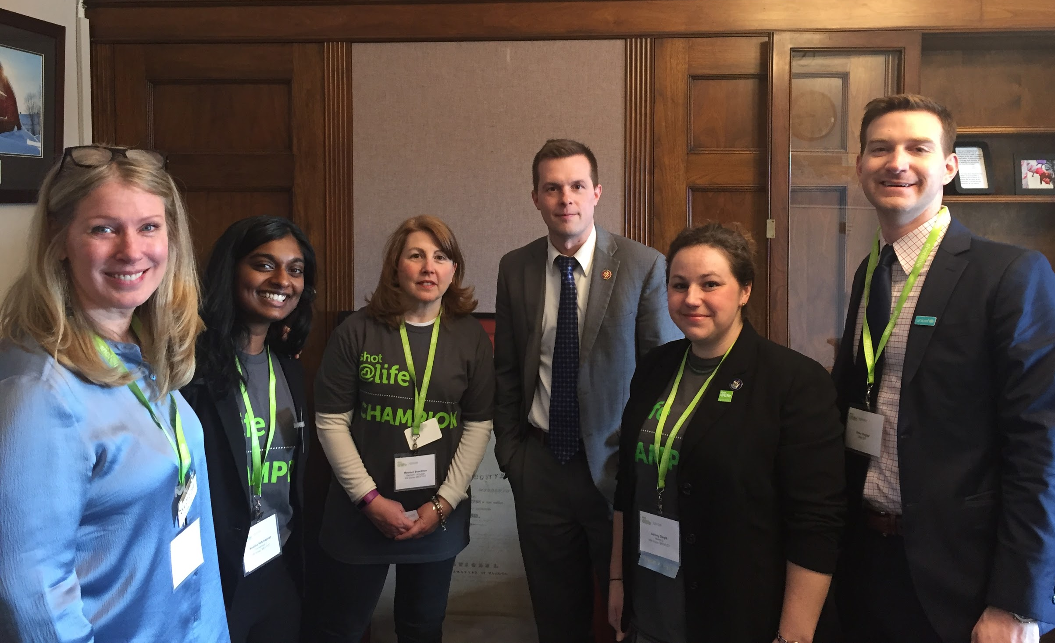
Building Relationships

Slide 18
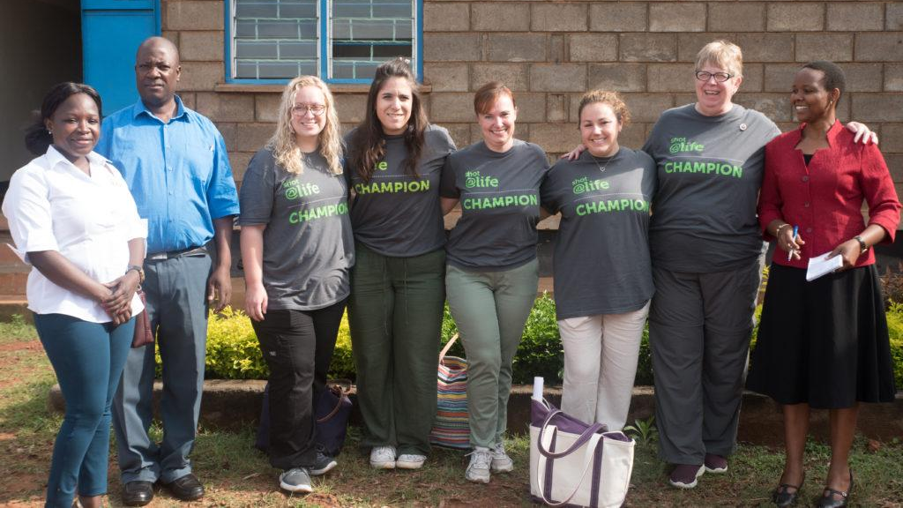

Uganda Trip

Slide 19
Questions

