Slide 1
Philippine Red Cross response to the
2019 Measles Outbreak in the Philippines
Ms. Elizabeth S. Zavalla
Secretary General
Notes:
A pleasant day to everyone, I am Elizabeth Zavalla, you may call me Liza,
I am the Secretary General of Philippine Red Cross.
Allow me to express our appreciation to the Measles & Rubella Initiative for inviting Philippine Red Cross to take part on this year’s partners meeting.
Allow me to share with you, the Philippine Red Cross response to the 2019 Measles Outbreak in the Philippines

Slide 2
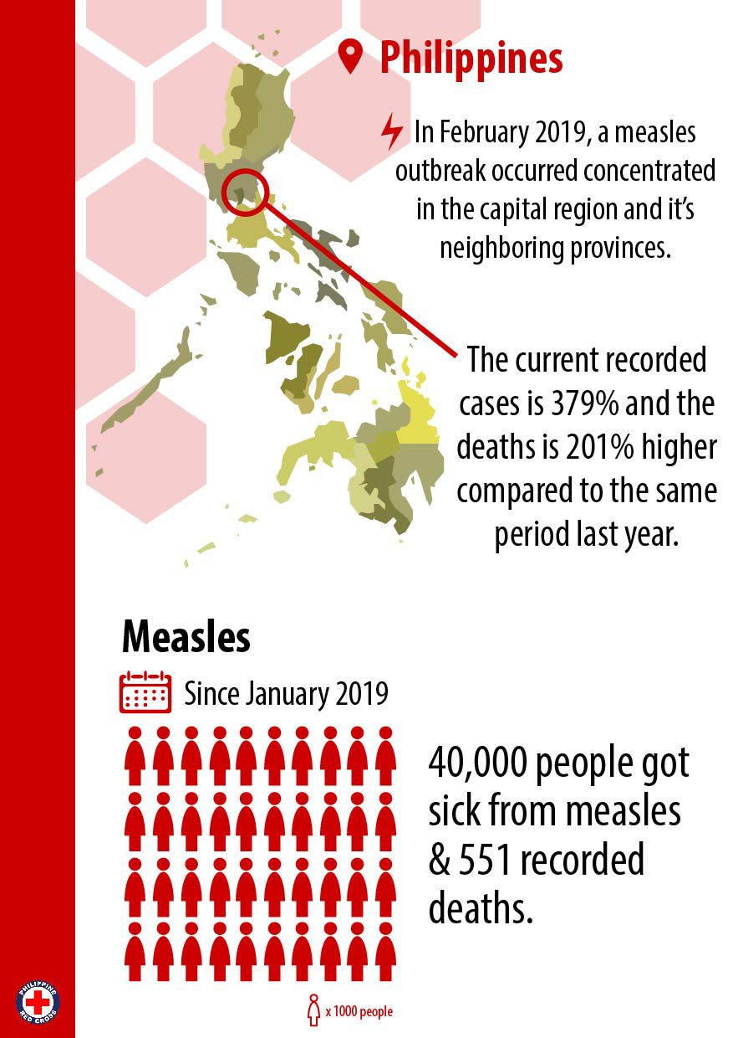
Notes:
Early this year, In February, a measles outbreak was declared by our Department of Health concentrated in the capital region and neighboring provinces.
Last February 7, there were 22 deaths recorded and around 1400 cases, by the end of February cases is already around 12,700 and with 203 deaths, already doubled of the statistics compared to last year.
As of last week of the 3rd week of August, since January of this year, there were 40,000 people got sick from measles and 551 of which died.
These recorded cases is at soaring high of 379% higher compared to same period in 2018 while the deaths is 201% higher compared to the period in 2018.
Though we have seen a slow down over the past 3 months in terms of cases and deaths, the numbers significantly piled up during the height of the outbreak in February, March & April. Indeed Measles moves fast.

Slide 3
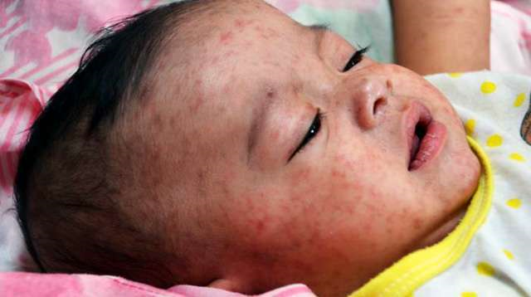
Notes:
The outbreak has numerous causes in the Philippines;
Philippines has a declining immunization coverage in the past 5 years.
Vaccine hesitancy is a major factor as we have experienced controversy in the vaccination program of the country
Poor caring practices of mothers as teenage pregnancy in the Philippines is at alarming rate of 9 percent, this is a big number as correlated to the number of the present population of the Philippines
Inadequate service delivery of our expended program on immunizations, our health workers are burdened of the tons of health priorities complicated by the devolution of our public health system

Slide 4
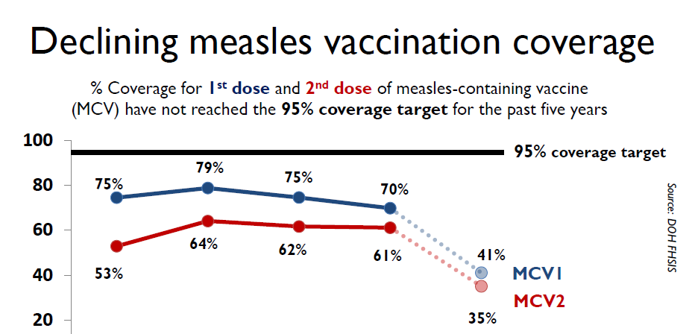
Notes:
Philippines has a declining immunization coverage in the past 5 years.
Starting in 2014, the decline was recoded for both 1st and 2nd dose of the measles vaccine, reaching a record low of 41% for the 1st Dose and 35% for the 2nd Dose in 2018.

Slide 5
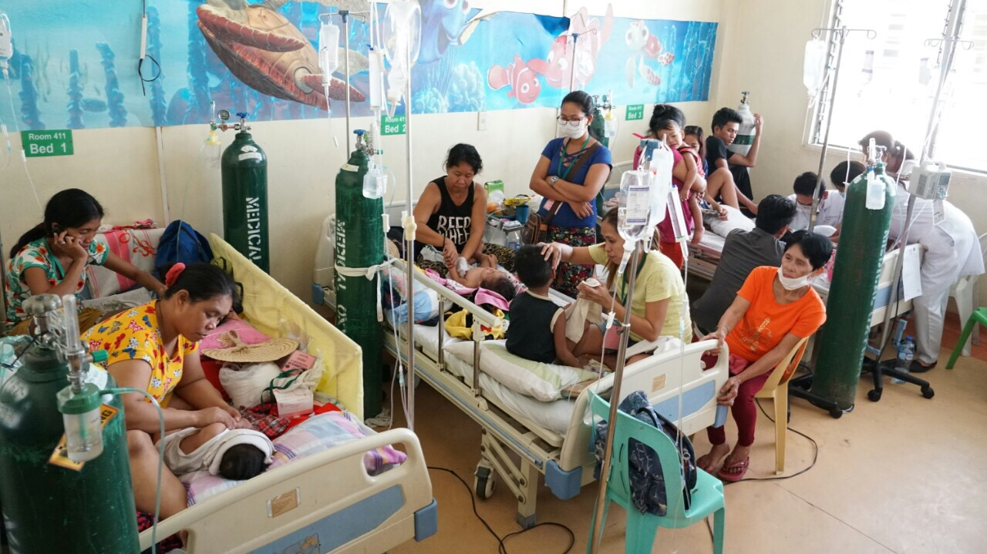
At the height of the Measles Outbreak, government hospitals were overburdened
Notes:
With these complicated situations, during the measles outbreak, patients piled up at government hospitals.
Government hospitals were over burdened, 3 patients in a bed,
The worse we can see, during our initial visits.
These situations broke our hearts, a heart breaking situation to our public health delivery system.
These situations call for Philippine Red Cross to act. To act fast.

Slide 6
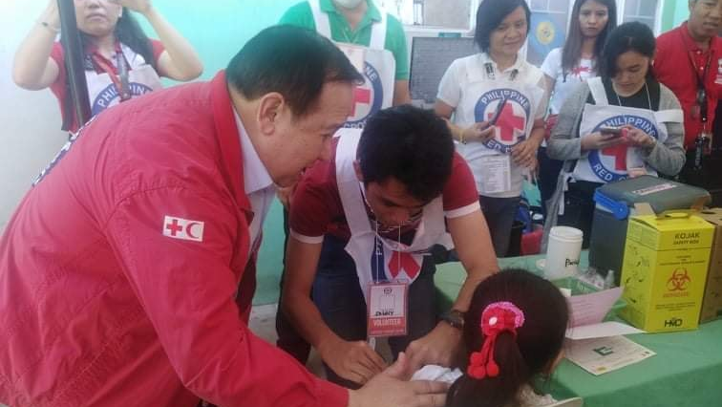
Philippine Red Cross
Measles Outbreak Response 2019
Always First.
Always Ready.
Always There.
Notes:
Living on its mantra. Philippine Red Cross aims to be ALWAYS FIRST, ALWAYS READY, ALWAYS THERE.
Philippine Red Cross needed to gear up to respond to the humanitarian call to act to the Measles Outbreak.

Slide 7
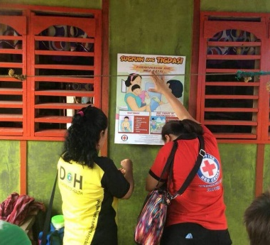
OBJECTIVE OF ACTION
To prevent the further spread of Measles by employing interventions targeting vaccine hesitancy, increasing vaccine coverage, information dissemination, care and support.
Notes:
Philippine Red Cross aimed to support our Ministry of Health – the Department of Health to prevent the further spread of Measles.
How do we prevent the spread?
By employing interventions targeting vaccine hesitancy,
increasing vaccine coverage,
correct information to mothers,
care and support to measles patients.

Slide 8
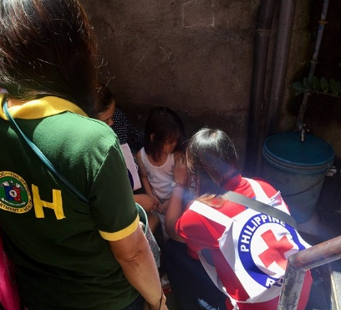



SCOPE OF INTERVENTION
Decongest hospitals.
Vaccinate the unvaccinated
Educate the community
Notes:
Philippine Red Cross aimed at;
Decongesting the Hospitals, especially the government hospitals
Vaccinate the unvaccinated
Educate the community

Slide 9
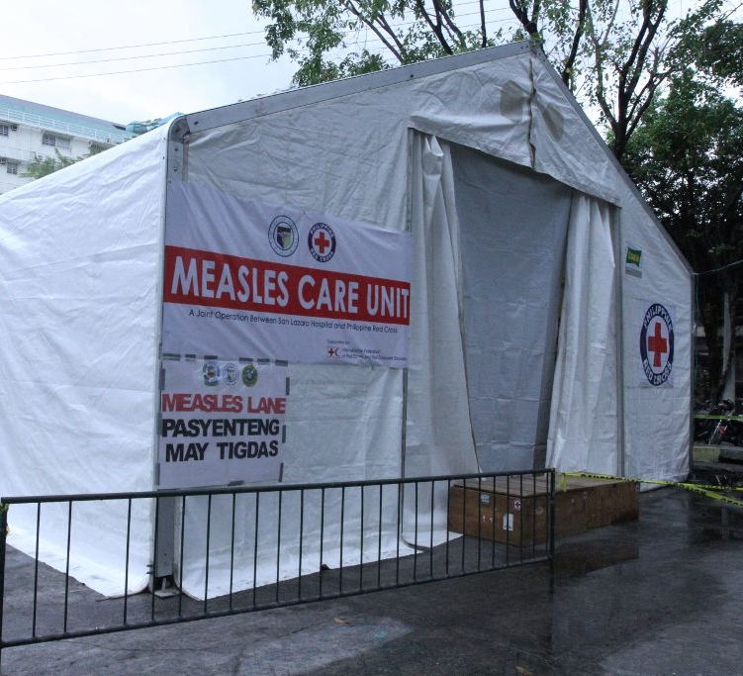
In the first week, 6 measles extension wards were set up in different government hospitals of NCR upon request of the local governments.
Notes:
In the first week,
6 measles care unit were set up in different government hospitals in the national capital region upon request of the local governments.
These measles care units acted as hospital extension wards providing additional beds for patients, these acted also as fast lanes or emergency room for suspected measles cases.
Philippine Red Cross ensured that these units has complete provisions so that it will be an effective support to the hospitals.
It has air conditioning units, water bladders, portable toilets and volunteers.

Slide 10
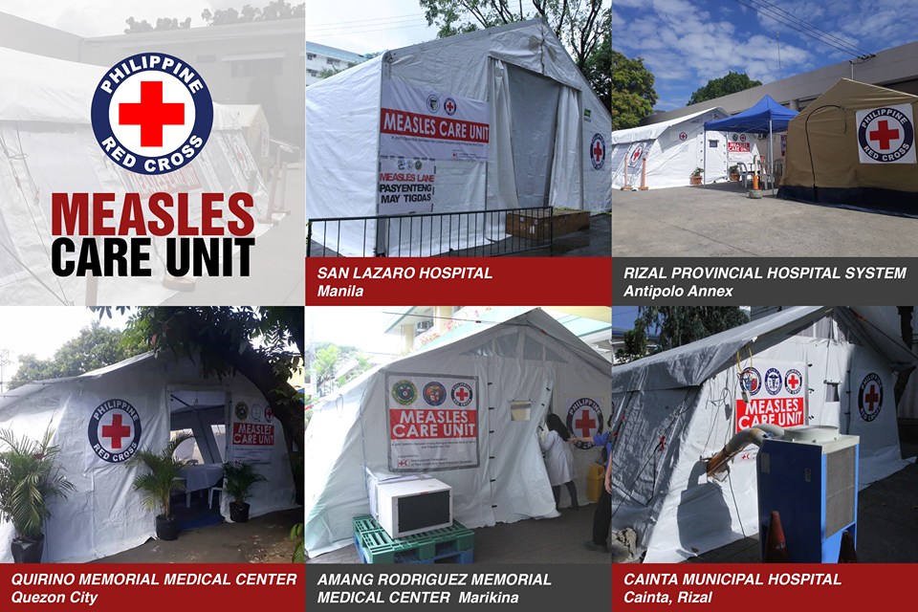
Notes:
The Measles Care Units were established in key government hospitals

Slide 11
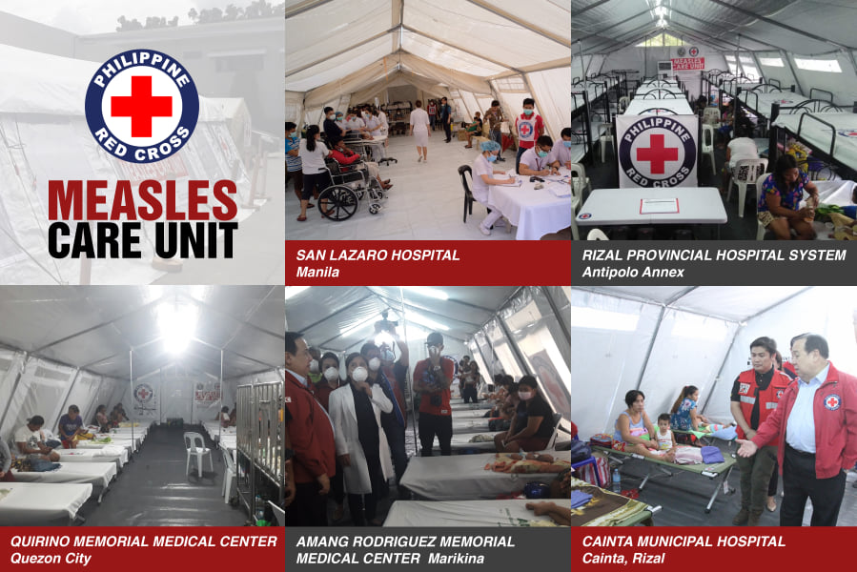
Notes:
Provided added logistics and human resources to the hospital in order for them to respond to the measles outbreak

Slide 12
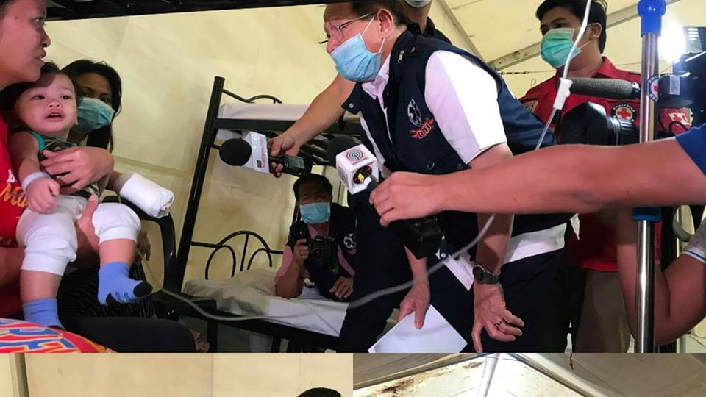
Philippine Red Cross has maintained close coordination with the Department of Health in assisting Government Hospitals
The Secretary Of Health has visited 3 Measles Care Units
Notes:
Philippine Red Cross has maintained close coordination with the Department of Health in assisting Government Hospitals
The Secretary Of Health has visited 3 Measles Care Units
Working hand in hand with the Ministry of Health is of crucial importance,
To ensure we fulfill our mandates as auxiliary to the governements.

Slide 13
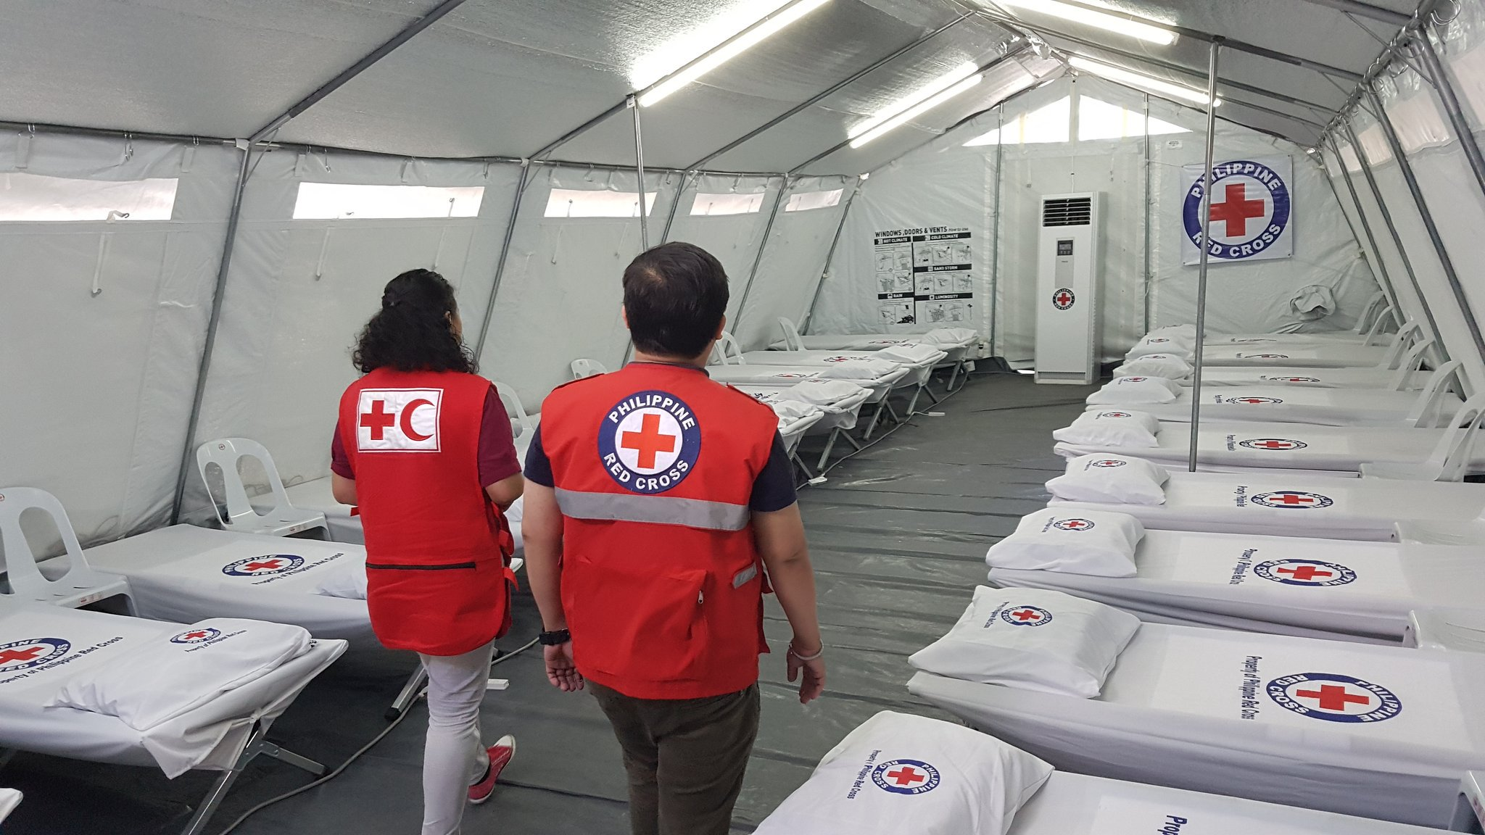
Philippine Red Cross Measles Care Units catered 3,700 patients from February to June 2019 with support from IFRC DREF
Notes:
Philippine Red Cross Measles Care Units catered 3,700 patients from February to June 2019 with support from the IFRC thru its DREF.
Of which we thank those who contributed to the DREF for the Measles Outbreak.
We were able to reach so many, because of these financial support

Slide 14
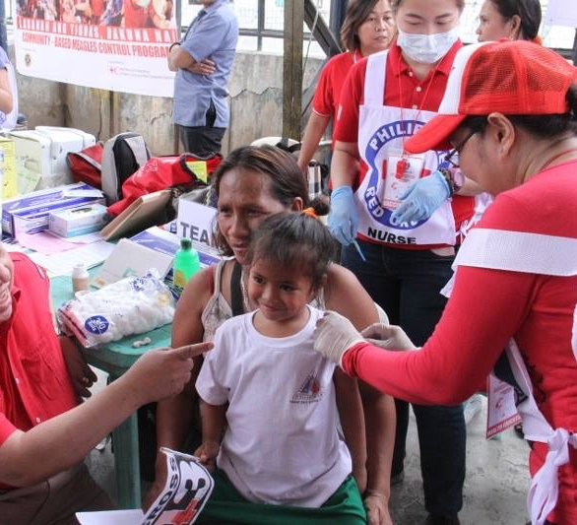
Ten days after the announcement of an outbreak, the Philippine Red Cross was vaccinating children in the slums of Manila. Other vulnerable areas in Metro Manila followed.
Notes:
We need to support vaccinating those who are unvaccinated.
Ten days after the announcement of an outbreak, the Philippine Red Cross
was vaccinating children in the slums of Manila.
Other vulnerable areas in Metro Manila followed.
We have organized our chapters to form their teams,

Slide 15
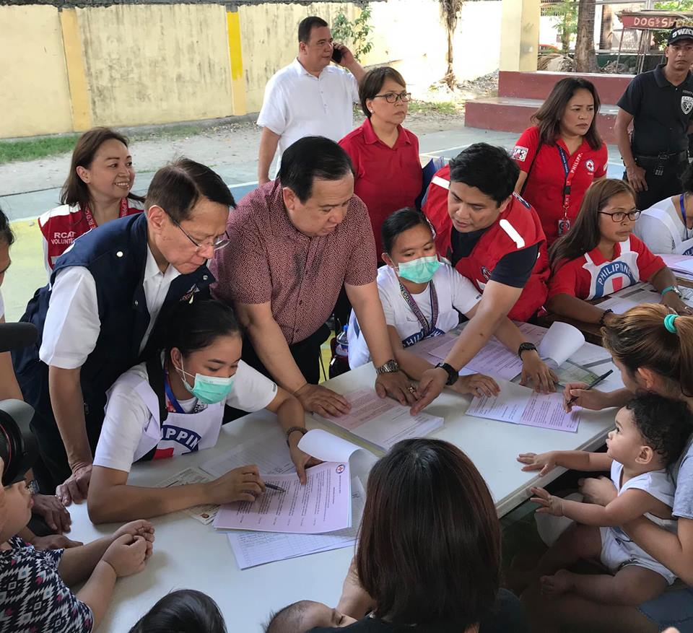
The Secretary of Health, Dr Francisco Duque with Phil Red Cross Chairman Richard Gordon in one of our vaccination sessions. Philippine Red Cross utilized key forms to guide volunteers in explaining to mothers and IEC materials as take home reminders to mothers
Notes:
We ensured that we compliment the initiatives of the government.
Here, the Secretary of Health, Dr Francisco Duque with Phil Red Cross Chairman Richard Gordon in one of our vaccination sessions.
Philippine Red Cross utilized key forms to guide volunteers in explaining to mothers and IEC materials as take home reminders to mothers
Ensuring mothers understand the importance of vaccination, these key messages will surely multiply to other mothers.

Slide 16
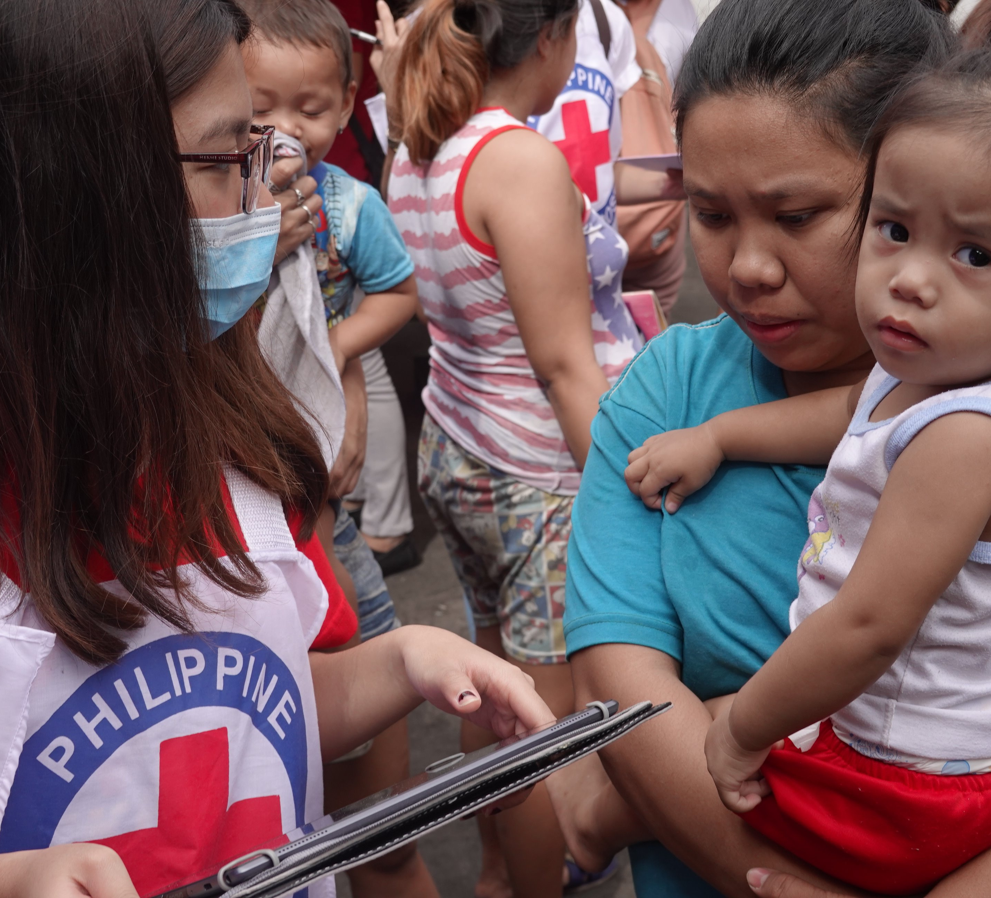
Delivered key messages on measles prevention, measles warning signs, measles vaccinations & caring practices thru its community health volunteers
Notes:
Our community health volunteers,
delivered key messages
on measles prevention,
measles warning signs,
Importance of measles vaccinations
& caring practices to their children

Slide 17
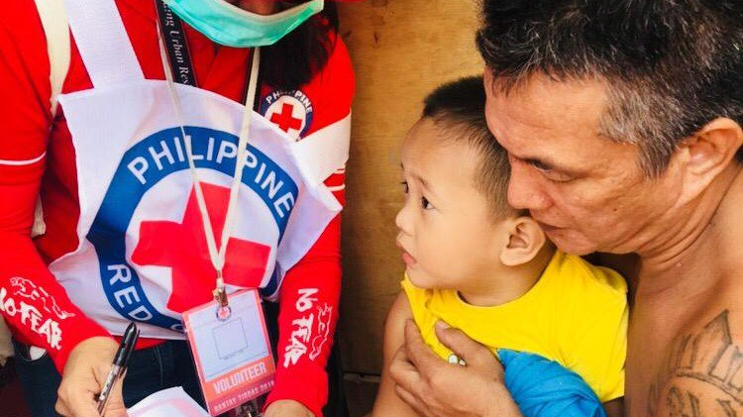
Philippine Red Cross Teams vaccinated 17,000 children
Notes:
Philippine Red Cross Teams vaccinated 17,000 children
These children of which we have reached in key areas with declared outbreak

Slide 18
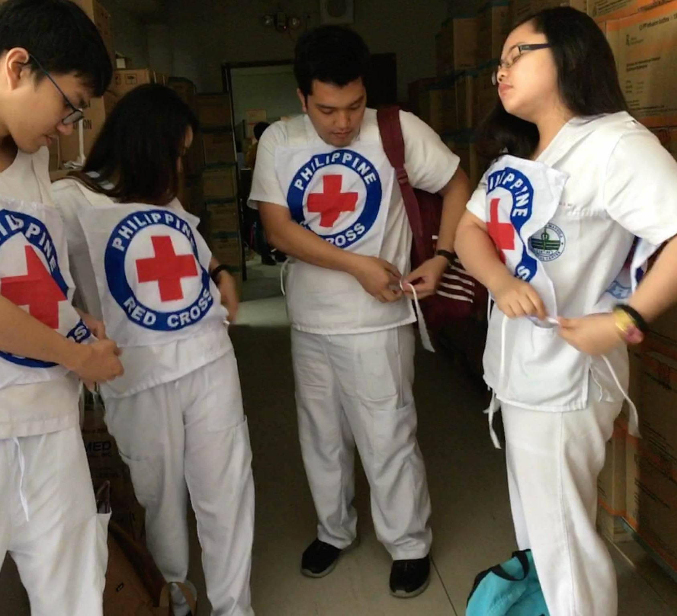
Philippine Red Cross has mobilized 2,000 volunteers from its community health volunteers, volunteer nurses, doctors and from its partner universities of medicine & nursing
Notes:
Philippine Red Cross has mobilized 2,000 volunteers from its community health volunteers, volunteer nurses, doctors and from its partner universities of medicine & nursing
Our volunteers who are very eager to reach out children, they are the multiplier support to the vaccination teams of the government.
During these times of outbreak, where government workers are on the front line,
Philippine Red Cross needed to tap volunteers of whom came from the private sector, the students of which they have a major role to take part

Slide 19
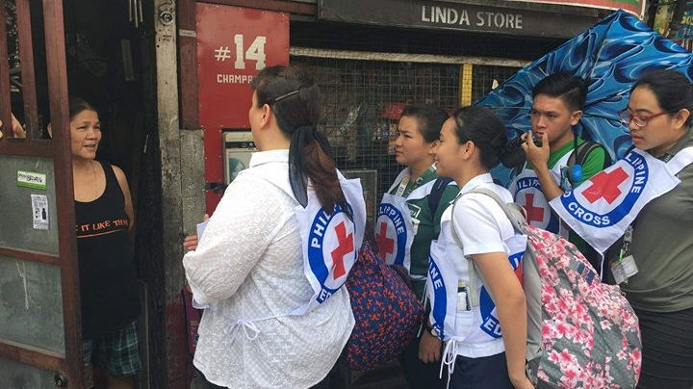
Partners & Volunteers were key to respond to the measles outbreak at a large scale
Notes:
Partners & Volunteers were key to respond to the measles outbreak at a large scale

Slide 20
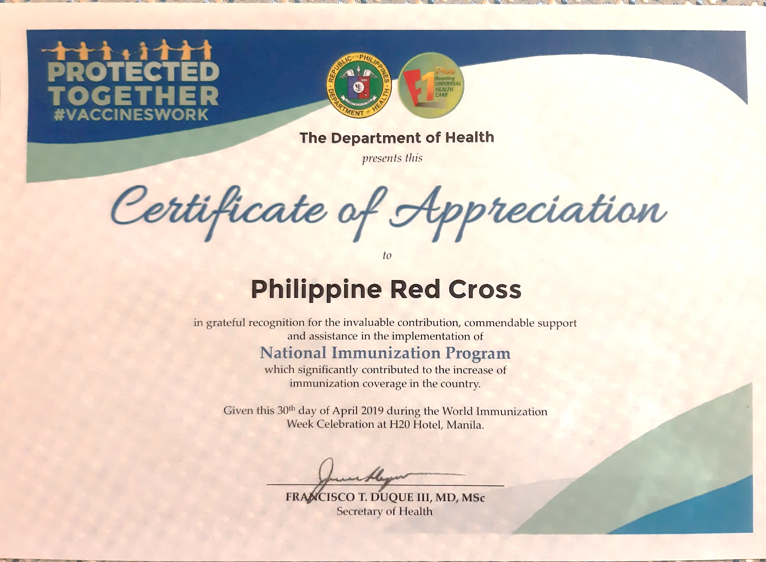
The Department of Health recognized the efforts of Philippine Red Cross, a grateful recognition of its staff & volunteers
Notes:
With all these efforts and support to the Department of Health
The Department of Health recognized the efforts of Philippine Red Cross, a grateful recognition of its staff & volunteers
But the work is not yet done

Slide 21
Ways forward to Philippine Red Cross in support to Department of Health of the Philippines
Measles Prevention Micro Intervention
“Bringing Back Compliance to Vaccines”
Notes:
Philippine Red Cross will continue to support to Department of Health
of the Philippines
Philippine Red Cross will reach out vulnerable communities with Measles Prevention Micro Intervention approach.
“Bringing Back Compliance to Vaccines”
Reaching those vulnerable communities of which has the potential source of the next outbreak.

Slide 22
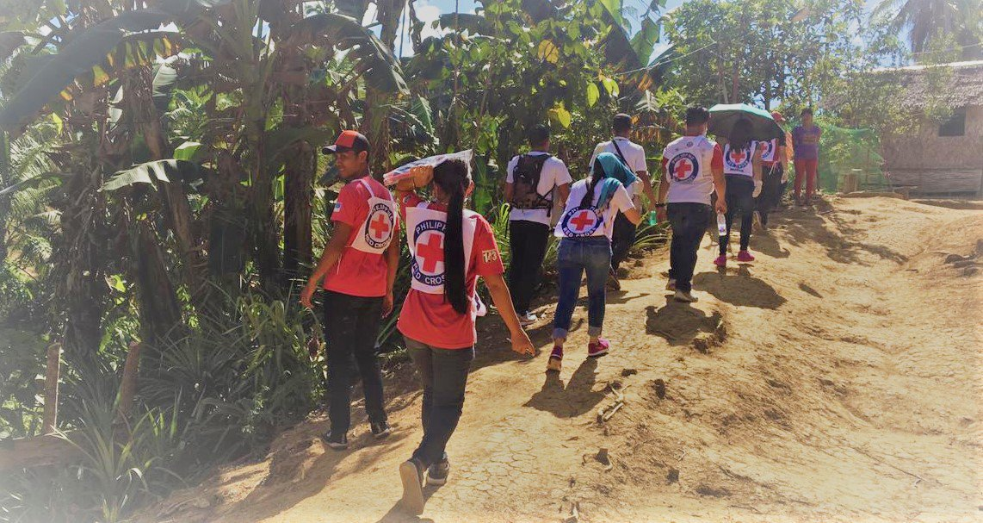
Philippine Red Cross will continue to reach vulnerable communities & children in high risk areas with the support from the IFRC Emergency Appeal
Notes:
Philippine Red Cross will continue to reach vulnerable communities & children in high risk areas
with the support from the IFRC Emergency Appeal, thanks again to those who contributed to the emergency appeal.
Your Philippine Red Cross will be able to do more!

Slide 23
Increased Awareness on EPI Compliance
EPI Vaccination on Measles
High EPI Coverage Communities
143 Community Health Volunteers as EPI Advocates
Vaccination Monitoring of Children
Urban Slums
Far Flung & IP Communities
Low Immunization Coverage Communities
Notes:
How do we do it?
We will go to these communities in those with high cases and deaths of measles.
Those in urban slums, those communities also which are far flung,
Communities with indigenous populations
As these communities are of mix characteristics, we also check those with low immunization coverage.
With our 143 community health volunteers, key components of the community based approach; Monitoring of the vaccinations of children, Increasing their awareness in EPI compliance, Vaccination on Measles thereby increasing EPI coverage.
We need to engulf these high risk communities so we can prevent the next outbreak
This will be the approach, in the coming months and years, as we face Measles in the Philippines.
Measles moves Fast, But, we must move Faster!

Slide 24
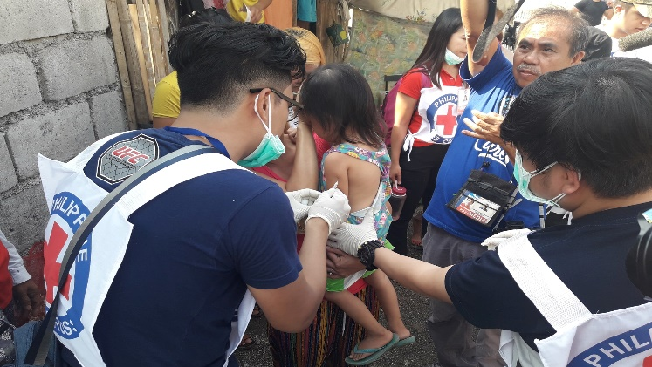
Philippine Red Cross www.redcross.org.ph health@redcross.org.ph
(+632) 790 2300
(+63) 917 805 2997
Notes:
For more information, you may write us on these contact details;

Slide 25
Thank you!
Maraming Salamat!
Ms. Elizabeth S. Zavalla
Secretary General
Notes:
Thank you.
And more success to the Measles & Rubella Inititaive!

