Slide 1
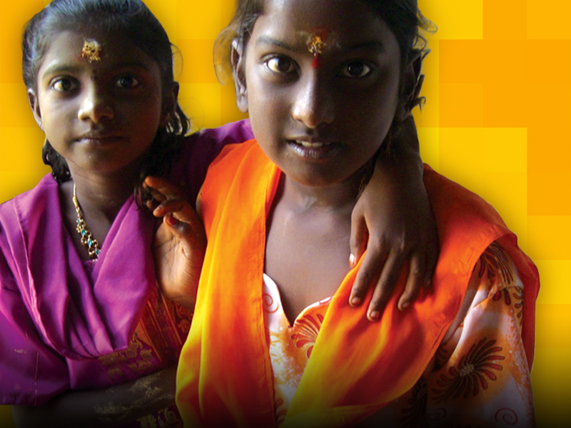

Supporting the Measles Rubella Initiative Globally, Impacting Communities Locally
LIONS CLUBS INTERNATIONAL FOUNDATION
September 18, 2012

Slide 2


About Lions Clubs International
Lions Clubs International is the world’s largest service organization.
  1.35 million members
  More than 46,000 clubs
  206 countries and geographical areas
Lions Clubs International Foundation (LCIF) supports the efforts of Lions Clubs worldwide in serving their local community and the world community as they carry out essential humanitarian service projects.
We Care. We Serve. We Accomplish.
Notes:
Founded in 1917

Slide 3

2012 Activities
    Conduct Lions’ advocacy & social mobilization in support of measles campaigns and routine immunization
    Challenge to mobilize US$15 million in support of MRI and 2012 campaigns
We Care. We Serve. We Accomplish.

Slide 4
Social Mobilization and Advocacy
    $575,000 to support Lions social mobilization and advocacy activities including $300,000 BMGF grant
      Measles & MR campaigns: Nepal, Cameroon, Uganda, Zambia, Kenya,
      Routine immunization promotion activities: Madagascar, Ethiopia, Mali
    $166,000 to PAHO in support of MR campaign in Haiti
We Care. We Serve. We Accomplish.

Slide 5
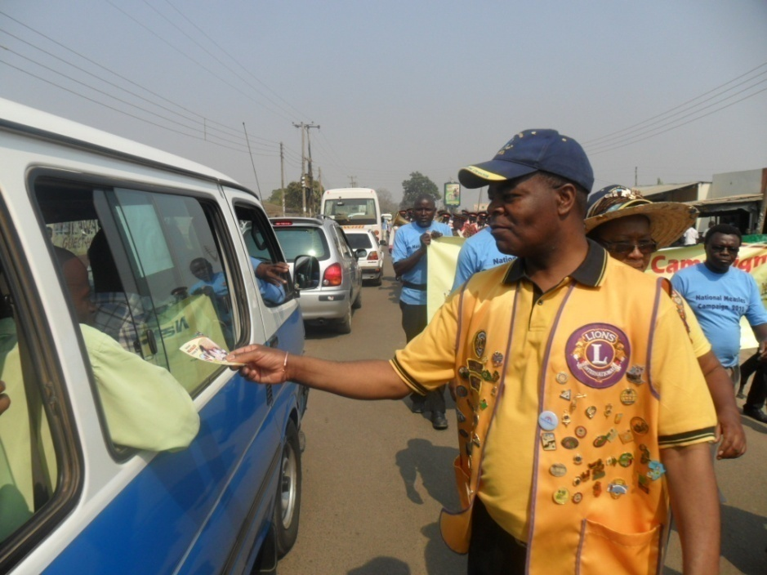
Measles and MR Campaigns
Lions campaign social mobilization activities include:
Meetings with local and national leaders
Funding radio, television, and printed awareness materials
Kick-off events
Volunteering at vaccination posts
We Care. We Serve. We Accomplish.

Slide 6
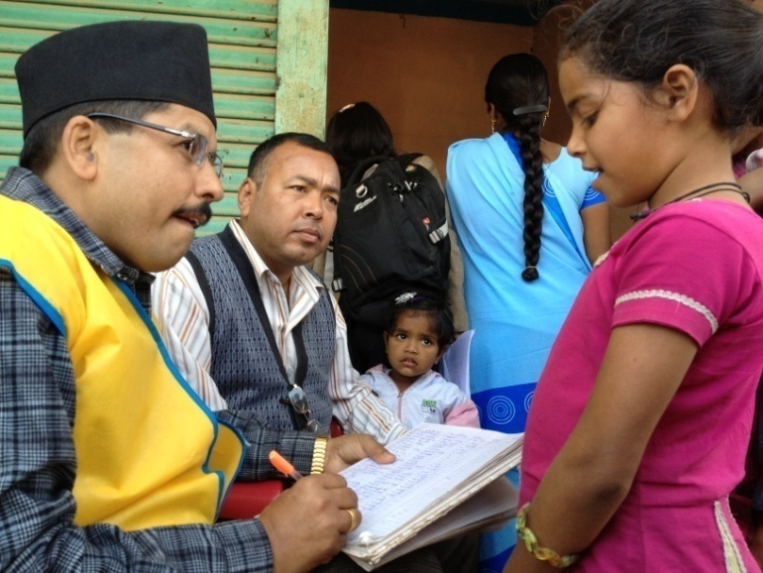
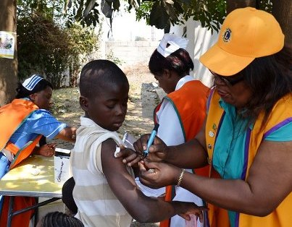
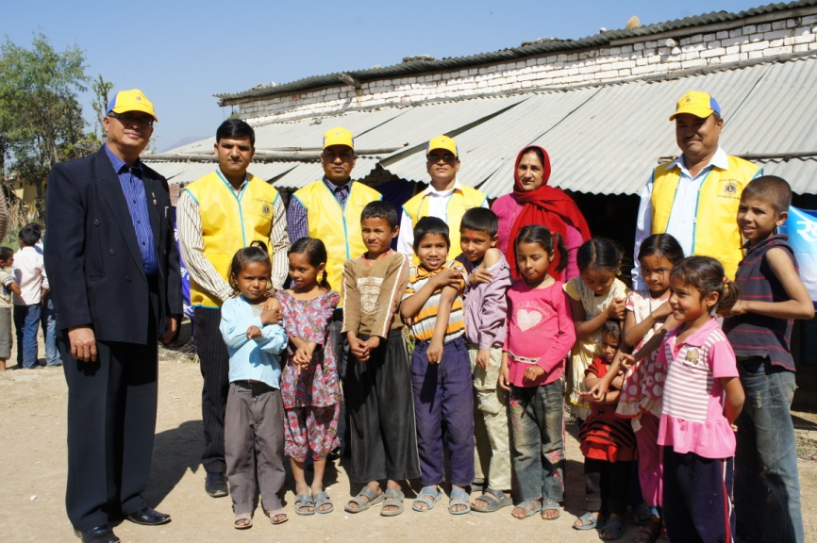
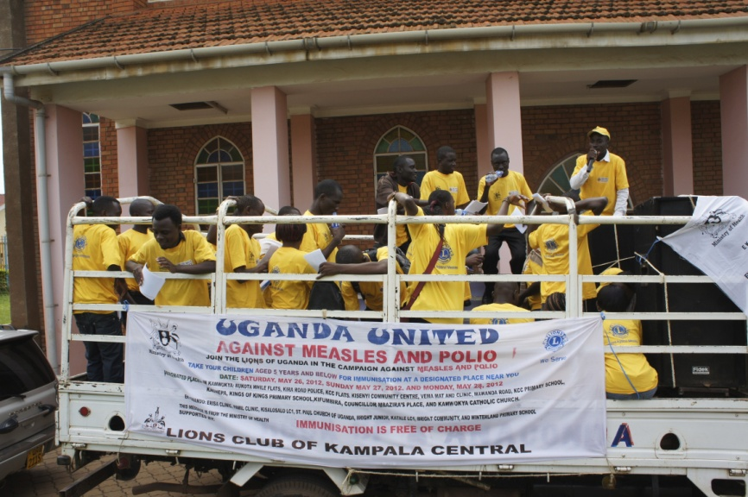
Measles and MR Campaigns
We Care. We Serve. We Accomplish.
Notes:
Lions at a vaccination centers in Nepal, Zambia, Uganda, and Nepal

Slide 7
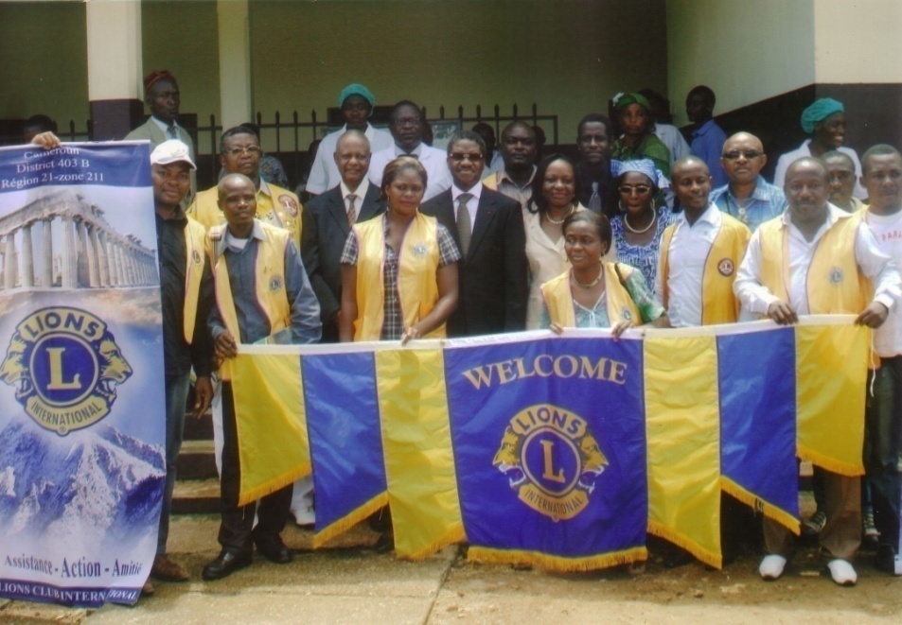
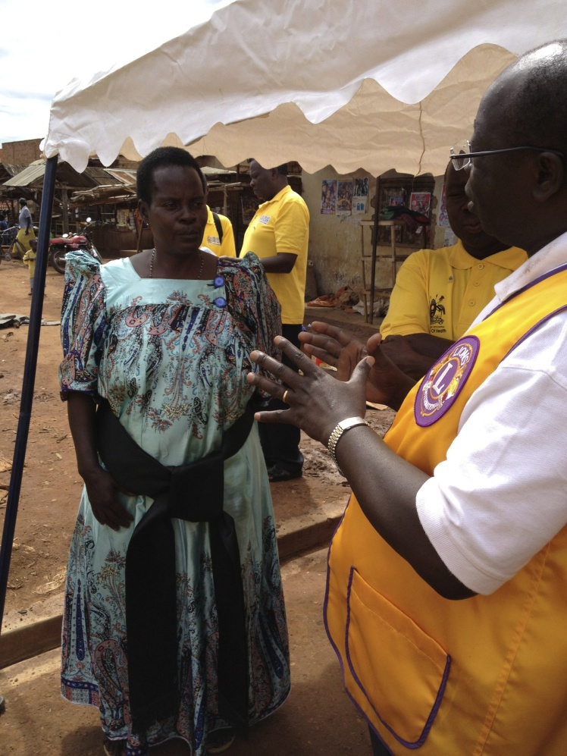
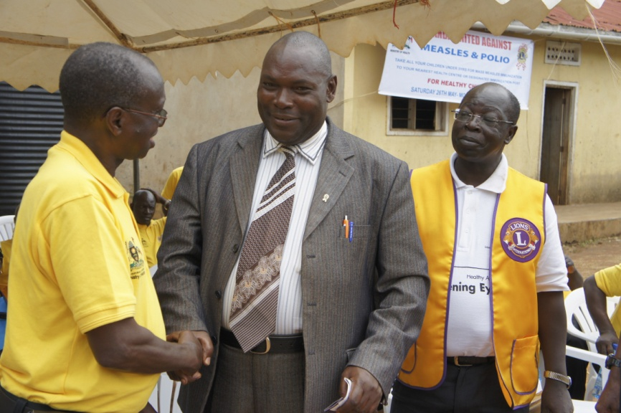
Measles and MR Campaigns
We Care. We Serve. We Accomplish.
Notes:
Lions meeting with a traditional leader in Uganda, with the Cameroon Minister of Health, and with a regional government official in Uganda.

Slide 8
Routine Immunization
    Lions routine immunization support activities include:
      Involvement in world immunization week in Ethiopia
      Involvement in mother and child health week in Madagascar
      Vaccine awareness events in Mali
We Care. We Serve. We Accomplish.

Slide 9
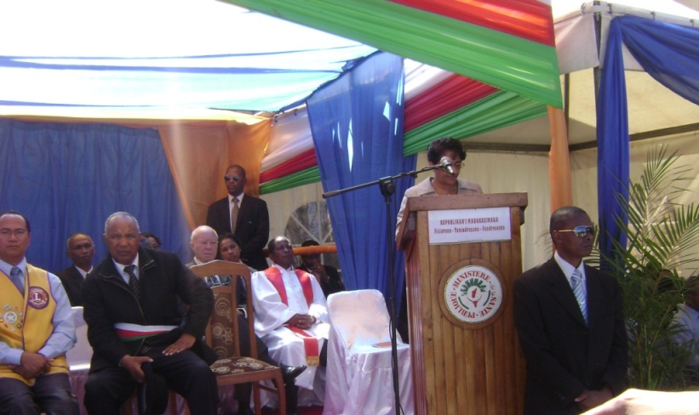

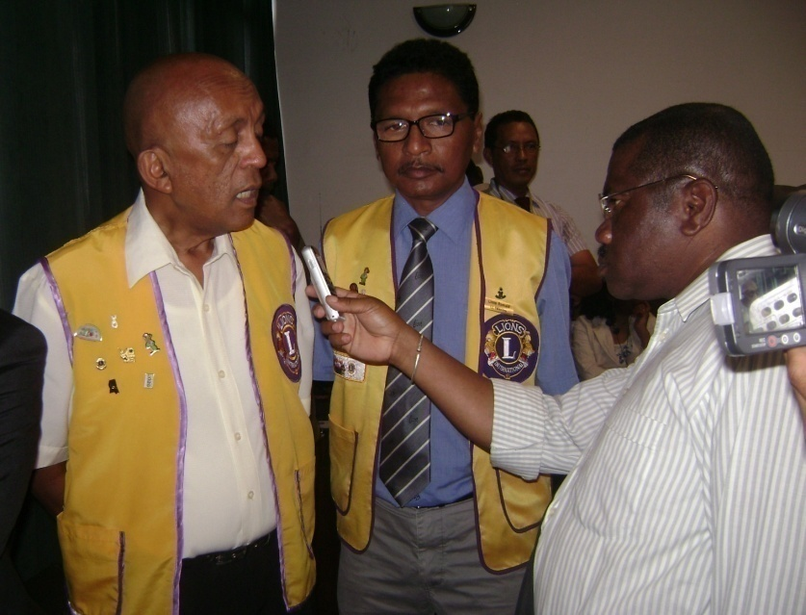
Routine Immunization
We Care. We Serve. We Accomplish.
Notes:
Madagascar Mother and Child health week

Slide 10
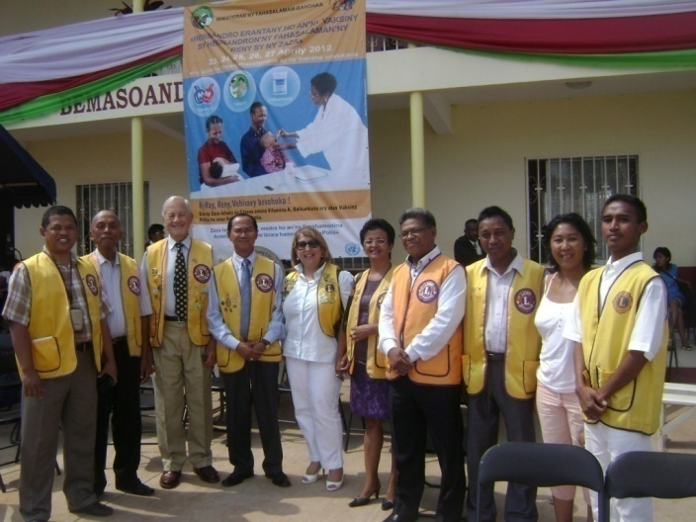
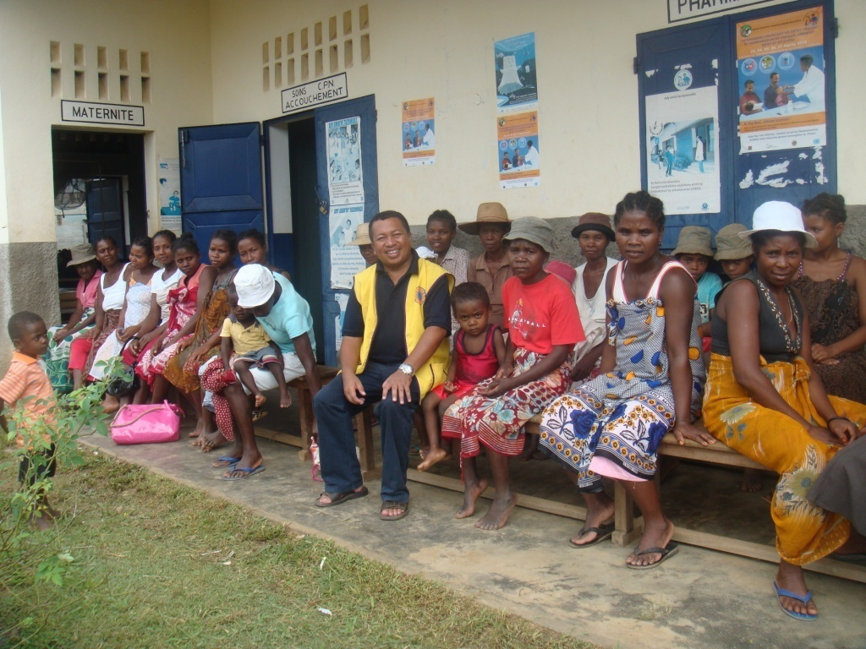
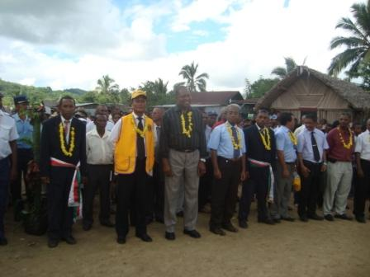
Routine Immunization
We Care. We Serve. We Accomplish.

Slide 11
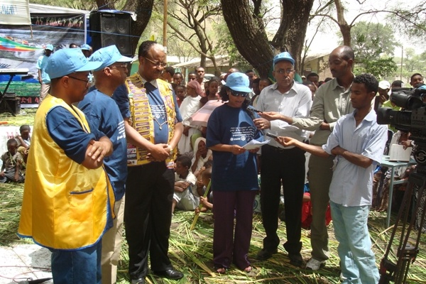
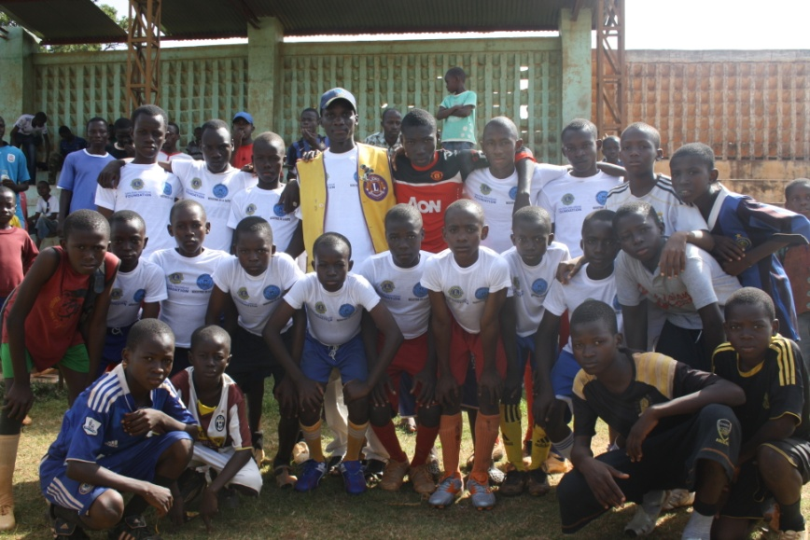
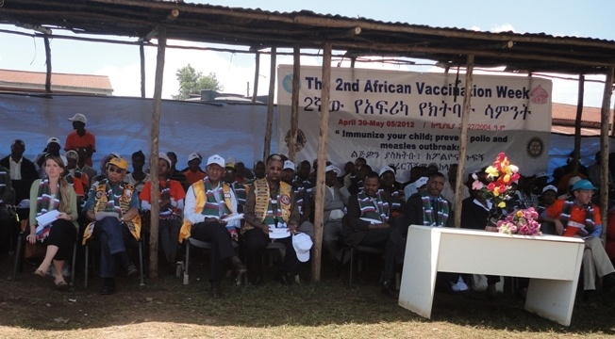
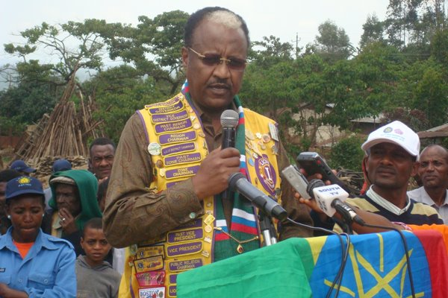
Routine Immunization
We Care. We Serve. We Accomplish.
Notes:
African Vaccination Week in Ethiopian
"Play Against Measles" soccer tournament in Mali

Slide 12
Fundraising
    LCIF’s goal is to mobilize $15 million to support 2012 SIA’s
    $5 million grant from BMGF
    To date, LCIF has received $7,710,000 in donations
We Care. We Serve. We Accomplish.

Slide 13
Fundraising
We Care. We Serve. We Accomplish.
Notes:
Note difference between first five months and second five months as significant information about the fundraising campaign reached Lions at the club level.
Estimated 2-3 additional months to complete challenge.

Slide 14

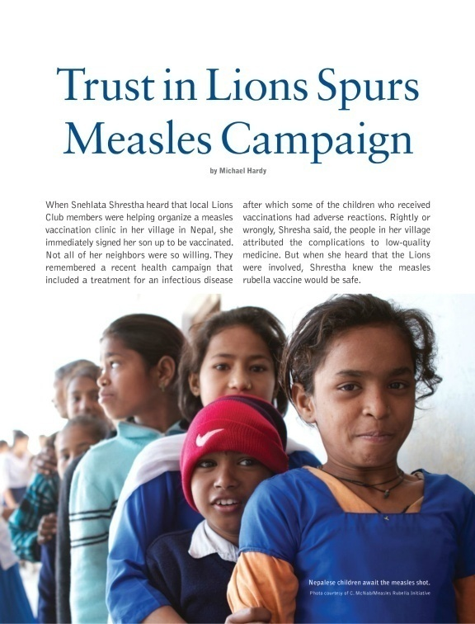
Fundraising
    Informing and educating Lions members around the world
    LCI & LCIF website, Facebook, twitter
    Lion magazine
We Care. We Serve. We Accomplish.

Slide 15
Thank you
We Care. We Serve. We Accomplish.
Notes:
In summary, Lions and LCIF have tried to do three things this year: contribute toward social mobilization and advocacy during measles campaigns, increase awareness, demand and support for routine immunization, and support the MRI so that needed measles campaigns can take place.
Thanks to the partners for all their support.

