Slide 1
Measles control and elimination in the
Eastern Mediterranean Region
Nadia Teleb MD, MPH, Dr.PH
Regional Adviser, Vaccine Preventable Diseases and Immunization
WHO/EMRO

Slide 2
The Eastern Mediterranean Region
Palestine
Bahrain
Pop: 555 Million
LB: 16.4 Million
GAVI eligible: 7 countries, 56%
LMIC: 7 countries, 38.5%
UMIC: 3 countries, 2.5%
HIC: 6 countries, 3% of LB

Slide 3
Outline
Regional targets
Regional strategy
Progress in implementation of the regional strategy
Progress towards achieving the target
Plans 2011-2012
Challenges and opportunities

Slide 4
Measles related targets in the EMR
Measles elimination from all countries by 2010 (resolution EM/RC44/R.6, 1997)
Target date revised to 2015 (EPI managers’ meeting , July 2010)
Measles Mortality reduction target:
EMR adopts the global target

Slide 5
Regional Strategy to achieve measles control/elimination in the EMR
Achieving high population immunity:
  Nationwide measles catch-up vaccination campaign, achieving homogenous high coverage
  sustaining population immunity through high vaccination coverage (≥95% coverage in all districts) with 2 doses of MCV; preferably during the second year of life:
    Routine MCV1; AND
    Second dose: routine second dose and/or Periodic follow-up SIAs which should continue until achieving the high routine coverage for MCV1 and MCV2
Strong case-based lab surveillance
Case management

Slide 6
Progress in implementation of the regional strategy
1. Measles vaccination

Slide 7
MCV1/MCV2 Schedule/type of vaccine, EMR, 2011
Country | MCV1 |  | MCV2
 | Type | Age | Type | Age
Afghanistan | M | 9 m | M | 15-18 m
Bahrain | MMR | 12 m | MMR | 5y
Djibouti | M | 9 m
Egypt | MMR | 12 m | MMR | 18 m
Iran | MMR | 12 m | MMR | 18 m
Iraq | M | 9 m | MMR | 15m, 4-6y
Jordan | MMR | 12 m | MMR | 15-18 m
Kuwait | MMR | 12 m | MMR | 2y, 12y
Lebanon | MMR | 12 m | MMR | 4-6 y
Libya | MMR | 12 m | MMR | 15-18 m
Morocco | M | 9 m
Oman | MMR | 12 m | MMR | 15-18 m
Pakistan | M | 9m | M | 15-18 m
Palestine | M | 9 m | MMR | 12m, 18 m Rubella 12Y
Qatar | MMR | 12 m | MMR | 4-6 y
Saudi Arabia | M | 9 m | MMR | 12m, 4-6 y
Somalia | M | 9 m
Sudan | M | 9 m
S. Sudan | M | 9M
Syria | MMR | 12 m | MMR | 15-18 m
Tunisia | M R | 15 m 12y | M | 6 y
UAE | MMR | 12 m | MMR | 4-6 y
Yemen | M | 9 m | M | 15-18 m
EMR | MCV1 @ 9m: 7 countries/ MCV2 18 countries, / R in 15 countries/ MMR2: 14 Countries

Slide 8
Source: JRF 2010

Slide 9
Reported district coverage of MCV1, 2010
Target 95% in all districts
Improving routine immunization:
RED approach in AFG, IRQ, PAK, SOM, SUD, YEM
CHDs in Somalia
Acceleration campaigns in SUD, AFG
Vaccination week of the EMR
Coverage%
Source: JRF 2010

Slide 10
Measles vaccination strategies in the EMR
2. Supplementary immunization activities (SIAs)
Palestine
Bahrain
High routine coverage
Response campaigns
Follow up campaigns
Catch-up campaigns implemented in all countries
Around 400 million people vaccinated 1994-2010 through SIAs
Notes:
10

Slide 11
Measles SIAs in EMR 2010-2011

Slide 12
Progress in implementation of the regional strategy
2. Measles surveillance

Slide 13
Measles Case-Based Surveillance in EMR, 2011
Palestine
Bahrain
Nation-wide Measles Case-based surveillance (19)
Moving to Nation-wide measles surveillance (1)
Sentinel sites measles surveillance (3)

Slide 14
Measles Laboratory Network in the EMR, 2011
Palestine
Bahrain
Serology capacity only (6)
Serology and virus detection/isolation capacity (11)
Serology and virus detection/isolation and sequencing capacity (6)
Regional Reference Laboratories

Slide 15
No genotype data from 4 countries: PAL, LEB, S.SUD, UAE

Slide 16
Measles surveillance performance indicators in the EMR
2010 | 2009 | 2008 | 2007 | 2006 | 2005 | Indicator
86% | 72% | 77% | 80% | 57% | 75% | % of countries ≥80% of suspected cases tested
100% | 95% | 91% | 100% | 68% | 100% | % of countries ≥80% cases with complete investigated
68% | 73% | 68% | 70% | 36% | 50% | % of countries with ≥80% specimen received at lab 7day of collection
91% | 96% | 96% | 100% | 89% | 100% | % of countries with ≥80% adequate specimens
86% | 95% | 81% | 90% | 58% | 75% | % of countries with ≥80% results reported within 7 days
42% | 52% | 52% | 42% | 22% | Zero% | % of countries that achieved the reporting rate ≥2 /100,000 population at national level
27% | 9% | 9% | 9% | 4% | Zero% | % of countries that achieved the reporting rate ≥1 /100,000 population at all sub-national level

Slide 17
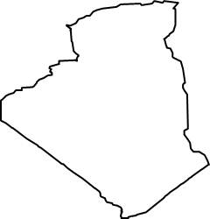
Rubella & CRS Surveillance system situation in EMR
Measles vaccination strategies in the EMR
2. Supplementary immunization activities (SIAs)
Palestine
Bahrain
Rubella testing and CRS system (9 countries)
Rubella testing only (12countries)
None (2countries)
Notes:
17

Slide 18
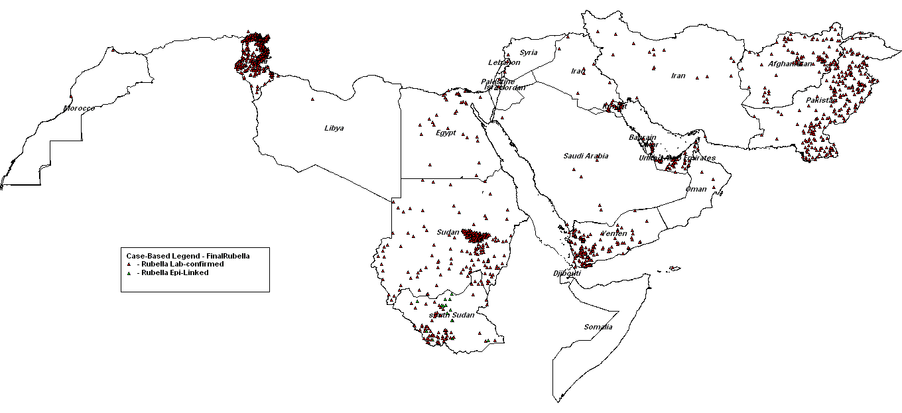
Geographic distribution of rubella cases in the EMR countries by district and final diagnosis between July 2010 and June 2011
The source of data in this slide is country measles surveillance DEFs received on monthly basis from countries
Notes:
18

Slide 19
Progress towards achieving the target

Slide 20
Estimated measles deaths
93%
90%

Slide 21
Progress in Measles elimination in the EMR
88% reduction in reported cases between 1998 to 2010
8 countries close to elimination in 2010
Source: Country reports
Inadequate surveillance

Slide 22
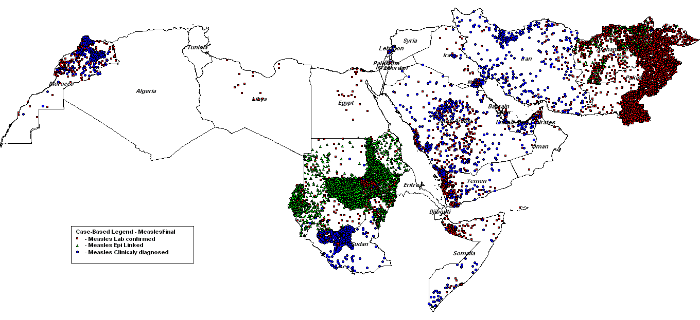
Geographic distribution of measles cases in the EMR countries by district and final diagnosis between July 2010 and June 2011
Source : Official countries’reports

Slide 24
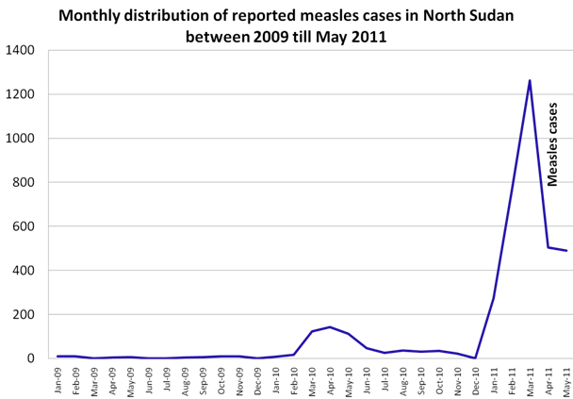
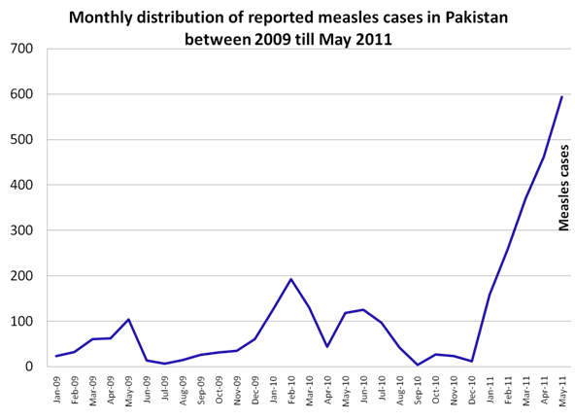
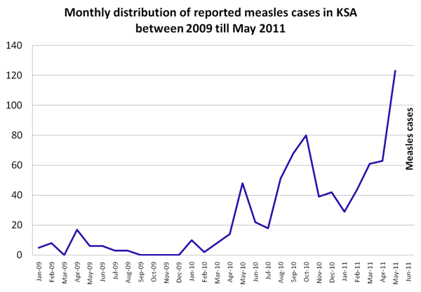
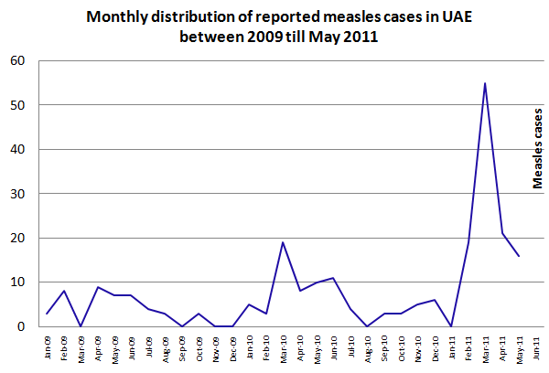

Slide 25
Progress In Eastern Mediterranean Region
Achieving the target:
  Measles mortality reduction target achieved 3 years ahead
    Sustainability is threatened
  Measles Elimination target goal by 2010 was not reached
    8 countries are close to elimination
    Target date postponed to 2015
Measles case-based surveillance in 20 countries, expanding in 3 countries
Regional guidelines for elimination validation developed, field tested and officialised
Regional Validation Commission was formulated
National validation committee established in 5 countries, others are in the process

Slide 26
Future plans
Supporting improving population immunity
  Continue strengthening routine immunization: RED approach, CHDs
  Introduction of MCV2 in Sudan Nov. 2011
  Timely follow up SIAs
Strengthening Measles surveillance:
  Case based surveillance in Somalia and S. Sudan
  Improving surveillance indicators to reach requirements of validation indicators
  Preparing for validation of elimination in the ready countries

Slide 27
Planned SIAs for 2011 and funding requirement

Slide 28
Challenges
Opportunities
Funding: specially for the follow-up campaigns
  FU campaigns needed in 7 countries
  Target:> 95 million for 2011-2015
National managerial Capacity:
  Inadequate number and qualification of staff
  Devolution in Pakistan
Competing priorities:
  Polio eradication
  Other EPI issues: NVI,..
Pockets of susceptible populations/groups
  Hard to reach populations in low income countries
  Pockets in countries with big expatriate population
Security situation: rapidly deteriorating in the EMR
  Delayed implementation of planned activities
  Financial support from international partners
  Interest of the countries
  Renewing commitment: EPI technical paper submitted to RC October 2011
  Polio infrastructures

Slide 29
Summary
Remarkable progress in measles mortality reduction,
Measles elimination was not achieved in time,
More efforts are needed with the current political turmoil and security situation in some countries
Bridging funding gaps to support LIC countries is challenging

Slide 30
Acknowledgements
Partners of the Measles initiative
CDC Atlanta
EMR RRLs in Tunisia and Oman
VIDRL Australia
EMR EPI staff, lab network
WHO/HQ

