Slide 1
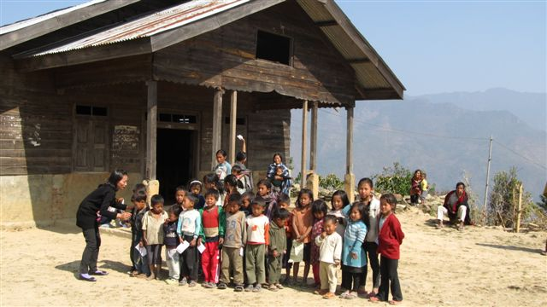



Measles
update- India
Dr. Satish Kumar Gupta
Health Specialist
UNICEF- India
June 2011
13th September 2011

Slide 2
Presentation outline
Global context
Update on accelerated measles control
  MCV-2 in Routine services
  Catch-up campaigns
  Laboratory supported measles surveillance
Linkages with RI, recent publications
Conclusions

Slide 3
Principles of accelerated measles control strategies in India
Improve and sustain routine immunization coverage (MCV-1)
Provide a second opportunity for measles immunization to all eligible children (MCV-2)
Sensitive, laboratory supported measles outbreak surveillance for case/outbreak confirmation
Fully investigate all detected measles outbreaks and ensure appropriate case management

Slide 4
Global Context: Worldwide measles vaccination delivery strategies, mid-2010
India
MCV1 & MCV2, no SIAs (40 member states or 21%)
MCV1, MCV2 & one-time catch-up (36 member states or 19%)
MCV1, MCV2 & regular SIAs (57 member states or 28%)
MCV1 & regular SIAs (59 member states or 31%)

Slide 5
Presentation outline
Global context
Update on accelerated measles control
  MCV-2 in Routine services
  Catch-up campaigns
  Laboratory supported measles surveillance
Linkages with RI, recent publications
To conclude

Slide 6
2nd Dose of Measles vaccine:
State specific delivery strategies
SIA: MCV1 <80%
RI: MCV1 > 80%
MCV1: Coverage of Measles containing vaccine per DLHS-3; CES-06 for Nagaland

Slide 7
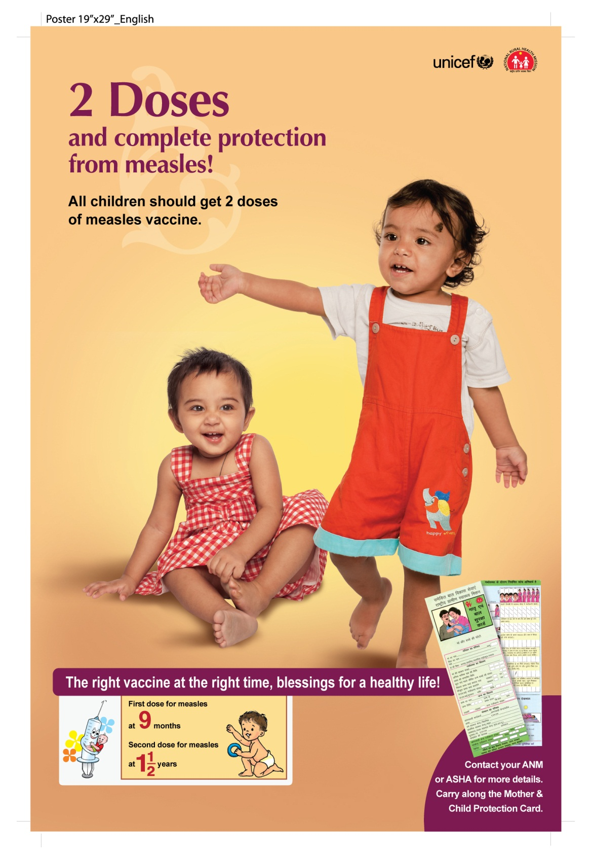
2nd Dose of Measles in RI
17 states (MCV1>80%) introduced measles 2nd dose in their routine immunization program
45 districts, who completed measles campaign in phase -1 are in process of introducing 2nd dose in their RI program

Slide 8
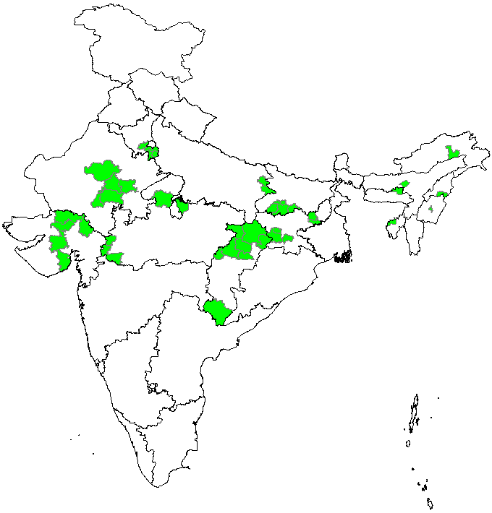
MCV2 introduction through Supplementary Immunization Activity (SIA) in Phases
Phase 1
  Initiated in November 2010;
  45 districts from 13 states
      9 district from Chhattisgarh
      5 districts from each of the 6 states (Bihar, Jharkhand, Rajasthan, Madhya Pradesh, Gujarat & Haryana)
      1 district from each of the 6 North-East states
  Approximately 14 million target children 9 months – 10 yrs

Slide 9
Coverage achieved: Administrative and RCA monitoring
11,963,663 of 13,845,686 vaccinated (86.4%)
18 of 45 districts with >= 90% coverage (40%)
Data as on 12 July 2011

Slide 10
Reasons for un-vaccinated children:
RCA surveys results
IEC/IPC
(43.7%)
Un-aware of need
(43.9%)
Operational Gap
(3.7%)
N=unvaccinated children; 30,200
Note: Figures are % of total responses provided

Slide 11
Selected session quality indicators
n=22,343
% session site with adequate vaccine & syringes | 97.4%
% sites where diluents kept cool before reconstitution | 98.4%
% sites where time of reconstitution written on vial | 93.5%
% sites where reconstituted vials kept in the hole of 1 icepack | 97.4%
% sites where sterile part of syringe remained untouched | 95.4%
% sites where vaccinators following ‘no recapping’ | 89.4%
% sites where vaccinators know what to do in case of a serious AEFI | 93.2%
% sites having functional hub cutter | 87.6%
% sites where supervisor visited once in a day | 75.4%
n=campaign vaccination sessions were monitored
Notes:
Call out weaknesses – AEFI and supervision.

Slide 12
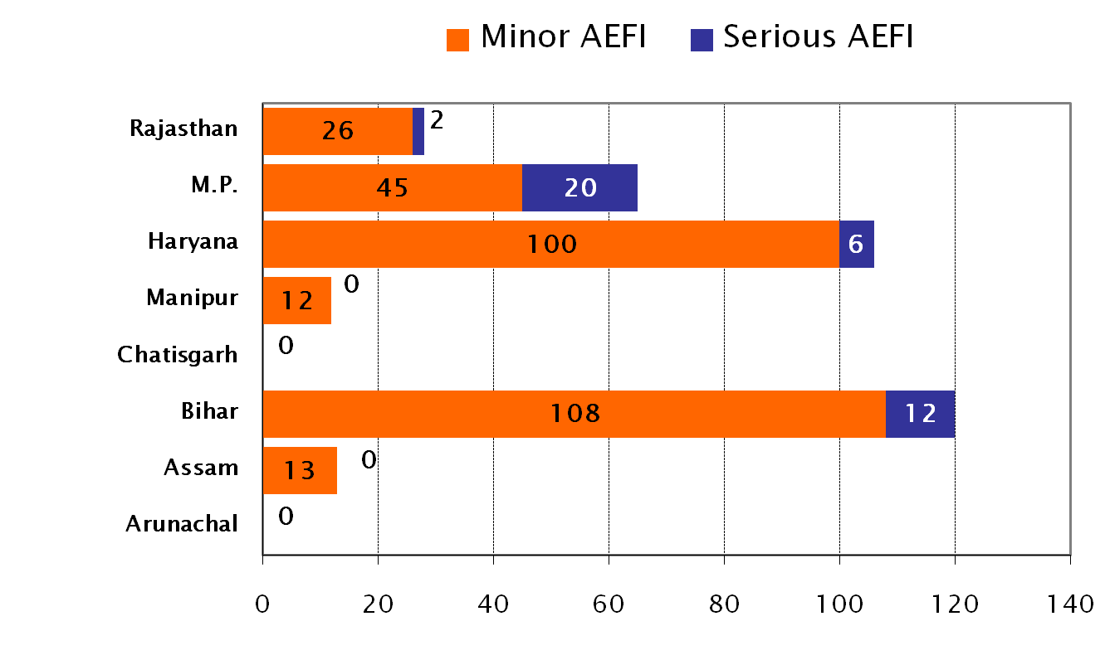
Enhanced AEFI surveillance during the Measles catch-up campaigns
304 minor AEFIs and 40 serious AEFIs reported
All serious AEFIs reported and correctly managed
NO DEATHS – VACCINE OR PROGRAMME RELATED
Notes:
12

Slide 13
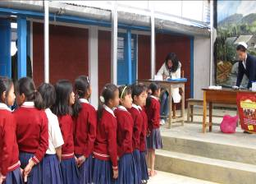
Lesson learnt from 1st Phase:
Areas for improvement
Coordination and planning:
  Better coordination of the three primary department of Health, Education and ICDS
  Clear timelines of availability of logistics
Communication and advocacy:
  IEC ,BCC and interpersonal communication
  IAP, IMA and private doctors sensitization
  Private school principals orientation
Vaccination in urban areas
Injection waste management
Supervision at all levels
Notes:
13
Measles, BCG
HepB, DTP, OP

Slide 14
Measles SIA plan, India
Phase 1, 45 districts covered
Phase 2 A (144 districts)
Phase 2 B (81 districts)
Phase 3 (91 districts)
Total target- 135 million children
Districts- 361

Slide 15
Planned phases of measles catch-up campaigns
 | Phase 1 | Phase 2A | Phase 2B | Phase 3 | Total
Dates | Q4 2010 – Q2 2011 | Q3 – Q4 2011 | Q1 2012 | Q4 2012
No. districts | 45 | 144 | 81 | 91 | 361
Target population (9m-10yrs) millions | 14.0 | 41.5 | 33.4 | 47.0 | 135.0
Children vaccinated (millions) | 12.0

Slide 16
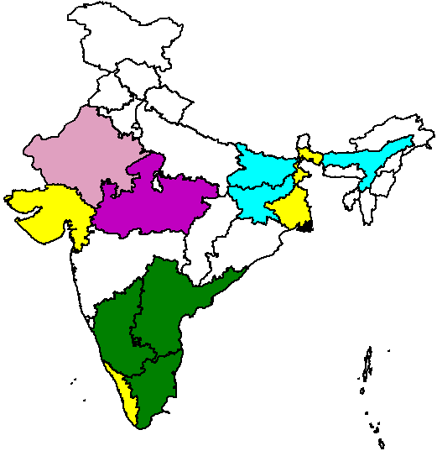
Expansion of measles outbreak surveillance
Reporting of clinical measles cases linked with AFP weekly reporting in these states
One state level lab strengthened in each state testing for measles and rubella IgM
2006
2007
2009
2010
2011

Slide 17
Serologically confirmed measles outbreaks:
Age and vaccination status of measles cases*, 2011
Total cases = 9,221
61 % no or unknown vaccination status
86 % < 10 yrs of age
Vaccinated Not Vaccinated Unknown
* Serologically and epidemiologically confirmed cases
** Data from 8 states (Andhra Pradesh, Gujarat, Karnataka, Kerala, Madhya Pradesh, Rajasthan, Tamilnadu and West Bengal
* data as on 15th Jun, 2011

Slide 18
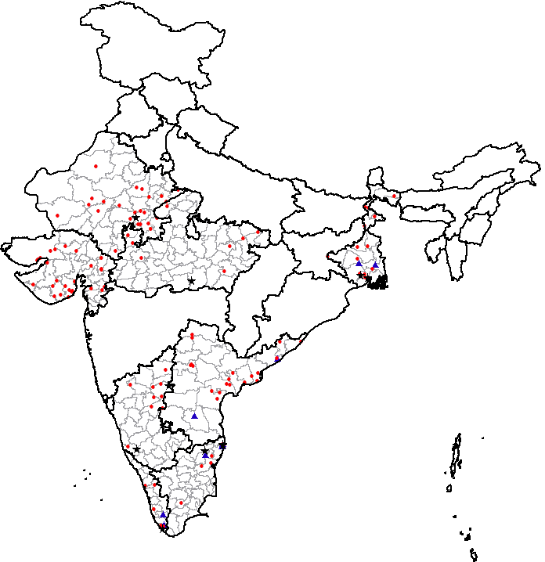
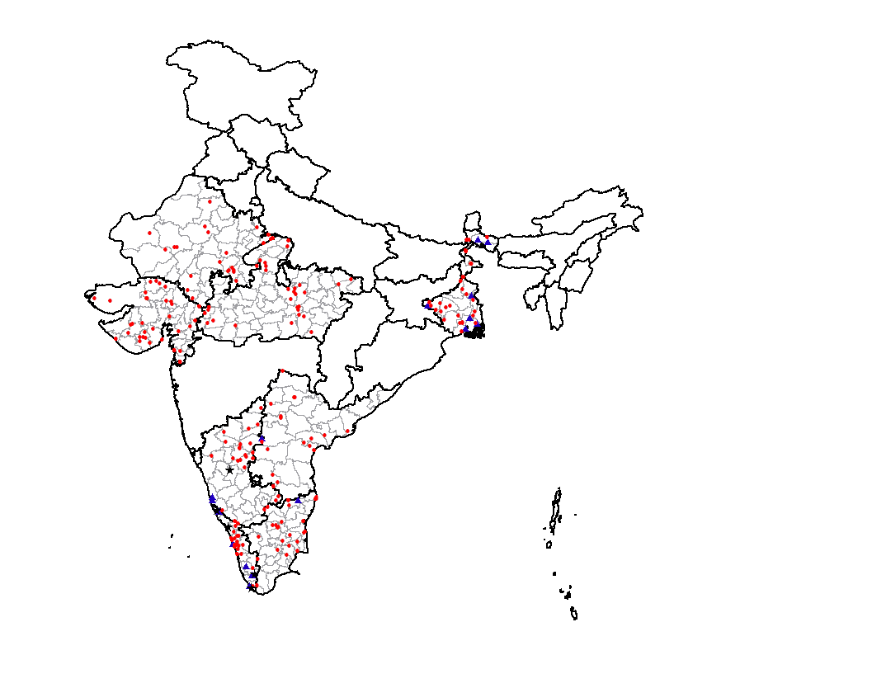
Serologically confirmed# measles, rubella and mixed outbreaks
(Andhra Pradesh, Gujarat, Karnataka, Kerala, Madhya Pradesh, Rajasthan, Tamil Nadu and West Bengal)
2011*
2010#
Widespread measles virus transmission indicating gaps in RI
129 outbreaks
219 outbreaks
Measles outbreaks confirmed
Rubella outbreaks confirmed
Mixed outbreaks confirmed
109
10
10
198
16
5
* data as on 15th Jun, 2011
# Outbreak confirmation for Measles: 2011 ≥ 2 cases IgM positive for measles and rubella

Slide 19
Presentation outline
Global context
Update on accelerated measles control
  MCV-2 in Routine services
  Catch-up campaigns
  Laboratory supported measles surveillance
Linkages with RI, recent publications
Summary and way forward

Slide 20
RI – Measles synergies
Measles catch-up campaigns has helped, RI
  By augmenting AEFI surveillance (reporting & management)
  By improving injection safety practices on a large scale
  By enforcing waste management practices (as per national guidelines)
  By optimizing cold-chain space & efficient vaccine stock management practice at various levels (state/district/block)
  Encouraging fixed-day , fixed-site session based approach
RI-Measles Synergy study is being done in Jharkhand
Year 2012 declared Year of intensification of RI
  Operational plan under development

Slide 21
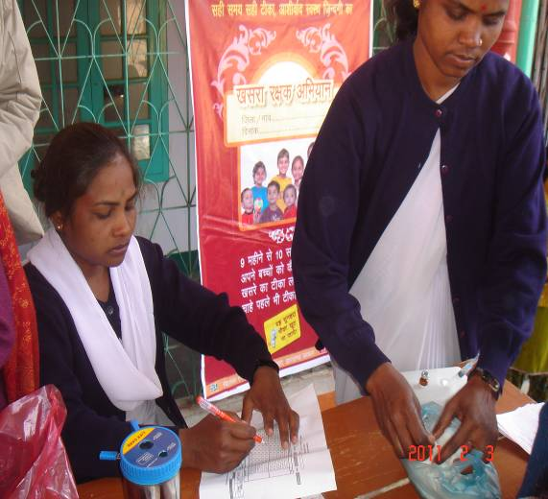
Recent Publications
Introduction Strategy of a second dose measles containing vaccine in India. Indian Pediatrics May 2011
Measles vaccine vs MMR reply Indian Pediatrics Sept 2011
Global Immunization Newsletter (GIN) November 2010

Slide 22
Presentation outline
Global context
Update on accelerated measles control
  MCV-2 in Routine services
  Catch-up campaigns
  Laboratory supported measles surveillance
Linkages with RI, recent publications
Conclusion

Slide 23
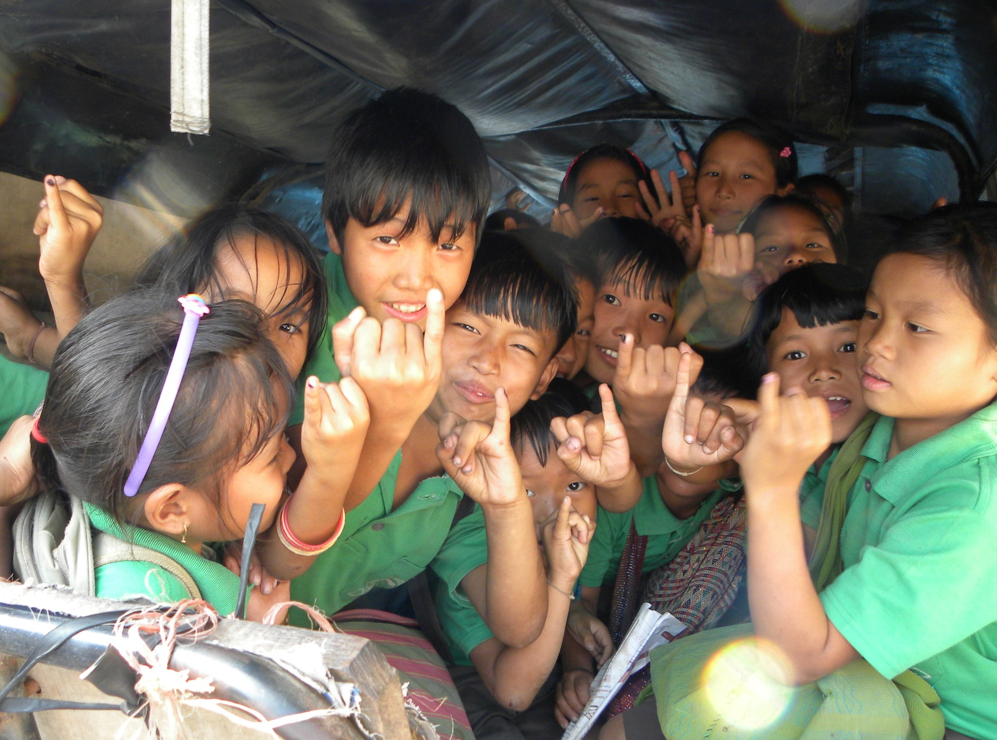
To conclude…
India is fully committed to control measles mortality as per its MYP
Expansion of measles surveillance to document virus transmission following the campaigns
Exploring how, Routine immunization could be further strengthened using Measles campaigns

Slide 24
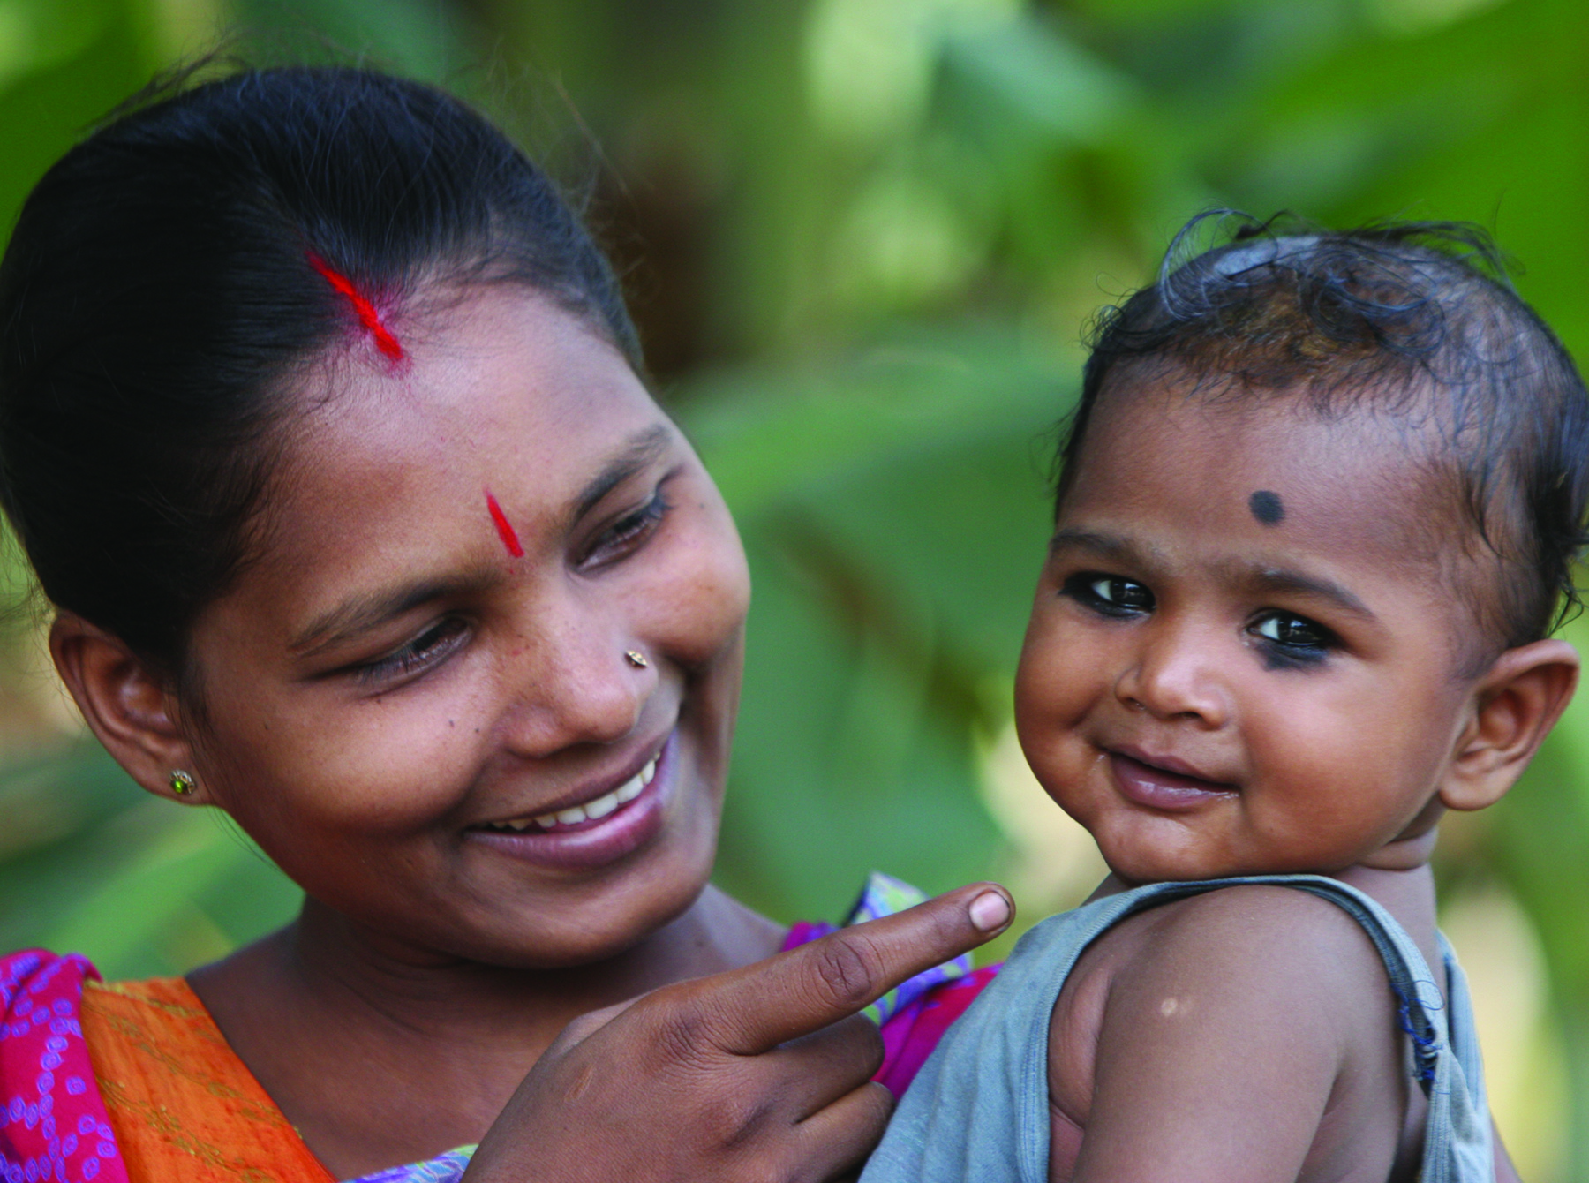
Thank you!
You got it!

