Slide 2

Long
&
Winding
Road
Notes:
Mary

Slide 3
Imagine
Notes:
Mary

Slide 4
Come Together
Notes:
Mary

Slide 5
Pilot of 5-Point Plan to
Strengthen Routine Immunization by
- Identifying Unvaccinated Children
- Determining the Reasons, and
- Rectifying the Barriers
American Red Cross & Kenya Red Cross Society
Notes:
Mary

Slide 6
5-Point Plan Pilot Objectives
Assess feasibility to mobilize CSOs & communities in a district to identify clusters of missed children and determine the reasons; and to engage partners to rectify the reasons in a sustainable manner for future generations;
Compare implementation in
  a peri urban area with low (60%-70%) and possibly decreasing coverage; and
  a high-density urban area with reported coverage of 70-80% but stagnating
Notes:
Mary

Slide 7
5-Point Plan Pilot Objectives
Assess feasibility to mobilize CSOs & communities in a district to identify clusters of missed children and determine the reasons; and to engage partners to rectify the reasons in a sustainable manner for future generations;
Compare implementation in
  a peri urban area with low (60%-70%) and possibly decreasing coverage; and November 2019 launch
  a high-density urban area with reported coverage of 70-80% but stagnating
Notes:
Mary

Slide 8
5-Point Plan Overview
Point 1.
Find clusters of unvaccinated children
Point 2.
Ask mothers & frontline health workers why
Point 3. Share information with MoH & partners and act to overcome barriers
Point 4. Social mobilization once barriers are removed
Point 5. Evaluate
~2 weeks for 1 district
November 2019
Jan 2020
Notes:
Mary

Slide 9
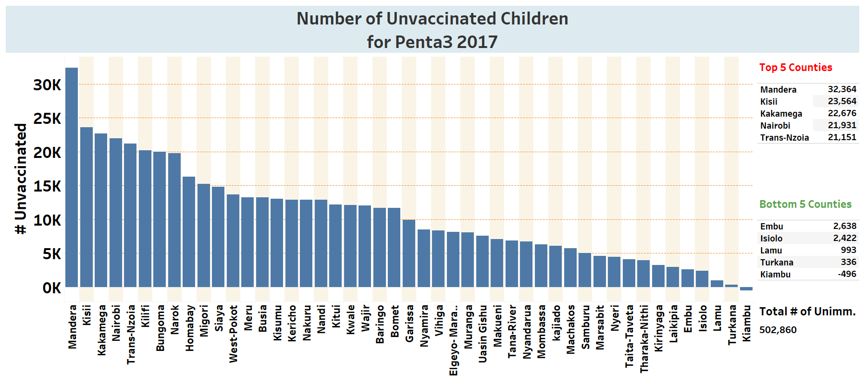
Planning: Selection of Targeted Area
5-Point Plan Pilot to Strengthen Routine Immunization
Kenya: natural fit
MoH consultations: Jan 2019
DHIS2 Data:
  Coverage (Penta1 & 3, MCV1)
    Low reported coverage of ~65%
  <2-year-old population
  Unknown reasons for low or stagnating coverage
  Geographical scale
Bobasi sub county, Kisi County ~12-hour drive from Nairobi
Top 5 Counties
Mandera | 32,364
Kisii | 23,564
Kakamega | 22,676
Nairobi | 21,931
Transnzoia | 21,151

Slide 10
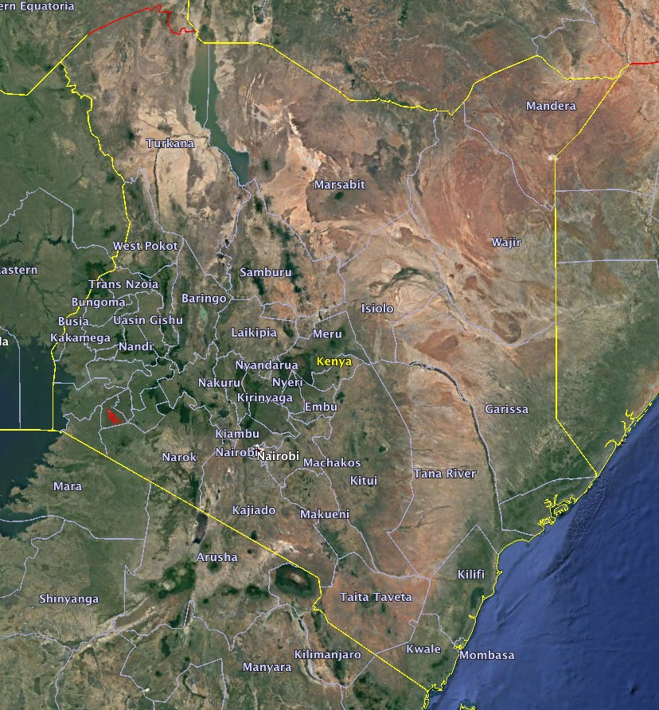
Bobasi sub county, within
Kisi County
Nairobi
Notes:
Amina

Slide 11
Building the Partnership
5-Point Plan Pilot to Strengthen Routine Immunization
Kenya: (Kenya Red Cross Society)
  Ministry of Health:
    National, county, sub county (district)
  Kenya Pediatric Society
  UNICEF
  WHO
  Living Goods
  Religious groups: 3 different denominations
National & International Consultants:
  Mr. Graham Sale; Dr Dale Rhoda; Mr Benard Mitto; Dr Karen Hennessey, Dr Felicity Cutts; Ms. Monique Petrofsky
AmRC Volunteers: Ms. Sara Horein; Ms. Kathy Flynn
Notes:
Amina

Slide 12
5-Point Plan Overview
Point 1.
Find clusters of unvaccinated children
Point 2.
Ask mothers & frontline health workers why
Point 3. Share information with MoH & partners and act to overcome barriers
Point 4. Social mobilization once barriers are removed
Point 5. Evaluate
~2 weeks for 1 district
November 2019
Jan 2020
Notes:
Amina

Slide 13
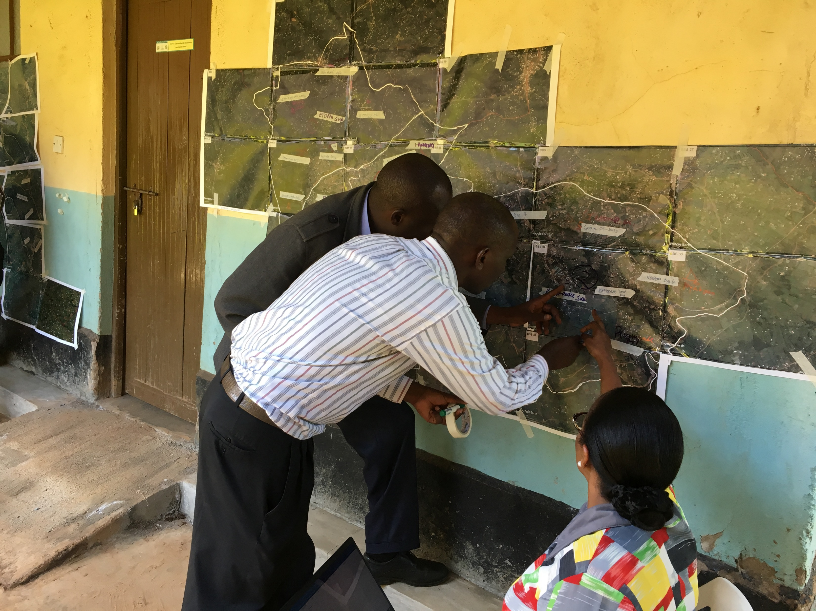
Satellite Maps, ‘Micromapping’,
Volunteers & Real-Time Data Collection
Satellite mapping
Est. 47,000 households
‘Micromapping’
>30 houses/volunteer/day
Recruit: 280 volunteers; 28 supervisors
  MoH & RC volunteers & partners
Notes:
Amina

Slide 14
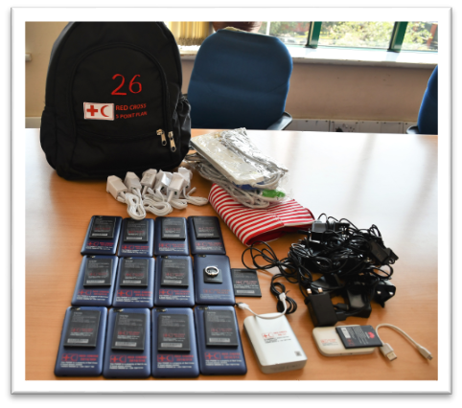
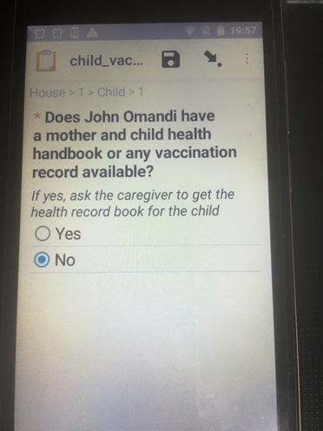
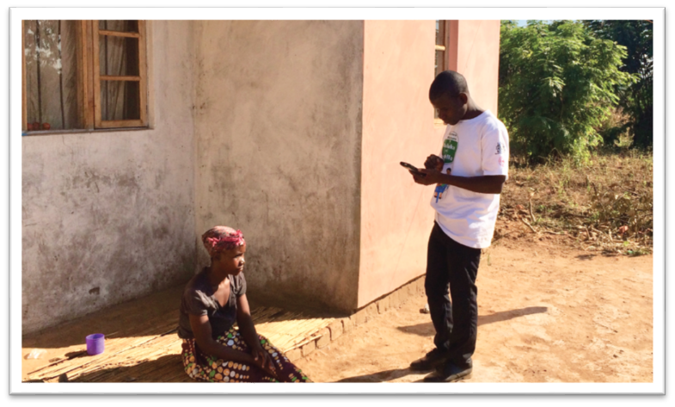
Real-Time Electronic Data Collection
Mobile data collection
Visit all buildings
Census of all residences with consent
Children <2 years, review home-based health records for Penta1, Penta3, MCV1
Notes:
Amina

Slide 15
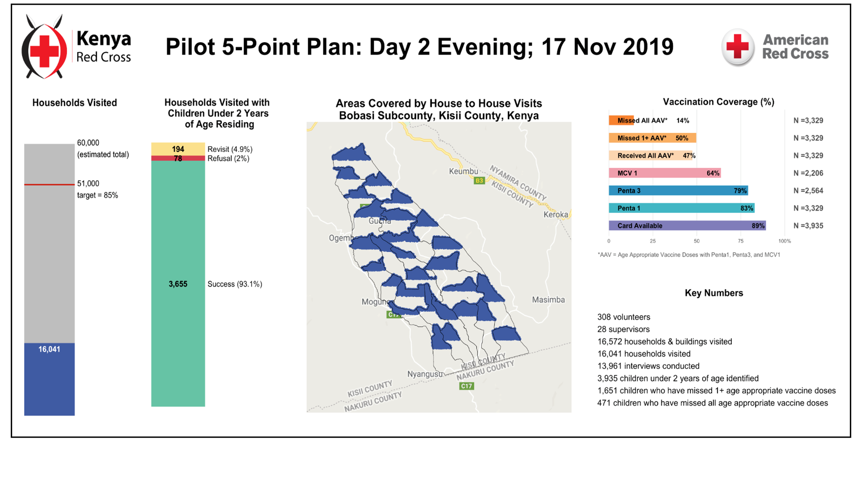
Monitoring Point 1: High-Level
5-Point Plan Pilot
Email mary.agocs@redcross.org for link to view live
Notes:
Mary

Slide 16
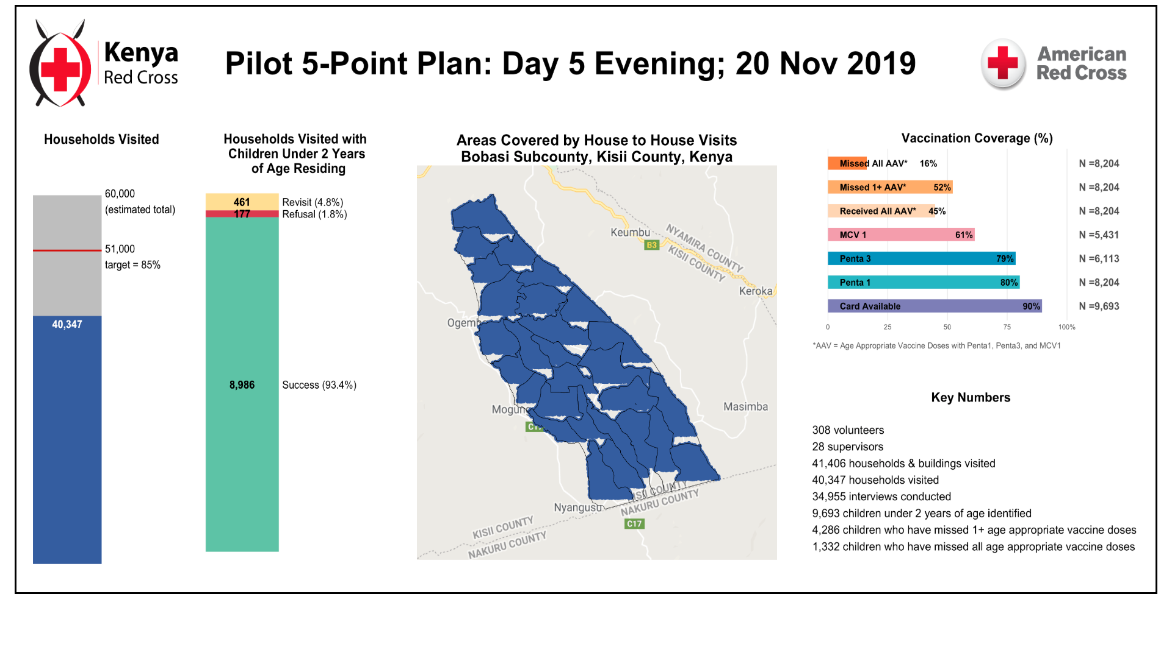
Monitoring Point 1: High-Level
5-Point Plan Pilot
Email mary.agocs@redcross.org for link to view live
Notes:
Mary

Slide 17
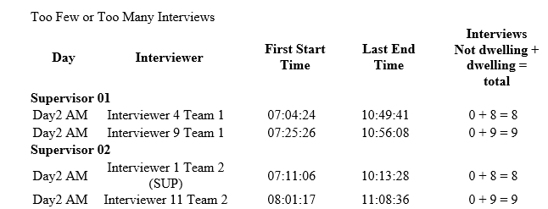
Monitoring Point 1: Situation Reports
5-Point Plan Pilot
Identify missed areas
Identify teams & volunteers not meeting targets
Track and return to houses: ‘Mop-Up’
  Houses with children <2 years of age; no interview
  No one at home
Notes:
Mary

Slide 18
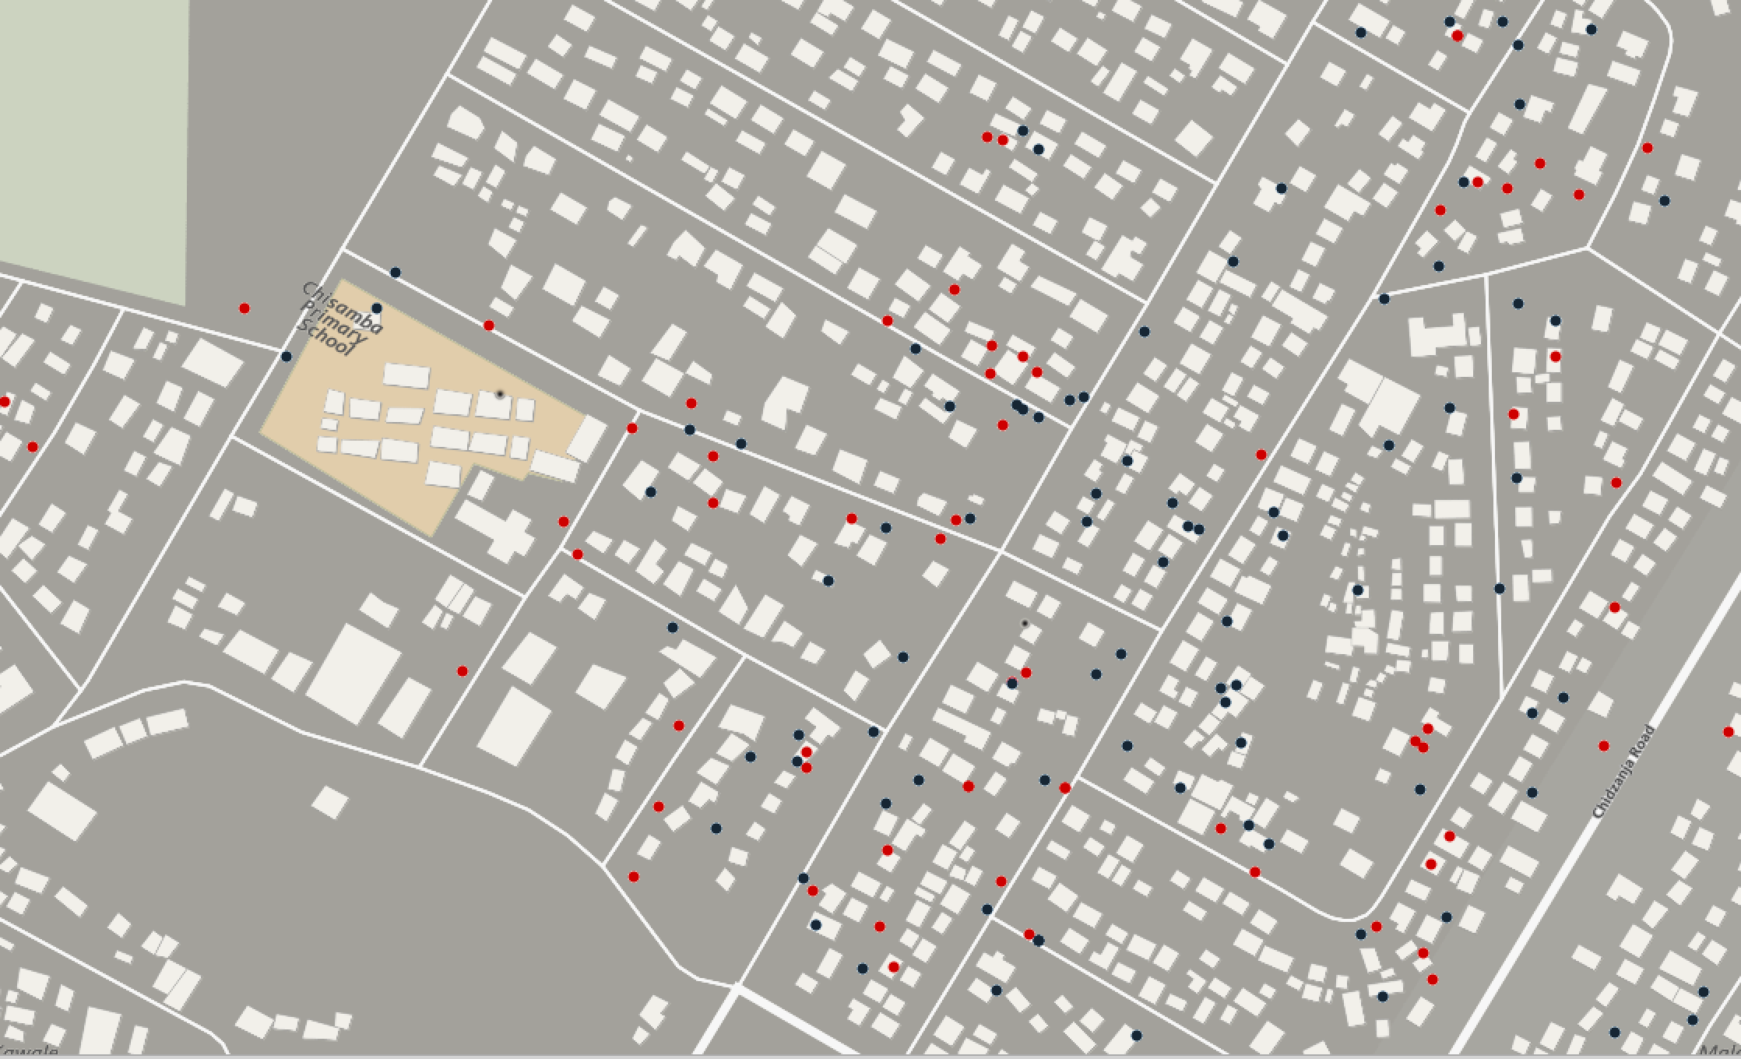

Defining a Cluster: A Work in Progress
Urban Africa: Mobile Phone GPS, Residence of Missed Child, 2017
Red dot: missed child; Blue dot: vaccinated child
Building-level data crowdsourced by volunteers, available through OpenStreetMap (OSM)

Slide 19
5-Point Plan Overview
Point 1.
Find clusters of unvaccinated children
Point 2.
Ask mothers & frontline health workers why
Point 3. Share information with MoH & partners and act to overcome barriers
Point 4. Social mobilization once barriers are removed
Point 5. Evaluate
~2 weeks for 1 district
November 2019
Jan 2020
Notes:
Amina

Slide 20
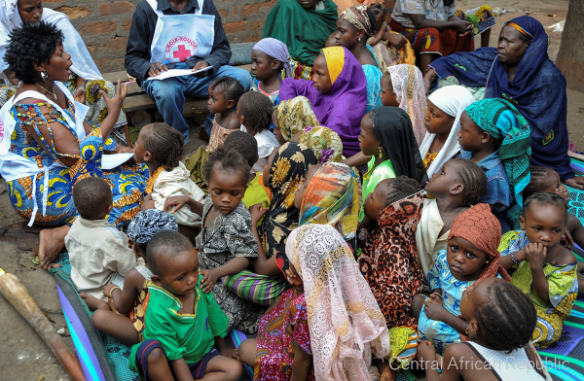
Barriers to Vaccination from the Mother/Caregiver Perspective
Point 2 of the 5 Point Plan
Focused group discussion
  Led by community & religious leaders: trusted setting
  Methodology melds with WHO/UNICEF MOV guidelines
Survey of mothers
  Senior Red Cross volunteer or community health worker
Notes:
Amina

Slide 21
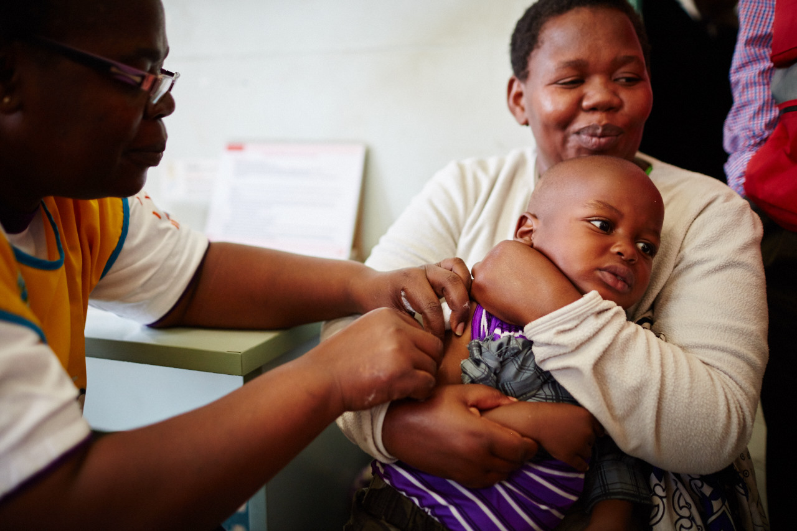
Barriers to vaccination from the health worker perspective
Point 2: Key queries in the Health Facility Interview
Health Facility-related Barriers
Long wait times
Stock-outs
Fixed sites – not convenient or consistent
Outreach - not convenient or consistent
Poor defaulter tracking
Do not vaccinate older (eligible) child
Do not vaccinate because of wastage associated with multi-dose vials
Do not vaccinate mildly ill or missing card
Missed opportunity – do not check for missed vaccines or refer eligible child to EPI clinic
Costs- charges a fee
Mother/Caregiver-related Barriers
Not aware of vaccine/services
Hesitant/afraid of vaccine
Lack of trust in HF /do not feel welcome or comfortable at facility
Social or political barriers
Costs –transportation, missing work
Notes:
Amina

Slide 22
5-Point Plan Overview
Point 1.
Find clusters of unvaccinated children
Point 2.
Ask mothers & frontline health workers why
Point 3. Share information with MoH & partners and act to overcome barriers
Point 4. Social mobilization once barriers are removed
Point 5. Evaluate
~2 weeks for 1 district
November 2019
Jan 2020
Notes:
Mary

Slide 23
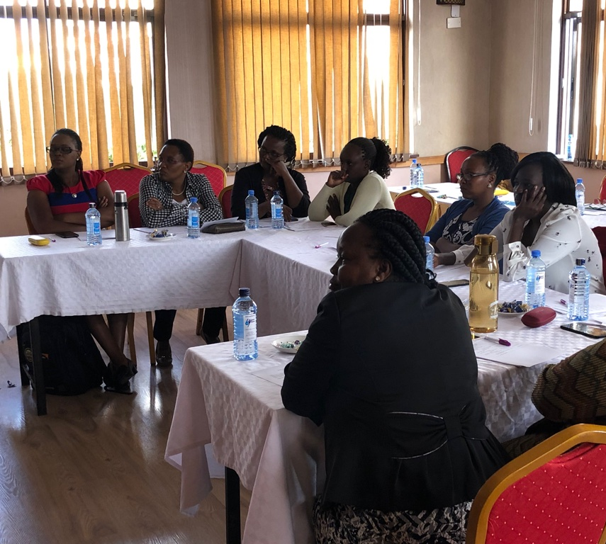
Piloting a Red Cross 5-Point Plan to
Strengthen Routine Immunization
Point 3. RC relays collated information to MoH and partners, who act to rectify problems
Coordination Meeting
MoH, WHO, UNICEF, RC & Partners take
ACTION
Notes:
Mary

Slide 24
5-Point Plan Overview
Point 1.
Find clusters of unvaccinated children
Point 2.
Ask mothers & frontline health workers why
Point 3. Share information with MoH & partners and act to overcome barriers
Point 4. Social mobilization once barriers are removed
Point 5. Evaluate
~2 weeks for 1 district
November 2019
Jan 2020
Notes:
Mary

Slide 25
With a Little
Help from
My Friends
Notes:
Mary

