Slide 1


Measles outbreak : increased partner support and a focus on strengthening routine immunization
(case of Madagascar)
Measles & Rubella Initiative Partners’ Meeting, September 11-12, 2019
Dr Hasimahery Randrianasolo R.
Chief of Staff, Office of the Minister of Public Health (Director of Cabinet)
Madagascar

Slide 2
Objectives
Share key message as lessons learned from 2018 Madagascar measles outbreak response:
At least four (4) key success factors for efficiently facing the measles outbreak :
Ensuring adequate case management (suspicious and confirmed), and facilitating access to treatment ;
Ensuring prevention through timely immunization campaigns and revitalization of routine vaccination throughout the territory;
Ensuring effective collaboration with all technical and financial partners for supporting the above ;
Ensuring good internal and external institutional coordination.

Slide 3
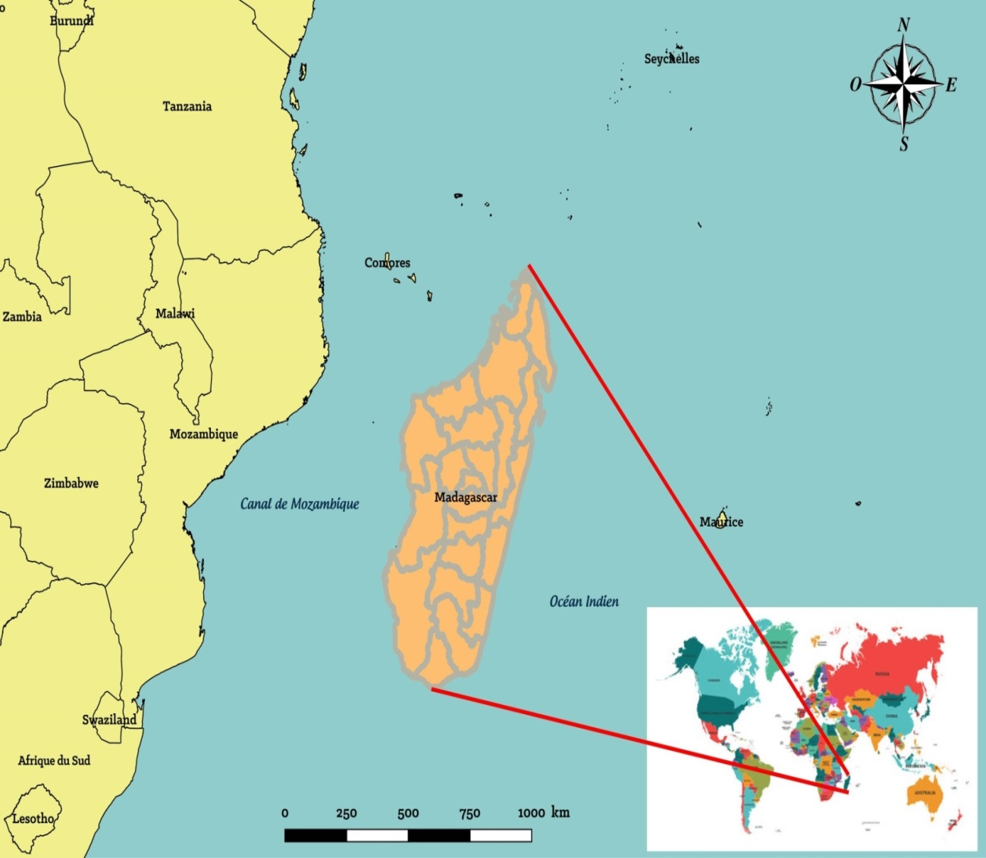
Presentation Plan
Madagascar : the world's 4th largest island
Located in the Indian Ocean Region
Area: 587,041 km²;
Population : almost 25,000,000 of inhabitants
  Children <15 years old : 45%
  Children < 1 year old : 3.53%
Administrative division:
  6 Provinces
  22 Regions
  119 Districts
  1 579 Communes
  20 348 Fokontany
  64 595 Villages
Public Health System Division:
  22 Public Health Regional Directorates (DRSP)
  114 Public Health District Services (SDSP)
  3,761 Health Facilities (public: CSB, CHRD,CHRR,CHU + private)
2018 measles outbreak started in the capital Antananarivo in September 2018
Context and generalities
Measles outbreak duration and ending
Measles outbreak causes
Measures adopted to fight measles epidemic
Collaboration between the Ministry of Public Health and its technical and financial partners towards a successful management of the measles epidemic
Lessons learned from the measles outbreak itself and its management
Measles current situation and measures
Conclusion
Source: OpenStreetMap (OSM)
3

Slide 4
Presentation Plan
Factor 1: Ensuring adequate case management and facilitating access to treatment
From week 35 of the outbreak in 2018 to week 34 in 2019:
202,692 cases, of which
26,795 (13 %) complicated cases.
946 deaths
Context and generalities
Measles outbreak duration and ending
Measles outbreak causes
Measures adopted to fight measles epidemic
Collaboration between the Ministry of Public Health and its technical and financial partners towards a successful management of the measles epidemic
Lessons learned from the measles outbreak itself and its management
Measles current situation and measures
Conclusion
Mortality:
  Before free care approach adopted: 0,8%
  After free care approach adopted: 0,1%
  Global : 0,5%
4

Slide 5
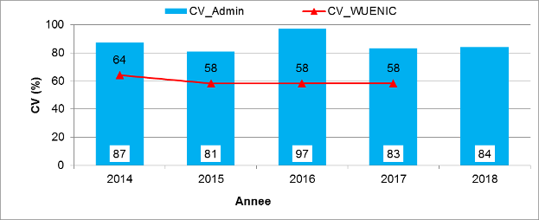
Presentation Plan
Factor 2: Ensuring prevention through timely immunization campaigns and revitalization of routine vaccination throughout the territory
Two (2) main causes of 2018 measles outbreak in Madagascar are:
Accumulation of children who were not reached by routine vaccination over a 10 year period, combined with a number of non-immunized adults who did not benefited from routine vaccination programme;
OMS-UNICEF estimates about 58% during the
last 3 years
significant difference (of about 20 points) between
the WUENIC estimates and the administrative data
National survey MICS 2018 confirmed the low
vaccination coverage : 54,4 %
(2) Inadequate quality of mass campaign of sensitization against measles undertaken (systematically carried out every 3 to 3 years since 2004)
(2) Inadequate quality of measles campaign (systematically carried out every 3 years since 2004)
Fact: Declared vaccination coverage (administrative) following official campaigns more than 80% since 2014, but:
Context and generalities
Measles outbreak duration and ending
Measles outbreak causes
Measures adopted to fight measles epidemic
Collaboration between the Ministry of Public Health and its technical and financial partners towards a successful management of the measles epidemic
Lessons learned from the measles outbreak itself and its management
Measles current situation and measures
Conclusion
5

Slide 6
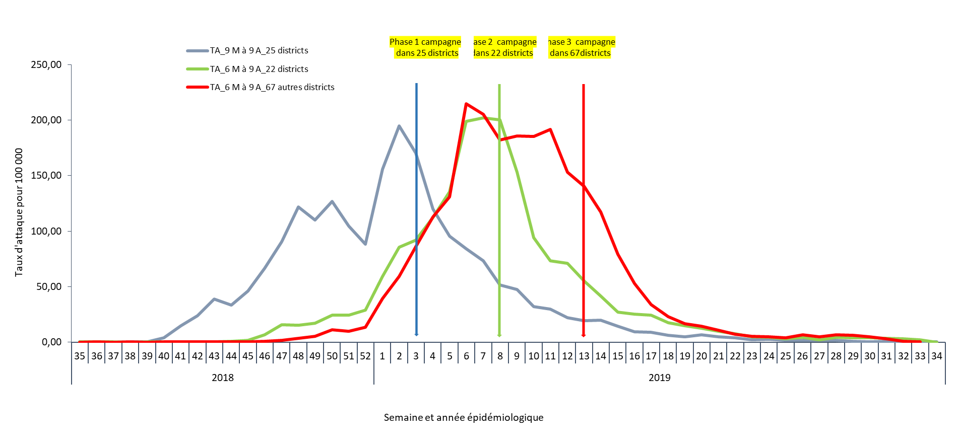
Presentation Plan
Factor 2: Ensuring prevention through timely immunization campaigns and revitalization of routine vaccination throughout the territory
Context and generalities
Measles outbreak duration and ending
Measles outbreak causes
Measures adopted to fight measles epidemic
Collaboration between the Ministry of Public Health and its technical and financial partners towards a successful management of the measles epidemic
Lessons learned from the measles outbreak itself and its management
Measles current situation and measures
Conclusion
Decrease of attack rates, for 6 months to 9 years children, as a result of vaccinal campaigns
6

Slide 7
Presentation Plan
Factor 3 : Ensuring effective collaboration with all technical and financial partners
Context and generalities
Measles outbreak duration and ending
Measles outbreak causes
Measures adopted to fight measles epidemic
Collaboration between the Ministry of Public Health and its technical and financial partners towards a successful management of the measles epidemic
Lessons learned from the measles outbreak itself and its management
Measles current situation and measures
Conclusion
  Collaboration between the Ministry of Public Health and its technical and financial partners for filling the needs gap towards a successful management of the measles epidemic
  (Part of the national budget dedicated to health sector: 9.6%)
N° | STRATEGIC AXES | COST (USD) | AVAILABLE | GAP
1 | Vaccinal response (3 phases) | 8 458 861 | 8 458 861 | 0
2 | Cases management /treatment | 835 367 | 802 406 | 32 961
3 | Epidemiological surveillance | 780 234 | 586 776 | 193 458
4 | Communication/Social Mobilization | 603 554 | 337 597 | 265 957
5 | Revitalization of routine vaccination | 2 270 913 | 1 778 709 | 492 204
6 | Vaccine for the revitalization | 323 785 | 323 785 | 0
7 | Coordination | 114 154 | 0 | 114 154
8 | Logistics | 36 249 | 1 825 | 34 424
 | TOTAL BUDGET | 13 423 117 | 12 389 964 | 1 133 153
(May 2019)
7

Slide 8
Presentation Plan
Factor 3 : Ensuring effective collaboration with all technical and financial partners
Various T&F Partners contributing in taking in charge identified needs
Context and generalities
Measles outbreak duration and ending
Measles outbreak causes
Measures adopted to fight measles epidemic
Collaboration between the Ministry of Public Health and its technical and financial partners towards a successful management of the measles epidemic
Lessons learned from the measles outbreak itself and its management
Measles current situation and measures
Conclusion
8

Slide 9
Presentation Plan
Factor 4: Ensuring good internal and external institutional coordination
Setting up an efficient institutional arrangement for a good coordination with external stakeholders / partners :
Context and generalities
Measles outbreak duration and ending
Measles outbreak causes
Measures adopted to fight measles epidemic
Collaboration between the Ministry of Public Health and its technical and financial partners towards a successful management of the measles epidemic
Lessons learned from the measles outbreak itself and its management
Measles current situation and measures
Conclusion
National Committee for the Coordination of the fight against measles
  Ministry of Public Health, other Ministries, T&financial Partners, Private sector
Operational Headquarter
Five (5) commissions :
  Monitoring and surveillance,
  Vaccination response,
  Case management,
  Social mobilization and communication,
  Logistics
SDSP
DRSP
9

Slide 10
Presentation Plan
Factor 4: Ensuring good internal and external institutional coordination
Madagascar Health System structure with a good internal coordination mechanism
Context and generalities
Measles outbreak duration and ending
Measles outbreak causes
Measures adopted to fight measles epidemic
Collaboration between the Ministry of Public Health and its technical and financial partners towards a successful management of the measles epidemic
Lessons learned from the measles outbreak itself and its management
Measles current situation and measures
Conclusion
Level | Institution | Amongst Missions | Health care structure*
Central | Cabinet/SG Central Directorates | Political orientation | 22 CHU
Intermédiate | 22 DRSP | Regional planning of programmes | 16 CHRR
Peripheral | 114 SDSP | Implementation management at the District level | 81 CHRD / 2567 CSB
Community | COGE | Health promotion | CSB
Central
Intermédiate
Peripheral
Community
10
* PNDRH 2014

Slide 11
Presentation Plan
For the future.. lessons learned from 2018 Madagascar measles outbreak response: "Let’s strengthen prevention and preparedness »
  Need for:
  (1)- An effective prevention plan:
  Strengthen routine vaccination and achieving maximum / optimal national vaccination coverage.
  *Strengthen monitoring of the quality and effectiveness of all activities ( routine and SIAs) .
  (2)- An effective warning system:
  Strengthen epidemiological surveillance and health surveillance system.
  (3)- A good coordination and internal monitoring system within all involved structures of the Ministry, at all levels at all times, for both prevention, preparedness and response.
  (4)- An effective collaboration and partnership with TF Partners:
  Strengthen collaboration and coordination mechanism and dialogue between partners and Ministries, at all times, for both prevention, preparedness and response (when needed).
  (5)- An effective preparedness plan for potential epidemics:
  Development of preparedness and response plans.
Context and generalities
Measles outbreak duration and ending
Measles outbreak causes
Measures adopted to fight measles epidemic
Collaboration between the Ministry of Public Health and its technical and financial partners towards a successful management of the measles epidemic
Lessons learned from the measles outbreak itself and its management
Measles current situation and measures
Conclusion
11

Slide 12
Thank you for your attention

