Slide 1

Measles Vaccination: Alternative Delivery Methods
GLOBAL MEASLES AND RUBELLA MANAGEMENT MEETING
15-17 March 2011
Salle B, WHO Headquarters, Geneva, Switzerland
Paul A. Rota, Ph.D.
Measles, Mumps, Rubella and Herpes Viruses Laboratory Branch
Division of Viral Diseases
DEPARTMENT OF HEALTH AND HUMAN SERVICES
CENTERS FOR DISEASE CONTROL AND PREVENTION

Slide 2
Dry Powder and Microneedle Vaccines
Demonstrate that dry measles vaccine can be reconstituted in vivo and produce an immune response

Slide 3
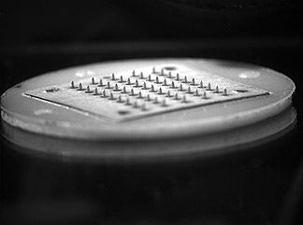
Long-Term Objective
To develop a microneedle-based patch that can successfully immunize an individual against measles virus

Slide 4
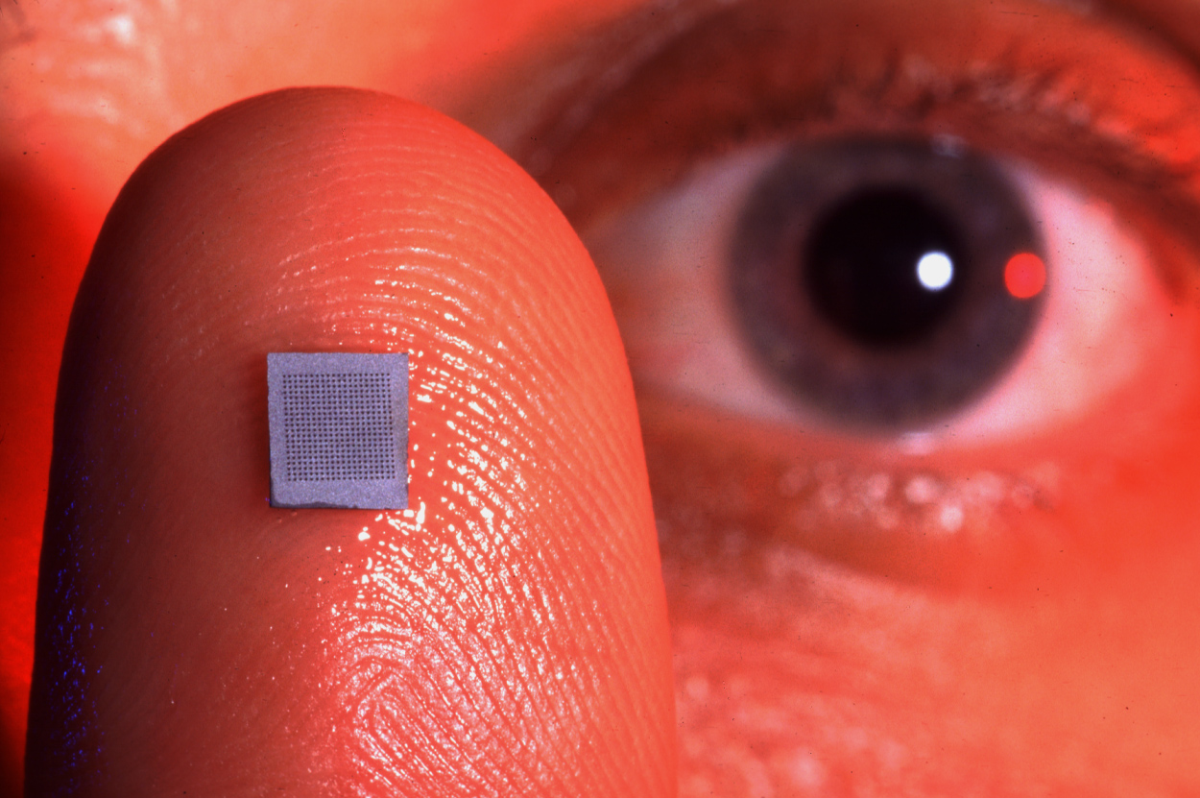
Microneedles
Micron-scale needles
Biologically inert: Stainless steel or titanium
Coated with dry vaccine
Vaccine rapidly dissolves in the skin
The “ouch factor” is significantly decreased

Slide 5
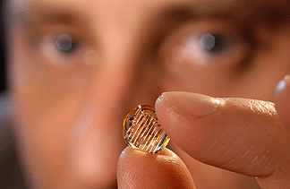
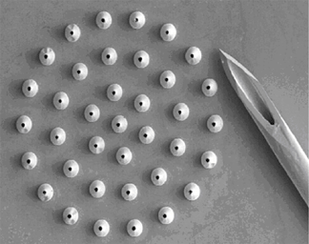

Slide 6
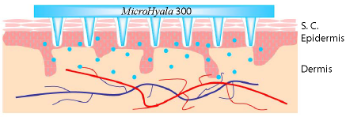

Slide 8
Excipient Selection
CMC and F68 were added to increase coating effectiveness
They negatively affect vaccine stability:
  2% CMC + 1% F68 creates 2.48 logTCID₅₀ loss after 1 day
  The addition of 15% trehalose reduces loss to 1.11 log units
  Replacing trehalose with 2.5% pig gelatin or 15% myo-inositol did not have a significant effect on stability

Slide 9
LOG(TCID₅₀) per array

Slide 10
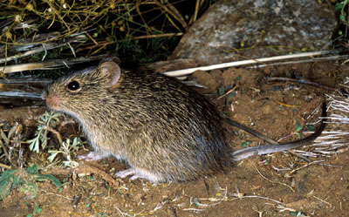

Immunogenicity in Cotton Rats: 1000 TCID₅₀ Microneedle and 1000 TCID₅₀ SQ

Slide 11
Plaque Neutralization Titer Against Measles Virus: 1000 TCID₅₀ Microneedle and 1000 TCID₅₀ SQ
Challenge study planned for April, 2011
Primate protocol is being written
Test in rhesus macaques in 2011?

Slide 12
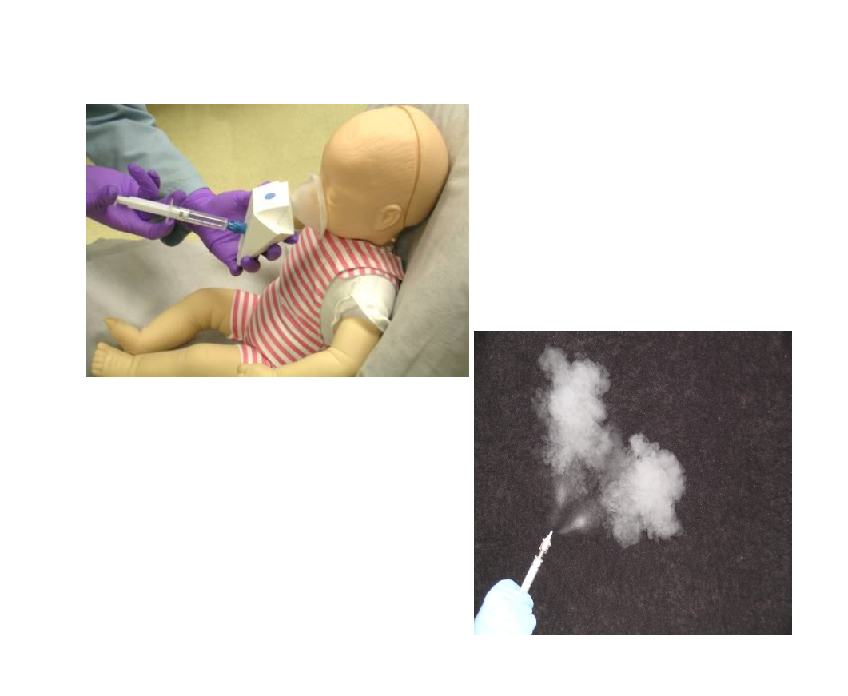
Dry Powder Vaccine for Measles

Slide 13
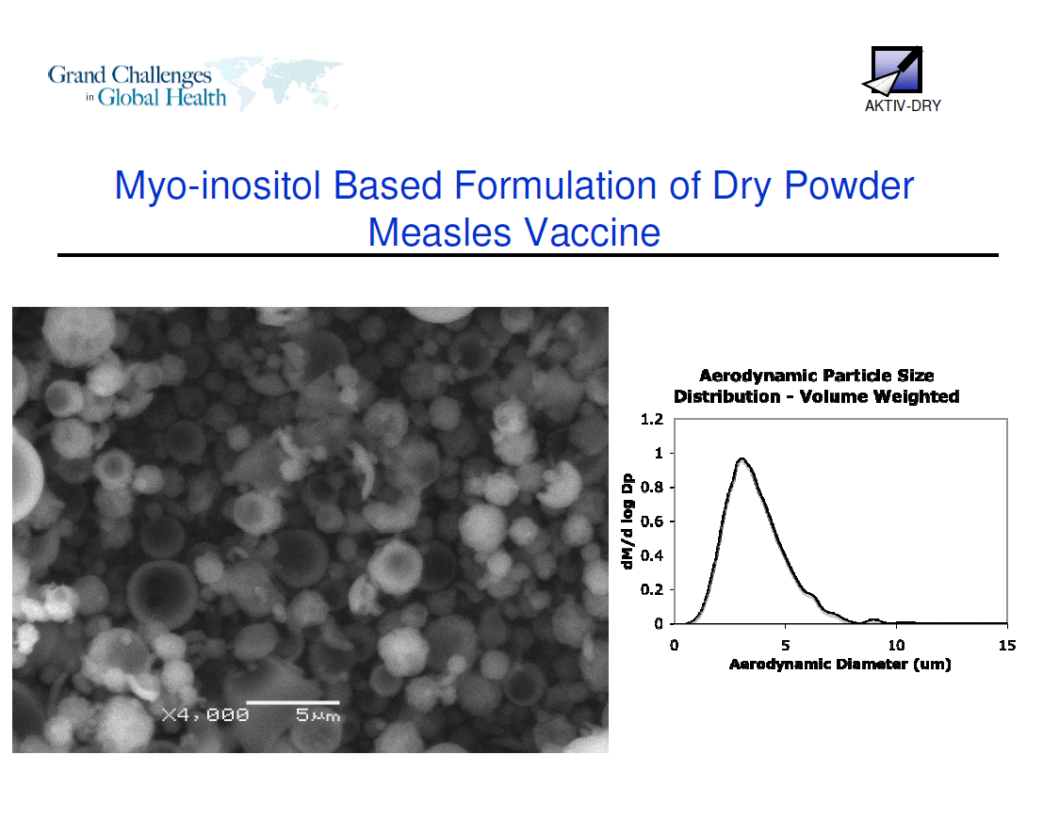

Slide 14
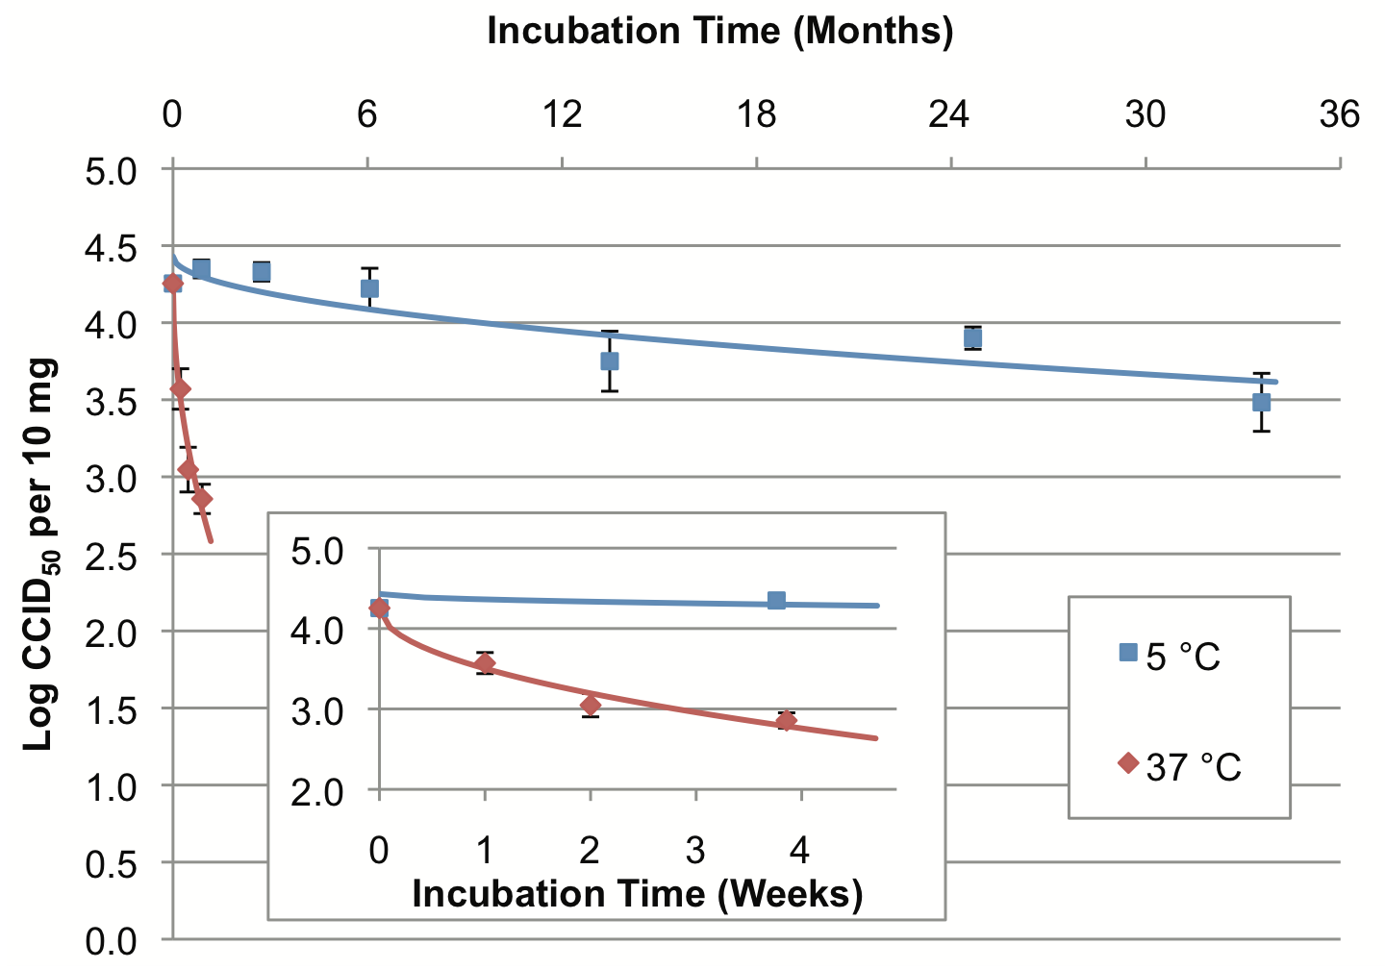
Retention of Dry Powder Measles Vaccine Potency
At 25 ºC the dry vaccine can be stored for 6 months

Slide 15
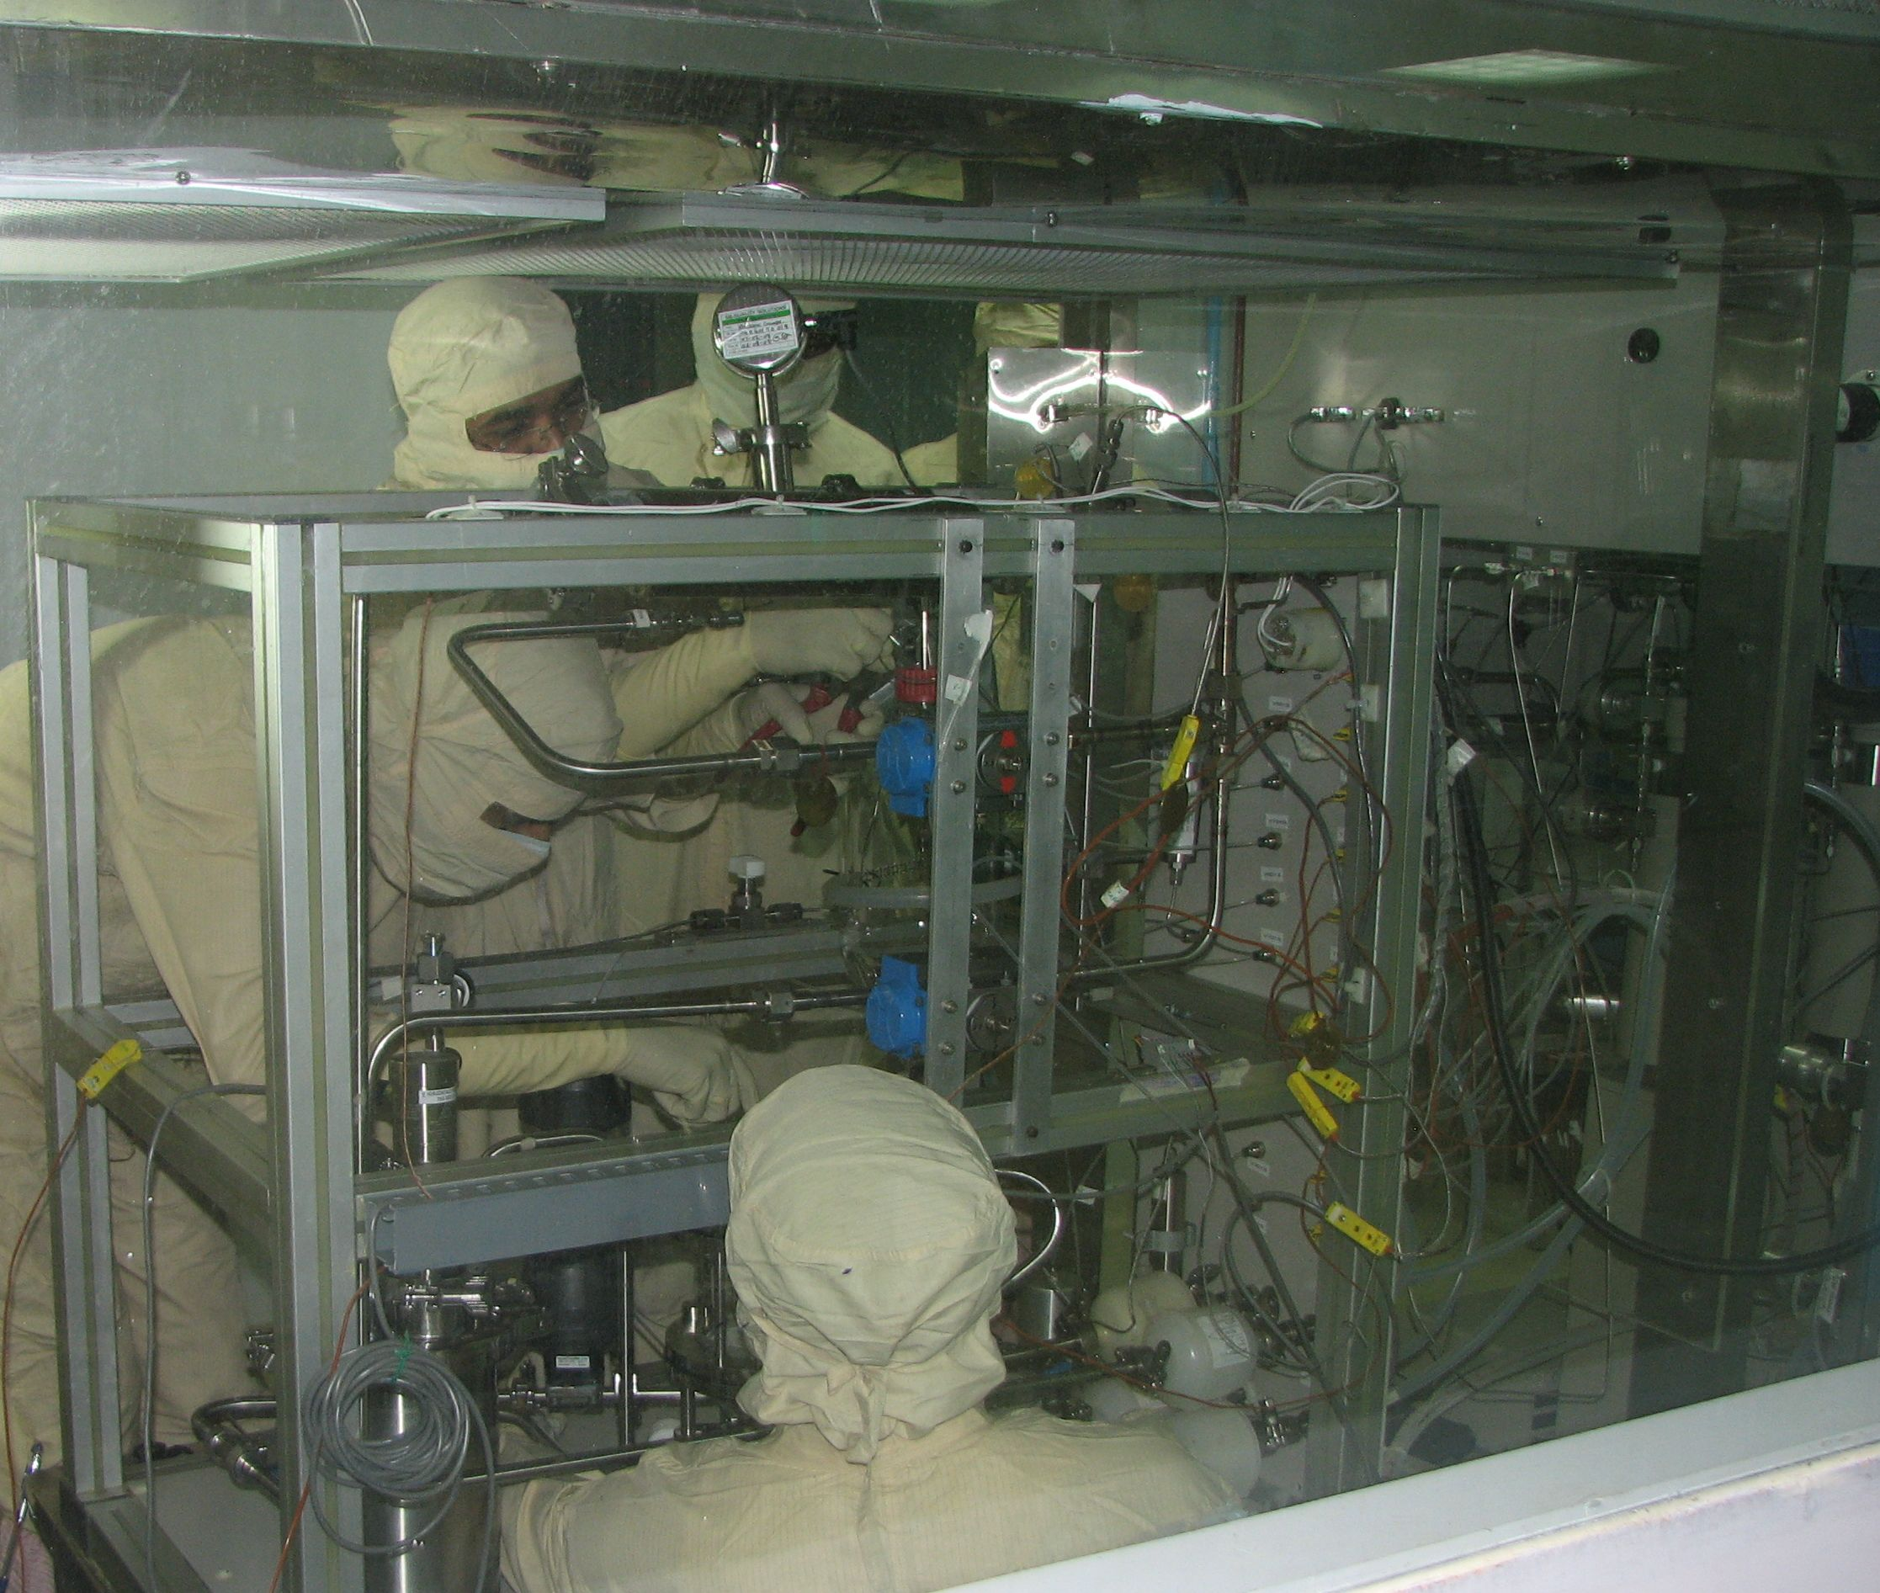
GMP CAN-BD powder manufacturing equipment installed at the Serum Institute of India (Pune, India) for the production of inhalable dry powder measles vaccine for the NHP toxicity study and Phase I clinical trial.

Slide 16
Conclusions from GLP toxicology study of MVDP in Rhesus macaques
No test article-related effects on:
  Clinical pathology including blood chemistry, hematology, coagulation, and urinalysis
  Gross pathology
  Organ weights
  Histopathology
The no-observed adverse effect level of MVDP is 50 mg when administered once or twice with PuffHaler or BD Solovent

Slide 17
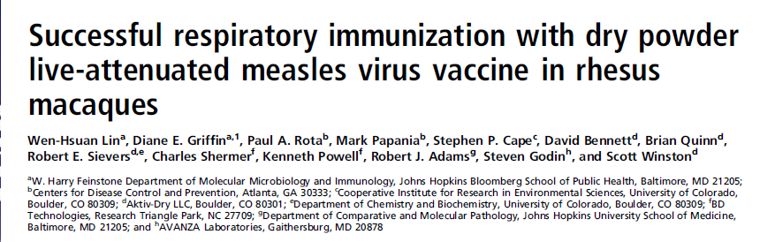

Slide 18
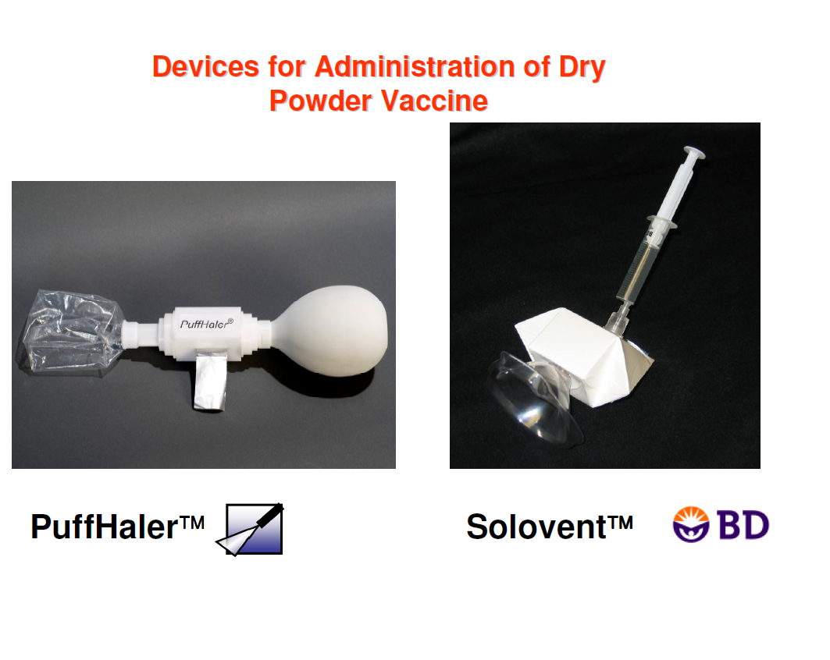

Slide 19
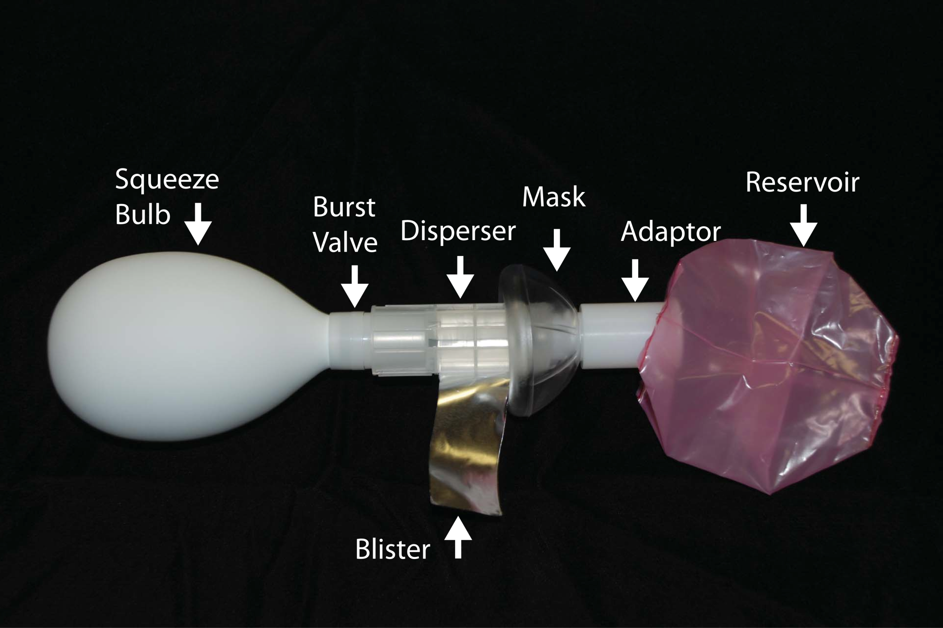

Slide 20
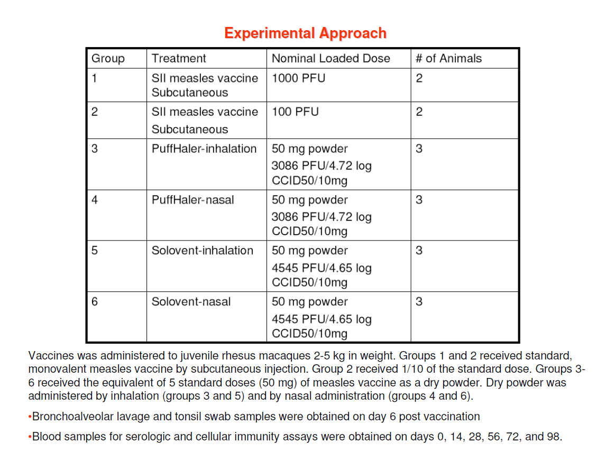

Slide 21
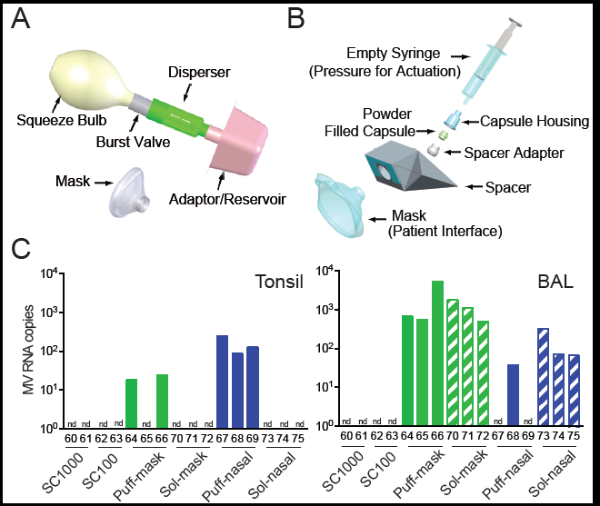

Slide 22
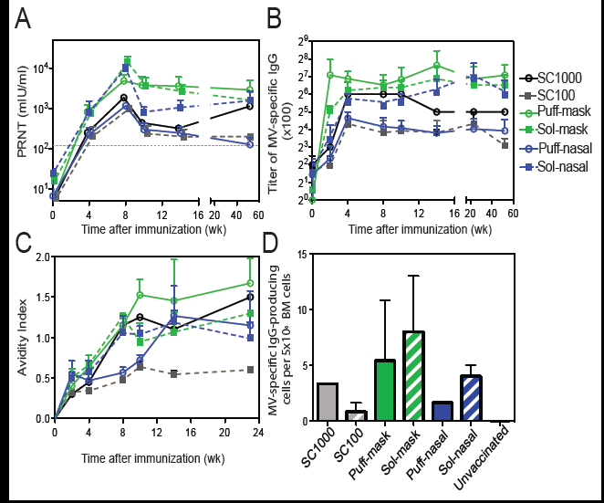

Slide 23
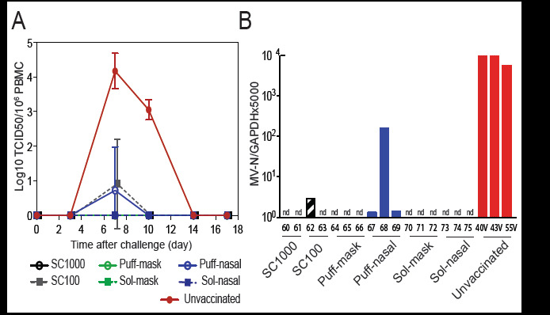

Slide 24
Status of Regulatory Submission
The results of the pre-clinical animal studies demonstrate that the Measles Vaccine Dry Powder can be delivered by inhalation using two novel, inexpensive, dry powder inhalers, is safe and non-toxic, and can induce protective immune responses against measles virus infection.
A Clinical Trial Application was submitted to the Drugs Controller General of India in July, 2010 to conduct a Phase 1 clinical trial of MVDP.

Slide 25
Design of Phase 1 Clinical Study
Study is sponsored by the Serum Institute of India, Ltd and will be conducted at a single hospital in Pune, India.
Study Objectives:
  Primary: to compare the safety of a single administration of 10 mg of inhaled MVDP aerosol given by PuffHaler or BD Solovent to a licensed Edmonston Zagreb measles vaccine given subcutaneously
  Safety will be determined by the incidence of solicited and unsolicited adverse events, physical examination, clinical laboratory testing, and concomitant medication use
  Secondary: to compare the immune responses, as measured by ELISA and PRNT, induced by the three delivery methods

Slide 26

Acknowledgements
MMRHLB, CDC: Marcus Collins, Mark Papania
Georgia Tech: Mark Prausnitz and Chris Edens
CDC ARB: Jessica Ayers
Support from Georgia Research Alliance
Aktiv-Dry, University of Colorado: Bob Sievers, Brian Quinn
SII: R Dhere
JHU: Diane Griffin
Support from Bill and Melinda Gates Foundation

Slide 27
Extra slides

Slide 28
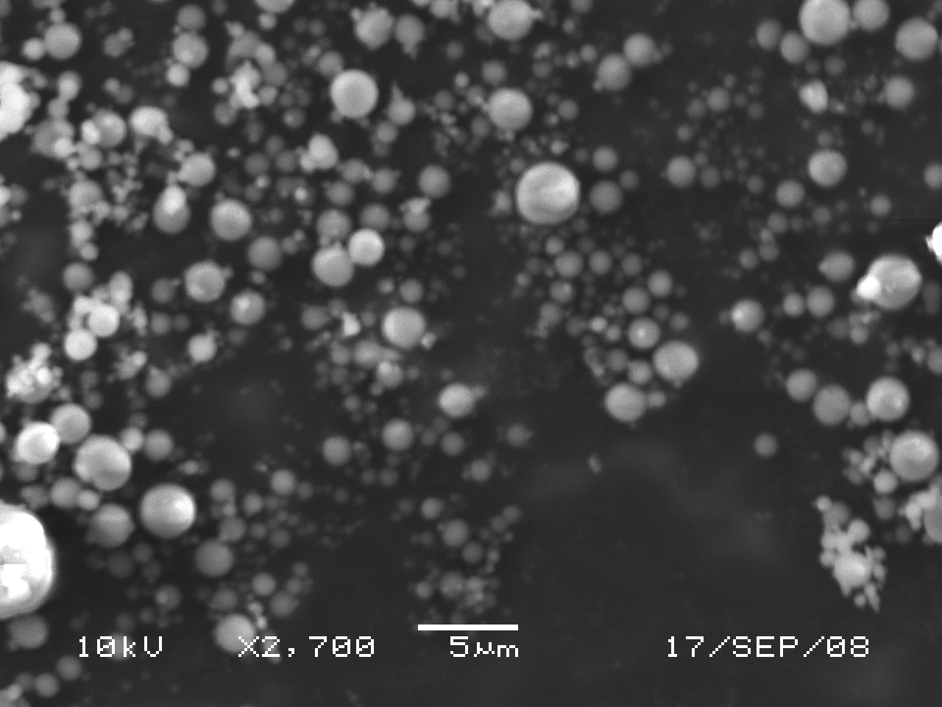
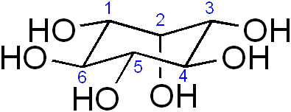
Formulation of Measles Vaccine Dry Powder
Structure of
myo-inositol
SEM of dry powder containing myo-inositol (rice-derived) manufactured by CAN-BD.

Slide 29
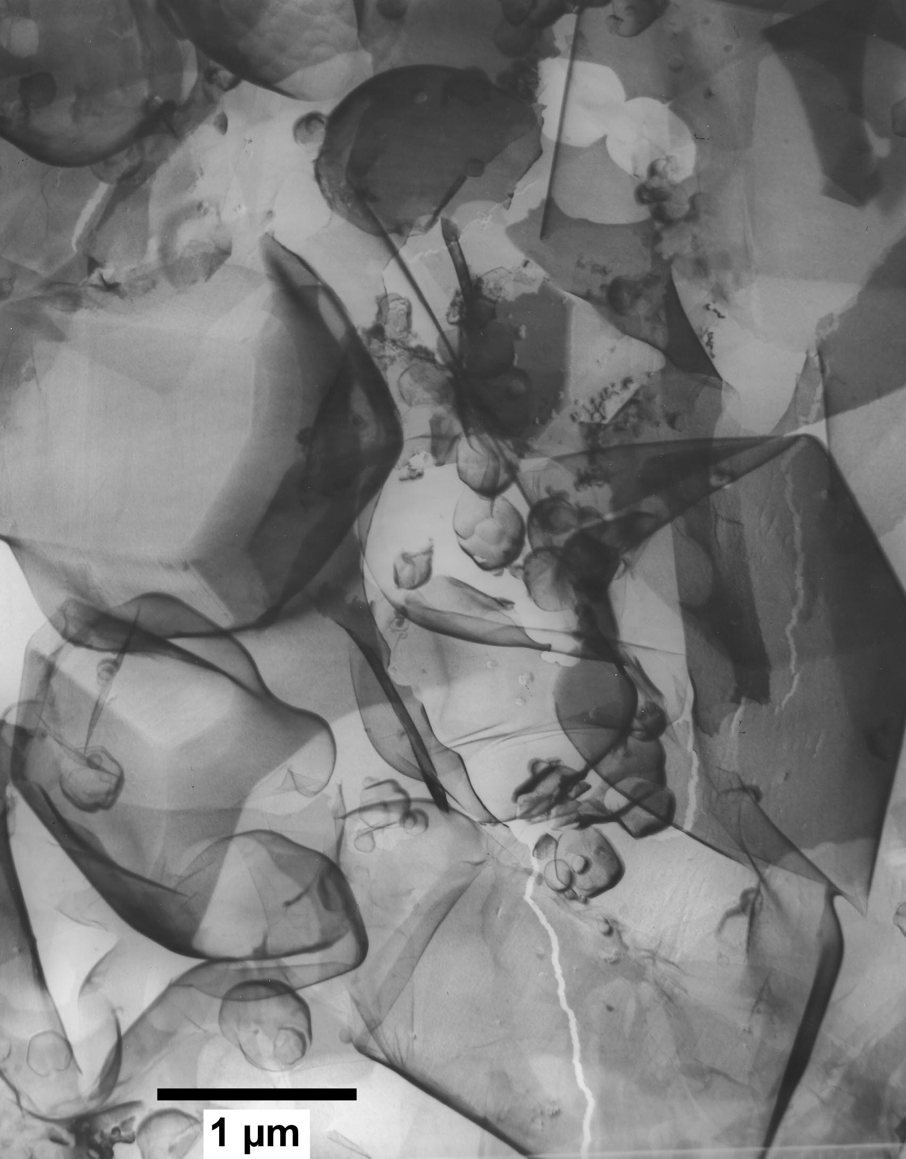
FREEZE-FRACTURE SEM OF E-Z SUB-MICRON MEASLES VIRUS ENCASED IN MYO-INOSITOL-STABILIZED EXCIPIENT MICROPARTICLES
Particles formed at <60 °C from an aqueous solution containing 11% total dissolved solids (50 g/L myo-inositol, 25 g/L gelatin, 16 g/L arginine-HCl, 1 g/L alanine, 2.1 g/L histidine, 3.5 g/L lactalbumin hydrolysate, 8.3 g/L MEM constituents, 3 g/L tricine, pH 6.5 - 7.0). Microparticles averaged 1 µm in diameter and encased spherical virus particles averaged 120 nm.
Mean viral potency of measles vaccine powder samples was 4.6 log CCID50 / 10 mg.

Slide 30
Vaccine Stability
Current WHO recommendations:
  Store lyophilized vaccine at 2-8ºC
  Required stability is 7 days at 37ºC
  After reconstitution of multidose vial, if not used within 8 hours, discard
Dry Stability
  Traditional vaccine rapidly loses titer after drying
  0.43 logTCID₅₀ units lost after 1 day
  Addition of 15% trehalose reduces loss

Slide 31
