Slide 1
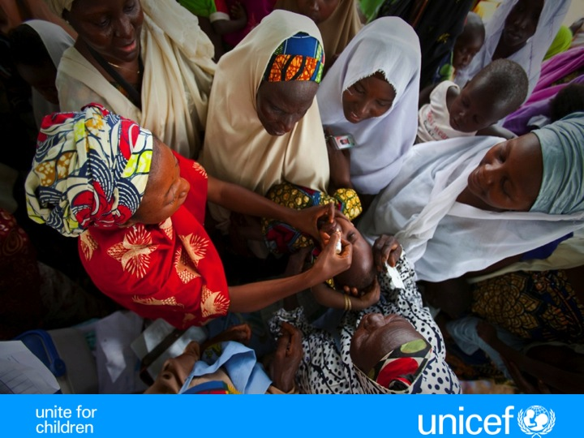


Photo: UNICEF
Reaching missed children
Lessons learned from polio
Susan MacKay, Maya van den Ent , UNICEF

Slide 2
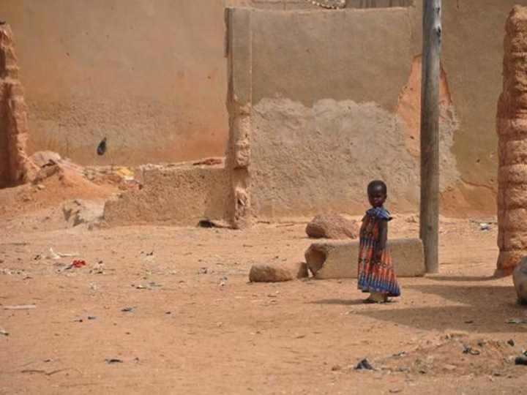
When it comes to missing children measles can learn a great deal from polio …
Photo: UNICEF

Slide 3
Routine and campaigns – we’re missing the same children

Slide 4
Polio SIAs and prior use of Routine
(Very) Low participation among non RI clients
In some SIAs, > 80% coverage overall, but <40% among non-RI users
Hellinger et all (2012) Bulletin WHO

Slide 5
Where do we miss the most children?

Slide 6
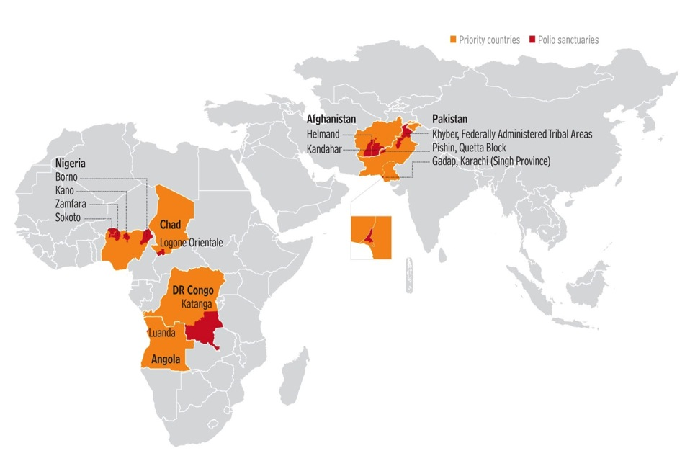
Polio Sanctuaries
Notes:
In all countries we continue to miss children. But this is most serious in the countries where polio is still endemic, or where low immunity allowed the poliovirus to become re-established. However, continued wildpolio or vaccine derived poliovirus circulation is a good indicator of where we continue to miss children. the ‘polio sanctuaries’ marked in red on this map are the arras with most missed children and require extra efforts. (mention some if necessary)
<number>

Slide 7
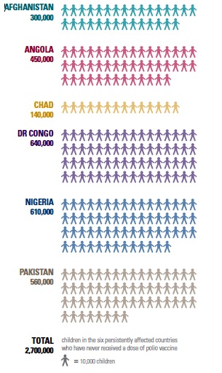
2.7 million children have not received a single dose. Many more are under-immunized.
Missed children disproportionately belong to minority groups.
Not all are in the sanctuaries. But if a data-driven, missed-children-focused approach can be honed in the sanctuaries, it can be applied elsewhere.
Every Missed Child, Report from the Independent Monitoring Board, June 2012
Notes:
Insert this as slide 7 after the sanctuary maps
In polio campaigns from IMB report; non AFP
<number>

Slide 8
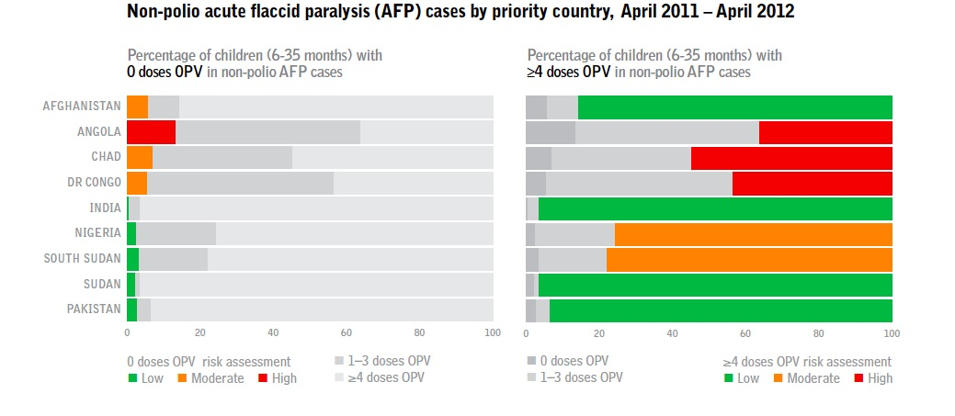
Polio Sanctuaries
Vaccination status non-polio AFP cases
Notes:
As you’ll see from this graph, in addition to Independent Monitoring of campaigns and the increasing use of LQAS, investigating the vaccination status of non-polio-AFP cases is also a good indicator of where we continue to miss children.
Trafic lights: CDC risk assessment
<number>

Slide 9
Who do we miss?

Slide 10
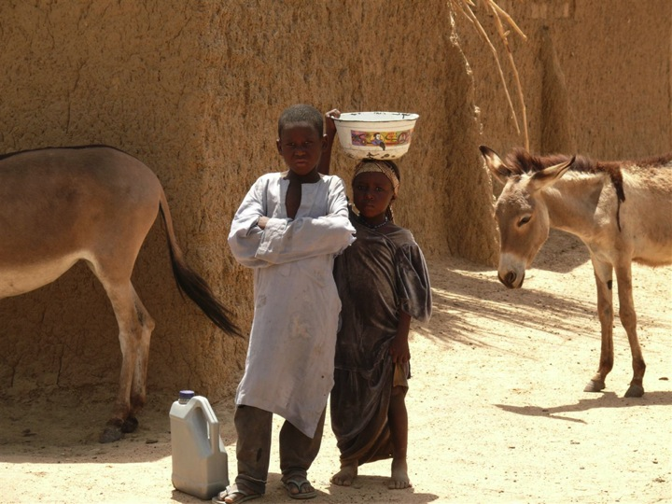
Photo: UNICEF
Risk profiling in Nigeria
Location: Rural 52%; Urban slums :28%
Literacy: Mothers (98%) , fathers (83%) illiterate
Occupation: 45% of cases are farmers; Trader 21%
Nomads: 8% with 49% living close to nomadic communities
Notes:
Out of actual cases n=77 cases 2012
Close to nomadic cases katsina state (CDC nomadic cases; 9 AFP compatible in fulani)
Concerns because can bring it to Niger or Mali; nomadic connections risk
<number>

Slide 11
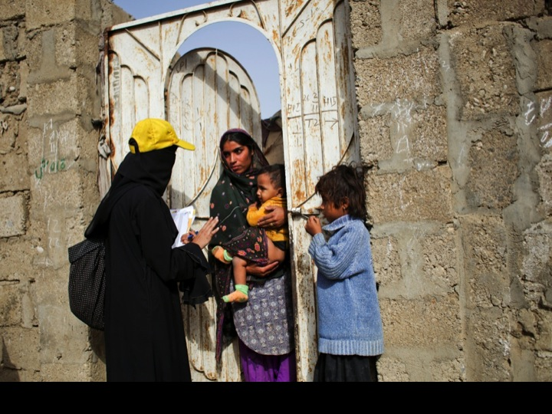
Photo: UNICEF
We’re rapidly expanding our use of risk profiling and special investigations to better understand exactly who is most at risk
Notes:
Special Investigation Tool:
including social elements with operational causes
- Confirmed case; zero AFP case; high % of missed children; high % refusals or missed children due to social reasons;
Page 7 may report;
<number>

Slide 12
Why do we miss them?

Slide 13
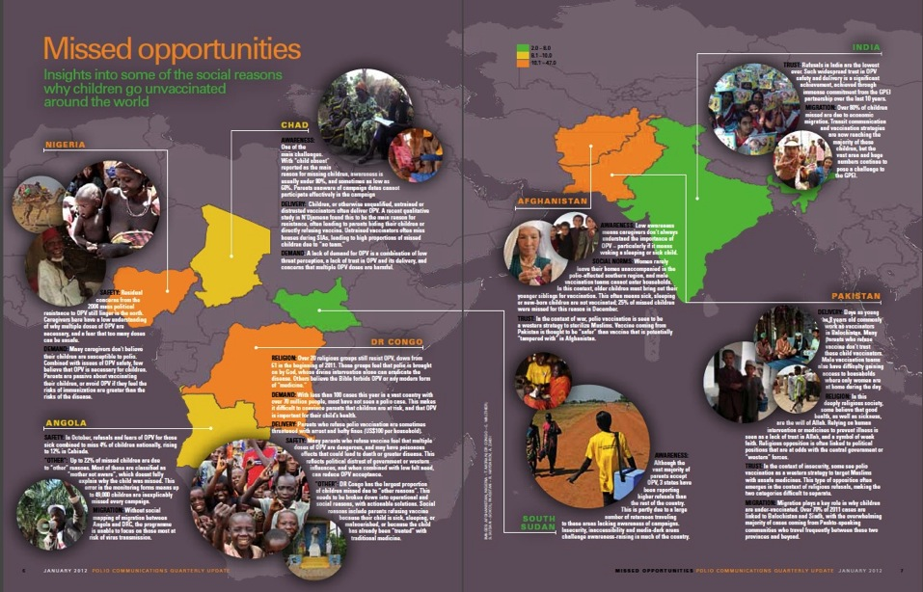
Reasons for missed children – both social & operational
www.polioinfo.org
Notes:
Team not visiting; poor team performance; refusals due to team performance; confusion of operational with social reasons
<number>

Slide 14
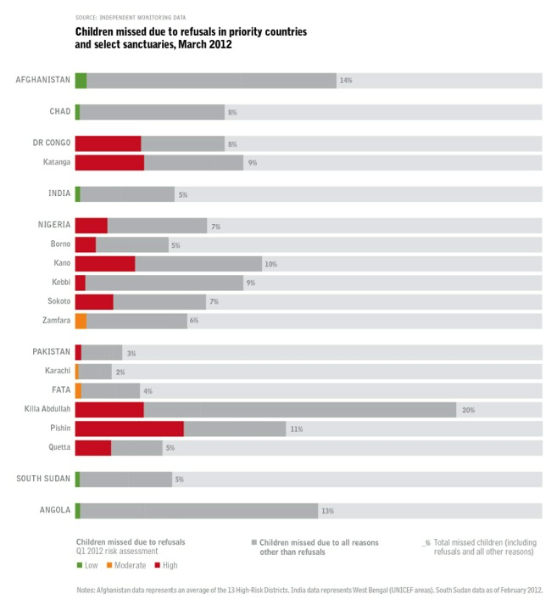
Overt refusals are not the main reason for missing children in any country
Share of refusals among all missed children in priority countries and select sanctuaries March 2012
Source: Independent Monitoring Data
DR Congo, Nigeria and Quetta Block (Pakistan) present the biggest challenges.
Notes:
Scale not 100%; refusals only small part of missed children;
Quetta block (3 red in pak)
<number>

Slide 15
NIGERIA: Reasons for Missed Children by State,
High Risk States, July 2012
Inside Household Monitoring

Slide 16
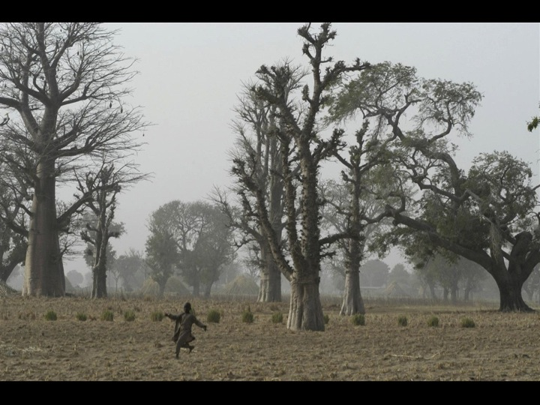
Can we increase demand from parents so that they make sure their children are immunized?
Photo: UNICEF
In Nigeria 22% are at the family farm, 28% at social events and 28% are playing nearby the house
Notes:
Soft refusals; covert refusals; 70% of missed children is absent in Niger State; to dig why are they absent;
If no refusal, the we could set up facility when mothers want active search for vaccinations ;
<number>

Slide 17
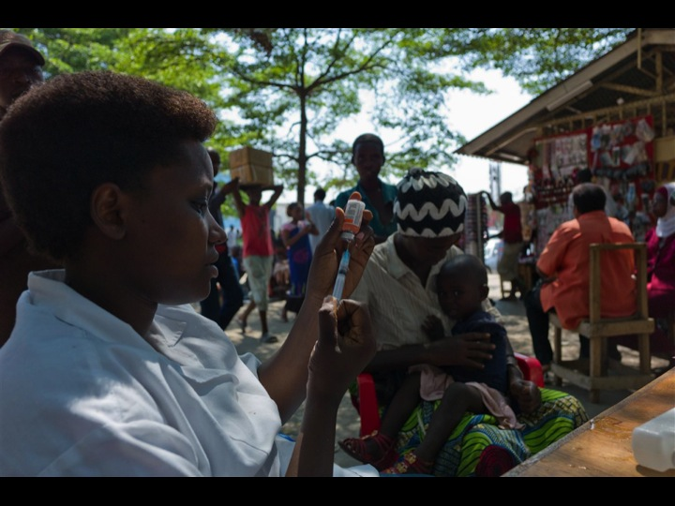
Can we innovate to bring the vaccines to where the children are?
Transit sites, border crossings, markets and other social gathering places give us valuable opportunities for both polio, measles and routine
Photo: UNICEF
Personal selling
(Volunteer Community Mobilization Network)
Notes:
Sometimes, service is not adapted to the beneficiaries and we need to understand the way high risk pops live;
Making the service more convenient; e.g. at koranic schools at night time; for nomadic populations at fulani market;
<number>

Slide 18
Importance of social data – answering the ‘what’

Slide 19
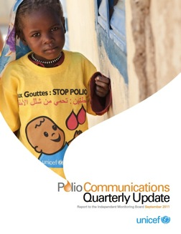
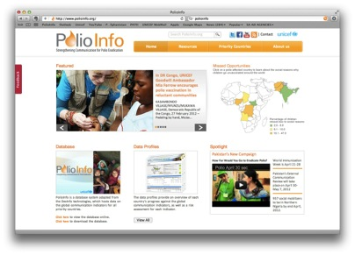
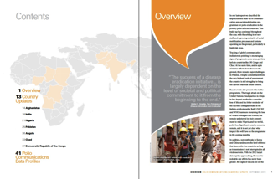
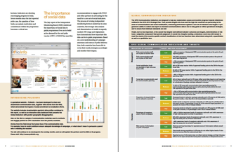

4
Data driven approach to communications and social mobilization
Indicators
Sources:
Surveillance reports (non – polio AFP cases)
Independent monitoring;
LQAs
UNICEF monitoring;
www.polioinfo.org
September 2011
Notes:
<number>

Slide 20
Importance of social research – answering the ‘why’

Slide 21
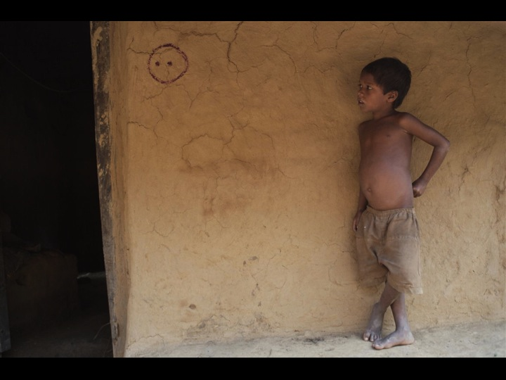
Rapid social research using FGDs and other qualitative techniques is proving vital for revising communication – and operational - strategies
Photo: UNICEF
Notes:
Nigeria: Men A and Polio for combination: too risky Pfizer scandal (Kano)
Older age groups risky for birth control issues;
<number>

Slide 22
How to improve communication and social mobilization

Slide 23
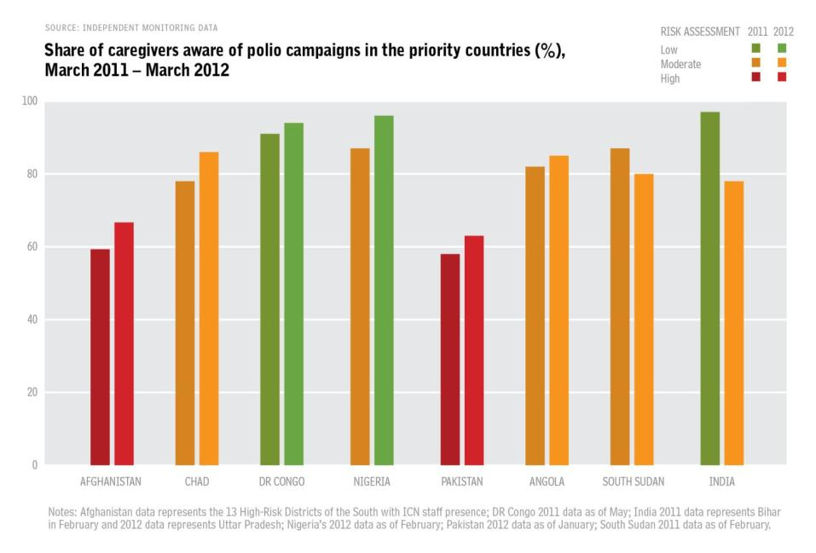
Campaign awareness globally
Notes:
CHALLENGE
Pakistan has one of the lowest awareness levels globally among endemic and re-established countries and India
<number>

Slide 24
Awareness & Knowledge of Polio - Pakistan
Example from Pakistan
Recent KAP study in high risk populations
  Only 6% heard of polio but don’t exactly know what it is
  Only 55% named polio vaccination as a way to protect from polio disease
  20% still don’t know how to prevent polio
Notes:
CHALLENGE
Recent KAP study further highlights this existing gap in awareness and knowledge leading to the current low demand for polio especially in high risk area
In line with the NEA, PCO has supported the program to increase demand and awareness to improve quality of activities in Pakistan through the following initiatives:
1-Mass media campaign
2- COMNet presence
3 – Outreach to religious groups
4 -
<number>

Slide 25
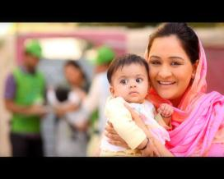
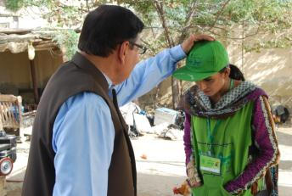
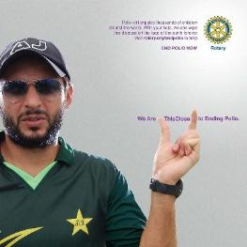
Mass Media Campaign reaches over 110 million caregivers each month with at least 3 contacts – through TV, radio, print materials
How Far Would You Go to Eradicate Polio?
Vaccination is important. It’s everyone’s responsibility. Going the extra mile to vaccinate your child/every child is heroic
Profiling Polio Hero’s: Mothers, Vaccinators, Athletes, Civil Society
Notes:
RESPONSE
This special initiatives is also in line with responding to IMB recommendation regarding the frontline workers and focus on high risk communities
The intensive mass media enables the program messages to better reach all areas, including inaccessible areas and high risk
<number>

Slide 26
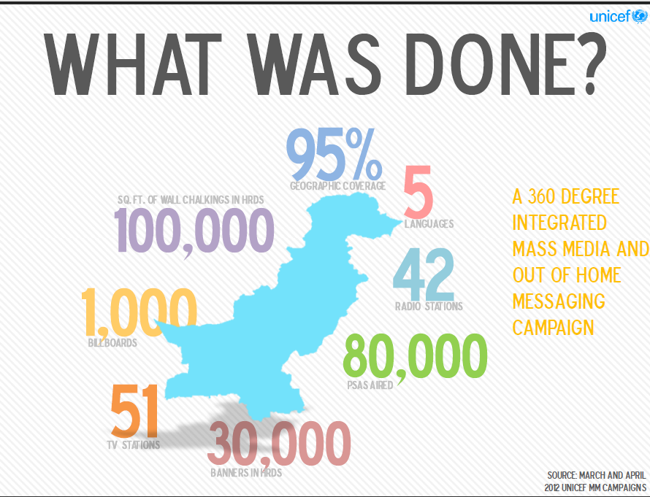
Notes:
RESPONSE
3 out of 5 Pashto speakers found out about campaign through Posters, Radio, TV
PSA Public Service Announcement (radio or TV spot)
It means that in addition to the interpersonal communication through COMNet, that even in the high-risk areas where we may not have access, we’re reaching Pashto speakers in Pakistan.
<number>

Slide 27
Polio campaign awareness nationwide has increased almost 10% after 3 campaigns
Source: PCM Data
Notes:
IMPACT
Source of information among those aware from TV has gone up from 27% to 51% in January – March
High risk: all but Punjab
<number>

Slide 28
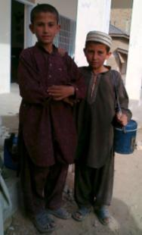
Overt refusals in Pakistan are limited to small pockets
Delivery: Many parents who refuse the vaccine don’t trust child vaccinators. Male vaccinators also have trouble reaching women.
Khyber Pakhtunwa
Federal Administrative Tribal Area
Killa Abdullah
Punjab
Pishin
Quetta
Balochistan
Sindh
Trust: Some see polio vaccination as a Western strategy to target Muslims. Minority groups do not trust vaccinators who are not from the area.
Religion: Religious opposition is often linked to political positions that are at odds with the central government or “western” influences. Religious groups are linked strongly to political parties in Pakistan.
Karachi Central
Notes:
Red areas are the high risk areas
No reach of media; need to go comnets ; high rate of refusals, actively have to persuade the pple to change attitudes;
Reaching out to underserved areas; for equity; mobilizers h2h in refusal areas; hard to reach areas;
CHALLENGE
This slide reflects data from what month? Source of data?
<number>

Slide 29
What does COMNet do?
EVERY MONTH:
25,347
Community Meetings
6,140
Influencers identified in microplans
4,581
Mosques announce polio campaigns
4,963
Schools and Madrassa’s support polio campaigns
Notes:
1085 Social Mobilizers; 202,481 doors
RESPONSE
<number>

Slide 30
Refusal Converted (%)
Refusal Reported (#)
* Source = PRIME Data
Notes:
IMPACT
By SM network
<number>

Slide 31
What are the take home lessons for measles?

Slide 32
Regular data collection (RCAs, IM, surveys) to identify awareness, motivation for vaccination, source of information and reasons for missed vaccinations
Development of evidence based communication plans

Slide 33
Systematically finding, understanding and addressing missed children requires considerable investment in collecting, analyzing and using social data
An integrated approach to communications and social mobilization is required to ensure behavioral impact

Slide 34

Political advocacy, mobilizing decision makers and opinion formers
Branding, advertising & ‘edu-tainment’ with national, provincial and community mass media
Point of service promotion (Vaccinator IPC)
integrated communication action
Community engagement and mobilization (meetings, forums, film showings and events)
Personal selling
(Volunteer Social Mobilization Networks)
COMBI Star adapted for polio eradication
Notes:
WHO behavioural impacts methods;
<number>

Slide 35
What Measles can Learn from Polio
Communication plans
  Based on evidence
Social data for action
  Surveillance data
  Independent Monitoring / Surveys
  Focus Group Discussion – In depth Interview
Measles to capitalize on polio investments
Notes:
<number>

Slide 36


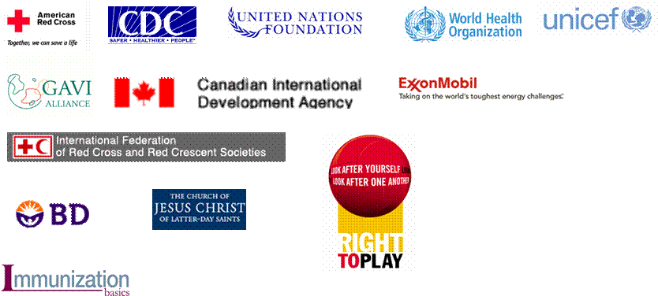














Anne Ray Charitable Trust
<number>

