Slide 1


Achieving High Population Immunity to Eliminate Measles and Rubella
Dr Pradeep Haldar
Deputy Commissioner - Immunization
Government of India

Slide 2
Presentation Outline
Back ground and Rationale for MR campaign
MR Campaign in India – overview
Strengthening RI to sustain the gains
Summary

Slide 3
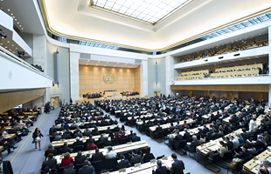

Measles and Rubella - Global Targets
Global: World Health Assembly, 2010
By 2015 (3 key milestones)
Coverage with first dose of a measles containing vaccine (MCV1) ≥ 90% national & ≥ 80% in every district
Measles reported incidence <5 cases/million popn.
Measles mortality reduction of 95% vs. 2000
September 2013: South-East Asia Region Countries adopted the goal of Measles elimination & Rubella/ Congenital Rubella Syndrome (CRS) control by 2020
Measles elimination and Rubella/CRS control is one of the 8 goals of the South-East Asia Regional Vaccine Action Plan: 2016-2020
September 2019: Measles elimination & Rubella/ Congenital Rubella Syndrome (CRS) elimination by 2023

Slide 4



Measles and Rubella Elimination
(Strategic Objectives)
95% coverage with two doses of MRCV
Sensitive Case-based MR Surveillance
Immunization
Surveillance
Support
&
Linkages
Laboratory Network
Accredited MR Laboratory Network
Advocacy, mobilization & communication
Outbreak preparedness and response
Measles in an emergency
Research and development

Slide 5
Measles Elimination and Rubella Control
(Strategic Objectives)
95% coverage with two doses of MRCV
Sensitive Case-based MR Surveillance
Immunization
Surveillance
Support
&
Linkages
Laboratory Network
Accredited MR Laboratory Network
Advocacy, mobilization & communication
Outbreak preparedness and response
Measles in an emergency
Research and development

Slide 6
Measles cases - SEAR
2000-2018
Source: WHO/UNICEF coverage estimates (Provisional), July 2019 and WHO/UNICEF JRF and EPI/MOHFW

Slide 7
Rubella cases - SEAR
2005-2018
Source: WHO/UNICEF coverage estimates (Provisional), July 2019 and WHO/UNICEF JRF and EPI/MOHFW

Slide 8
INDIA

Slide 9
MRCV1 and MRCV2 Coverage from HMIS, India
Percent coverage
* data as on Sep 2019

Slide 10
MRCV1 and MRCV2 Coverage from HMIS, 2018 - 19*
% MRCV1
% MRCV2
86%
71%
Legends |  | # Districts with %MRCV1 Coverage | # Districts with %MRCV2 Coverage
 | >=95% | 109 | 53
 | 80% to 95% | 181 | 87
 | 60% to 80% | 270 | 270
 | 40% to 60% | 80 | 140
 | <=40% | 19 | 55
 | Data not available
* data as on Sep 2019

Slide 11
MCV1 Coverage India (NFHS-4, 2015 – 16)
81%
>=95%
80% to 95%
60% to 80%
40% to 60%
<=40%
Target data not available
No data available

Slide 12
% MCV2 Coverage, RI Concurrent Monitoring, India
% MCV2 Coverage
N =
8811
69922
132251
132711
166046
148302
156895
102360

Slide 13

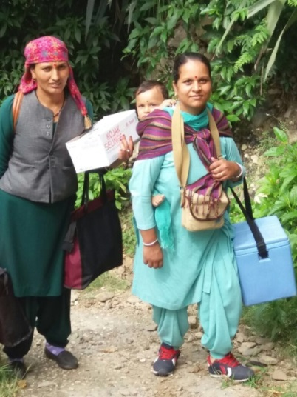
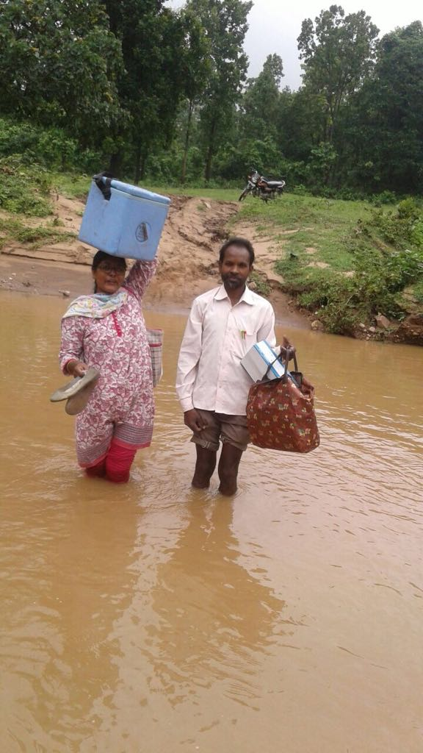
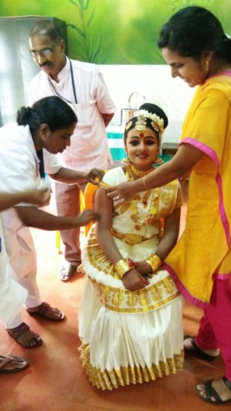
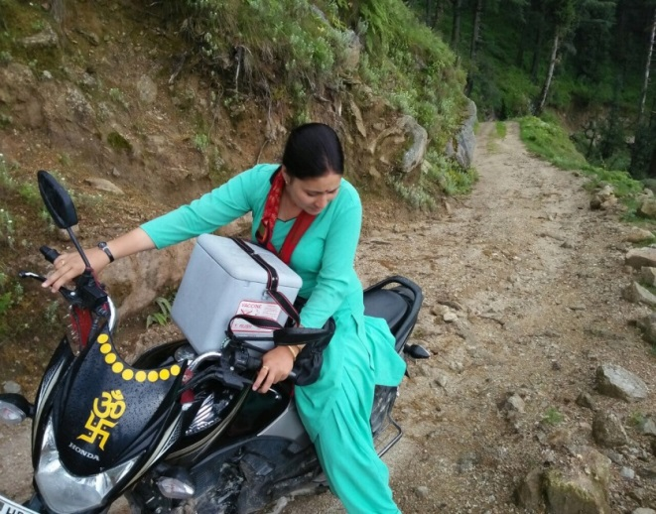
MR Campaign in India
The story so far…..

Slide 14
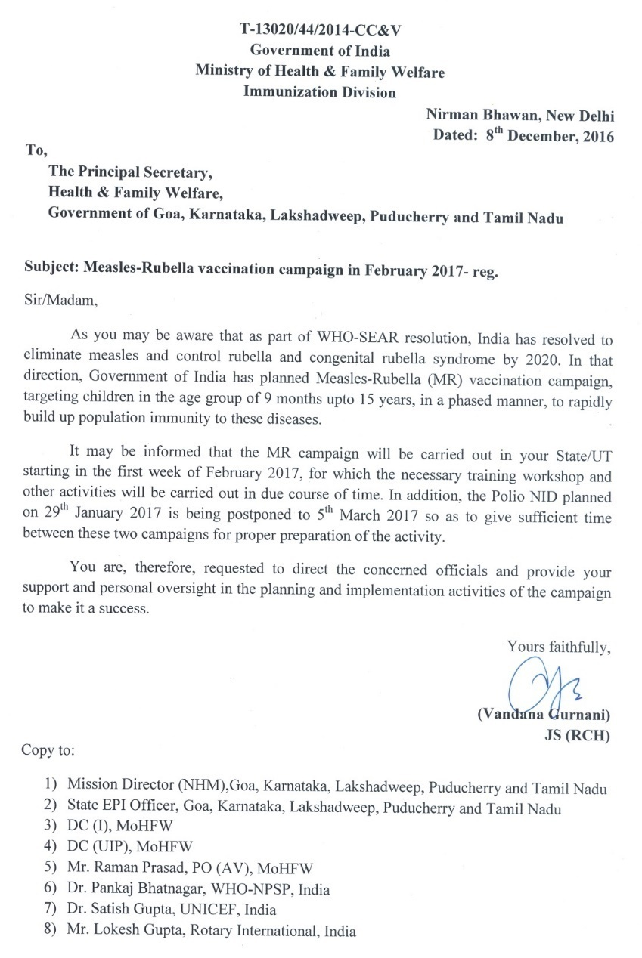
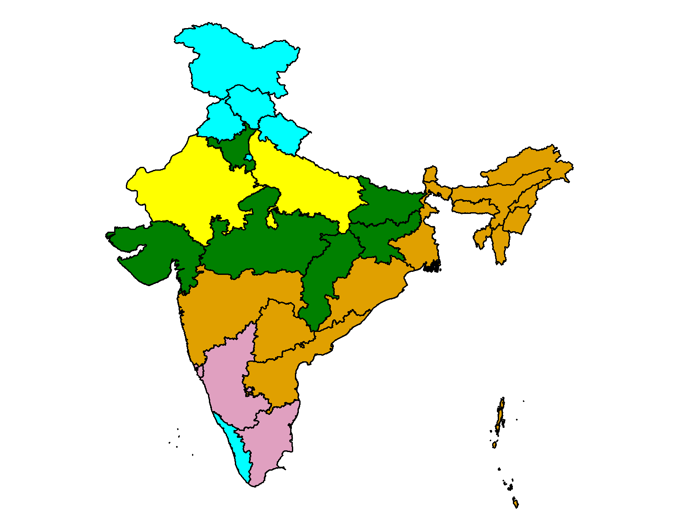
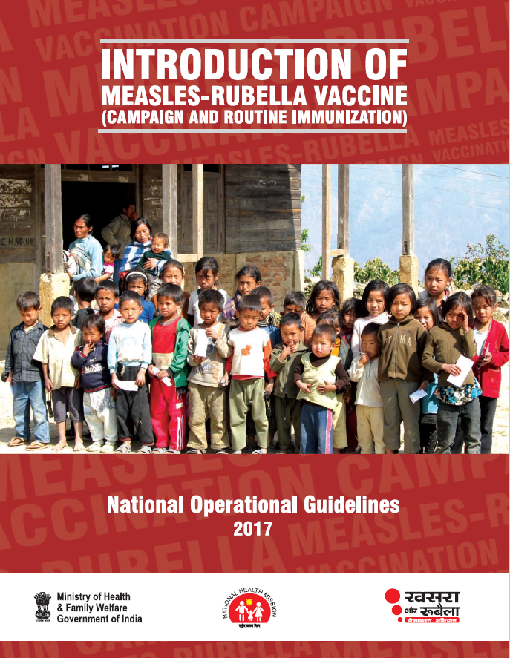



MR Campaign - India
Campaign Phases
MR campaign
started in Feb 2017
9 months to 15 years
Target
Nearly 400 million Children
Wide Age Range:

Slide 15
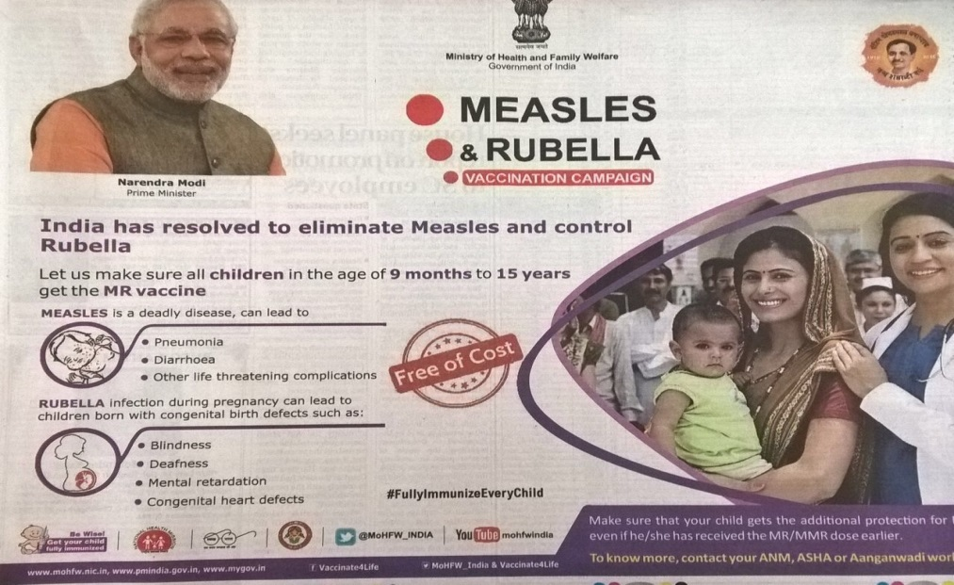
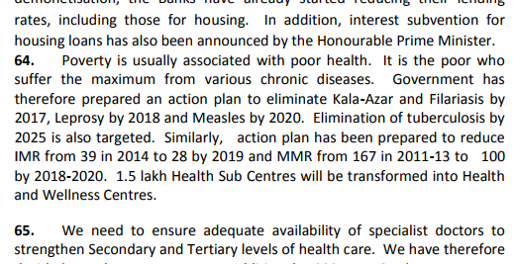
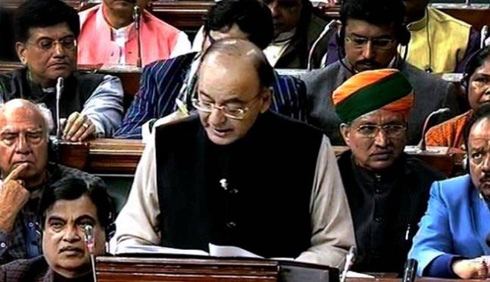
Political Will & Ownership
Government commitment to eliminate Measles and Rubella
Hon’ble PM Shri Narendra Modi promoting Measles Rubella vaccination campaign
Arun Jaitley, Finance Minister’s speech, 2017-2018

Slide 16
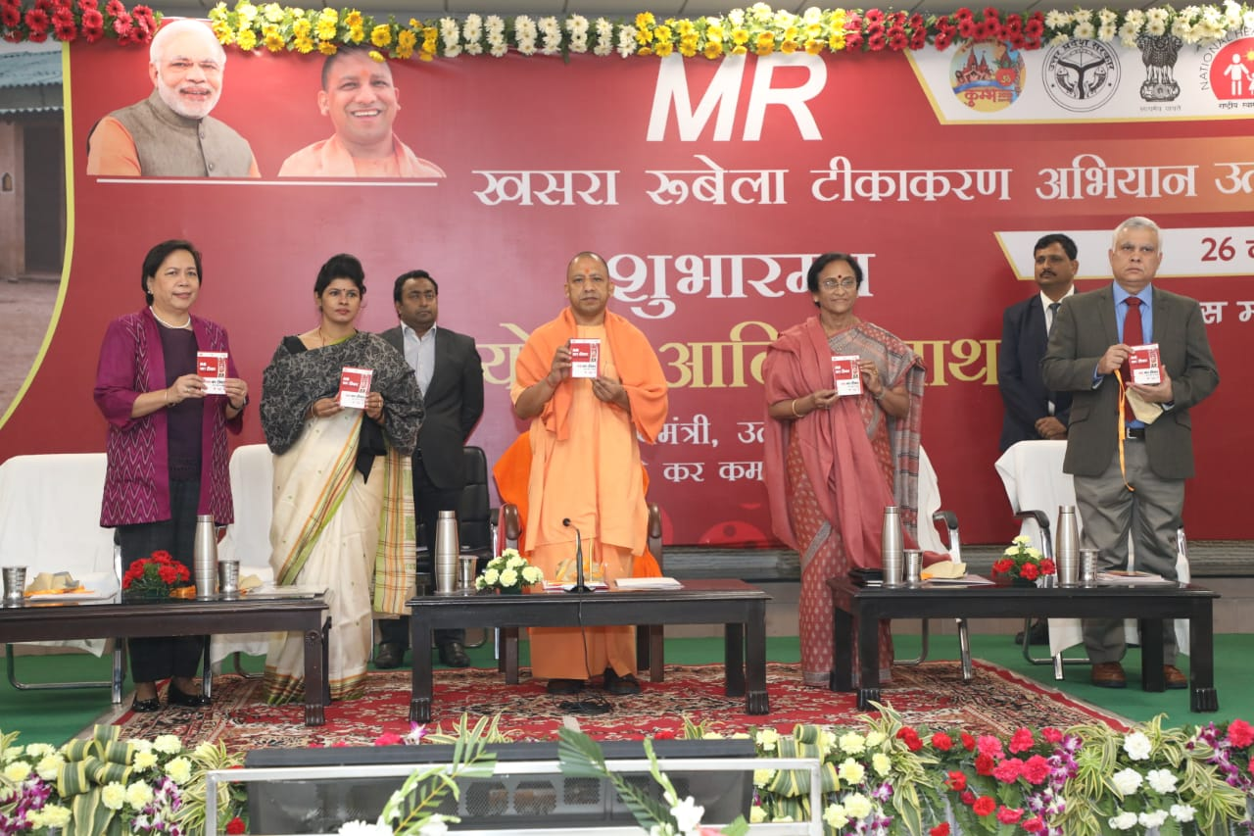
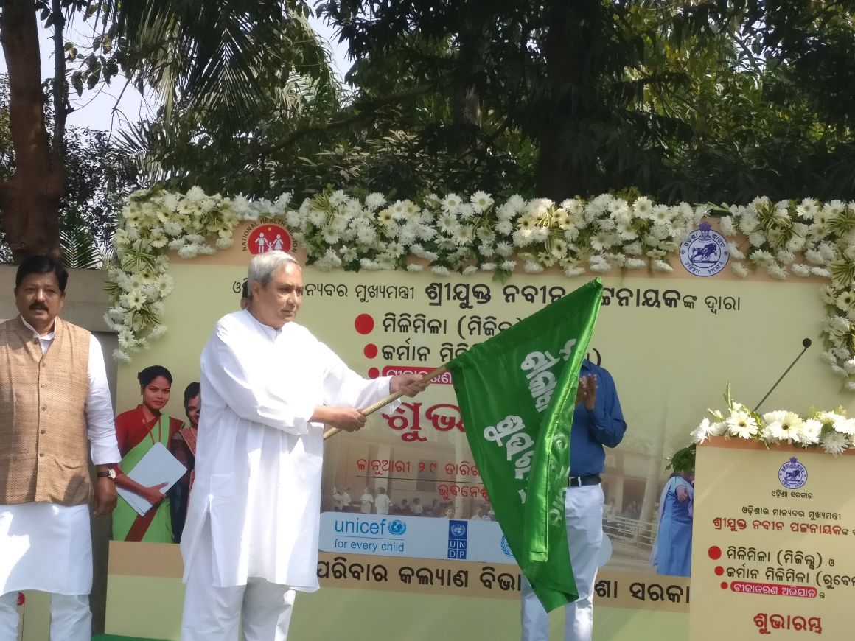
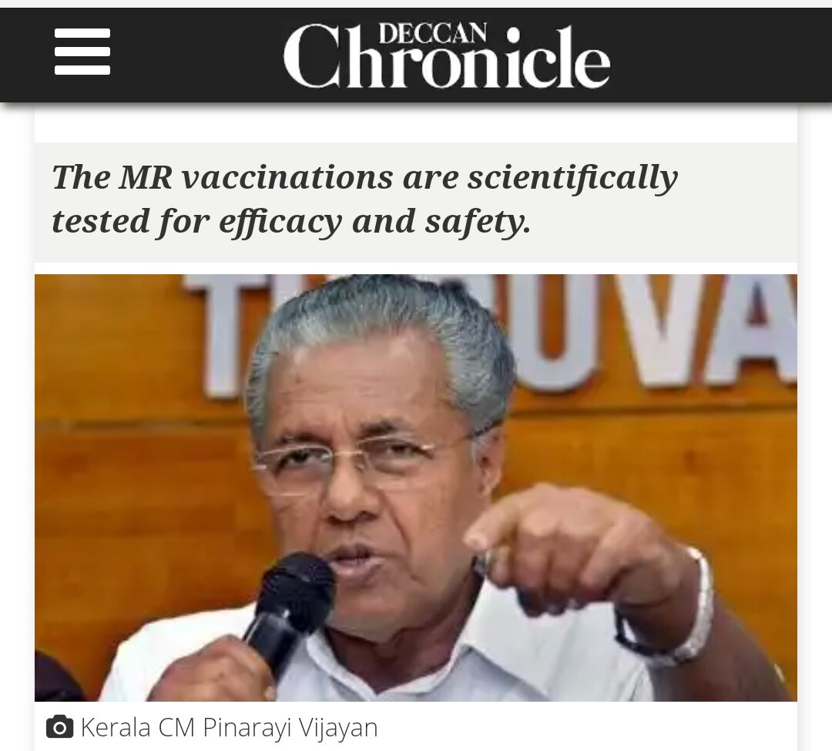
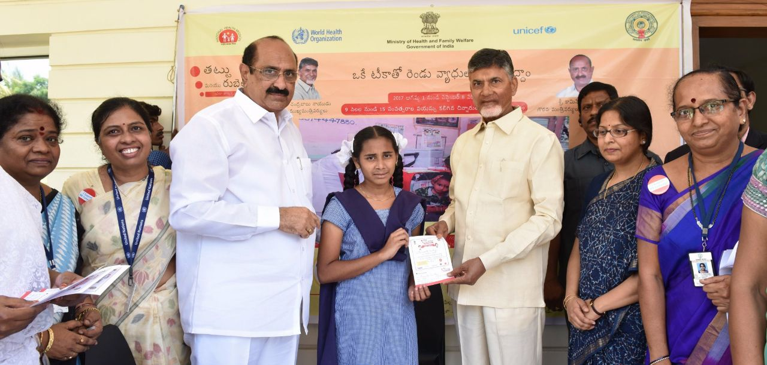
Highest level of Advocacy at States

Slide 17
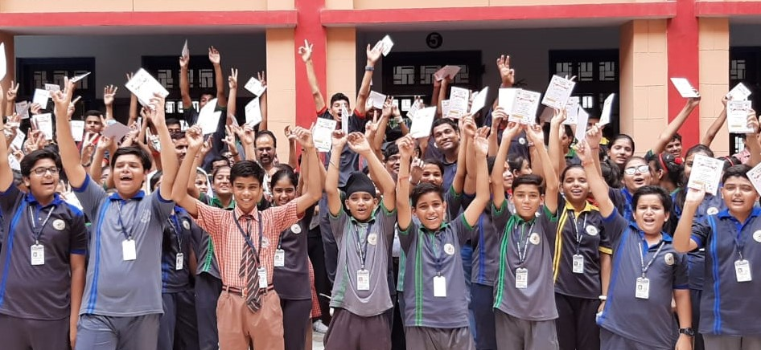
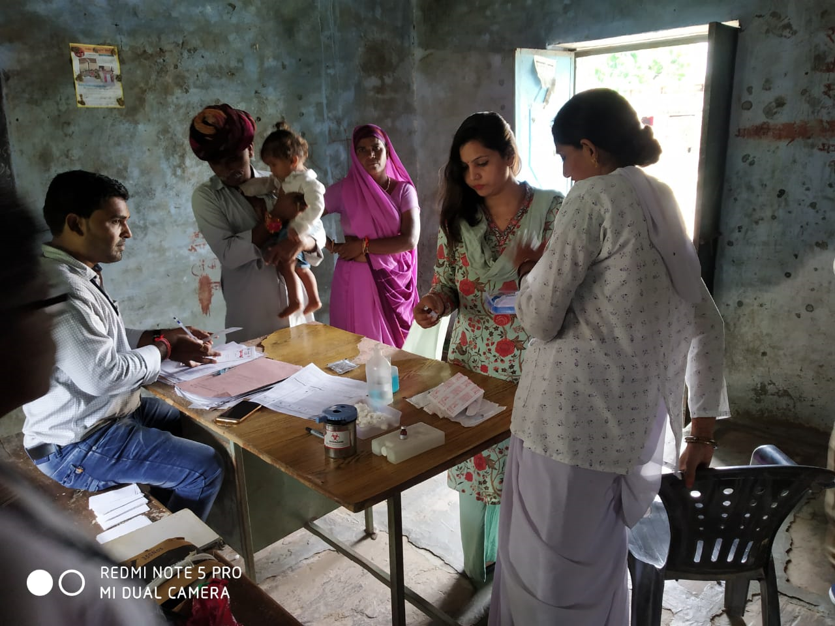
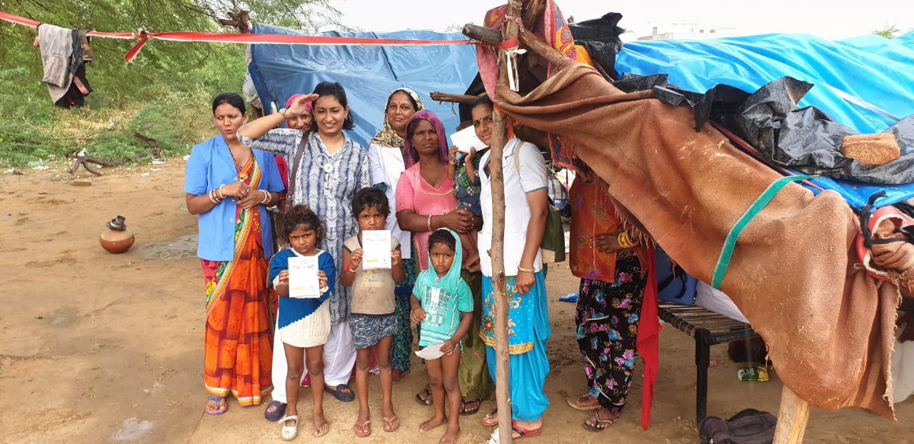
MR Campaign: Implementation Strategy
Intensive Preparatory Phase of 4-5 months
4-5 weeks activity
1 week sweeping
Schools
Community
Missed/ low performing areas
Notes:
Total duration of campaign 4 weeks (first in schools and then in community) and 1 week sweeping activity in low performing areas
Vaccination will be provided at: schools, health facilities and routine immunization session sites. Migratory sites to be approached through mobile teams
Regular RI sessions will be conducted as per usual planning

Slide 18
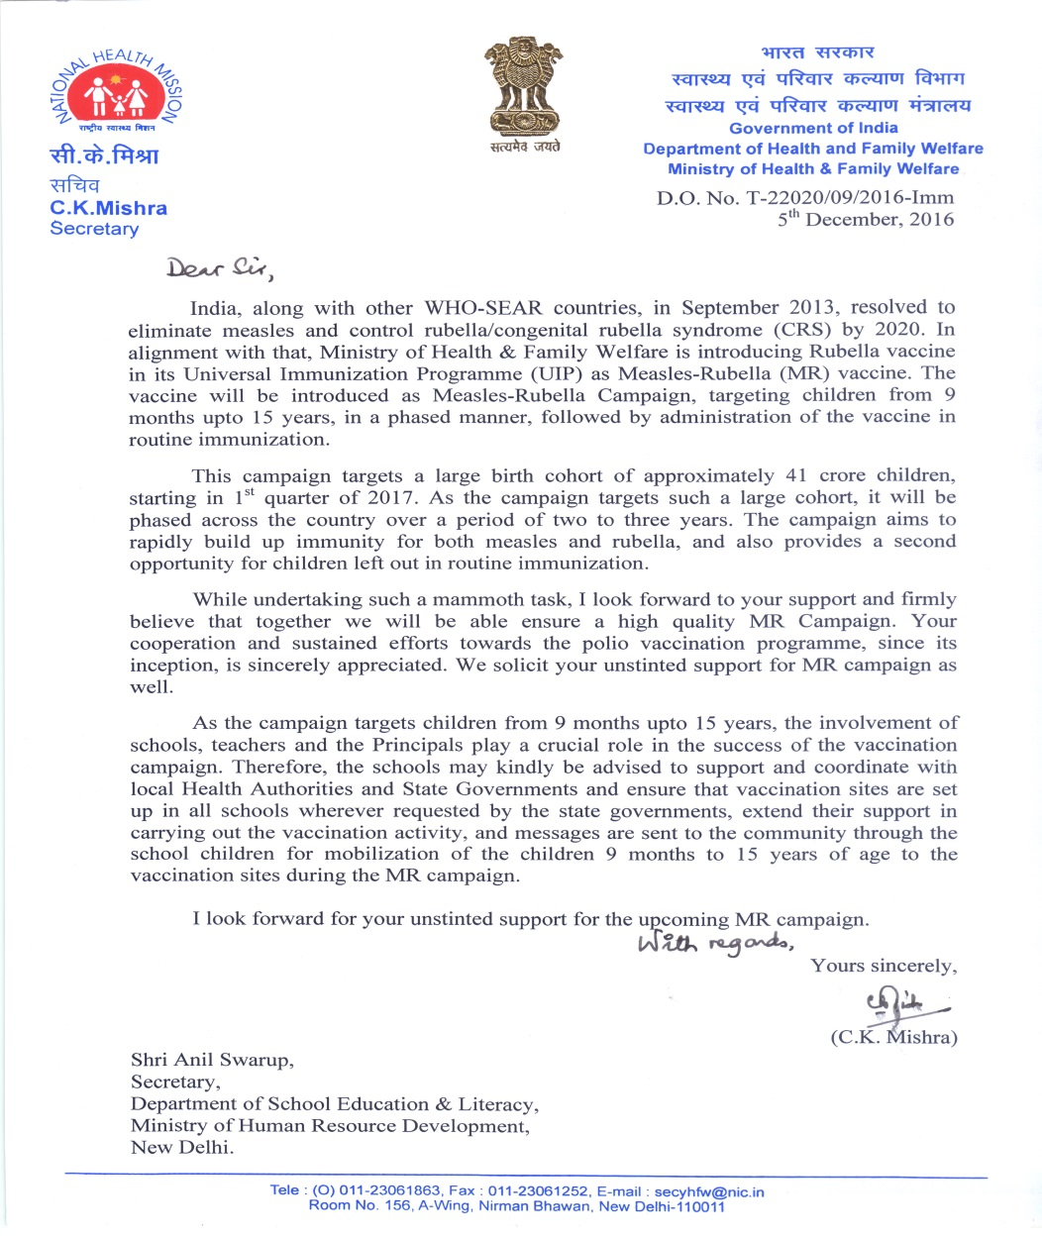
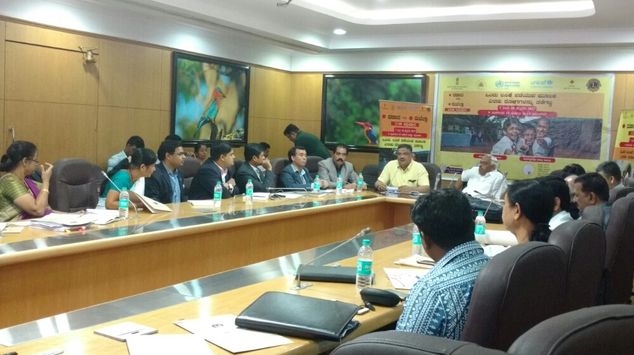
Intersectoral Convergence
  Ministry of Home Affairs
  Ministry of Human Resource Development
  Ministry of WCD
  Ministry of Information and Broadcasting
  Ministry of Panchayati Raj
  Ministry of Youth Affairs and Sports
  Ministry of Road Transport and Highways
  Ministry of Urban Development
  Ministry of Defence
  Railway Board
  Ministry of Civil Aviation
  Ministry of Shipping

Slide 19
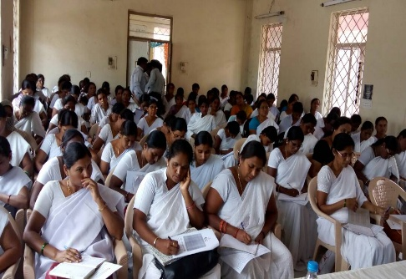
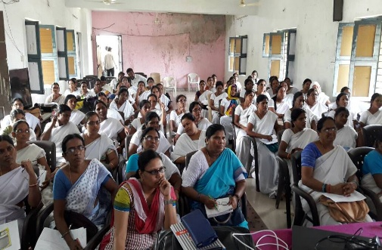
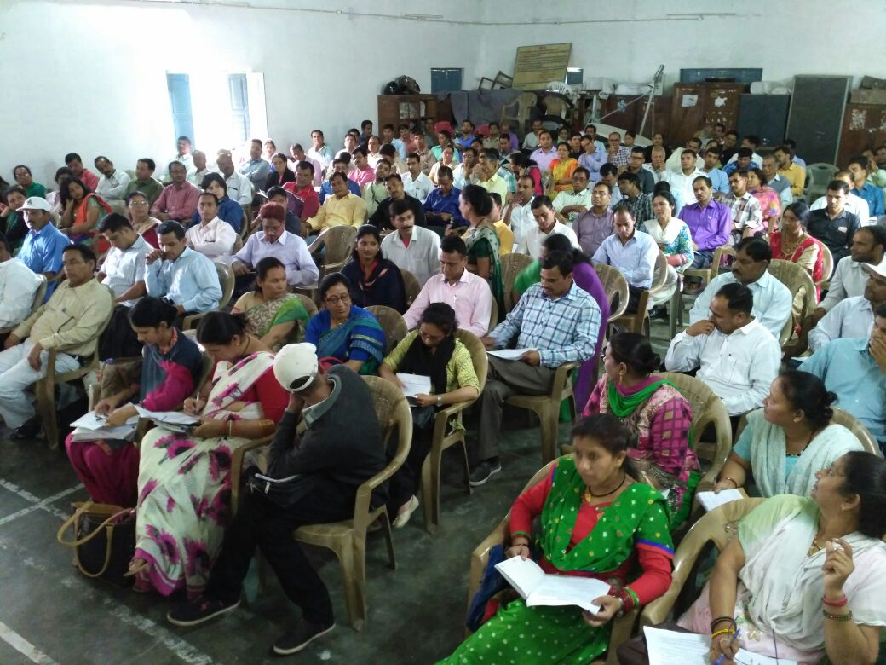


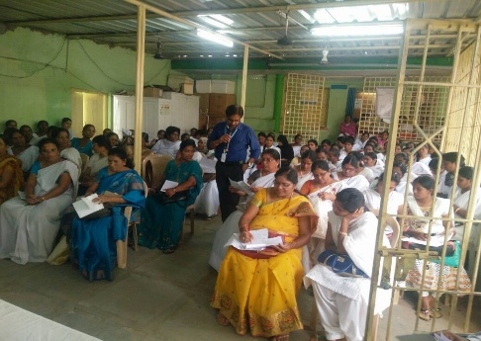
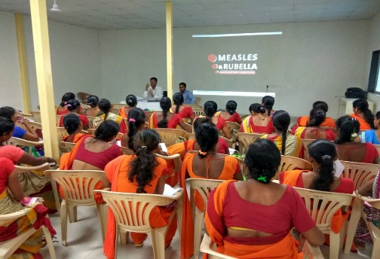
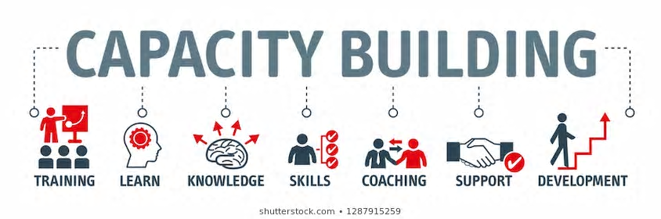
Capacity building of various stakeholders

Slide 20
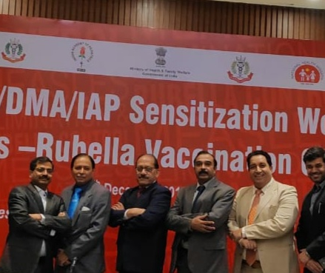
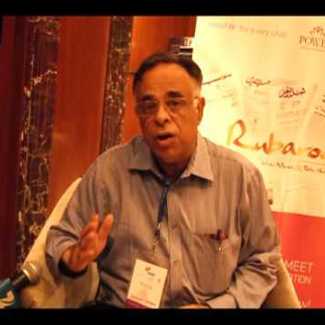
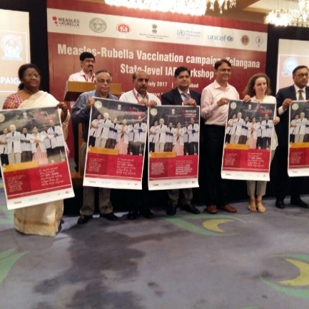
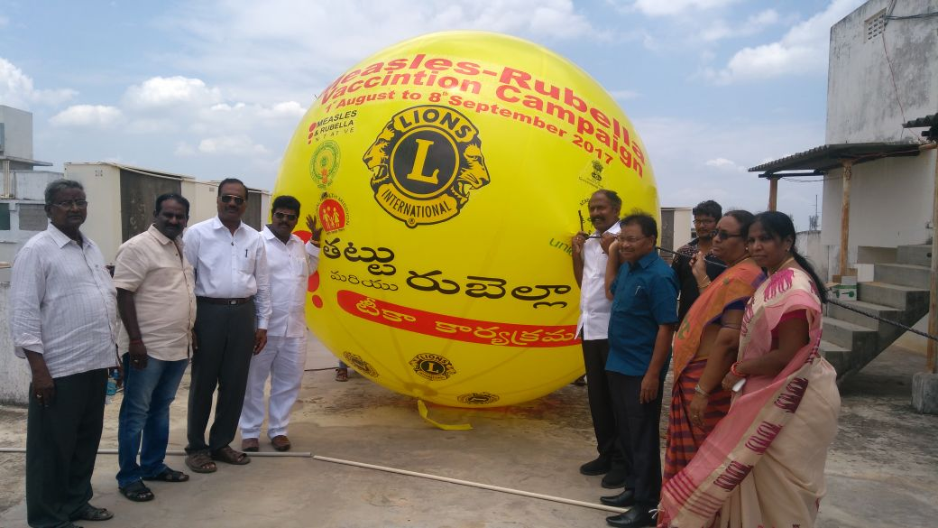
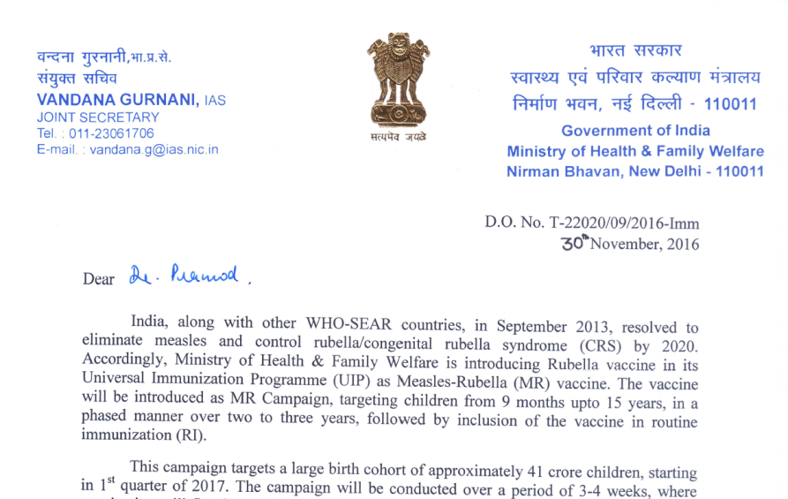
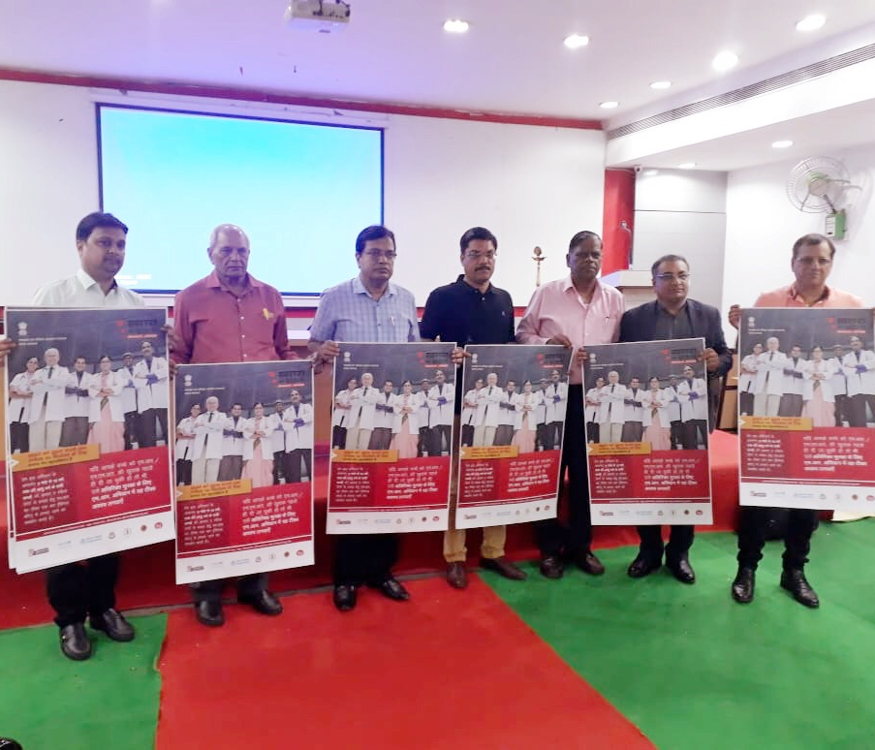
Engaging Professional Bodies and NGOs
  Indian Academy of Paediatrician (IAP)
  Indian Medical Association (IMA)
  Indian Public Health Association (IPHA)
  Indian Association of Preventive & Social Medicine (IAPSM)
  Indian Red Cross Society (IRCS)
  Lions Clubs International
  Rotary international

Slide 21
MR Campaign – Accountability Framework
National Level Oversight
National Measles-Rubella Task Force
Measles-Rubella Operations group
Measles-Rubella Communications group
India Expert Advisory Group on Measles & Rubella (IEAG-MR)
Inter-Ministerial Committee
State, District and Sub-districts Level Overview
State level
  State Steering Committee
  State Operations Group
  State Task Force on Immunization
District / Sub-district level
  District Task Force on Immunization
  District Operation Group
  Block task force
  Urban task force
Notes:
Institutional mechanism of supervision and monitoring was established at all levels in coordination with all stakeholders to make the implementation smooth
National Measles-Rubella Task Force Chaired by Joint Secretary, Govt. of India
Members from WHO, UNICEF, BMGF, ICMR, National CDC
Monitors and reviews campaign planning & surveillance data; national action plan development for measles elimination & rubella/CRS control
Measles-Rubella Operations group members include WHO, UNICEF, BMGF and ITSU
Phasing plan, strengthening operational strategies following learnings from phase 1
Measles-Rubella Communications group
members include WHO, UNICEF, BMGF, GHS
Communication plan, media package, developing special strategies following learnings from phase 1
IEAG for MR members include national and international experts to provide technical strategic guidance for Measles elimination and Rubella control
Secretary, H& FW is the chair

Slide 22
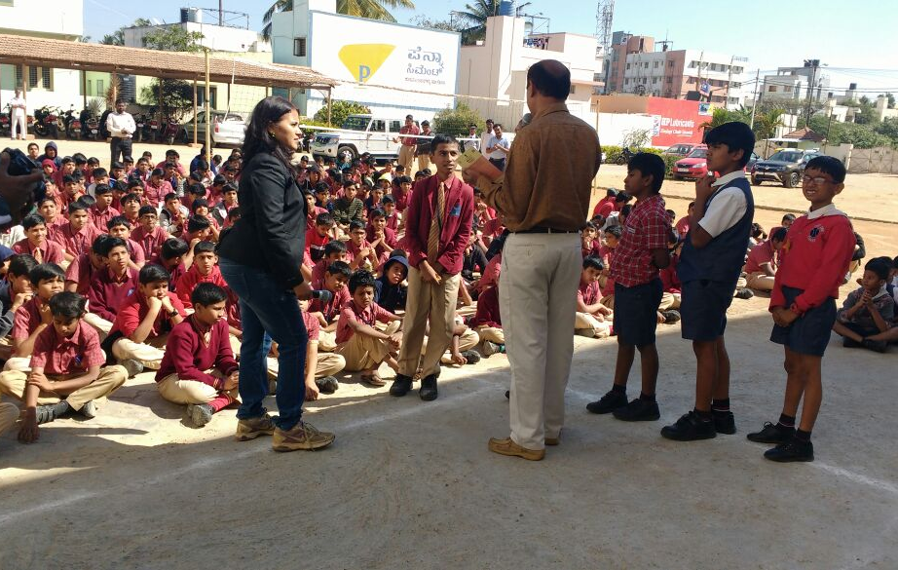
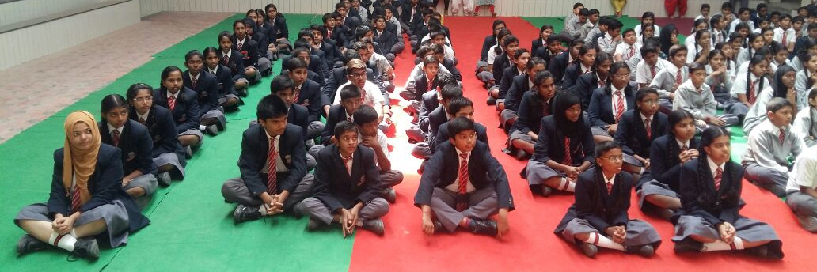
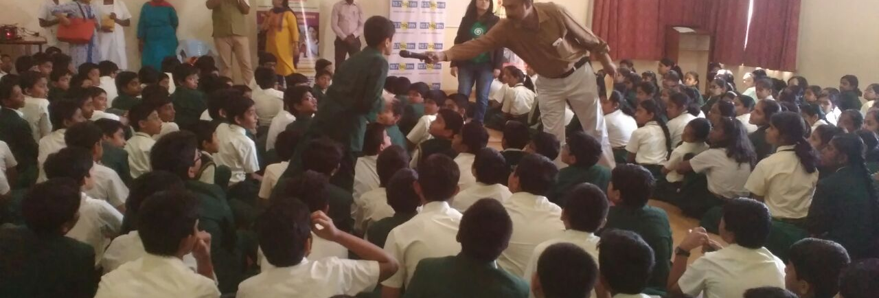
School Engagement :
Sensitization of Students

Slide 23
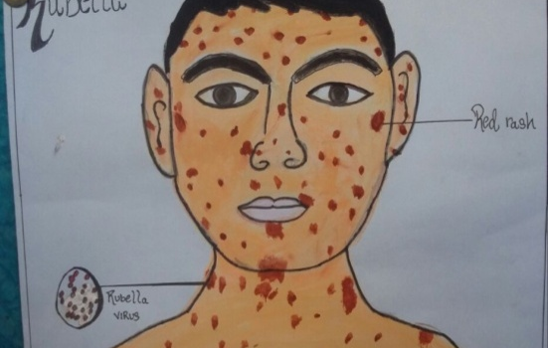
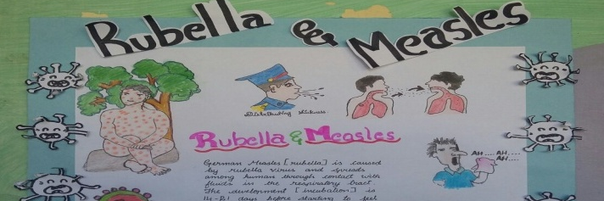
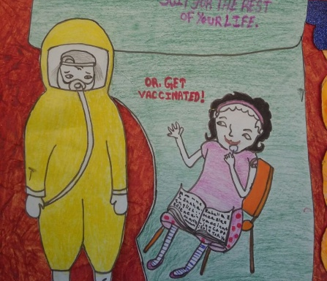
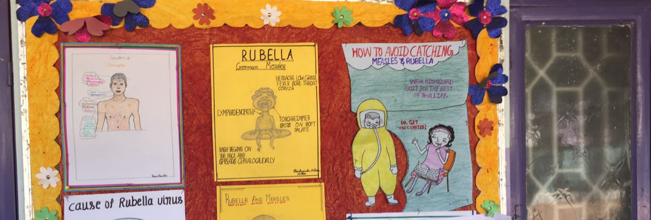
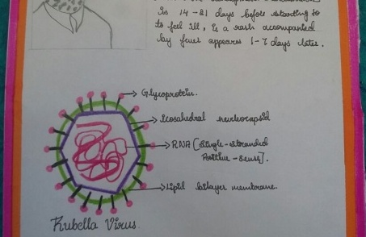
Enhancing Student Participation:
Competitions amongst students

Slide 24
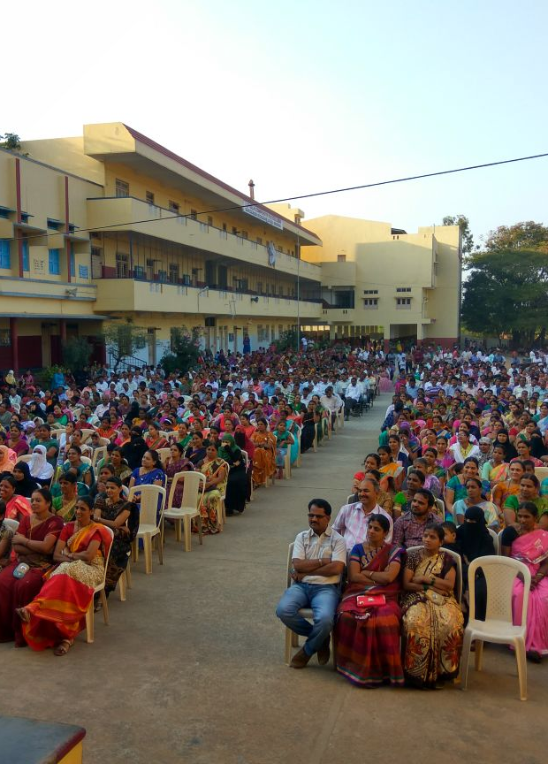
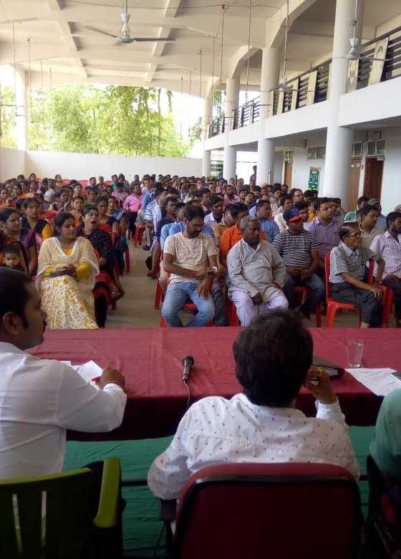
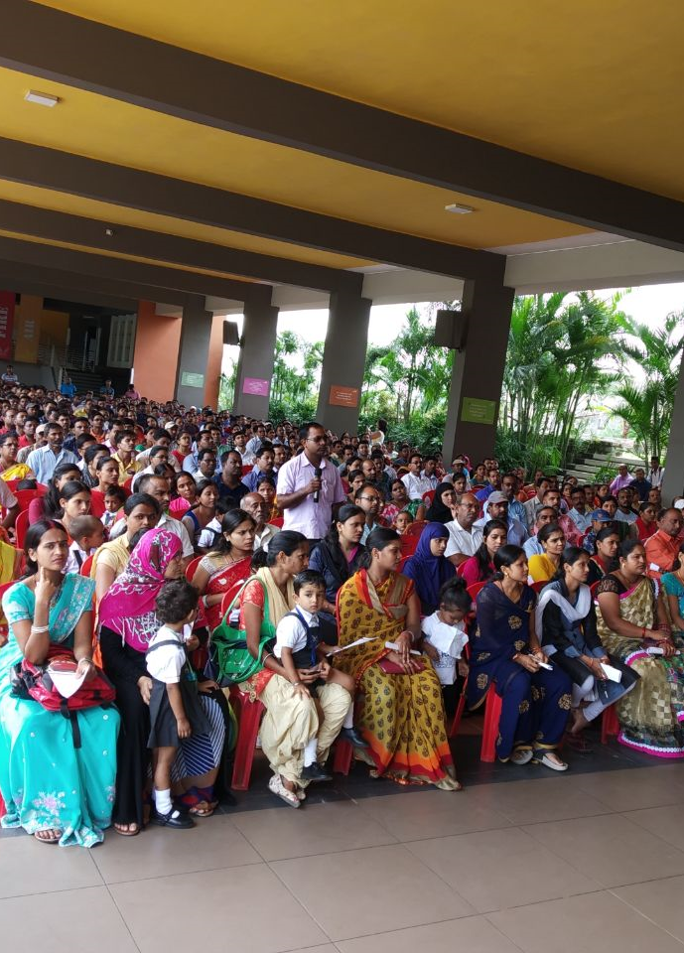
Developing Parent’s trust:
Parent-Teacher’s meeting

Slide 25
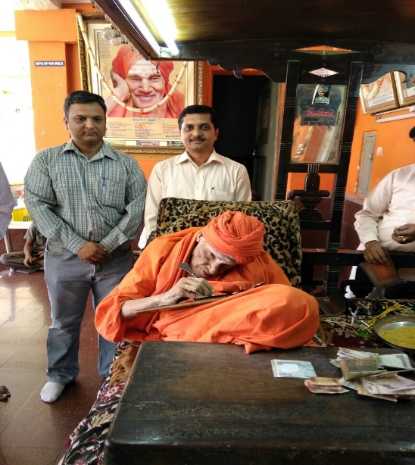
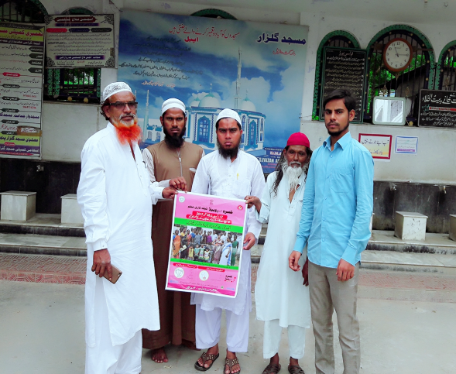
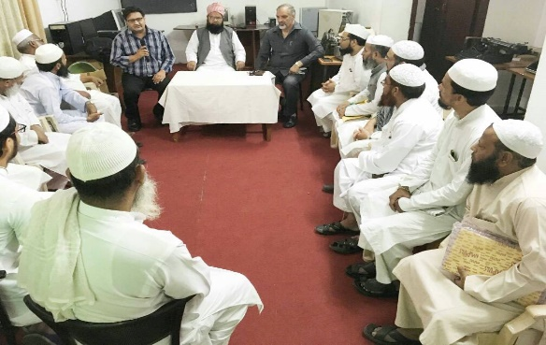
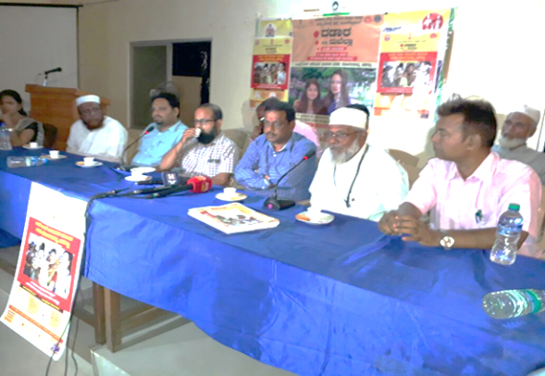
Engaging Religious Leaders
Address community concerns

Slide 26
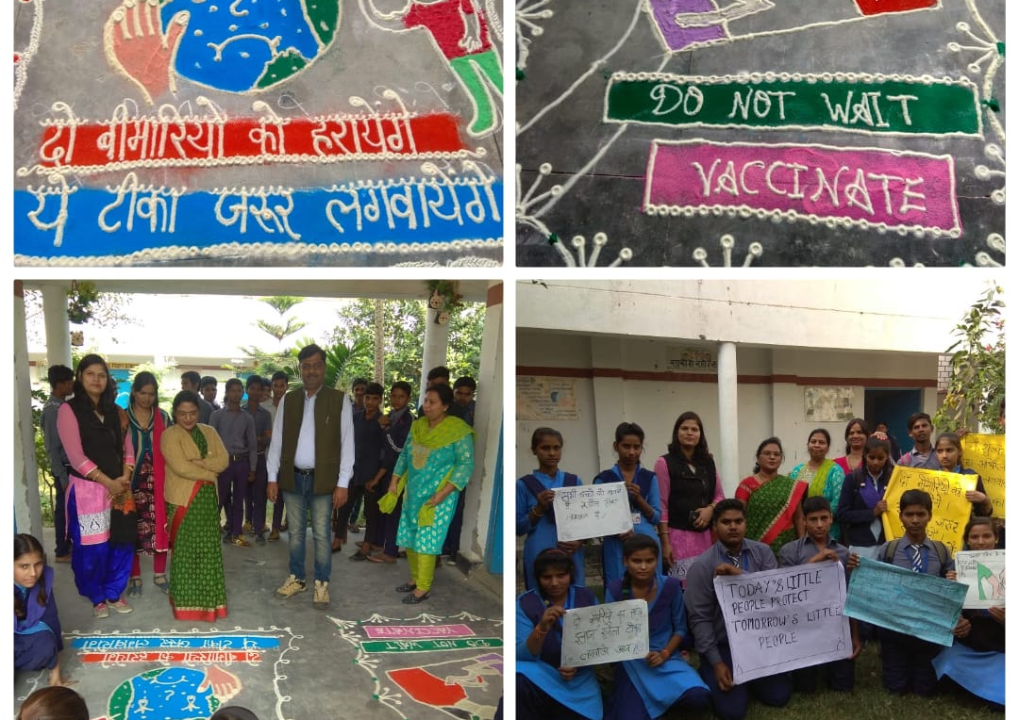
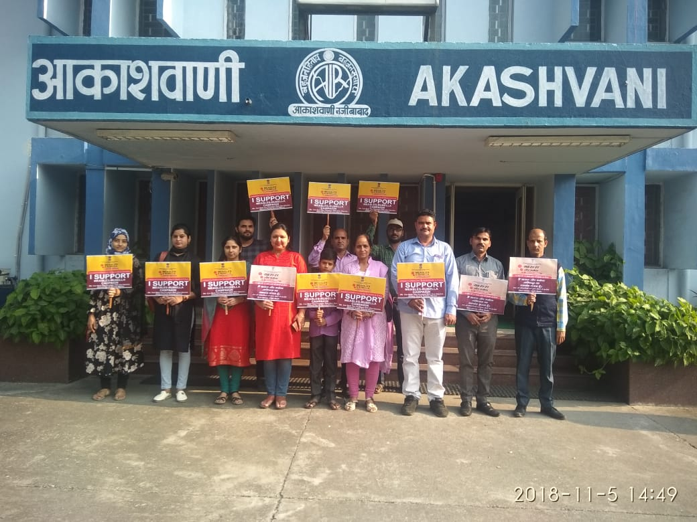
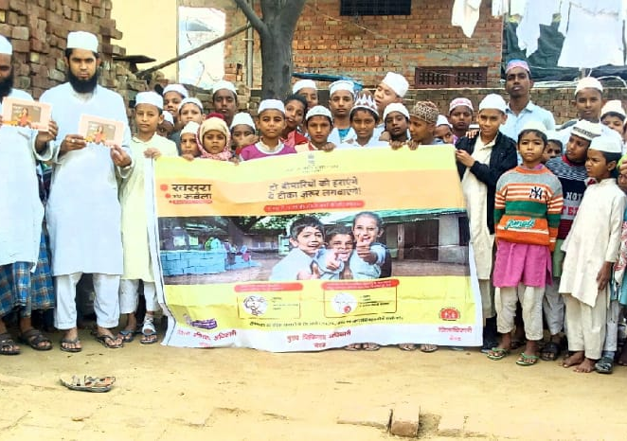



Community Participation

Slide 27





Advocacy activities in schools and community

Slide 28




Enhancing reach:
Social Media campaign
Pradeep Haldar, Deputy Commissioner Immunization, speaks about the safety of the vaccine and that it has been in use since years. https://www.youtube.com/watch?v=SuvbeTlLKQI&feature=youtu.be
Anupam Sachdeva, President, IAP, speak about the targetted age group of the MR vaccine and the arrangements made by the Government in schools and health centres to provide vaccination to the children. https://www.youtube.com/watch?v=VKSaLi9NVIs&feature=youtu.be

Slide 29
Factoid Videos and WhatsApp messages
  Age group
  Vaccination sites
  Double Protection
  Break the chain
  Vaccine efficacy & safety
  One syringe One Child
  Additional dose
  No link to infertility
  No adverse reactions
  Global scenario
11

Slide 30



Celebrity endorsement:
TV spots –
Amitabh Bachchan

Slide 31



Accountability Framework:
State level review meetings

Slide 32




Accountability Framework:
District task force meetings

Slide 33
Preparedness Assessment
Assessing Readiness Status through National Monitors
 | First Assessment
District | Operations | Communications
ADILABAD | Moderate | Moderate
HYDERABAD | Critical | Critical
KARIMNAGAR | Moderate | Moderate
KHAMMAM | Moderate | Critical
MAHABUBABAD | Moderate | Moderate
MAHBUBNAGAR | Critical | Moderate
MANCHERIAL | Moderate | Critical
MEDCHAL MALKAJGIRI | Moderate | Critical
NALGONDA | Critical | Critical
RANGAREDDY | Moderate | Moderate
SANGAREDDY | Critical | Moderate
WARANGAL URBAN | Moderate | On track
STATE | Moderate | Critical
 | Final Assessment
District | Operations | Communications
ADILABAD | On track | On track
HYDERABAD | Moderate | Moderate
KARIMNAGAR | Moderate | Moderate
KHAMMAM | On track | On Track
MAHABUBABAD | On track | On Track
MAHBUBNAGAR | Moderate | On Track
MANCHERIAL | On track | Moderate
MEDCHAL MALKAJGIRI | Moderate | On Track
NALGONDA | On track | On Track
RANGAREDDY | On track | Moderate
SANGAREDDY | On Track | Moderate
WARANGAL URBAN | On track | On track
STATE | On track | On track
Helpful in timely identifying gaps and planning interventions

Slide 34


MR Campaign Coverage Update
( as on 8 September 2019)
Completed - 32
Ongoing – 2
Planned - 2
More than
322 million children
vaccinated in 34 states/UTs.

Slide 35



MR Campaign Coverage, Phase 1 to 8
Administrative Coverage (%)
Rapid Convenient Monitoring (%)
97%
88%
Data as on 12 February 2019

Slide 36


Impact of MR Campaign
Before Campaign#
After Campaign##
Rates* | Before campaign | After campaign
Measles Incidence | 4.2 | 1.9
Rubella Incidence | 1.9 | 0.5
NMNR Discard Rate | 0.1 | 0.5
Measles Cases: 1815
Measles Cases: 735
Rubella Cases: 808
Rubella Cases: 207
Negative Cases: 597
Negative Cases: 1990
*: States conducted MR campaign are Andhra Pradesh, Arunachal Pradesh, Chandigarh, Daman & Diu, D&N Haveli, Goa, Haryana, Himachal Pradesh, Karnataka, Kerala, Lakshadweep, Manipur, Mizoram, Odisha, Punjab ,Pondicherry, Tamil Nadu, Telangana & Uttarakhand
# Before campaign time period: Phase-1: Aug_15-Jan_17'; Phase-2: Aug_16-Jul_17; Phase3: Mar_17-Dec_17’; Phase4: Sep_17-Mar_18
## After Campaign time period: Phase-1: Jan_17-Nov_18; Phase-2: 'Apr_18-Mar_19'; Phase3:Jul_18-Apr_19; Phase4: Oct_18-May_19

Slide 37





Strengthening Routine Immunization to sustain gains from MR Campaign
Strengthening Immunization
Mission Indradhanush to Address Equity

Slide 38

Using MR campaign lessons to strengthen RI
Background:
State with low RI coverage (NFHS-4)
AFP – UIP review identified poor RI planning
Commitment from state to improve coverage
Arunachal Pradesh Experience
Opportunities:
MR Campaign reaching all beneficiaries
High Risk Areas and Missed Areas in RI micro plan identified
Surge support for RRTs and NPSP SMOs
RI micro plans revised using MR plans
Analysis of revised Micro-plans*
10% Increase in total Immunization Sessions
Immunization Session at Hospitals: Reduced by 23%
Immunization Session at Sub-Center: Reduced by 4%
Immunization Session at Outreach: Increased by 51%
*Activity ongoing

Slide 39


Strengthening Immunization Delivery
(System Strengthening)
  Comprehensive Multi-Year Plan
  (cMYP 2018-22) developed
  Health workers Handbook revised 2018
  Medical Officer’s handbook, updated in 2017

Slide 40

Roadmap of vaccine Introduction and other mile stone
Since 2010 several new vaccines introduced in Country’s UIP
1995 – Pulse polio
1997 – WHO-NPSP
2008 – Manual to digital reporting (HMIS)
2011 – Last Polio case
2015 – MNTE elimination
2019
2017
Rotavirus nation wide
Td vaccine
2016
2015
MR PCV JE
Rotavirus vaccine
Switch from tOPV to bOPV
-IPV
introduction
(2015-16)
Penta scaled up entire country
2013
2011
2010
JE 2nd dose intro
Pentavalent (2011-2015)
2006
Measles 2nd
dose intro
(2010-14)
Hep. B scaled up nationwide
2002
1985
JE vaccine introduced
Hep. B vaccine piloted
Vaccines against 6 VPDs-
Measles,
DPT, TB,
Polio

Slide 41


Rotavirus vaccine Expanded nationwide
Rotavirus vaccine introduced in 11 states from 2016 till March 2019
By May’ 19, around 5.3 crore doses of Rotavirus vaccine administered to children.
Expanded to remaining 25 State/UTs under ‘POSHAN Abhiyaan’ by Sep 2019
JAMMU & KASHMIR
HIMACHAL PRADESH ^{PUNJA}C^{B}HANDIGARH
UTTARAKHAND
HARYANA
DELHI
SIKKIM
ARUNACHAL PR.
RAJASTHAN
UTTAR PRADESH
^{ASSAM} NAGALAND MEGHALAYA
MANIPUR
BIHAR
MADHYA PRADESH
JHARKHAND
WEST BENGAL
TRIPURA
MIZORAM
GUJARAT
CHHATTISGARH
ODISHA
DAMAN & DIU D&N HAVELI
MAHARASHTRA
TELANGANA
ANDHRA PRADESH GOAKARNATAKA
PONDICHERRY TAMIL NADU
June-19- 11 States
July-19- 10 States
LAKSHADW ^{KERALA}
EEP
A&N ISLANDS
Aug-19- 3 States
Sep-19- 1 State
Already introduce 11 States

Slide 42

Pneumococcal Conjugate Vaccine (PCV) Expansion Plan, India
Introduced in Bihar, Himachal Pradesh, Madhya Pradesh, 19 districts of Uttar Pradesh and 18 districts of Rajasthan and Haryana (state initiative)
14 million doses administered as on May ’19
2017
2018
2019
2020 (Planned)
.
State wide expansion in Rajasthan and Uttar Pradesh planned in January 2020

Slide 43




Communication Strategy for RI
Advocacy
Social Mobilization
Capacity Building
Media
Monitoring
Political Advocacy
Mother Meetings
Front Line Workers
Mid Media
Communication Monitoring at District, Block & Sessions
Religious Advocacy
Community Meetings
Medical Officers
Mass Media
Professional Bodies
Influencers Meetings
IPC Skills/ BRIDGE
Media Orientation
Using Mobile App
Other Line Depts.
Miking/ Drum Beating
Other Line Depts.
Media Tracking
Media Advocacy
Rallies
Crisis Management
CBOs & NGOs
Street/ Folk Plays
Youth Networks (NYK)

Slide 44




Reaching the unreached with all available vaccines
(554 districts covered in six phases)
Mission Indradhanush (MI)
Launched on 25th December 2014
Oversight by Hon’ble Prime Minister

Slide 45




Mission Indradhanush Phases 2015 - 2019
MI-2
MI-3
MI-1
MI-4
352 Districts
216 Districts
201 Districts
Mission Indradhanush – Area Selection
Coverage
- Reported & Evaluated
- Underserved Pockets
Surveillance
- Outbreaks of Measles,
- Diphtheria and Pertussis
Monitoring
- Low coverage Pockets
- High missed children
Weak Health System
- Human resource gaps
- Operational Challenges
254 Districts
IMI
MI-5
GSA
EGSA
190 Districts
75 Districts
484 Districts
115 Districts

Slide 46






Mission Indradhanush - Key Focus Areas
Head count and due list
Session micro plan
Vaccine supply & logistics
Financial flexibility
Interdepartmental coordination
Social mobilization

Slide 47


Performance: Mission Indradhanush
365
Children Immunized
Pregnant Women Immunized
315
265
215
33.9 million
children immunized
165
115
65
8.7 million
pregnant women vaccinated
15
MI-1
MI-2
MI-3
MI-4
IMI
MI-GSA & EGSA
MI-6

Slide 48

Coverage Evaluation Survey- Post IMI

Slide 49

CES post IMI in 190 Districts
Number of districts
99
77
14
00
Number of districts
15
75
84
16
An average 18.5% increase in full immunization coverage as compared to NFHS-4 has been reported in 190 districts covered under IMI

Slide 50

Continue focus to Achieve 90% Immunization Coverage*
Districts divided in 3 categories:
Category I: FIC ≥ 90% (54 districts)
  Sustain current coverage levels
Category II: FIC of 50 -90% (555 districts)
  Prioritization & rapid coverage improvement actions in identified pockets of low coverage within the districts
Category III – FIC < 50% (91 districts)
  MI campaigns to meet gaps in coverage across the districts and other health system strengthening activities
*Categorization based on Full immunization coverage : Latest IMI survey (120 districts by UNDP, 70 districts by WHO) and NFHS 4 data for remaining districts

Slide 51








Sustaining the Gains
(Tracking progress through Improvement plans)
Madhya Pradesh
Maharashtra
Uttar Pradesh
Rajasthan
Bihar

Slide 52
Inequity in Immunization: NFHS – 4 (2015-16)
Full Immunization Coverage
Full Immunization Coverage in Urban & Rural areas
EDUCATION
No education Primary complete
Secondary or more complete
CASTE/TRIBE
Scheduled Caste Scheduled Tribe Other backward Class
None of them Don't Know WEALTH QUINTILE
Lowest
Second Middle Fourth Highest
10%
52
70
60
%age of children 12-23 months
67
60
63
36%
56
50
40
62
64
46
53
20
10
0
61
64
67
70
0 20 40 60
% age of children 12-23 months
80
Data Source: NFHS-4 (2015-16)

Slide 53
Strengthening Urban Immunization- Background
Immunization coverage in India increased from 43.5% in 2005-
06 to 62% in 2015-16*.
– rural areas (from 38.6% to 61.3%) – 22.7
– urban areas (from 57.6% to 63.9%) – 6.3
70
22.7%
6.3%
60
FIC has increased between NFHS-4 and CES (IMI), in 190 IMI districts altogether by
– 18.5 % points (from 50.5% to 69%),
– 16.7% in urban areas
57.6
50
63.9
40
61.3
30
38.6
Efforts bring changes in both rural and urban however urban areas need more intense efforts
20
Currently nearly 33% population is urban, by 2030, it will be 46%#
10
0
Urban NFHS-4
Rural
Focus needed on urban immunization
NFHS-3

Slide 54
Urban Immunization-Efforts being taken
Coordination meetings amongst MoHFW, NUHM and immunization partners being held to develop implementation strategies
  Review mechanism in urban areas (city task force)
  Area demarcation amongst facilities/health workers
  Stakeholders coordination (municipal bodies, partners )
  Recording and reporting mechanism
  Social mobilization
Pilot intervention being done in 16 cities to create replicable model
  WHO focussing on 14 cities
  ITSU in 2 cities (Jabalpur and Rajkot)
Urban immunization specific dashboard to identify gaps for corrective measures
Special communication strategies for IEC in urban areas

Slide 55

Strengthening Tribal Immunization
Letter issued on 3rd June 2019
States with tribal population to develop strategies to strengthen immunization coverage in tribal population
Generate awareness using existing traditions and customs
Special strategies and effective interventions may be funded under upcoming PIPs
In coordination with Ministry of Tribal affairs and UNICEF
These strategies may be used to deliver other public
health programmes

Slide 56

STRENGTHENING RI IN INDIA
INTENSIFIED MISSION INDRADHANUSH (IMI 2.0)
Plan in place for:
Strong Intersectoral Coordination
Robust Communication Strategy
Organize Immunization weeks to:
  Sustain achievements and bridge the gaps

Slide 57
Criteria (271 Districts + 652 Blocks in UP & Bihar)
Where IMI 2.0
State with FIC less than 70% based on CES 2018 - 14 States ( 306 districts)
  Exclusion criteria for 14 state with less than 70% FIC (104 districts out of total 306 in these states)
    Districts already achieved more than 80% FIC based on IMI-CES & NFHS 4
    Districts reported more than 95% FIC HMIS coverage
    Total Districts identified 202
  Other Inclusion criteria (for all 14 states) : 69 Districts
    Districts with vaccine preventable diseases: 32 districts
      Measles incidence more than 1 per 100,000 population (WHO NPSP Surveillance data)
      Diphtheria and Pertussis incidence more than 1 per 100,000 under 5 year population (WHO NPSP Surveillance)
Aspirational districts with FIC less than 80% (for all 36 states - IMI CES & NFHS4)-37 districts
Separate block prioritization for UP & Bihar (Adequate sample for RI concurrent monitoring)- 652 Blocks in 109 districts
  Blocks with less than 80% FIC (concurrent monitoring data) and
  Blocks with high VPD cases
  Measles incidence more than 10 per 100,000 population (WHO NPSP Surveillance)
  Diphtheria Pertussis incidence more than 1 per 100,000 under 5 year population (WHO NPSP Surveillance)
RI microplan strengthening week in Feb 2020
INTENSIFIED MISSION INDRADHANUSH (IMI 2.0)

Slide 58



Selection Criteria
UP
State | District
ANDHARA PR. | 3
ARUNACHAL PR. | 16
ASSAM | 18
CHHATTISGARH | 7
DADRA & NAGAR HAVELI | 1
DELHI | 1
GUJARAT | 23
HARYANA | 2
HIMACHAL PR | 1
JAMMU AND KASHMIR | 2
JHARKHAND | 24
KARNATAKA | 19
KERALA | 2
MADHYA PRADESH | 43
MAHARASHTRA | 26
MANIPUR | 2
MEGHALAYA | 7
MIZORAM | 5
NAGALAND | 8
ODISHA | 5
PUNJAB | 1
RAJASTHAN | 32
TAMIL NADU | 2
TELANGANA | 3
TRIPURA | 6
UTTARAKHAND | 10
WEST BENGAL | 2
Grand Total | 271
Bihar
Districts of States with FIC <70% CES 2018 (202)
*Other VPD Cases districts2018 (32)
27 States, 271 Districts
Other Aspirational Districts (37)
State | District | Blocks
Bihar | 36 | 227
Uttar Pradesh | 73 | 425
109 Districts, 652 Blocks
*VPD cases in year 2018-19 (More than 10/ 100,000 population measles and more than 1 per 100,000 population for remaining VPDs)

Slide 59
Other Activities to strengthen system

Slide 60




Printing and dissemination of new MCP card
Dated: 8th May 2018
All States/UTs to ensure use of new MCP cards

Slide 61




National Effective Vaccine Management (EVM) Assessment 2018
Status –
Diagnostic tool to assess and review three “P”s - Process, Practices and Policies of Efficient Immunization Supply Chain-Cold Chain – Supported by comprehensive Improvement plan
Data collection -
May’18
Data analysis – June’18
Improvement plan workshop – July’18
Participation by - MoHFW, Medical Colleges (16), ITSU, NCCVMRC, UNICEF, UNDP, WHO, JSI.
Under 9 Global Criteria's
1. Vaccine Arrival Process
2. Vaccine Storage Temperature
3. Storage Capacity
4. Building, CCE & Transport
5. Maintenance & Repair
6. Stock Management
7. Distribution
8. Vaccine Management Practices
9. MIS & Supportive Functions
2018 – 23 states
What make this assessment unique –
EVM 2018 is world’s largest assessment
Participation by players from different domains of public health
Mobile Based Paper less assessment
Shortest duration (2 months) –
EVM Assessment
40 teams - 74 assessors
– Data collection from
145 sites

Slide 62


eVIN scale up
Internet base supply chain management with temperature monitoring
PHASE 1 | Current eVIN states
PHASE 2 | Completed (Loggers to be installed)
PHASE 3 | Implementation Initiated. Expected roll out completion by March 2020
PHASE 4 | Initiation planned in May 2019
21 States, 505 District and 20,000
Cold Chain points covered.
By 2019 pan India expansion
to cover all District Vaccine Stores.

Slide 63




New Initiatives in AEFI
Adrenaline use – operational guidelines, animation training film
Quality Management System – implementation underway (GJ, WB, Goa); Gujarat & Goa will be certified soon; initiated in CHD, HR, HP
Surveillance and Action Following Events following Vaccine (SAFE-vac):
Software migrated to Health Portal: 12 states using, will be nationwide soon
National

Slide 64

Strengthening VPD (Diphtheria, Pertussis and NNT*)
Surveillance with laboratory support
Number of Diphtheria, Pertussis and Neonatal Tetanus cases, 2018-19*
State | # Diphtheria cases |  | # Pertussis cases |  | # Neonatal Tetanus cases
 | 2018 | 2019* | 2018 | 2019* | 2018 | 2019*
Bihar | 82 | 22 | 150 | 45 | 10 | 7
Haryana | 237 | 22 | 81 | 30 | 3 | 0
Himachal Pradesh | 0 | 1 | 7 | 3 | 0 | 0
Karnataka | 26 | 110 | 2 | 25 | 0 | 0
Kerala | 321 | 81 | 179 | 65 | 0 | 0
Madhya Pradesh | 87 | 19 | 180 | 47 | 11 | 7
Punjab | 9 | 6 | 54 | 16 | 1 | 0
Uttar Pradesh | 1310 | 120 | 1351 | 155 | 28 | 6
Total | 2072 | 381 | 2004 | 386 | 53 | 20
By 2018 – 8 states
2019 (State workshop done) – 4 states
2019 – 4 states (planned)
2020 – 12 states / UTs
*: as on 30 June 2019
*NNT – Neonatal Tetanus
2021 – 8 states

Slide 65

VPD surveillance data analysis
VPD bulletins shared regularly with States
States do gap analysis and take corrective measures to increase immunization coverage in areas with VPD outbreaks
Review done in STFI/DTFI
Actions taken shared with Immunization Division, MoHFW

Slide 66



Prevention and control of VPD – Guidelines revised
Increase immunization coverage to prevent vaccine preventable diseases particularly Diphtheria
Strengthening of VPD surveillance
Availability of Anti- Diphtheritic serum
Dated 4th Aug ’17, 25th Sep’18, 27th Mar ‘19,

Slide 67

Monitoring and Feedback Mechanisms
Task forces at various levels

Slide 68




Immunization Dashboards: feedback regularly shared
Urban immunization dashboard and
its feedback letter to States
Routine immunization dashboard and
its feedback letter to States
Corrective measures to be taken by States

Slide 69
Improving Immunization Coverage
Concurrent RI Monitoring: 2011-2019*
No immunization
No immunization
No immunization
No immunization
No immunization
No immunization
No immunization
No immunization
No immunization
7%
5%
6%
4%
3%
2%
2%
1%
6%
Partial
Immunization
Partial
Immunization
Partial
Immunization
Partial
Immunization
Partial
Immunization
Partial
Immunization
Partial
Immunization
31%
32%
30%
Full
Immunization
61%
Full
Immunization
64%
Full
Immunization
64%
Full
Immunization
67%
Full
Immunization
75%
Full
Immunization
78%
Full
Immunization
79%
Full
Immunization
83%
Full
Immunization
82%
N - 376,992
438,845
250,562
410,312
434,423
482,538
428,002
356,594
326,854
Data source : Concurrent RI monitoring data, 1st Jan 2010 to 31st Aug 2019

Slide 70
Revised National Immunization Schedule
Age | Vaccines given
Birth | BCG, OPV-0, Hepatitis B Birth dose
6 Weeks | OPV-1, Rota-1, fIPV-1, Pentavalent-1, & PCV-1
10 weeks | OPV-2, Rota-2, Pentavalent-2
14 weeks | OPV-3, Rota-3, fIPV-1, Pentavalent-1, & PCV-2
9-12 months | MR-1, JE1*, PCV-Booster
16-24 months | MR-2, JE2*, DPT-Booster 1, OPV- Booster
5-6 years | DPT-Booster 2
10 years | Td
16 years | Td
Pregnant Mother | Td1, 2 or Td Booster**
* in endemic districts only
** one dose if previously vaccinated within 3 years

Slide 71
Summary
Strong ownership for Strengthening Immunization and MR Elimination
More than 322 million children already vaccinated during ongoing MR campaign
Preparedness assessment prior to campaign helped to identify and bridge the gaps
Robust planning, Intersectoral coordination and community engagement are key success factors
Lessons being used to strengthen Routine Immunization
Scope of vaccination expanded through introduction of new vaccines

Slide 72



Thank You

