Slide 1
Competent and Sustainable Global Laboratory Surveillance for Measles and Rubella is Provided by the WHO Global Measles and Rubella Laboratory Network
Jim Goodson, Paul Rota, David Featherstone
11th Annual Measles & Rubella Initiative Meeting
Washington D.C.
September 19, 2012

Slide 2
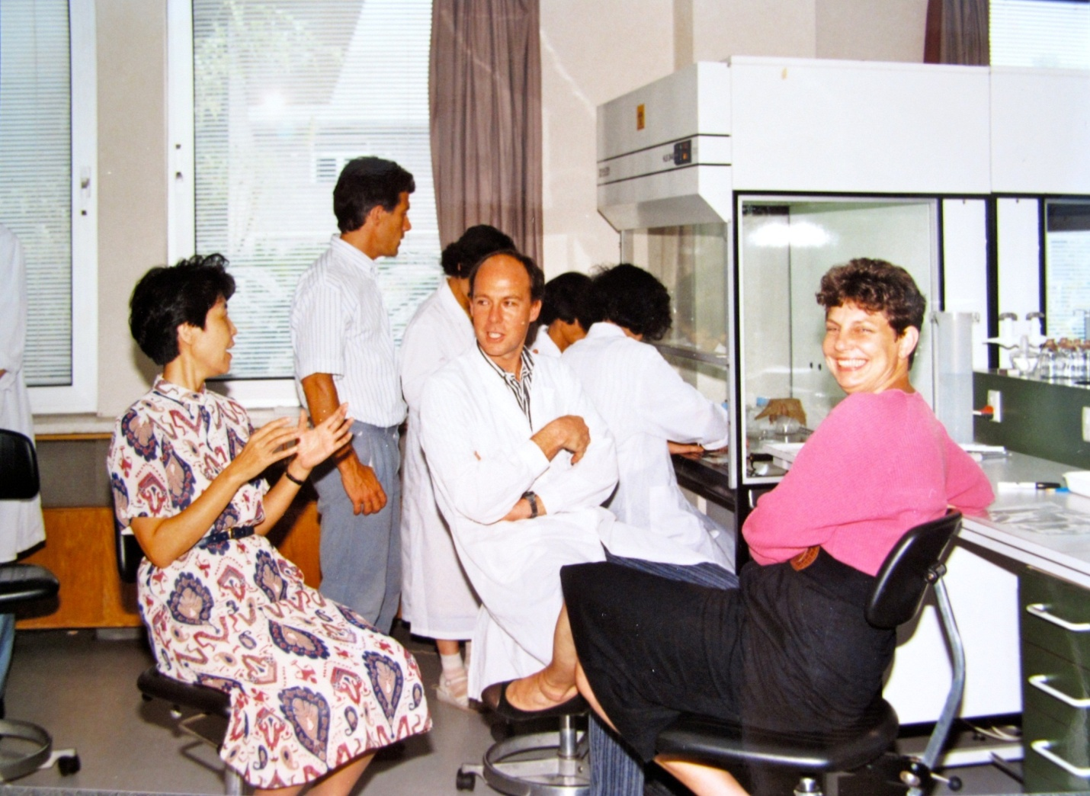
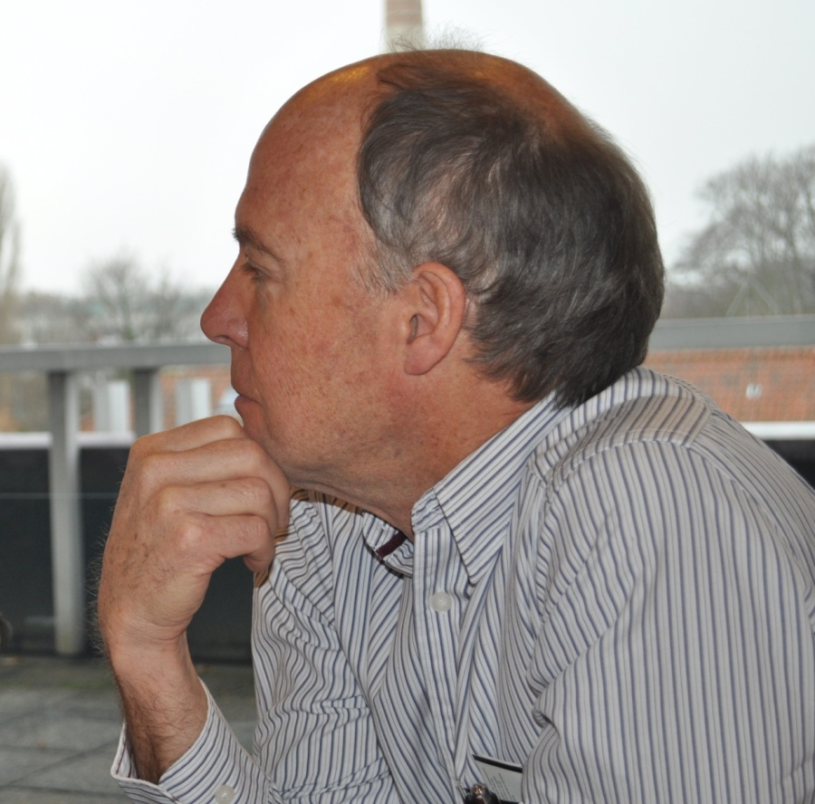

Slide 3
Quick Quiz…

Slide 4
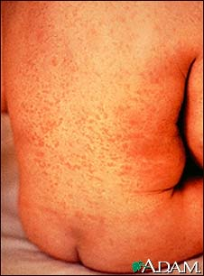
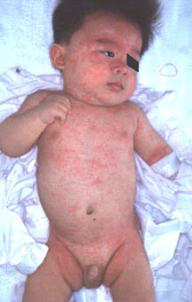
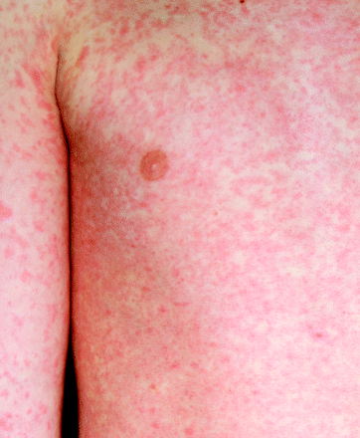
What's causing these fever and rash cases?
Measles
HHV-6
Rubella

Slide 5

Countries Conducting Measles Case-Based Surveillance with Laboratory Testing in 2011
Case-based measles surveillance implementation status at national level
Yes
(181 countries or 94%)
No
(12 countries or 6%)

Slide 6
WHO Global Measles and Rubella Laboratory Network (LabNet): 2012
N= 690 labs
10 Sub-National Labs
2012
N= 690 labs
31 Prov. Labs
+ 331 Prefect. Labs
124 Sub-National Labs
184/194 countries served by proficient labs
National Laboratories
Regional Reference Labs
Global Specialised Labs
6
Provincial Labs China
Sub-National Labs Russia
Notes:
The Global Measles and Rubella Laboratory Network was fully established in 2000 and has grown from 80 national and reference labs in 2001 to 172 labs serving 159 countries. Some large countries have a large number of subnational laboratories including China (331), the Americas (124) and Russia (10) making a total number of 690 labs. All labs follow the same standardized procedures and a strong quality assurance programme with annual proficiency testing and accreditation assessments in place.

Slide 7
LabNet Plays a Critical Role in Measles and Rubella Control Programs
Laboratory confirmation of suspected cases of measles and rubella
  Detection of measles/rubella specific IgM in a serum or oral fluid sample taken at first contact with patient
  Detection of viral RNA in an appropriately collected clinical sample
  Isolation of virus in cell culture
Genetic characterization of circulating strains for molecular epidemiology analysis
Measurement of population immunity

Slide 8
Structure of the WHO Global Measles and Rubella Laboratory Network (LabNet)
Multiple layers (similar to polio lab network)
  Global Specialized Labs (CDC-Atlanta, HPA-London, NIID-Japan)
  Regional Reference Labs (molecular biology, cell culture, sequencing)
  National Labs and sub national networks (sample collection, EIA, some molecular testing and cell culture)
Management and supervision
  Lab Coordinator at WHO Geneva (annual meeting)
  Regional Lab Coordinators at WHO Regional Offices
Financial support
  Host country/institute
  WHO, CDC, MR Initiative, Others
GSL
RRL
NL

Slide 9
Strengths of the LabNet Structure
Standardized testing and reporting structure
Excellent quality control at all levels
High quality data reported with stringent timeliness requirements
Use of lab data linked with epi data to drive public health decisions
Local ownership and alignment with national public health priorities
National laboratories are nominated by MOH in collaboration with WHO
Integrated surveillance for measles and rubella and other VPDs (e,g, Yellow Fever and Japanese Encephalitis)

Slide 10
Major Activities of the Measles and Rubella LabNet
Serologic testing for detection of measles and rubella IgM
Training and Capacity Building
Standardization
Quality Control
Verification of Elimination
Virologic Surveillance

Slide 11
Activity: Serologic Testing: IgM test results as reported to WHO HQ by WHO region, 2010 & 2011
(N= 375,012 tests)
Rubella
results
Measles
results
As of May 31, 2012: N= 74,504 tests

Slide 12
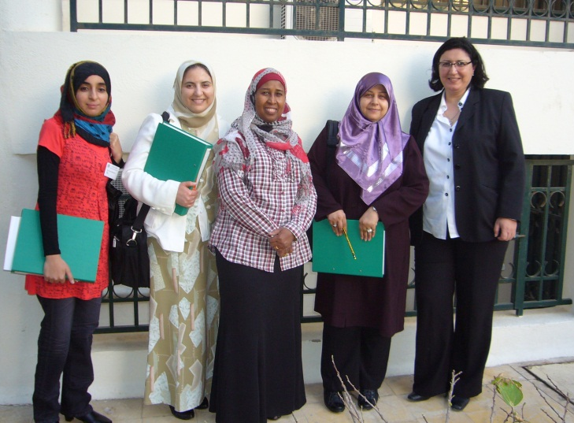
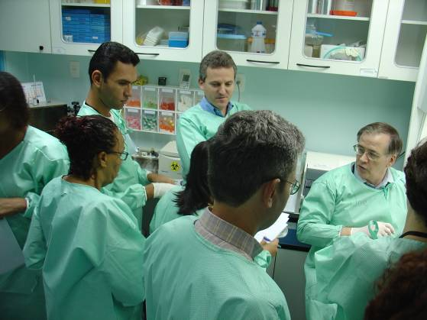
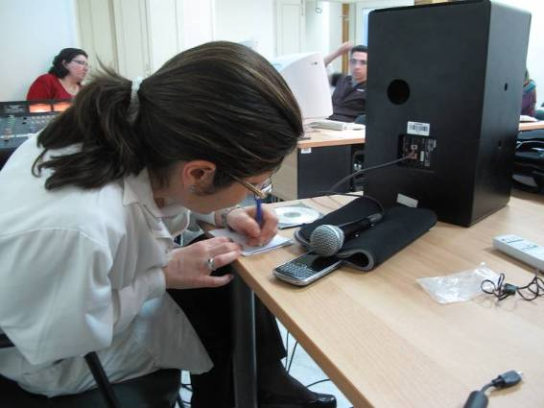
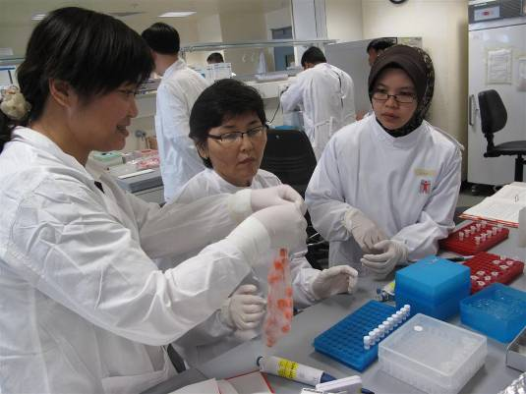
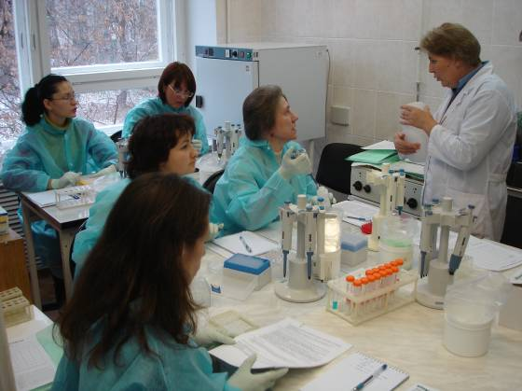
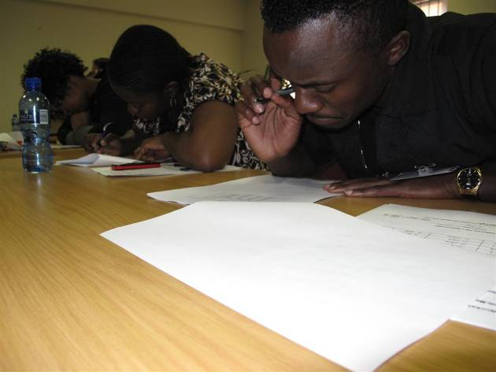
Activity: Training and Capacity Building
Training workshops
Multifunctional
  Measles, Rubella, YF, JE
  Serological, molecular, data analysis
Continual process:
  Staff attrition
  New methods
  QA processes
  Molecular techniques
  Data management
  Laboratory management

Slide 13
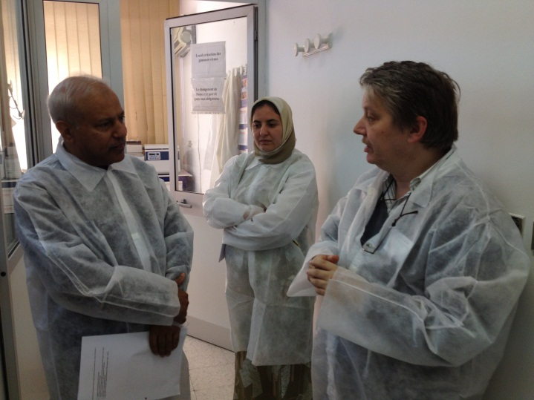
Activity: Capacity Building for 2012
Region | Focus | Planned quarter | Participants
AFR | YF, M&R, Mol IgM/QA | 1st -3rd quarters | W&C, E&S
AMR | Molecular | 3rd | NLs
EMR | Molecular | 2nd | Mol Labs
EUR | IgM | 2nd | TUR
EUR | Molecular | 3rd | Mol Labs
WPR | Molecular | 4th | Mol labs
WHO Vaccine Preventable Disease Lab Network

Slide 14
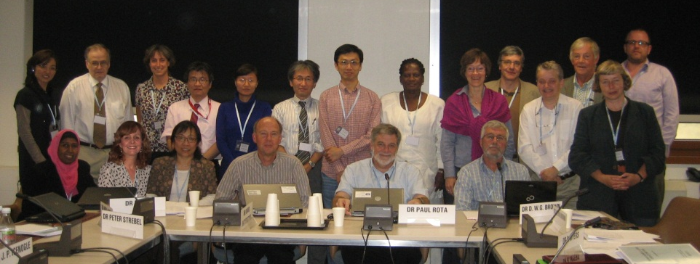
Activity: Standardization
2012 WER nomenclature articles published
  Measles virus: published 2 March 2012
    Genotype D11 was verified
    Decisions were made on subgenotypes
    6 genotypes not detected since 2000
    5 genotypes not detected since 2006
    Protocols were made accessible on WHO genotype database
  Mumps virus: published 1 June 2012
    Nomenclature and genotype classification
    Reference strains revised
    Global distribution of genotypes reported, including map
  Rubella virus Nomenclature update
    planned for late 2012 - early 2013

Slide 15
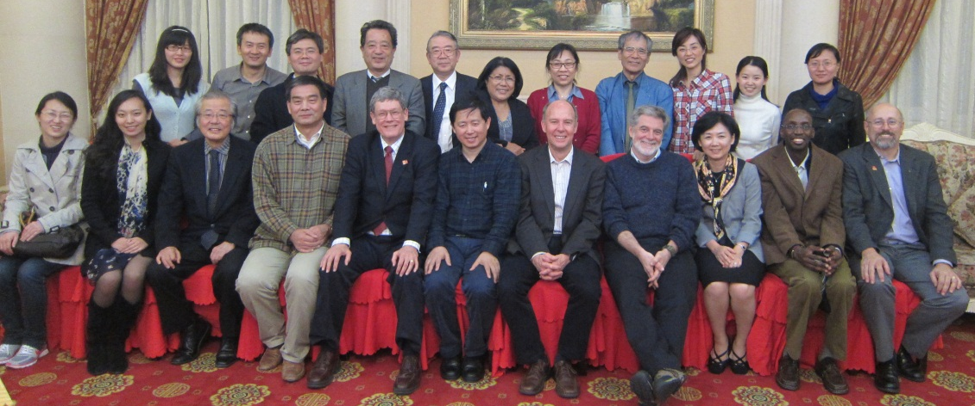
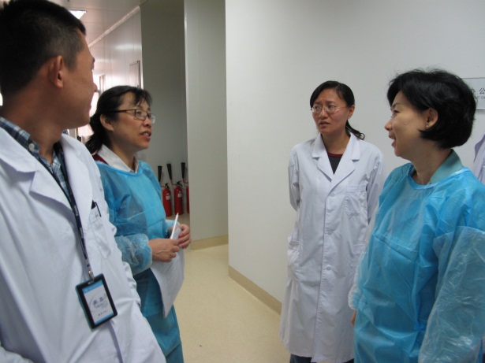
Activity: Quality Assurance
A proficiency testing (PT) panel for serology is sent annually from VIDRL, in Melbourne
  180 laboratories participating with excellent results
A PT for molecular techniques is being planned
Regular laboratory accreditation processes including site visits
15

Slide 16
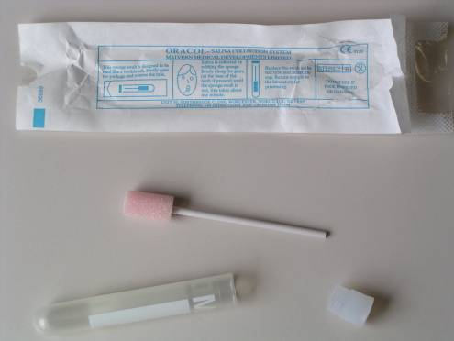
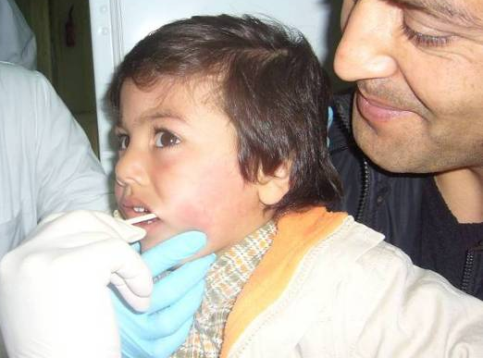
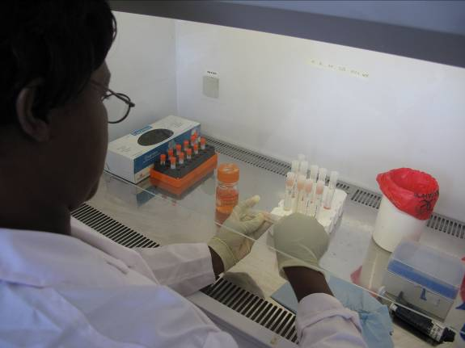
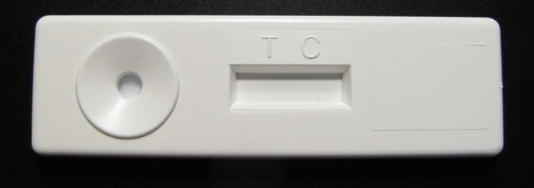
Meeting the Need for Enhanced Surveillance
Oral fluid samples (OF)
  AFR
    5 country trial: Zimbabwe, Malawi, Kenya, Benin, CIV
  SEAR
    India and Sri Lanka good correlation with serum but highlighted need for adequate training of surveillance staff
  EUR
    France tested >3500 OFs in recent measles outbreak
Point of care
  Refinements of sample type and field testing is underway
WHO Vaccine Preventable Disease Lab Network

Slide 17
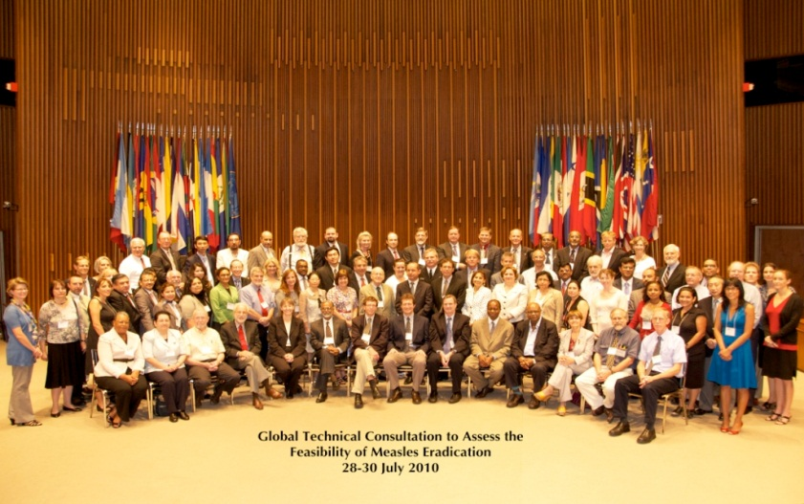
Activity: Verification of Elimination of Measles and Rubella
Monitoring of surveillance performance indicators
  ≥80% of confirmed outbreaks with a sample for virus detection and genotyping
Determining population immunity using serosurveys to validate reported vaccination coverage

Slide 18
Activity: Virologic Surveillance for Measles and Rubella
Molecular epidemiology is a key component of the verification process for measles and rubella elimination
  A criterion for elimination is the absence of an endemic genotype for one year
Genetic data in conjunction with standard epidemiologic information can be used to track transmission patterns and identify sources of infection

Slide 19
Measles D4 (Enfield strain) distribution Mar 2007–Dec 2011
As of 01 July 2012
Aug 07
Dec 08 (MA)
Apr 07
Mar 07- Dec 11
Apr 07
Jun 08 (CA)
Feb 08
Jan 08
Jan 08
Jan 09 (CA)
Oct 08
Oct 08
Nov 07
Feb 08
Jun-Jul 08
Jun-Jul 08
Jun-Jul 08
Apr 08 x3
Mar-May 08
Mar-May 08
Dec 08
Aug 08
Aug 08
XX 08 (JAM)
Dec 08 (IL)
May 2010
Acknowledgements:
WHO Measles LabNet esp HPA, Lux, RKI & CDC
Measles Surveillance Programmes
The boundaries and names shown and the designations used on this map do not imply the expression of any opinion whatsoever on the part of the World Health Organization concerning the legal status of any country, territory, city or area or of its authorities, or concerning the delimitation of its frontiers or boundaries.
Dotted lines on maps represent approximate border lines for which there may not yet be full agreement.
© WHO 2008. All rights reserved
Notes:
UK Single case in ‘Irish traveller’ (March ‘07), No known contacts, No foreign travel
Funeral in ‘Irish traveller’ community (April ‘07) Spread around SW England, Travellers from site to Norway
Norway, Cluster of cases in Apr 07
Spread to Orthodox Jewish community in London (end of April 07) then to Israel and Belgium
Israel from UK
Antwerp from UK
Germany from UK
Ireland
To Italy then to Croatia
Same strain in France, Portugal, Spain and Morocco
Spread to Gibraltar
Data for Jamaica and USA from CDC:
New York: June 2007 imported from Israel, Feb 08 unknown source, Apr 08 Israel, Apr 08 Belgium
California; Jun 08 import from Italy, Jan 09 UK
Florida; Dec 08 import from UK
Illinois; May 08 import ?Italy
Massachusetts; Dec08 Import from India
2010-11
Enfield strains reported from UK, Germany, Romania, Switzerland, France (though the 2010-11 outbreak was predominantly the closely related D4 variant “Manchester”) and Luxembourg.

Slide 20
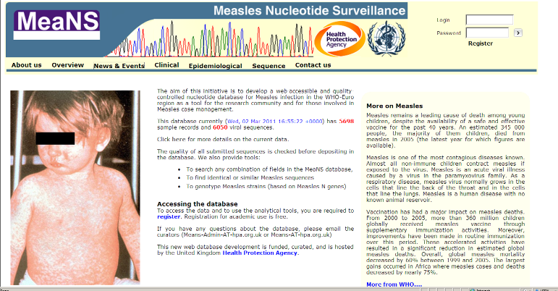
LabNet Genetic Sequence Data as of July 2012
Viruses submitted dating from 1954 to 2012
WHO Databases (started 2006) | No. of viruses | Genotypes | Countries and Territories | Proportion with GenBank entries
Measles | 13,312 | All 24 | 135 | 32%
Rubella | 1,302 | All 9 + 4 prov. | 49 | 22%
MeaNS database (HPA/WHO, started 2008)
    N – 450bp – 9632 sequences
    N – full – 3 sequences
    H – full – 592 sequences

Slide 21
MeaNS: Global Measles Sequence Database Allows Real Time Reporting and Analysis of Sequence Data

Slide 22
MeaNS: Circulating genotypes
1 - 10
10 - 100
> 100

Slide 23
Distribution of measles genotypes, 2011. Data as of 19 June 2012
Distribution of measles genotypes, 2011. Data as of 19 June 2012
Viruses =2946
Genotypes = 8
Countries = 74

Slide 24
2011
120 countries reporting laboratory confirmed rubella
12 countries reporting genotype information

Slide 25
Measles and Rubella LabNet Challenges (1)
  Financial support to maintain laboratory activities
  Financial support to expand case based surveillance for measles and rubella (especially GAVI countries)
  Staff turnover (RLCs, GLC) and training needs
  Need to maintain and expand sequence databases
  Better use of date by linking epi and lab data in Africa
  Expansion in India
  Introduction of new methods (Molecular)
  Maintain and expand QC/QA Program
  Integration with surveillance for other VPDs
  Development of testing strategies for low incidence settings

Slide 26
Measles and Rubella LabNet Challenges (2)
Molecular surveillance plays a vital role in monitoring progress with rubella control and in verification of elimination
Large gaps in surveillance for rubella virus
Baseline data should be collected well before acceleration of activities for control
Global rubella sequence database (RubeNS) under development
Enhance laboratory capacity in GAVI eligible countries
26

Slide 27
Global Measles and Rubella LabNet Estimated Costs 2011
$1,600,000
$1,400,000
Estimated shortfall
$1,300,000
Estimated shortfall
$1,300,000
$1,200,000
Shortfall
Funds Identified 2011
$1,000,000
Shortfall met
$800,000
$600,000
$400,000
$200,000
$0
Lab Support
Meetings
Consumables
Training
Travel
Equipment
Kits
WHO Vaccine Preventable Disease Lab Network

Slide 28
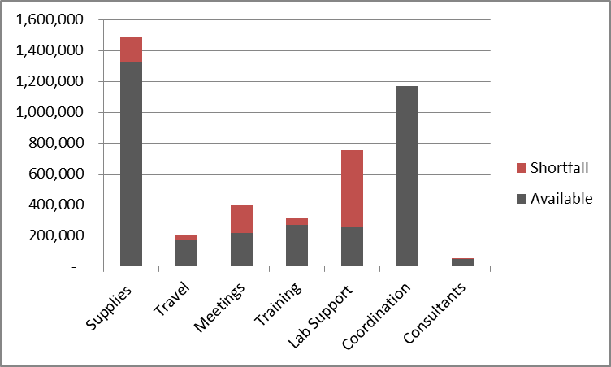
Global Measles and Rubella LabNet Projected Budget, 2012
Total : $4,376,000
Shortfall : $900,000

Slide 29
Summary
Strong capacity: >200,000 IgM tests, 3,000 measles sequences and 330 rubella sequences annually
Proficiency high -- closely monitored and maintained
Molecular surveillance is becoming increasingly important for monitoring progress of elimination and verification
Still gaps in molecular surveillance, especially for rubella
Financial support for the LabNet is tenuous
Search for new coordinator is ongoing

Slide 30
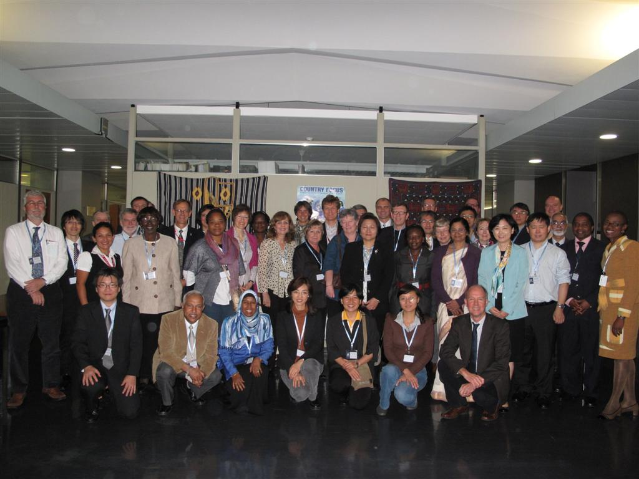
Summary
10th Annual Measles and Rubella LabNet Meeting: 2012
30

Slide 31


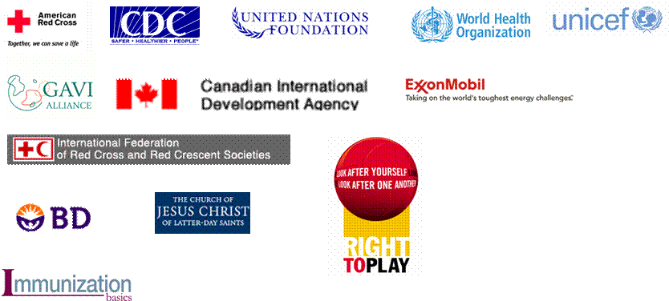














Anne Ray Charitable Trust

