Slide 1
Pulse Comment – US Situation
Measles and Rubella Initiative
September 11, 2019
Cindy Weinbaum, MD MPH
Deputy Director, Immunization Services Division

Slide 2
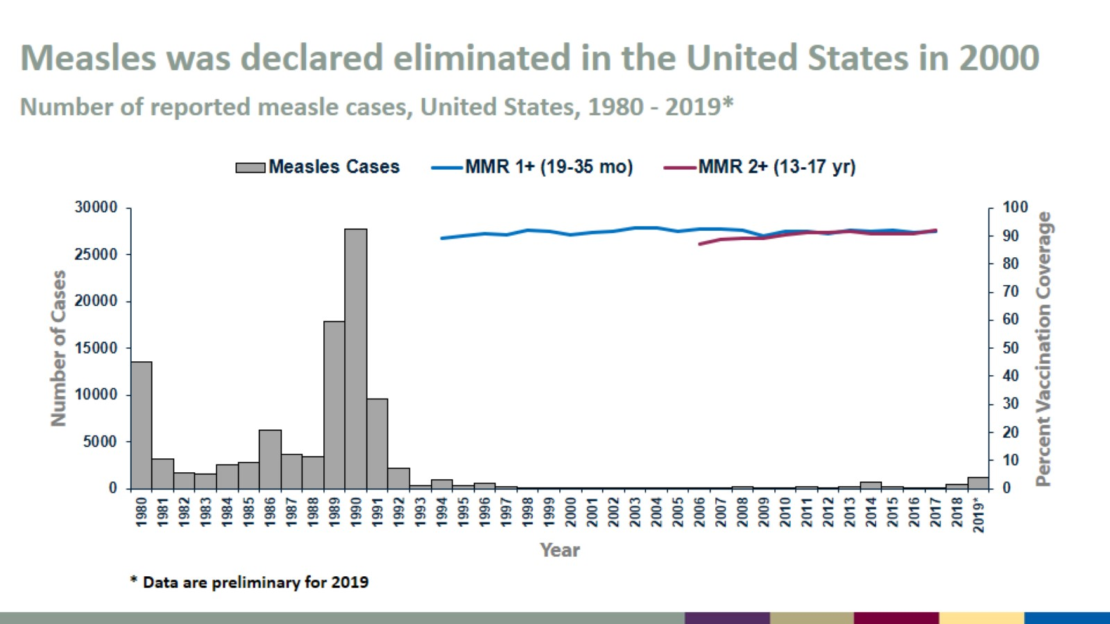
Measles was declared eliminated in the United States in 2000
Number of reported measle cases, United States, 1980 - 2019*

Slide 3
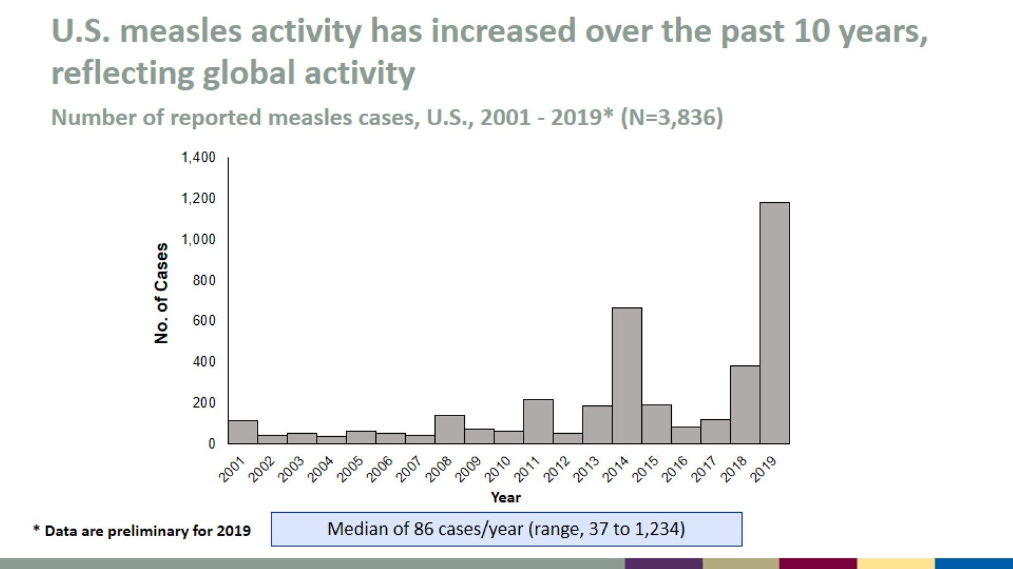
U.S. measles activity has increased over the past 10 years, reflecting global activity
Number of reported measles cases, U.S., 2001 - 2019* (N=3,836)

Slide 4
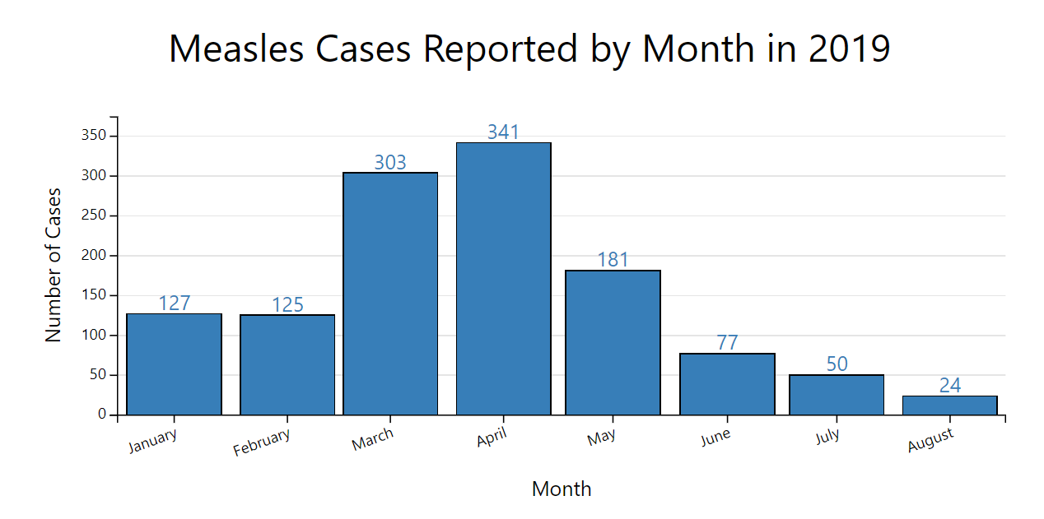

Slide 5
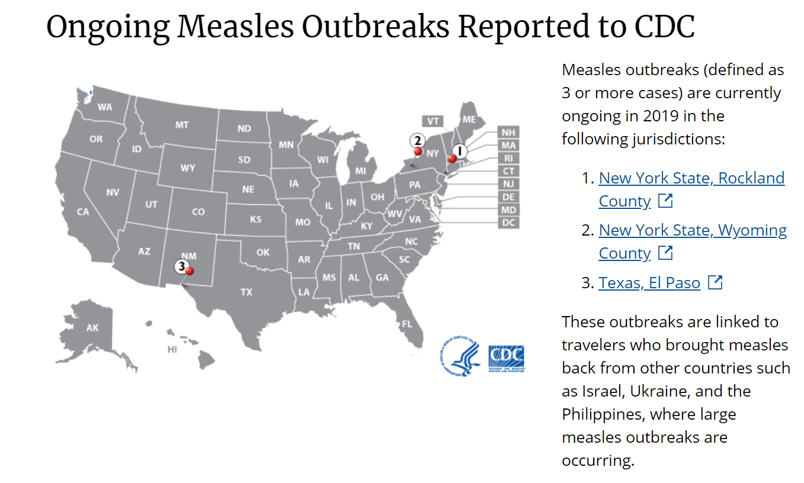

Slide 6
Few children have received no vaccinations by age 24 months
HP2020 Goal: <1%
Estimated percentage of children who received no vaccinations by age 24 months, by year of birth. National Immunization Survey-Child, United States, 2013-2017. https://stacks.cdc.gov/view/cdc/59413
6
Notes:
As we can see from this slide, very few children are not receiving any vaccines at all. This has remained below 1% for many years, although there was a small increase in 2017, with a rate of 1.3%. Continued evaluation of prevalence and reasons for nonvaccination is needed, as are improvements in access to and delivery of age-appropriate vaccinations to all children.
Even though there is a lot of discussion about parents choosing not to vaccinate their children, very few parents are choosing not to vaccinate at all. And most kids are up to date on their vaccines by 35 months.

Slide 7
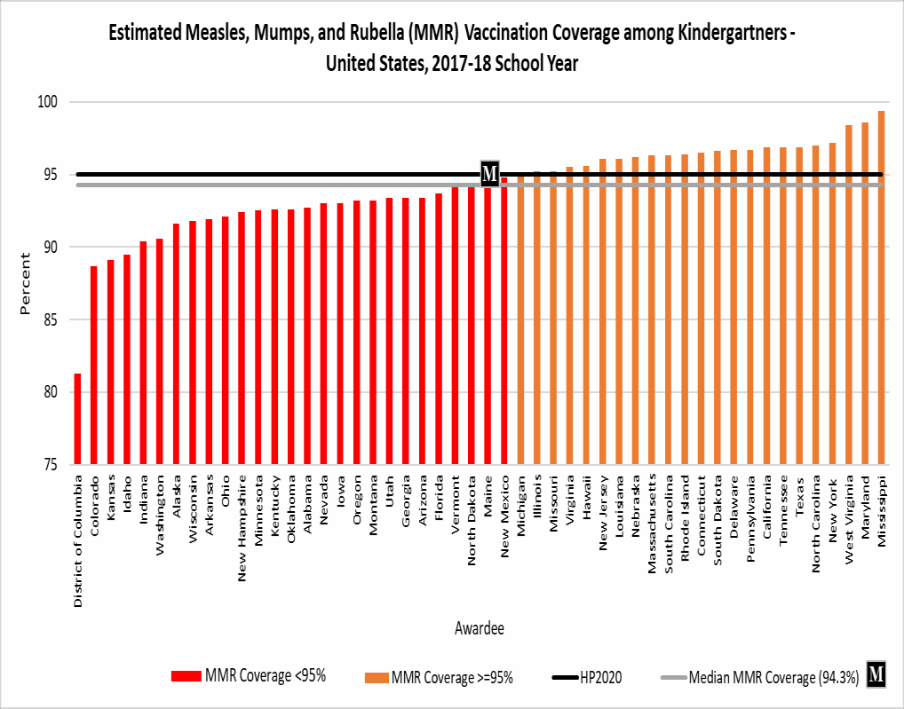
MMR vaccination coverage is high among children in kindergarten
United States, 2017-2018 School Year
Median 2-dose measles, mumps, and rubella (MMR) coverage: 94.3%
• Range: 81.3% to ≥99.4%
  Increase of 0.3 percentage points from 94.0% in 2016-17
23 states reported coverage ≥95%
  3 states and DC reported coverage
<90%
Mellerson et al, MMWR October 12, 2018

Slide 8
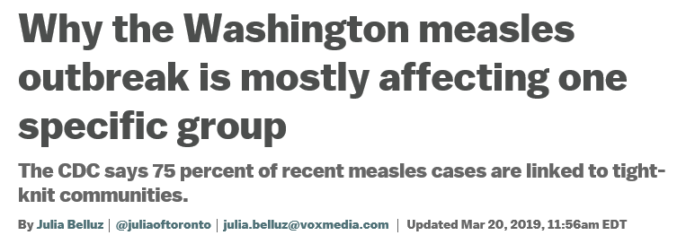
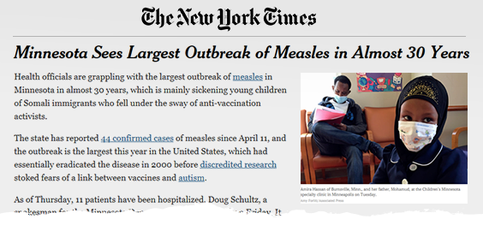
Hot Spots of Vaccine Hesitancy
When small communities have lower rates of vaccination, it can create a foothold for diseases to spread
The reasons specific communities may be hesitant to vaccinate are diverse
Public health and medical providers must work together to identify pockets of reduced vaccination rates

Slide 9
CDC’s Strategy to Reinforce Confidence in Vaccines
Driver #1
Access to Vaccines
Strategy: Dismantle barriers to access
Minimize vaccine costs to patients
Driver #2
Pockets of Low Vaccination
Strategy: Identify, Reach, and Assist Communities at Risk
Driver #3
Bad Information
Leverage data to identify pockets of low vaccination before an outbreak occurs
Work with health partners and providers to reach groups at risk
Create tailored, effective, and empathetic materials and approaches to increase vaccine confidence among at-risk communities
Strategy: Immunize against bad information with accurate, persuasive communications
Contain and counter false safety and efficacy claims
Partner with health agencies, providers, and other stakeholders to educate the public and policy makers
Empower health care providers to make a positive case for vaccines
Connect parents with health care providers
Find new opportunities to vaccinate and minimize missed chances
Notes:
Most Americans are getting their children vaccinated, however we have identified 3 key drivers that lead to reduced vaccination rates.
CDC’s strategy responds to the 3 key drivers of low vaccination rates

