Slide 1
Measles Outbreaks – Access Issues and the Need to strengthen Routine Immunization
Summary of lessons learnt
and vision for the future
Ann Lindstrand MD, MPH, PhD
WHO/IVB/EPI
11th of September 2019, Washington

Slide 2

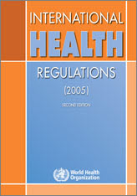
Reasons for measles outbreaks and how to avoid their devastating effect in countries
IHR- meeting international health regulation requirements and strong immunization system in every district prevent outbreaks
OUTBREAKS
PREVENT DETECT AND RESPOND
Low vaccination coverage
Accumulation of susceptible people
Vaccine shortage
Lack of quality surveillance systems
Migrants, IDPs, crowding, slums, humanitarian crisis, and insecurity
Delayed campaigns due to planning, training, logistics, funding etc
Vaccine hesitancy
Vaccine policy not appropriate
High coverage and equity
Timely access to affordable vaccines
Effective surveillance to detect and respond to outbreaks
Stable contexts
Good infrastructure
High demand for vaccines
Clinicians recognize the disease
International Health Regulation
Political will
Notes:
When a large measles outbreak hits a country – all focus goes to response to the outbreak and it can even block/paralyse health services and public health authorities – see the experience from Colombia/ Filippines in last session
Here are some of the reasons why outbreaks like measles happen – to the left
The opposite is of course an immunization system in place that works all the way out to the individual person being vaccinated with an effective vaccine by a health worker
There is an interesting process of Joint External Evaluations of the capacity towards the IHR happening at the moment. 19 technical competencies are evaluated including surveillance, lab services and health care force. Funding within GHSA is hopefully coming forward which will help countries to prevent, detect and respond to outbreaks better.

Slide 3
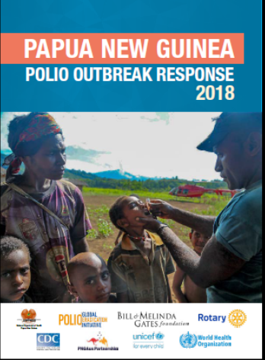
Papua New Guinea: Optimizing Polio Outbreak Response Resources to Integrate Other Health Interventions
Optimizing outbreak resources (e.g. surge, surveillance, capacity building, cold chain, logistics, communication, advocacy) to incorporate other interventions:
  Combined polio/measles and rubella campaigns
  Vitamin A <5Y;
  Strengthening EPI
  Strengthening vaccine-preventable disease surveillance
Government declared 2019 as “Immunization Year”
3
Notes:
We have much to learn from polio and there are so many parallells to do with the measles outbreak response.
Polio transition – big challenge
Phase 1 and 2 (July 2018 – June 2019) – estimated GPEI budget US$ 30 million (WHO - $25 million, UNICEF - $5 million)
Growing donor demands for good financial stewardship (especially Gavi)
Opportunity to build on momentum (preparations for Phase 2 and implementation of OBRA recommendations)
Supporting equity and gender in most remote areas despite higher costs of interventions (60% budget is dedicated to transportation)
2019 priorities:
Stop the polio outbreak by implementing three high-quality SIAs polio vaccination campaigns in the first six months of the year.
Rapidly improve MCV coverage (0-5) by an innovative combination of MR/bOPV in the June round
Strengthen RI delivery across the country by leveraging on the polio SIAs and the declaration of the Gov of PNG of 2019 as the Year of Immunization.
Second half of the year - Focus on enhancing surveillance and establishing a sensitive surveillance system for VPDs
Phase 1 - Vit A was delivered in the October SIA (+HPV in some schools)
Phase 2 activities:
February: bOPV NID (0-15 Y)
April: bOPV + Vit A (0-5 Y)
End May/early June – bOPV (0-5 Y)+ MR (9 m-5 Y)

Slide 4
Reported measles cases and MCV coverage, Ethiopia, 2008-2017
Inter SIA intervals
Notes:
This is reported number of cases in Ethiopia in 2000-2017. Ethiopia is among the top ten countries reporting most measles cases in the world. Big country, many challenges. MCV coverage around 60% and SIAs needed to close the immunity gap.
But what I want to point out here is the importance of not just effective outbreak response to limit the spread of the outbreak and save lives – to be active inbetween the SIA or right after the outbreaks –
To re-establish and build stronger immunization systems
Establish touch points for immunization across the life-course
2 YL
Missed opportunities built into the system
Country tailored approach
Reach zero dose children
People centred services and
UHC
GHSA
So the idea

Slide 5
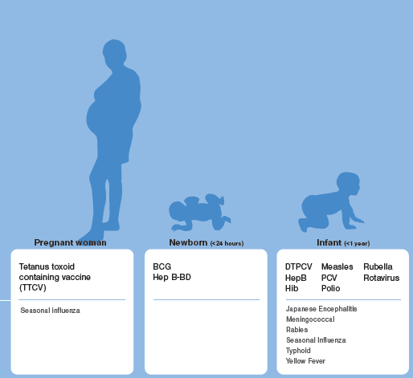
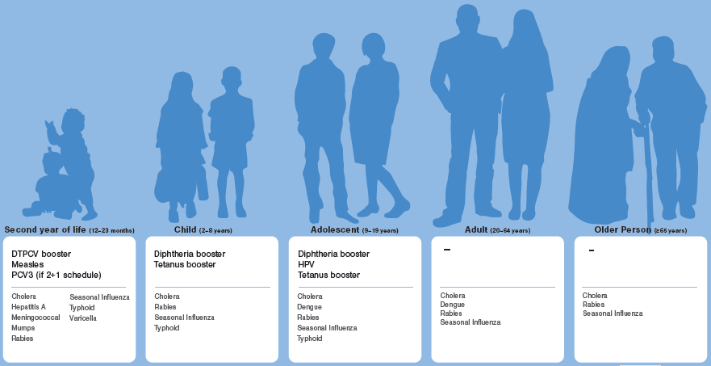
Immunization Service Delivery Platforms across the life-course
Pregnant
Women
Newborn
<24 hrs
Infant
< 1 yr
2nd Year of life
(12-24 months)
Child
(2-8 yrs)
Adolescent
(9-19 yrs)
Adult
(20-64 yrs)
Older Person
>65 yrs
MCV1
MCV2
And catch up……………
Notes:
Vaccination across the life course

Slide 6
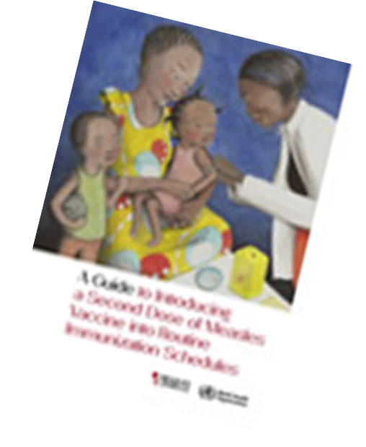


Establishing and strengthening immunization in the second year of life
Practices for vaccination beyond infancy
A platform to deliver MCV2 AND catch-up of MCV1

Slide 7
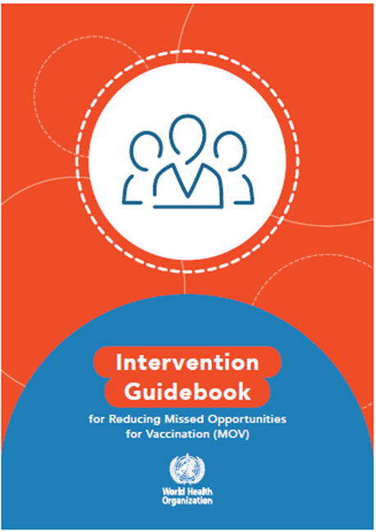
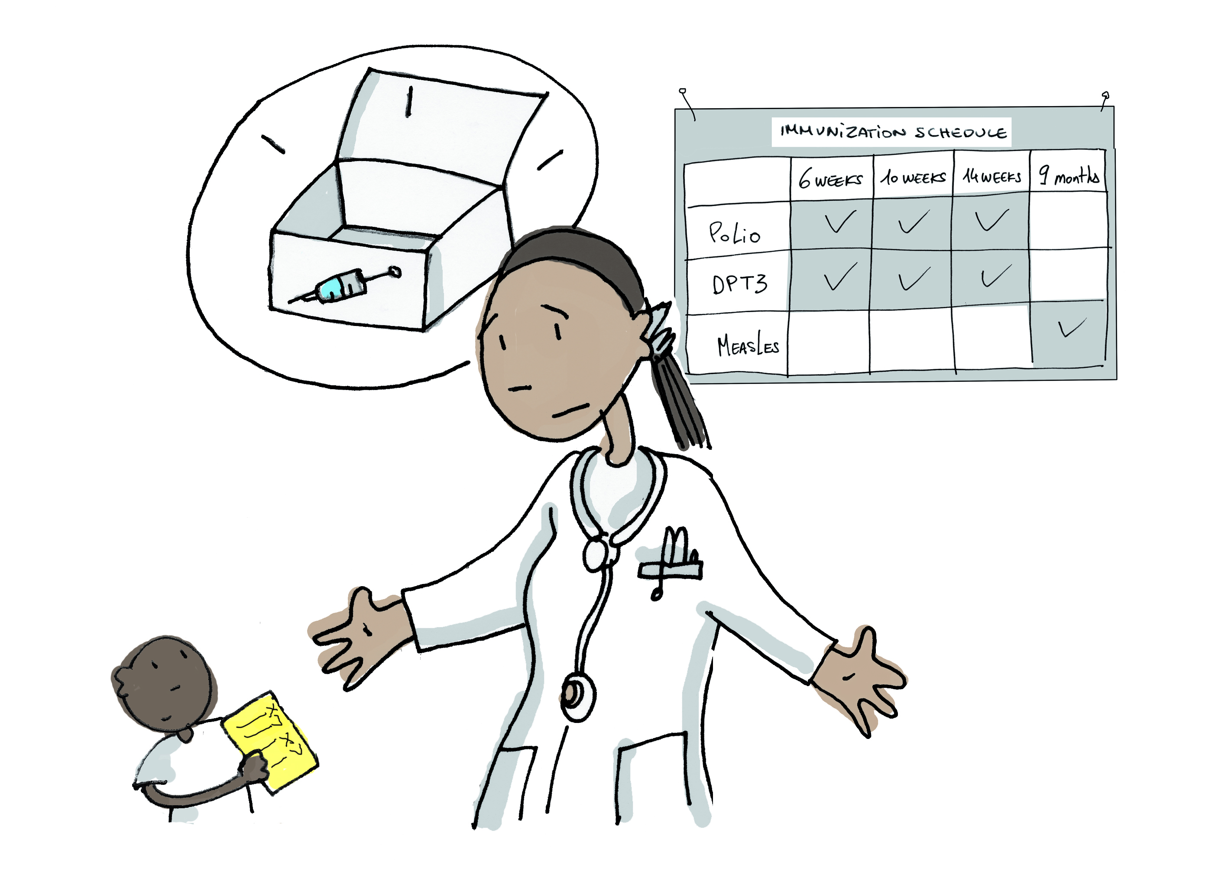
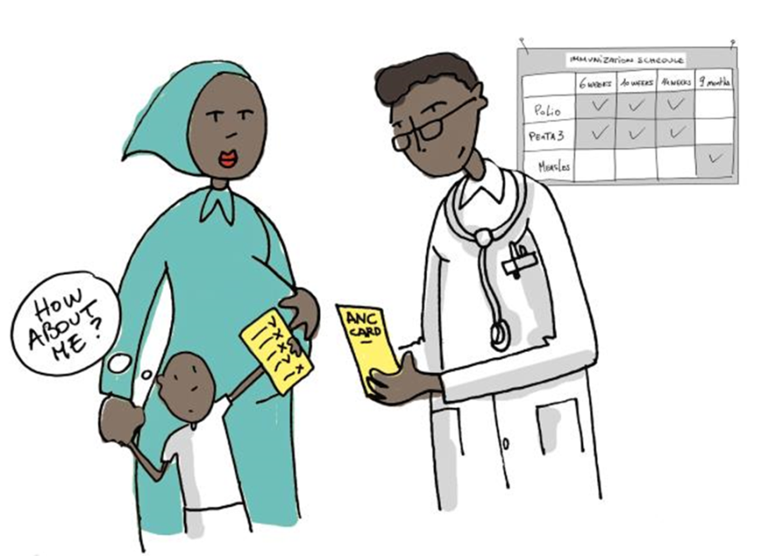
Missed Opportunities for vaccination
  Any visit to health facility by child (or adult) who is eligible for vaccination, which does not result in person receiving all eligible vaccine doses

Slide 8
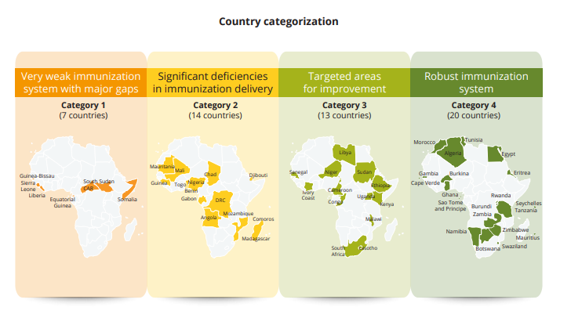
WHO African Business Case (2018-2030)
Country Tailored Approach

Slide 9
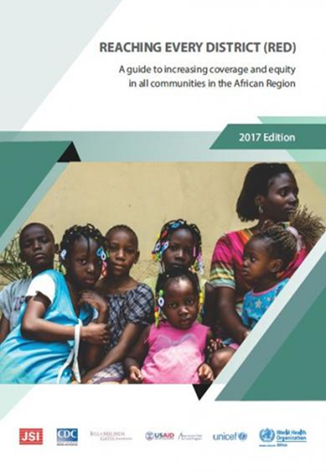
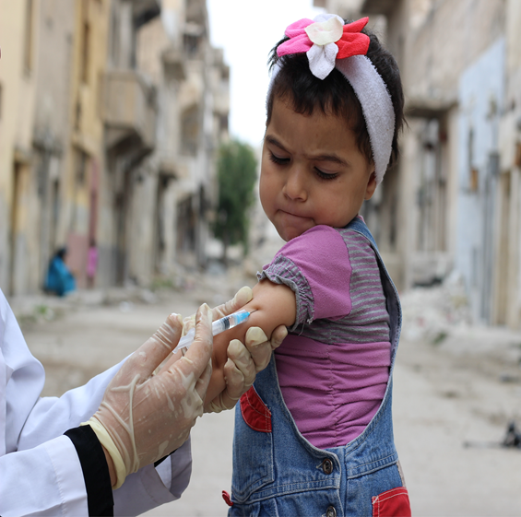
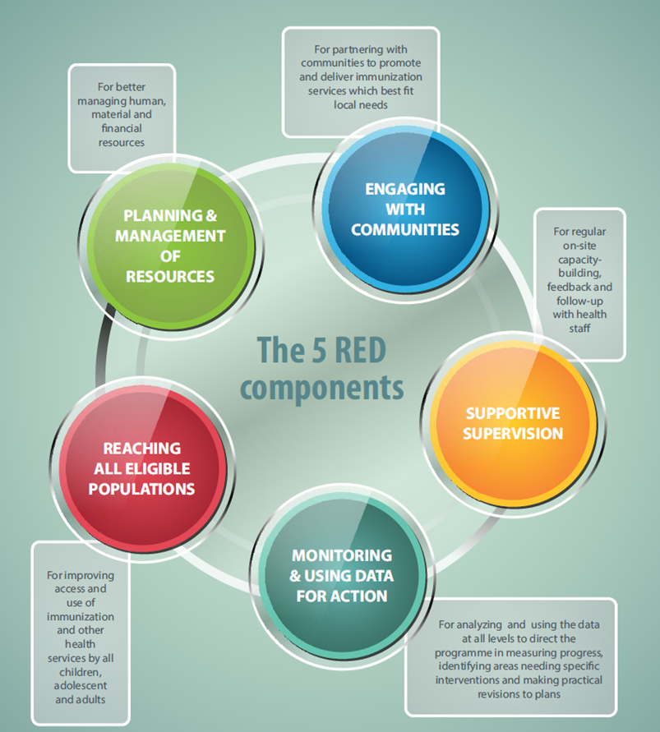
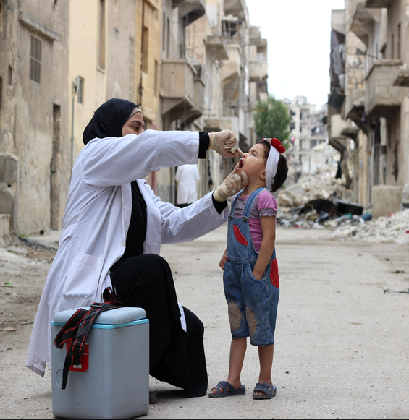
Equity and focus on the Zero Dose Children
– Close the immunity gap and reaching un- and under vaccinated Children

Slide 10
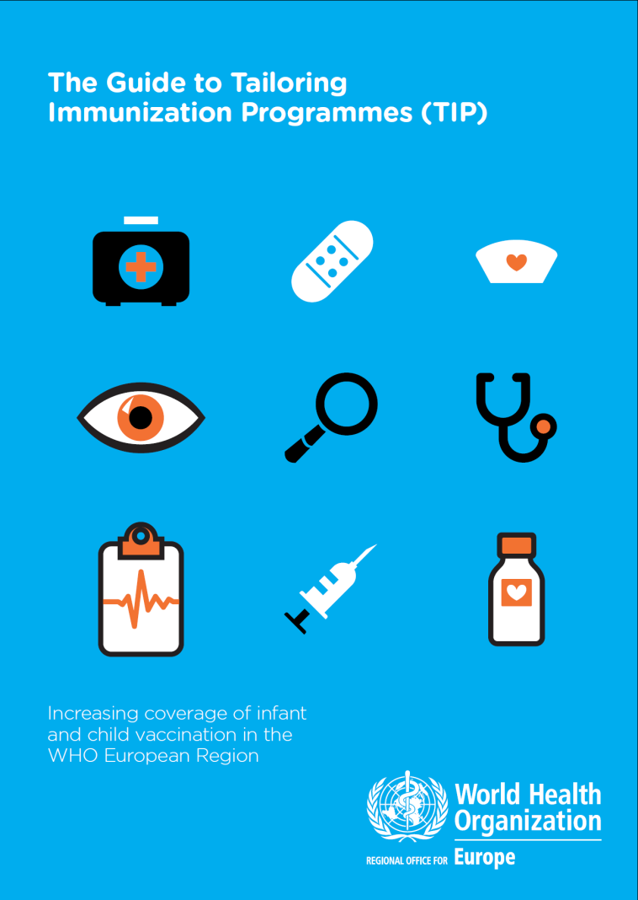
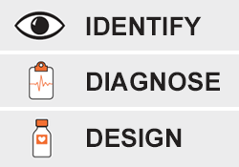
People centred services-
Tailoring Immunization Programmes (TIP)
For under-vaccinated or hesitant target populations
People-centered approach using behavioural theoretical model, linking research to interventions to M&E
Defines and evaluates evidence-informed interventions to increase coverage

Slide 11



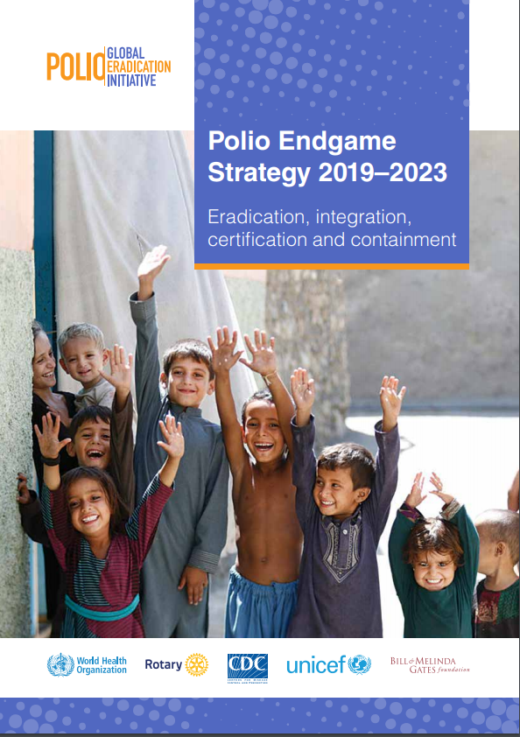
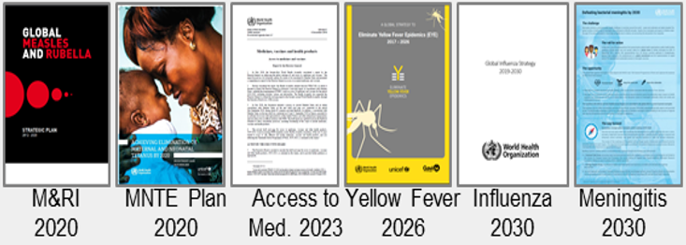

Integrated, Vertical or Diagonal approach to elimination…?
VERTICAL PROGRAM
INTEGRATED PROGRAM
Sustainable
Development
Goal 3 (SDG 3)
Disease-specific strategies
Universal Health
Coverage (UHC)
Resilient
Health Systems
(HSS)
Primary Health
Care (PHC)
Polio Endgame 2023
Vaccine preventable diseases
(VPD)

Slide 12

Thank you!

Slide 13
Why Now? Cause(s) of Measles Outbreaks
Gaps in population immunity because of insufficient vaccine coverage
    Weaknesses in reach of health systems in many countries (CAR, DRC, Madagascar)
    Civil unrest, famine, active conflict, socio-economic/political crisis (Syria, Venezuela, Yemen)
    Vaccine hesitancy, or quality and access of services (Philippines, Ukraine, United States)
    Susceptible populations distributed across wide age groups (France, Bangladesh
    Outbreaks affecting sub-groups: adolescent-adults, migrants, indigenous, religious groups (United States)
Global spread
  Increasing interconnectedness
  Measles virus highly infectious, incubation period 7-21 days
  Outbreaks in countries with high international travel creates pressure on eliminated countries
Notes:
Regional challenges are grouped together and between brackets I have highlighted the regions that are most affected by the challenge or where many countries struggle with the challenge.
EMR:
Many member states affected by civil unrest, famine in Yemen, Sudan, Somalia
Persistent low coverage in some countries (Somalia, Pakistan, Afghanistan)
Decreasing coverage in countries with active conflict (Iraq, Syria, Yemen)
WPR:
Measles resurgence in endemic countries (Philippines)
Outbreaks following measles importations in Cambodia and Mongolia
<1y and adolescents/adults increasingly affected by measles
Rubella outbreak among women of child-bearing age in Vietnam, Philippines
SEAR:
Need to increase routine immunization and strengthen surveillance (India and Indonesia)
Outbreaks in some high coverage countries (Bhutan, Sri Lanka, Thailand)
the current status of measles control leads to a situation in which susceptibility to measles is distributed across increasingly wide age groups, which will make eventual elimination both more expensive and more technically difficult. Incomplete control allows persons to grow to older ages still susceptible as they have neither been vaccinated nor exposed to measles (because measles incidence has decreased). This can lead to outbreaks which have wider age ranges of cases than in the pre-vaccine era.

Slide 14

One of the 7 strategic priorities in
Immunization Agenda 2030 focus on
Outbreaks and Emergencies
Immunization Programs for primary health care /
universal health coverage
DRAFT
      Outbreaks
      & Emergencies
      Life course
      & Integration
      Commitment
      & Demand
      Research
      & Innovation
Outbreak preparedness and response
Strengthen coordination and implementation of outbreak preparedness, detection, and response and vaccination activities – in the contexts of the overall humanitarian response, international health regulations, and health systems development programming.
Local capacity
Invest in and sustain local capacities and health systems to ensure timely detection of and response to outbreaks; identify and address the underlying causes of outbreaks; and ensure communities affected by outbreaks and emergencies have access to essential immunization services.
Multi-level responses
Ensure global, regional, national, and sub-national coordination and governance mechanisms can effectively support equitable, transparent, and timely decision-making on the allocation of essential supplies and vaccines and mobilization of trained human resources.
Integrated surveillance
Build national, regional, and local capacity to conduct integrated surveillance for priority diseases, maximizing opportunities to monitor and characterize multiple pathogens.
Reaching affected populations
Develop, implement, and evaluate innovative, tailored approaches and relevant frameworks and tools to safely, ethically, and equitably vaccinate populations during outbreaks and in humanitarian settings.
Community engagement
Prioritize two-way communication and engagement with communities and health workers to promote participation in decision-making; ensure access to and utilization of services; and identify and address unmet health needs.
      Coverage & Equity
      Supply &
      Financing

Slide 15

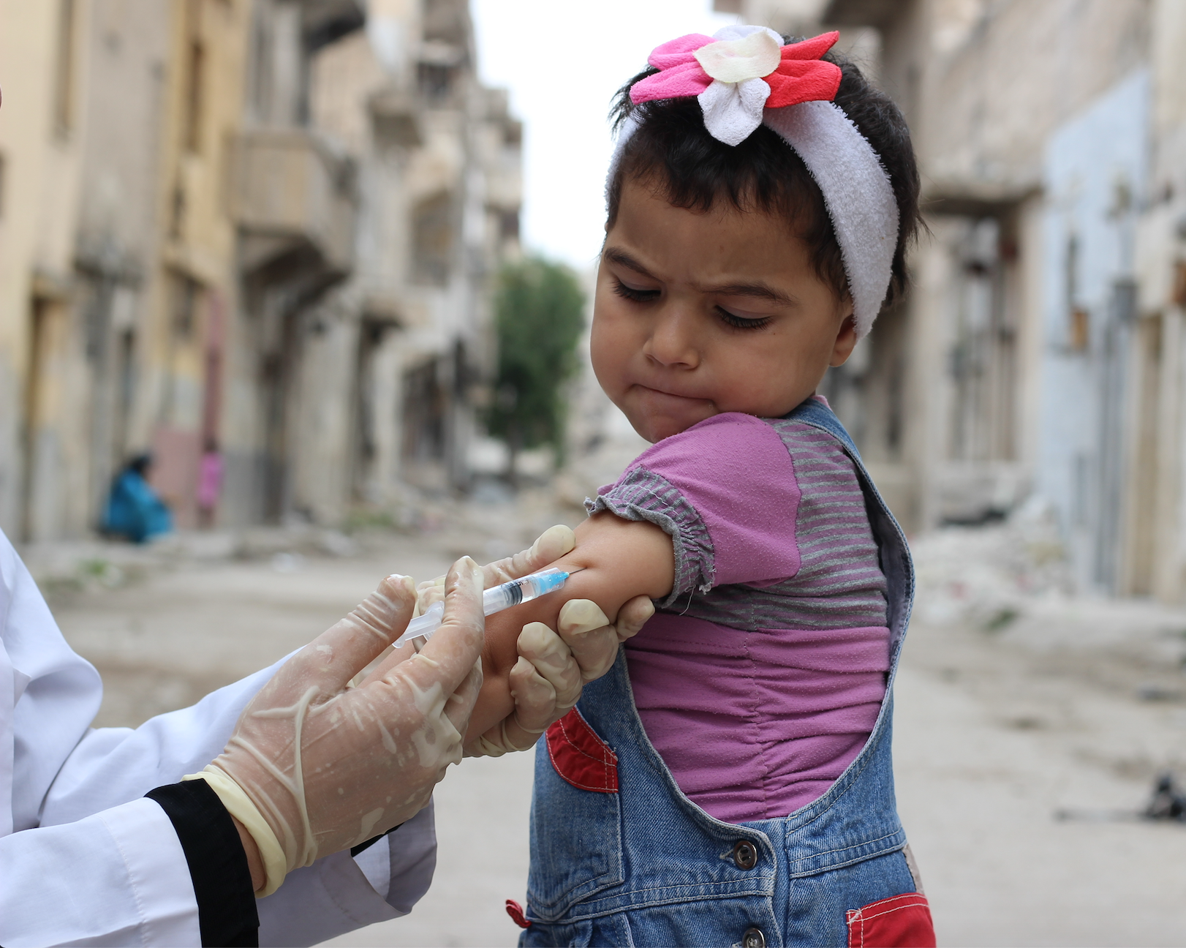
Integration:
Combined Polio and Measles Campaigns
Priority - non polio endemic, non-outbreak countries, with high performance in previous MCV SIAs (Admin ≥90% )
Upon country request (e.g. PNG, DRC)
Implemented in 7 countries (Nepal, Myanmar, Uganda, Sierra Leone, Sudan, PNG, DRC)
Potential to reach more children, with less cost:
  Uganda – 8.5 million children vaccinated, $4M cost savings
  Sudan – 8.1 million children vaccinated, $1.85M cost savings
15
Notes:
GPEI support of $0.25 per child ($0.15 per dose bOPV, $0.10 per child ops costs) - approximately 10% of integrated MCV/polio campaign costs
The figures are for nation-wide campaigns:
In Uganda, $1M would be used to cover only 22% of the 8.5 million children. A nationwide campaign would cost $5M
In Sierra Leone, a single H2H round would cost $800,000 dollars. However, we are now covering the entire country for nearly half the price
In Sudan, one round of H2H SIAs costs $5.9M. Thanks to integration with measles, the actual cost comes down to 4.05 million dollars
Drawbacks for polio: No house-to-house (can be mitigated by HTH social mobilization)

Slide 16
Lessons learnt
inadequate country ownership and political will;
excessive focus on SIAs at the expense of routine immunization;
resource (both human and financial) constraints;
failure to fully exploit the links with the Global Polio Eradication Initiative (GPEI);
failure to adapt to the evolving situation, e.g. conflict and insecurity and hesitancy
the global health environment.
Cover and close immunity gaps
Tailored approach between national non-selective or targeted sub national
Use the attention of outbreaks
Increased demand for vaccines in light of outbreaks
Focus on root cause analysis post outbreaks – Use HSS to build systems
Global Health Security
Focus on equity, migrant populations refugee population

Slide 17
Outbreaks and Emergencies
      A framework for action
Key areas of focus
Draft
One
1
  Strengthening country outbreak preparedness, detection and response capacities
  Integrating immunization system strengthening plans into outbreak responses to address the underlying causes of outbreaks and reduced the risk of recurrence.
  Strengthening international, regional, national and subnational coordination mechanisms and governance for the rapid deployment of vaccines and medical counter-measures.
  Developing, implementing and evaluating innovative, tailored and gender-sensitive approaches to safely vaccinate populations affected by humanitarian emergencies
  Ensuring the resilience of primary health care systems to provide an essential package of services, including vaccination, during emergencies and in disordered settings
  Ensuring close alignment of humanitarian responses and development programming
  Using the vaccination in humanitarian emergencies framework as a basis to extend and adapt the vaccines provided
2
3
4
5
6
7
To maintain and strengthen capacity to prepare for, prevent and respond to vaccine-preventable disease outbreaks, and ensure that those affected by emergencies continue to receive essential immunization services.

Slide 18
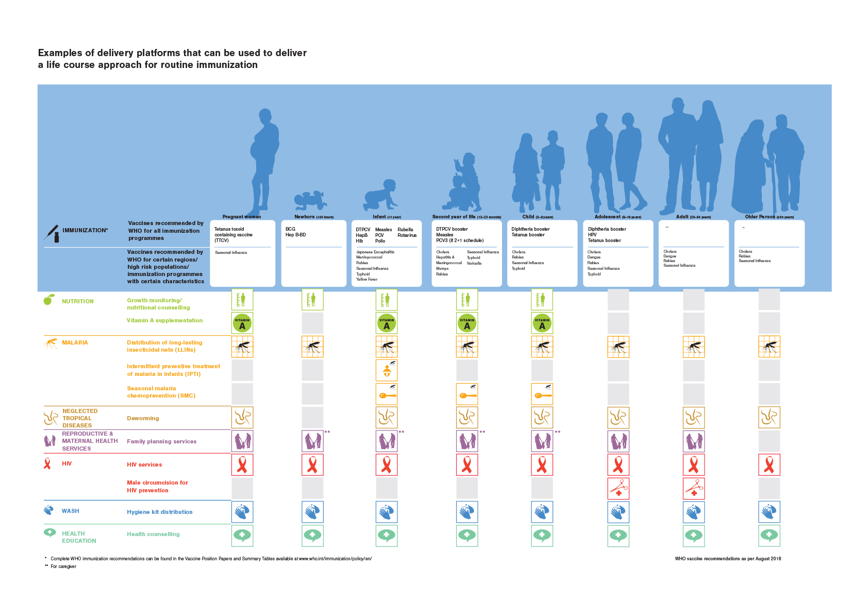
Life course immunization opportunities for integration
Source: Working Together. WHO, 2018.

Slide 19
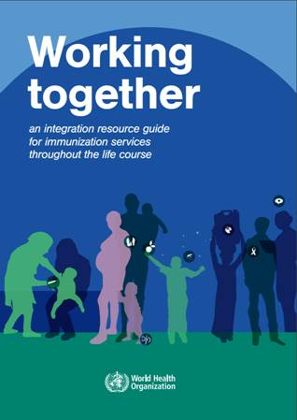
WHO Integration Resource Guide
NEW!
Resources, current knowledge and guidance on the integration of immunization with other health interventions, health policies or activities to strengthen health systems.
Considerations for planning of integrated services.
.
Where to find it? Available on the WHO website in English and French:
https://www.who.int/immunization/documents/ISBN_9789241514736/en/

Slide 20
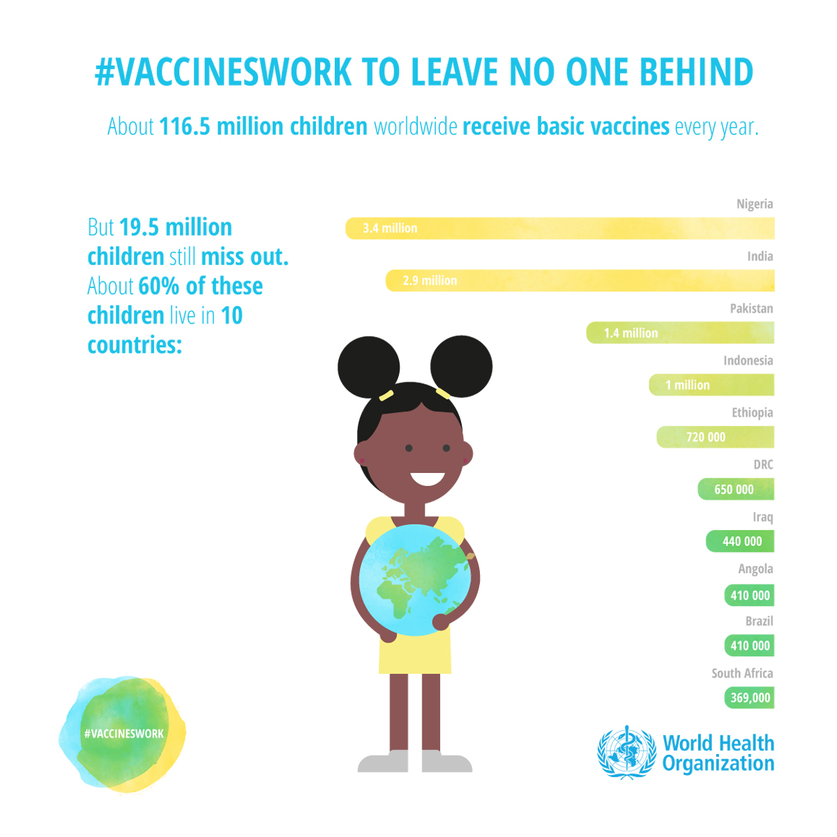

Slide 21
Examples of activities
cost category | MOV/2YL | RED/REC | PIRI | School screening
Service delivery | Update existing immunization guidelines for MOV and disseminate (including promotion of screening and catch up vaccination) | Expand sessions (fixed, outreach, mobile) to reach targeted groups (e.g. urban, rural, pastoralist) | Plan for additional outreach or mobile sessions to provide immunization plus other PHC services as feasible to populations currently missed | Pilot school screening program in targeted district(s) or nationwide as appropriate.
Capacity building | Develop and produce training materials (including e-material) for screening and eligibility criteria of both EPI and non-EPI staff | Develop and conduct supervisor trainings for integrated delivery | Designate supervisors for the PIRI activities and develop a supervision checklist | Conduct workshops for school staff and proprietors to educate them about vaccinations and school screening procedures.
Procurement and supply chain mgt | Assess and meet additional cold chain space requirements, if needed | Calculate and order commodities for integrated interventions | Develop a detailed schedule and budget for distribution of vaccines and other commodities | Procure additional cold boxes as needed (if vaccines are to be transported to school)
Health information systems | Modifiy information system Field test | Revise/distribute tally sheets, registers, and cards | During training and supervision, include skills practice on screening, recording of doses given during PIRI and how to capture these doses in monthly summary reports to the HMIS | Develop and procure necessary data collection and child tracking tools, e.g. school registers.
Advocacy, coms and socmob | Advocacy, sensitization of professional societies, private practitioners, etc | Create and pilot health messages to address demand | Conduct meetings with community leaders so that they can convey the importance of routine immunization and features of the PIRI activity | Conduct social mobilization activities to communicate school vaccination and/or screening activities with parents
Legal, policy and regulatory | To place emphasis on country leadership to reduce MOV, create MOV Strategy Team at the national or subnational level | Review and revise catch-up vaccination and multiple injection policies | Develop and distribute operational guidelines for PIRI service delivery activities | Review and revise policies for school immunization screening

Slide 22
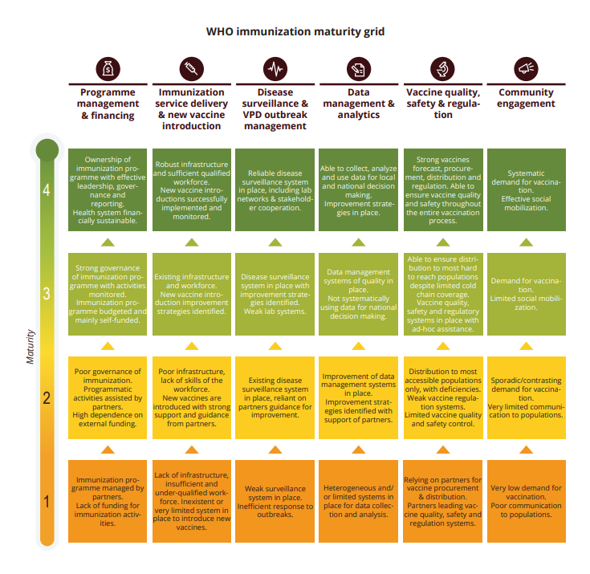
WHO African Business Case (2018-2030)
a four level scale maturity grid
  As per countries’ immunization systems maturity and performance along six key components
The maturity grid defines the ability of a country to efficiently plan, implement, monitor and evaluate its immunization programme.`

Slide 23
WHO response to global outbreaks
Director General and World Health Emergencies (WHE) engaged
IVB / WHE work v closely together on outbreaks (grading, response)
Strong communication response in process
  Media
  Advisories
Under discussion:
  Measles task force (IVB, WHE, others) or incident management structure to make a global risk assessment, root cause analysis and action plan including enhanced and prioritized country support
  WHO’s Strategic Technical Advisory Group for Infectious Hazards (STAG-IH) to review measles situation (including RRA) to advise WHO

Slide 24
EXTRA SLIDES

Slide 25
Strengthening of RI Systems
RI is critical for achieving the elimination goals:
  > 95% coverage with 2 doses of MCV is needed
  Central theme for M&R Initiative Strategic Plan (2012-2020) and ongoing activities
  2/3 of measles cases averted through RI (J. Inf Dis. 204, 2011)
Studies demonstrate that properly planned SIAs can strengthening RI (E.g.,):
  Improve micro-planning, training and supervision of HCW
  Improvement of CC, waste management system & injection-safety standards
  strengthened AEFI surveillance
MCV2 in the 2YL offers an ideal opportunity by:
  fixing an immunization/health check contact during 2YL (e.g. growth monitoring, booster doses, Vit A)
  catch-up vaccination for all missed vaccines
Measles vaccination school entry checks can improve coverage of other VPDs.
Measles Outbreaks as an indicators of weak RI:
  Measles is highly infectious and seeks out susceptibles; disease is highly visible,
  Outbreaks identifies gaps in RI programs and population groups missed by RI.
Notes:
US experience: outbreak investigations and finding “preventable cases” was used to develop our financing system for poor children, our coverage survey methods, and our school mandates with enforcement.

Slide 26
Country Survey on Strengthening
Routine Immunization through SIAs
Most frequent activities associated with SIAs
  Extensive advocacy and education on RI targeted to public and health professionals
  Extensive HCW refresher training on RI knowledge and skills
  Substantial cold chain expansion
  Unvaccinated children identified before, during and after SIAs, but little evidence that these children were followed up and vaccinated
Other RI-strengthening activities associated with MR elimination
  Additional training and resources for MR surveillance benefited all VPDs
  MR outbreak risk assessment and preparedness extended to VPDs and non-VPDs
  No examples identified using 2YL platform
Biellik RJ, Orenstein WA. Strengthening routine immunization through measles-rubella elimination. Vaccine (2018), https://doi.org/10.1016/j.vaccine.2018.07.029

Slide 27
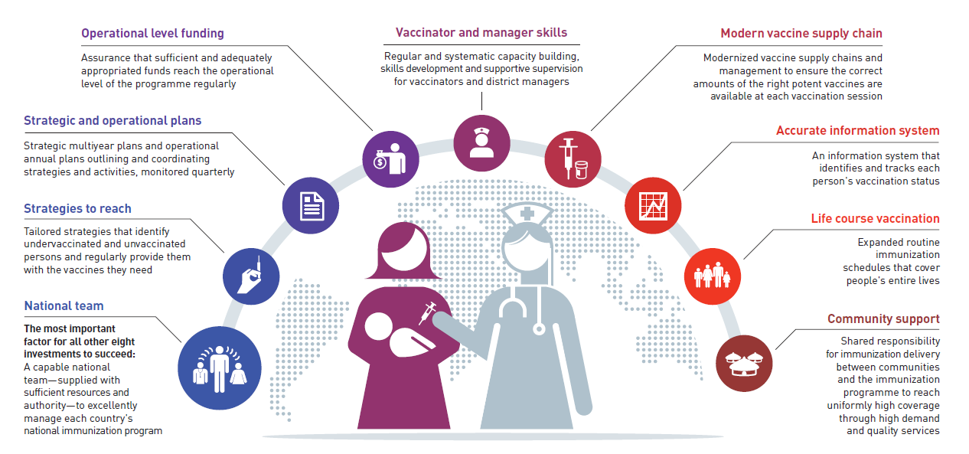
Synergy Opportunities
Training HCW for RI during SIA and 2YL training
Update cold chain for SIAs
Update micro plans post SIA
Missed Opp for Vac (MOV)
2YL
Using outbreaks to signal
RI gaps
School entry checks
Social mob
for SIAs
Integration
Notes:
WHO GRISP proposes the areas requiring attention and investments to respond to the challenges of underperformance (a number of guidance documents and initiatives have been developed in the past few years to support improvement plans). Although MR elimination activities alone can not address ALL RI weaknesses, it can serve as a tugboat and contribute to increasing RI coverage. The slides highlights how measles specific activities can contribute to RI strengthening. The categorization guidance places RI as a highest priority and proposes multiple strategies that countries should use to increase MCV coverage.

Slide 28
Gavi PPC (October 2017)
Potential approaches to ensure campaigns are benefitting Routine Immunization Systems
Program focus remains on raising routine coverage as a top priority
Prioritize alternative delivery strategies (e.g. PIRIs or child health days) that improve routine coverage
Promote multiple interventions at the same time
Explore and evaluate the possibility of funding expanded partners with comparative advantages
Ensure better planning of campaigns as well as adherence to timelines and best practice in new WHO Field Guide – otherwise no/delay campaign
Include interventions that deliberately target the strengthening of RI in the planning of campaigns
Alternative delivery strategies (e.g, PIRIs*):
Need to be conducted between SIAs (intra-campaign)
By raising routine coverage, can decrease frequency of SIAs
Cannot substitute for SIAs, due to need to rapidly increase population immunity
*PIRI: periodic intensification of routine immunization

Slide 29
Current Policy Guidance on inter -SIA Intervals:
WHO Measles Position Paper, 2017
“Because the risk of measles outbreaks is determined by the rate of accumulation of susceptible people in the population, programmes should use available good quality data on population immunity (i.e. vaccination coverage, surveillance, serological studies) to monitor the accumulation of susceptible people and conduct follow-up campaigns before the number of pre-school children susceptible to measles approaches the equivalent of one birth cohort, in order to prevent an outbreak of measles.”
“This approach has been found to be programmatically useful in preventing large outbreaks. However, for large countries and countries which are close to measles elimination, a more extensive assessment of the accumulation of susceptible persons should be carried out at the subnational level”.
Notes:
The above is a rule of thumb that was used in the Americas and elimination was achieved. However, questions are raised about this rule of thumb in other regions as outbreaks continue to occur in many countries implementing the strategy-

Slide 30
Reported Global Cases are <10% of Estimated Total Cases
Measles Global Annual Reported Cases and
MCV1* and MCV2** Coverage, 1980-2019
EPI Schedule
established, 1983
Measles Initiative
launched, 2001
85%
67%
Vaccine Coverage
Case Count
Measles outbreaks are in all regions; increased size and frequency
2018 reported measles cases to date = 341,092 (JRF)
2017 reported measles cases = 173,330
2018
2019
*MCV1 coverage: first dose of measles-containing vaccine as estimated by WHO and UNICEF.
**MCV2 coverage estimates are only available from 2000 when global data collection started, however some countries introduced MCV2 earlier.
Source: WHO/IVB database & WHO/UNICEF coverage estimates 2017 revision, July 2018. 194 Member States.
Date of slide: 20 August 2018
2017 estimated total measles cases = 6,700,000
(95% CI: 2.95 M – 36.84M)
2019 reported measles cases (through July 2019, monthly data) = 269,522.
At same time in 2018, 103,728 cases

Slide 31
Global transmission = threat to measles-eliminated countries
Regional Scorecard on Verification of Elimination, June 2019
WHO Region (No. Member States) | Regional Verification Commissions Established | Elimination Achieved
 |  | No. of MS (areas) | % of MS
Americas (n=35) | Yes | Measles: 33 Rubella: 35 | 94% 100%
Europe* (n=53) | Yes | Measles: 37 Rubella: 37 | 70% 70%
Western Pacific (n=27) | Yes | Measles: 7 (+2) Rubella: 4 (+1) | 26% 15%
Eastern Mediterranean** (n=21) | Yes | Measles: 2 Rubella: 3 | 10% 14%
South-East Asia (n=11) | Yes | Measles: 5 | 45%
Africa (n=47) | Yes | - | -
TOTAL (n=194) |  | Measles: 84 (43%) Rubella: 79 (41%)
*EUR: The results of the June 2019 EUR RVC meeting are embargoed and not yet reflected. In addition, a number of countries have been verified as having interrupted transmission for 12 or 24 months, these are not reflected.
**EMR: The EMR RVC verified three countries as having eliminated rubella, despite the absence of a rubella elimination goal.

Slide 32
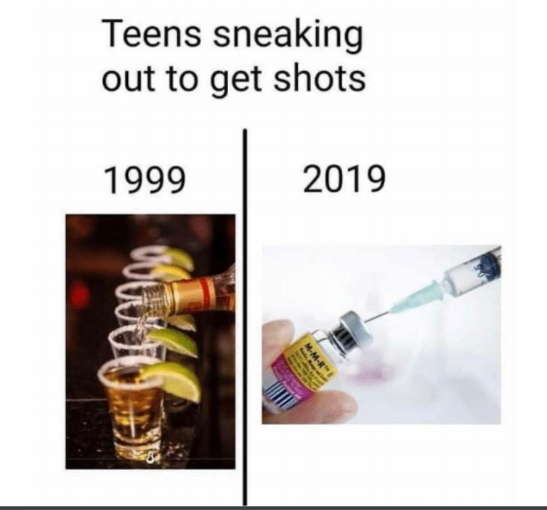
Vaccine Hesitancy
Increasingly important issue among subgroups
Increasing use of social media and need to develop better tools in response
Most hesitancy exists along a spectrum, which requires tailored approaches
Service delivery is most critical in increasing vaccination coverage

Slide 33
Madagascar measles outbreak, 2018-2019*
Classic island epidemiology
145,136 cases
>1,000 deaths
3 waives of campaigns
7.26 children 6m to 9y vaccinated
Plan for EPI strengthening elaborated
Coverage MCV1 58% and MCV2 not introduced
*Data source: Madagascar MoH situation reports
Notes:
145 136 cases
>1200 deaths

Slide 34
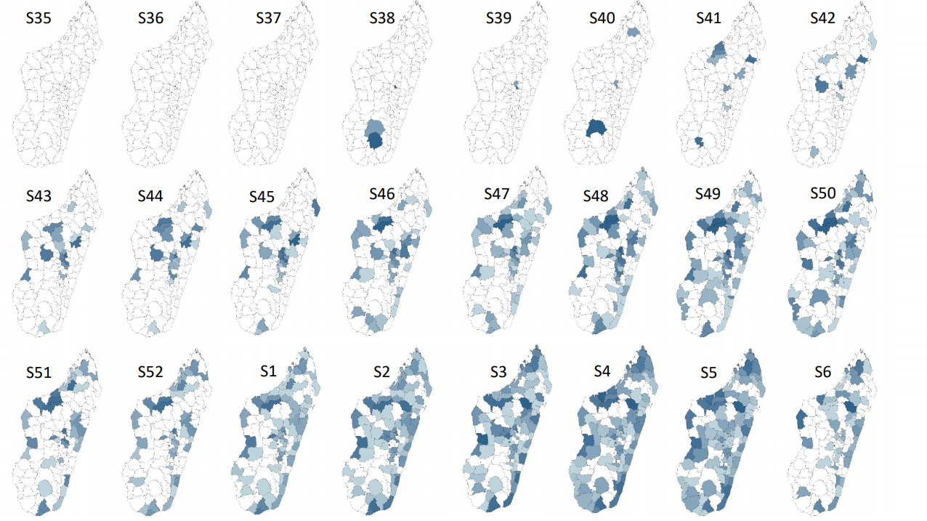

Slide 35
Comoros measles outbreak, 2019
Rapid response in a vulnerable population
60
50
40
Number of cases
30
20
10
0
Discarded
2017-06
2017-07
2017-08
2017-09
2017-10
2017-11
2017-12
2018-01
2018-02
2018-03
2018-04
2018-05
2018-06
2018-07
2018-08
2018-09
2018-10
2018-11
2018-12
2019-01
2019-02
2019-03
2019-04
2019-05
2019-06
2019-07
Clinical
Epi
Lab
Month of onset
Year | Confirmed Cases
2011 | 3
2012 | 0
2013 | 0
2015 | 0
2016 | 0
2017 | 0
2018 | 0
2019 | 26
Comoros age distribution, vaccination status, and incidence, 2018-06 to 2019-05
5
160.5
150
100
Number of cases
Incidence rate per 1,000,000
42.4
47.4
23.8
50
21.5
6.4
6.8
0
0
<1 year
1-4 years
5-9 years
10-14 years
15-24 years
25-39 years
40+ years
Age at onset
0 doses
1 dose
2+ doses
Unknown

Slide 36
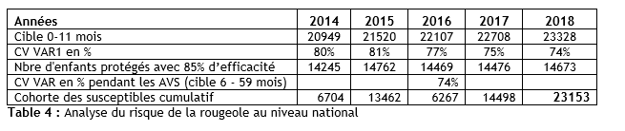
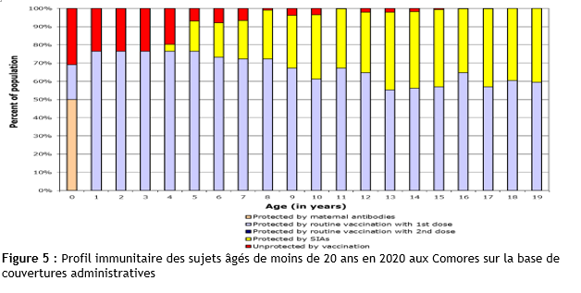
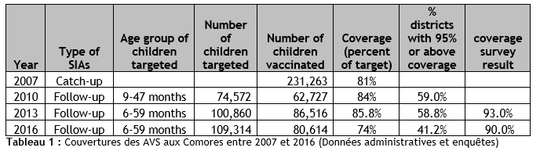
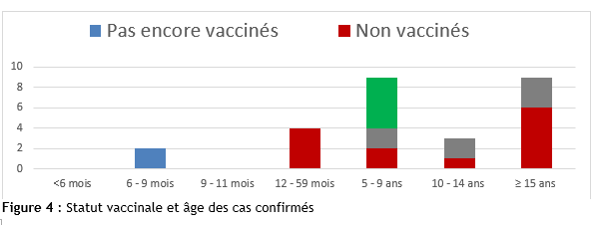
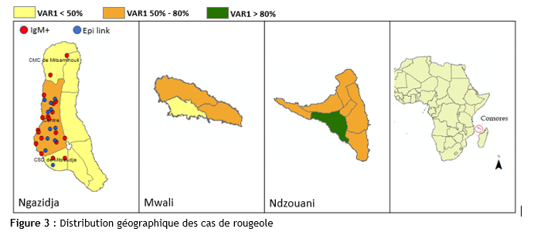
Comoros

Slide 37
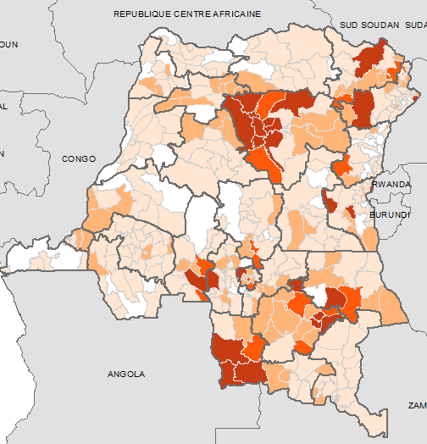
DRC measles outbreaks, 2010-present
Classic endemic transmission
Nombre de cas suspects de rougeole cumulé par ZS, et classification des cas de Rougeole IgM+ par statut vaccinal et par groupe d’âge Sem.1-27, 2019
0 cas
1 - 100 cas
100 - 500 cas
500 - 1000 cas
> 1000 cas

Slide 38
Evolution hebdomadaire de la notification des cas suspects de rougeole en RDC, 2010-2019 (sem.27)

Slide 39
Depuis le mois d’août 2010, la RDC connait une résurgence des épidémies de rougeole dans presque toutes les provinces du pays.
Rubriques | 2010 | 2011 | 2012 | 2013 | 2014 | 2015 | 2016 | 2017 | 2018 | 2019(*)
Cas (agrégés) | 5 407 | 134 041 | 73 794 | 87 366 | 33 711 | 50 889 | 22 162 | 45 165 | 65 098 | 118 647
Décès | 185 | 1 652 | 2 023 | 1 393 | 402 | 565 | 278 | 535 | 901 | 2061
Letalite | 3,40% | 1,20% | 2,70% | 1,60% | 1,20% | 1,10% | 1,30% | 1,20% | 1,30% | 1,70%
Cas investigués | 1444 | 2 443 | 3 032 | 2 553 | 3 133 | 2 516 | 2 189 | 3 319 | 2 908 | 3 225
Cas IgM+ Rougeole | 187 | 1079 | 1 191 | 811 | 1009 | 537 | 406 | 659 | 961 | 1204
Cas IgM+ Rubéole** | 201 | 296 | 460 | 779 | 854 | 442 | 223 | 688 | 291 | 235 (**)
ZS en epidemie | 22 | 104 | 124 | 77 | 97 | 45 | 37 | 61 | 100 | 144
* semaine 27 ; ** Le test est réalisé seulement pour les prélèvements négatifs à la rougeole,

Slide 40
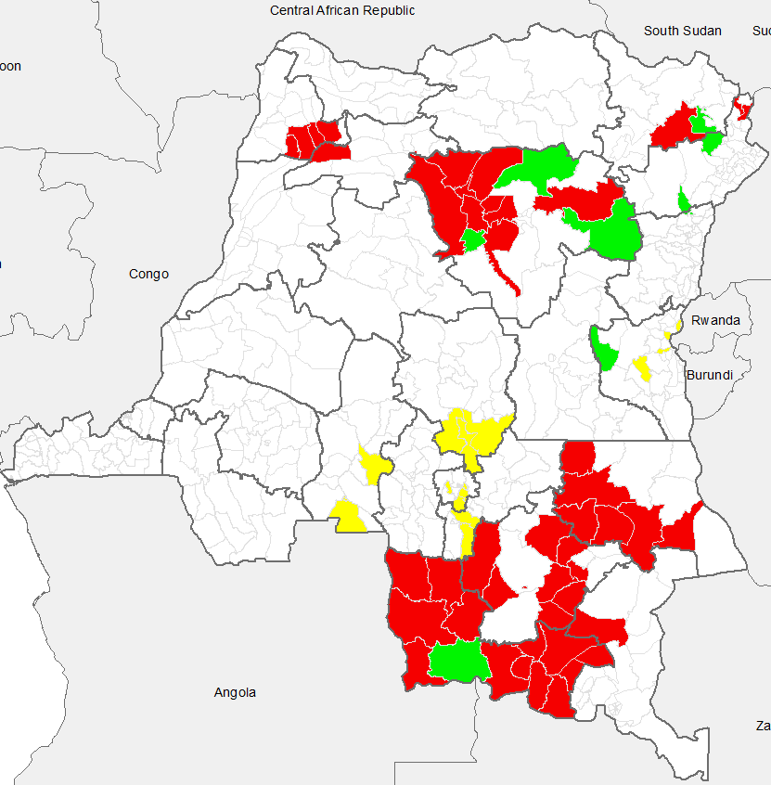
Carte et liste des ZS ciblées pour la riposte Rougeole avec les fonds MRI, UNICEF et MSF,
19-23 avril 2019
MRI
Province | ZS | Population
Haut-Katanga | Mufunga-Sampwe | 263 339
Haut-Lomami | Bukama | 387 308
 | Butumba | 222 397
 | Kabondo-dianda | 278 667
 | Kinkondja | 288 834
 | Lwamba | 151 624
 | Kabongo | 411 170
 | BAKA | 36 073
 | Kamina | 335 452
 | Kaniama | 322 243
Haut-Uélé | Gombari | 135 663
Lualaba | Dilolo | 105 903
 | Kafakumba | 290 896
 | Kalamba | 242 477
 | Kapanga | 267 641
 | Sandoa | 83 273
 | Dilala | 138 897
 | Fungurume | 167 357
 | Kanzenze | 61 743
 | Bunkeya | 202 529
 | Lualaba | 201 604
 | Lubudi | 187 774
 | Manika | 125 693
 | Mutshatsha | 422 911
Mongala | Binga | 309 833
 | Bumba | 339 814
Ituri | Ariwara | 240 424
 | Laybo | 169 407
UNICEF
Provinces | ZS | Population
Kasai | Tshikapa | 423 834
 | Kanzala | 177 338
 | Luebo | 488 051
 | Kamonia | 185 900
 | Kalonda-Ouest | 220 055
Kasai Oriental | Kasansa | 230 799
 | Miabi | 175 174
 | Citenge | 266 809
 | Tshilenge | 325 367
Sankuru | Minga | 175 290
 | Lusambo | 123 248
 | Pania Mutombo | 87 878
Lomami | Luputa | 110 285
 | Kanda Kanda | 354 101
Sud-Kivu | Kabare | 162 054
 | Kamituga | 137 009
 | Mubumbano | 215 873
 | Idjwi | 414 343
MRI
Province | ZS | Population
Sud-Ubangi | Bangabola | 162 570
 | Budjala | 153 984
 | Bulu | 152 498
 | Mbaya | 76 727
Tanganyika | Ankoro | 280 734
 | Kabalo | 273 375
 | Kansimba | 181 784
 | Kiambi | 181 382
 | Manono | 337 335
 | Kongolo | 352 036
Tshopo | Bafwasende | 245 270
 | Basali | 70 148
 | Yaleko | 181 024
 | Yakusu | 233 763
 | Basoko | 189 164
 | Yalimbongo | 171 199
 | Isangi | 232 132
 | Yahuma | 104 517
 | Yabaondo | 309 243
Riposte fonds MRI
Riposte fonds UNICEF
Riposte fonds MSF
Zones non concernées
MSF
Provinces | ZS | Population
Tshopo | Yahisuli | 184 528
 | Opienge | 112 355
 | Banalia | 146 368
Haut-Uélé | Watsa | 309 243
Lualaba | Kasaji | 361 000
Sud-Kivu | Shabunda Centre | 197 186
Ituri | Mandima | 166 839

Slide 41
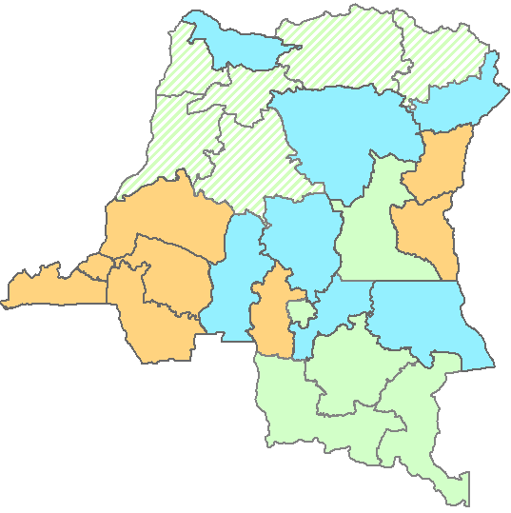
Proposition des blocs actualisés de la mise en œuvre des campagnes de suivi en RDC Octobre 2019 - Février 2020
Bloc 1
Bloc 2
Bloc 3.1
Bloc 3.2

Slide 42
Measles cases: Angola
Cases in Lunda Norte and Lunda Sul at border with DRC
National (6 M-14 Y)
Cov: 93%
1500
1000
Number of cases
500
0
Discarded
2017-06
2017-07
2017-08
2017-09
2017-10
2017-11
2017-12
2018-01
2018-02
2018-03
2018-04
2018-05
2018-06
2018-07
2018-08
2018-09
2018-10
2018-11
2018-12
2019-01
2019-02
2019-03
2019-04
2019-05
2019-06
2019-07
Clinical
Epi
Lab
Month of onset
National SIA
Sub-national SIA
Angola age distribution, vaccination status, and incidence, 2018-06 to 2019-05
Year | Confirmed Cases
2006 | 825
2007 | 245
2008 | 120
2009 | 2441
2010 | 1390
2011 | 192
2012 | 4470
2013 | 6564
2014 | 12002
2015 | 103
2016 | 51
2017 | 27
2018 | 57
2019 | 2864
2000
458.6
500
1500
420.8
400
300
Number of cases
Incidence rate per 1,000,000
1000
200
500
143.1
28.1
14.4
5.1
2.9
100
0
0
<1 year
1-4 years
5-9 years
10-14 years
15-24 years
25-39 years
40+ years
Age at onset
0 doses
1 dose
2+ doses
Unknown

Slide 43
Measles cases: Central African Republic
Low coverage; cases among young children; concern regarding nutritional status
150
100
Number of cases
50
0
Discarded
2017-06
2017-07
2017-08
2017-09
2017-10
2017-11
2017-12
2018-01
2018-02
2018-03
2018-04
2018-05
2018-06
2018-07
2018-08
2018-09
2018-10
2018-11
2018-12
2019-01
2019-02
2019-03
2019-04
2019-05
2019-06
2019-07
Clinical
Epi
Lab
Month of onset
Central African Republic age distribution, vaccination status, and incidence, 2018-06 to 2019-05
Year | Confirmed Cases
2006 | 9
2007 | 54
2008 | 13
2009 | 11
2010 | 3
2011 | 671
2012 | 67
2013 | 370
2014 | 210
2015 | 123
2016 | 191
2017 | 73
2018 | 29
2019 | 128
80
140
113.6
118.2
120
60
100
80
Number of cases
Incidence rate per 1,000,000
40
60
20
27.4
40
5.1
8.9
8.6
2.1
20
0
0
<1 year
1-4 years
5-9 years
10-14 years
15-24 years
25-39 years
40+ years
Age at onset
0 doses
1 dose
2+ doses
Unknown

Slide 44
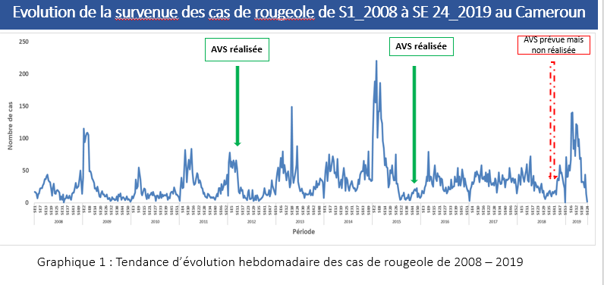
Measles cases: Cameroon
Last SIA 2015; declining MRCV coverage; SIA delayed from 2018; now planning for October 2019; importations from Nigeria
Year | Confirmed Cases
2006 | 192
2007 | 96
2008 | 494
2009 | 870
2010 | 228
2011 | 909
2012 | 616
2013 | 774
2014 | 765
2015 | 1872
2016 | 658
2017 | 710
2018 | 896
2019 | 1224
Sub-national (9-59 M)
Cov: 88%
500
400
300
Number of cases
200
100
0
Discarded
2017-06
2017-07
2017-08
2017-09
2017-10
2017-11
2017-12
2018-01
2018-02
2018-03
2018-04
2018-05
2018-06
2018-07
2018-08
2018-09
2018-10
2018-11
2018-12
2019-01
2019-02
2019-03
2019-04
2019-05
2019-06
2019-07
Clinical
Epi
Lab
Month of onset
National SIA
Sub-national SIA
Cameroon age distribution, vaccination status, and incidence, 2018-06 to 2019-05
1000
299.4
301
300
800
600
200
Number of cases
Incidence rate per 1,000,000
400
79.8
100
200
28.3
10.1
6.1
1.3
0
0
<1 year
1-4 years
5-9 years
10-14 years
15-24 years
25-39 years
40+ years
Age at onset
0 doses
1 dose
2+ doses
Unknown

Slide 45
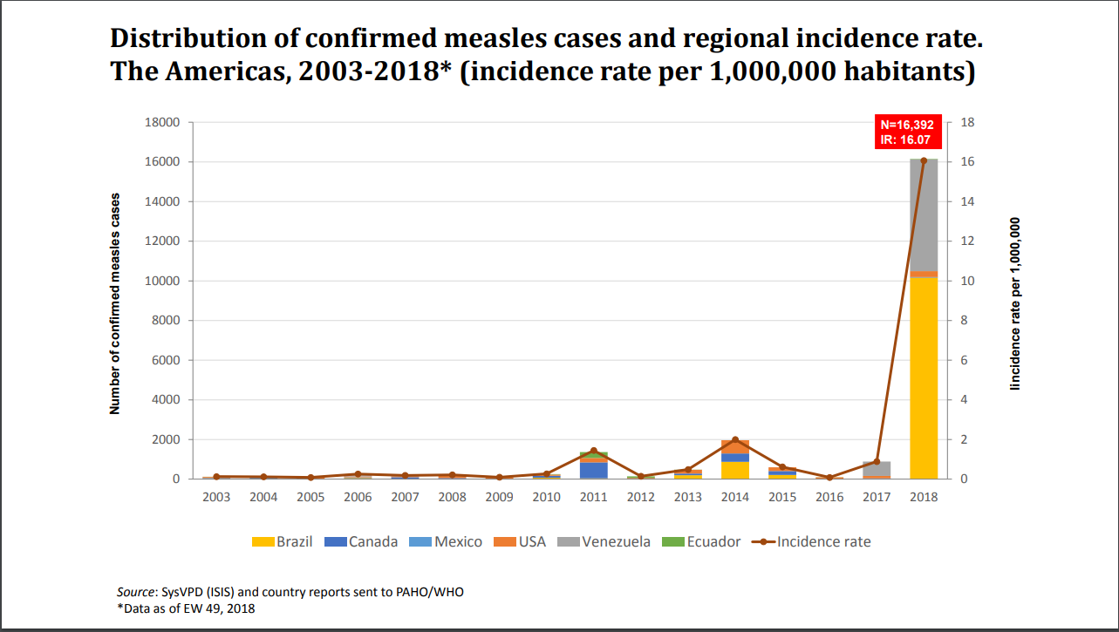
Measles cases in PAHO:
The cost of being the first; and the risk of weak health infrastructure

Slide 46
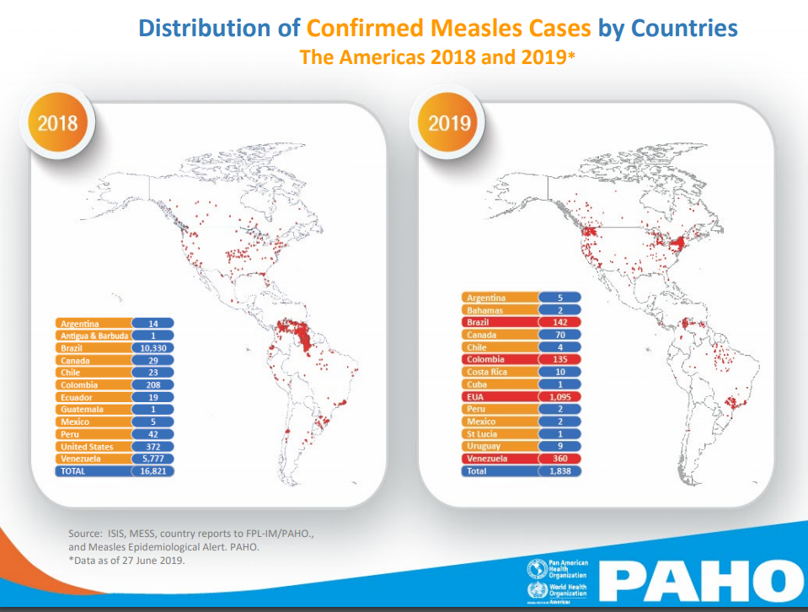

Slide 47
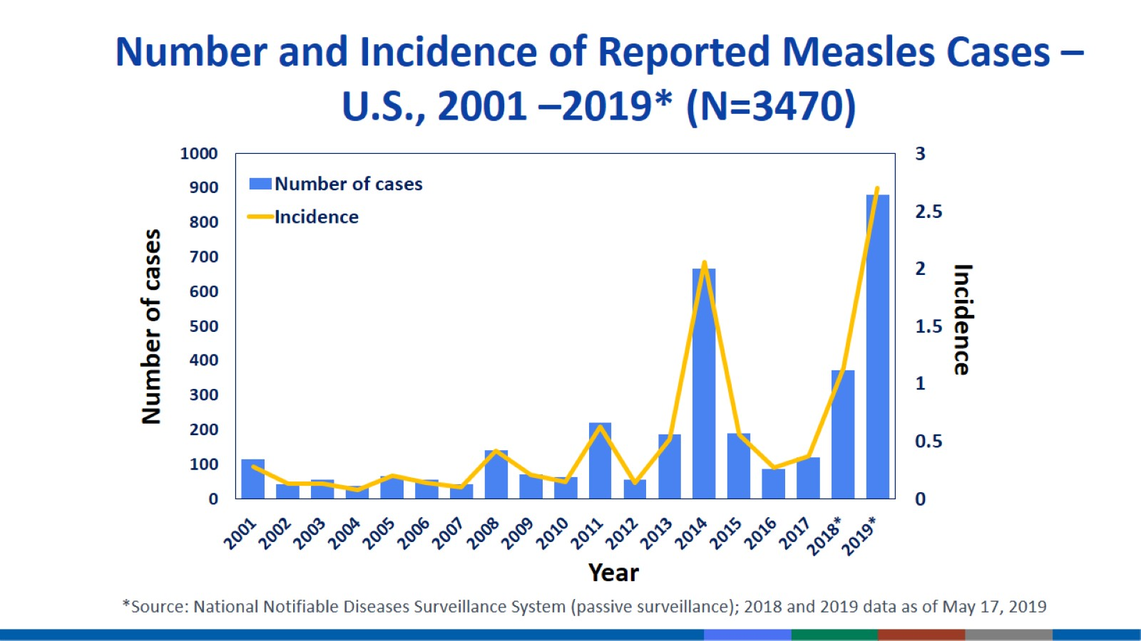
United States measles outbreak, 2018-2019
Numerous importations, pockets of under-vaccinated
As of week 29, 2019:
1,148 confirmed measles cases in 2019
  Greatest number of cases since 1992
  69% unvaccinated; 20% unknown status; 11% vaccinated
Most outbreaks / transmission strains of limited duration
Several large outbreaks persisting since 2018
  NYC, NY 9/30/18 – 7/8/19 684 cases
  Rockland Co, NY 10/1/18 – 7/11/19 374 cases

Slide 48
Measles cases: France
Age shift to older populations
800
600
Number of cases
400
200
0
Discarded
2017-06
2017-07
2017-08
2017-09
2017-10
2017-11
2017-12
2018-01
2018-02
2018-03
2018-04
2018-05
2018-06
2018-07
2018-08
2018-09
2018-10
2018-11
2018-12
2019-01
2019-02
2019-03
2019-04
2019-05
2019-06
2019-07
Clinical
Epi
Lab
Month of onset
Year | Confirmed Cases
2006 | 16
2007 | 40
2008 | 606
2009 | 1541
2010 | 5019
2011 | 15214
2012 | 859
2013 | 272
2014 | 267
2015 | 373
2016 | 79
2017 | 518
2018 | 2913
2019 | 1526
France age distribution, vaccination status, and incidence, 2018-06 to 2019-05
600
333.4
400
500
300
400
Incidence rate per 1,000,000
Number of cases
200
300
138.5
200
53.9
100
100
37.1
45.7
43.1
4.4
0
0
<1 year
1-4 years
5-9 years
10-14 years
15-24 years
25-39 years
40+ years
Age at onset
0 doses
1 dose
2+ doses
Unknown

Slide 49
Measles cases: Ukraine
Many years of sub-optimal routine coverage
15000
10000
Number of cases
5000
0
Discarded
2017-06
2017-07
2017-08
2017-09
2017-10
2017-11
2017-12
2018-01
2018-02
2018-03
2018-04
2018-05
2018-06
2018-07
2018-08
2018-09
2018-10
2018-11
2018-12
2019-01
2019-02
2019-03
2019-04
2019-05
2019-06
2019-07
Clinical
Epi
Lab
Month of onset
National SIA
Sub-national SIA
Year | Confirmed Cases
2006 | 945
2007 | 232
2008 | 41
2009 | 24
2010 | 42
2011 | 1313
2012 | 12744
2013 | 3308
2014 | 2326
2015 | 141
2016 | 90
2017 | 4782
2018 | 53218
2019 | 50803
Ukraine age distribution, vaccination status, and incidence, 2018-06 to 2019-05
20000
8541.4
10000
9000
6636
6489.7
8000
15000
5771.9
7000
6000
Number of cases
Incidence rate per 1,000,000
10000
5000
4000
1978.8
3000
5000
1355.4
814.7
2000
1000
0
0
<1 year
1-4 years
5-9 years
10-14 years
15-19 years
20-29 years
30+ years
Age at onset
0 doses
1 dose
2+ doses
Unknown

Slide 50
Measles cases: Bangladesh
Making progress in an endemic setting; high infant incidence
Sub-national (6 M-<15 Y)
Cov: 107%
1200
1000
800
Number of cases
600
400
200
0
Discarded
2017-06
2017-07
2017-08
2017-09
2017-10
2017-11
2017-12
2018-01
2018-02
2018-03
2018-04
2018-05
2018-06
2018-07
2018-08
2018-09
2018-10
2018-11
2018-12
2019-01
2019-02
2019-03
2019-04
2019-05
2019-06
2019-07
Clinical
Epi
Lab
Month of onset
National SIA
Sub-national SIA
Year | Confirmed Cases
2006 | 6028
2007 | 15977
2008 | 10180
2009 | 15107
2010 | 14704
2011 | 4715
2012 | 1804
2013 | 292
2014 | 336
2015 | 359
2016 | 1069
2017 | 4001
2018 | 2263
2019 | 1491
Bangladesh age distribution, vaccination status, and incidence, 2018-06 to 2019-05
800
243.1
250
600
200
Incidence rate per 1,000,000
Number of cases
150
400
100
200
57.5
32.2
50
8.7
4.4
5.8
0.5
0
0
<1 year
1-4 years
5-9 years
10-14 years
15-24 years
25-39 years
40+ years
Age at onset
0 doses
1 dose
2+ doses
Unknown

Slide 51
Major reason: failure to vaccinate
Age and Vaccination Status of Confirmed* Measles Cases, 2010-2014 (n=356,632)
2/3 of all cases are children who should have been vaccinated;
Most had <2 doses
41%
Percent of confirmed cases
25%
13%
11%
10%
*Lab-confirmed or epi-linked.

Slide 52
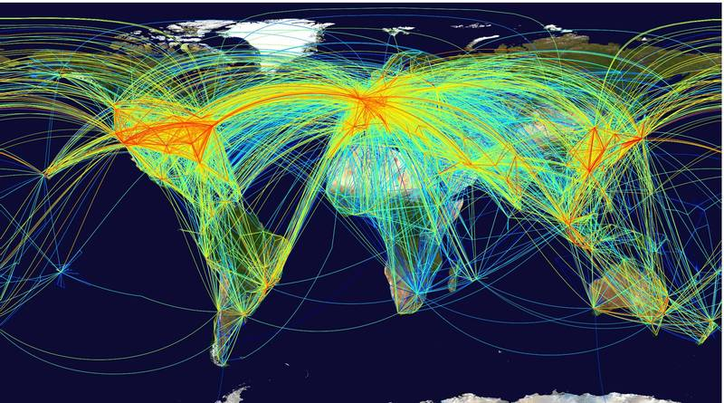
Measles anywhere is measles everywhere!

Slide 53
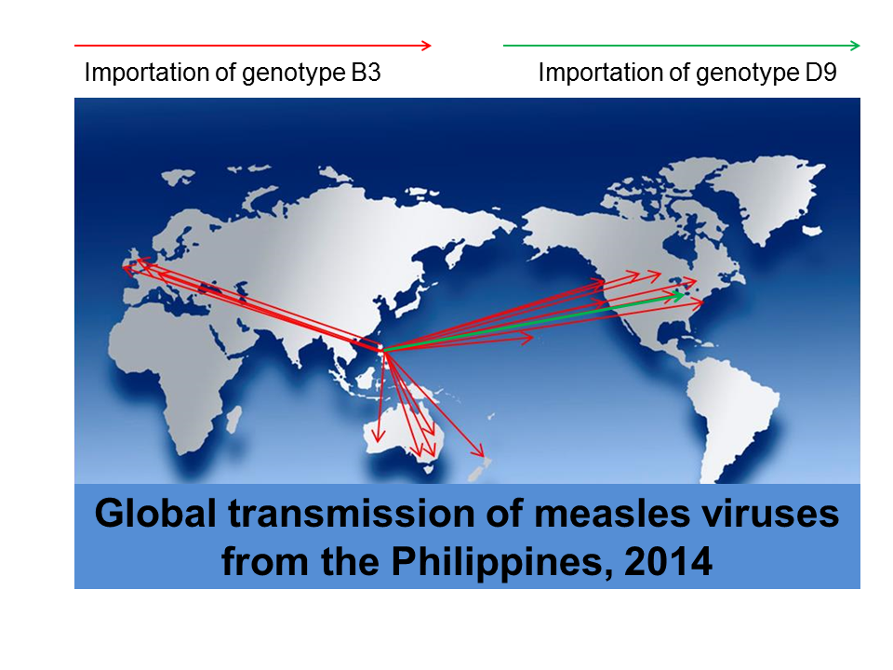
Genetic Characterization of Measles Viruses to Track Transmission
Notes:
This slide illustrates how quickly measles can spread during large outbreaks. During the outbreak in the Philippines, imported cases were detected thought the world. Strains could be traced to the Philippines based on the sequence information. Most of the viruses that were exported were genotype B3, but genotype D9 was circulating in southern Philippines and was imported to the US when it was associated with a very large outbreak in Ohio.

Slide 54
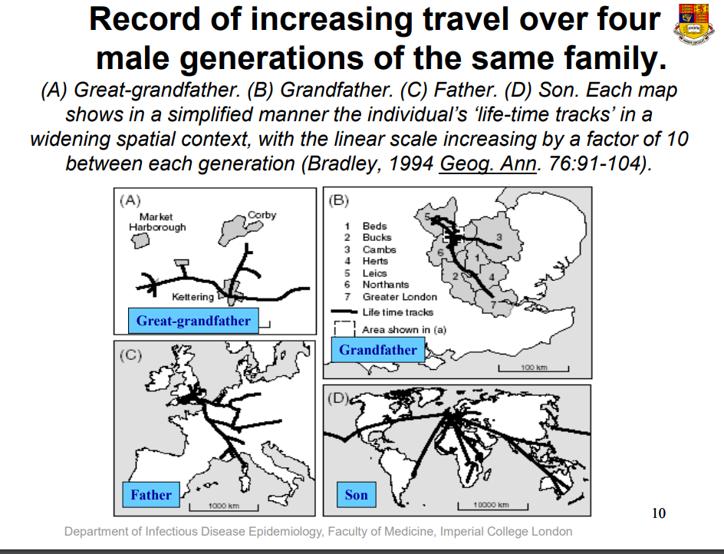
Increasing interconnectedness means more opportunities to share diseases
Slide courtesy Roy Anderson, Imperial College London

Slide 55
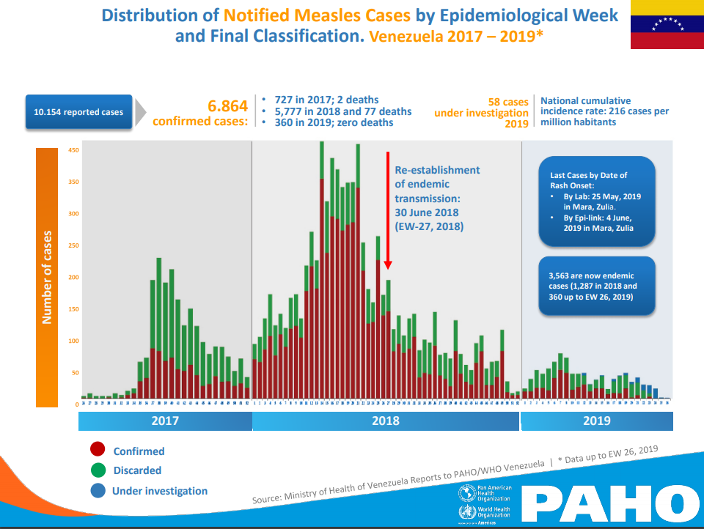

Slide 56
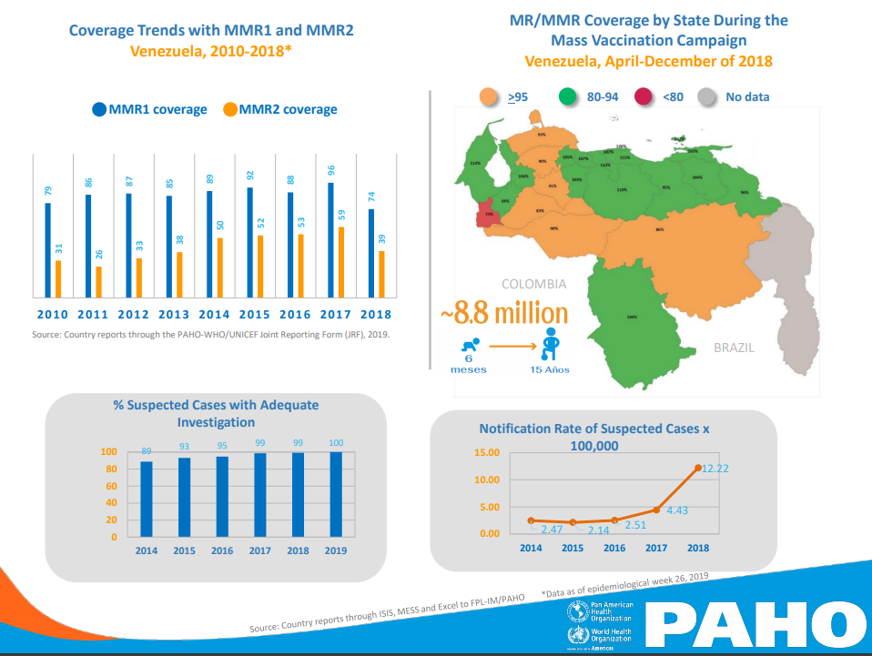

Slide 57
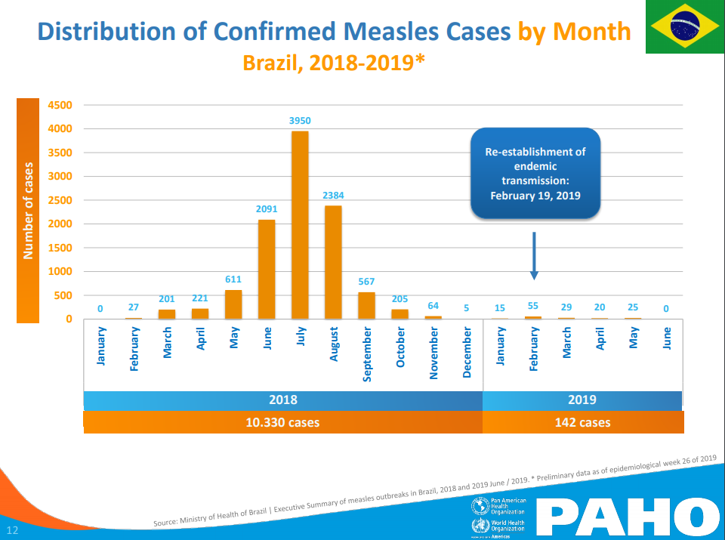

Slide 58
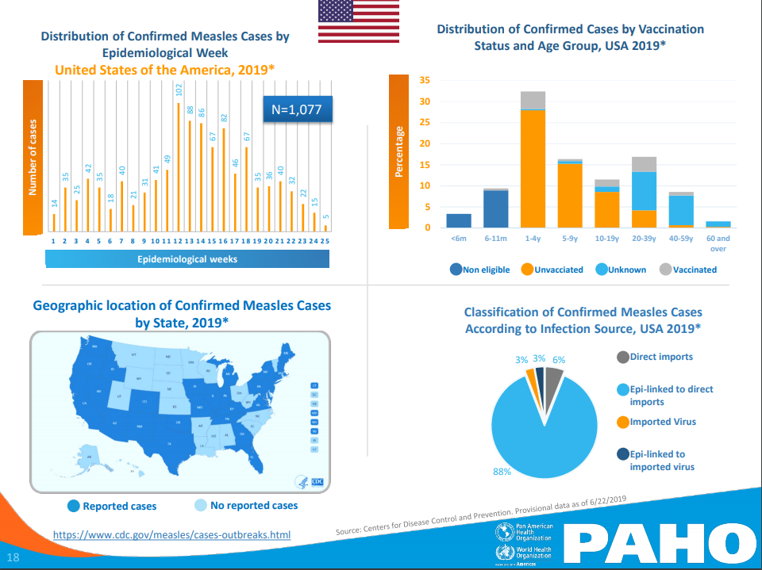

Slide 59
Measles cases: Thailand
2000
Number of cases
1000
0
Discarded
2017-06
2017-07
2017-08
2017-09
2017-10
2017-11
2017-12
2018-01
2018-02
2018-03
2018-04
2018-05
2018-06
2018-07
2018-08
2018-09
2018-10
2018-11
2018-12
2019-01
2019-02
2019-03
2019-04
2019-05
2019-06
2019-07
Clinical
Epi
Lab
Month of onset
Year | Confirmed Cases
2006 | 3962
2007 | 3517
2008 | 6339
2009 | 5272
2010 | 2273
2011 | 2873
2012 | 4072
2013 | 2056
2014 | 834
2015 | 190
2016 | 1009
2017 | 2033
2018 | 4938
2019 | 3069
Thailand age distribution, vaccination status, and incidence, 2018-06 to 2019-05
2000
1717.9
2000
1500
1500
Number of cases
Incidence rate per 1,000,000
1000
1000
613.9
500
500
219.8
108.5
132.8
81.2
0
6.9
0
<1 year
1-4 years
5-9 years
10-14 years
15-24 years
25-39 years
40+ years
Age at onset
0 doses
1 dose
2+ doses
Unknown

Slide 60
Measles cases: Tunisia
600
400
Number of cases
200
0
Discarded
2017-06
2017-07
2017-08
2017-09
2017-10
2017-11
2017-12
2018-01
2018-02
2018-03
2018-04
2018-05
2018-06
2018-07
2018-08
2018-09
2018-10
2018-11
2018-12
2019-01
2019-02
2019-03
2019-04
2019-05
2019-06
2019-07
Clinical
Epi
Lab
Month of onset
Year | Confirmed Cases
2006 | 0
2007 | 5
2008 | 0
2009 | 2
2010 | 0
2011 | 14
2012 | 48
2013 | 17
2014 | 16
2015 | 19
2016 | 7
2017 | 5
2018 | 12
2019 | 853
Tunisia age distribution, vaccination status, and incidence, 2018-06 to 2019-05
400
1882.9
2000
300
1500
Number of cases
Incidence rate per 1,000,000
200
1000
100
174.7
500
0
47.9
19
15.4
47.4
21.8
0
<1 year
1-4 years
5-9 years
10-14 years
15-24 years
25-39 years
40+ years
Age at onset
0 doses
1 dose
2+ doses
Unknown

Slide 61
Measles cases: Philippines
Sub-national (6-59 M)
Sub-national (6-59 M)
Cov: 69%
Cov: 32%
15000
10000
Number of cases
5000
0
Discarded
2017-06
2017-07
2017-08
2017-09
2017-10
2017-11
2017-12
2018-01
2018-02
2018-03
2018-04
2018-05
2018-06
2018-07
2018-08
2018-09
2018-10
2018-11
2018-12
2019-01
2019-02
2019-03
2019-04
2019-05
2019-06
2019-07
Clinical
Epi
Lab
Month of onset
National SIA
Sub-national SIA
Year | Confirmed Cases
2006 | 216
2007 | 612
2008 | 838
2009 | 1351
2010 | 6363
2011 | 6519
2012 | 1441
2013 | 4855
2014 | 53906
2015 | 2021
2016 | 647
2017 | 2409
2018 | 20764
2019 | 21749
Philippines age distribution, vaccination status, and incidence, 2018-06 to 2019-05
4748.9
5000
10000
4000
3000
Number of cases
Incidence rate per 1,000,000
5000
1091.7
2000
196
105.7
246.2
149.3
16.8
1000
0
0
<1 year
1-4 years
5-9 years
10-14 years
15-24 years
25-39 years
40+ years
Age at onset
0 doses
1 dose
2+ doses
Unknown

Slide 62
Measles cases: Afghanistan
National (9 M-10 Y)
Cov: 92%
600
400
Number of cases
200
0
Discarded
2017-06
2017-07
2017-08
2017-09
2017-10
2017-11
2017-12
2018-01
2018-02
2018-03
2018-04
2018-05
2018-06
2018-07
2018-08
2018-09
2018-10
2018-11
2018-12
2019-01
2019-02
2019-03
2019-04
2019-05
2019-06
2019-07
Clinical
Epi
Lab
Month of onset
National SIA
Sub-national SIA
Year | Confirmed Cases
2006 | 4458
2007 | 982
2008 | 1189
2009 | 2873
2010 | 1989
2011 | 1384
2012 | 2671
2013 | 430
2014 | 552
2015 | 1185
2016 | 641
2017 | 1511
2018 | 1899
2019 | 106
Afghanistan age distribution, vaccination status, and incidence, 2018-06 to 2019-05
250
200
200
174.6
150
150
Incidence rate per 1,000,000
Number of cases
100
100
51.8
50
20.2
50
6.3
1.2
0.8
0.2
0
0
<1 year
1-4 years
5-9 years
10-14 years
15-24 years
25-39 years
40+ years
Age at onset
0 doses
1 dose
2+ doses
Unknown

Slide 63
Measles cases: Myanmar
2000
Number of cases
1000
0
Discarded
2017-06
2017-07
2017-08
2017-09
2017-10
2017-11
2017-12
2018-01
2018-02
2018-03
2018-04
2018-05
2018-06
2018-07
2018-08
2018-09
2018-10
2018-11
2018-12
2019-01
2019-02
2019-03
2019-04
2019-05
2019-06
2019-07
Clinical
Epi
Lab
Month of onset
Year | Confirmed Cases
2006 | 760
2007 | 1087
2008 | 334
2009 | 501
2010 | 432
2011 | 1810
2012 | 2164
2013 | 1000
2014 | 110
2015 | 6
2016 | 274
2017 | 1246
2018 | 1391
2019 | 4842
Myanmar age distribution, vaccination status, and incidence, 2018-06 to 2019-05
2000
602.3
1500
600
462.1
400
Number of cases
Incidence rate per 1,000,000
1000
238.8
500
80.8
111.6
200
50.9
2.8
0
0
<1 year
1-4 years
5-9 years
10-14 years
15-24 years
25-39 years
40+ years
Age at onset
0 doses
1 dose
2+ doses
Unknown

Slide 64
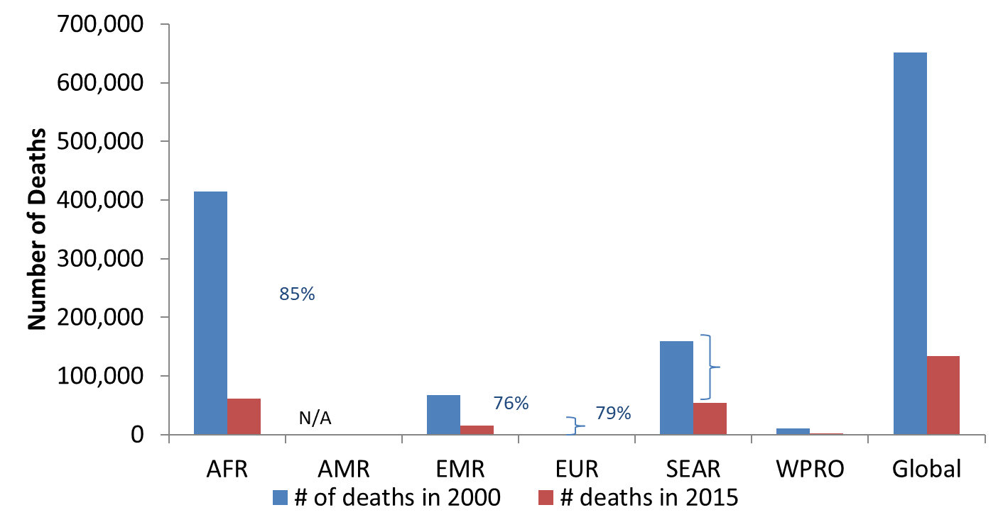
Global Milestone #3
95% Reduction in Measles Deaths
No. of measles deaths
Measles deaths down 80%
Year
21.1 million deaths prevented from 2000-2017 by measles vaccination
Notes:
Deaths have decreased by an 80% which has resulted in measles moving down from being the 5th to the 15th leading cause of <5 child mortality (might needt o update). Despite this impressive reduction, it is still short of the 2015 target of a 95% reduction. Importantly, for both cases and deaths, progress has levelled off for the past 8 years and all three 2015 control targets were not met.
Measles vaccination has averted about 21 million deaths since 2000 with 5.5(?update) billion doses of MCV administered during this time.

