Slide 1
Accelerating Progress towards Measles and Rubella Elimination in AFR
B Masresha
WHO AFRO
June 2016

Slide 2
Outline
Regional goal
Routine immunisation
SIAs
Disease Surveillance
Plans for 2017 - 2018
Challenges
TA to countries

Slide 3
African Regional goal:
Measles elimination by 2020
>95% MCV1 coverage at national and district level
> 95% SIAs coverage
incidence of < 1 case / 10⁶ population /year (excluding imported cases).
Achieve the surveillance performance targets

Slide 4
Routine immunisation

Slide 5
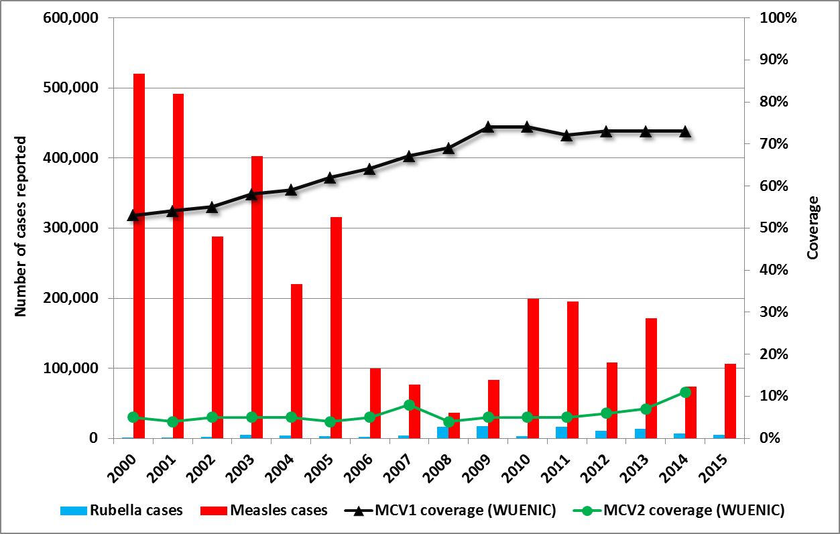
Measles and rubella reported cases & Regional MCV1 and MCV2 coverage. AFR. 2000 - 2015

Slide 6
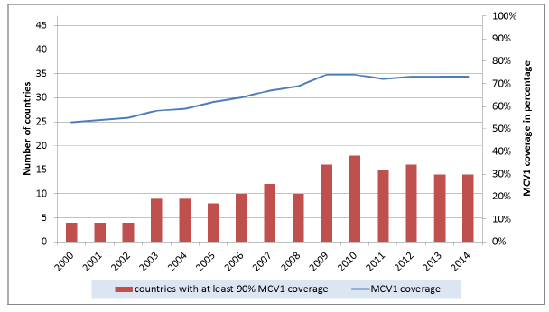
Regional MCV1 coverage ( WUENIC) and # of countries achieving 90% MCV1 coverage.
2000 – 2014.
More than 5.7 million infants in AFR do not get MCV1 every year!!!

Slide 7
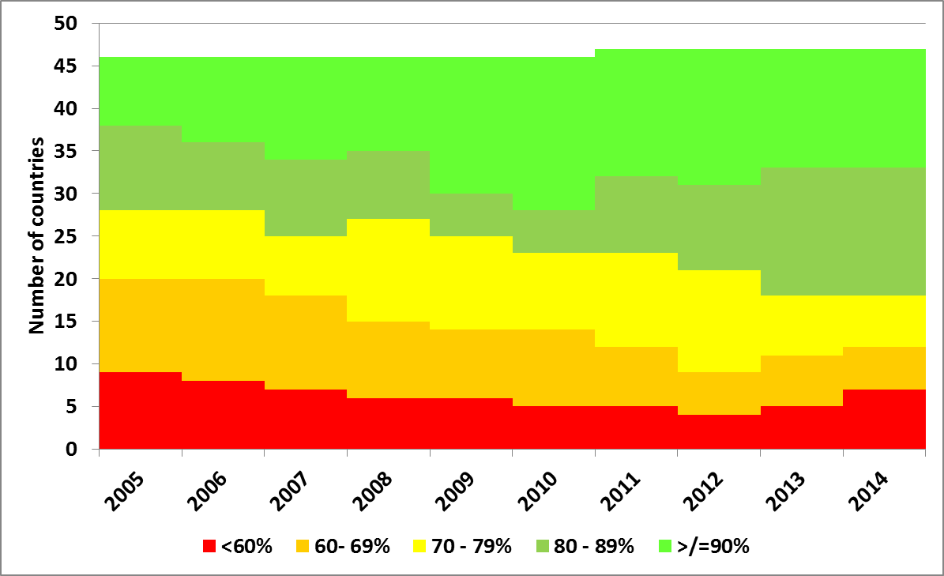
MCV1 coverage (WHO UNICEF estimates) in AFR countries. 2005 – 2014

Slide 8
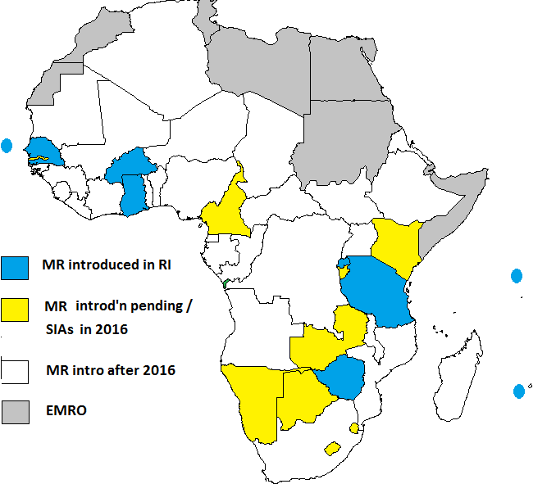
Status of Measles-Rubella vaccine ( MR) introduction in AFR. June 2016.
9 countries with MR in routine EPI
MR SIAs in 8 countries in 2016.

Slide 9
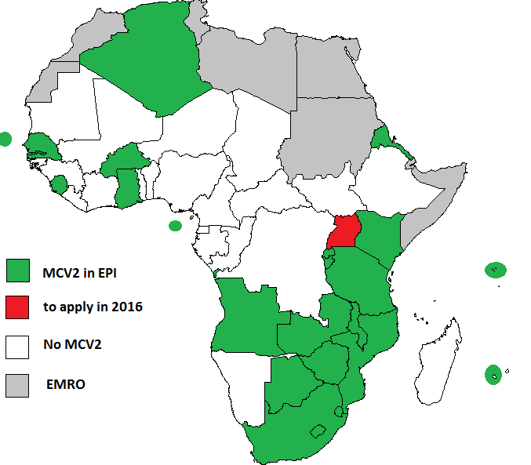
Status of MCV2 introduction in AFR. June 2016
24 of 47 countries with MCV2
Uganda to apply in Sept 2016.
Cameroon and Comoros deferred application till late 2016

Slide 10
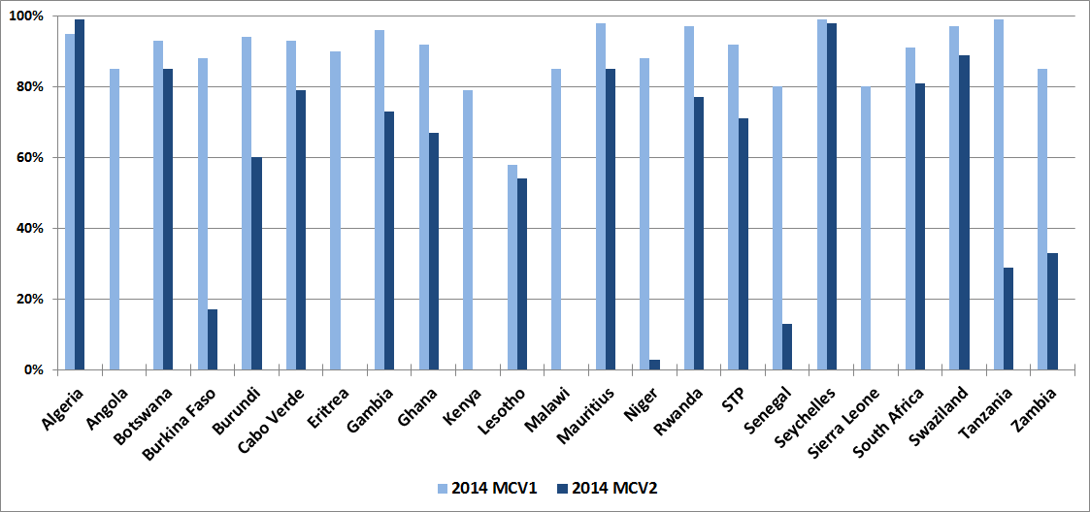
MCV1 and MCV2 reported admin coverage. AFR. 2014

Slide 11
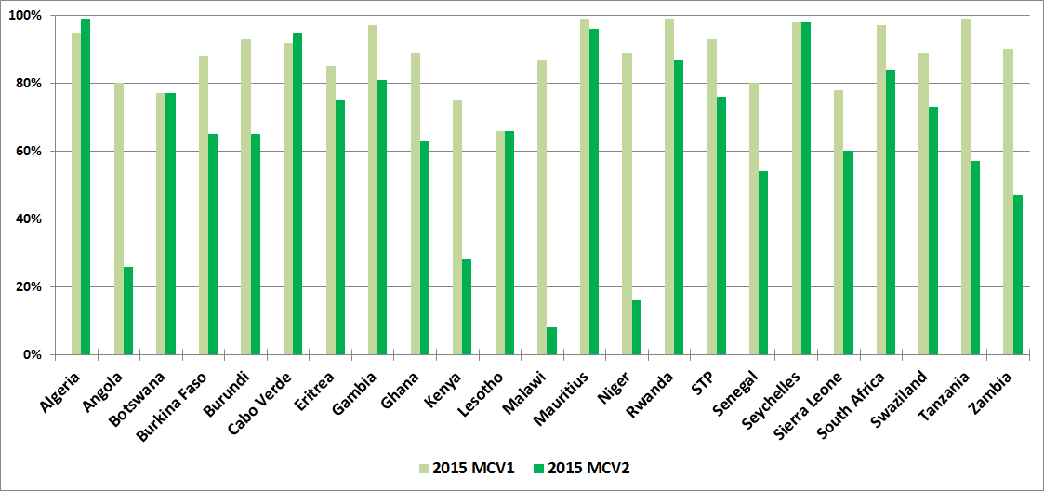
MCV1 and MCV2 reported admin coverage. AFR. 2015

Slide 12
Major findings from MCV2 PIE across 8 countries*
Informal roll-out
Caregivers not adequately sensitised/ trained
Failure to update all recording/ monitoring tools
Weak supervision and monitoring
Inadequate demand creation for 2nd yr platform
Different antigens (eg M/ MR) used for MCV1 and MCV2 = high wastage, confusion, etc
Cont’d missed opportunities for MCV1/ 2 because of “minimum # needed to open vials”
* ERI, KEN, TAN, RWA , SEN, GHA, STP, BUR

Slide 13
MCV2 intro plans 2017 - 2018
2017 introduction
Cameroon
Comoros
Uganda
?Congo?
2018 introduction
Mali ?
Mauritania?

Slide 14
Scheduled MCV2 / MR PIE in second half of 2016
Mozambique
Zimbabwe
Malawi
Sierra Leone
? Angola?

Slide 15
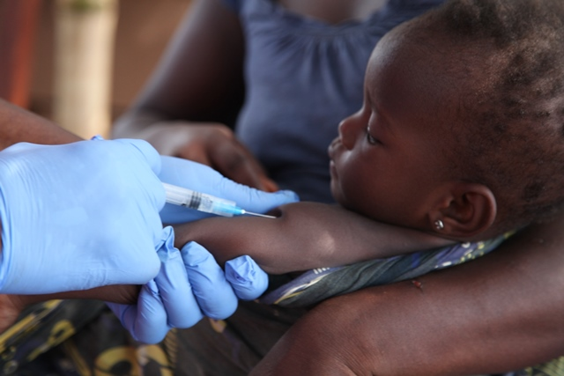
M/ MR SIAs

Slide 16
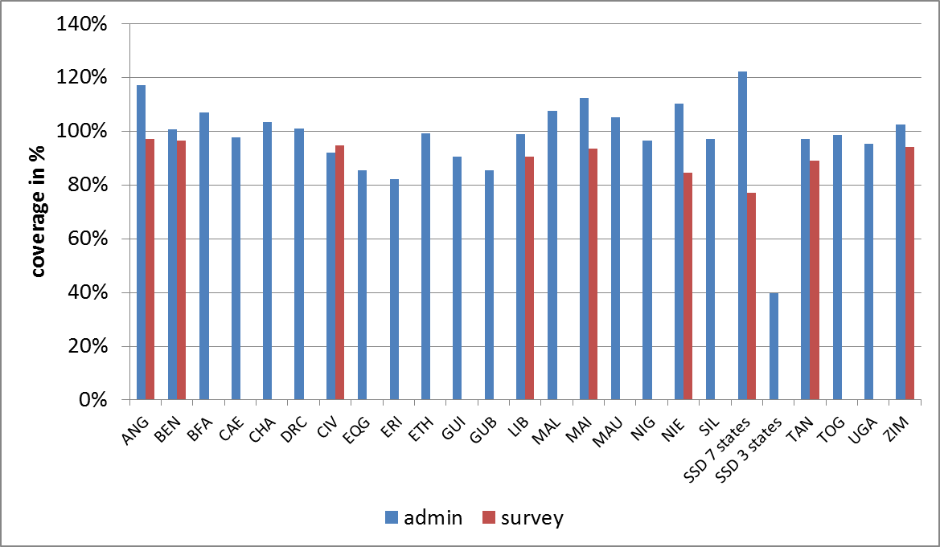
Admin vs survey coverage in M/ MR SIAs in AFR. 2014 – May 2016

Slide 17
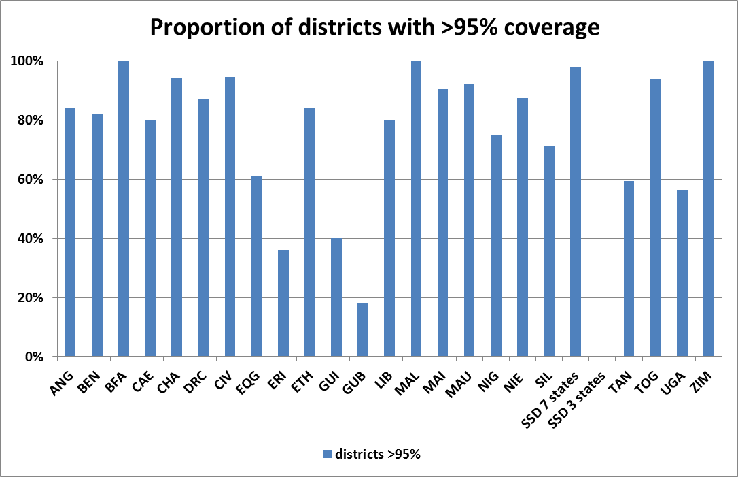
District coverage in M/ MR SIAs in AFR. 2014 – May 2016

Slide 18
Measles surveillance

Slide 19
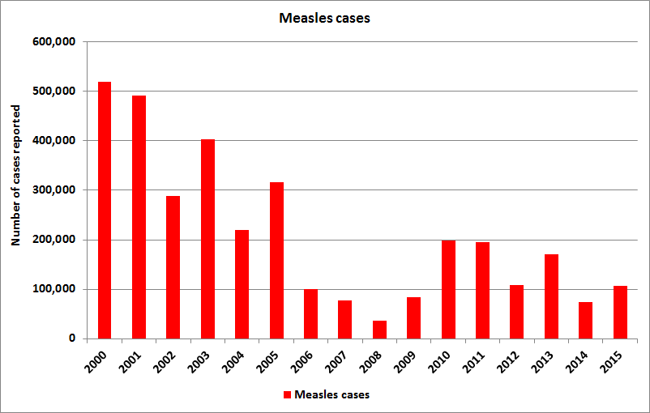
Official measles case reports. AFR. 2000 - 2015
?
Malawi = 64% of case reports in 2010
DRC = 45 - 69% of cases between 2011 – 2014.
Nigeria = 30% cases in 2013

Slide 20
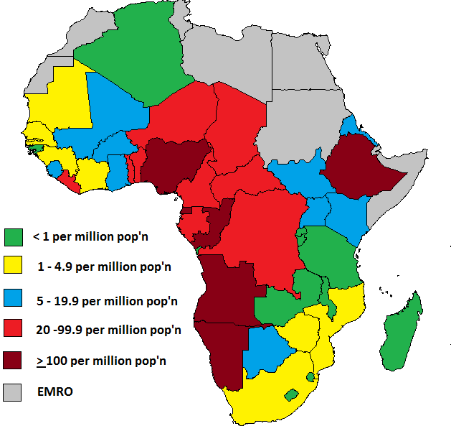
Average incidence of confirmed measles.
2012 – 2015. AFR
17.4% population in 12 countries
15.2% population in 8 countries
17.4% population in 9 countries
17.9% population in 9 countries
32.1% population in 6 countries

Slide 21
Category | 2020 target | 2010 | 2011 | 2012 | 2013 | 2014 | 2015 | Last 12 months
Incidence (% countries < 5 per million population) | 100% | 36% | 56% | 47% | 53% | 48% | 77% | 53%
Incidence of confirmed measles per million population | <1/ per million | 172 | 42 | 25 | 76.9 | 40 | 39.4 | 29.3
Non-Measles Febrile Rash Illness rate | ≥2 per 100,000 pop’n | 4.1 | 4.4 | 3.4 | 2.9 | 3.0 | 2.5 | 2.2
% of districts reporting ≥ 1/100,000 suspected measles cases with blood specimens | At least 80% | 86% | 82% | 84% | 78% | 77% | 82% | 81%
% of suspected cases with adequate blood specimens | at least 80% | 96% | 82% | 91% | 78% | 85% | 82% | 88%
% countries with MCV1 >90% |  | 39% | 32% | 34% | 30% | 30%
% SIAs with all districts >95% coverage |  | 0 /16 | 1 /11 | 3 /14 | 2 /14 | 1 /8 | 2 /14

Slide 22
Regional Strategic Plan for Immunisation (2014 – 2020)
Objective 3: To attain the elimination of measles and make progress in the elimination of rubella/congenital rubella syndrome
Milestones for 2015:
  By 2015: MCV1 > 90% nationally in > 20 countries
    14 countries as of 2014 (WUENIC)
  By 2015: > 10 countries introduced RCV in RI
    9 countries with RCV as of June 2016
  By 2015: > 22 countries introduced MCV2
    24 countries with MCV2 as of June 2016

Slide 23
Regional and National Verification
Verification commissions not yet set up in AFR

Slide 24
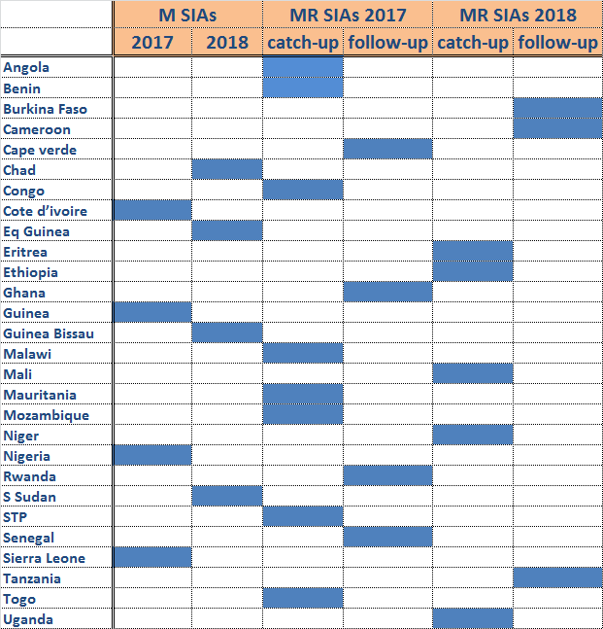
2017 - 2018 SIAs plans. AFR

Slide 25
Challenges
measles elimination low on the agenda in many countries/ countries still in “control” mode
Plateauing MCV1 coverage
Lack of funding for wide-age range M-SIAs as per the epidemiological picture
Inadequate and late preparation for SIAs – gaps in SIAs quality
Lessons from GPEI not adequately tranferred/ applied to measles SIAs – issues of funding & program focus??

Slide 26
Challenges (2)
ADC Staffing at Regional and IST level
Heavy dependency on GPEI for staff and disease surveillance:
  “Polio transitioning” :
    risk of losing polio-paid staff at WCO level in coming years
    Risk of significant decline in case-based surveillance without polio staff and AFP surveillance funding

Slide 27
Technical support to countries
To be prioritised as per:
  the experience in past few years
  In-country program strengths
  New GAVI policy for MR
Areas for tech support:
  Updating cMYP and/ or National Measles Strategic plan to reflect these introductions,
  Updating annual EPI plan document to give a brief 5-year perspective on M/ MR plans
  Review key program elements as part of JA
  Developing good quality GAVI application and SIAs POA

Slide 28
Plans for Technical support for 2016- 2017
Regional Planning workshop with target countries for 2017 – 2018 (August 2016)
JA visits to a number of countries
Deploying consultants and IST/ RO support for planning/ implementation/ evaluation of SIAs
MCV2/ MR PIE exercises in 2016 – MOZ, MAL, ZIM, ANG, SIL
Support and close follow-up for implementing PIE, JA and/ or program review recommendations

Slide 29
Resource needs and gaps : 2017-2018
Disease surveillance and lab:
    Annual estimated needs for 43 countries to cover field surveillance activities : USD 6 M/ yr
    purchase of lab reagents: USD 2.4 M/ yr
    Scaling up to elimination mode surveillance in 18 selected countries : USD 3.4 M/ year
Coverage surveys in 28 M/MR SIAs in 2017 and 2018: USD 3.6 M
Regional/ sub-regional TA: USD 2 M/ yr
TOTAL: USD 31.2 million over 2 years

Slide 30
Resource needs and gaps : 2017-2018 (2)
Resource needs not included in the estimate
Outbreak response: GAVI/MRI funding
SIAs: GAVI (+ country) co-funding
AFR/ IST/ WCO Staffing and surveillance infrastructure* – currently paid-for by the GPEI
* SMOs, drivers, vehicles, etc…

Slide 31
Thanks

Slide 32
Additional slides

Slide 33
Categorising countries according to levels of program implementation
Strong program, very low incidence sustained, nearing elimination (ALG, BFA, CAV, RWA, ERI, GAM, GHA, MAS, SEN, SEY, STP, ZIM) – 12 countries
  Increase MCV2 coverage, MR intro, elimination-standard MR surveillance, space SIAs wider,
Coverage or surveillance gaps, on track for elimination, (BEN, BUR, BOT, CAE, CIV, COM, CON, LES, MAD, MAL, MAU, MOZ, SWZ, TAN, UGA, ZAM) – 16 countries
  Wide age-range SIAs, MCV2 intro, address surveillance gaps

Slide 34
Categorising countries according to levels of program implementation (2)
Larger countries, various forms of program gaps. (GUI, KEN, MAI, NAM, SOA,TOG, LIB, SIL) – 8 countries
  Improve quality of SIAs, Wide age-range SIAs, MCV2 intro
Very challenging countries, insecurity, high incidence and frequent large outbreaks, leadership gaps. (ANG, CAR, CHA, DRC, EQG, ETH, GAB, GUB, NIE, NIG, SSD) – 11 countries
  Advocate for better pgm ownership, RI strengthening, regular high quality SIAs (age group to target according to epi data), ..

