Slide 1
Accelerating Progress towards Measles and Rubella Elimination
Measles and Rubella elimination progress in the Americas
Desiree Pastor MD, MPH
Regional Advisor PAHO/WHO
21 June 2016
Geneva, Switzerland

Slide 2
PAHO Measles and Rubella Goals
1. To maintain the regional elimination of measles and rubella in light of continuous virus importations from abroad that continue to challenge the goals achieved;
2. Strengthen national ownership and capacity within the framework of all immunizations strategies, for increasing immunization coverage among vulnerable and hard-to-reach populations;

Slide 3
Measles and Rubella Regional Goals
3. Assure a high quality MR surveillance and focus on improving reporting from public and private sector;
4. Promote strong advocacy to maintain population confidence in the immunization programs (mainly MMR);
5. Advocate with other WHO Regions and the development cooperation partners (M&RI) to step up our efforts to increase measles and rubella coverage, with a view to achieving elimination worldwide.
http://www.paho.org/hq/index.php?option=com_content&view=article&id=7022&Itemid=39541&lang=en

Slide 4
Impact of Measles and Rubella Elimination Strategies in the Americas
Impact of measles and rubella elimination strategies: The Americas, 1980-2016*
Catch up campaign for measles
Speed-up campaigns for Rubella
Follow-up campaigns for measles
Confirmed cases
Last endemic measles case
% Vaccination Coverage
Last endemic rubella case
The Comprehensive Family Immunization Unit (FGL/IM) – Pan American Health Organization, data as of June 8, 2015
Source: Country reports to FGL/IM - PAHO
* Data as of 17 June 2016
Notes:
This graph summarizes the history of measles elimination in the Americas and the impact of vaccination strategies. In the pre-elimination era, during the 60s, > 600,000 measles cases were reported annually in the Americas.
The bars represent measles and rubella cases and the black line represent the vaccination coverage against measles and rubella. As you can see, as vaccination coverage goes up, the number of cases goes down.
By the early 90s, several countries started vaccinating all children aged 9 months to 14 years through “catch up campaigns”, a strategy recommended by PAHO aimed at interrupting endemic measles transmission. Later, “Follow-up campaigns” were conducted to give children aged 1-5 years, a second opportunity to be immunized against measles and rubella.
Therefore, in 1994, a goal to eliminate measles from the Americas by 2000 was set for all countries. Since then, PAHO has established the main vaccination and surveillance strategies, and as result, this Region was the first one to achieve endemic measles elimination in 2002, the year when the last endemic outbreak was reported in Venezuela.
Very briefly, I would like to show my favorite picture of the mealses elimination history, in the pre elimination era. In red bars, you can see measles cases and rubella in the blue ones.
The vaccination strategies recommended by the Pan American Health Organization, allow to control the measles endemic transmission since the earlys 20,s and the last endemic measles case ocurred in 2002 in Venezuela.

Slide 5
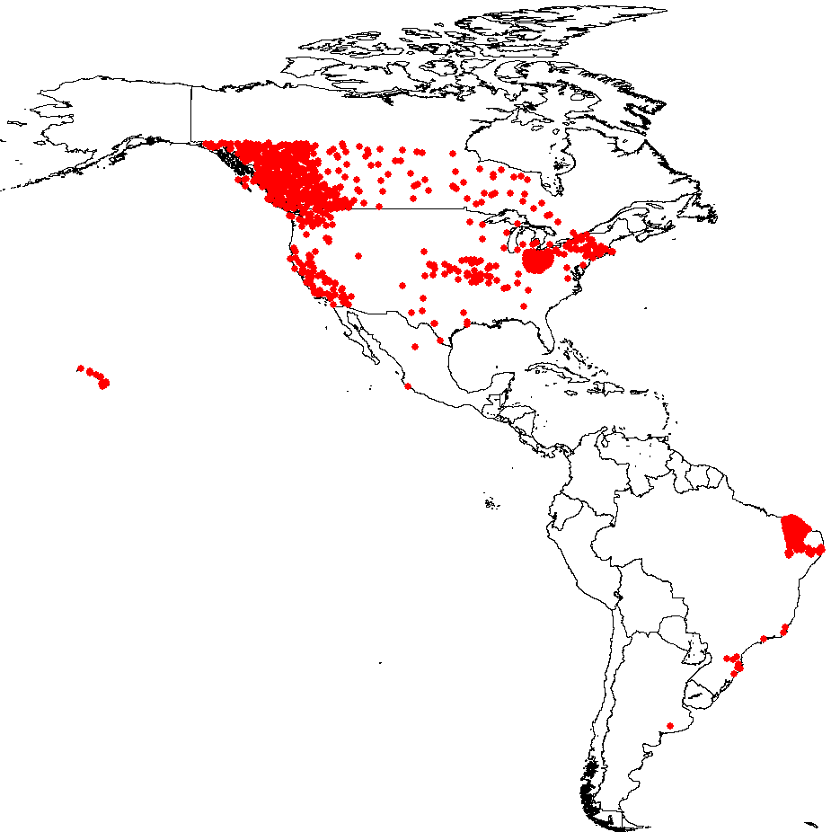
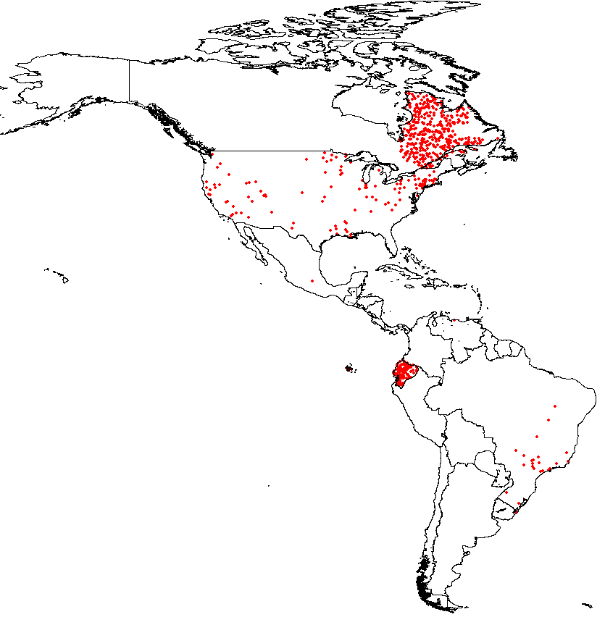
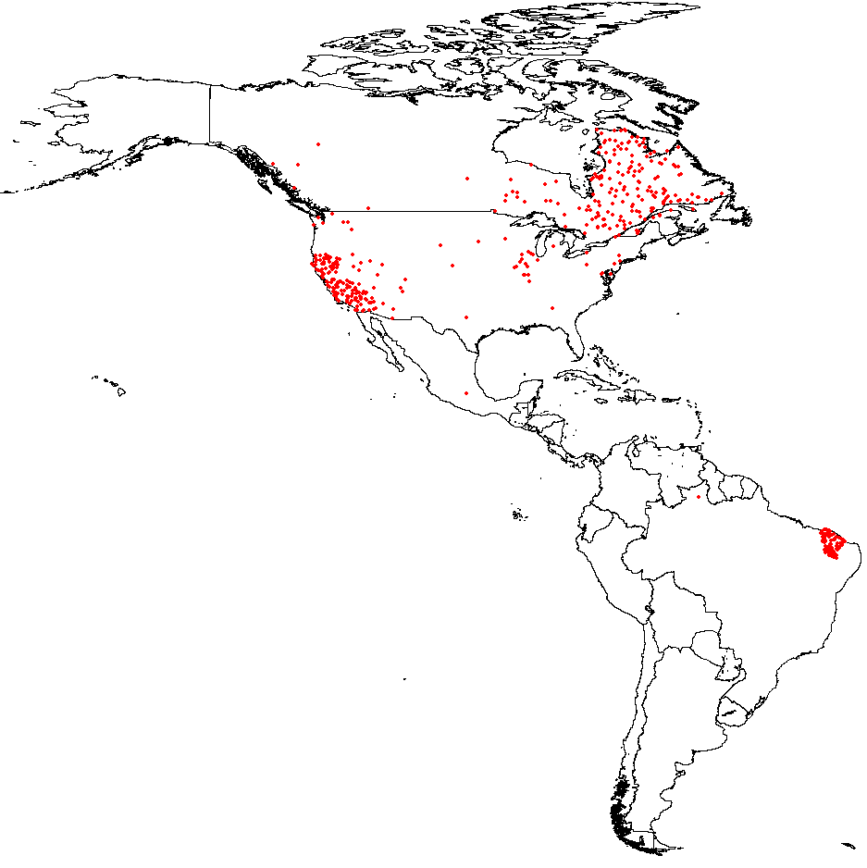
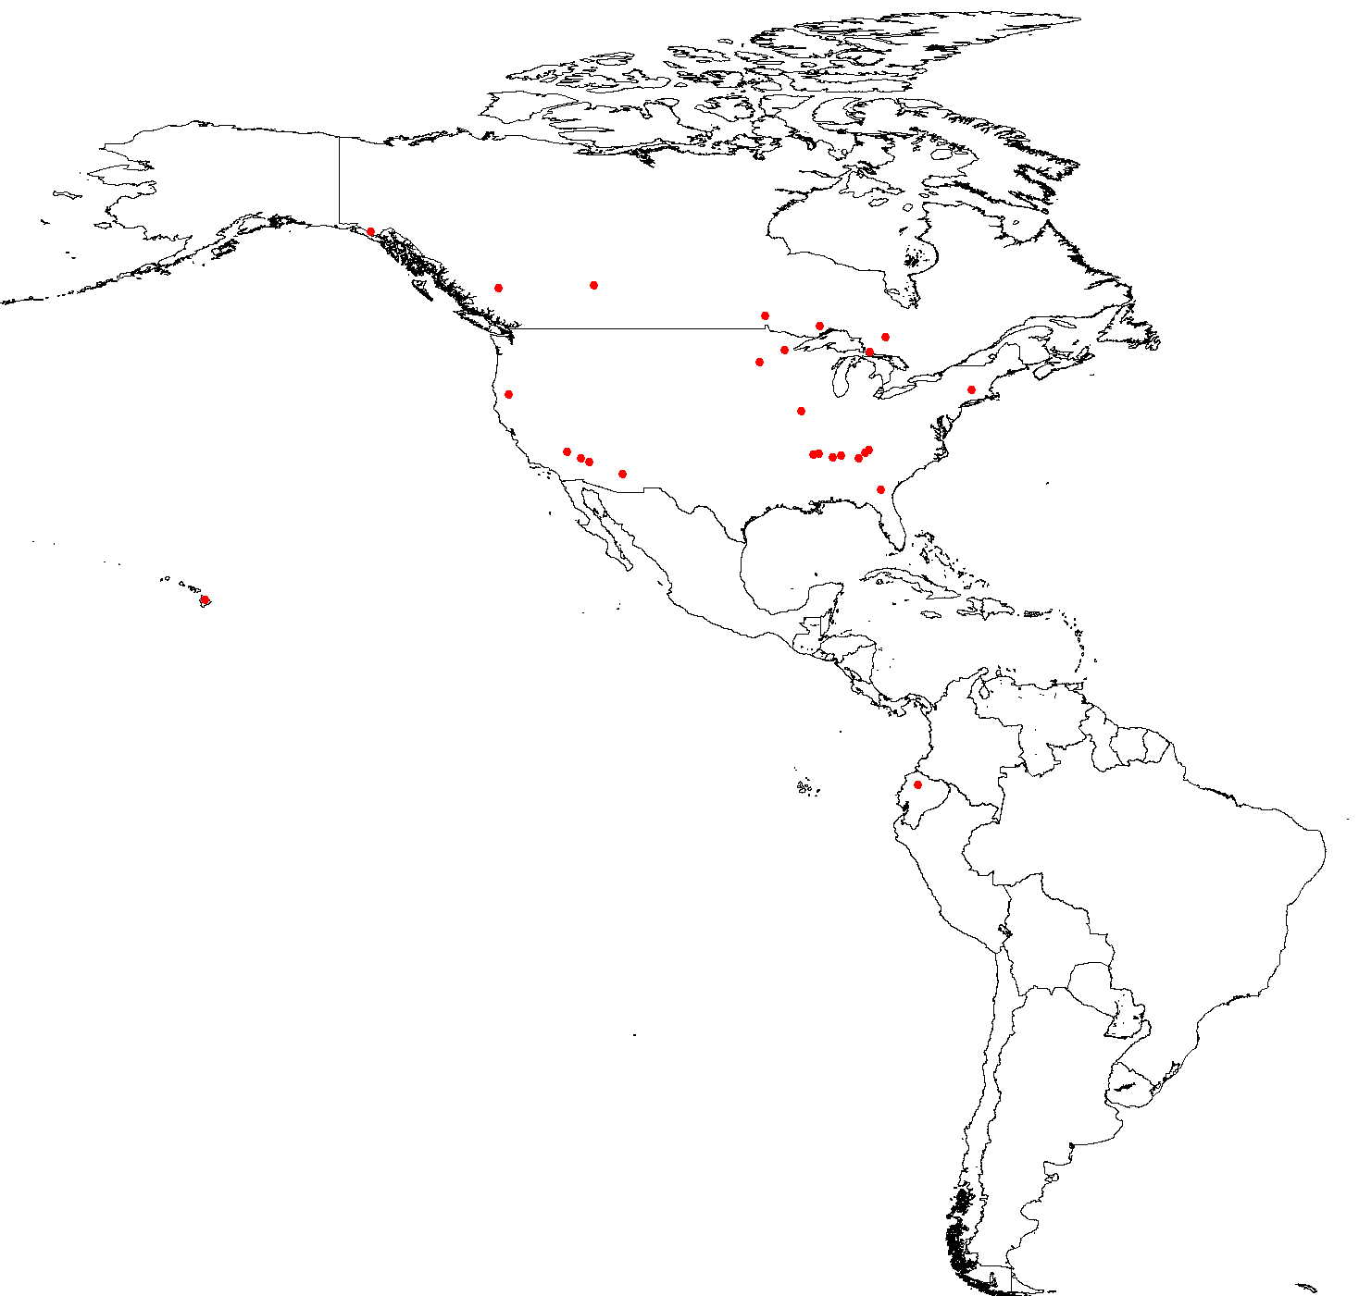
Confirmed measles cases by second administrative level
The Americas, 2011, 2014, 2015, and 2016*
2011
N=1,369 cases
2014
N=1,966 cases
2015
N=611 cases
Brazil= 214
Canada= 196
Colombia=1
Chile=9
Mexico= 1
United States= 186
Peru=4
Total (2015)= 611
Canada= 7
Ecuador=1
United States= 19
Total (2016)= 27
2016*
N=27 cases
Source: Country reports to FGL-IM/PAHO.
*Data as of epidemiological week 23, 2016

Slide 6
Distribution of imported rubella cases
after interruption of endemic transmission
The Americas, 2009-2016*
Number of rubella cases
Fuente: ISIS, MESS e informe de los países a FGL-IM/OPS.
*Datos de semana epidemiológica 23, 2016.

Slide 7
Distribution of confirmed measles cases by age
groups, American Region, 2010-2014
N=3,787 cases with data on age available
Measles confirmed cases
Source: Country reports

Slide 8
Distribution of confirmed measles cases by age
The Americas, 2015
N=568 confirmed cases
Source: Country reports to FGL/IM

Slide 9
Attack rate and proportion of confirmed measles cases by age group,
Ceará, 2014 & 2015*
Source: SESA/COPROM/NUVEP/SINAN. * Updated on: 11/24/2015
Notes:
4

Slide 10
Measles-Rubella Surveillance Indicators,
The Americas, 2011-2016*
Source: ISIS, MESS systems and country reports
*Data as of epidemiological week 23, 2016.

Slide 11
Rate of suspected measles and rubella cases
The Americas, 2003 -2015
Rate per 100,000 population
Source: ISIS, MESSS and country reports to FGL-IM/PAHO.
Notes:
The rate of suspected measles and rubella cases has dropped in 2012 from 3 to near 2 cases per 100 thousands population. This needs to be addressed with PAHO and TAG recommended strategies as for the surveillance indicators as well.

Slide 12
Comparing the number of suspected measles and rubella cases reported in the Americas, 2015 and 2016*
Number of cases
Source: country report to FGL-IM/PAHO.
*Data from epidemiological week 1-23 of 2015 and 2016.

Slide 13
Imported Cases Are Biggest Threat to
Maintaining Elimination Efforts
Distribution of confirmed measles cases by import status,
The Americas, 2011-2015*
N=4,357
Confirmed Measles Cases
PAHO Measles Eradication Surveillance System and Integrated Surveillance Information System and country reports
*Data as of 21 May 2015
Notes:
During 2011-2015 there were more than 4,000 imported or “imported related” cases.
Measles does not respect international, national, or state borders.
It is far more efficient and less costly to prevent an outbreak than to be forced to attempt to control one.
Measles importations should result in significant efforts to trace all contacts.
Best practices for outbreak response include intensifying epidemiological surveillance, quality case investigation, and follow-up of contacts.

Slide 14
Measles and rubella reported cases and coverage of MCV1 and MCV2, 1980-2015

Slide 15
MCV1 coverage WHO UNICEF estimates, and number of countries reaching >90% coverage. 2000 – 2015. (N=35)

Slide 16
MCV1 coverage by WHO UNICEF estimates in AMRO countries, 2010 – 2015

Slide 17
SIA administrative coverage target
In campaigns. The Americas 2010-2015
Country | Year | <80% | 80-89% | 90-94% | ≥95%
Paraguay | 2014 | 72
Peru | 2011 | 78
Chile | 2015 |  | 81
Argentina | 2014 |  | 82
Honduras | 2012 |  | 84
Brazil | 2014 |  | 89
Costa Rica | 2011 |  |  | 93
Colombia | 2010 |  |  | 93
Bolivia | 2011-2012 |  |  | 94
Dominican Republic | 2015 |  |  |  | 95
Venezuela | 2014 |  |  |  | 99
Mexico | 2010 |  |  |  | 104
Nicaragua | 2012 |  |  |  | 107
Ecuador | 2012 |  |  |  | 112
Haiti | 2012 |  |  |  | 118
Source: Country reports through PAHO-WHO/UNICEF Joint Reporting Form (JRF).
Note: Administrative data as of 26 February 2016.

Slide 18
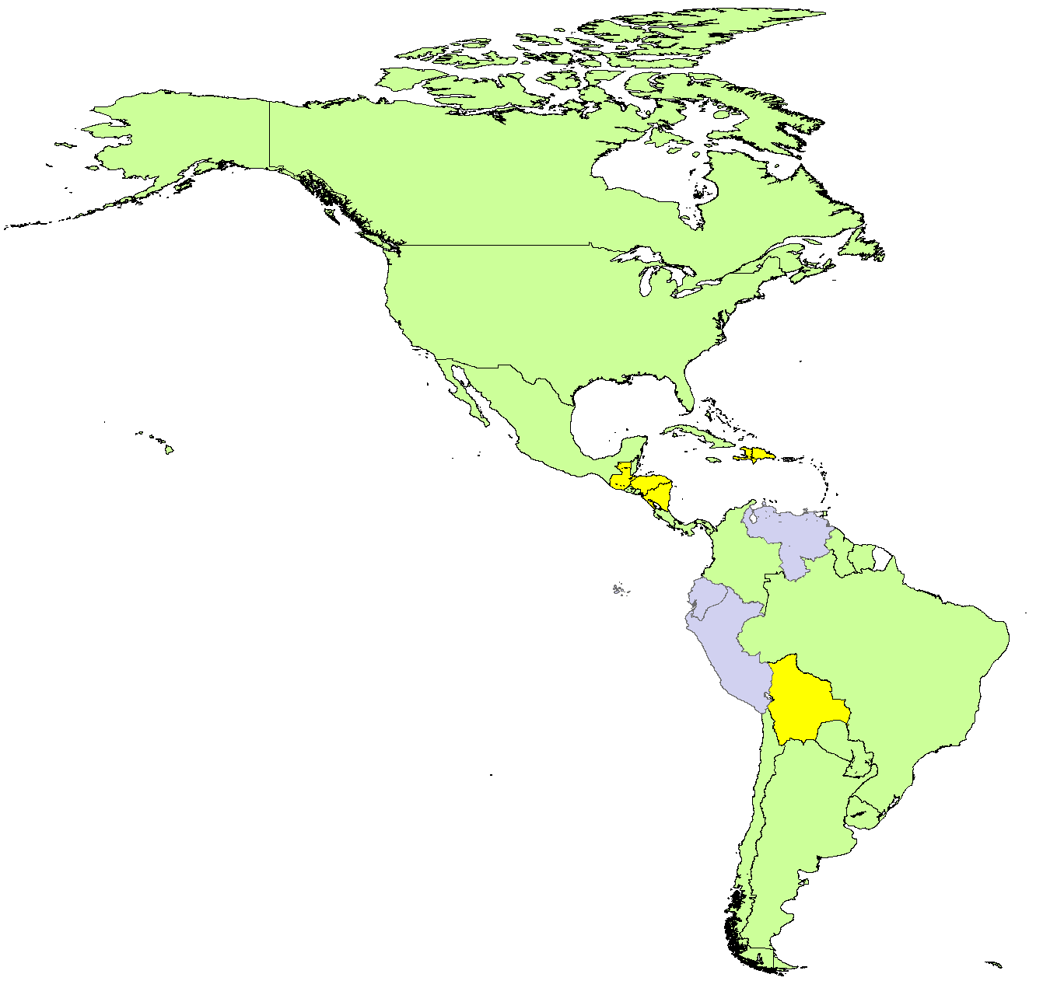
MCV2 introduction into routine EPI in (region) 2015-2016
Introduced before 2007
2007-2014
Not introduced
Data not available
A total of 4/6 countries are expected to introduce MCV2 by the end of 2020

Slide 19

Routine strengthening activities
Plans for Regional Immunization Week (April 2016)
Nominal registries training, (March 2016)

Slide 20
Regional and National Verification
We are reviewing the updated country elimination reports, to assess sustainability of measles and rubella elimination: (n=15/24)
Status of RVC
Two IEC meetings in April and December 2015
One IEC meeting in Brazil on July 20-21, led by IEC Chair, Dr Merceline Dahl-Regis

Slide 21
Challenges to Sustain the Gains
Increase quality of MR surveillance indicators to
rapidly respond to imported MR cases
Increase data analysis at the local level for strengthening MR surveillance
Increase MMR1 and MMR2 vaccination coverage
Support countries to ensure high quality
follow-up campaigns
Declare measles eliminated in the Americas by 2016
Notes:
In conclusion, our challenges to sustain the gains are:
Increase quality of MR surveillance indicators for rapid response to imported measles/rubella cases.
Increase data analysis and decision making at the local level for strengthening measles and rubella surveillance
Increase MMR1 and MMR2 vaccination coverage in routine program
To support countries to ensure high quality follow-up campaigns, to reach at least 95% of coverage at sub national level.
To declare the Measles elimination in the Americas by 2016

Slide 22
Barriers to sustain the elimination goals
Global efforts are threatened for the lack of financial resources, which is also a big threat for the sustainability of the elimination in the Americas.
Compelling public health emergencies such as Zika and Chickungunya virus, which become the highest political priority among countries of the Americas.
Insuficient human and financial resources (attending other public health priorities)
Need to improve planning and supervision to ensure high-quality campaign at the local levels.
Reported high vaccination areas (>100) masked immunity gaps at the local levels, and led to a false security among program managers.

Slide 23
Barriers to sustain the elimination goals
Current surveillance indicators should be changed/adjusted, to reflect the new epidemiological scenarios and challenges.
CRS surveillance has to be strengthened mainly at the specialist health services to identify the rubella virus circulation, since this a silent virus in 50% of cases.
Procurement of laboratory supplies and reagents may be threatened due to the lack of financial resources.

Slide 24
Programme Plans
2017-2018

Slide 25
2017-2018 SIA plans and budget
Country | Vaccine | Target Age | Dates | Geographic Extent | Other intervent | Funding source | If Gavi, JA dates
Guatemala
Panama
El Salvador
Costa Rica
Ecuador

Slide 26
2017-2018 GAVI application and introduction plans for MSD, MR, measles
Country | Vaccine (MSD, MR, M) | Year of Intro of GAVI support (or Measles SIA) | MCV1 coverage (2012) | Year of planned GAVI application | Budget
Haiti | MR |  |  | 2016 | 600,000

Slide 27
2016-2017 measles and rubella/CRS surveillance plans and budget
For 2016 / surveillance:
Active case finding for measles/rubella post Olympic games and in light of Zika epidemic
  It will allow for onsite training and supervision in high-risk areas
Development of case studies based on Ceará /Brazil outbreak and Zika epidemic
Risk assessment exercise in Ceará, Brazil
Harmonization of surveillance data reported through different sources (JRF, country elimination report, etc.)

Slide 28
2016-2017 measles and rubella/CRS sustainibility support
For 2016/vaccination
Implementation of follow-up campaigns (SIA) in 3 countries (HON, MEX and PER); financial support will be for TA, campaign training, supervision and RCM.

Slide 29
2016-2017 Advocacy Plans
For 2016:
Development of marketing materials to increase awareness for measles/rubella, due to the 2016’s Olympics games.
Maintain our advocacy efforts to push for a MR global eradication goal in the 2017’s WHA.

Slide 30
Technical Assistance needs 2017
Include anticipated TA needs for SIA planning, monitoring and evaluation, for surveillance , for GAVI applications and for strengthening routine activities.

Slide 31
Resource gaps 2017-2018
For 2016, we are facing a potential gap of 750,000 as we have only received 200k (first trench). We hope to receive the remaining funds, to move forward with our planned activities.
For 2017-2018, gaps will be determined based on country needs and availability of external funds (UNF and other donors).

Slide 32
Thanks! Gracias!
Merci! ¡ धन्यवाद! Terima kasih! Jërëjëf! Murakoze! Asante!
بہت بہت شکر …یہ شكرا

