Slide 1
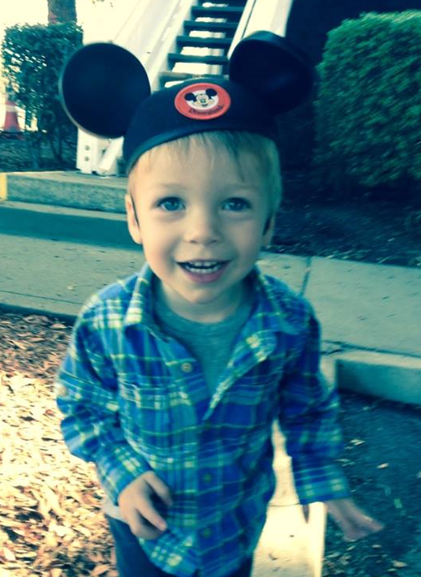
Measles: A Story from the Field
Jennifer Zipprich, PhD
Immunization Branch
California Department of Public Health
September 15th, 2015

Slide 2
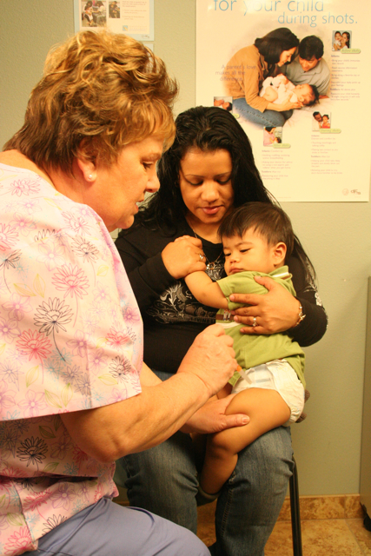
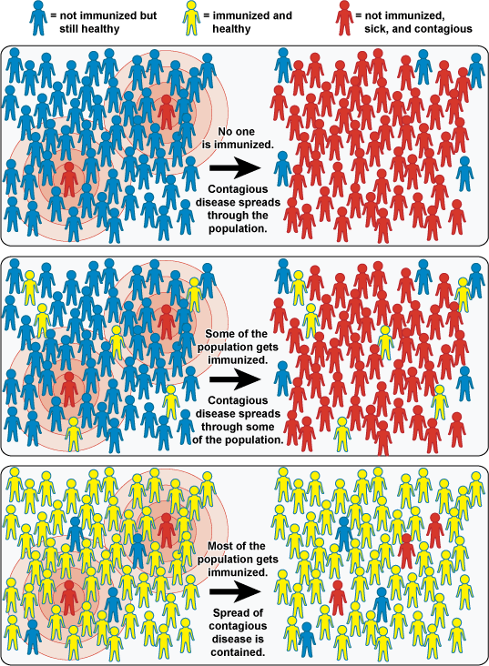
What Does Maintaining Elimination Take?
Elimination of measles requires maintaining the effective reproduction number R at <1
Adapted from NIAID

Slide 3
Measles Requires Urgent Public Health Action
Measles Case
Collect information on patient whereabouts during infectious period
Measles Contacts
Assess immune status
Complete follow-up
Monitor exposed persons through their incubation period
Test symptomatic contacts for measles
Get contact information for exposed persons
Determine who is considered exposed
Determine if prophylaxis is indicated
Determine if quarantine is warranted

Slide 4
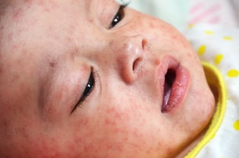
Measles Contact Investigations Can Be Large
-4
-3
-2
-1
0
1
2
3
4
Fever Runny nose Cough
Kawasaki disease?
Viral exanthem?
Epstein Barr?
“if he [the 44 yo patient] was a kid we would think he had measles”
Notes:
We often see quotes like this one taken from the chart of a 44 yo patient with recent travel to the philippines who presented to his physician and had numerous consultations.

Slide 5
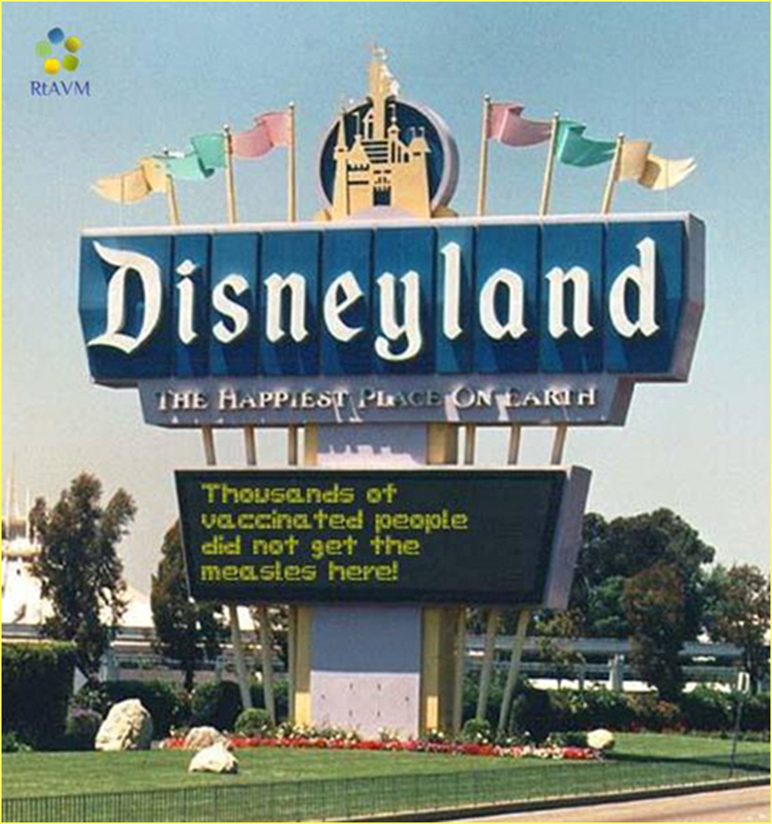

Slide 6
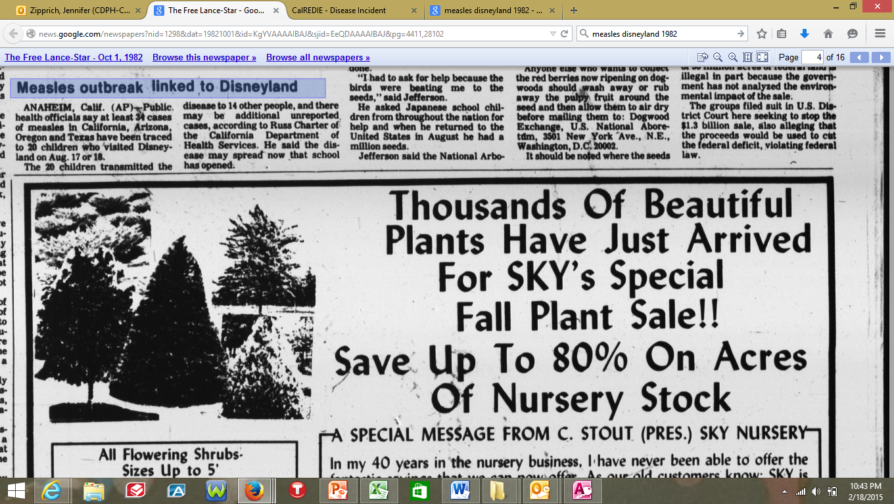
Measles Associated with a Theme Park?
34 cases linked to Disneyland in 1982

Slide 7
California Measles Cases,
December 2014 – April 17th, 2015
131 outbreak-associated measles cases in California
Outside of CA:
AZ 7
UT 3
NE 2
WA 2
CO 1
OR 1
Mexico 1
Canada 159
88% of outbreak cases in SoCal

Slide 8
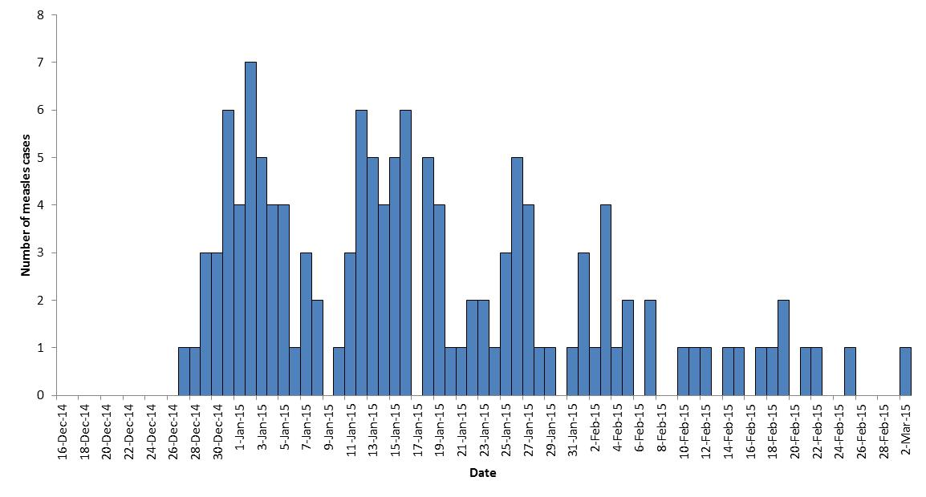
Epidemic curve of measles cases
42 of 45 went to a Disney Theme Park
Exposure

Slide 9
Economic/Personal Burden
Orange County
  1,767 additional hours of work
  Investigated approximately 2,000 community contacts, 1,800 were healthcare contacts
CDPH
  15 full-time staff working on measles for approximately14 weeks, including staffing on weekends
    Providing technical assistance
    State public health laboratory tested 866 patients
Direct medical costs?
  23 hospitalized cases; 2 severely ill cases

Slide 10
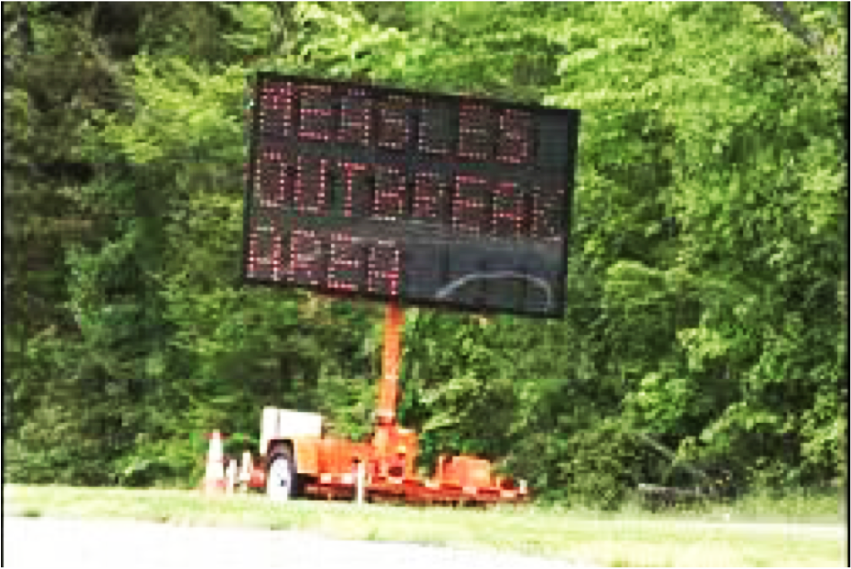
Photo credit: WFMY news

Slide 11
