Slide 1



Polio Eradication Legacy Planning:
Transitioning Polio Assets to Support
MR and Routine Immunization
Measles & Rubella Initiative Annual Meeting
September 15-16, 2015

Slide 2
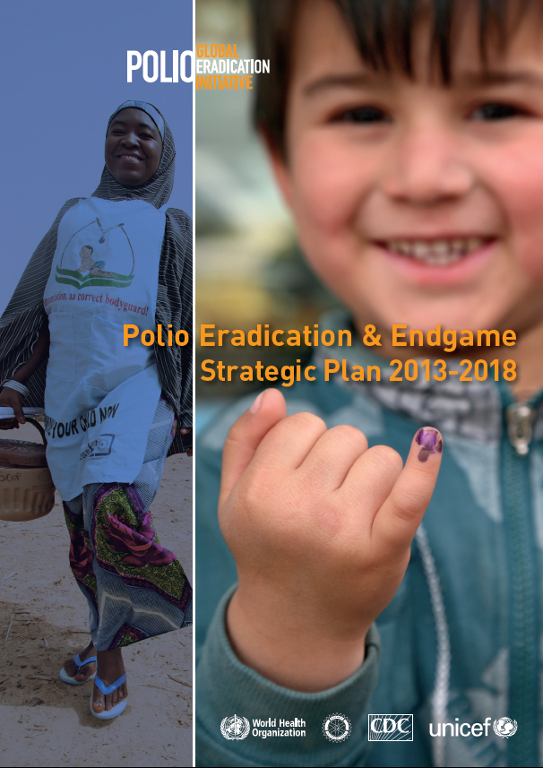
Polio Endgame Strategic Plan 2013-18
  Objective 1
    Polio virus detection and interruption
  Objective 2
    Immunization systems strengthening and OPV withdrawal
  Objective 3
    Containment and certification
  Objective 4
    Legacy planning
  “…ensure that the investments made to eradicate poliomyelitis contribute to future health goals, through a programme of work to systematically document and transition the knowledge, lessons learned and assets of the Global Polio Eradication Initiative… establishment of a comprehensive polio legacy strategic plan by no later than end-2015.”

Slide 3
  THE GPEI WORKFORCE (N=30,000+)
  is focused in endemic and
  transitioning countries
Millions of vaccinators
Tens of thousands of
local social mobilizers
Thousands of skilled technical staff
Includes social mobilizers. Does not include vaccinators or regional/headquarters personnel.
>1000 personnel
Hundreds of highly skilled technical managers/leaders
>100 personnel
>40 personnel
>10 personnel
1+ personnel

Slide 4
Evidence Base – Contributions to other priorities
Supporting Health Systems
Estimated time allocation
of polio workers¹
Critical activities and contributions of
polio programme (not exhaustive)
Other programs
Disasters and crises
Health systems strengthening
MNCH, Nutrition
Sanitation & Hygiene
Child health days
New vaccine intro
Routine Immunization
  National planning and local staff training
  Technical assistance
  Monitoring of field activities
  Communication and community engagement
1%
4%
2%
5%
1%
1%
4%
Surveillance
  Surveillance for vaccine preventable diseases, e.g. measles, rubella, yellow fever, neo-natal tetanus, JE
  Activities including front-line training, case detection, laboratory support and case reporting
Routine immunization
26%
Measles & rubella
12%
Supply Chain
  Country supply chain management, e.g.
    Vaccine procurement
    Cold chain maintenance
Polio
43%
Resources &
Capacity
  Polio funds provide critical support to national and local WHO / UNICEF offices
Overall
1.Data based on survey of staff in DRC, Nepal, India, Somalia, and Ethiopia. Source: Polio Legacy Survey

Slide 5
Key Areas of GPEI Expertise
Policy & strategy development
Planning
Management & oversight
Implementation & service delivery
Monitoring & evaluation
Communications & community engagement
Disease surveillance and data analysis
Capacity building
Partnerships & coordination

Slide 6
Examples of
“Legacy-in Action”

Slide 7
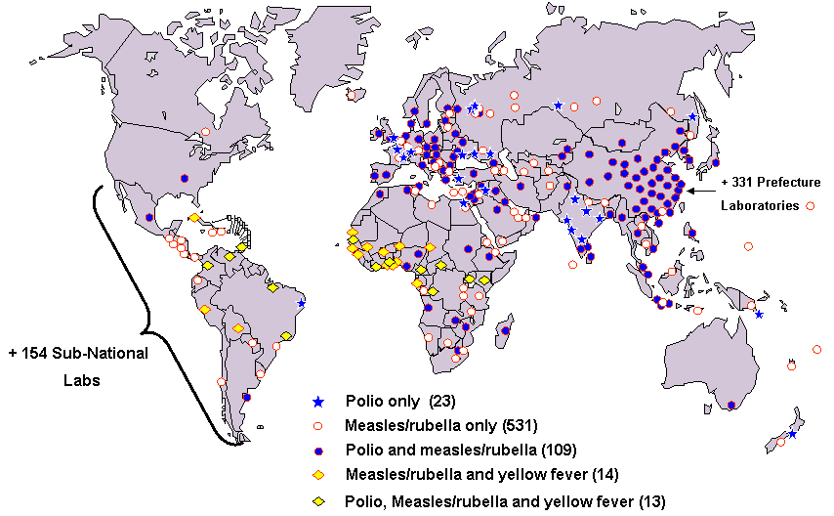
Building on the Polio Laboratory & Surveillance Network (>700 labs)

Slide 8
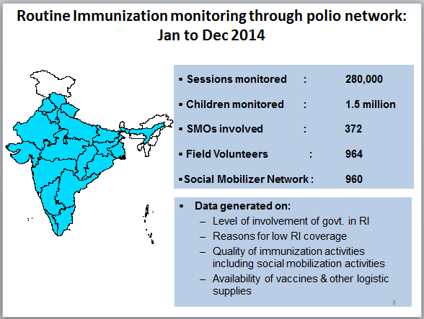
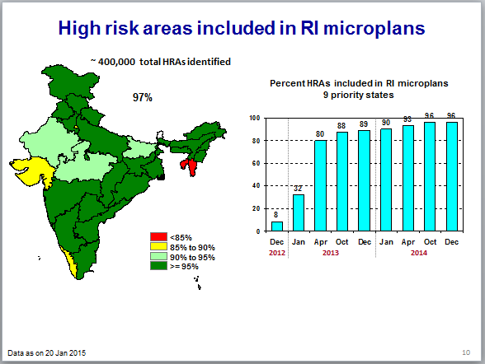
India -- Intensification of routine immunization
Intensified
RI monitoring
Capacity building of frontline workers
Advocacy & Integrated
communication
Tagging of HRAs to RI
session sites
Accountability
through
Task Forces

Slide 9
Polio network house to house monitoring data
Percentage DPT 3 coverage
N:
244,729
206,844
107,407
37,377*
335
764
823
1,500
Data Source : RI House to House monitoring data
* Bihar data as of May 2014

Slide 10
Polio Legacy Transition Planning Toolkit
Polio Legacy Transition Planning – Frequently Asked Questions
Polio Legacy Communication Slides
Transition Guidelines and Appendices
Lessons Learned -- an example (from the global perspective) of a Lessons Learned paper
India Lessons Learned and Transitioning (country example)
Lessons Learned Framework – Guidelines for documenting lessons learned at the country level
GPEI website: (http://www.polioeradication.org/Resourcelibrary/Resourcesforpolioeradicators.aspx).

Slide 11
  GPEI PRIORITIES FOR TRANSITION PLANNING
  in 2015-2016
Raise awareness of the importance and urgency of transition planning amongst donors, country governments and other stakeholders.
Ensure all countries that have been polio free for 12 months have established transition plans by Q3 2016.
Develop greater understanding of technical models, costs and financing mechanisms for successful transitions.
Begin to rigorously capture the lessons learned from the polio eradication effort.
Priority countries for GPEI transition planning:
Afghanistan
Angola
Chad
DR Congo
Ethiopia
India
Nigeria
Pakistan
Somalia
South Sudan

Slide 12
Additional Short-list of
Priority Countries
Bangladesh
Cameroon
Indonesia
Myanmar
Nepal
Sudan

Slide 13
Potential Country Transition Timelines
2014
2015
2016
2017
2018
POST GPEI
PHASE
COUNTRY EXAMPLES
WHA
RCMs
Stakeholder engagement needed to raise awareness of need for country-level planning
Transition planning underway
DR Congo
Nepal
India
Planning
& Decision
Preparation & Execution
All other polio-free and recent outbreak
Sudan
Ethiopia
Somalia
S. Sudan
Angola
Bangladesh
Indonesia
Myanmar
Cameroon
Chad
Planning
& Decision
Preparation & Execution
Legacy transition phase
Timeline contingent upon eradication status
Current endemics
Planning
& Decision
Preparation & Execution
Nigeria
Pakistan
Afghanistan
Timeline contingent upon eradication status

Slide 14
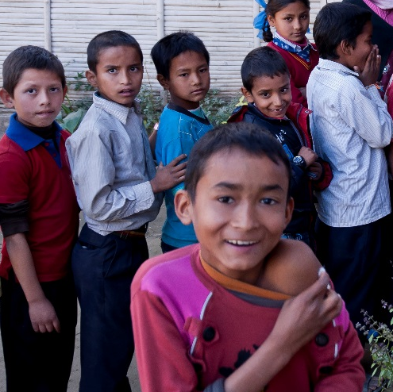
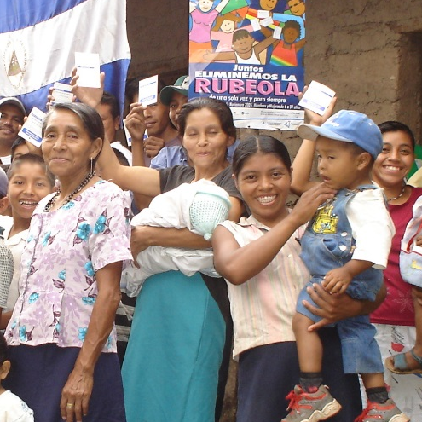
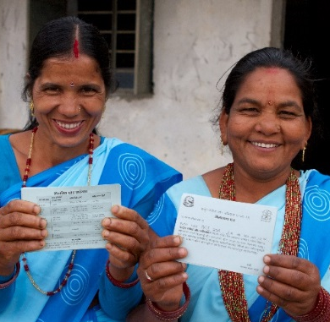
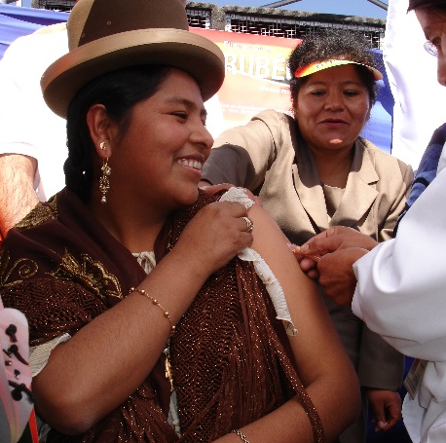
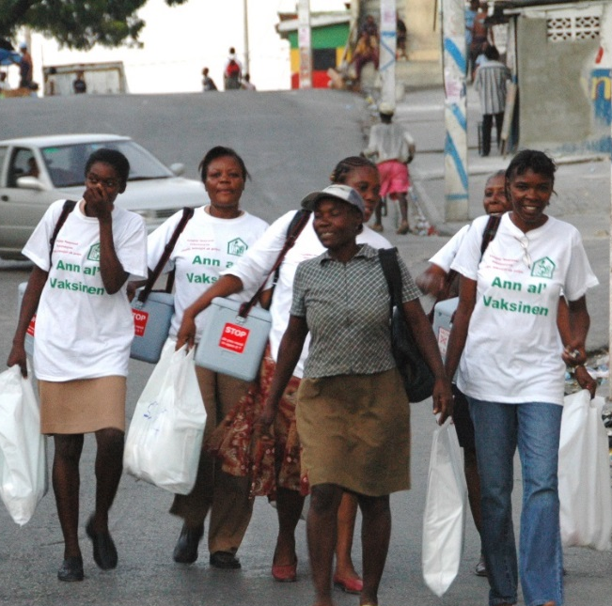
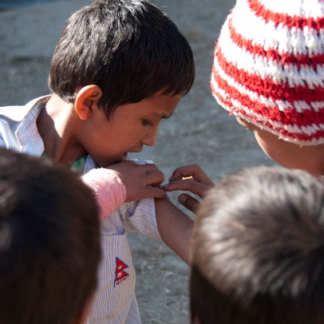
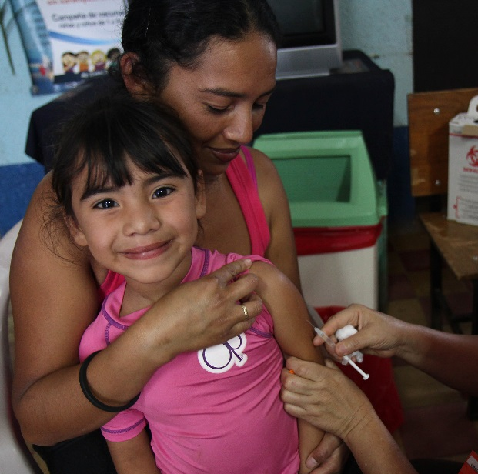
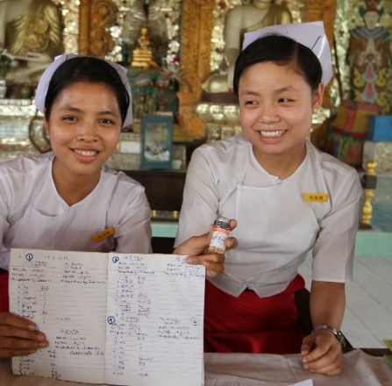
Achieving a World Without Measles and Rubella by connecting the dots

