Slide 1
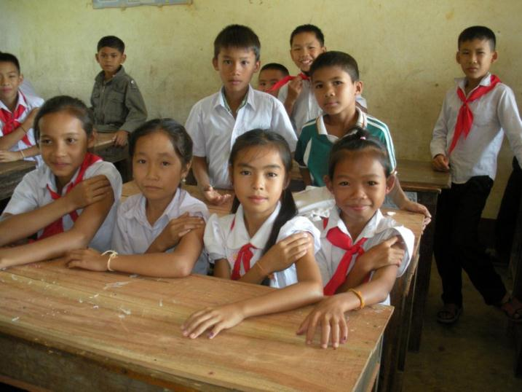
Measles & Rubella Initiative
--Who We Are--
Stephen Cochi, MD, MPH
Global Immunization Division
Centers for Disease Control & Prevention

Slide 2
What is the Measles & Rubella Initiative?
National Governments
(all countries)
WHO/UNICEF regional and country offices
Founding Partners: American Red Cross, CDC, UN Foundation, UNICEF, WHO
Public Sector Donors
Private Donors and Foundations
Civil Society Organizations

Slide 3


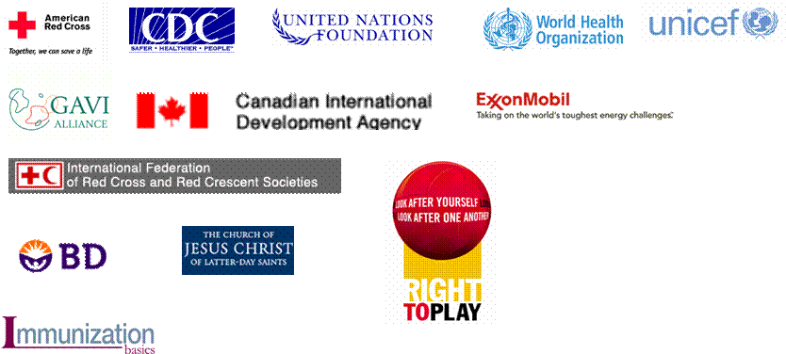



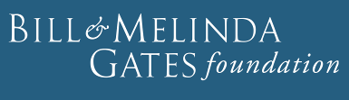










Anne Ray Charitable Trust

Slide 4
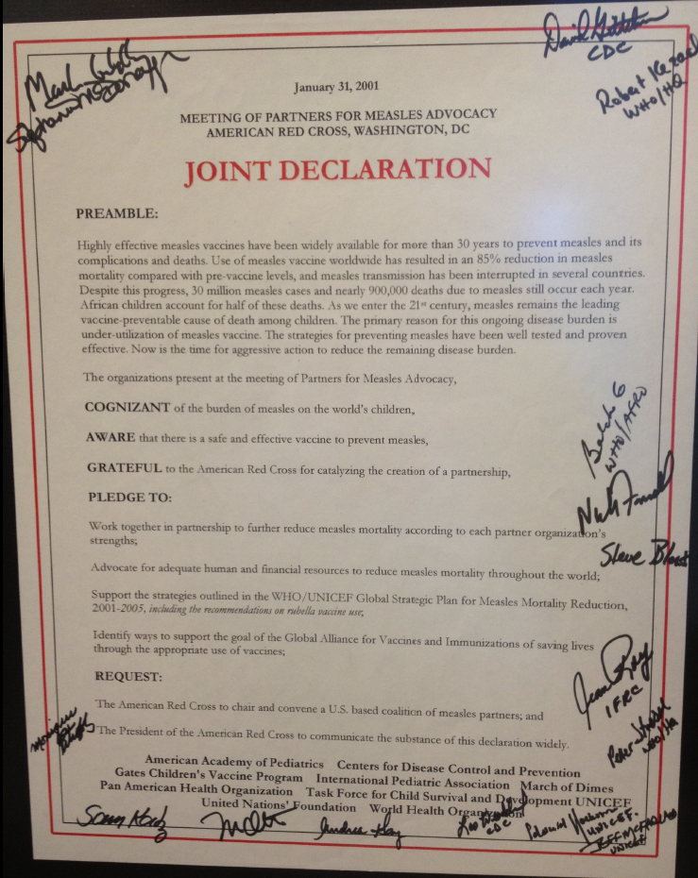
January 31, 2001
The Measles Initiative
is Established
Founding Partners:
American Red Cross
United Nations Foundation
World Health Organization
UNICEF
Centers for Disease Control
And Prevention

Slide 5
Vision/Mission
To globally lead and coordinate efforts to achieve a world without measles, rubella and congenital rubella syndrome
Notes:
5
Our common vision is a world without measles, rubella and congenital rubella syndrome

Slide 6
Functions of the M & R Initiative
  Lead and coordinate the global effort to control and eliminate measles and rubella
  Fundraising/Resource Mobilization
  Communications & Advocacy
  Surveillance and Laboratory Networks
  Outbreak Investigation and Rapid Response
  Immunization Policy Development
  Technical and Programmatic assistance
  Monitoring, evaluation and reporting
  Research

Slide 7
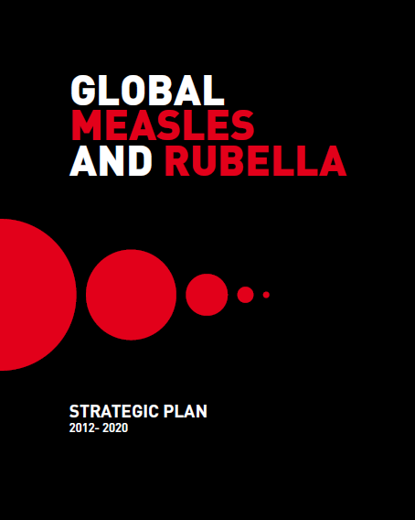
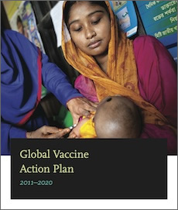
What is Our Strategic Framework?
Notes:
The Global Measles and Rubella Strategic Plan lays out the vision, goals, strategies and guiding principles. These same goals are reflected in the Global Vaccine Action Plan which was developed under the leadership of BMGF; Gavi, the vaccine alliance; UNICEF; NIAID & WHO and later endorsed at the World Health Assembly.

Slide 8
Measles and Rubella Targets
Global targets by 2015:
  Measles vaccination coverage ≥ 90% national and ≥ 80% district
  Measles reported incidence <5 cases per million
  Measles mortality reduction of 95% vs. 2000
  Regional targets:
    Measles Elimination goals:
    2000 AMRO
    2012 WPRO
    2015 EURO, EMRO
    2020 AFRO, SEARO
  Rubella Elimination goals:
    2010 – AMRO, 2015 – EURO, TBD -- WPRO
Global Vaccine Action Plan (GVAP):
  2020 Measles and rubella elimination in 5 WHO regions

Slide 9
GLOBAL MEASLES AND RUBELLA
STRATEGIC PLAN
2012–2020

Slide 10
Global Measles and Rubella Strategic Plan
Five Key Strategies:
Achieve high population immunity
through vaccination
Conduct effective surveillance
and monitoring
Develop outbreak preparedness
and response
Communicate to engage public’s confidence and build demand
Perform research and development to improve program efficiency
Notes:
There are 5 key strategies for achieving the elimination of measles and rubella. These are laid out in the Global Measles and Rubella Strategic Plan. The strategies are: 1) achieve and maintain high population immunity through vaccination with two doses of measles and rubella containing vaccines; 2) conduct effective disease surveillance and programme monitoring; 3) develop outbreak preparedness, response and case management; 4) communicate clearly to build public confidence and demand for immunization; and 5) perform research and development to improve programme efficiency

Slide 11
R Rubella as the "game changer"
  2011 WHO Rubella vaccine position paper:
  "In light of the remaining global burden of CRS and proven efficacy and safety of RCVs, WHO recommends that countries take the opportunity offered by accelerated measles control and elimination activities to introduce RCVs."
The preferred approach is to begin with MR vaccine or MMR vaccine in a wide-age range campaign followed immediately with introduction in the routine programme.
Countries introducing RCV should achieve and maintain immunization coverage of 80% or greater with RCV delivered through routine services and/or regular SIAs.
Wkly Epid Rec, 15 July 2011,
vol 86:301-316

Slide 12
Name Change--2011
Measles Initiative
Measles & Rubella Initiative

Slide 13
Measles and Rubella Initiative
Management Team
Strategies
Working Groups
1. Achieve and maintain high levels of
population immunity
2. Communicate and engage to build
public confidence
3. Monitor disease using effective
surveillance
4. Maintain outbreak preparedness
and response
5. Research and develop improved
vaccination & diagnostic tools
Resource Mobilization
Routine Immunization
Strategic Communications
Programme Implementation
Vaccine Supply Coordination
Research and Innovation
2013 Annual Report of the Measles and Rubella Initiative
http://www.measlesrubellainitiative.org/wp-content/uploads/2014/08/annual-report_2014.pdf
Notes:
To make the program more effective, the Measles and Rubella Initiative has put in place a management team with working groups (shown on the right) to directly support implementation of the 5 key strategies to achieve measles elimination (on the left) that I described earlier.

Slide 14
Impact of Measles & Rubella Initiative

Slide 15
75% Decrease in estimated global measles mortality, 2000 - 2013
15.6 million deaths averted
Notes:
Similar to

Slide 16
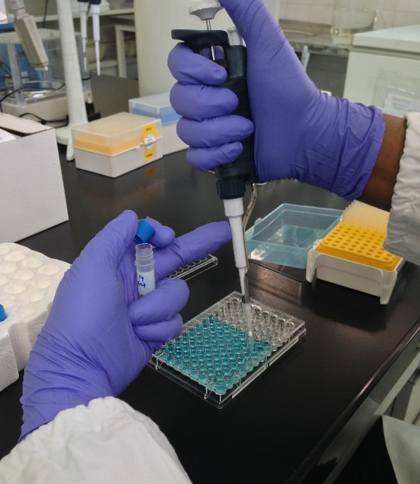
Global Measles and Rubella
Laboratory Network (GMRLN)
Initiated in 2000
Built on Global Polio Laboratory
Network model
Multi-tiered structure
  3 Global Specialized Laboratories
    CDC, PHE-UK, NIID-Japan
  14 Regional Reference Laboratories
  161 National Laboratories
    586 Subnational laboratories (including 362
    subnational laboratories in China)
7 Global/Regional Laboratory Coordinators
Dr. M Mulders, WHO Headquarters
Notes:
Read the bullets
The 14 RRLs are effectively also NLs.
Nearly half of the labs are in China where testing is performed…
There are microbiologists in each region that serve as regional lab coordinator and one global cl at WHO HQ

Slide 17
Measles and Rubella Initiative
Partner Contributions, 2001-2014 ($ 1,162 million)

Slide 18
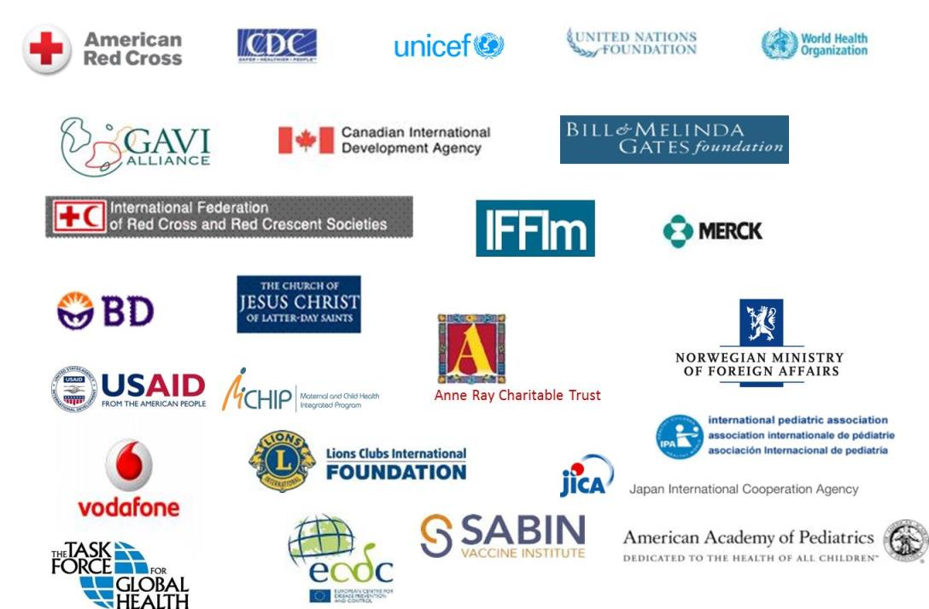
  We Are Working Towards A World Without
  Measles and Rubella!
Notes:
I would like to acknowledge here ALL the partners of the Measles & Rubella Initiative. And NOW, With polio ending, it is time to STRENGTHEN the partnerships and work together to achieve…. a world without measles. Thank you.

Slide 19
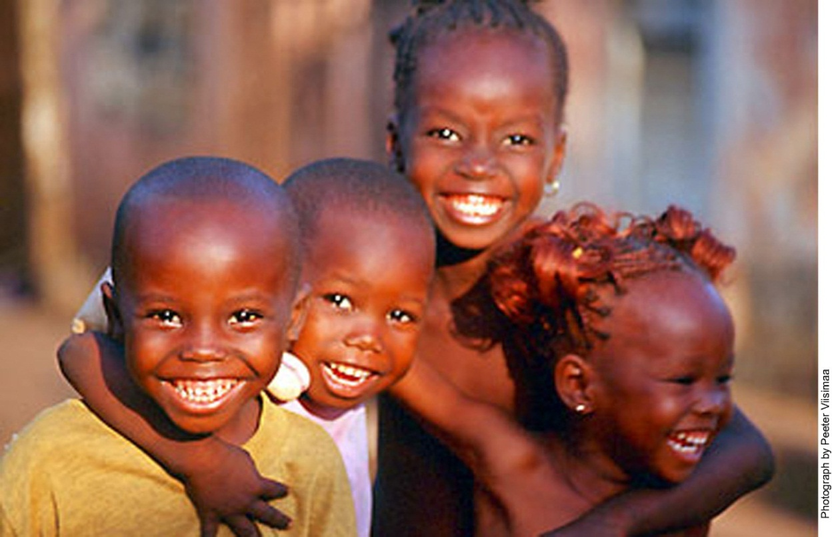
Thank you!

