Slide 1
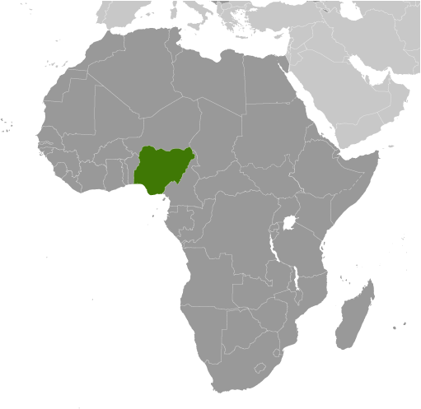
Conducting a Measles campaign among conflict-displaced populations in North East Nigeria
Measles Rubella Initiative - Partner’s meeting
Washington DC. September 7-8, 2017
Gatei wa Nganda
CDC Nigeria

Slide 2
Idea: simple and extraordinary
Measles will be ….
… eliminated

Slide 3
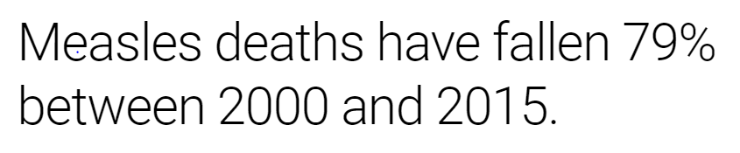
……. Great global progress in reduction of cases (source MRI)

Slide 4
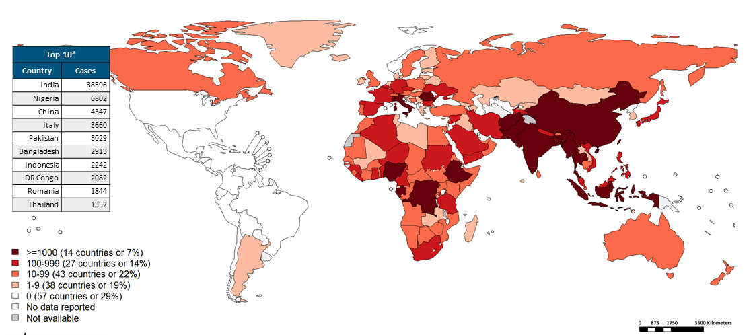
…….despite the progress, high no. of cases in Nigeria (WHO)
Based on surveillance data Jan-June 2017

Slide 5
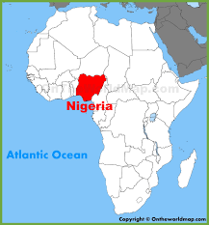
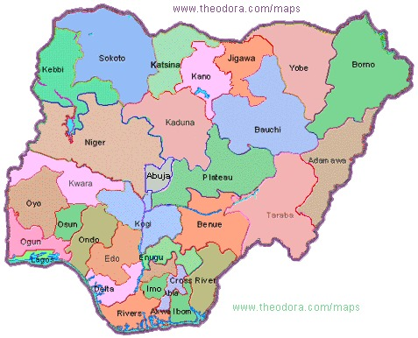
Map and Location of Nigeria
Area of Interest
Profile:
Most populous country in Africa
Pop. 170m (projection 2006 census)
Area 923,768 sq km (356,669 sq. M)
In the area of interest:
Insecurity a major challenge
Mainly Borno State, but spills to:
  neighboring states: Yobe, Adamawa
  neighboring countries: Cameroun, Niger, Chad

Slide 6
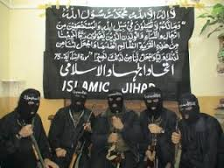
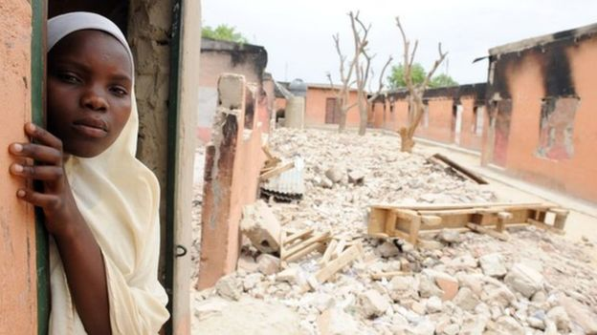
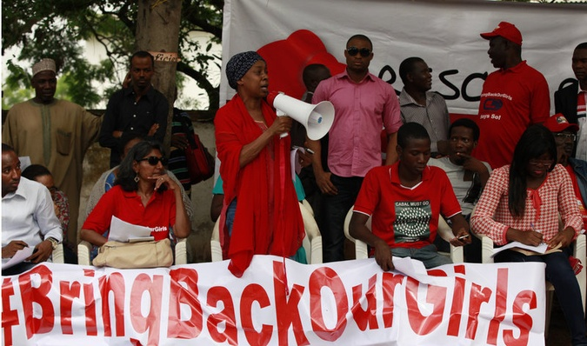
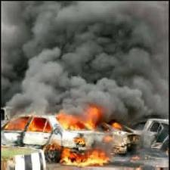
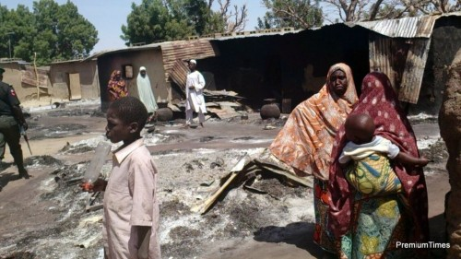
…. insurgency by the militant islamist group
Aim was to overthrow Gov’t and create an Islamic state
Commenced violent activities in 2009
use terror as a weapon of intimidation
Increasingly target civilians (rural and urban)
destroy everything in their path (livelihood)
Abductions (mainly women and girls)
Currently mainly using Improvised Explosive Devises (IEDs)

Slide 7
Feb 17, 2014

Slide 8
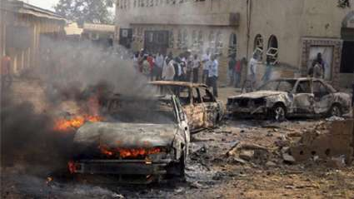
Since the start of the conflict in 2009
  more than 20,000 killed
  1000s of women and girls abducted
  2.1 million people fled
    1.9 million of internally displaced (June 2017)
    over 200, 000 people refugees Cameroon, Chad and Niger
EOC Nigeria

Slide 9
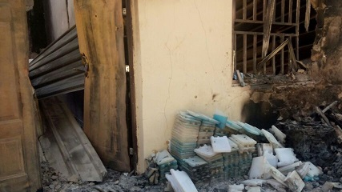
Health facilities targeted in Borno state
46 % of Health Facilities offering Routine immunization destroyed
Health sector a key state Gov’t priority
EOC Nigeria

Slide 10
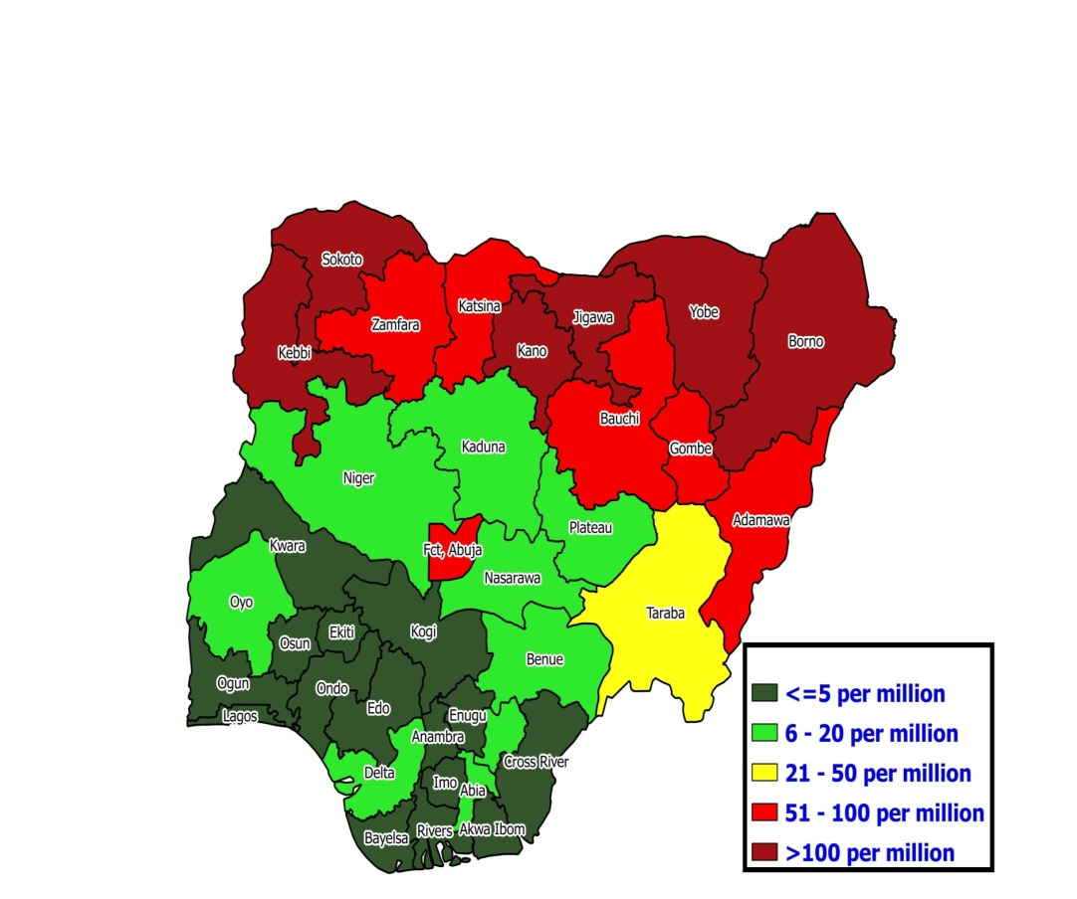
…... Multiple outbreaks reported across the country
No of confirmed cases by state, 2016
Area of Interest
Source: NPHCDA Nigeria

Slide 11
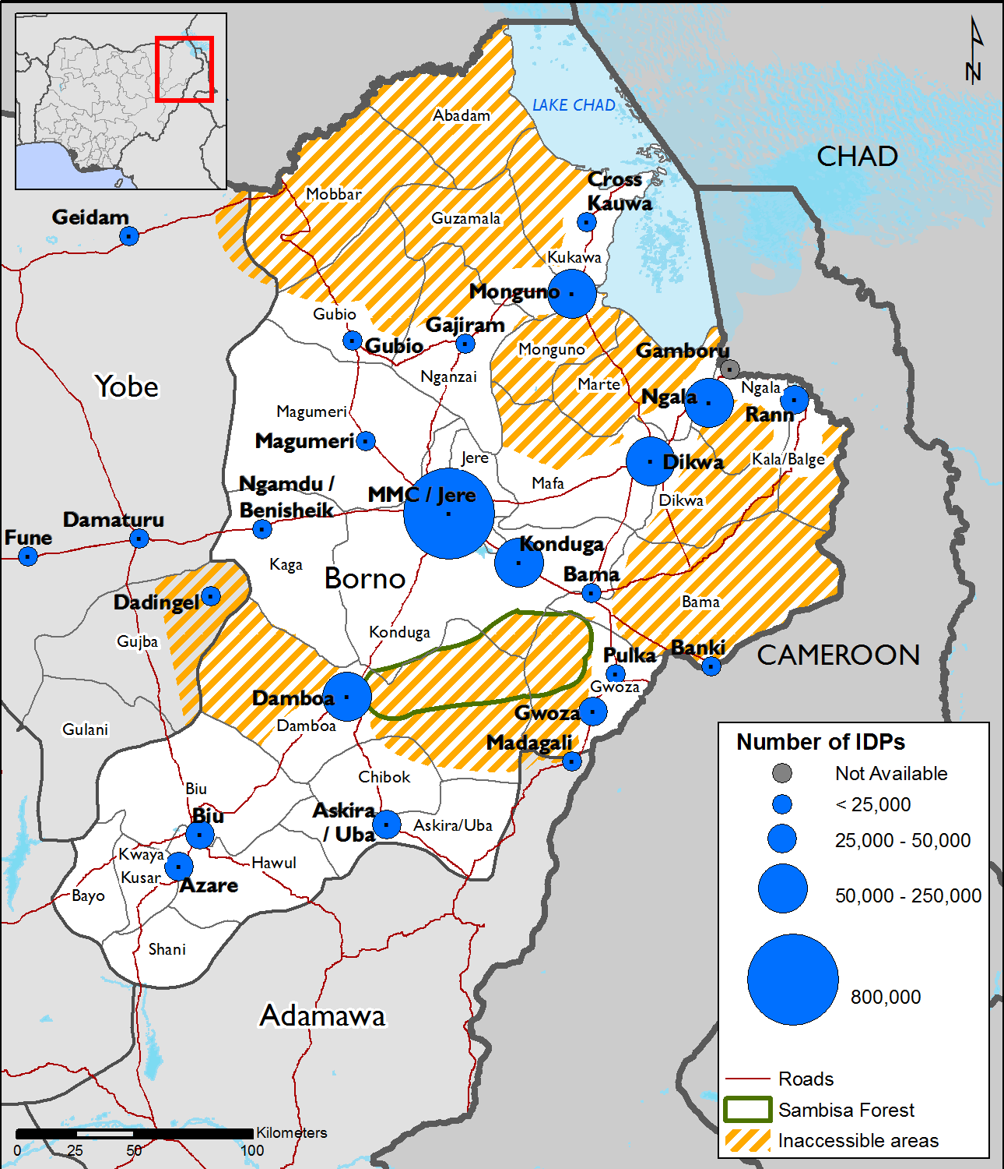
Program context - NE Nigeria
Due to insecurity:
  Inaccessibility (partial/fully)
  Loss of livelihood
  Population displacement in search of safety, food shelter, healthcare
    IDPs camps
    Host communities (safe areas)
Source: acaps.org

Slide 12
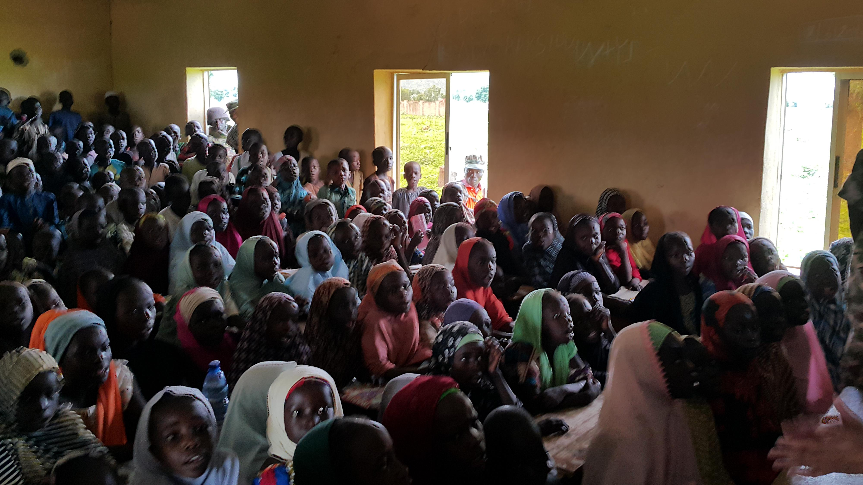
Measles in the NE
Clustering of susceptible population among displaced communities
  Low population immunity due to destruction of health systems
    Health workers (members of communities)
    Facilities destroyed
  Undernourished population
  Overcrowding in camps and host in communities
A perfect storm for measles outbreaks
The no. of deaths from suspected measles in the IDPs camps high
EOC Nigeria

Slide 13
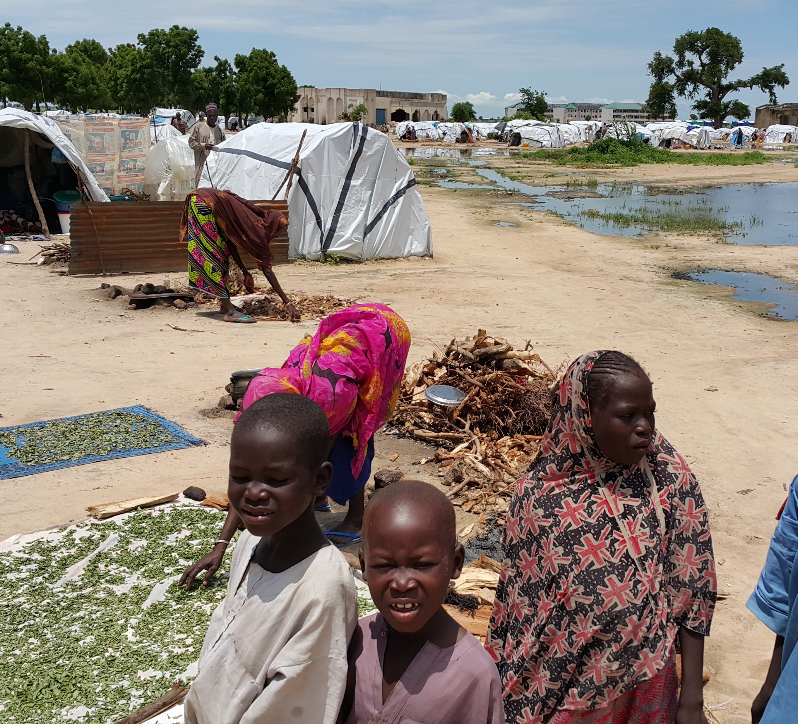
Approach in organizing mass measles campaign
Understand the conflict:
  insurgency
  asymmetrical
Understand the population
  Culture/social structure and leadership
Understand Measles susceptibility in these population
  Ages of the “conflict cohort”
Recognizing mass campaigns still a critical strategy
  RI improving but still sub-optimal
Draw on collective experience and capacities
  Previous campaigns
  Polio structures:
    mass IPV/OPV
    EOC: platform for coordination:
      Planning, Implementation, monitoring
EOC Nigeria
IDPs camp, Maiduguri Borno

Slide 14
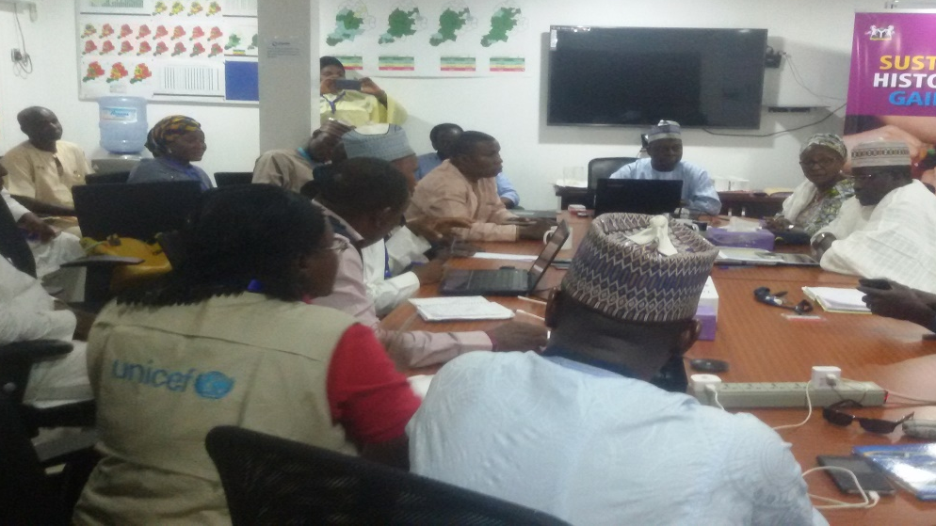
Planning
Emergency Operation Center (EOC) activated
Target: (moving)
  adjusted polio target
Security Assessment:
  where to implement
Vaccination sites (Microplanning)
  HFs, mobile FPs, schools
  Nos. and distribution (urban vs. rural)
Human Resources: cadre/numbers
  Recruitment, Training , Deployment
Logistics
  Vaccines/Ancillary supplies/Data tools
  Adverse effects kits, Waste disposal
  Cold chain
  Transport, storage, distribution
Advocacy and social mobilization
Borno EOC in session

Slide 15
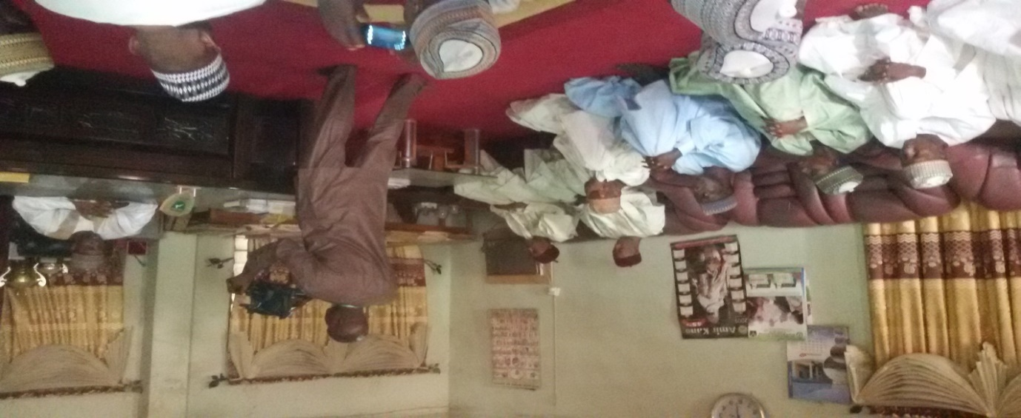
Advocacy and Community mobilization
EOC Nigeria
Development of key messages
Advocacy to political leaders:
    Local resource mobilization
Engagement of traditional leaders
  Community influencers, women leaders, youth leaders
Engagement of town announcers
Promote ownership at all levels
Advocacy to The Shehu of Borno

Slide 16
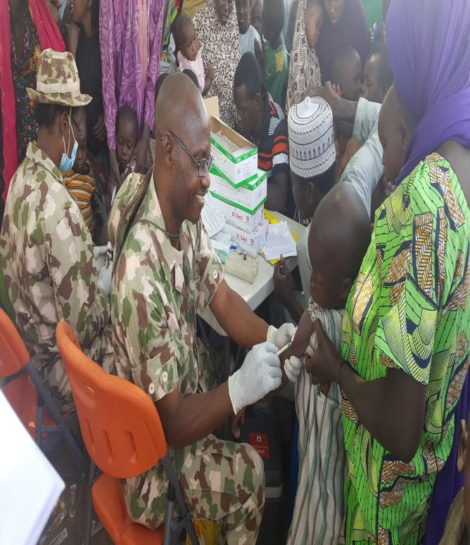
Implementation
Supervision
Monitoring
Daily review meetings
  Ward
  LGA (District)
  State (EOC)
Coverage survey
EOC Nigeria
Military medical corps engaged

Slide 17
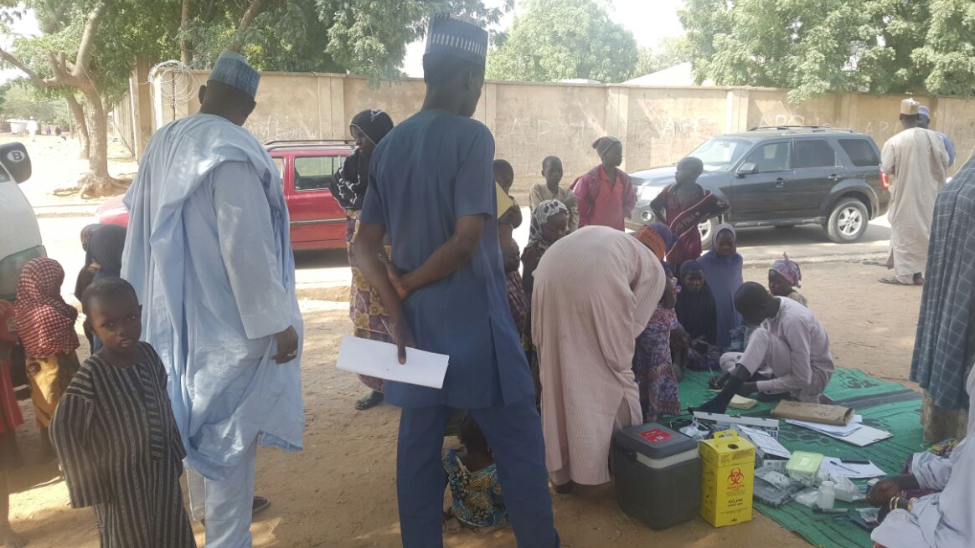
Plan summary – Borno state
Target 3.1 m
25/27 LGAs (districts)
Age: 6 months - 10 years
No of teams: 2,490
2 phases over 10 days
Conducted in Jan 2017
Vaccination site

Slide 18
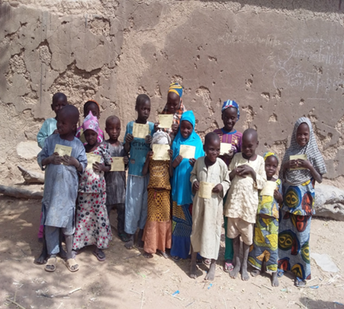
Evaluation
Coverage survey post campaign
all 46 high risk LGAs from the 3 states
  89.9% were immunized
State specific immunization coverages
  Yobe 87.8%
  Borno 92.5%
  Adamawa 85.6%
Children display vaccination cards following injection

Slide 19
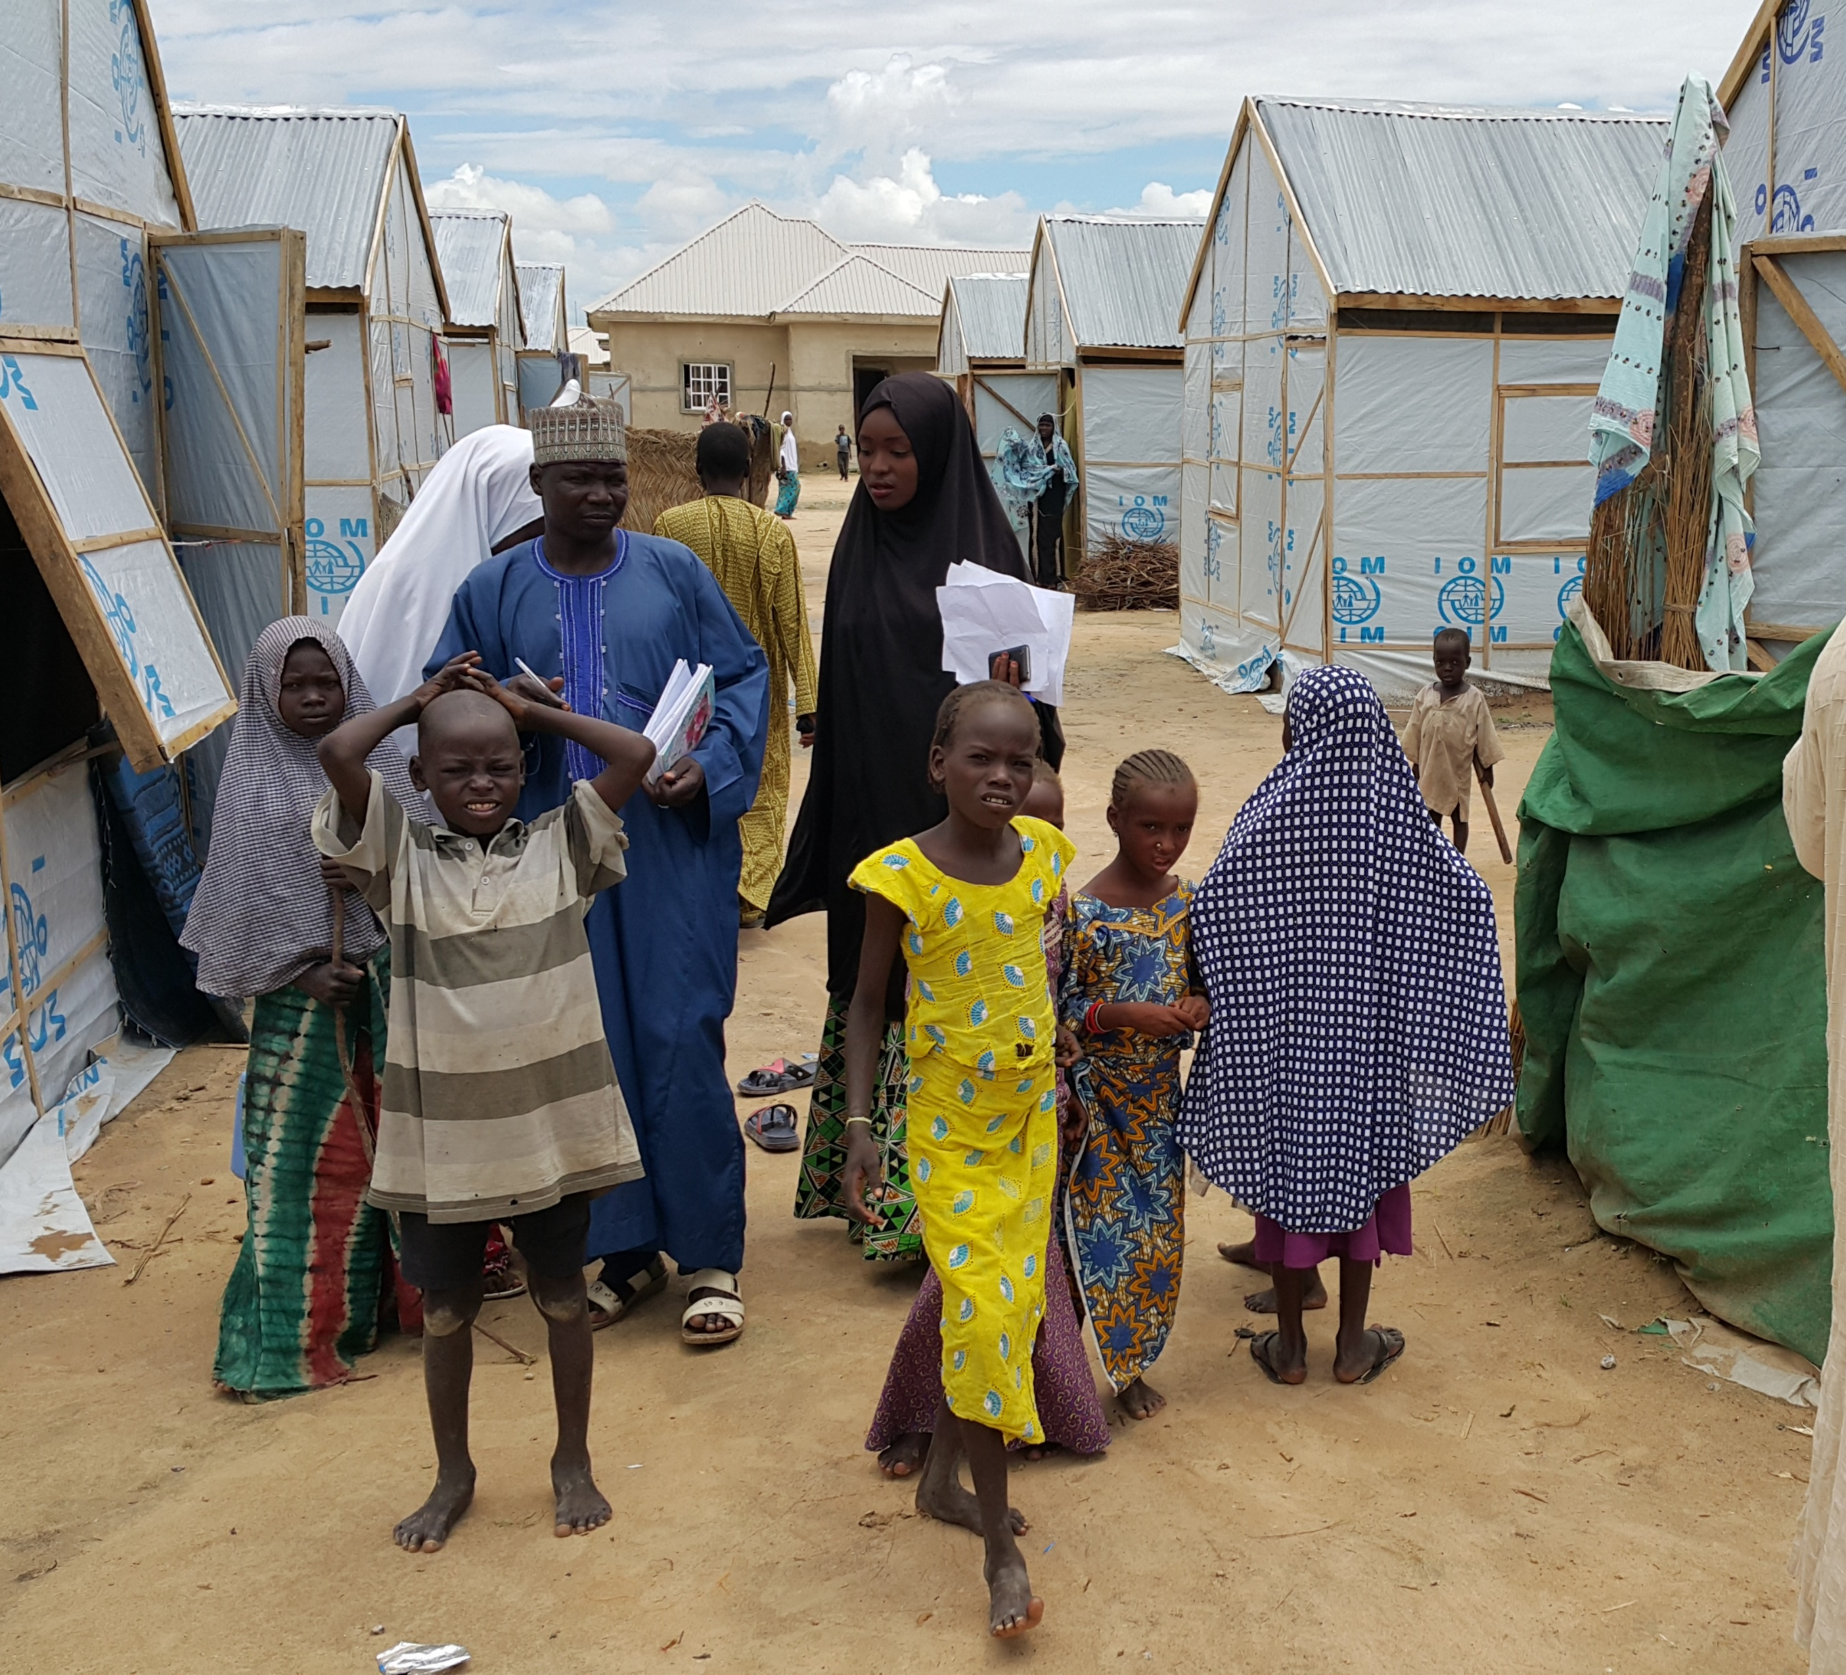
Going forward
Population movement still dynamic
National campaign starting Oct 2017 (targeting 33m children)
  Phased (non synchronized)
  Great progress in mobilizing resources
Stepping up Measles surveillance
  Ensure we promptly detect and confirm cases
Improve data quality
IDPs camp Maiduguri

Slide 20
Conclusion
Road to elimination, goes through challenging locations such as NE Nigeria
Successful campaigns have been implemented despite challenges
We should feel positive about the prospects of measles elimination

Slide 21
Acknowledgement
The GON and MRI for mobilizing the resources for the OBR and forthcoming campaign
The state (Borno, Yobe and Adamawa) and frontline teams whose efforts brings closer the goal and vision of Measles elimination

Slide 22
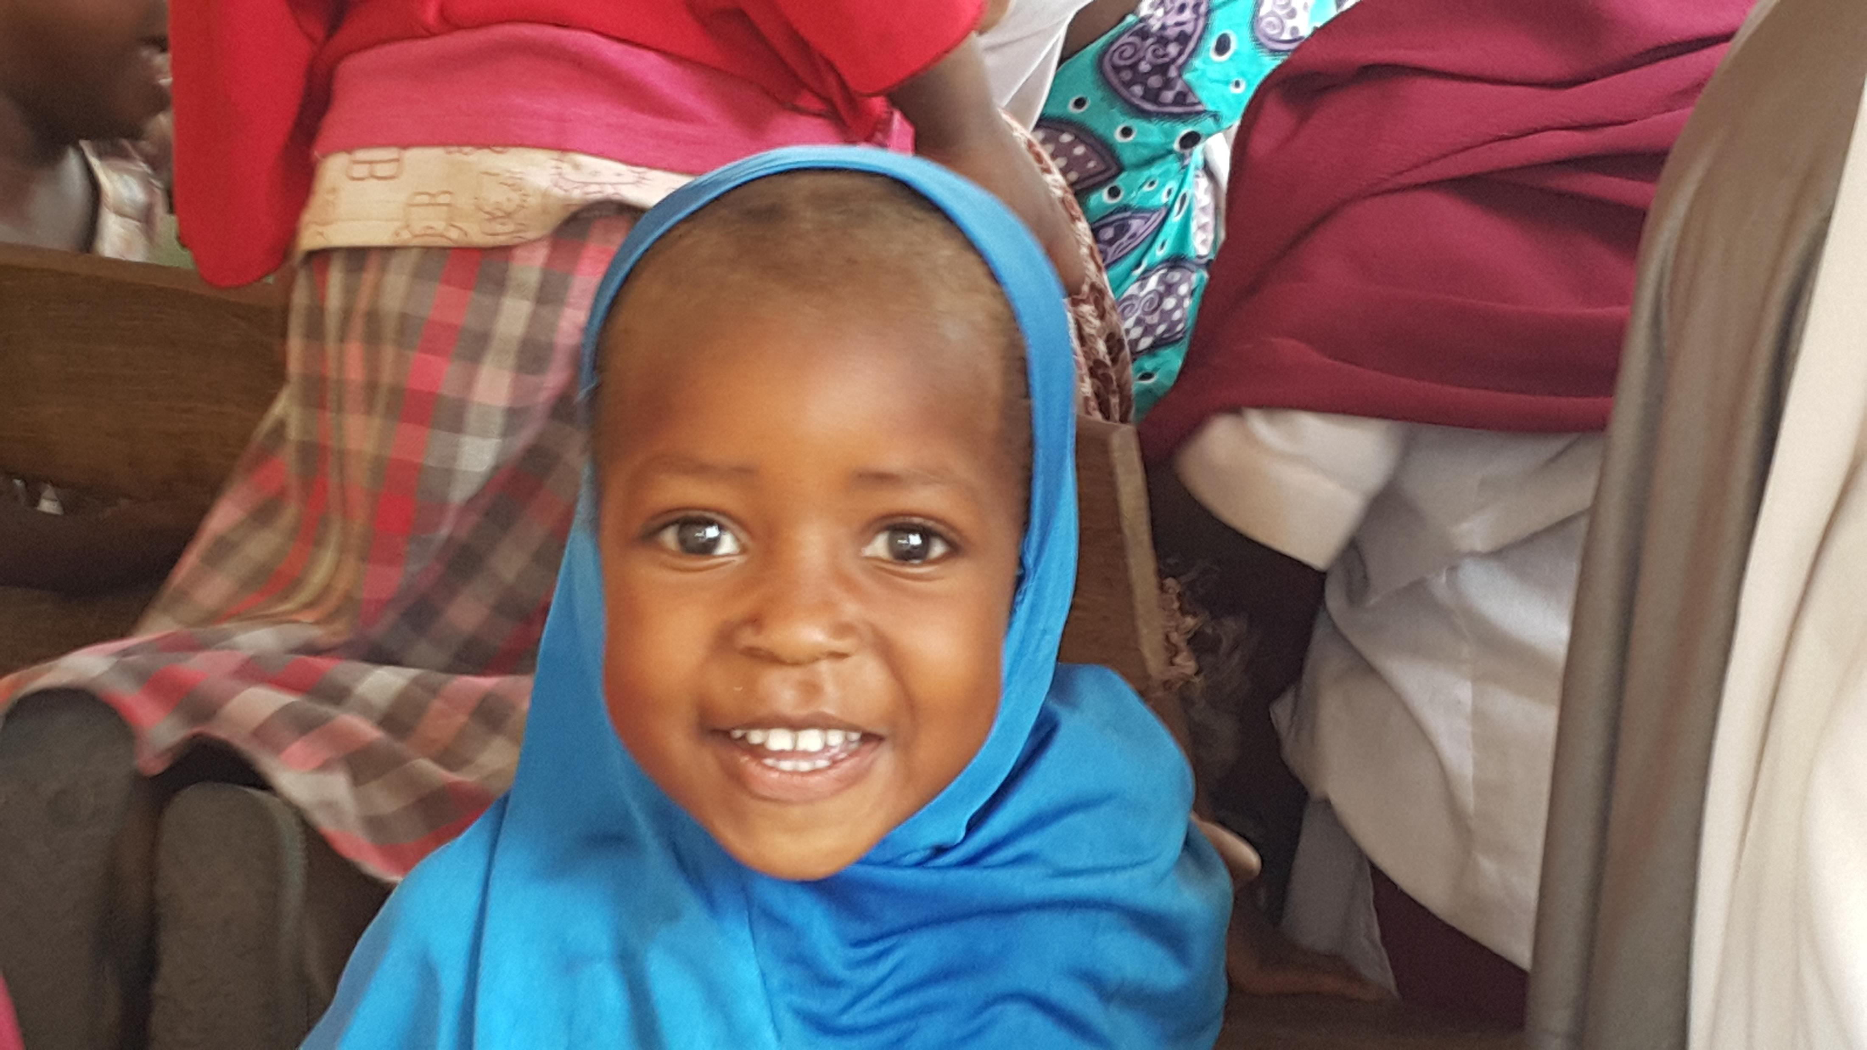
Thank you

