Slide 1
2017 Measles & Rubella Initiative Partners’ Meeting
Opening Comments & Perspectives
Dr. Suresh Jadhav
Executive Director
Serum Institute of India Pvt. Ltd.,
ssj@seruminstitute.com

Slide 2
We, at Serum Institute of India Pvt. Ltd., feel proud of being a partner to PAHO / WHO in achieving what is designated to be a historical achievement in eradication of Measles & Rubella diseases from the Americas.
It is also acknowledged that such historical milestones would not have been achieved without the sincere & strong political will and commitment by all the Members State

Slide 3
Elimination of Measles & Rubella from PAHO Region will act as an example to the entire world that sustained efforts along with involvement of all agencies would culminate into winning over the most dreadful infectious diseases

Slide 4
Measles, Mumps, Rubella
Vaccine Preventable Diseases.
MCV part of EPI since 1974. *
Prior to 1974, 90 % individuals were infected with Measles before the age of 10 years ! *
2011 : Recommendation by WHO to include Rubella.
2013 : GAVI announced its support for large scale catch up campaigns with MR vaccine.
* MSF, The Right Shot 2nd Edition January 2015

Slide 5
The Incidence
Almost 20 million people are affected by Measles every year.
Year 2015 : 134200 reported cases of Measles deaths : 315 children killed by Measles complications every day!
100-1000 cases of Mumps per 100000 population.*
> 100000 children are born every year with CRS.*
It costs < $2 to vaccinate a child against Measles & Rubella
One child sick from Measles = Monthly Ethiopian family income
* MSF, The Right Shot 2nd Edition January 2015

Slide 6
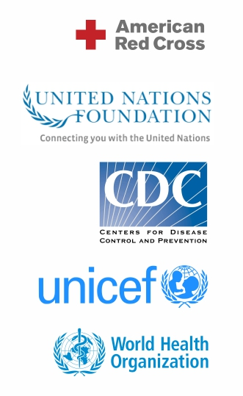

Measles & Rubella Initiative
Launched in 2001.
By the American Red Cross, United Nations Foundation, U.S. Center for Disease Control and Prevention, UNICEF and World Health Organization.
Measles & Rubella Initiative first aimed to make a difference in Africa.
Since then the American Red Cross and its Measles & Rubella Initiative partners have helped to vaccinate more than one billion children in more than 80 developing countries, making significant gains in the global effort to stop the disease.
GAVI’s support for Rubella is a Game Changer in the
control of a disease that causes serious, life-long
disabilities in infants.

Slide 7

WHO SAGE Recommendations
Countries to use a Rubella containing combination vaccine such as MR or MMR, as a First dose MCV.
Countries that introduce MR or MMR combination vaccines in routine immunisation should carry out one-time catch-up campaigns to reach all children between 9 to 15 years of age.
Countries should switch to the same combination vaccines (MR or MMR) for both routine doses.
Source : WHO, Meeting of SAGE on Immunization, November 2013; Conclusions and Recommendations , WHO, Geneva, January 2014, P12

Slide 8


Slide 9

Rubella Elimination in the America’s
1993 : PAHO adopted a resolution for elimination of Rubella & CRS in the Americas by 2010.
PAHO developed a strategy to introduce MR vaccine into routine immunisation programs of all countries for children aged 12 mos & reaching > 95 % coverage.
1998 to 2005 : Vaccination campaigns were carried out in Chile, Brazil, Costa Rica, Honduras, Ecuador & El Salvador.
Another 18 countries were added in subsequent years.

Slide 10
America’s Rubella Free
Vaccination effort led to eradication of Rubella in the Americas, 10 months before target.
The Rubella & CRS initiative will have saved an estimated US$ 3 bio by preventing >112500 CRS cases in Latin America and the Caribbean.
The MR initiative launched a new Global Measles & Rubella Strategic Plan in 2012 – Reduction of global Measles deaths by at least 95 %.

Slide 11
Measles Elimination in the America’s
Large outbreaks reported between 2011 & 2015 : Brazil, Ecuador.
Efforts started in 1994. Campaign lasted 22 years.
IEC reviewed evidence on Measles elimination presented by all countries of the region between 2015 & August 2016.
27 September 2016 : IEC announced that Measles had been eliminated from Americas. Ref.: www.eurosurveillance.org, P1, 29 Sept 2016
America’s Measles & Rubella Free

Slide 12
Measles Elimination in S. Korea
Measles, endemic in S. Korea. 1965 : MCV became available in S. Korea.
1983 : Measles, Mumps and Rubella (MMR) vaccine : added to national immunization program.
2000–01 : Measles epidemic : 55000 reported cases.
2001 : 5-year National Measles Elimination Plan.
2006 : Interruption of indigenous measles transmission achieved : S. Korea, first country in the World Health Organization’s (WHO) WPR : declare measles eliminated.
Ref. : MMWR Vol. 56, No 13, April 6, 2007 PP 304

Slide 13
Other Campaigns
2003 : Iranian campaign : World’s largest vaccination operation. Measles and Rubella (MR) vaccine was administered to more than 33 million people aged between 5 and 25 years, in less than one month : Decline in measles incidence due to the vaccination. Ref. : Bahman Pourabbas et al Efﬁcacy of measles and rubella vaccination one year after the nationwide campaign in Shiraz, Iran; Int.ernational Journal of Infectious Diseases (2008) 12, 43—46.
In Albania, the incidence of Measles and Rubella infections significantly dropped after the mass immunization campaigns of MR vaccine. Ref. https://academic.oup.com/jid/article-lookup/doi/10.1086/368055
MR vaccine was used extensively in mass immunization campaigns in various countries in Latin America, Southern Europe, Central Asia, East Asia and Western Asia

Slide 14
Recent Measles Outbreaks
Year | Region
2014-15 | Increased no. of reported Measles cases. 33 % : African Region (AFR). 18 % : Eastern Mediterranean Region (EMR). 83 % : European Region (EUR) *.
Mid 2016 | Japan, USA, Australia
June / July 2016 | Malaysia / Yemen
End 2016 | Romania
January 2017 | S. Africa
February 2017 | Conakry, Guinea
Also reported : Vietnam, The Philippines, China.
* : Minal K. Patel et al Progress toward reigonal Measles Elimination – worldwide, 2000-2015 weekly/Nov 11, 2016/65(44);1228-1233

Slide 15
Mumps Outbreaks in last decade
Region | Year
United Kingdom | 2014
USA | 2016-17
Moldova | 2008
Iraq | 2015-16
Palestine | 2014-15
Belgium | 2012
Australia | 2015

Slide 16
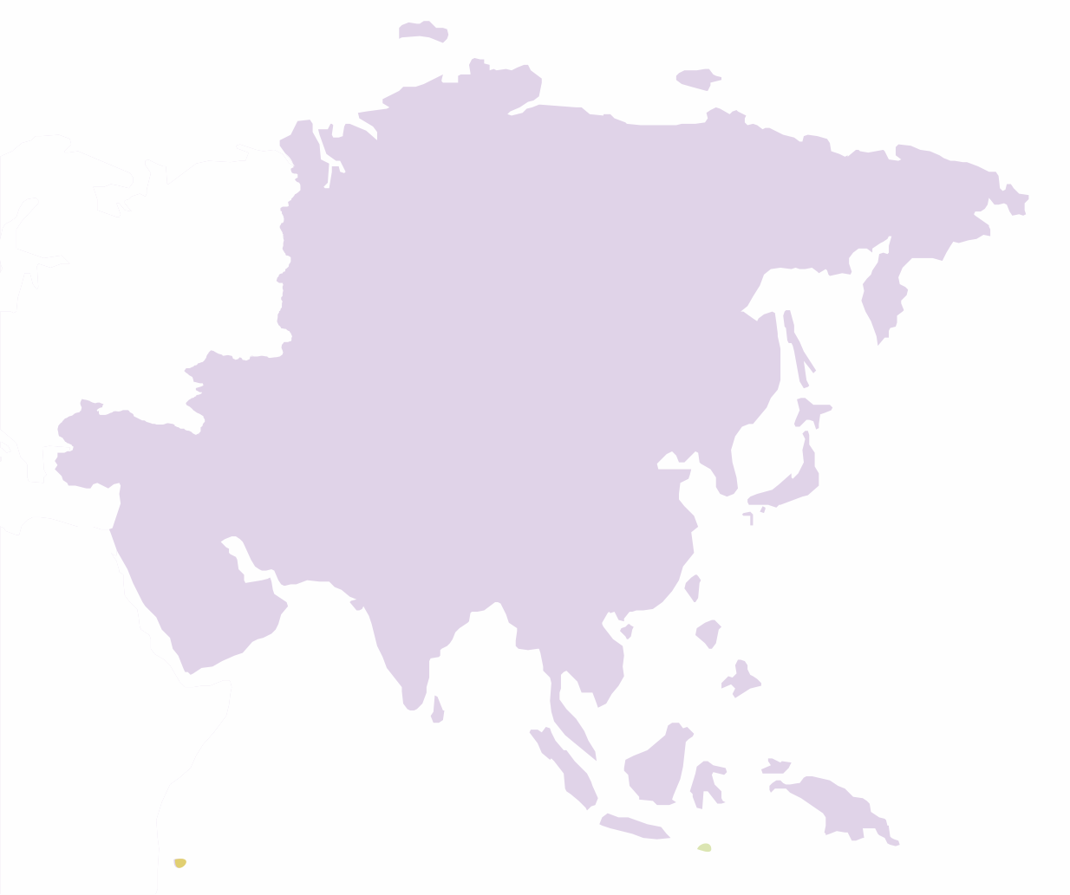
S. E. Asia Scenario*
Measles remains a significant cause of morbidity and mortality.
2012 : 122000 global measles deaths : 43 % in the SE Asian region.
2010 : 103000 infants born with CRS, globally : 46 % in the SE Asian region.
*Strategic plan for Measles elimination and Rubella and CRS control in the SEA region 2014-2020

Slide 17
Measles & Rubella Elimination
Progressing slower than expected.
Since 2010 global Measles incidence has decreased by 21 % from 50 cases per mio to 39.3 cases in 2015.
Measles outbreak have occurred in numerous countries
– sub-optimal immunisation coverage.
– increased susceptibility in older age groups.
45 Member States have not yet introduced Rubella vaccine!

Slide 18
Measles & Rubella Elimination
2015 Goal or Milestone | Evaluation (based on 2015 data)
Achieve > 95% reduction in estimated measles mortality compared to 2000 | Reduction of 79%*
Reduce annual measles incidence to less than 5 cases/million & maintain that level | Global incidence of 36 per million
Achieve at least 90% MCV1 coverage nationally, and > 80% coverage in every district or equivalent administrative unit. | 119 (61%) countries have MCV1 coverage > 90% at national level.
Achieve at least 95% coverage with M, MR or MMR during SIAs in every district. | Of 104 SIAs from 2013-2015, 52 (50%) had a reported coverage of ≥95%. Only 19 conducted a post- SIA coverage survey; 9 (47%) reached ≥95% national coverage.
Establish a rubella/CRS elimination goal in at least three additional WHO regions (i.e., in addition to the AMR and EUR that had established goals before 2012). | One additional region, WPR, has established a rubella elimination goal but no date is associated with It.
Establish a target date for the global eradication of measles. | No target date for global measles eradication established.
Source : Midterm review of the Global Measles & Rubella strategic plan 2012-20

Slide 19
Current Status
Tremendous progress made towards both Measles and Rubella Elimination since 2001. Significant gains made during 2012 – 2015.
23/194 WHO Member States introduced MCV2. Global MCV2 coverage rose from 48% to 61%.
17 countries introduced RCV in their schedule. Global RCV coverage rose from 39% to 46%.
4.25 million deaths estimated to have been averted during 2012 – 2014 relative to no vaccination.
Neither Measles nor Rubella elimination on track to achieve ambitious goals laid out in the Global Measles and Rubella Strategic Plan, 2012-2020.
Source : Midterm review of the Global Measles & Rubella strategic plan 2012-20

Slide 20
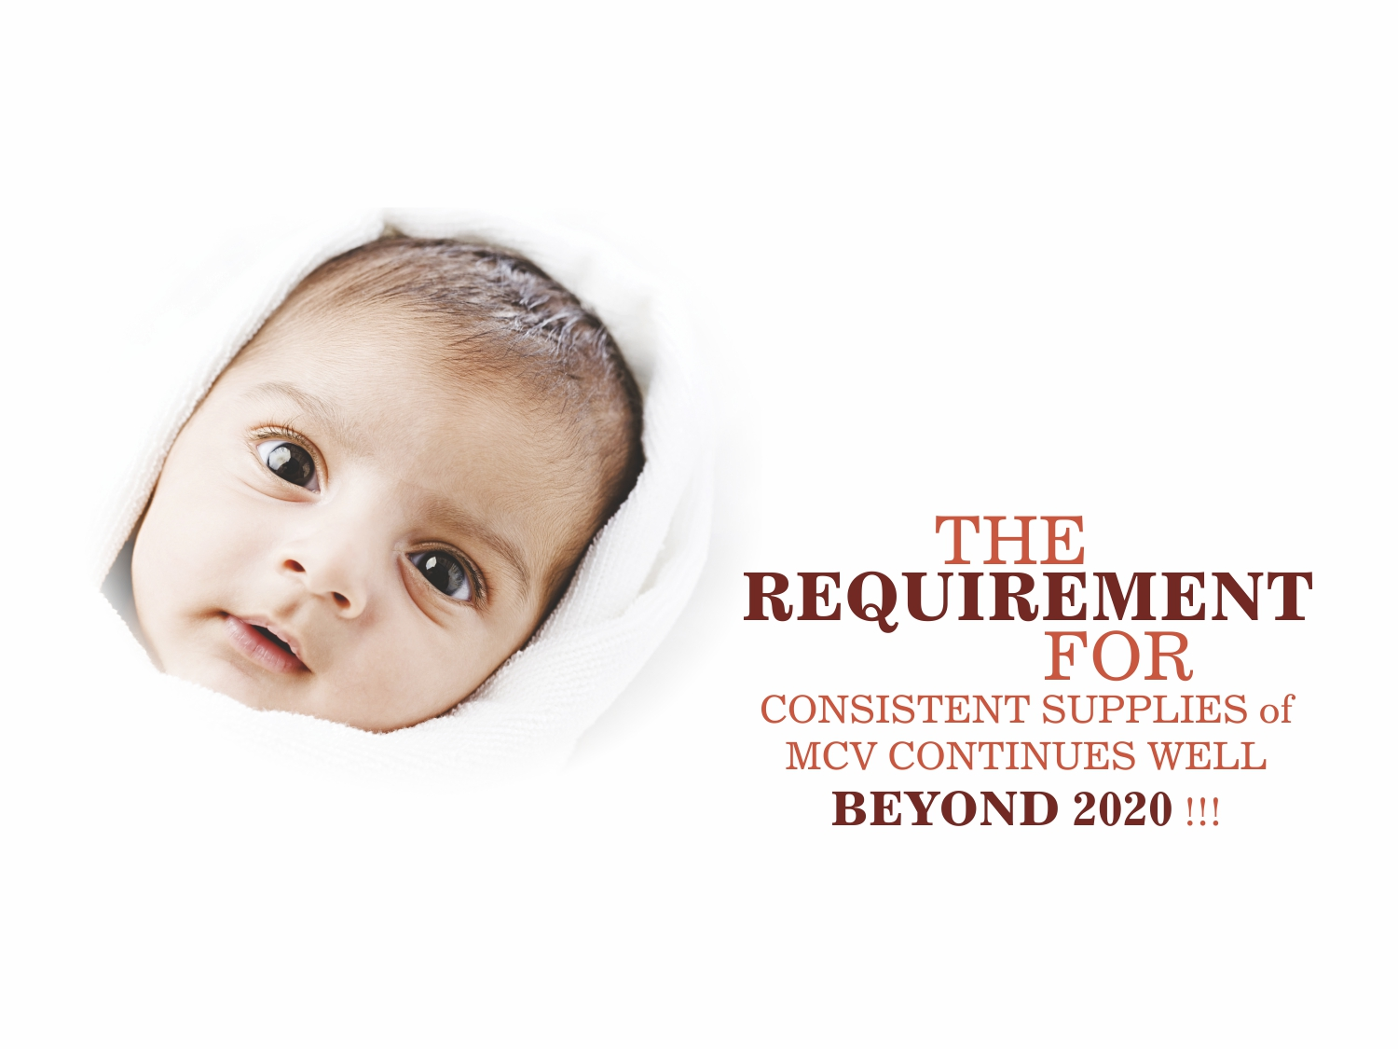

Slide 21
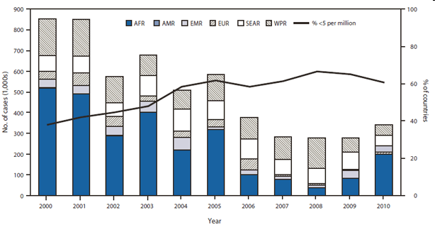
Reliable Supplies
MMR Group of Vaccines
SII is partner to Measles Rubella (MR) Initiative and catering to majority of UN supplies since Year 1993. Led to prevention of nearly 7.5 million deaths between 1999-2005. Measles deaths dropped by 75 % in Africa during this initiative.
Helped UN agencies to achieve goal of reducing measles death by 90 % in 2007, three years early.
Year 2009-10: 90 % of supplies to UN agencies was met by SII. 74 % drop in measles deaths world wide between 2000 and 2010
Looking forward to 2012–2020 Global Measles and Rubella Strategic Plan.
http://www.cdc.gov/mmwr/pdf/wk/mm6104.pdf

Slide 22
Commitment from SIIPL
Since last over 20 years, SII has supplied more than 5 billion doses globally containing Measles & Rubella Vaccine.
Production capacity: 600 million doses per annum for Measles & Rubella, in order to support the global elimination programme of these diseases.
Mass immunization campaign in Iran covered 33 million people in 1 month period without any safety issues.
Immunization campaign in Albania, incidences of measles and rubella infections significantly dropped after the mass immunization campaigns with this vaccine.
Measles was eliminated from South Korea after mass immunization campaign with this vaccine.

Slide 23
Other initiatives at SIIPL
To meet future demands, SII is investing heavily in creating huge infrastructure for continued production of this vaccine at a very high scale.
Preparations for offering 5 dose presentation along with the present 10 dose presentation is nearly completed. This would save lot of vaccine wastage and hopefully, improve immunization coverage.

Slide 24
Supply Challenges
Regulatory environment in certain countries.
Country Registration a prerequisite for supplies.
At times local clinical trials a prerequisite for granting registration.
Audit by the country authorities.
Country specific packaging.
The solution could be consideration for WHO PQ

Slide 25
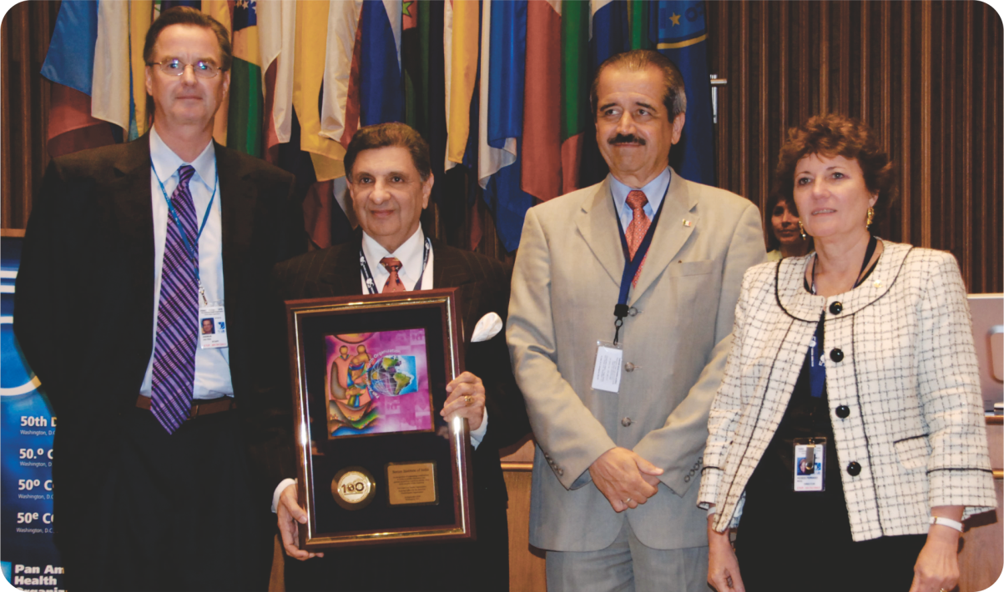
Rubella Eliminated in the America’s
The campaigns had a huge impact on Measles as well as preventing the re-establishment of endemic Measles virus transmission in the region.
Consistent supply was ensured by Serum Institute of India.
PAHO extended a special award to Serum Institute in Sept’2010.
America’s Rubella Free!

Slide 26
Thank YOU

