Slide 1
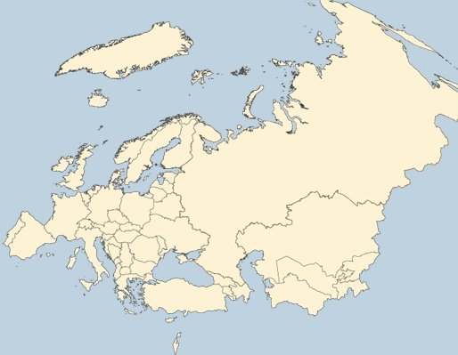
WHO European Region
53 Member States
  >900 million inhabitants
  Large cultural and social diversity
1

Slide 2
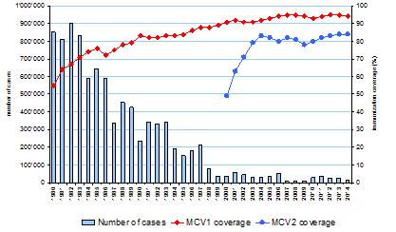
Number of measles cases and coverage with measles-containing vaccine, WHO European Region, 1980-2014
Data source: WHO/UNICEF JRF and CISID (as of 10 February 2014)
2
Notes:
With the widespread use of measles-containing vaccines there has been a dramatic decline in the number of measles cases in the last 3 and a half decades.

Slide 3
Measles in the WHO European Region,
1993, and 2007-2015*
341982
Bulgaria
21 664
France
14 966
Ukraine
12 744
Georgia
7868
Russian Federation
3264
Kyrgyzstan
17 779
1993
98 % REDUCTION
30604
33268
26786
32174
30 762
17782
7075
9168
7892
2007
2010
2011
2012
2013
2014
2015
2009
2008
*Data extracted 04 June 2016

Slide 4
Top 10 countries with measles cases, WHO European Region, 2015
88% of cases in the Region
in 4 countries
(n=27 085)
11 countries reported zero cases
*Data extracted 04 June 2016

Slide 5
Age distribution and vaccination status of measles cases, 2015*
Age known in 10 630 cases (35%)
*Data extracted 04 June 2016

Slide 6
Measles outbreaks occurred in several susceptible populations
Roma and Sinti communities
Susceptible adults
Unvaccinated adolescents
Traveller communities
Unvaccinated children
Health care workers
Orthodox protestant communities
Followers of anthoposophy
Ultra-orthodox jewisish communities

Slide 7
Rubella in the WHO European Region,
2000 and 2011-2015*
621 039
Romania
4805
Romania
20 773
Poland
38 585
Poland
5899
Poland
2029
98 %
REDUCTION
29618
39 554
2368
9464
6516
2000
2014
2011
2012
2013
2015
*Data extracted 04 June 2016

Slide 8
Countries with rubella cases, WHO European Region, 2015*
86% of cases in the Region
in 1 country
(n=2029)
21 countries reported zero cases
*Data extracted 04 June 2016

Slide 9
Monthly distribution of rubella cases, WHO European Region, 2015
92% of cases in the Region
(n=2259)
*Data extracted 04 June 2016

Slide 10
Diagnosis classification of reported rubella cases in top four countries, 2015
10

Slide 11
the challenges

Slide 12
1. High vaccination coverage
2. Closing Immunity gaps
Commitment
3. High-quality surveillance
4. Knowledge and training

Slide 13

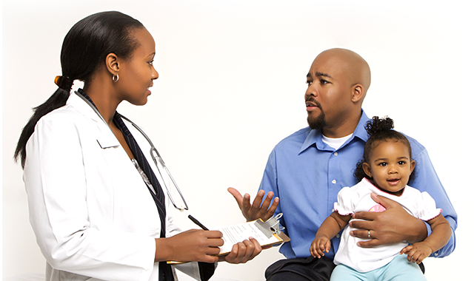
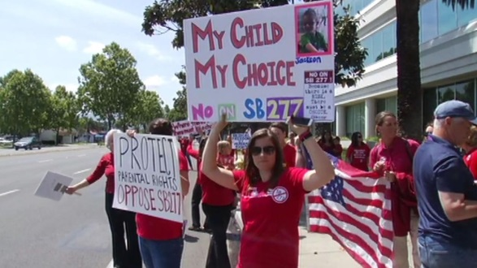
Challenge no. 1
Reaching and maintaining high vaccination coverage
Delayed vaccination
Vaccine hesitants
Lost to follow up
Vaccine refusals
Distrust in vaccines
Previously not targeted for vaccination
Distrust in health authorities
Lack of access
13

Slide 14
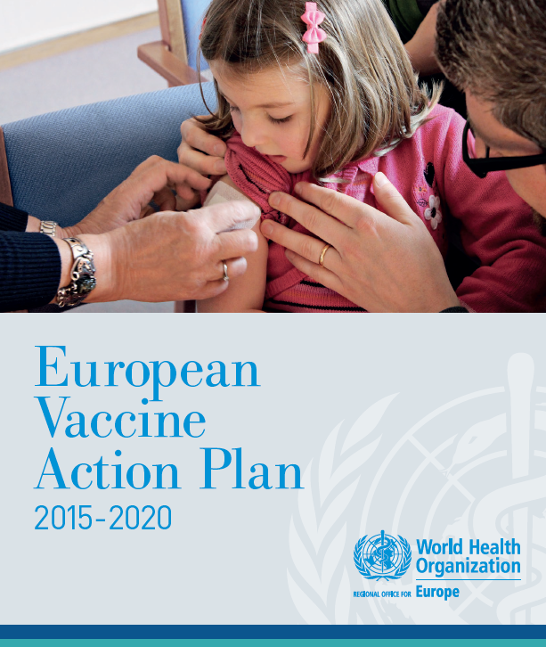
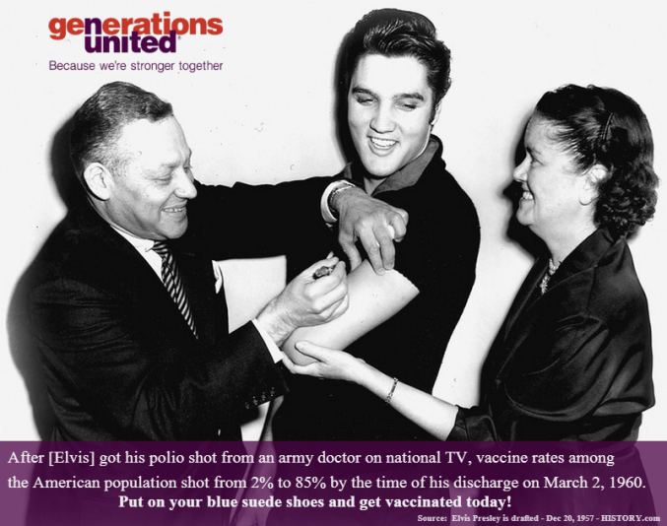
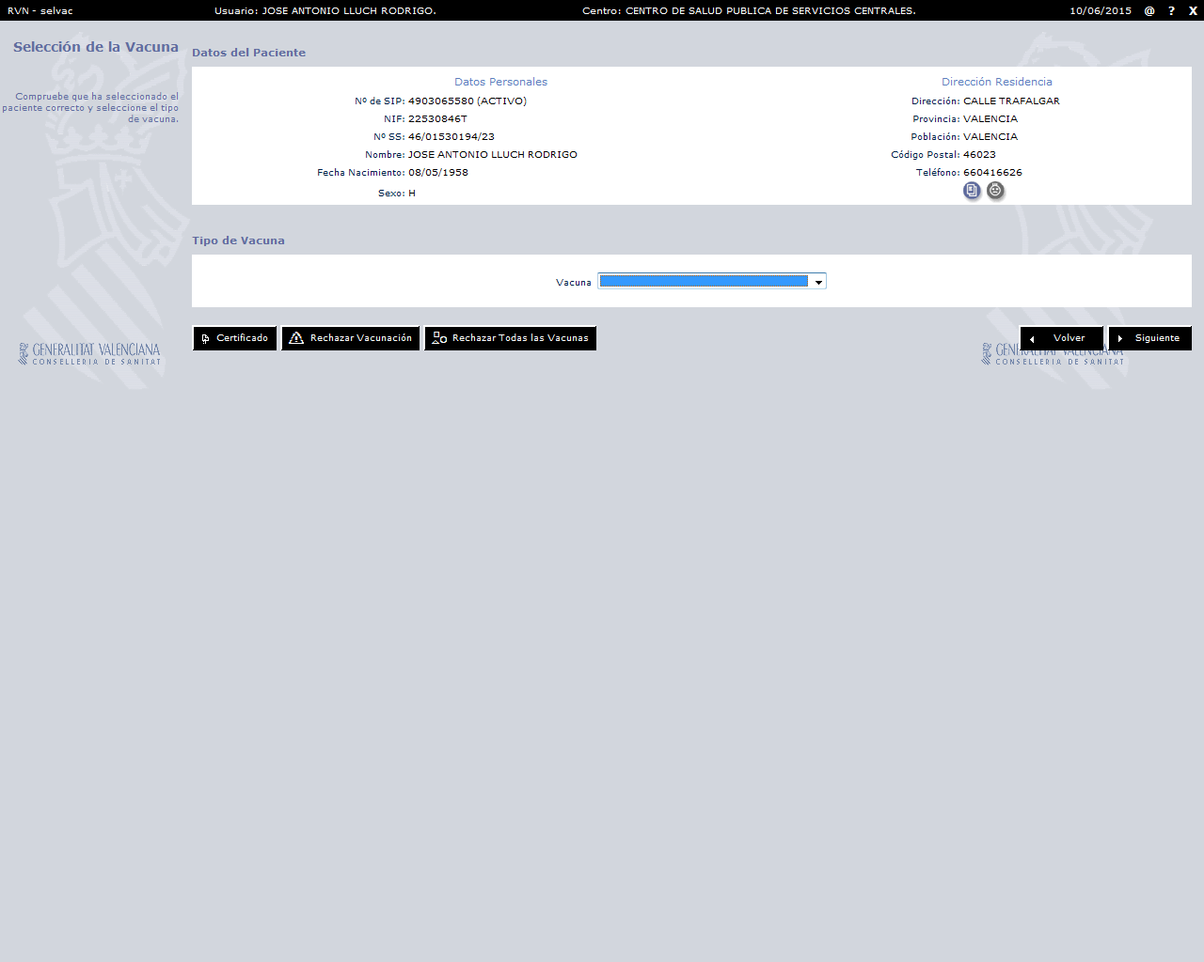
Addressing the challenge
Reaching and maintaining high vaccination coverage
Strengthem immunization programmes
Electronic vaccination registry
Reminder and recall systems
Champions and experts as advocates
14

Slide 15
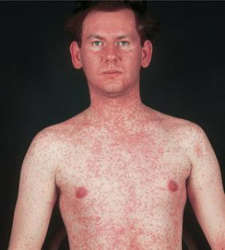

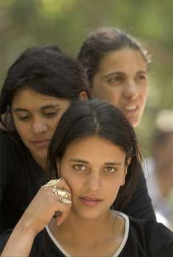
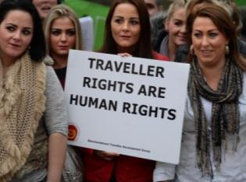
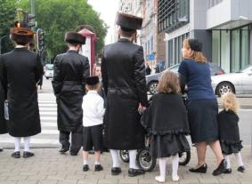
Challenge no. 2
Closing immunity gaps
Susceptible adults
Unvaccinated adolescents
Susceptible health care workers
Low coverage communities

Slide 16
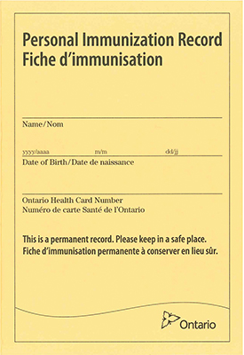
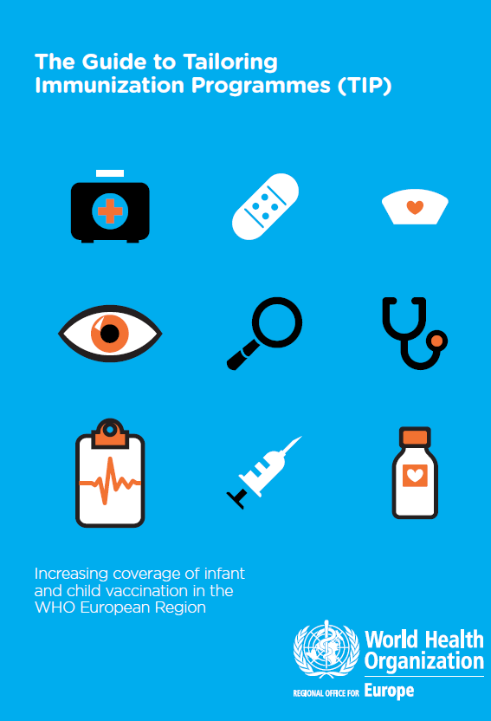
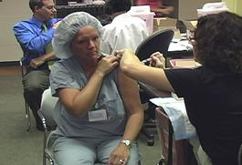
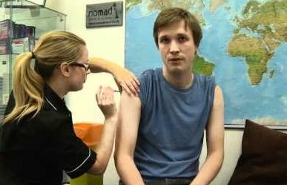
Addressing the challenge
Closing immunity gaps
Supplementary immunzation activities
Tailoring Immunization Programmes
Pre-school entry policies
Health care workers policies
Opportunity vaccination
Pre-travel vaccination

Slide 17
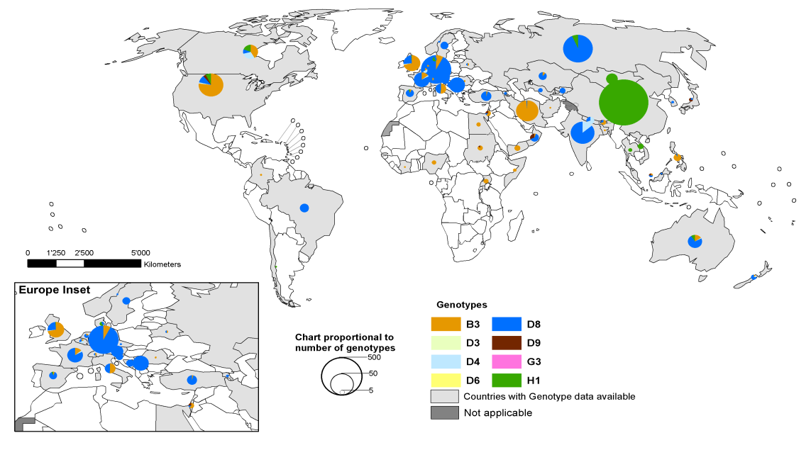
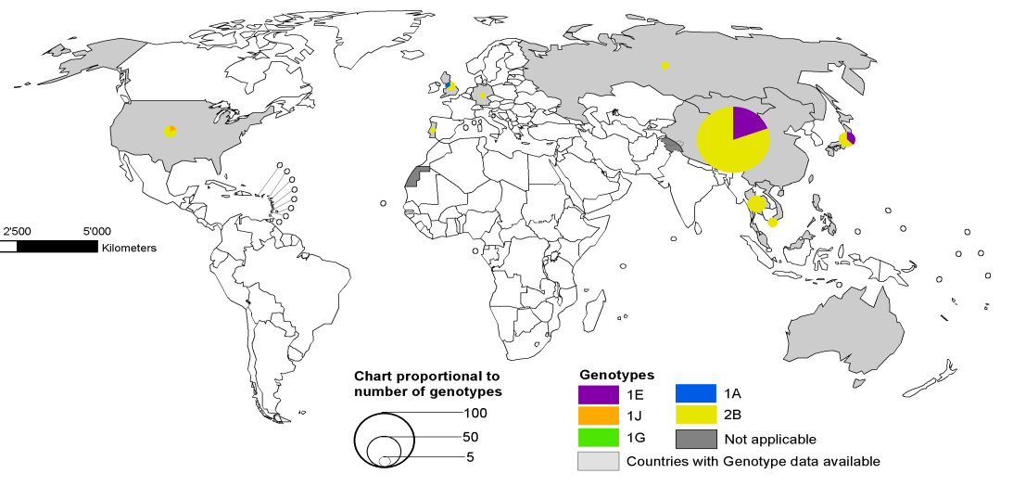
Challenge no. 3
Performing high-quality surveillance
Inadequate reporting of suspected cases
Sub-optimal laboratory testing rate
Distribution of rubella genotypes
year 2015
Measles
No genotyping and sequencing
Lack of national operating procedures for epidemiological and laboratory investigations
Rubella

Slide 18
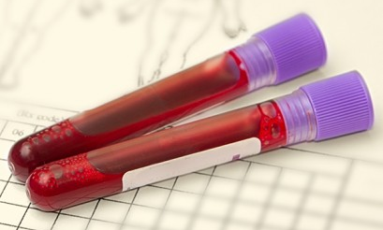
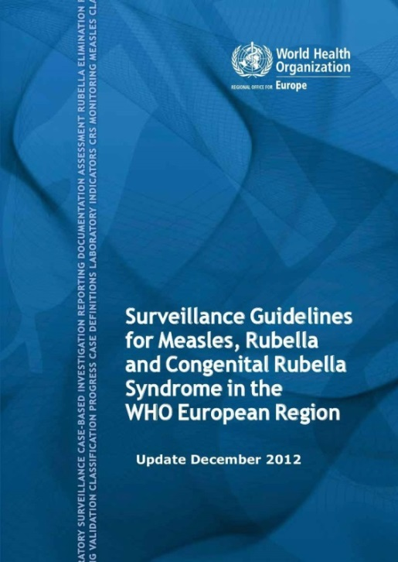
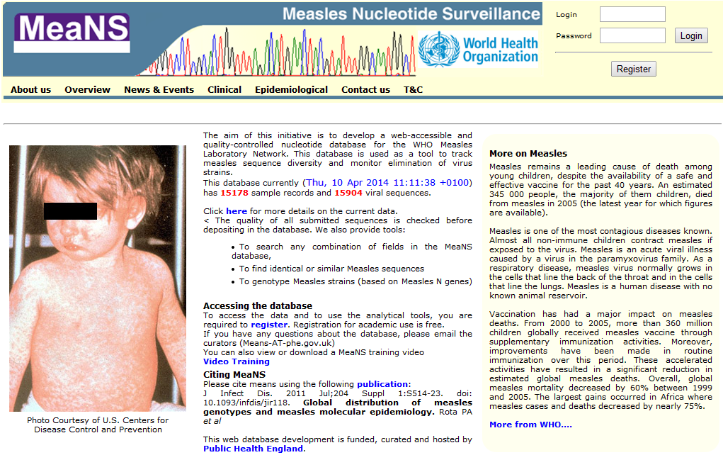
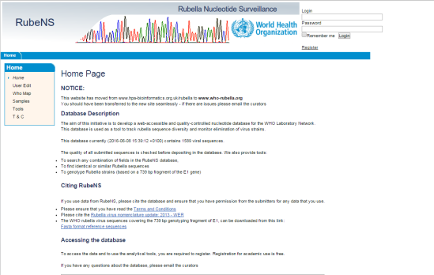
Addressing the challenge
Performing high-quality surveillance
Reporting of suspected cases
Epidemiologial investigation
Laboratory confirmation
Genotyping and sequencing
Establishing national operating procedures for epidemiological and laboratory investigation
Notes:
Testing of suspected cases
Complete epidemiological investigation for relevant information such as travel history and vaccination status
Submit clinical specimens for laboratory confirmation
Clinical specimens of positive cases of measles AND rubella submitted for genotyping and sequencing

Slide 19
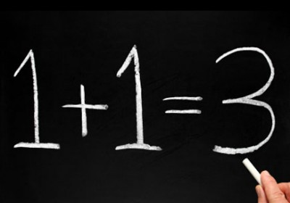

Challenge no. 4
Knowledge and training
Widespread misinformation and myths
Vaccine side-effects are worse than the actual disease
Lack of education and training on vaccines in medical curricula
MYTH
False contraindications
Lack of information
The MMR vaccine casues childhood disorders, including autism
Lack of personal knowledge and disease awareness
MYTH
Sophistication of anti-vaccine lobbying and media skills

Slide 20


Addressing the challenge
Knowledge and training
Web-based information on diseases and benefits of vaccines
Medical curricula
Continued medical education
Training in communication
School-based learning
Health care workers to promote vacines
Champions and experts as advocates

Slide 21
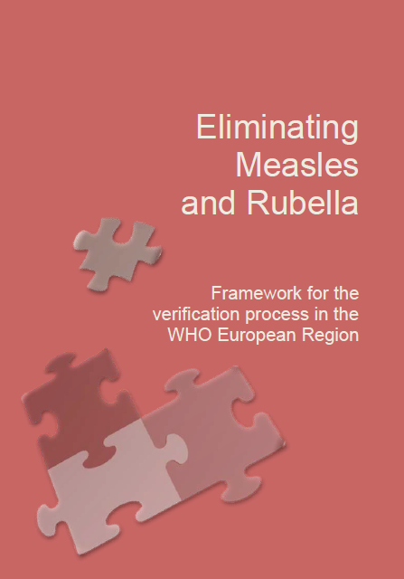
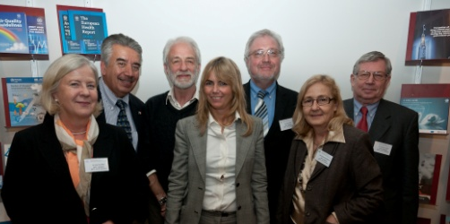
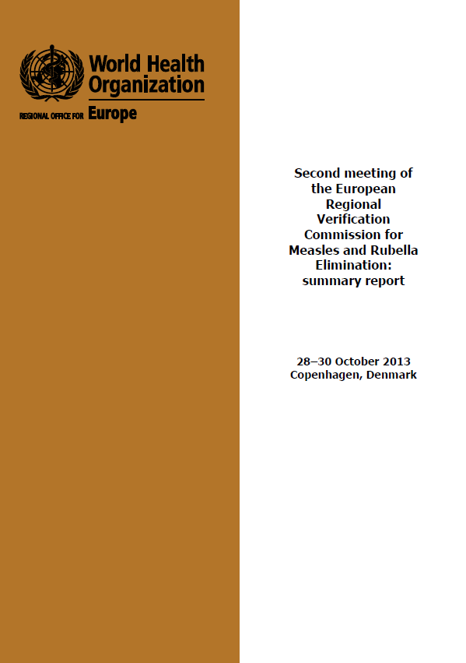
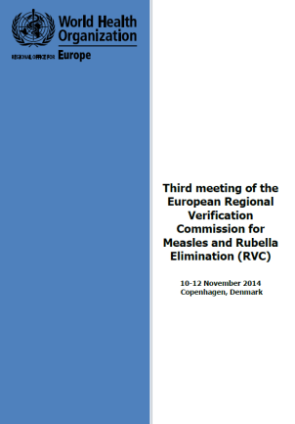
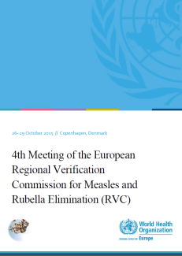
Verification of Measles and Rubella elimination
Regional Verification Commission (RVC) established 2012
4th RVC meeting, November 2015
Evaluation of Country Annual Status Updates and feedback to countries
Meetings with National Verification Committees
Modifications to verification process
Updating of annual reporting form
Messaging and communication
21

Slide 22
Summary
Progress has been made toward eliminating measles and rubella
WHO European region “off track” for 2015 goal
More action needed:
    Commitment
    Maintaining high vaccination coverage
    Closing immunity gaps
    High-quality surveillance
    Foster partnerships
22

