Slide 1
Measles and Rubella Initiative Financial Resource Requirements for 2015-2020
Measles and Rubella Annual Partners Meeting, September 15-16 2015

Slide 2
Background
The MRI FRR is developed by the M&RI FRR/RMAWG
Country population data is drawn from UNDP estimates
Vaccine type and timing of SIAs is from countries cMYPs.
Vaccine and devices costs are projected from UNICEF SD data
Operational cost data is generated from >10 yrs of M&RI experience in 88 countries.
FRRs are reviewed and updated biannually to reflect changes.
Data for this FRR is as of June 2015

Slide 3
Donors to Measles and Rubella Initiative, 2001 - 2014

Slide 4
GAVI’S COMMITMENT TO MEASLES and Rubella
Measles-Rubella Catch up campaigns for children aged 9 months to 14 years
Measles follow up campaigns 6 high risk countries (Afghanistan, Chad, DRC, Ethiopia, Nigeria, Pakistan) for children aged 9 – 59 months
Outbreak response fund to Measles Rubella Initiative (US$ 55m through to 2017)
Routine Measles second dose for (duration of 5 years)

Slide 5
Overview of the 2015-2020 FRRs
The 2015-2020 FRRs are the projected cost estimates necessary to support the Global Measles & Rubella Strategic Plan 2012-2020.
As of Jun 2015 data, M&RI estimates FRRs budget of $2.6 billion for the period 2015-2020 to further advance measles, rubella, and CRS control in the 77 focus countries. Annual costs peak at $662 million in 2016 and declining to $276 million in 2020.

Slide 6
These FRRs have 7 major cost categories
Measles/Measles Rubella (MR) “Follow Up” SIAs (23%)
MR Catch-up campaigns (57%)
Surveillance and Laboratory (4%)
Outbreak Preparedness and Response (3%)
Communication (0.26%)
Research and Development (0.39%) and
Core Functions: modest RI support & Human resources (10%).

Slide 7
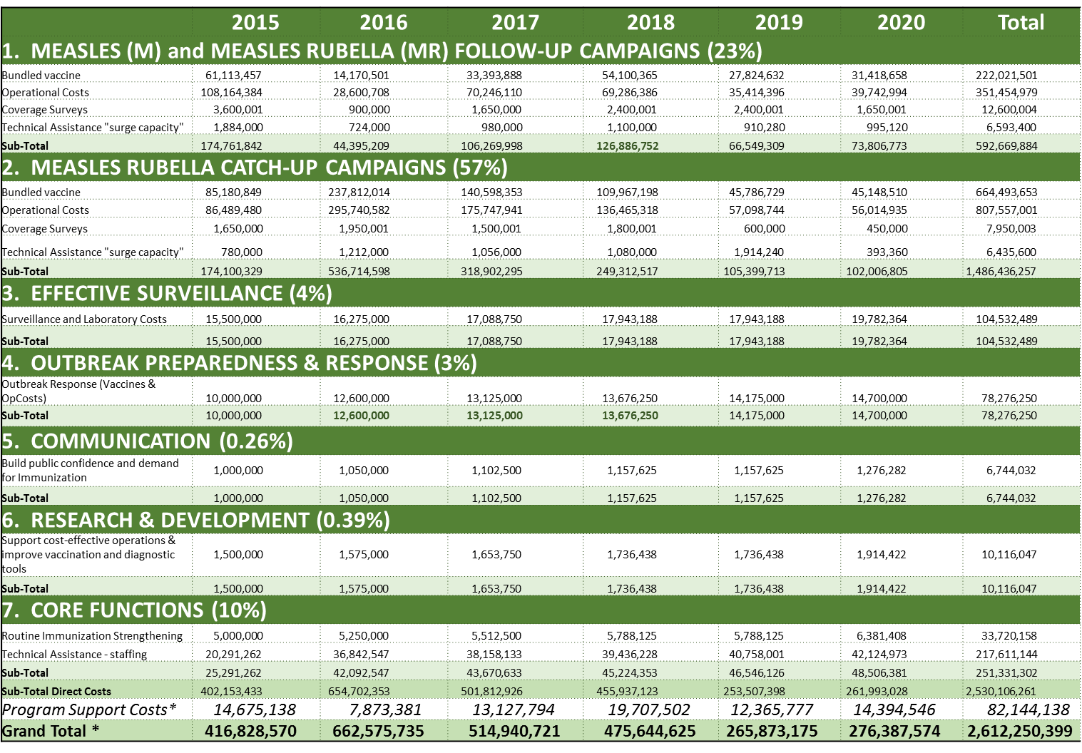
Summary of resource requirements by major category of activity, 2015-2020

Slide 8
Budget by Major Category and sub categories, 2015-2020 (US$)

Slide 9
Why Measles and Rubella and Why these huge sums?
Measles and Rubella exert tremendous socio-economic toll:
  Africa: it has been documented that medical costs can equal one month of family income
  Re-infected countries: maintaining elimination means US$5,000 to 50,000 per outbreak case on treatment and outbreak investigation cost
  Rubella: lifetime costs for chronic care per case of Congenital Rubella Syndrome (CRS) range between $11,300 for low income countries to $934,000 for high income countries.
  Maintaining high control is very costly: estimated at >$8 billion per year, meaning that time limited global elimination has enormous returns.

Slide 10
Pledged and Expected Contributions

Slide 11
Expected Contributions and Funding Gap, 2015- 2020

Slide 12
Challenges and way forward
Challenge in securing timely national government funding and the promotion of sustainability through domestic resource allocation
Need to further streamline information flow from countries to regions/ global levels
Frequent changes in the SIAs schedule & target population
Need for Prog. innovations, further improve quality of immunization activities and accountability
Gavi new measles and rubella strategy
Costing of measles elimination/eradication and investment studies

Slide 13
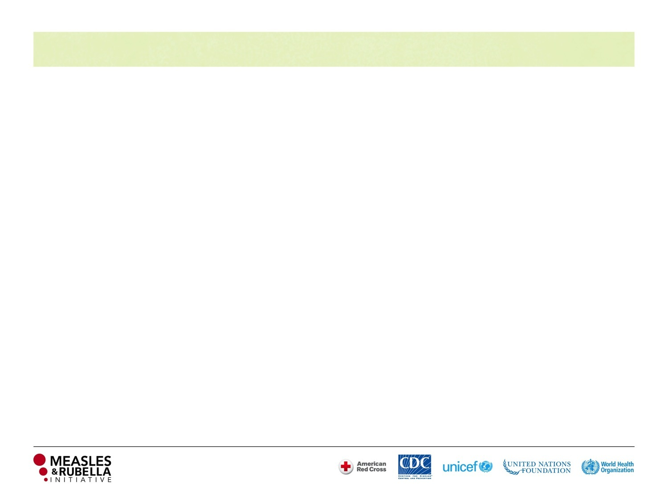


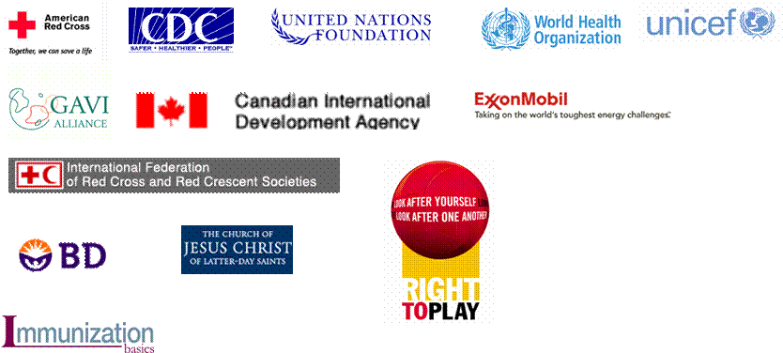

















Anne Ray Charitable Trust

