Slide 1
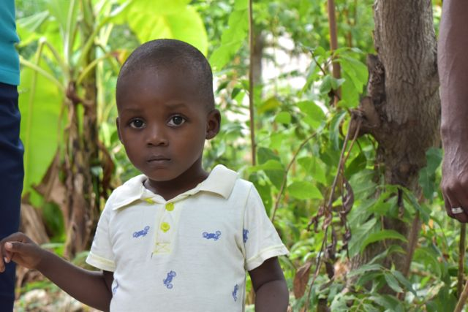

______________________
Emilee Gibson
From Campus to Capitol Hill
September 7, 2017

Slide 2
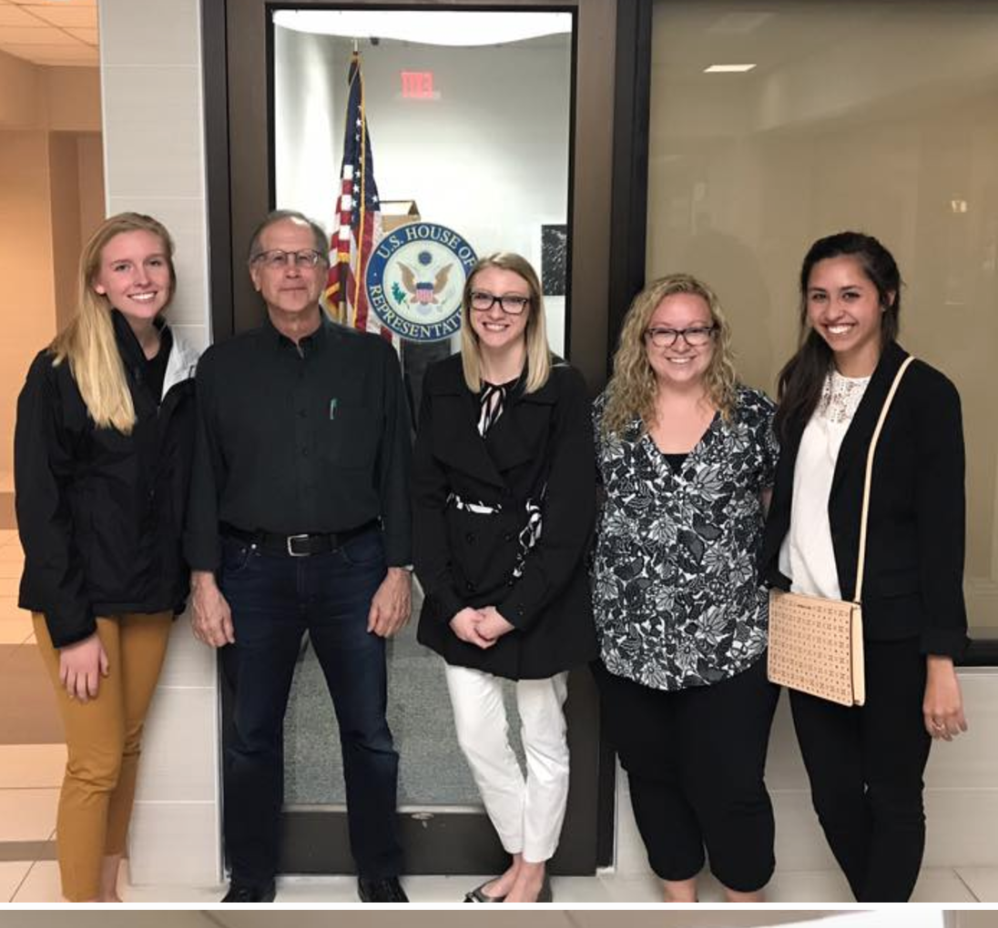
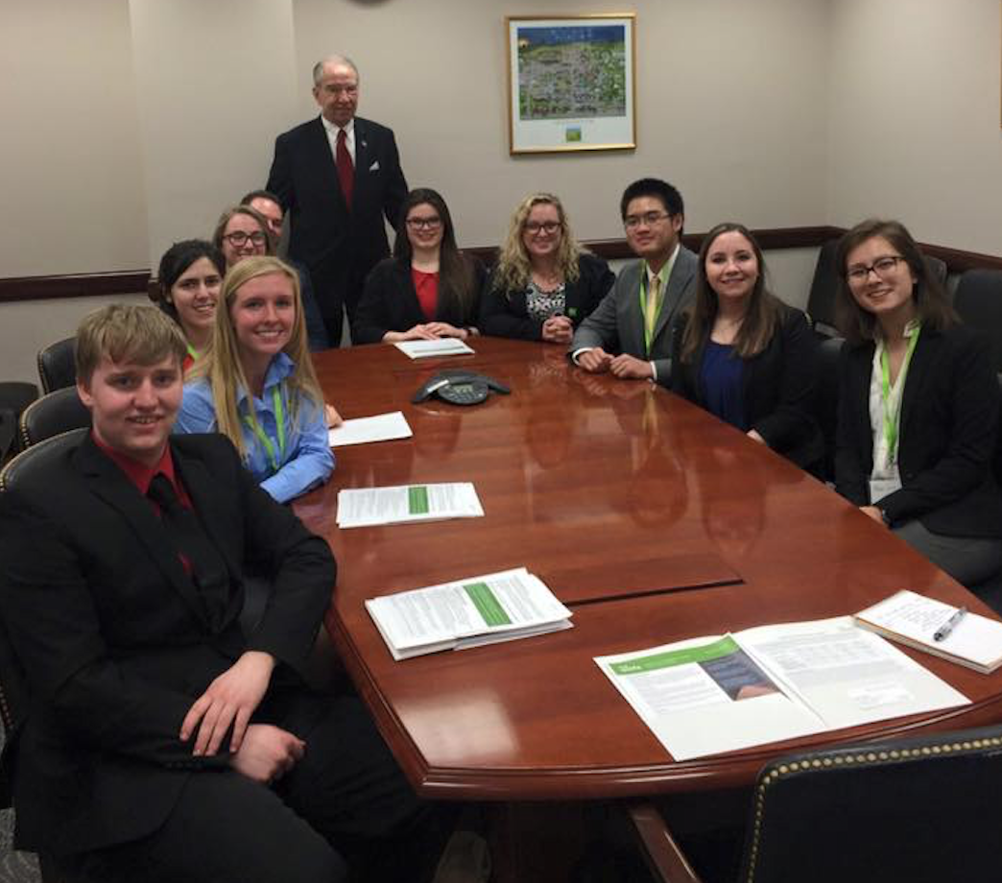
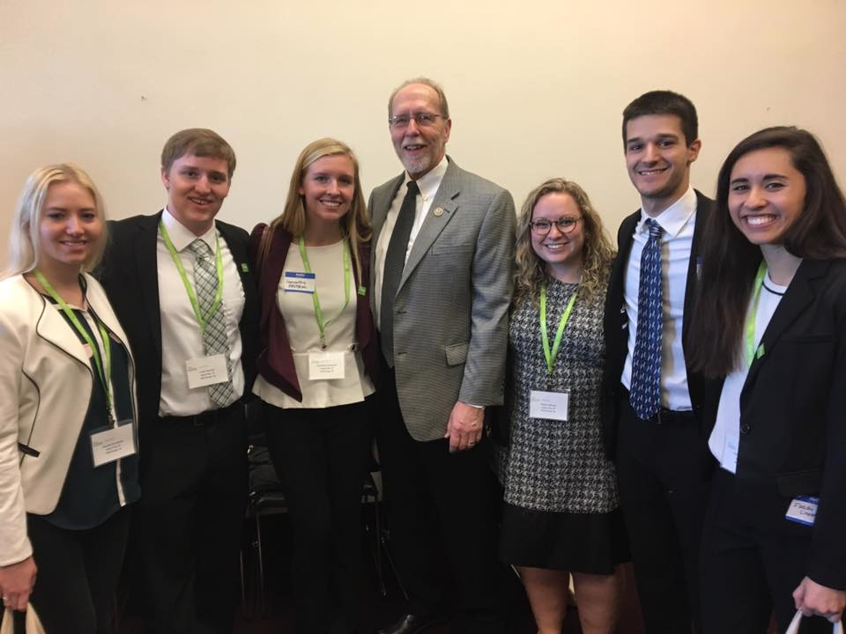
Shot@Life’s 2016 Champion Summit:
Kicking off large-scale advocacy efforts

Slide 3
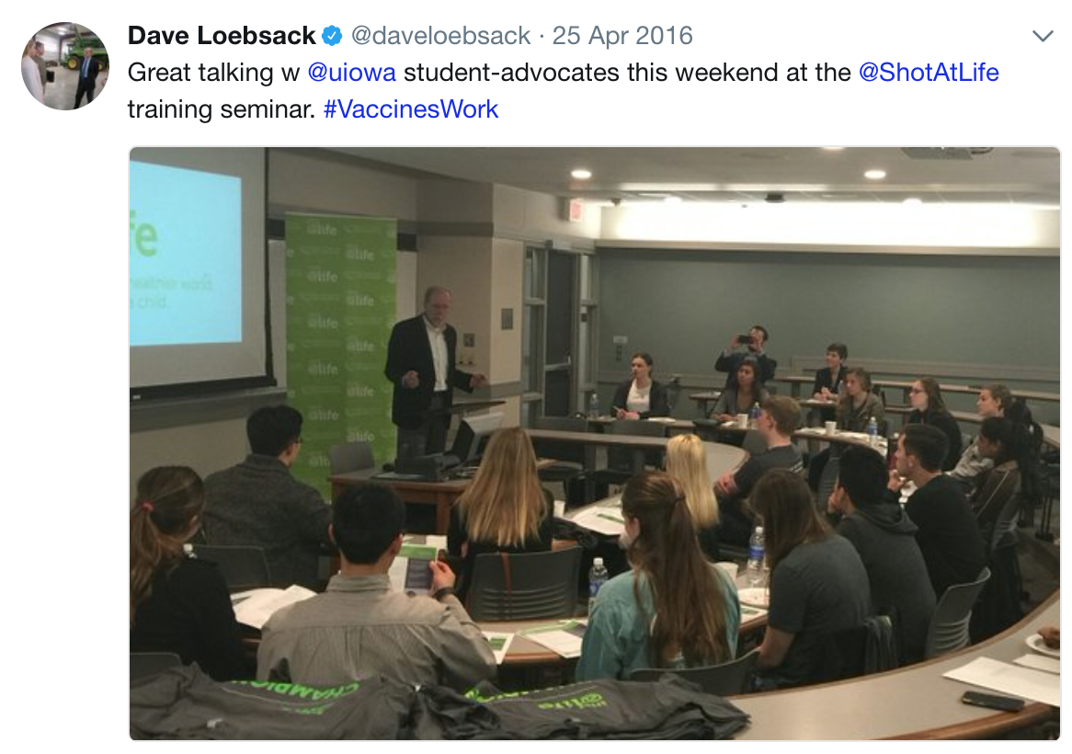
University of Iowa on- campus advocacy training and meeting with Rep. Dave Loebsack

Slide 4
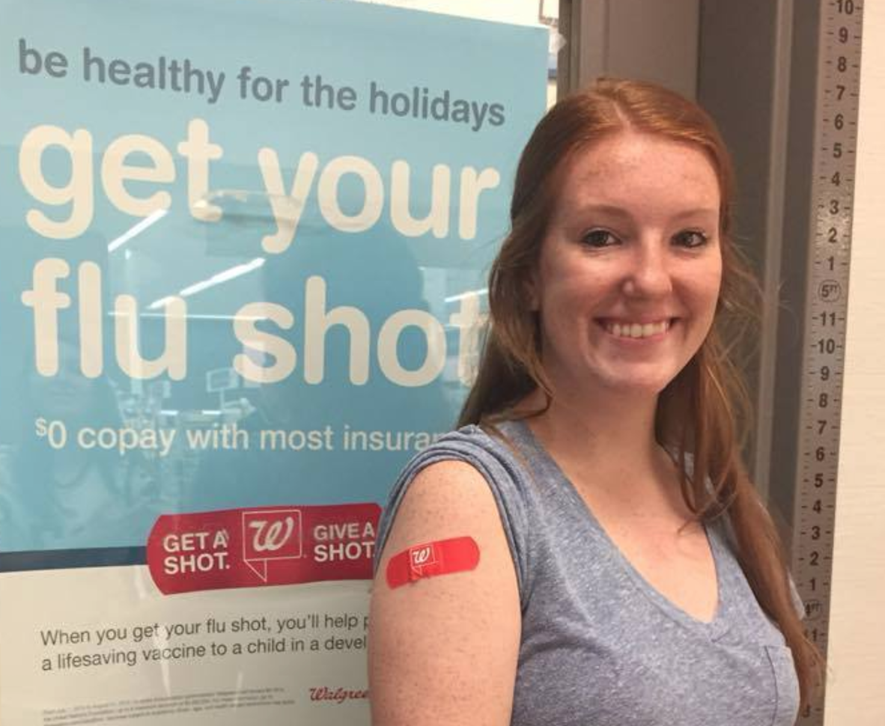
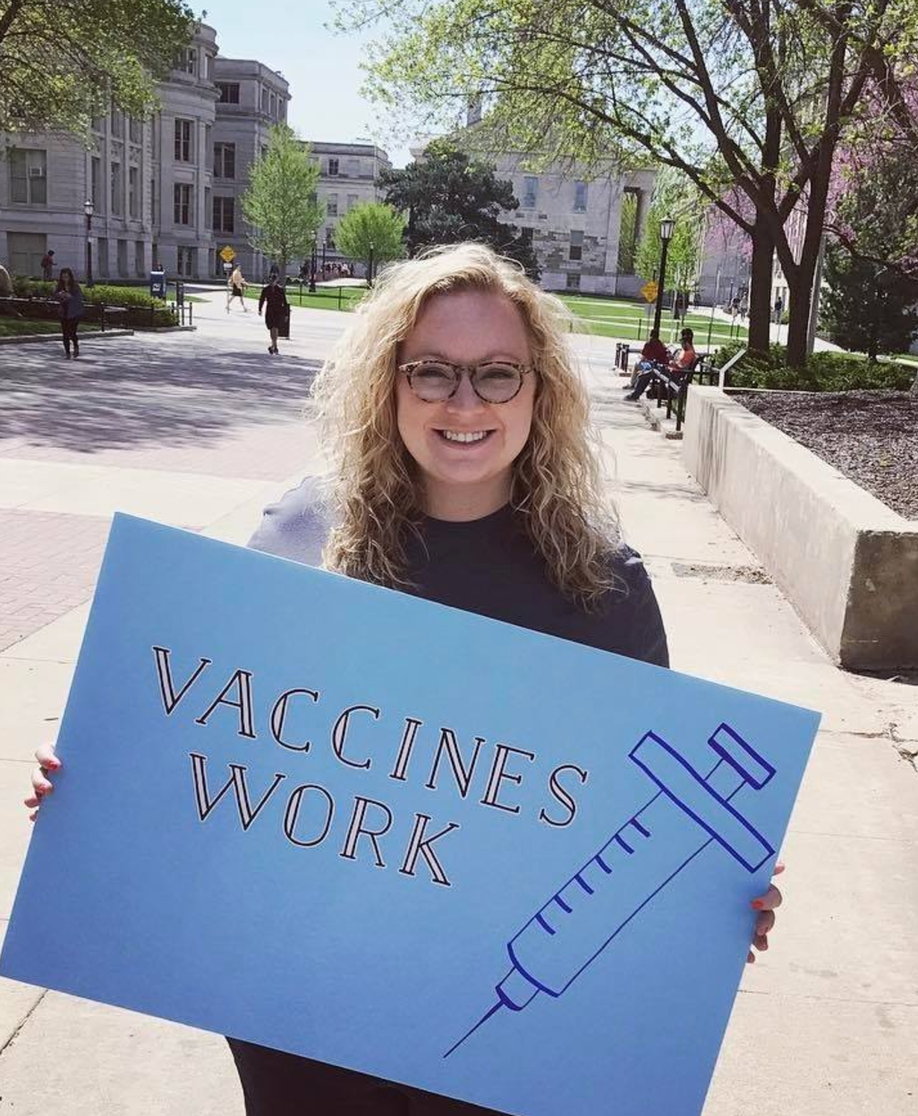
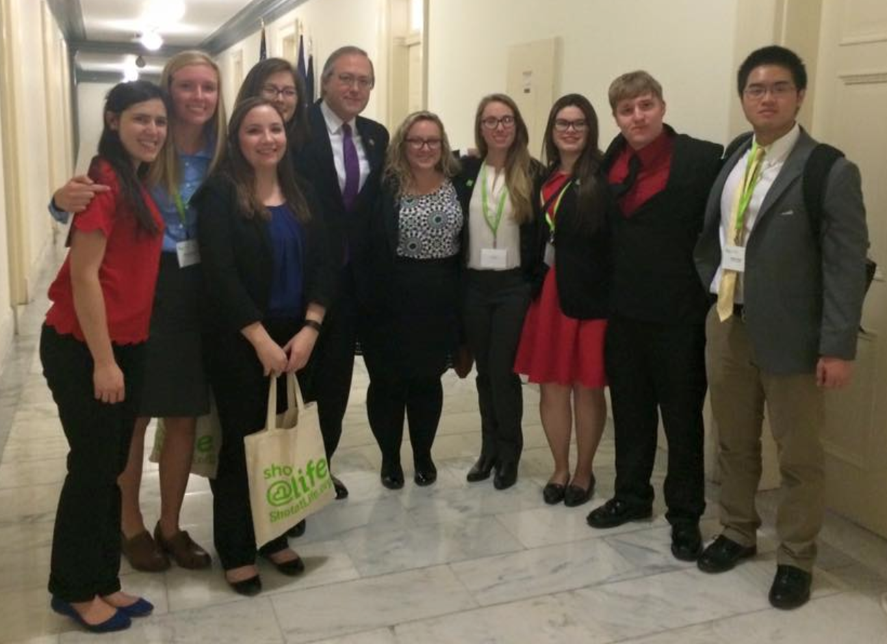
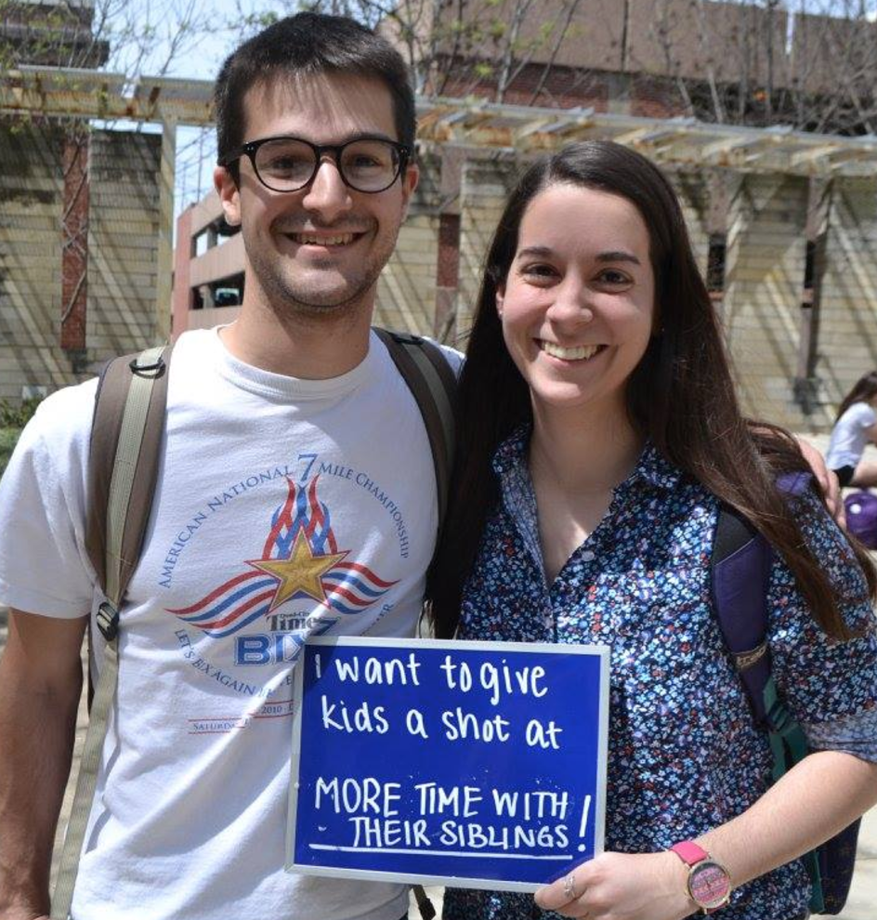
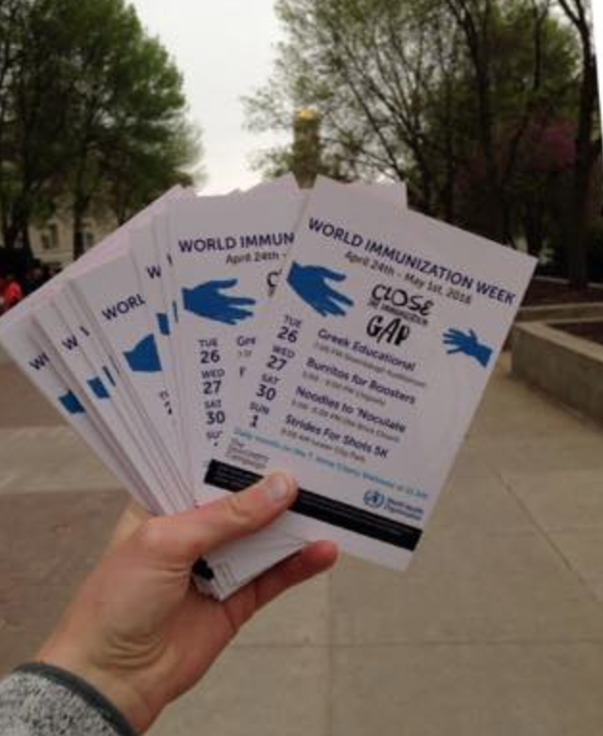
Plugging trained advocates (champions) into the activities they enjoy

Slide 5

Results after two years of focused advocacy:
Shot@Life champions in Iowa are seen as a resource to Congressional offices, even known as “the vaccine people” to some of the office staffers
Iowa’s members of Congress have moved on this issue, some from neutral to very supportive, others from oppositional to neutral
Iowa has a consistent presence on this issue, continuously engaging and training new advocates to ensure a consistent stream of contact with Congressional offices

Slide 6
______________________
Emilee Gibson
From Campus to Capitol Hill
emilee-gibson@uiowa.edu

