Slide 1

Gavi’s Measles and Rubella Programme
M&RI Partners’ Meeting
Michael F Thomas,
Director Vaccine Implementation
September 2017, Washington DC
Reach every child
Notes:
- Introductory remarks by Michael

Slide 2



Measles and Rubella support in Gavi countries by end of 2016
Measles and Measles-Rubella 2nd dose
21 countries
>41 million people immunised
Measles-Rubella catch-up campaigns*
20 countries
>196 million people immunised
Measles follow-up campaigns
6 countries, 9 campaigns
>132 million people immunised
*with catalytic support for routine introduction of MR 1st dose (provision of VIG)
Notes:
Successes of the Gavi programme to date; by the end of 2016, under these 3 historical support windows, Gavi had supported:
For Measles or Measles-Rubella 2nd dose, Gavi had supported 21 countries and over 41 million people immunised
For Measles-Rubella catch-up campaigns, 20 countries and over 196 million people immunised
And for Measles follow-up campaigns, 9 campaigns in 6 countries, with over 132 people immunised.

Slide 3
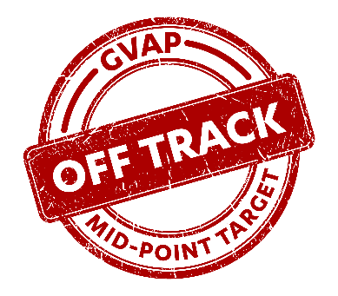
Nonetheless, MCV1 coverage has stagnated in Gavi countries
MCV1
78%
MCV1
coverage
range:
20-99%
MCV2
50%
“recommends focusing on improving ongoing immunization systems -- although this may delay reaching measles and rubella elimination goals -- in order to ensure that gains in measles and rubella control can be sustained”
Measles and Rubella Global Strategic Plan 2012-2020 Midterm Review
Source: Gavi; WHO/UNICEF vaccination coverage estimates, 2016 revision, July 2017; Weighted coverage for Gavi 73 countries
(Date of slide 11 August 2017)
#vaccineswork
Notes:
Despite these Gavi investments and broader comprehensive global efforts from the Measles & Rubella Initiative, MCV1 coverage has remained stagnant at 78% for the past few years; MCV2, while increasing as new countries introduce it, lags behind MCV1 in most of the countries that have introduced it
As indicated by the Midterm Review, as we move forward, we must shift towards a focus on the improvement of routine immunisation systems….

Slide 4

Gavi’s new Measles and Rubella Strategy: Best pragmatic return on investment
Principles
- Measles control: an important step on the continuum towards elimination
- Gavi support should be to contribute to countries along this continuum through improved disease control
- Gavi’s estimated investment for 2016-2020 is ~US$ 1 billion
Increased
country ownership
Routine immunisation strengthening
Programmatic and
financial sustainability
- Measles is the ‘canary in the coalmine’
- More than 95% of measles deaths occur in countries with low per capita income and weak health systems
#vaccineswork
Notes:
Gavi will have invested approximately US$ 1.5 billion in measles and rubella by 2020, and we seek a pragmatic return on this investment by working on increased country ownership, routine immunisation strengthening, and programmatic and financial sustainability.
We would like to support countries to enable them to achieve sustainable control and elimination when the world is ready for an eradication goal.
This needs a sound health system, centered on attaining a high routine vaccine coverage, complemented by targeted campaigns.

Slide 5
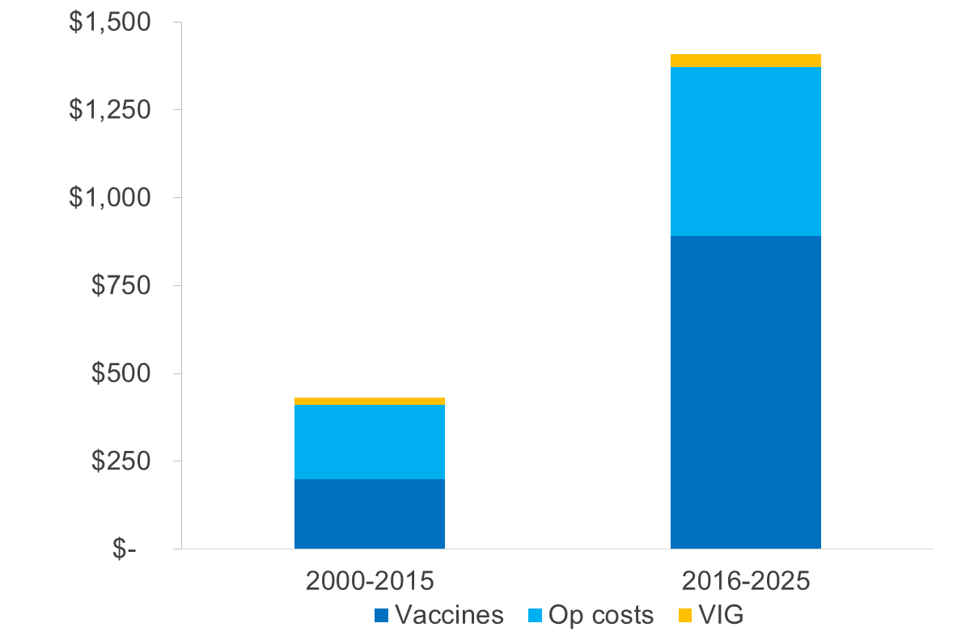
Gavi investments in Measles and Rubella programmes, 2000-2025
Gavi expenditure (US$ million)*
**
*Does not include expenditure/investments through the Partners Engagement Framework (Foundational Support or Targeted Country Assistance)
**2016-2025 includes India and Indonesia MR campaigns in 2017 (US$115M and US$31M resp.)
Source: Gavi, the Vaccine Alliance (Financial Forecast v14.0 / Dec 2016).
Notes:
This slides demonstrates the large investment in measles and rubella in 2016-2025 period, amounting to close to US$1.5 billion, a steep increase from the ~US$500k for the 200-2015 period

Slide 6
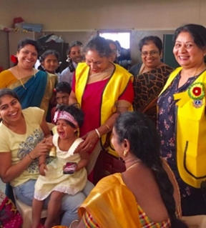
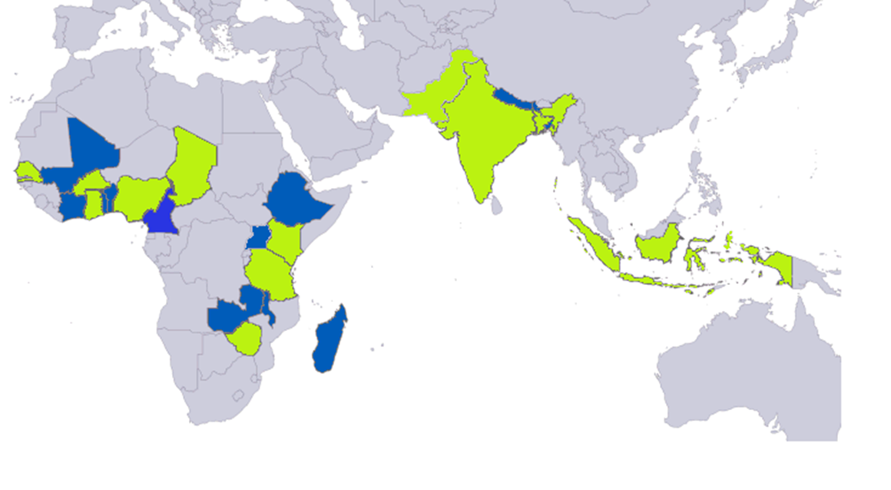
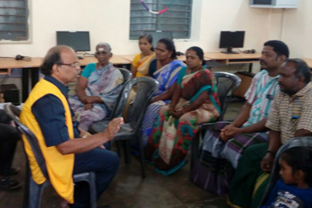
Gavi & LCIF Partnership: Social Mobilisation
LCIF Social Mobilisation Campaigns in Gavi-supported Countries (2013-2017)
Joint Gavi-LCIF SM activities (13)
Lions-led SM activities
38 social mobilisation campaigns by the end of 2017
Notes:
M&RI is premised on the fact that partnerships are critical to achieving strong coverage of measles and rubella vaccines. Gavi and Lions Clubs International Foundation have been working in partnership to help move the needle on this strategy.
The partnership between LCIF and Gavi is guided by a three-pronged approach that combines resource mobilization, advocacy and partnership awareness, and social mobilization to fight measles around the world.
As the world’s largest service club organization, LCIF has committed to:
Raise USD $30 million during the 2014-2017 period for the purchase of measles and measles-rubella vaccines (MR), supporting introductions and campaigns (SIAs)
This helps leverage an additional USD $30 million contribution through the Gavi Matching Fund in support of Gavi’s measles programs
Tap into LCIF’s global network of donors and volunteers in implementing countries to increase awareness of the benefits of measles vaccines and routine immunisation and advocate for increased funding
Engage local Lion’s clubs in social mobilization activities designed to address barriers affecting low immunisation coverage through community service and locally driven, interpersonal advocacy and communication to increase awareness of and participation in measles and measles-rubella campaigns
The partnership with LCIF is unique because it’s not just LCIF’s incredible financial commitment to beat measles and rubella. But LCIF’s vast network of volunteers who are leaders in their communities are able to raise awareness of the benefits of vaccines, and actually increase demand for many of the measles and rubella campaigns that Gavi supports.
This slide is a snapshot of all the countries LCIF has worked on social mobilization campaigns throughout our partnership.
In countries around the world, LCIF has helped Gavi, UNICEF, WHO, and many other critical partners of M&RI achieve great outcomes for MR campaigns, through SMS messaging, mass media campaigns, door to door outreach, and stakeholder coordination among many other activities. Ministries of Health have noted their ability to reach marginalized communities, increase demand for vaccinations, and build greater awareness within local communities about the benefits of immunization.

Slide 7
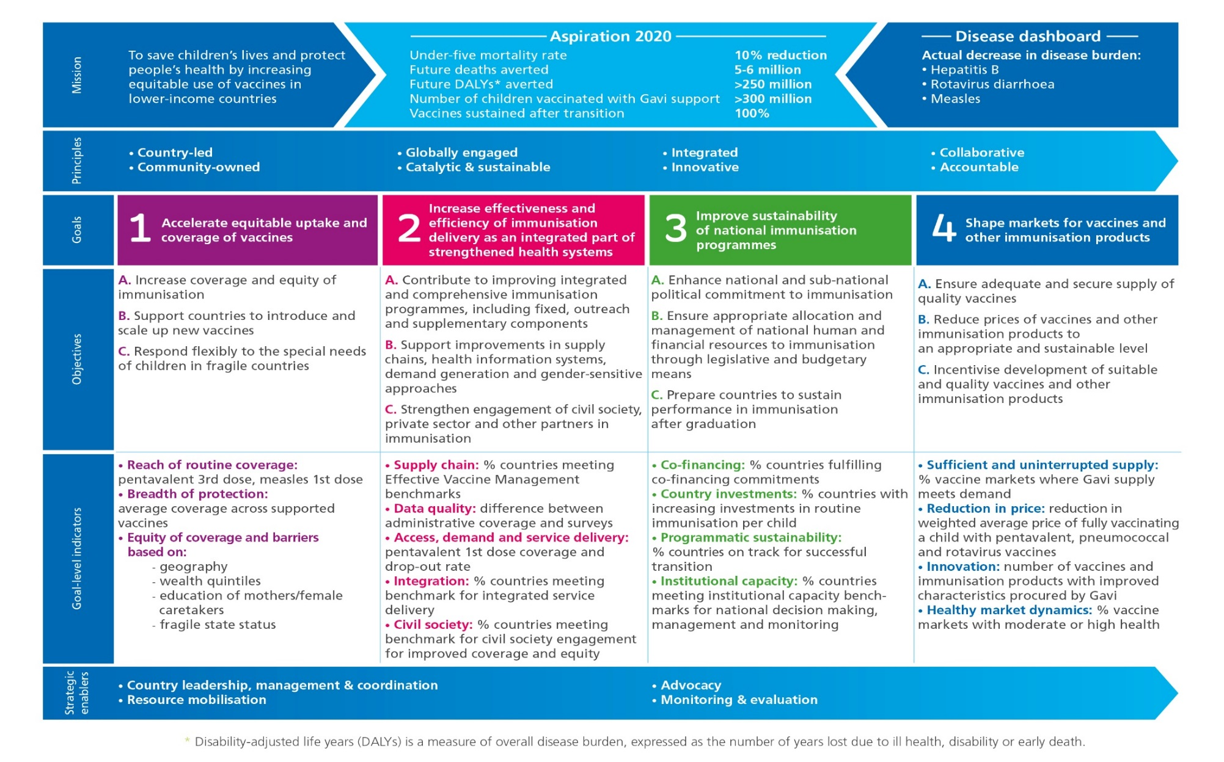
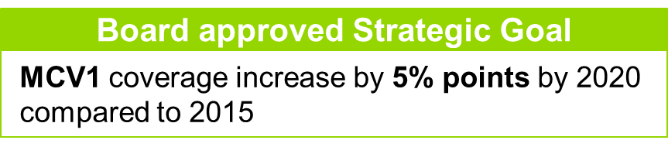
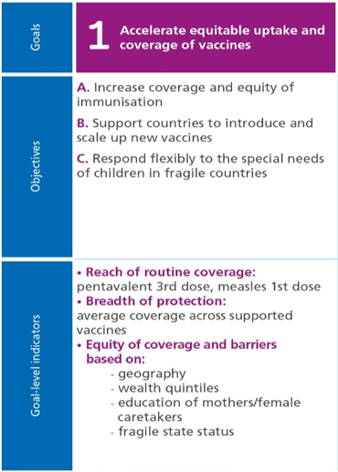
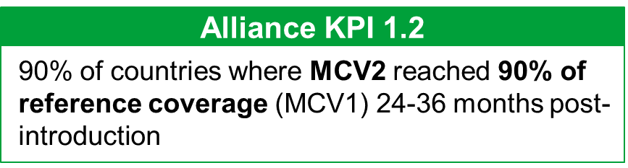
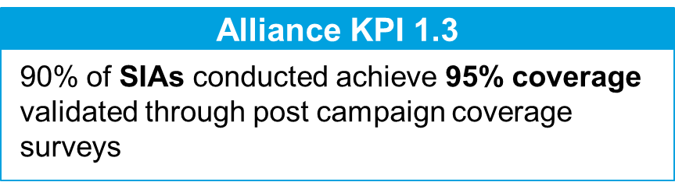
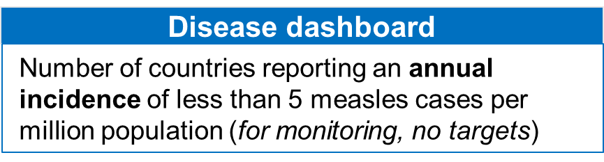
Gavi, the Vaccine Alliance strategy, 2016-2020
Renewed focus and shared accountability on Measles and Rubella
#vaccineswork
Notes:
- The Gavi strategy for the 2016-2020 period places a renewed focus and aims for shared accountability on Measles and Rubella across the Alliance; CLICK
Strategic Goal 1 in particular focuses on the coverage and equity of immunisation;
As part of this Strategic Goal, there are 4 Measles and Rubella-related indicators as outline on the slide
Strategic Goal on MCV1, which aims for a 5% point increase by 2020
Key Performance Indicator on MCV2, which aims for MCV2 reaching 90% of MCV1 coverage within 24 months of introduction
Key Performance Indicator on SIA coverage, which aims for 90% of SIAs reaching 95% coverage (as validated by survey)
And an indicator on the disease dashboard for measles incidence, to be used for monitoring purposes

Slide 8
THANK YOU
Reach every child

Slide 9
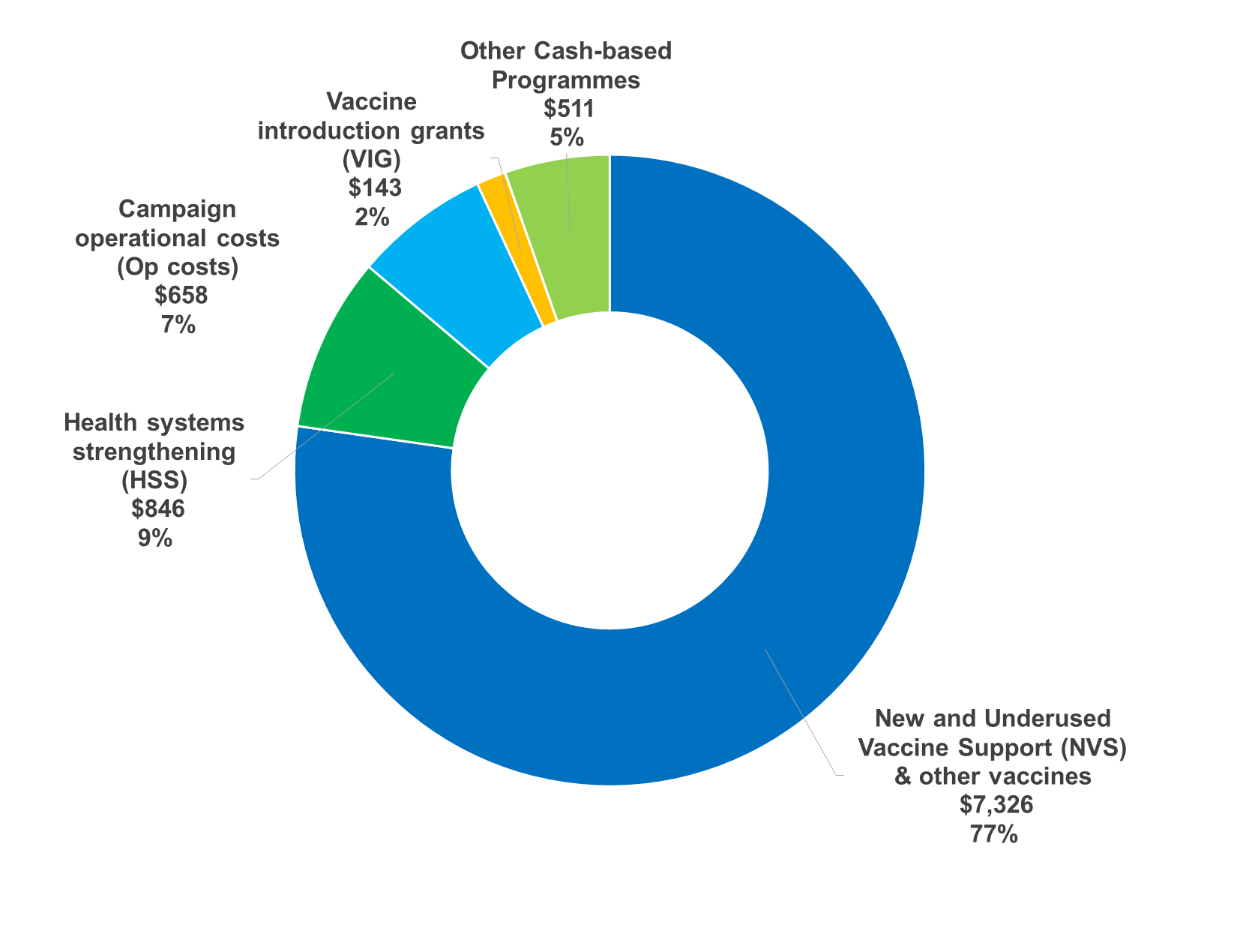
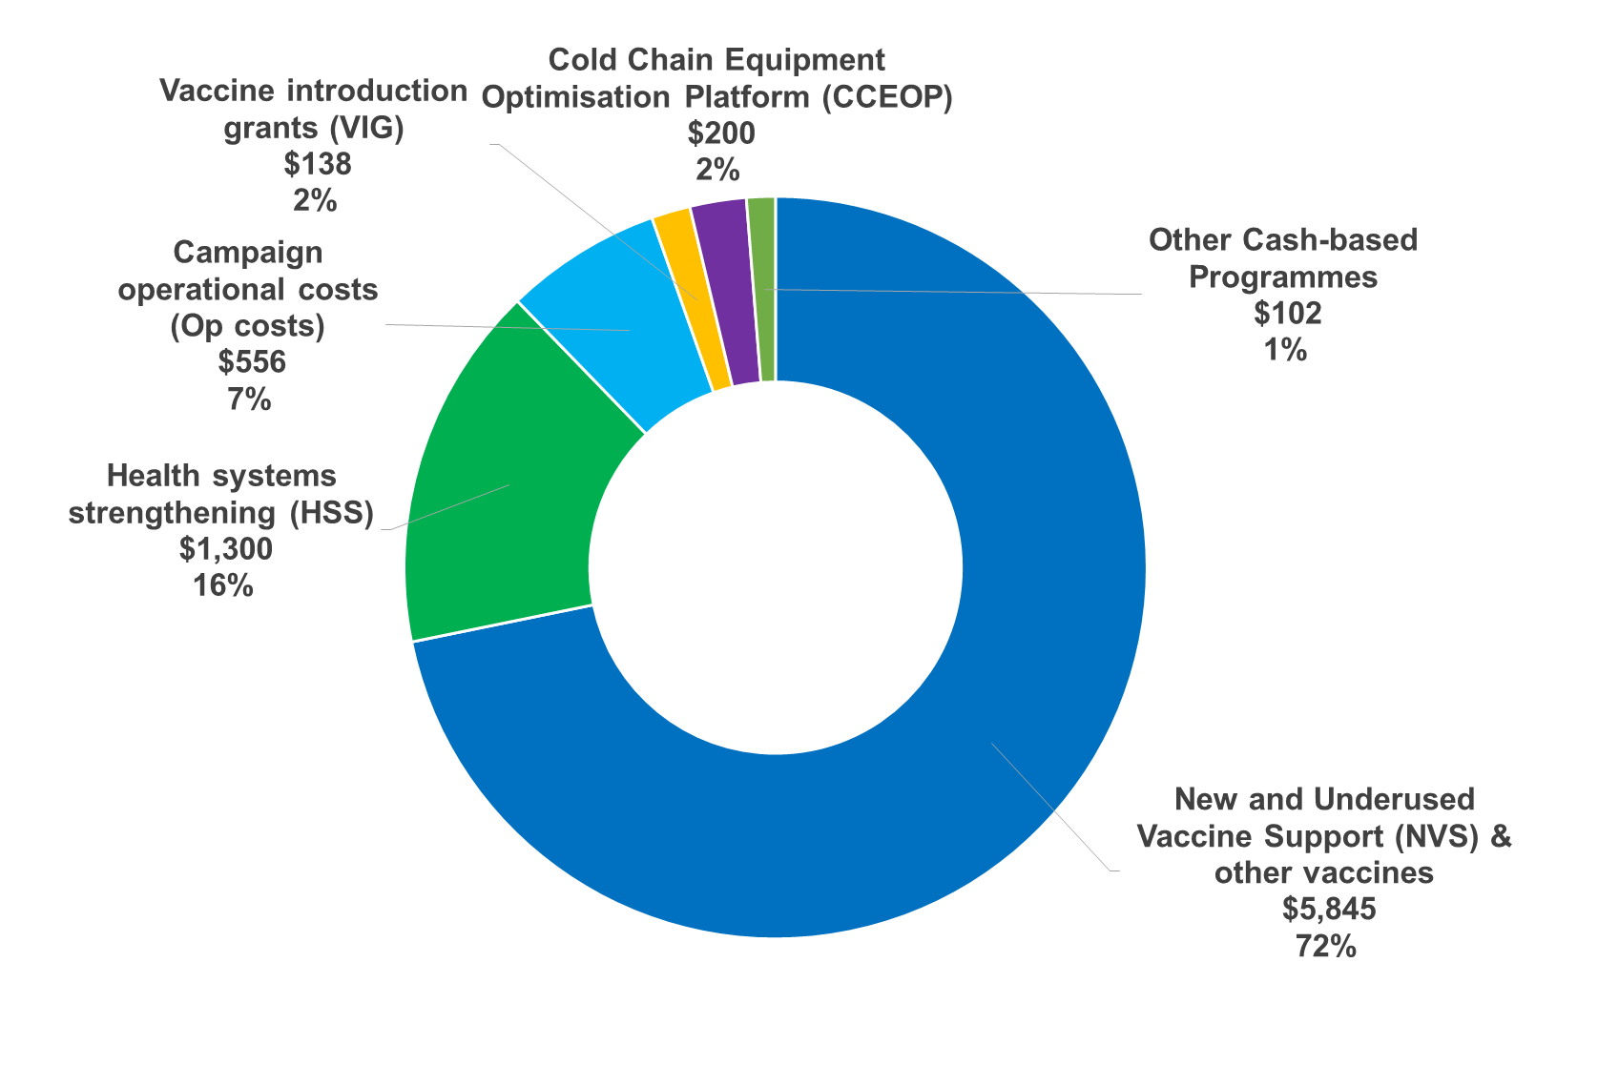
Gavi forecasted expenditure for all programmes, 2000-2015 and 2016-2020
2000-2015
2016-2020
US$ 9.5 billion
US$ 8.1 billion
Source: Gavi, the Vaccine Alliance (Financial Forecast v14.0 / Dec 2016).

Slide 10
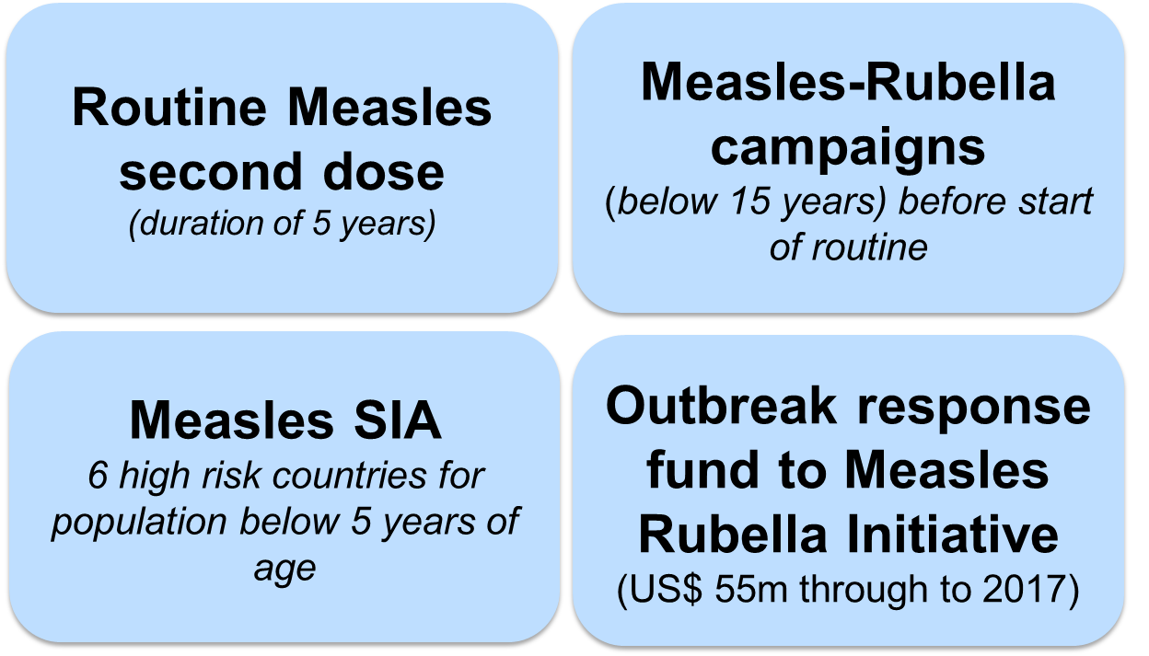
PREVIOUS Gavi Measles-Rubella ProgramME
  Past: Gavi-IFFIm provided US$ 176M to M&RI in 2004-2008
  Current:
  Direct:
  Indirect support:
    HSS Performance-based funding with measles coverage indicator
  Gavi has disbursed US$550 million by end 2014. US$ 700 million more forecasted by 2020
Notes:
Large Gavi investment (1.3b) in measles, which should be protected in next measles strategy.
IMPACT:
Projected by 2020: the current Gavi support totalling US $1.3 billion, countries will have averted more than 2 million future deaths from both measles and rubella.
Worldwide coverage for both routine doses and SIAs contributed to a 72% reduction in measles incidence and an estimated 75% reduction in measles mortality.
From inception to the end of 2014, a total of 25 million children in their second year of life have been vaccinated with measles through the routine programme with Gavi support contributing to 20,000 future deaths averted.
Past Gavi’s investment in M&RI of US$ 176 million contributed to averting 860,000 future deaths.
COST:
By the end of 2014 Gavi had disbursed US$ 338 million for the various components of the measles and rubella programme and US$ 201million to the Measles & Rubella Initiative (M&RI).
For the period 2015-2020, US$ 747 million are forecasted for the support to countries across the 4 components of the programme, bringing to a total of approximately US$ 1.3 billion the total size of Gavi’s investment in measles and rubella by 2020, excluding the funds provided through the Business Plan.

Slide 11
Gavi supported 50 Measles and Rubella programmes by end 2016
Measles Second Dose (21 countries)
Measles-Rubella campaigns (20 countries)
Country | Date
Viet Nam | 2007-2011
DPR of Korea | 2008-2012
Bangladesh | 2012
Cambodia | 2012
Eritrea | 2012
Gambia | 2012
Ghana | 2012
Myanmar | 2012
Burundi | 2013 (Jan)
Zambia | 2013 (Jul)
S Tome & Principe | 2013 (Oct)
Tanzania | 2014 (May)
Burkina Faso | 2014 (Oct)
Senegal | 2014
Malawi | 2015 (Jul)
Rwanda | 2015 (Jul)
Sierra Leone | 2015 (Sep)
Nepal | 2015 (Sep)
Zimbabwe | 2015 (Oct)
Mozambique | 2015 (Nov)
Papua New Guinea | 2016 (Aug)
Countries | Date
Cambodia | 2013 (Oct)
Ghana | 2013 ( Sep)
Lao PDR | VIG for routine
Nepal | VIG for routine
Rwanda | 2013 (Mar)
Senegal | 2013 (Nov)
Viet Nam* | 2014 (Aug)
Bangladesh | 2014 (Jan)
Tanzania | 2014 (Oct)
Burkina Faso | 2014 (Nov)
Solomon Islands | 2014
Yemen | 2014 (Nov)
Myanmar | 2015 (Jan)
PNG | 2015 (Aug)
Zimbabwe | 2015 (Sep)
Cameroon | 2015 (Nov)
Gambia | 2016 (Apr)
Kenya | 2016 (May)
Zambia | 2016 (Sep)
Sao Tome e Principe | 2016 (Nov)
Measles SIAs (6 countries)
Countries | Date
Ethiopia | 2013
Nigeria | 2013, 2015
DRC* | 2013, 2016
Pakistan* | 2014
Chad* | , 2016
Afghanistan | 2015
* In phases

Slide 12
Gavi support to enable successful implementation of Measles and Rubella strategy
New Vaccine Support (NVS) for Measles and Rubella
  Measles and Measles-Rubella vaccines and devices
  Vaccine Introduction Grants and Campaign Operational Costs
Partners’ Engagement Framework (PEF)
  Foundational support (FS)
  Targeted country assistance (TCA)
  Strategic Focus Areas (SFA)
Health Systems and Immunisation Strengthening (HSIS)
  Routine immunisation strengthening (MCV1 and MCV2)
  Strengthening of measles, rubella and/or CRS surveillance

Slide 13
1. NVS for Measles and Rubella
Routine measles 2nd dose and MR 1st & 2nd dose
  Previously Gavi supported measles second dose for 60 months
  Now M2, MR1 and MR2 supported with co-financing
Wide age initial MR catch-up SIA
  Support of males and females aged 9 months – 14 years; any expansion of target pop is country financed
Measles and MR follow up SIA
  Previously only 6 priority countries, now all Gavi eligible countries
  Focus on children 9mo – 5yo; countries can adjust target age within funding envelope IF evidence provided by the country supports this
  Countries co-finance vaccine costs from 2018 onwards
Outbreak response fund (through M&RI)
Notes:
The new Gavi Measles & Rubella programme includes the following components:
Measles Follow-up Campaigns
Measles vaccination campaigns at national or subnational levels, for countries which have not yet introduced MR, with a focus on children up to 5 years of age; noting that the timing, target age range, and geographical scope should be based on epidemiological data. Co-financing of vaccine 2% or 5% if in transition phase
What is the country funding envelope ? 5 year plan, but we don’t have that yet; speak about CEF envelope for 5 years, estimated budget; Sub-national targets in some areas; Country to focus on 9mo-5yo for control purposes; Country to see if thise makes sense from an epidemiological perspective; How much is this over? We don’t want to encourage countries to; we want to encourage countries to make campaigns decision based on epidemiological data
Measles-Rubella (MR) Catch-Up and Follow-up Campaigns
MR catch-up campaign providing MR vaccine for a target population of males and females aged 9 months to 14 years, prior to introducing MR vaccine into the routine national immunisation schedule. Any expansion of the target population would need to be financed by the country.
Support is also available for periodic MR follow-up campaigns, noting that the timing, target age range, and geographical scope should be based on epidemiological data. Co-financing of vaccines 2% or 5% if in transition phase.
Gavi provides support for the above mentioned campaigns in the form of vaccines and associated supplies (i.e. auto-disable syringes, reconstitution syringes and safety boxes). In addition, Gavi provides direct financial support to cover a proportion of the operational costs related to campaigns. The exact level of support available in terms of campaigns will be communicated to countries in due course after the Gavi Board discussion in June 2016.
MCV2 or MR vaccine introduction with co-financing (only for countries who have not yet introduced MR and/or MCV2.)
Routine measles second dose (MCV2) and MR vaccine introduction, requiring countries to co-finance a portion of the vaccine costs according to a specific co-financing formula (and provided that current government financing is not replaced with Gavi funds), as follows:
1) For countries adding a routine measles second dose:
Countries would pay US$ 0.40 for 2 doses of MCV, while Gavi would pay the rest (approximately US$ 0.14-US$ 0.20).
2) For countries introducing MR vaccine (switching from one dose measles to one dose MR vaccine): Countries would pay US$ 0.30 per dose (comparable to the current Weighted Average Price [WAP] of measles vaccine) and Gavi would pay for the rest (approximately similar amount).
3) For countries adding 2 doses of routine MR vaccines:
Countries would pay US$0.60 for 2 doses of MR (comparable to WAP of 2 doses of measles vaccine) and Gavi would pay the rest (approximately similar amount).
For MCV2 or MR vaccine introduction, Gavi will also provide a Vaccine Introduction Grant (VIG) to facilitate activities in the first year of new vaccine introduction. This is a one-time cash grant of US$0.80/child in the birth cohort. Countries are encouraged to identify cross-cutting synergies across VIGs and operational cost support (e.g. communications, training, etc).
Outbreak response (Managed by the Measles & Rubella Initiative [MRI])
Please refer to WHO and UNICEF for the details of this support.

Slide 14
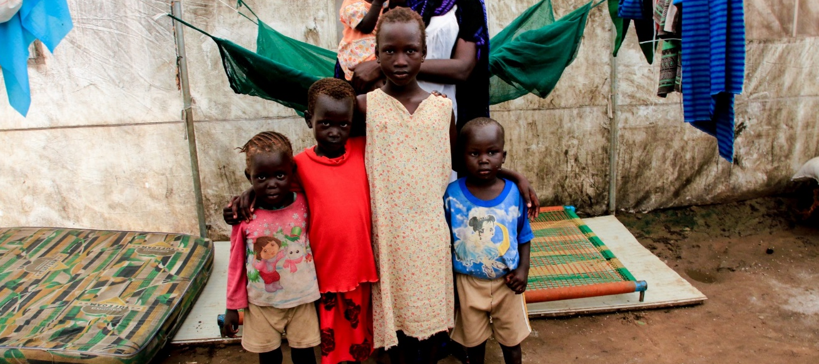

2. Partners’ Engagement Framework (PEF): Key principles
PEF is a new model aimed at purposeful partnerships
Replaces the Business Plan model applied in 2011-2015
Funds technical assistance to countries via partners to boost immunisation
Seeks to leverage the comparative advantage of partners

Slide 15
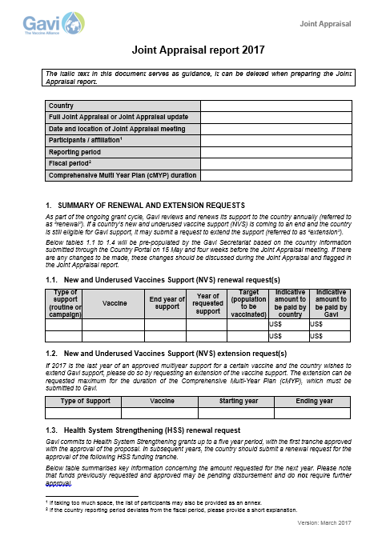
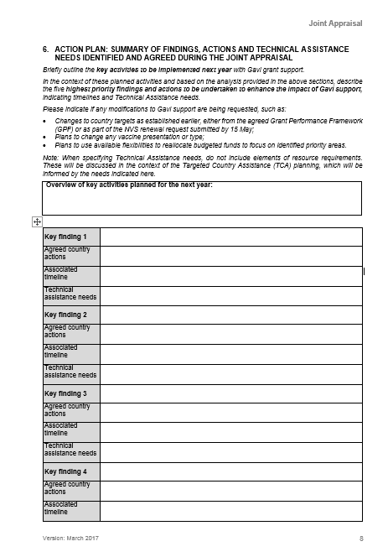
2. PEF Targeted Country Assistance (TCA): High-level identification of technical assistance needs takes place during country-led processes
During the JA, partners will discuss:
  Summary of key insights generated during the appraisal of Gavi TCA activities and milestones
  Identification of high level needs
Post-Joint Appraisal, partners will discuss:
  How has the 2017 technical assistance progressed?
  What adjustments in TA required in 2018?
  What areas would benefit from additional support from other non-core partners?
Menu of TA support
  A menu of potential technical assistance activities is incorporated into the TCA guidance
  It provides overview of the types of activities by programmatic area that EPI program and partners can consider

