Slide 1

Gavi’s Measles and Rubella Programme:Update
Stefano Malvolti
September 2015, Washington DC
Reach every child

Slide 2
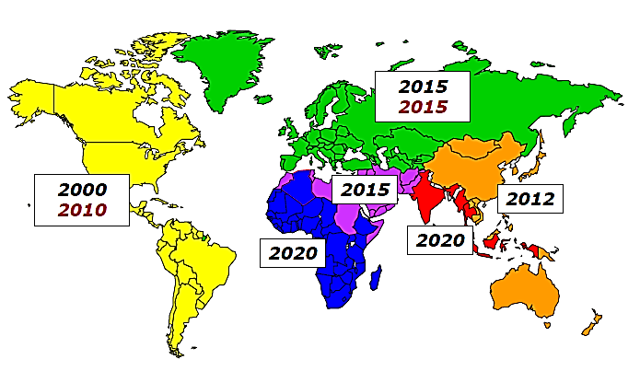
MANY REGIONS AT RISK / OFF TRACK FROM MEASLES ELIMINATION GOALS
Source: WHO
85%
72%
78%
59%
56%
46%
37%
22%
15%
2%
Source: WHO/UNICEF coverage estimates 2014 revision. July 2015. Immunization Vaccines and Biologicals, (IVB), World Health Organization.
RCV data is per July 2014 estimates, except for the year 2014
194 WHO Member States. Date of Slide: 16 September 2015.
Gavi 73 numbers are Gavi Secretariat calculated. May revise upwards after reconciliation of data
Notes:
Elimination requires: ≥95% and 2 MCV doses
All 6 WHO regions have elimination goals – off track
In 2013 – MCV1: 84%; MCV2 53% (but this is globally, so if few number of countries that introduce, the average remains low); RCV 44% (same).
MCV1 has remained at 83-85% since 2009
In Gavi 73 countries, the average MCV1 is 78% FOR THE PAST 5 YEARS!!
Americas had eliminated measles in 2002 but Brazil has become re-infected and transmission has continued for more than a year…Outbreaks in the US of A. Three regions (SEAR, AFR and EMR) still have coverage of 80% or less and are a long way from 95% in every district that will be required to eliminate measles.

Slide 3
Gavi 4.0: RENEWED FOCUS ON measles
Gavi 2016-20 strategy indicators
Reach of routine coverage
3rd dose of pentavalent vaccine
First dose of routine measles vaccine
Breadth of protection
Average coverage across all Gavi supported vaccines
Equity of coverage
Difference in penta3 coverage based on:
Geography (by district)
Wealth
Education status of mother / female caregiver
Gavi 2016-20 strategy targets to be approved by Board in December
Source: Gavi; GVAP

Slide 4
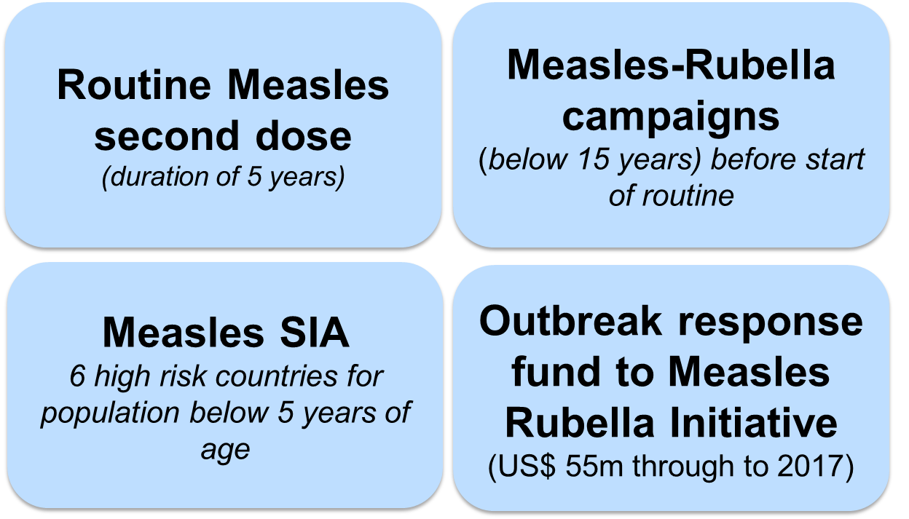
Existing Gavi Measles-Rubella Program
  Past: Gavi-IFFIm provided US$ 176M to M&RI in 2004-2008
  Current:
  Direct:
  Indirect support:
    HSS Performance-based funding with measles coverage indicator
  Gavi has disbursed US$550 million by end 2014. US$ 700 million more forecasted by 2020
Notes:
Large Gavi investment (1.3b) in measles, which should be protected in next measles strategy.
IMPACT:
Projected by 2020: the current Gavi support totalling US $1.3 billion, countries will have averted more than 2 million future deaths from both measles and rubella.
Worldwide coverage for both routine doses and SIAs contributed to a 72% reduction in measles incidence and an estimated 75% reduction in measles mortality.
From inception to the end of 2014, a total of 25 million children in their second year of life have been vaccinated with measles through the routine programme with Gavi support contributing to 20,000 future deaths averted.
Past Gavi’s investment in M&RI of US$ 176 million contributed to averting 860,000 future deaths.
COST:
By the end of 2014 Gavi had disbursed US$ 338 million for the various components of the measles and rubella programme and US$ 201million to the Measles & Rubella Initiative (M&RI).
For the period 2015-2020, US$ 747 million are forecasted for the support to countries across the 4 components of the programme, bringing to a total of approximately US$ 1.3 billion the total size of Gavi’s investment in measles and rubella by 2020, excluding the funds provided through the Business Plan.

Slide 5
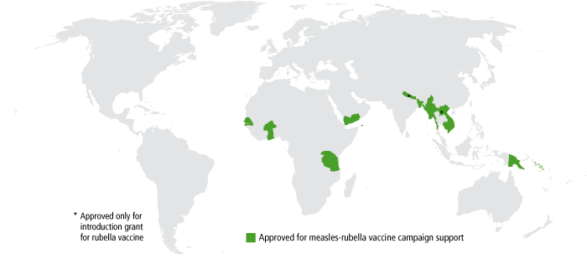
MEASLES AND RUBELLA PROGRAMMES REACHED 24 COUNTRIES BY END 2014
Measles Second Dose (14 countries)
Measles-Rubella campaigns (13 countries)
Country | Year
Viet Nam | 2007-2011
DPR of Korea | 2008-2012
Ghana | 2012 (Feb)
Cambodia | 2012 (Jun)
Eritrea | 2012 (Jun)
Gambia | 2012 (Aug)
Bangladesh | 2012 (Sep)
Myanmar | 2012 (Nov)
Burundi | 2013 (Jan)
Zambia | 2013 (Jul)
Sao Tome and Principe | 2013 (Dec)
Tanzania | 2014 (May)
Senegal | 2014 (Aug)
Burkina Faso | 2014 (Oct)
Myanmar in Jan 2015, PNG in August 2015
Measles SIAs (5 countries)
Countries | Year
Ethiopia | 2013 (May-Jun)
Nigeria | 2013 (Oct, Nov)
DRC* | 2013 Aug, 2014 July
Pakistan* | 2014 (May)
Chad* | (Jun, Oct)
* In phases

Slide 6
MOST OF GAVI COUNTRIES FORECASTED TO INTRODUCE MR
Number of country introductions
 | <2014 | 2015 | 2016 | 2017 | 2018 | 2019 | 2020 | >2020 | Total
MR | 14 | 4 | 6 | 9 | 7 | 3 | 1 | 3 | 47
MSD | 13 | 5 | 3 | 3 | 0 | 5 | 0 | 8 | 37
MSIA | 5 |  | 1 |  |  |  |  |  | 6
MR forecast latest as of 16 Sep 2015. MSD forecast from SDFv11
MSIA countries with more than 1 campaign counted once
Notes:
PNG intro of MSD was delayed. Country currently has a MCV dose at 6 and 9 months. Will introduce the dose at 18 months late in 2016.

Slide 7
,GAVI PROGRAMS REACHED IN EXCESS OF 650M CHILDREN AND ADOLESCENTS
Forecasted number of children and adolescents vaccinated
 | Program start – 2015 | 2016 - 2020 | Program start – 2020
MR | 170M | 480M | 650M
MSD | 64M | 236M | 300M
MSIA | 149M | 3M* | 151M*
*Does not include DRC and Ethiopia measles SIA in 2016, and does not include numbers vaccinated through US$176m grant to MRI before 2010
Notes:
PNG intro of MSD was delayed. Country currently has a MCV dose at 6 and 9 months. Will introduce the dose at 18 months late in 2016.

Slide 8
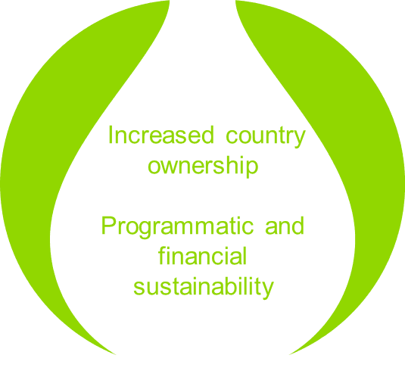
Gavi’s LOOKING AT DEFINING A Measles and Rubella Strategy
Aim: Determine what Gavi should support to get the best pragmatic return on investment
Steering Committee highlighted the following key principles:
Technical Working Group addressed the following questions:
What makes sense for Gavi to support?
Ideal pre-requisites for MR introduction
Measles Second Dose Rationale
Surveillance

Slide 9
SPECIFIC GOALS DEFINED FOR THE DEFINTION OF THE STRATEGY
Simplicity and clarity of Gavi support
Alignment with key principles of support applied to Gavi vaccines (support till graduation and co-financing)
Recognition of the specific role of SIA in measles control
Self-financing of the first dose of measles vaccine in national immunization programme
Definition of a long term plan for measles and rubella activities based on solid modelling of the diseases

Slide 10
Measles Cases, Routine MCV1 Coverage, and
National Measles SIAs, Zambia, 1999 – 2014
Courtesy of WHO (JM Okwo Bele)
Notes:
The Zambian experience with measles control illustrates 3 important lessons: 1) routine coverage with 1 dose of 80% (years 1999-2003) is NOT sufficient to achieve high level control; 2) regular high quality SIAs (green arrows) are needed to knock down measles to low levels; and 3) during the resurgence of measles in 2010-2011 over 50% of measles cases were aged >5 years; hence the 9-47m SIA done in 2010 did not stop the outbreak and a second wide age-range SIA was needed. Only 35 and 9 measles cases were confirmed in Zambia in the years 2013 and 2014 respectively. Zambia is planning to conduct their next campaign in 2016 using MR vaccine for 9m to 14 year-olds.

Slide 11
THANK YOU
Reach every child

