Slide 1
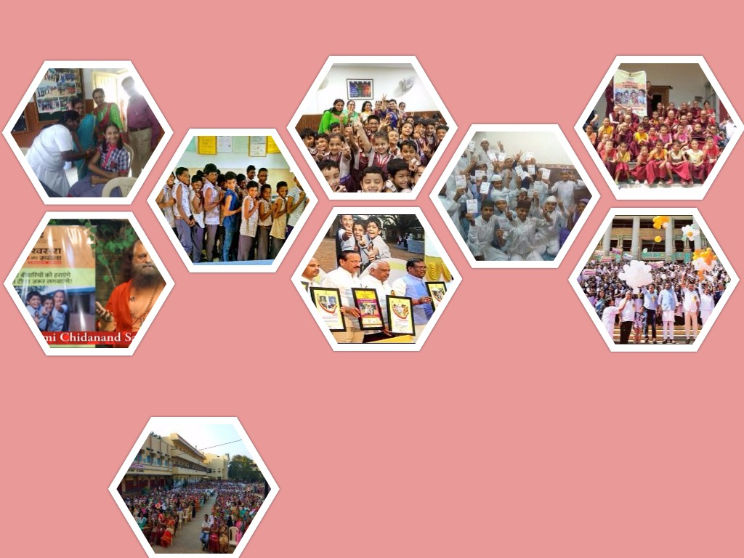


India-Country Experience - Measles Rubella Vaccination
Ms. Vandana Gurnani
Joint Secretary (Reproductive and Child Health)
Ministry of Health & Family Welfare
Government of India

Slide 2
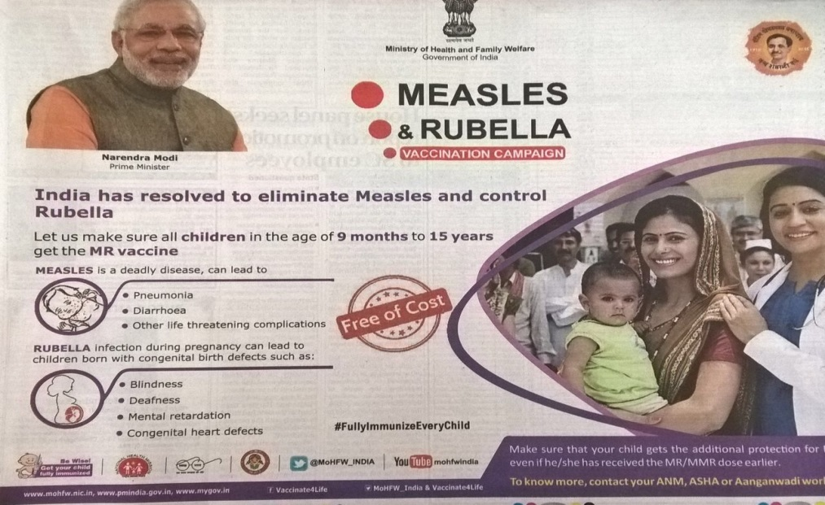
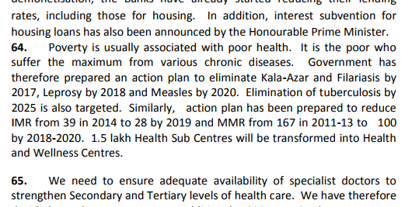
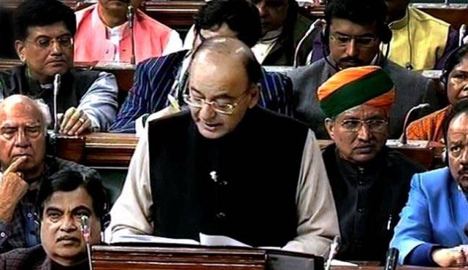
Political Will & Ownership
Government commitment to eliminate measles and control rubella by 2020
PM Narendra Modi in government advert to promote Measles Rubella vaccination campaign
Arun Jaitley, Finance Minister’s speech, 2017-2018

Slide 3
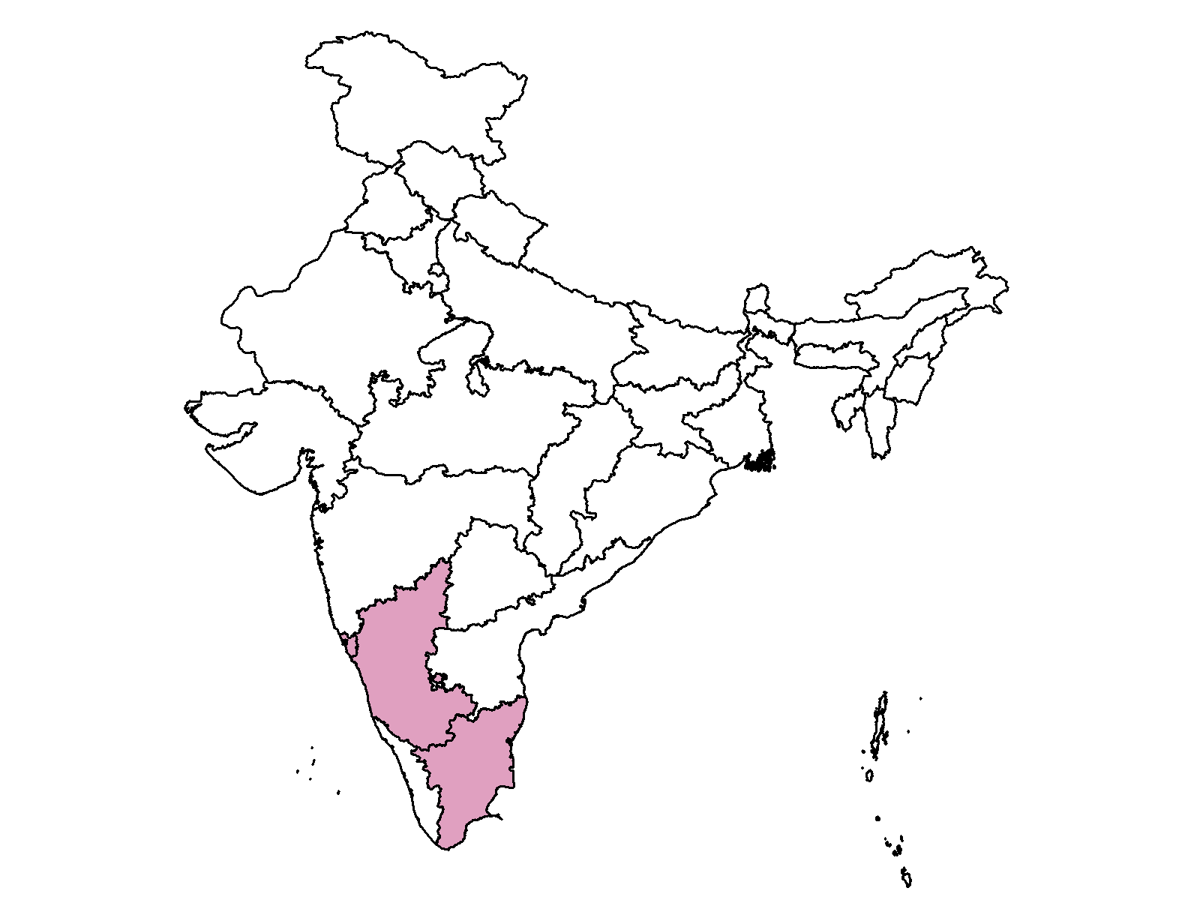
Measles Rubella Campaign Phase – 1
Country Preparedness

Slide 4
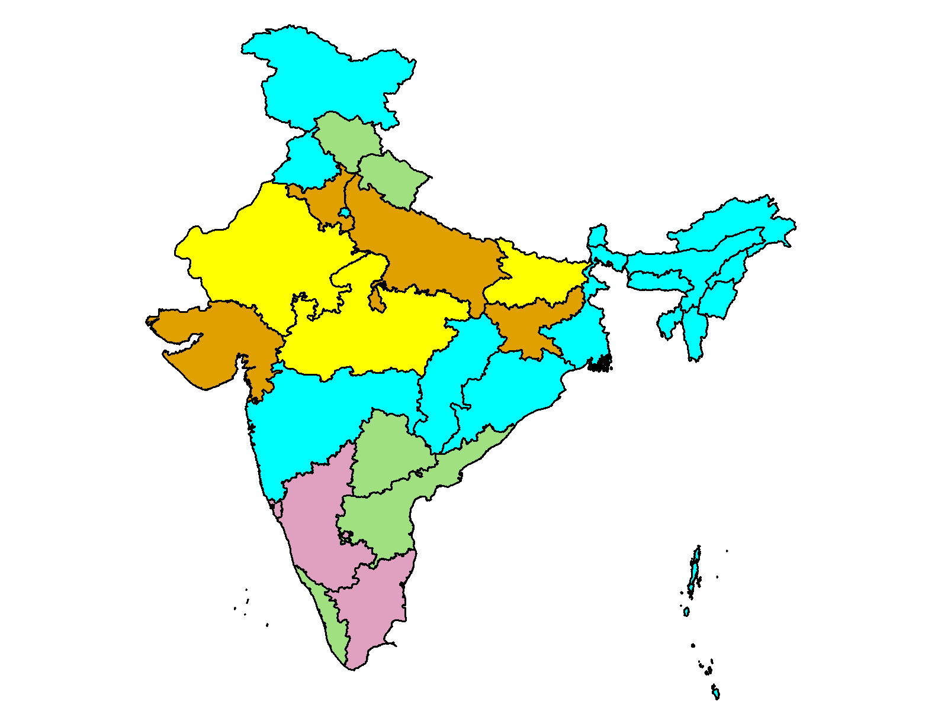
Measles-Rubella Vaccine Introduction in the Country
NTAGI in 2014 recommended introduction of rubella vaccine as Measles-Rubella (MR) vaccine through a wide age range campaign (9 months to 15 years)
Vaccine introduction in routine immunization, in replacement of 2 doses of measles.
Phase 1
COMPLETED BY FEB 17: ~35 mn
Phase 2
  ONGOING AUG - SEPT 17: ~35 mn
Phase 3
Phase 4
Phase 5
  PLANNED FEB - OCT 18: ~336 mn
>400 million children targeted
(9 months to < 15 yrs)
Gavi supporting about 45% of target cohort MR vaccine requirement for the campaign.
Notes:
Measles Rubella Campaign Phase – 1 was started in February 2017 in 5 States/UTs ( Goa, Lakshadweep, Karnataka, Tamil Nadu and Puducherry)
Phase 2 from August in 8 States/UTs. 6 States has started: Andhra, Telangana, Himachal, Chandigarh, Daman and Diu , Dadra and Nagar Haveli
Phase 3: planned in first quarter 2018, 11 states /UTs (8 NE states, WB , Odisha, Andaman )
Phase 4 planned in Bihar, Rajasthan and MP
Phase 5 in Gujarat, UP, Haryana, Jharkhand

Slide 5
SIA*: Phase 1 (Feb/March 2017) – Institutional Mechanism
National Level Oversight
National Measles-Rubella Task Force
Measles-Rubella Operations group
Measles-Rubella Communications group
India Expert Advisory Group on Measles & Rubella (IEAG-MR)
Inter-Ministerial Committee
PHASE 1 : COVERAGE OF 5 STATES
State Level Overview
State level
  State Steering Committee
  State Operations Group
  State Task Force on Immunization
District level
  District Task Force on Immunization
  District Immunization Officer’ review
Goa, Tamil Nadu, Puducherry, Karnataka, Lakshwadeep islands
*Supplementary Immunization Activity
Notes:
Institutional mechanism of supervision and monitoring was established at all levels in coordination with all stakeholders to make the implementation smooth
National Measles-Rubella Task Force Chaired by Joint Secretary, Govt. of India
Members from WHO, UNICEF, BMGF, ICMR, National CDC
Monitors and reviews campaign planning & surveillance data; national action plan development for measles elimination & rubella/CRS control
Measles-Rubella Operations group members include WHO, UNICEF, BMGF and ITSU
Phasing plan, strengthening operational strategies following learnings from phase 1
Measles-Rubella Communications group
members include WHO, UNICEF, BMGF, GHS
Communication plan, media package, developing special strategies following learnings from phase 1
IEAG for MR members include national and international experts to provide technical strategic guidance for Measles elimination and Rubella control
Secretary, H& FW is the chair

Slide 6
MR Vaccine Campaign: Implementation Strategy
Implementation of Session Sites
Fixed in-facility sites
Hospitals, CHCs, PHCs, SC
Outreach session sites
Villages, resettlement areas
(one village, one day)
Mobile sessions
For far flung areas
Continuous sessions in some facilities with high vaccination load to function throughout campaign period.
4 weeks activity
1 week sweeping
Schools
Community
Last week sweeping in low performing areas
Notes:
Total duration of campaign 4 weeks (first in schools and then in community) and 1 week sweeping activity in low performing areas
Vaccination will be provided at: schools, health facilities and routine immunization session sites. Migratory sites to be approached through mobile teams
Regular RI sessions will be conducted as per usual planning

Slide 7
Preparedness Assessment and deployment of monitors
The preparedness assessment by national monitors led to improvement before start of campaign, e.g.
Improved accountability
Sensitization of Education Dept.
Engagement of schools
Communication plans
Injection safety
AEFI management system
WHO-NPSP and UNICEF supported in monitoring training, advocacy and capacity building
Additional SMO/ RRTs (Rapid Response Teams) from other states deployed
Both session site and community were monitored

Slide 8
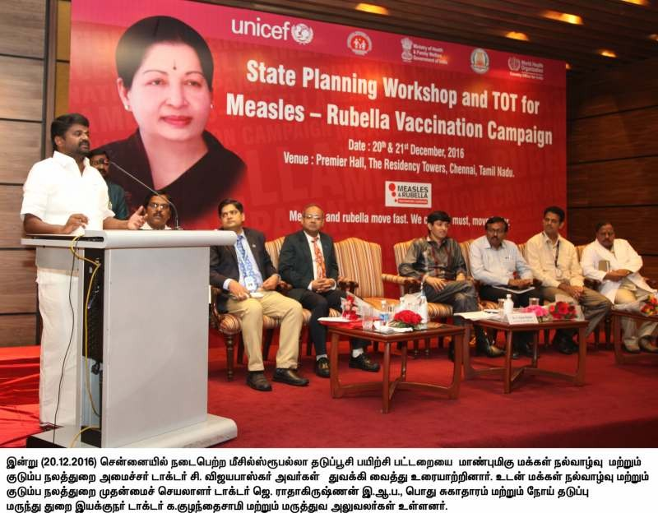
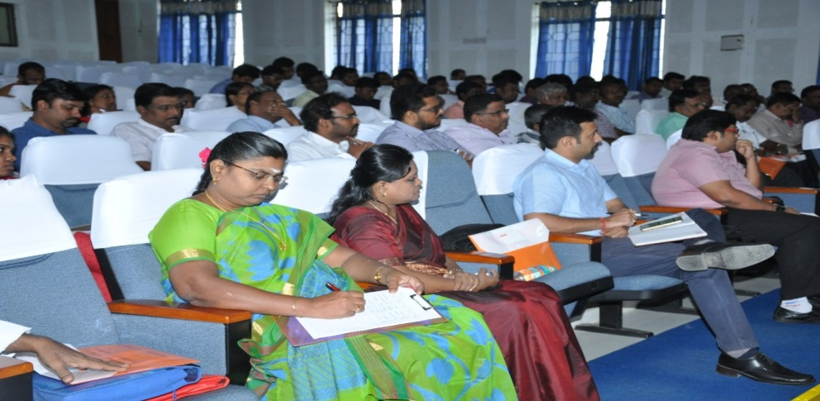
State Planning workshop and TOT
Capacity building and trainings for MR campaign
Cascaded Trainings and micro-planning:
  At all levels including stakeholders like Education Dept., WCD dept., Media, Schools etc.
Medical Officers orientation in AEFI management
State Nodal Officers Orientation Meeting
Notes:
State level workshops in all states
69 district level training workshops were conducted to sensitize key health and other department officials
Further trainings done at sub-district levels

Slide 9
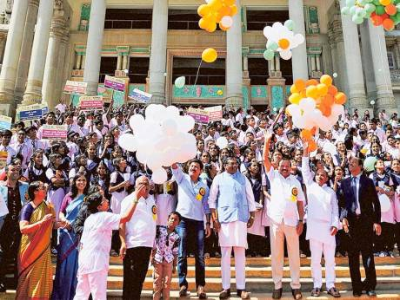
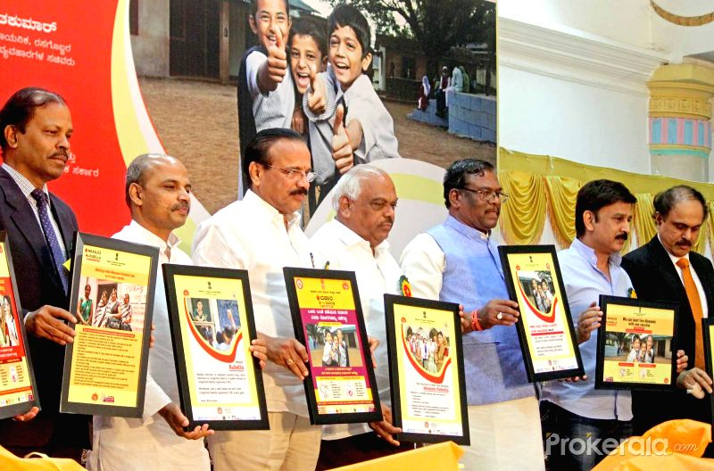
Measles-Rubella Campaign Launch
Campaign launched on 5th February, 2017 at Bangalore, Karnataka
Highest level political involvement at the launch

Slide 10
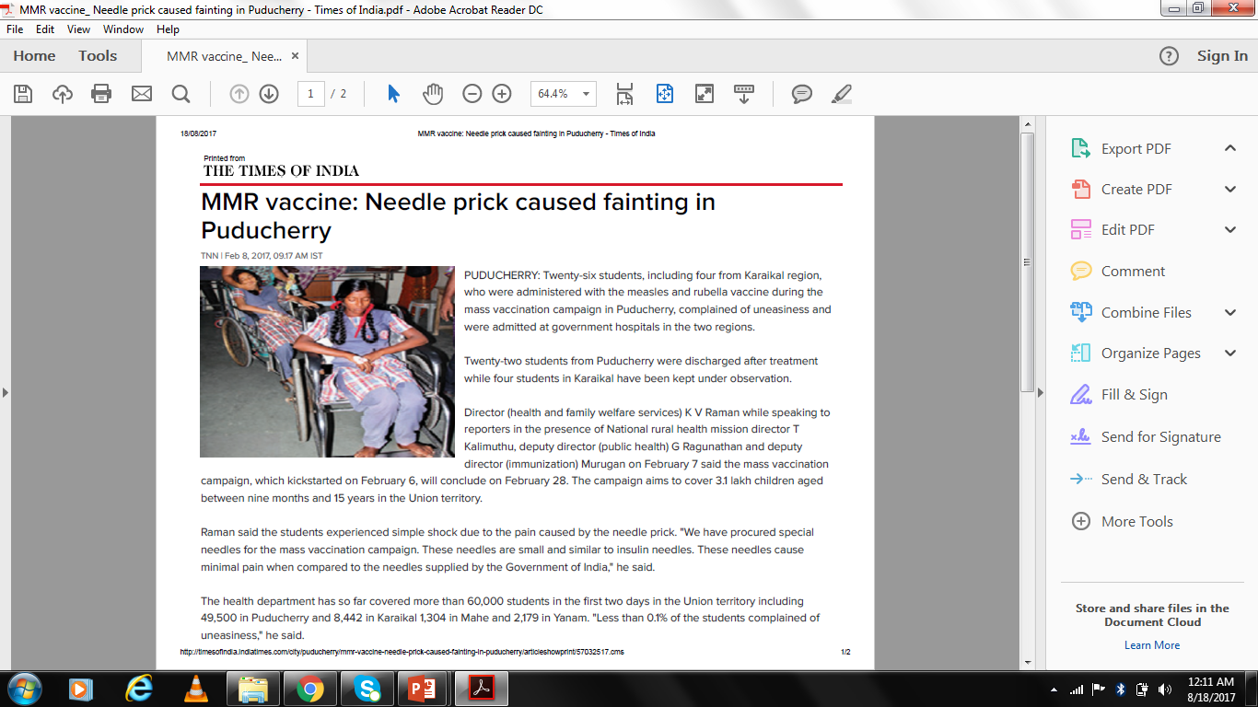
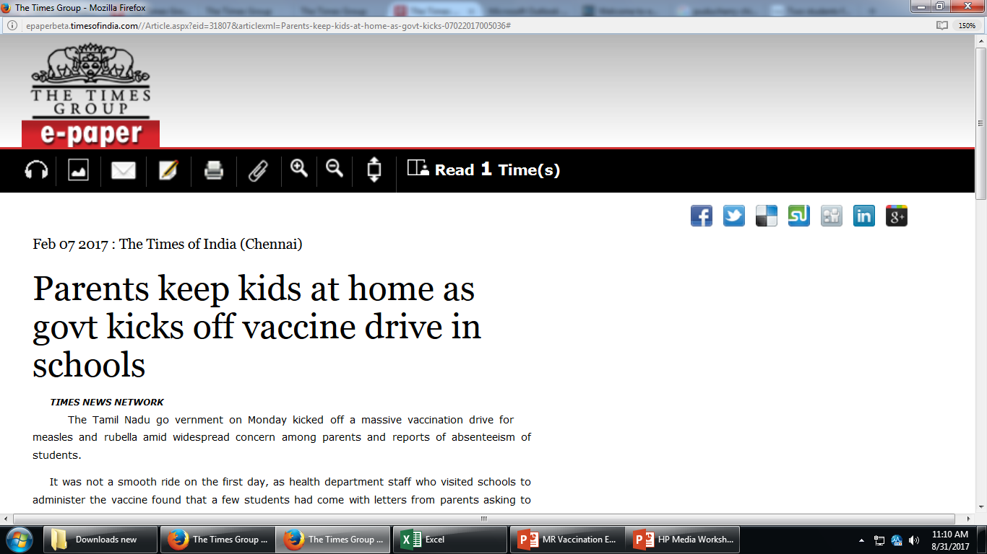
Campaign Challenges
Rumors, misconceptions and inaccurate information disseminated through social media affected the campaign at the early stage
Other media platforms such as print and electronic media, opinions of leaders also played a role to some extent
  Inaccurate reports of AEFI cases, wrong information about vaccines had a negative impact
Sub-optimal participation of school Principals
Varied involvement of pediatric associations

Slide 11
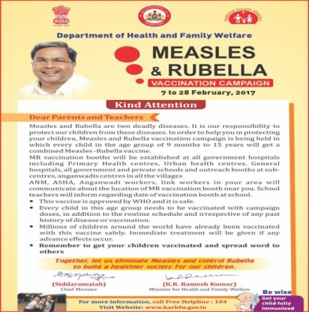
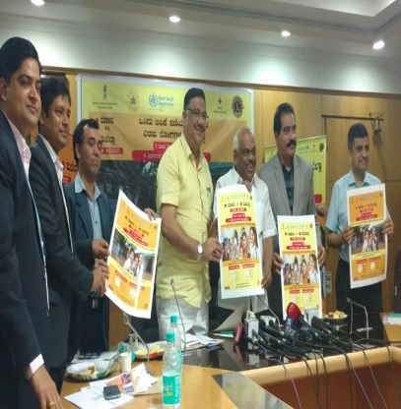
Addressing the Challenges (National, State and District Level)
Strong IEC approach - Appeals from Chief Minster & Health Minister published in 41 newspapers in different languages
FAQs put up on MoHFW website, WHO website
  Health Minister’s Appeal to Doctors
  Letter from Chief Secretary to DCs
  District level sensitization of Education and WCD Dept.
  Letter from religious Waqf Board and Urdu Appeals
Stakeholder orientation
  Parents, Teachers and Head masters meeting by District Collectors and Medical Officers
  Pediatric association presence in all advocacy meetings
Inter-ministerial support for MR campaign
  For eg. Ministry of HRD followed-up for issue of letters to schools

Slide 12
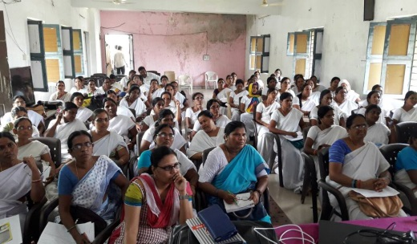
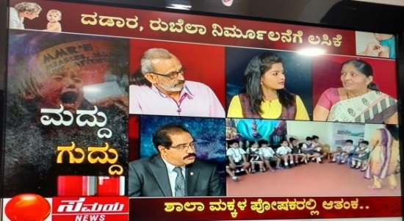
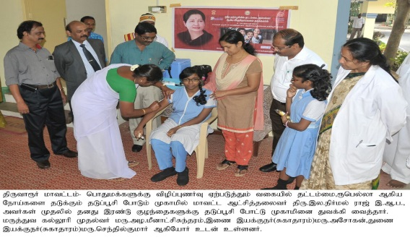
Addressing the Challenges (Contd.)
Convergence Meetings with all key stakeholders at both district and sub-district level
Media Engagement
  Opinion articles, stakeholder interviews on national, local media including vernacular language to dispel the myths
  Awareness programs in Radio and TV
  Panel discussions and live phone in programs
  Warnings through visual and print media
  All India Radio (AIR) jingles
  A-V clips of experts, pediatricians, opinion leaders circulated on social media
Awareness campaigns
District Collector getting his child vaccinated on the day-1 of MR Campaign- Thiruvarur, TN

Slide 13

Addressing the Challenges (Contd.)
Polio SIAs rescheduled in some states for focus on MR campaign activities
Extension of MR activity to allow more time to states to achieve the target
Campaign coverage review and feedback shared with States/UTs
Notes:
Daily coverage is reviewed at national level and feedback shared with states. On the basis of performance, states were asked to take corrective actions to increase the coverage, involve schools and stakeholders . Also states were asked to increase the duration of campaign to achieve the desired coverage.

Slide 14
Learnings from the 1st phase
National Polio Surveillance Project (NSPS) support at field level critical in achieving good coverage in campaign
Potential for negative influence through social media and chat platforms (e.g. WhatsApp)
Resistance from minority communities
Need for effective
media engagement
Need for brand ambassador/
champion for MR campaign
Variable preparation of
communication plans
Scope of improvement of coordination with education department /private sector/pediatricians/clinicians
Addressing critical FAQs such as the need of an additional dose and vaccine safety (sterility of vaccines, imported vaccines)
Notes:
Challenges during phase-1 were identified
WHO-SMO support at field level critical in achieving good coverage in MR campaign
Need for a special strategy for schools
involvement of under-served community and private sector
Need to bust myths through a proactive approach
more focussed approach is needed to target social media
Timely sensitisation of press and electronic media

Slide 15


Action taken from learnings -Revision of IEC
Redesigned IEC and development of additional material
MR Vaccination
certificate Card
MR Information
Card
Handbook on MR campaign for Health Workers and teachers
Myths & Facts
booklet
Health workers’ module
Posters for private
practitioners
Leaflets for ASHAs & other FLWs and Religious leaders
Posters,
Hoarding and Banner
Advocacy for
MR campaign
Poster for Schools

Slide 16
Measles Rubella campaign phase – 2

Slide 17
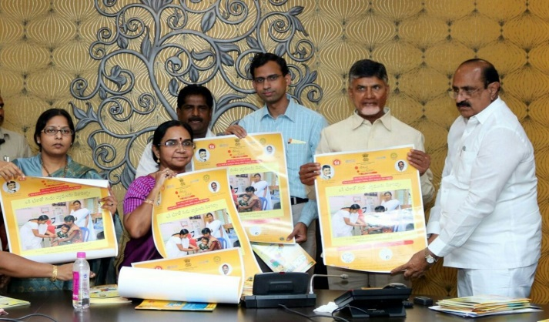
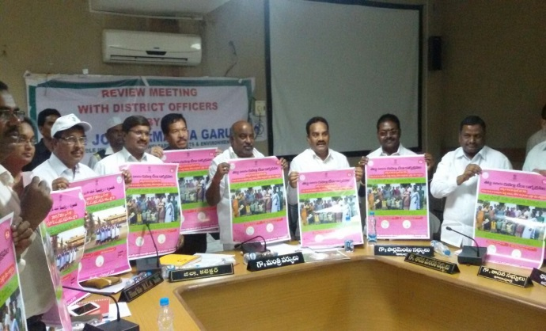
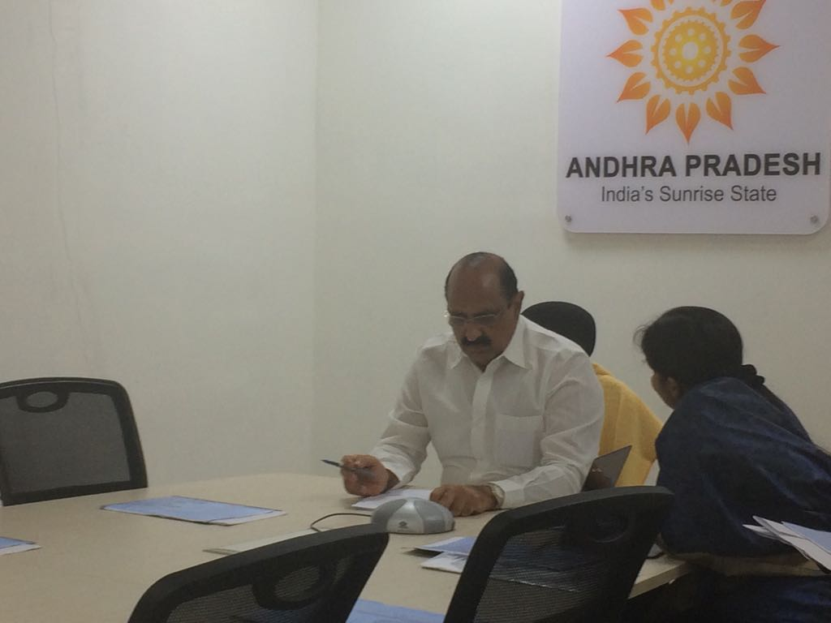
Strong government ownership

Slide 18
Preparedness for phase 2
High-risk areas identified for preparedness assessment
Operation and communication assessed together using one tool
Daily feedback reporting by monitors
Monitors debriefing to district/State and National task force
Meticulous tracking helped to complete training timely before start of campaign
Intense monitoring to ensure quality of trainings
Conducted
Planned
Notes:
More than 39 monitors from national level (from GoI, WHO, UNICEF, ITSU, UNDP, GHS) were deployed for preparedness assessment for phase-2
More than 30 monitors from national level (from GoI, WHO, UNICEF, ITSU, UNDP, GHS) and 10 international monitors (from CDC, SEARO) were deployed for monitoring of campaign

Slide 19
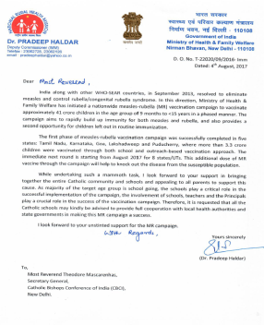
Improved school strategy
Increased convergence between Health-Education-Women & Child Development at state & district level
Improved engagement with private, public, religious, play schools/creche
Mandatory key education staff training at state/district level
Duration of microplanning increased
Special training material for school teachers, parents & children
WhatsApp/other social media factoids for circulation
Improved engagement with schools

Slide 20
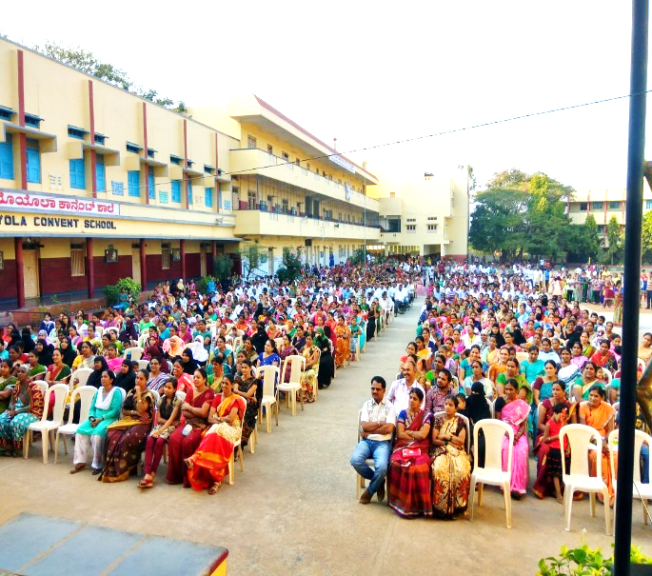
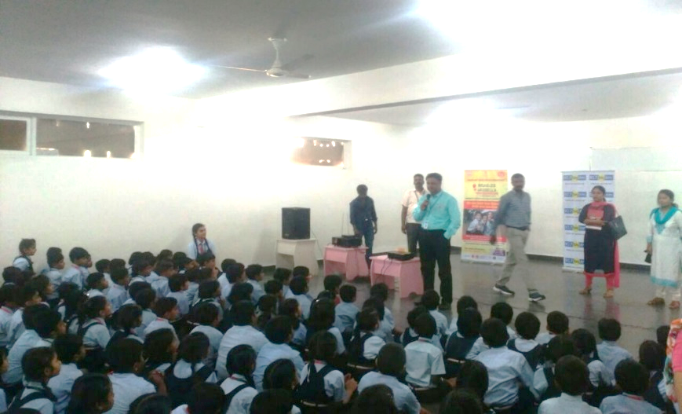
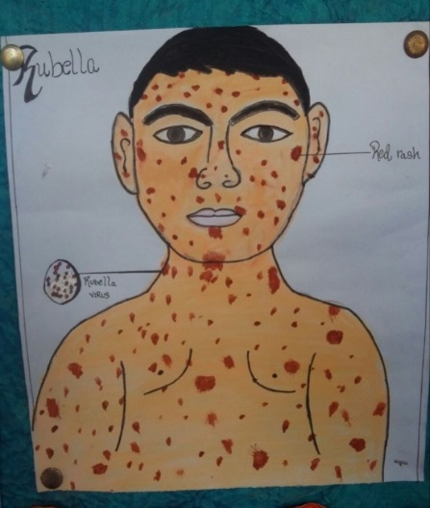
Focused attention on Parent-Teacher meeting at schools
Interaction of health department with students, especially large private schools
Improving children participation: Drawings, painting competitions

Slide 21
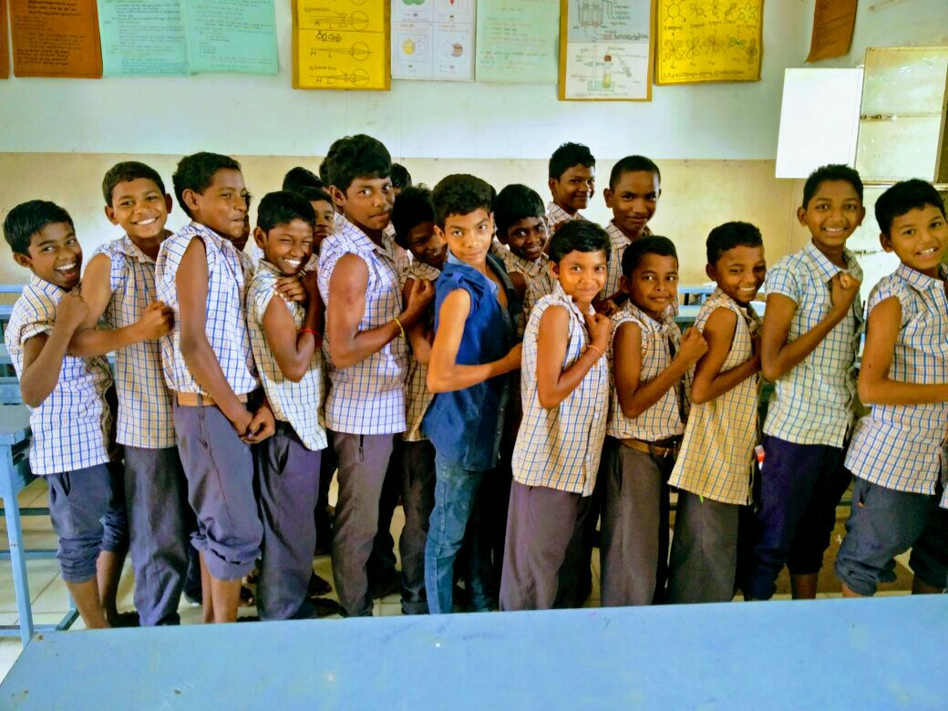
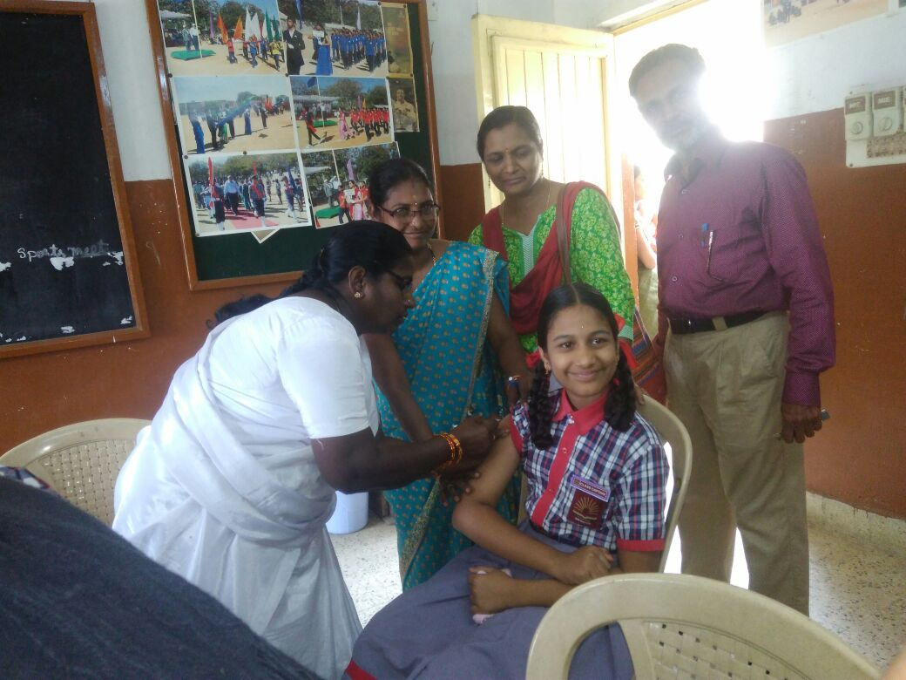
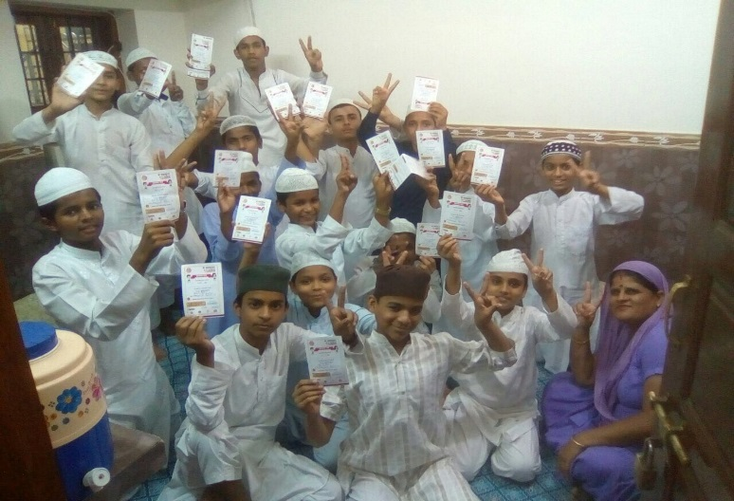
School children excited for vaccination
Improved communication of health delivery staff & education staff pre, during & post vaccination
(Starts & ends with smiles)
Delighted after Vaccination
A good example of MR vaccination: Video (2:15 -2:45)

Slide 22


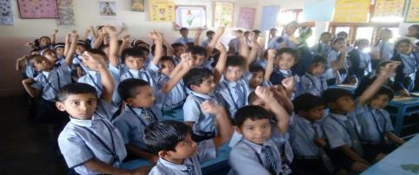
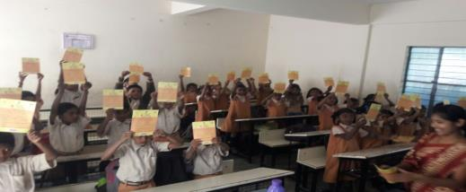
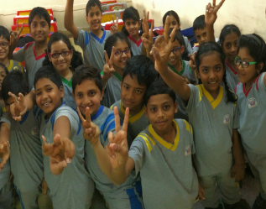
Engagement with children during observation period for
30 min after MR vaccination
Increased engagement with children – MR Warrior Concept

Slide 23
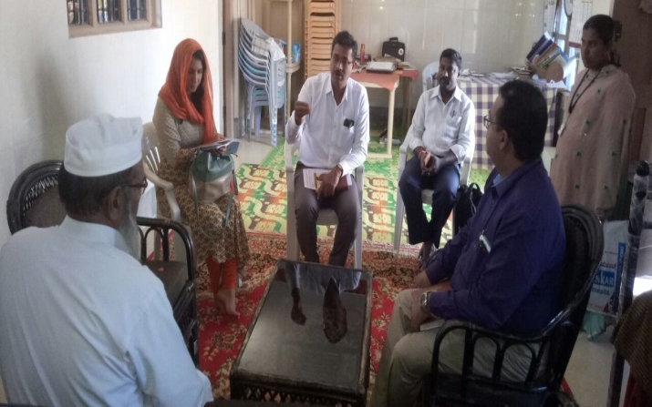
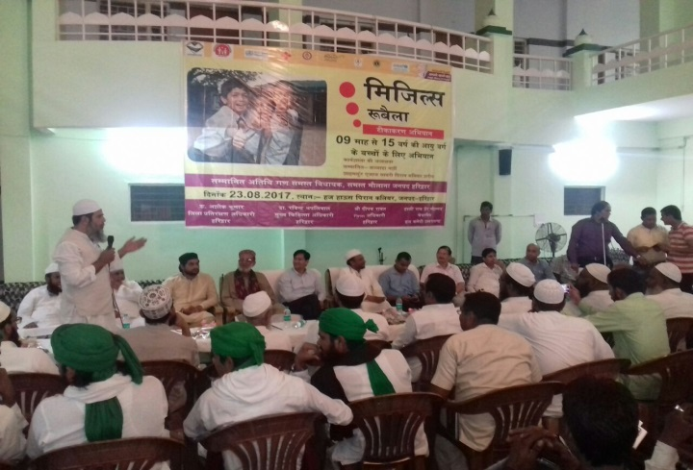
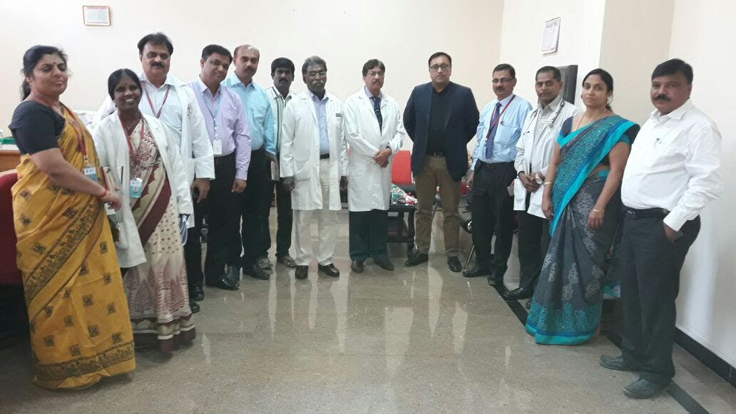
Improved urban strategy for campaign
Involvement of Medical Colleges
Addressing madrasa schools leads
Program tracking meeting at district level
Religious leaders’ meetings
Continued engagement with Lions club

Slide 24
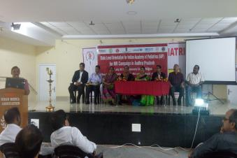
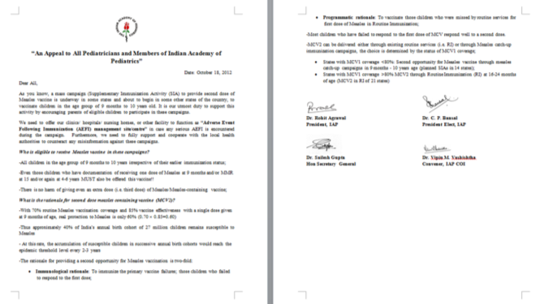
Improved convergence with Professional Bodies
Unlike phase 1, support provided for state & district level orientation of leading paediatricians, physicians, clinicians
Intensive support provided by Indian Academy of Paediatricians
  Appeal to endorse & support MR campaign
  Dissemination of FAQs, especially why additional MR dose, safe vaccine messages
  Participation in task forces & awareness through various platforms
  Audio-Visual appeals shared
MR related: IAP endorsement
http://iapindia.org/page.php?id=202
http://iapindia.org/page.php?id=132

Slide 25
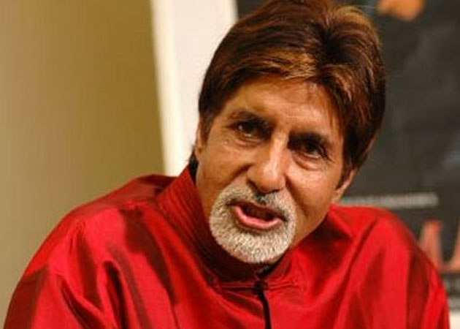
Celebrity involvement
Amitabh Bachchan, Bollywood actor
  Video 1
Dr Devi Shetty, Famous Cardiologist
Factoid videos on MR

Slide 26
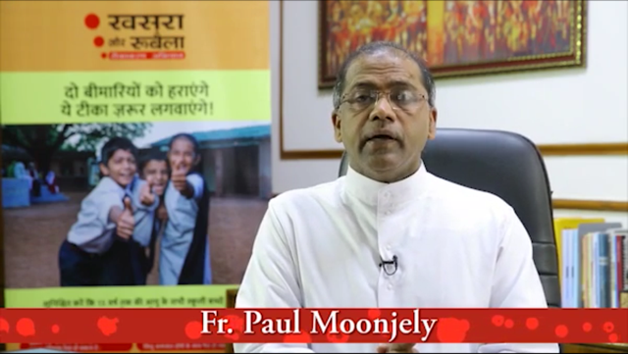
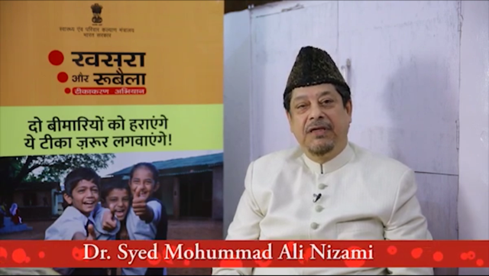
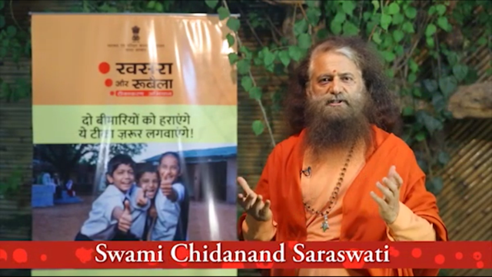
Appeals from Religious leaders
Appeals and endorsement for MR campaign from religious leaders

Slide 27
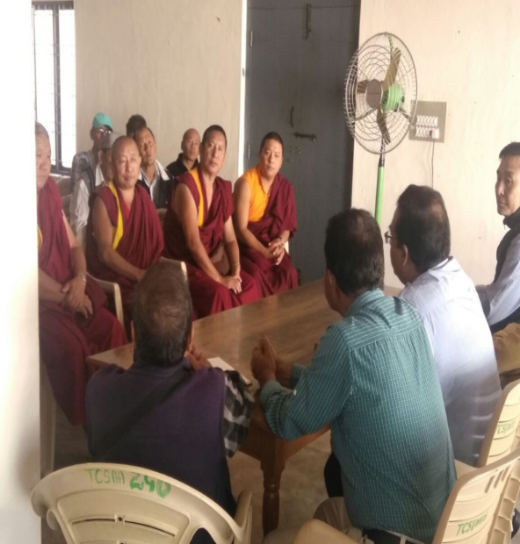
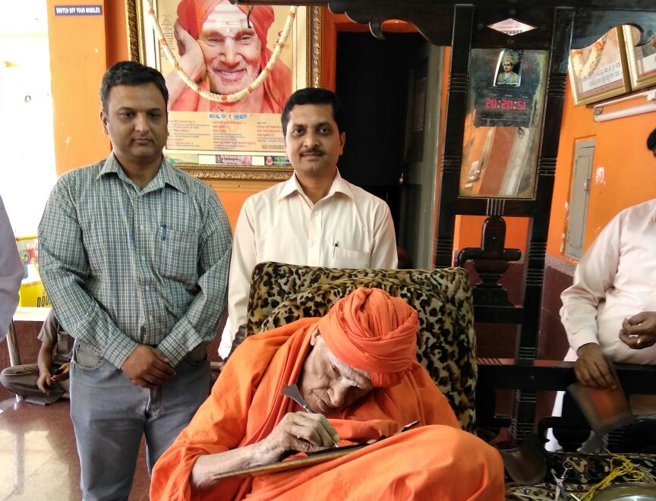
Engaging Civil Society & Faith Based Organizations
Engaging community opinion makers

Slide 28
Additional HR deployment
WHO NPSP & UNICEF experts deployed
Selected experienced government/other staff deployed in phase 2 states as rapid response team members
Built capacity of select Govt/WHO/UNICEF/CSOs for next phase

Slide 29
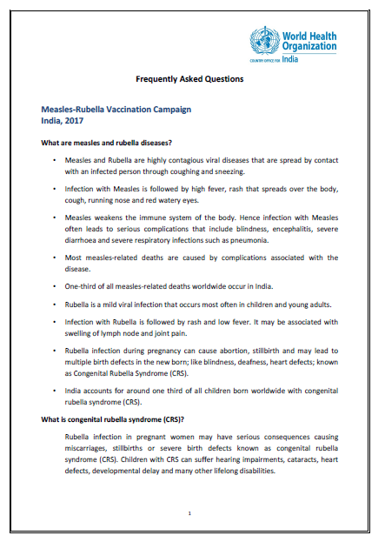
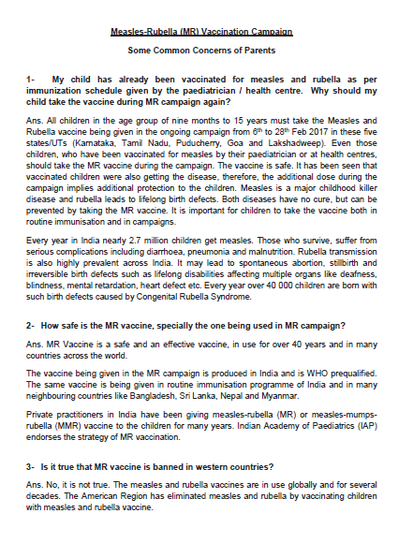
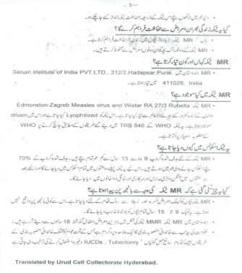
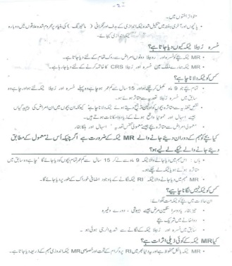
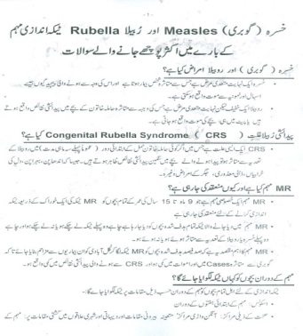
Intensified FAQ dissemination
Samples of FAQ documents
FAQs on WHO website
FAQs in Urdu
FAQs on MoHFW website

Slide 30
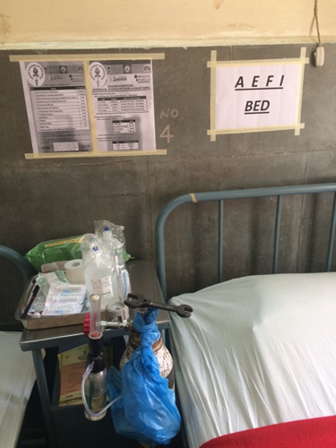
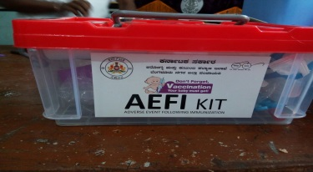
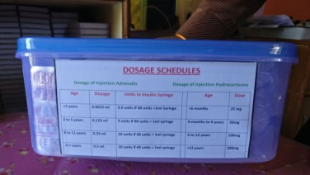
Increased emphasis on AEFI management
AEFI committee meeting
AEFI trainings for MO & Health worker
Tagging of session sites to identified AEFI centers
AEFI Kits supplied to each ANM , Supervisor and facility
AEFI communication plan
AEFIs are promptly being managed at session sites
AEFI management in
health facilities
Phase 1: Children were not engaged during observation period for 30 min after MR vaccination
Phase 2: Engagement with children during observation period for 30 minutes after MR vaccination

Slide 31

Phase 1: Key lessons learned
Phase 2: Interventions
Optimize National, State and District task forces for convergence
  Strengthening inter-departmental coordination
Sufficient preparatory time for SIA
Special attention on School strategy and Urban area planning
Further strengthening Communication and media strategy, including social media management
Engagement of pediatricians & private practitioners
Strengthening supportive supervision
Pre, intra and post-campaign monitoring
Plan post-campaign sweeping based on RCM and administrative coverage data

Slide 32
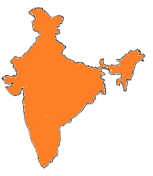
Reiterating the commitment
India committed to achieve measles elimination and rubella control by 2020
Sustained efforts are being made to conduct high quality MR campaign
Partner support critical to achieve quality of MR campaign

Slide 33

Thank you

