Slide 1




Communication Strategy for MR Campaign
2016
2017

Slide 2
Communication objectives for the MR campaign
Positive positioning of MR campaign
Strengthen capacity of health workers on interpersonal communication (IPC) skills to ensure effective mobilisation
Build an enabling environment - positive media reporting and creating awareness on date/ time and place of the campaign, need for MR
Facilitate community acceptance of MR vaccination during the campaign

Slide 3
Communication strategy contents following components:
Advocacy
Social Mobilization
  Media Management – new media and social media
  Communication planning , implementation and monitoring

Slide 4
Advocacy :
Advocacy is the process of building support and gaining consensus for encouragement a commitment for an issue at all levels for:
  Policy decisions
  Bringing focus
  New initiatives

Slide 5
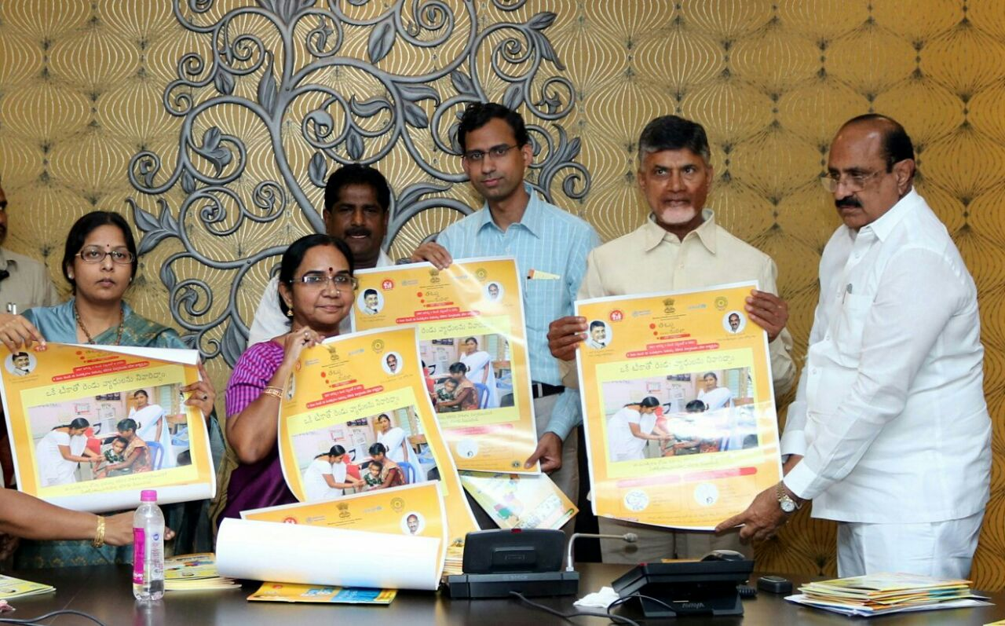
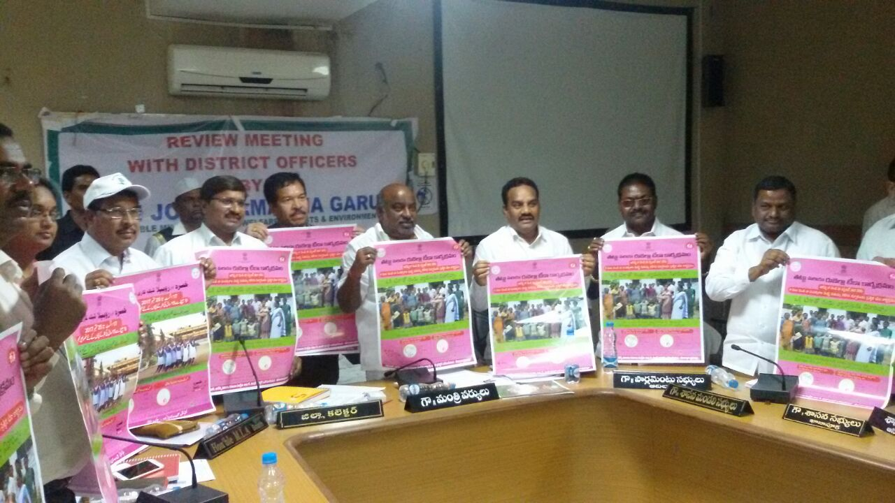
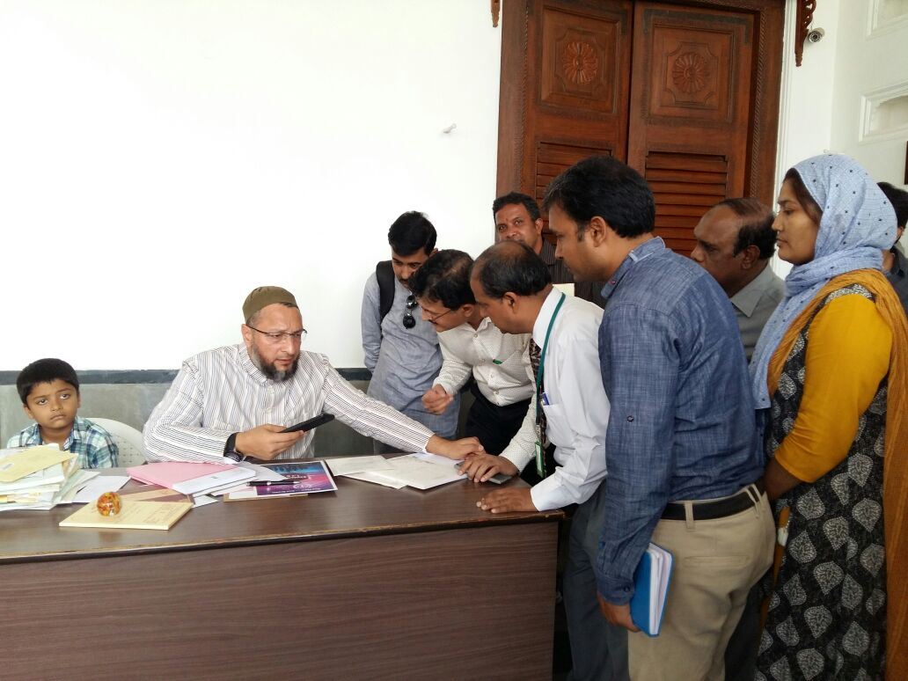
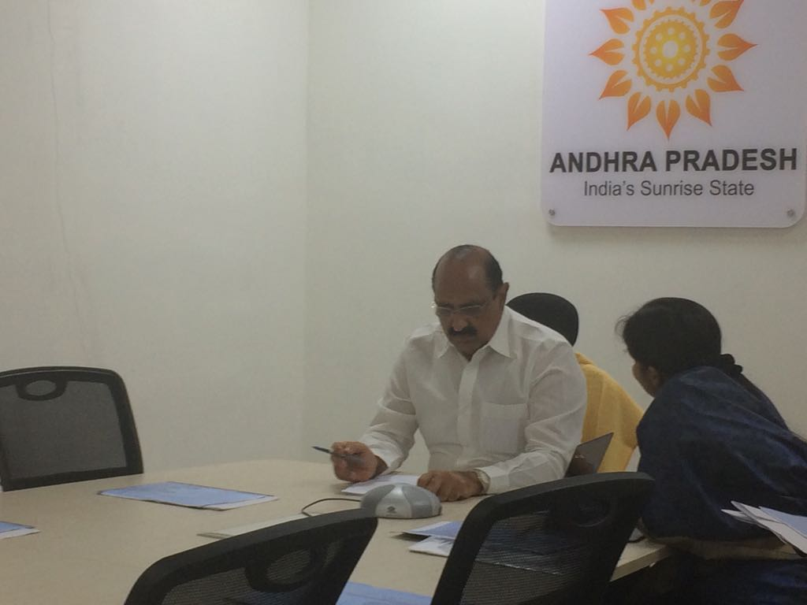
Advocacy with policy makers

Slide 6
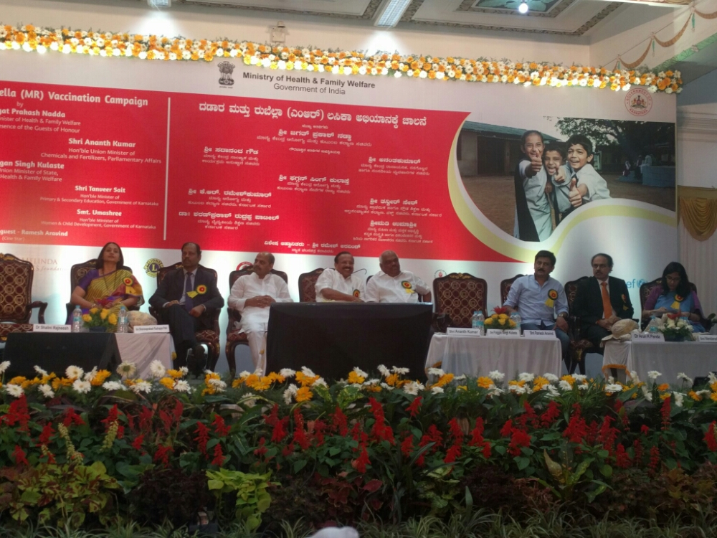
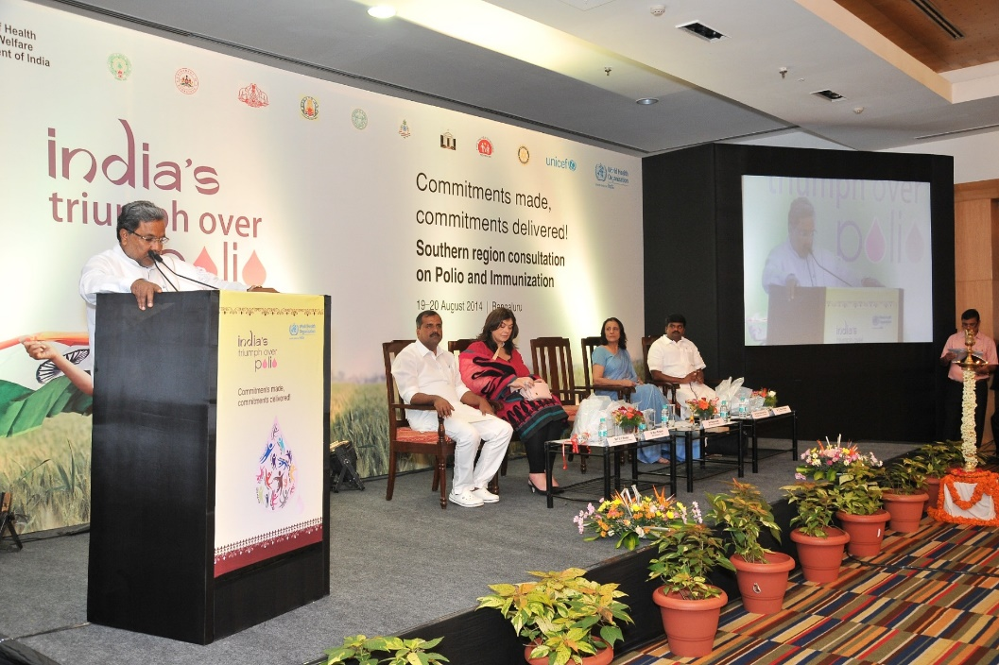
Advocacy and sensitization of all key stakeholders and partners
Major stakeholders in MR campaign :
Top government officials from Health, Education, ICDS, PRI and state Minority board.
IMA/IAP, IPHS , Rotary clubs, Loins clubs
Education boards including Madrasa Board and schools ( major focus on big private schools)
Local media representatives
Public sector companies
Development partners NGOs, CBOs
Religious leaders
Notes:
This is essential to mitigate any risks to noncompliance, community participation, vaccine avoidance behavior and risk communication for any AEFIs that can jeopardize the campaign, as was observed in few states in the last campaign.

Slide 7
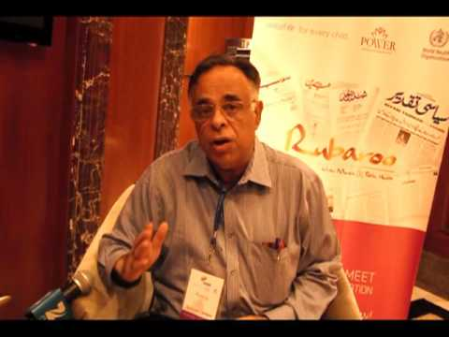
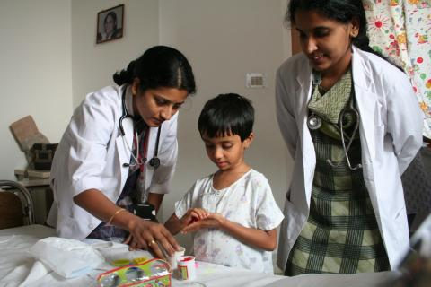
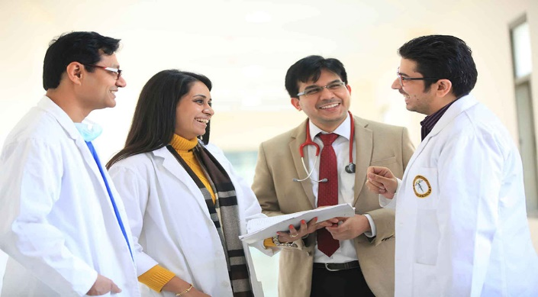
Advocacy with Private practitioners
Role is important, sensitize the leading private pediatricians through IAP/IMA /lions
Facilitate/ influence acceptance of the MR campaign in the communities
Support the school campaigns - high end posh schools in cities
Serve as a spokesperson in crisis
Source:pimsj.com

Slide 8
Poster for IAP/IMA doctors

Slide 9
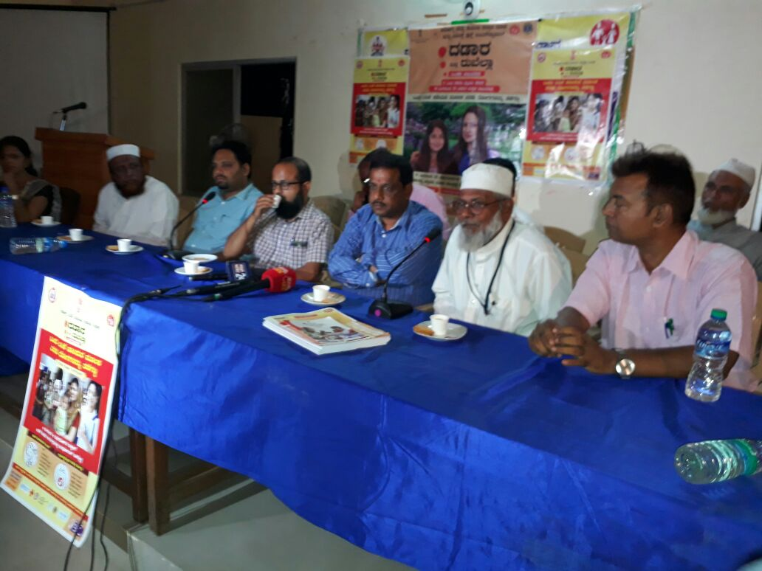
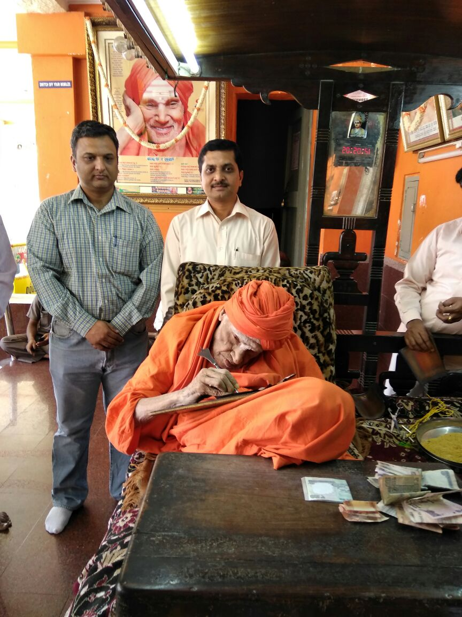
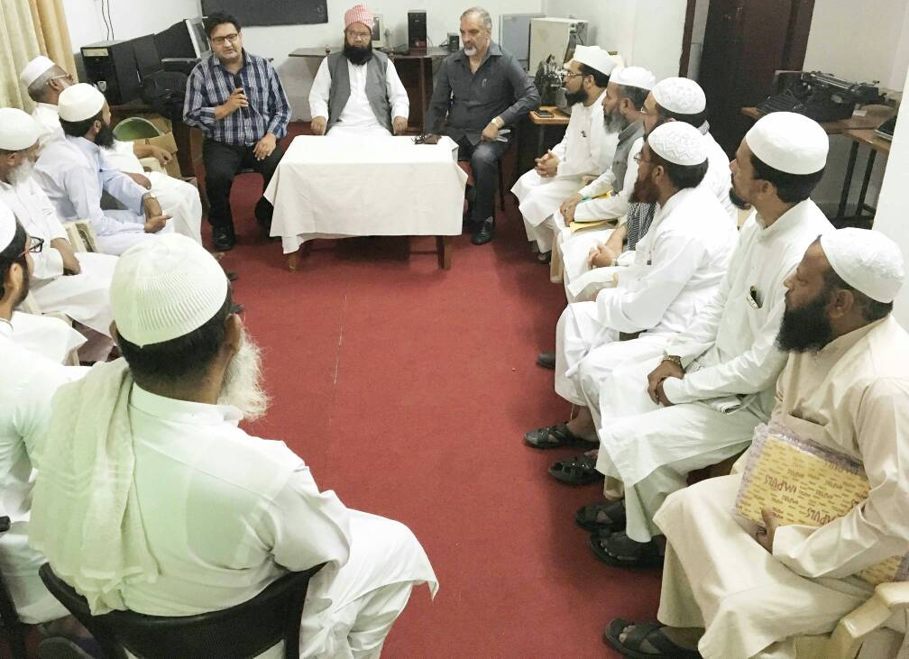
Advocacy with religious leaders
Advocacy with religious leaders at all levels
Involvement of Religious institutions and influencers (interfaith associations)
Information through Madrasa Board, Wakf boards, councils, Church/ temple associations, Shikh institutions etc.
Identify and orient a Key influencers

Slide 10
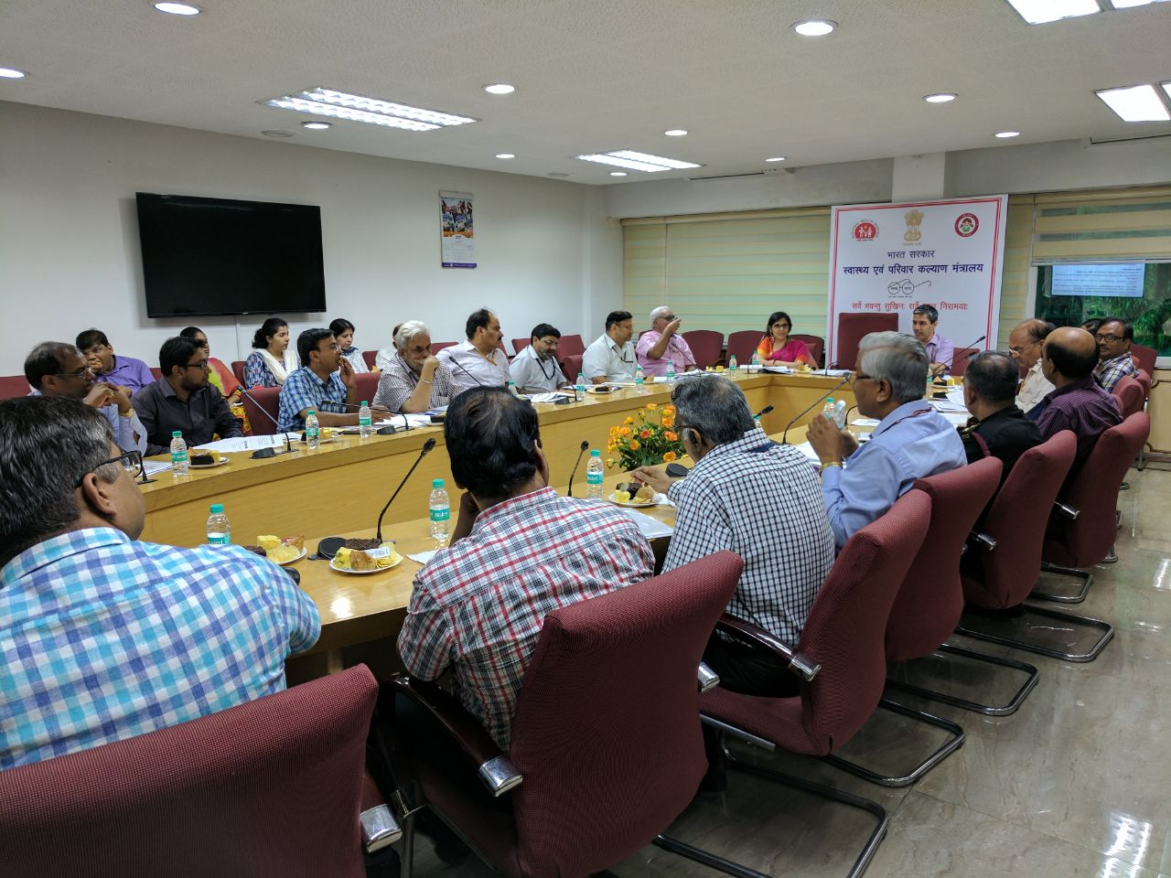
Joint Ministerial support for MR campaign at National level
There was a national inter- Ministerial meeting organized on 25th of July with following ministries on their role and support:
Ministry of Home Affairs:
Ministry of Women & Child Development:
Ministry of Human Resource Development:
Ministry of Information & Broadcasting:
Ministry of Urban Development:
Ministry of Civil Aviation:
Ministry of Shipping:
Ministry of Road Transport & Highways:
Ministry of Defence:
Ministry of Railways- Railway Board:
Ministry of Sports and Youth Affairs:
Ministry of Panchayati Raj:
Ministry of Minority Affairs and Ministry of Tribal Affairs:
Ministry of Labour and Employment:

Slide 11
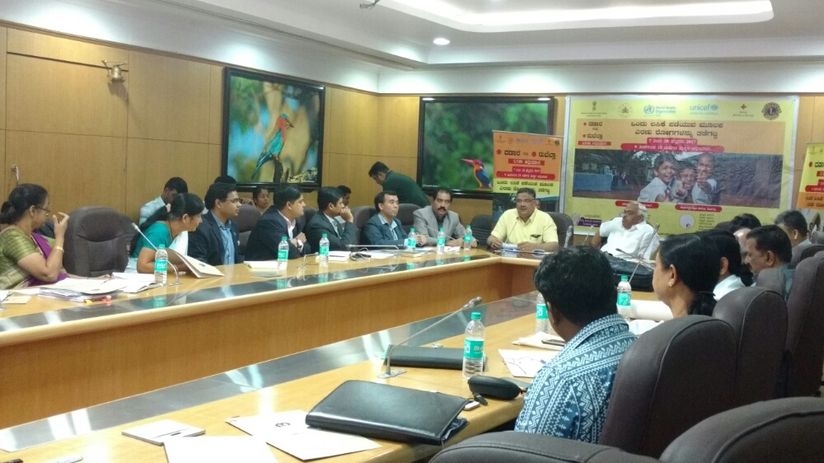
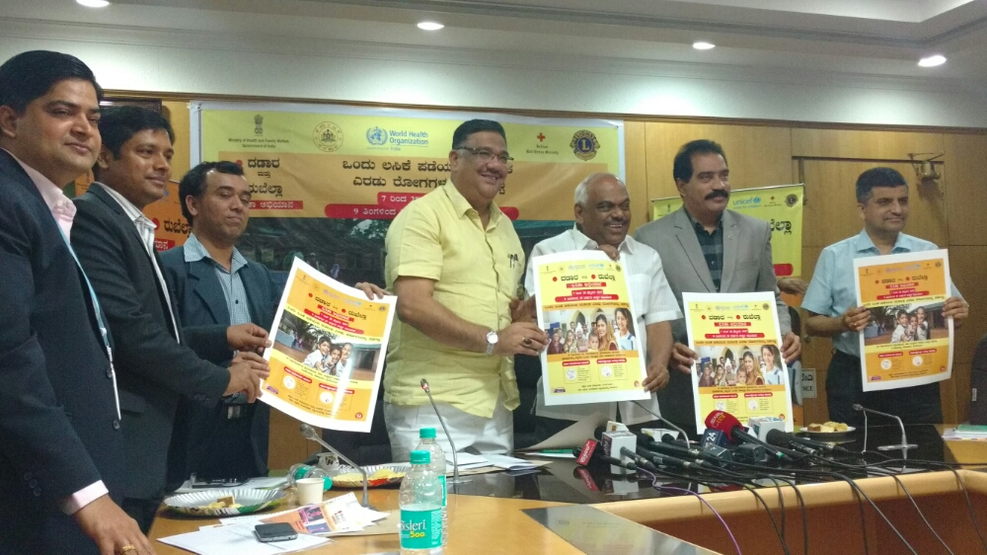
Joint Ministerial support for MR campaign at state level
Measles-Rubella Vaccination Campaign February 2017 Karnataka

Slide 12
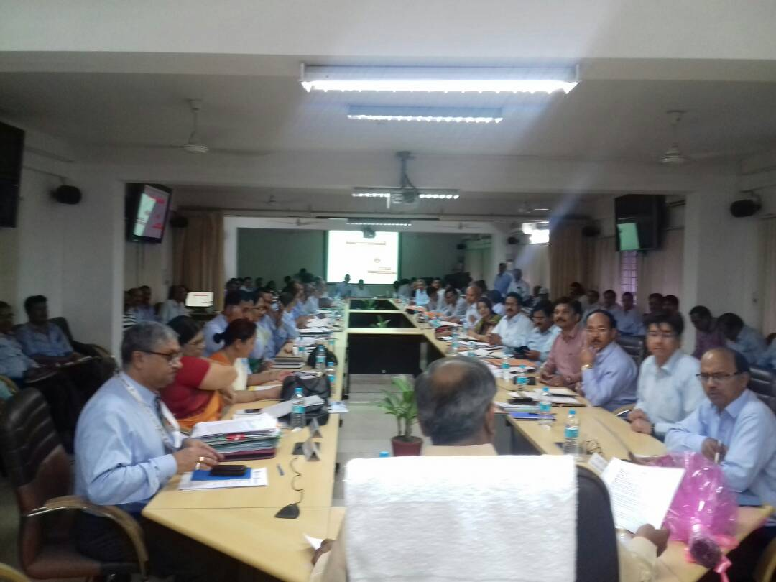
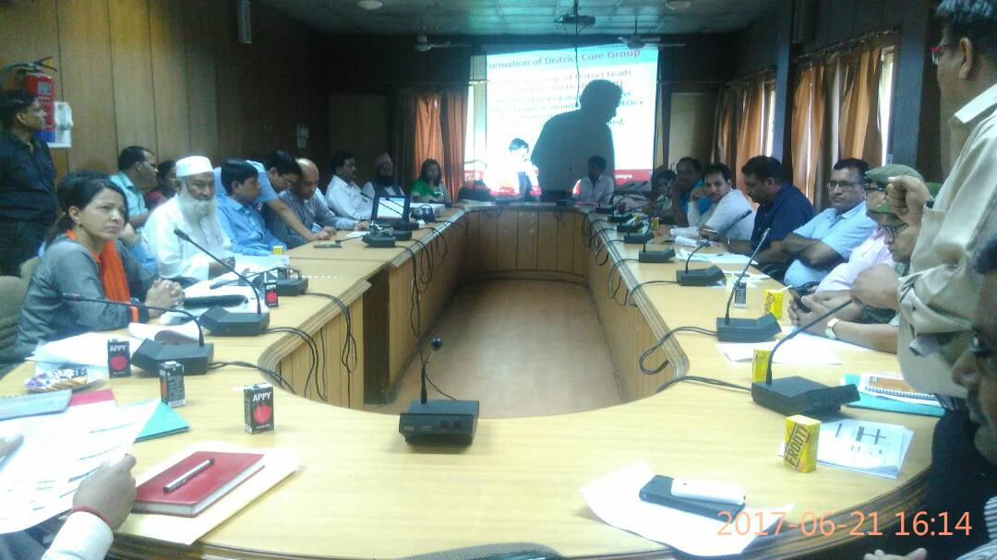
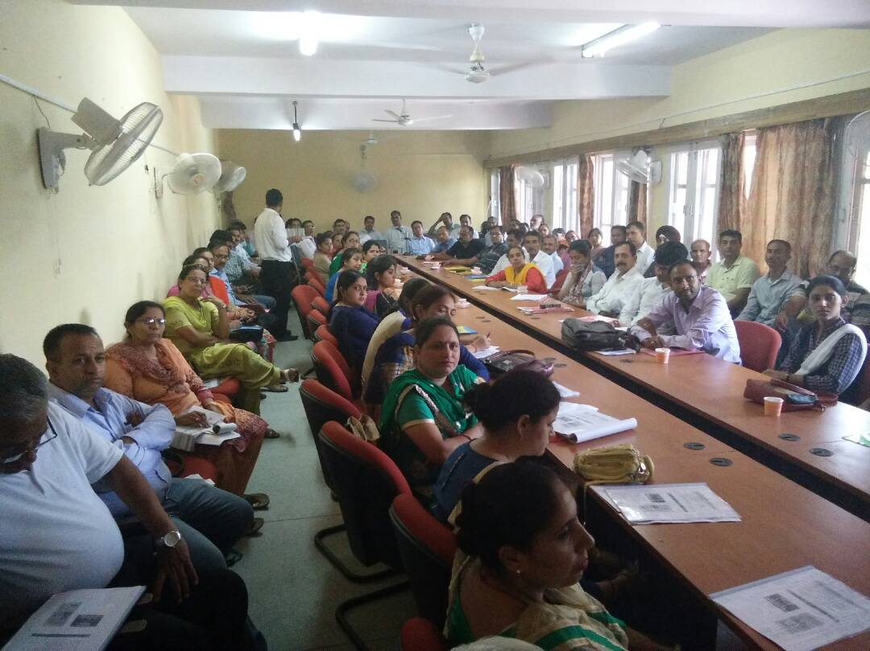
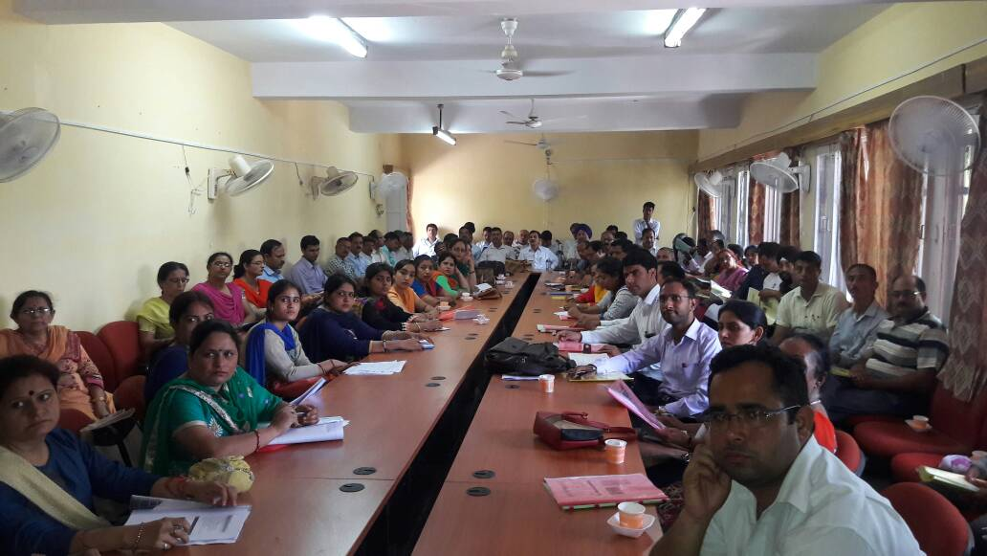
Convergence Meetings with all key stakeholders at district level
Measles-Rubella Vaccination Campaign February 2017 Karnataka

Slide 13
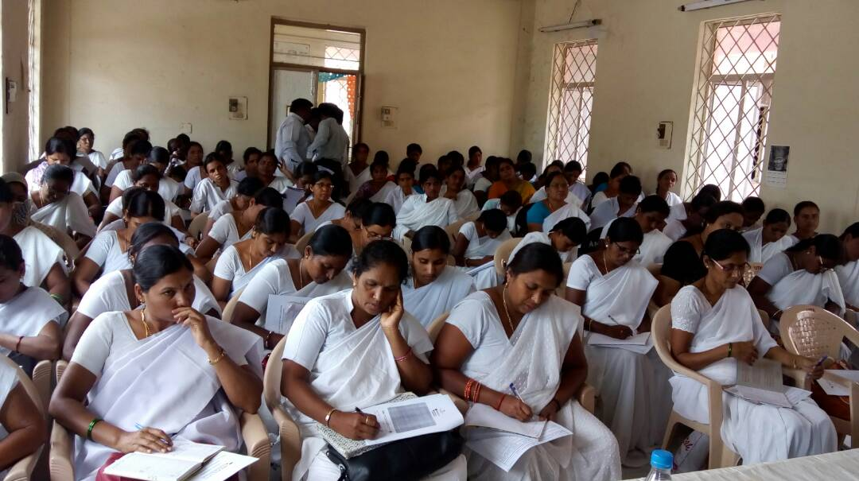
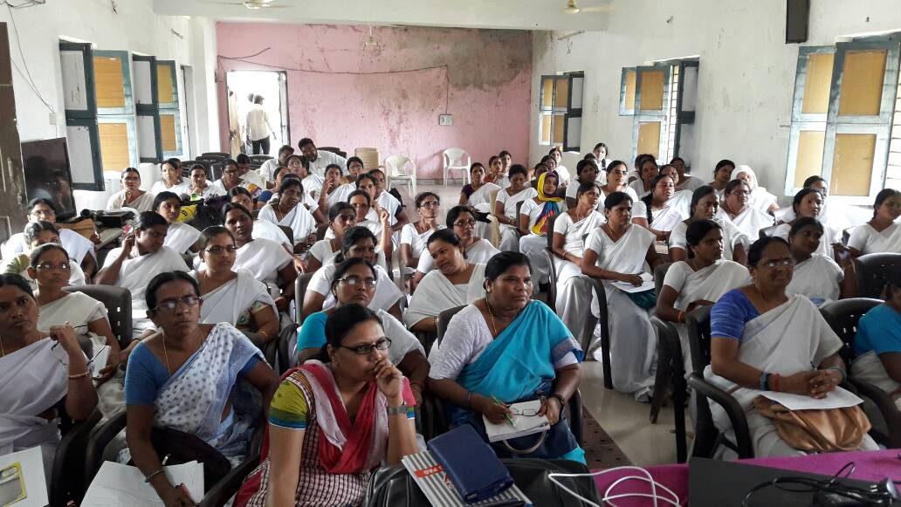
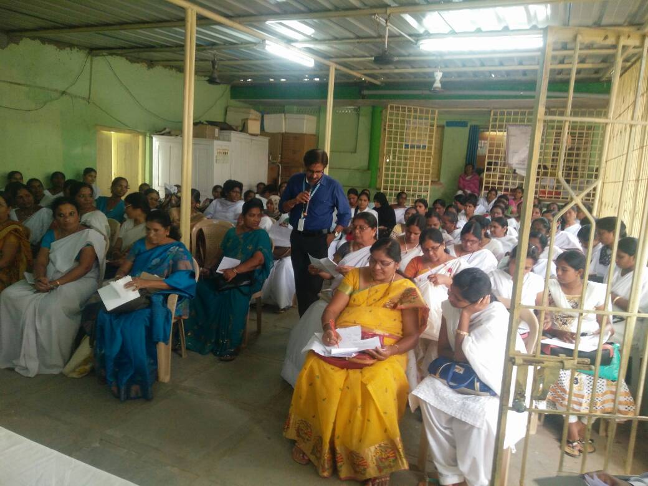
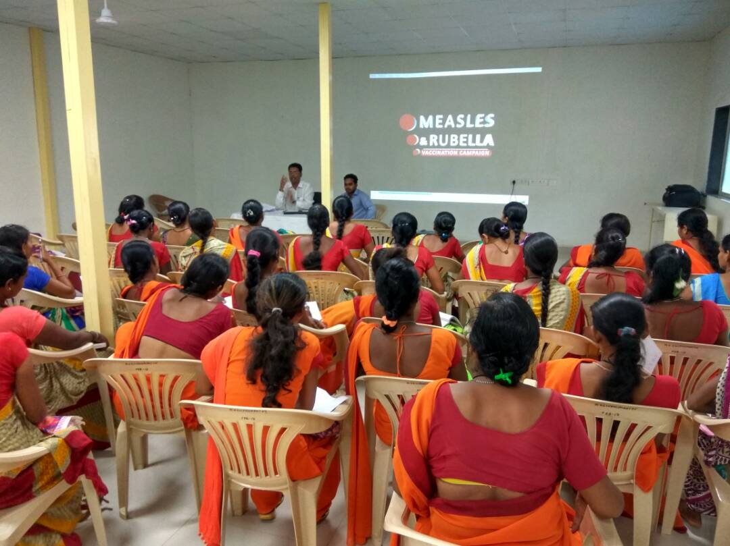
Convergence meetings / trainings with stakeholders at Sub-district level
Measles-Rubella Vaccination Campaign February 2017 Karnataka

Slide 14
Social Mobilization
Why Social mobilization?
New vaccine to be introduced, hence many queries, doubts in community
Need to generate awareness on MR vaccination quickly on the following aspects :
  About MR
  The MR vaccine
  Need for the vaccine
  Its efficacy and side effects
Build trust and confidence in the community especially the target groups on MR vaccination
Role and responsibility of communities members to support in vaccination.

Slide 15
Major stakeholder for Social Mobilization for MR at Community Level
Advocacy at community level to help in IPC :
Ward Member/ Pardhan
Govt. Officials
Namghar President
Vikas Mitra
Tola Sevak
Teacher
ASHA
Police Patel
Jagaliya
Sarpanch
Kotwar
Nayak
Maulavi
Hafiz
Ojha
Godit (Informer)
Postman
Cycle Vendors-Pheriwalas
NGO/CBOs
For Group Communication:
Meetings By Rabidas Vikas Manch
Handloom Units
Mosque
Temple
Gurudwara
Annual Dang Darbar
Puja
Gram Sabha
Women groups

Slide 16
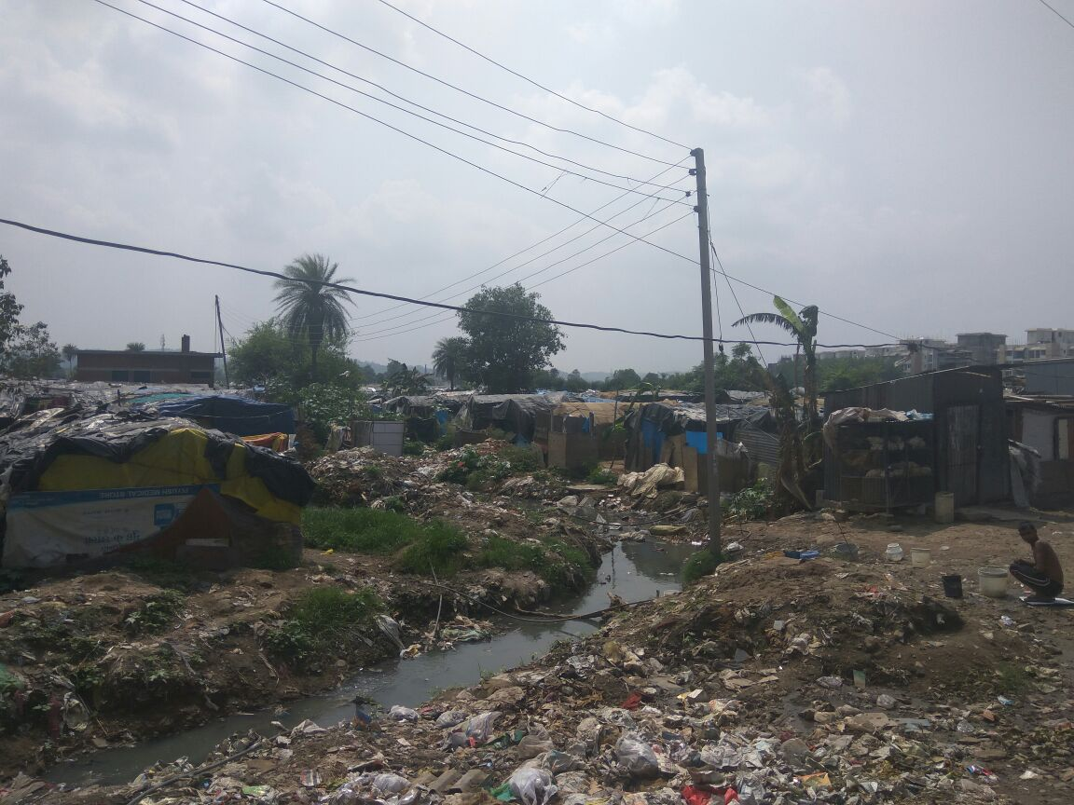
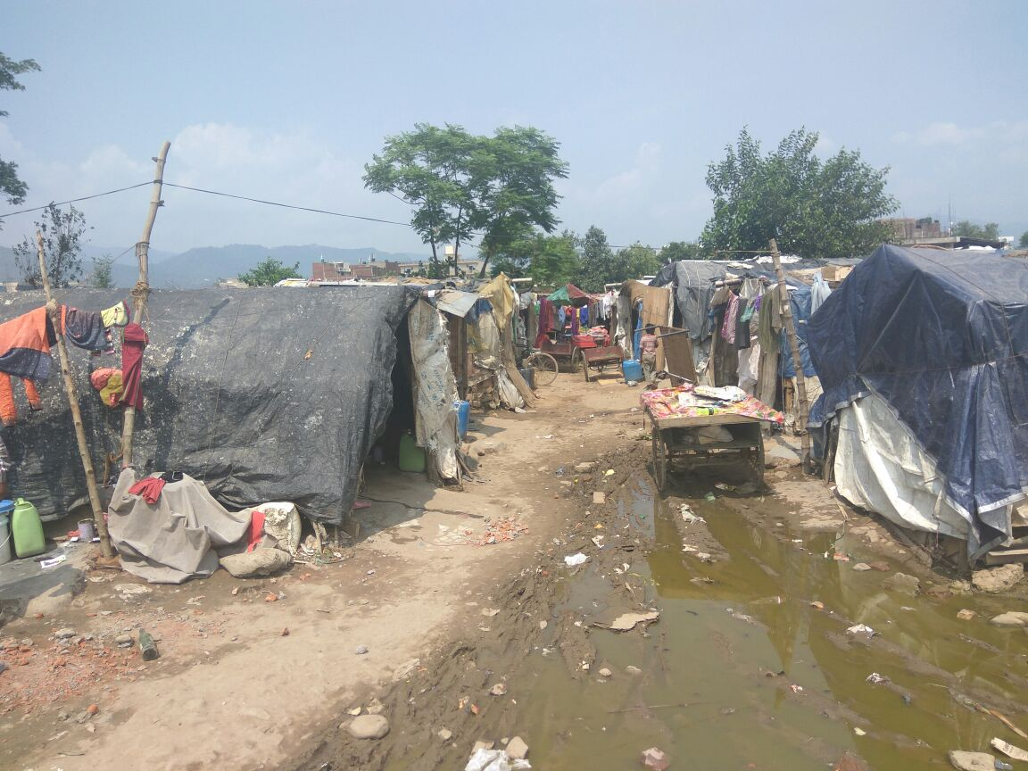
Special focus on High risk areas/population
Identify high risk population – migrants, mobile population, slums, labor colonies, children out of schools, in institutions – orphanage, JJ homes, street / beggar children, etc.
Deploy FLWs for communication activities including the IPC with the HR community .
Engage the influencers of the community
Identify supervisors and monitors to focus on the High Risk Areas / Population

Slide 17
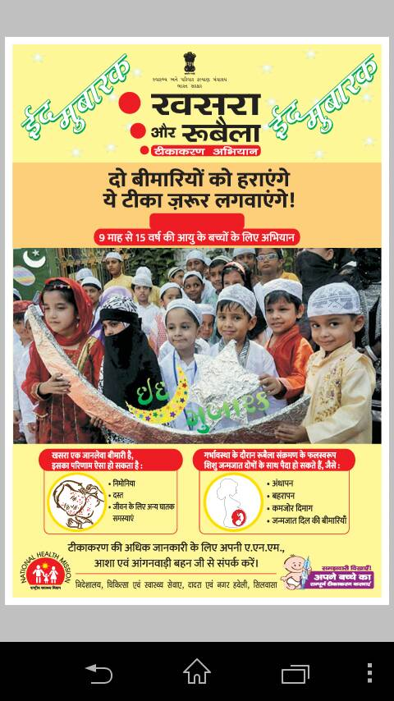
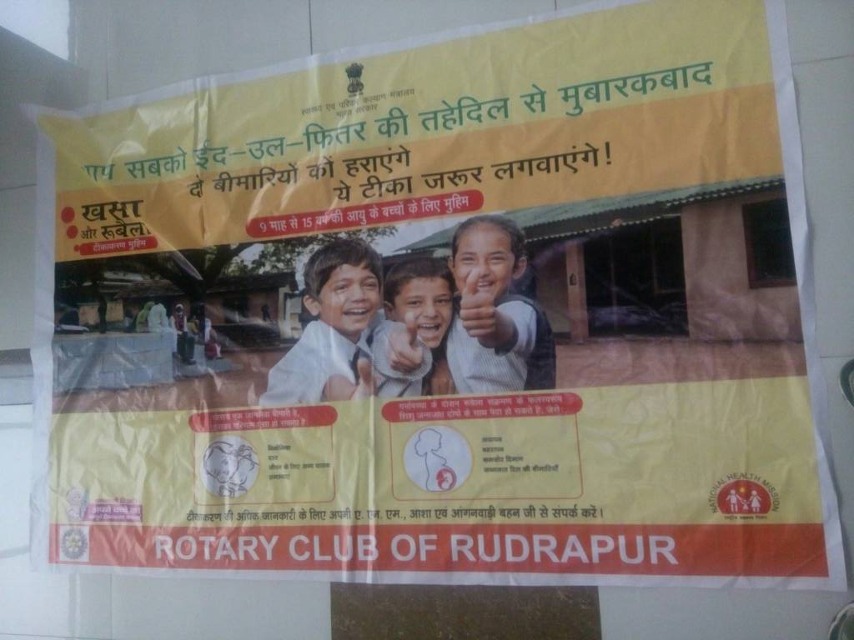
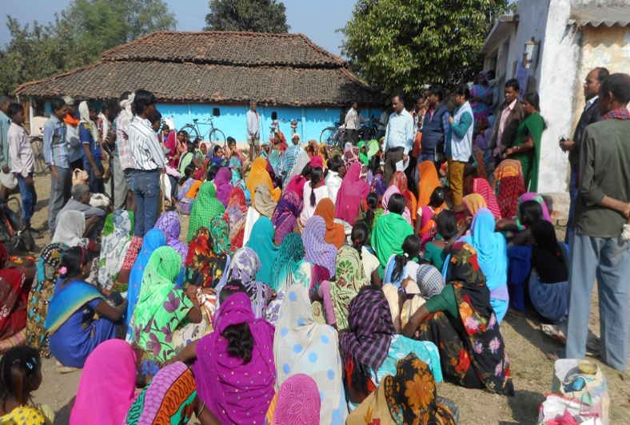
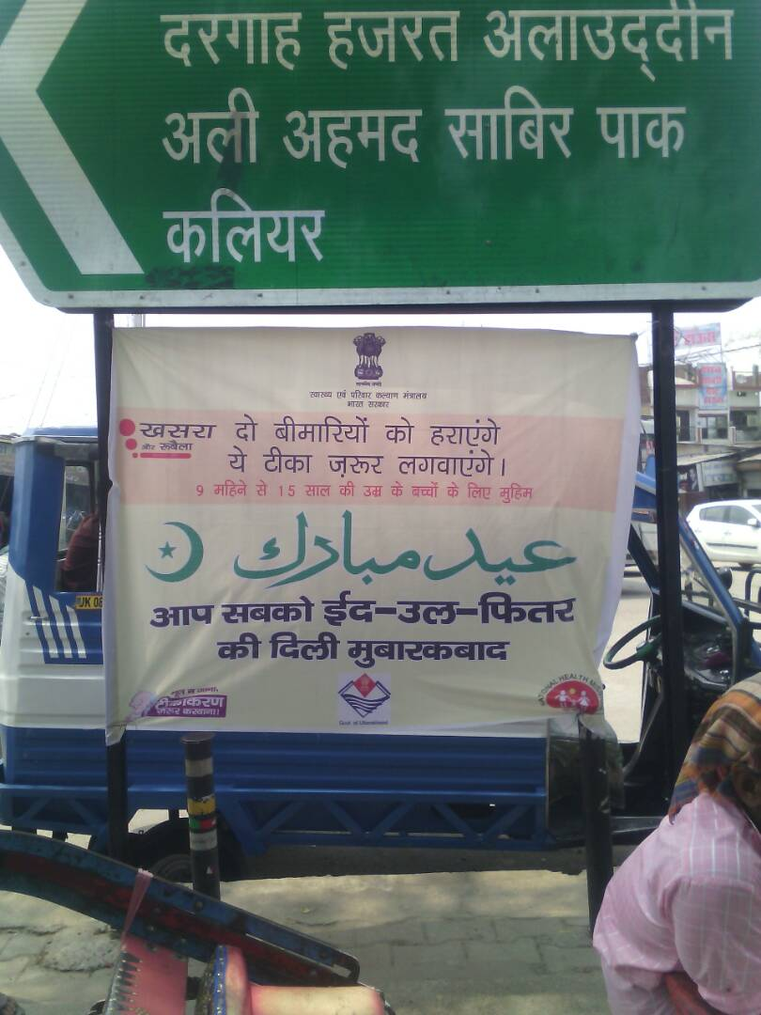
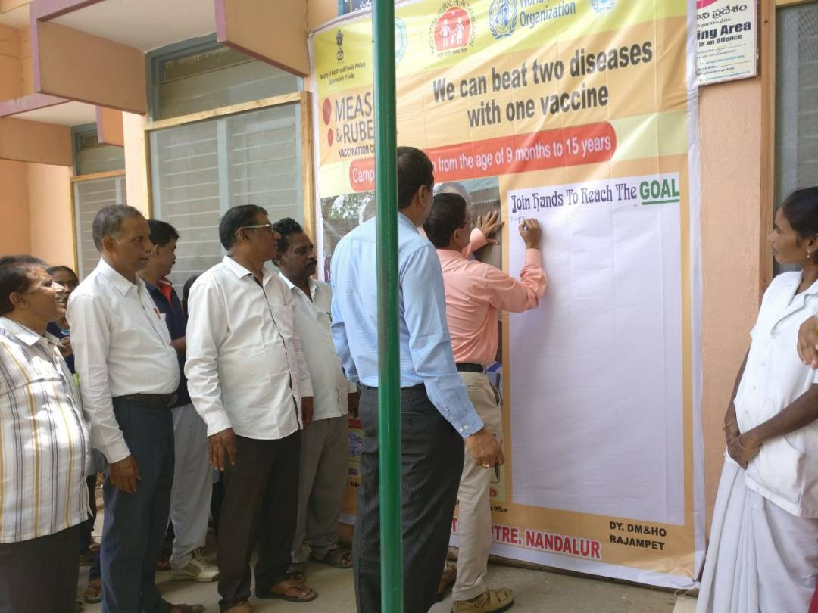
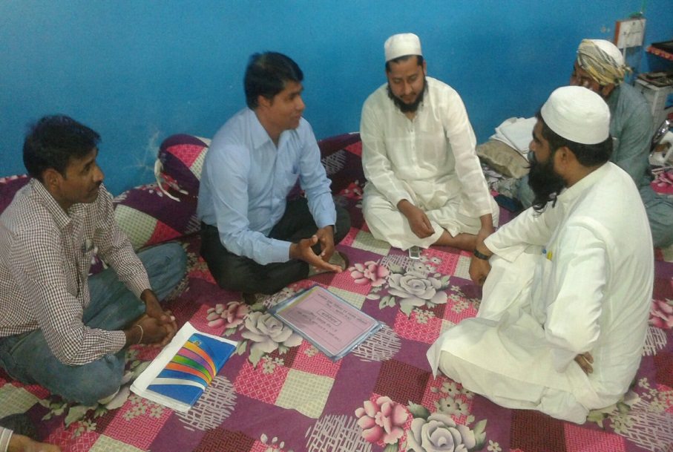
Social Mobilization

Slide 18
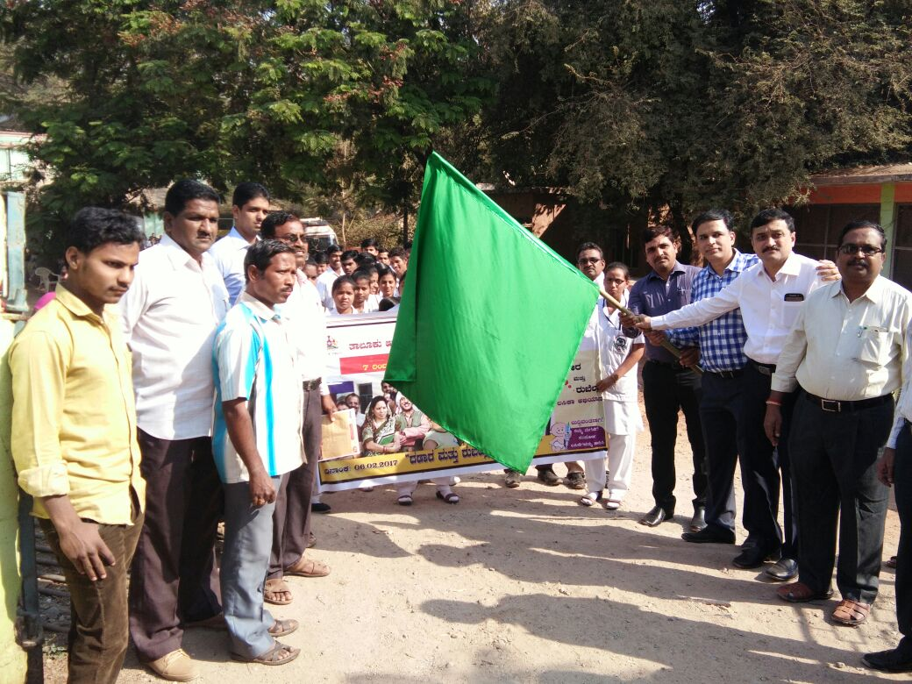
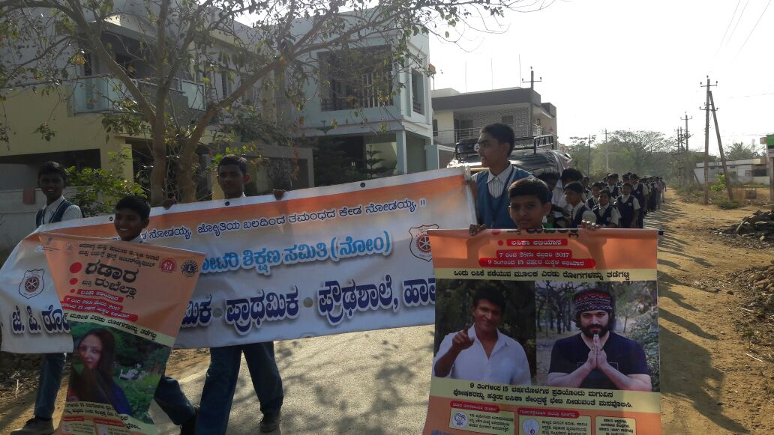
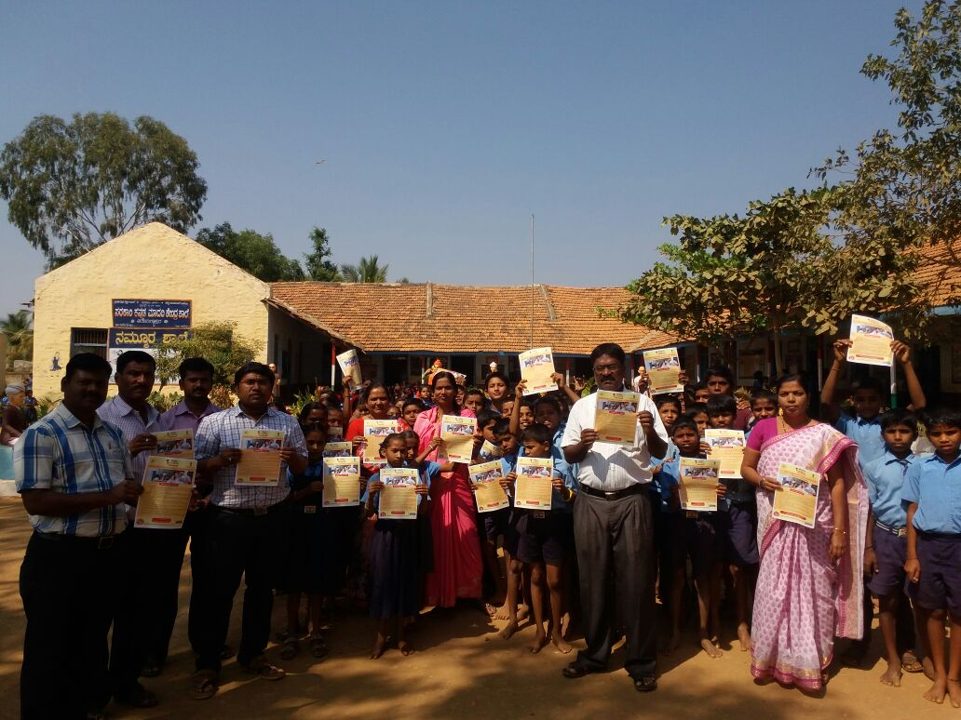
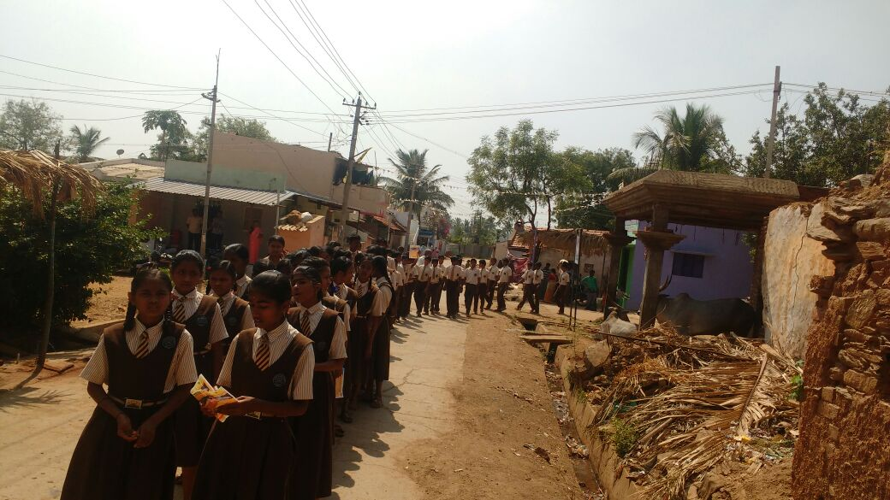
MR Campaign Awareness Rallies
Measles-Rubella Vaccination Campaign February 2017 Karnataka

Slide 19
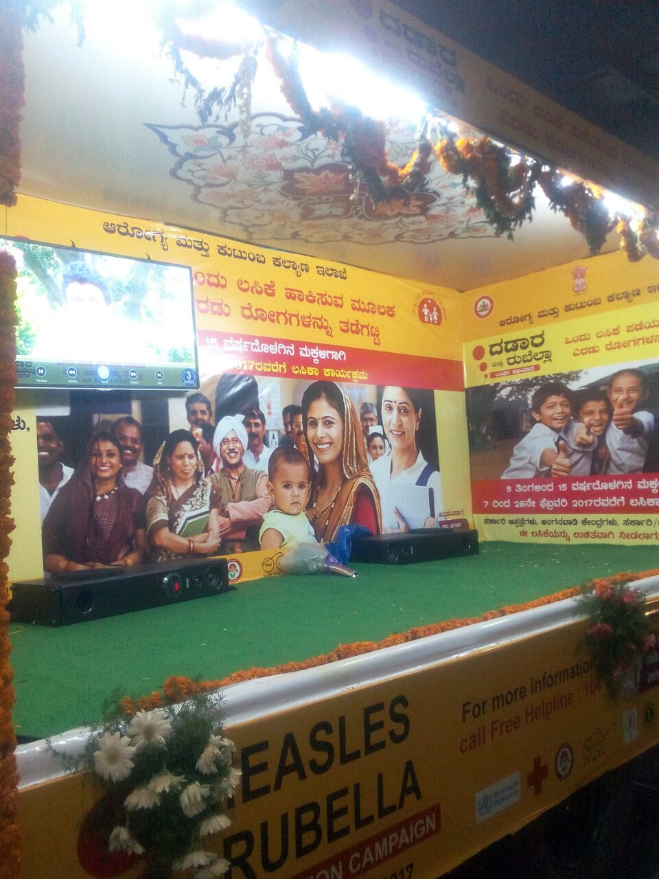
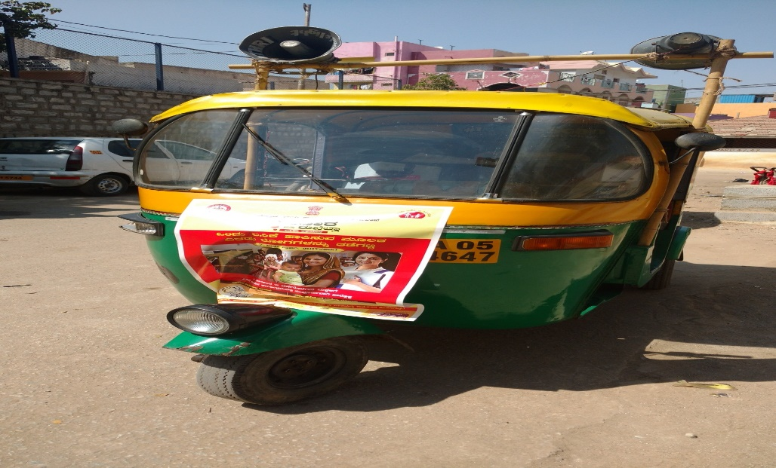
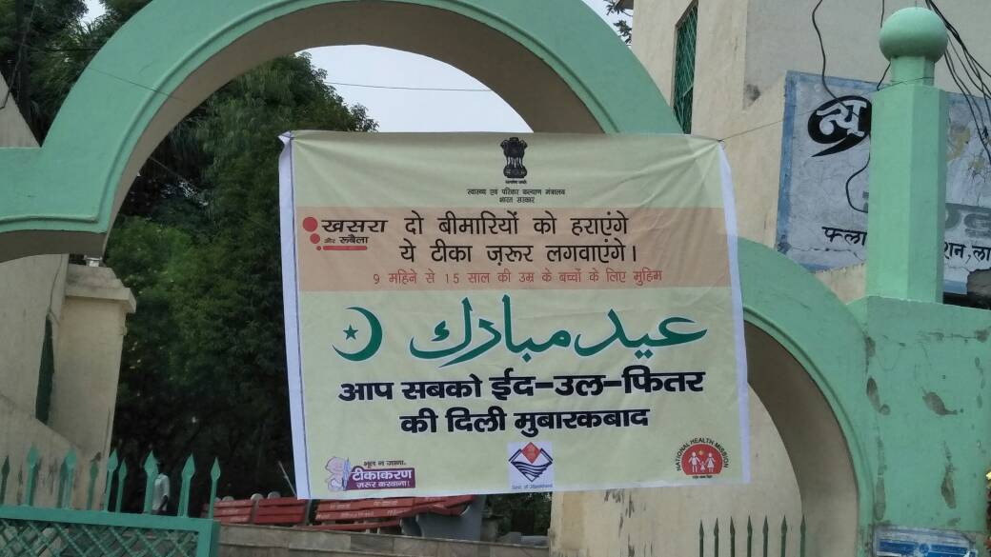
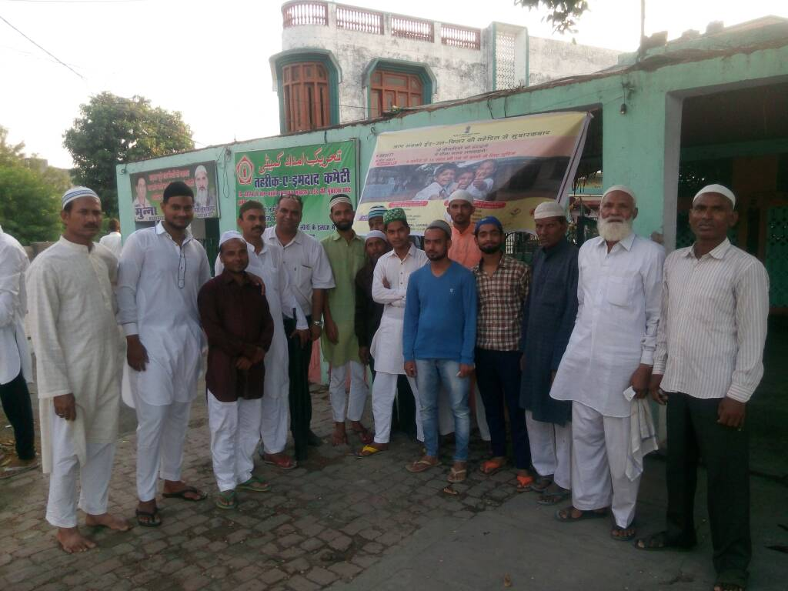
Kala Jatha Van
Miking and supervision through Autos
Measles-Rubella Vaccination Campaign February 2017 Karnataka

Slide 20
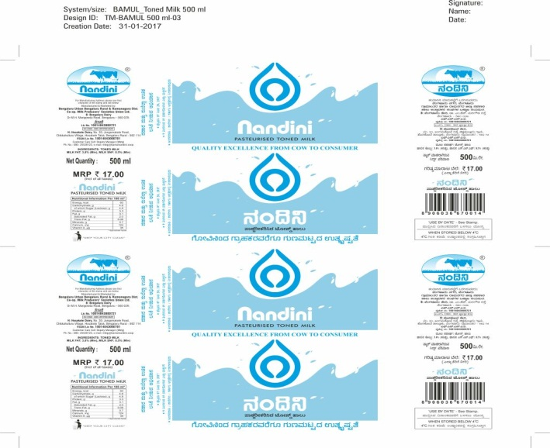
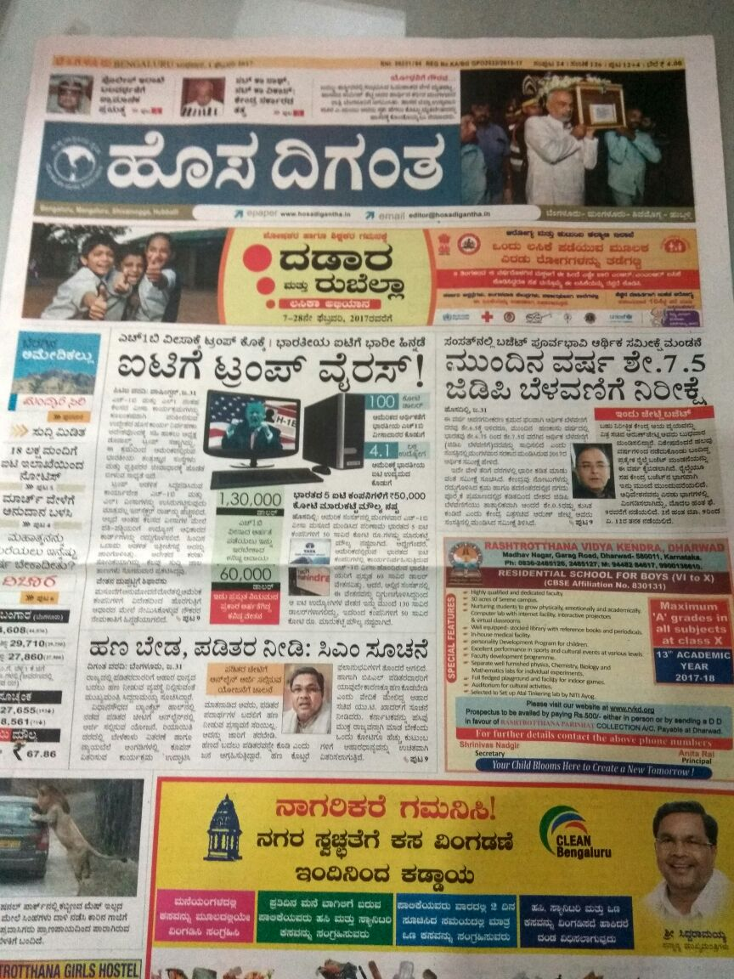
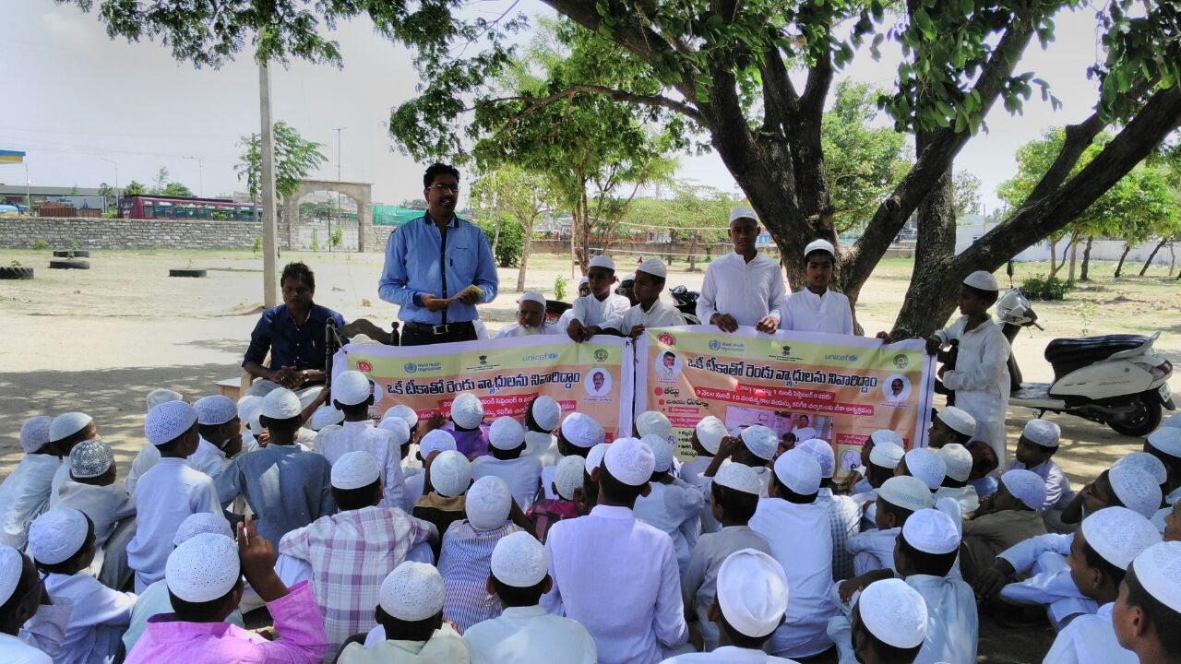
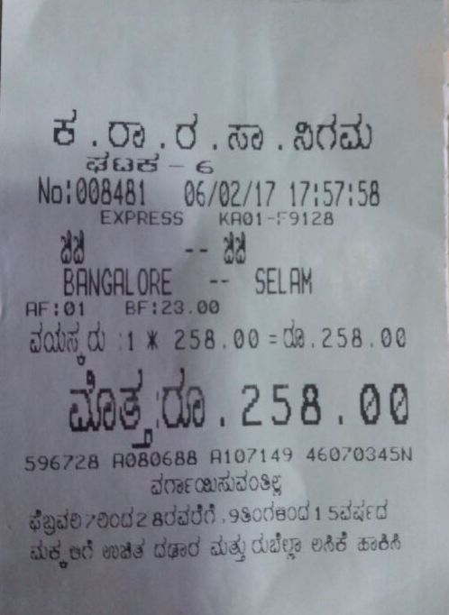
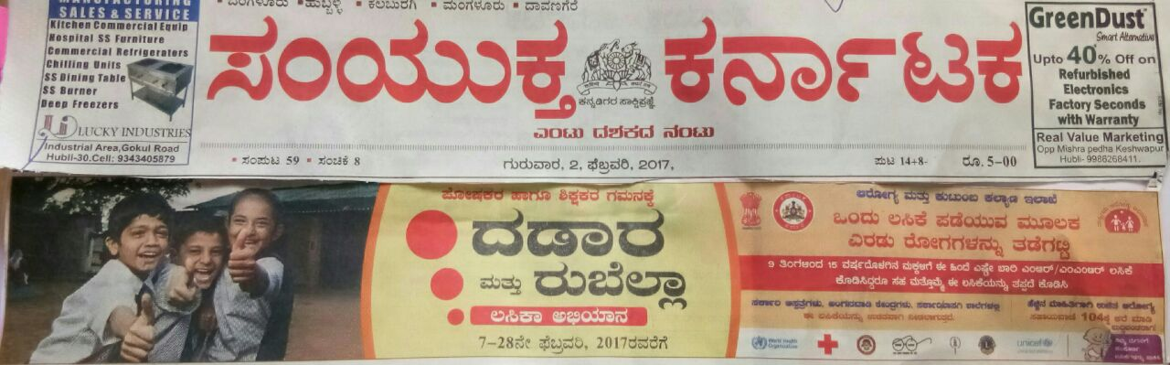
Announcements in Trains, Milk packets, Bus tickets,
Newspaper skyber ads
Measles-Rubella Vaccination Campaign February 2017 Karnataka

Slide 21
Platforms use for MR campaign
Theatre group
Tamasha group
Pooja
Melas/Fairs
Mosque announcements
Drum beat
Haat/Bazar
Local folk songs
Football / cricket matches
Kala Jathas
Kathputli
Local Dance forms
Munadi

Slide 22
School strategy
Major stake holders in SM for MR:
Schools : Education Boards
Private schools , government schools, minority schools ( Madrsha), children enrolled in NEF, Balwaries , play schools, boarding schools etc.

Slide 23

Mobilization of Schools
A government order from Education department should be sent to all schools – for information
Sensitize public & private school teachers/ principals
Include Heads of public/private schools in the planning meetings.
Teachers/association should be oriented at district/ block level
Distribute posters and information and vaccination certificates to the schools
Link schools with AEFI management centers
Notes:
Private School and Private Pediatrician axis needs to be addressed appropriately to soften resistance by families:
Scale up communication – coordination efforts with the education department and heads of schools to improves coverage

Slide 24
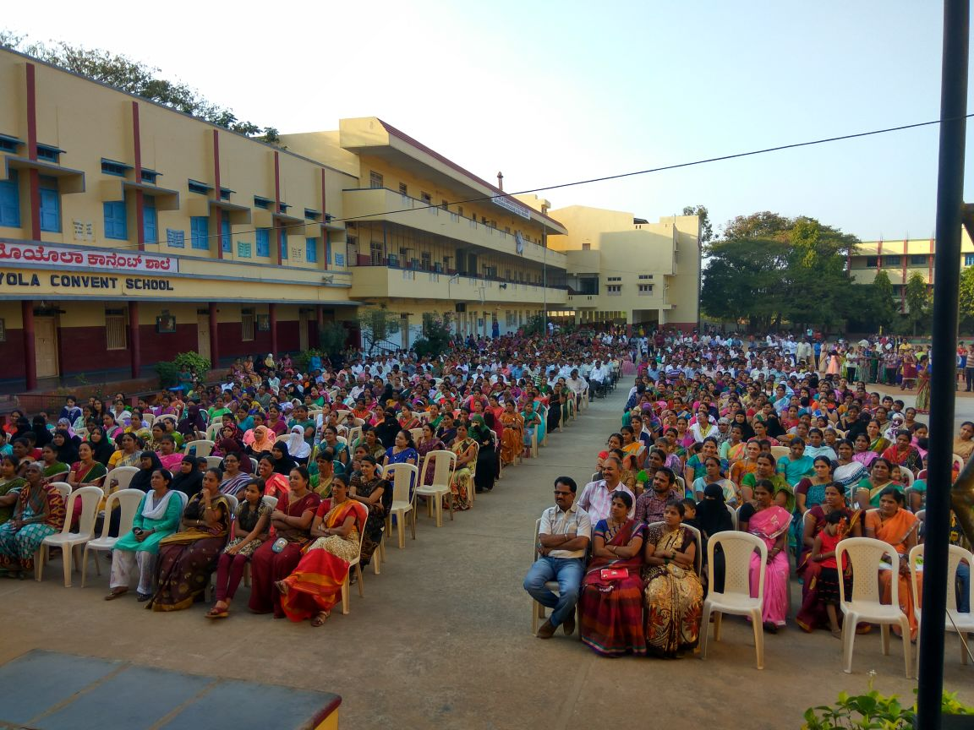
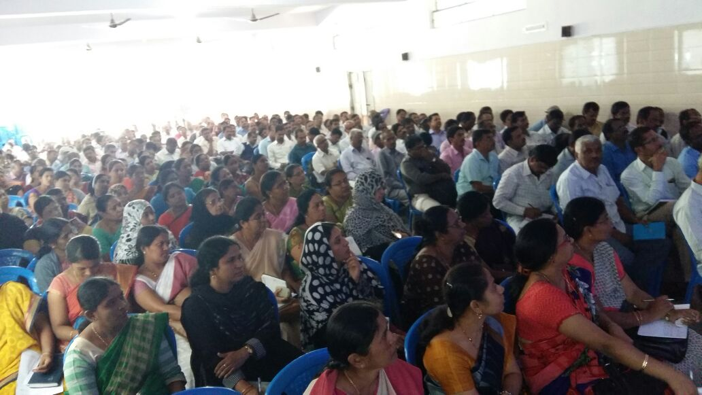
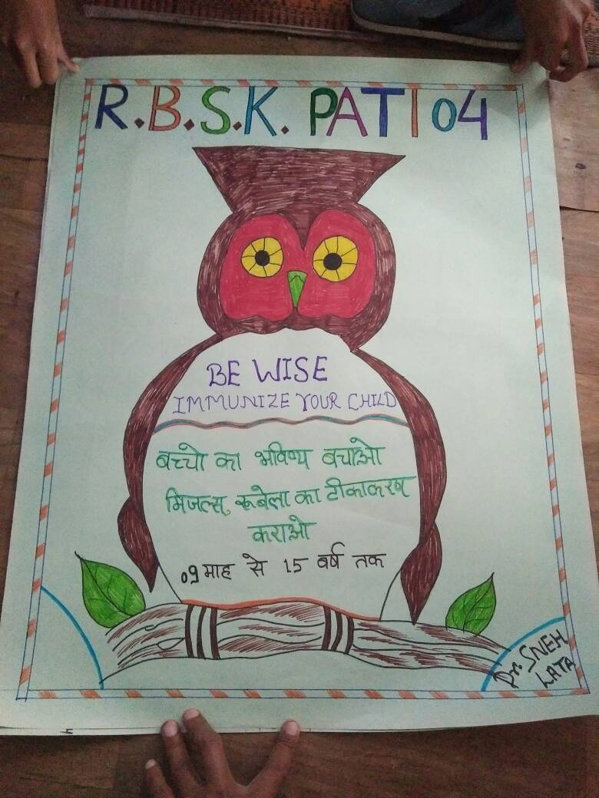
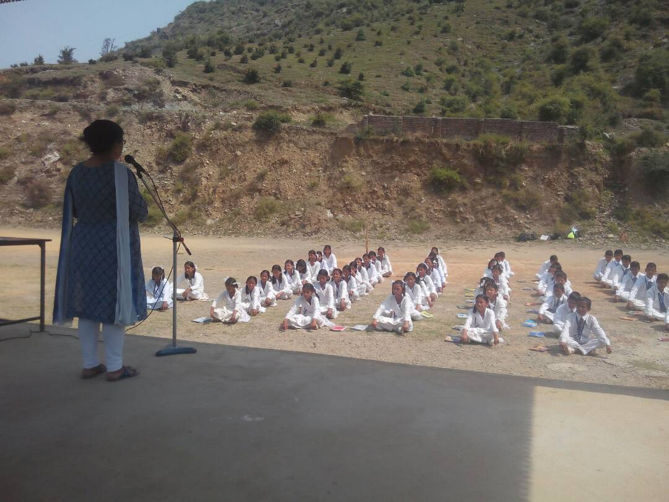
Parents- Teachers meeting at school
Measles-Rubella Vaccination Campaign February 2017 Karnataka

Slide 25
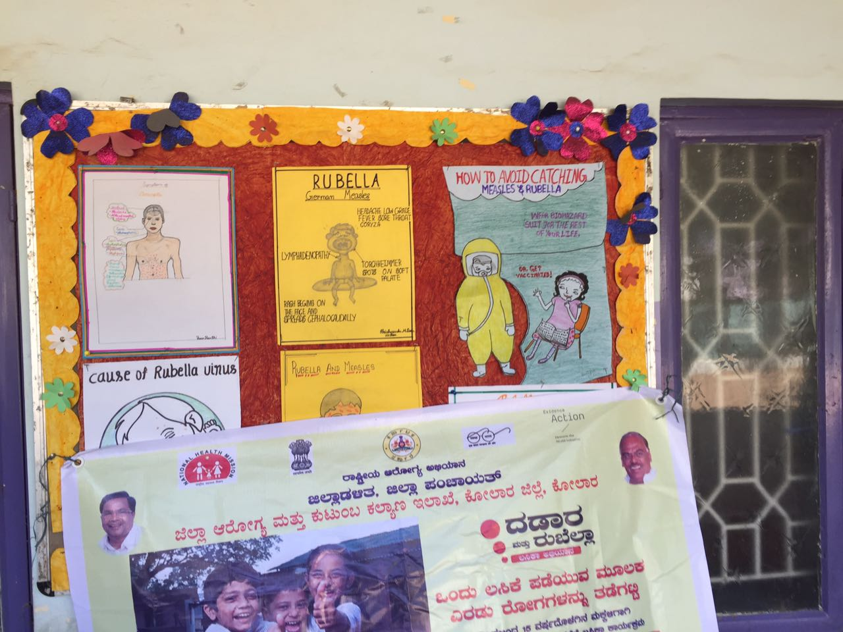
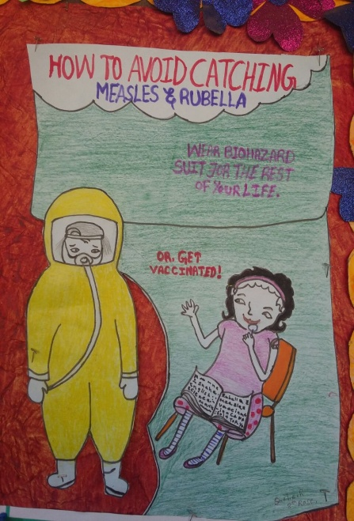







Drawings by School Children displayed in notice board
Measles-Rubella Vaccination Campaign February 2017 Karnataka

Slide 26




MR campaign awareness at Reluctant schools by BIG FM RJs
Chaitanya School
BGS Nobel School
Thathva School
At Mysore

Slide 27
MR communication Package
Mass media
TV/Radio spot – 30 sec duration
Miking/ mosque announcement
Press advertisement – Quarter + half page
Tweets, SMS on MR for social media
Factoid videos
WhatsApp messages
IEC/IPC materials
Poster
Banners
Hoardings
TV scroll/ tickers
Leaflet of key messages for frontline workers, caregivers, community and religious leaders and media etc.
Materials for Schools:
Information cards and vaccination certificate
Handbook for teacher Hindi , English and Urdu
Two animated videos on teachers role – under approval
Materials for Doctors:
Poster for doctors – for use in their clinics and OPD waiting areas
Appeal/ request letters to for public for support in MR campaign

Slide 28

Communication package for all stakeholders
  Double Protection
  Age group
  Break the chain
  Vaccine efficacy & safety
  One syringe One Child

Slide 29
Introduce communication package
  6. Additional dose
  7. No link to infertility
  8. No adverse reactions
  9. Global scenario
  10. All materials have been approved and ready for use

Slide 30

IEC materials – Posters

Slide 31


Customize communication package based on field reality / experience

Slide 32

Banner/ hoarding and ticker

Slide 33

Information card
FLWs to distribute at the household level in the communities 3-4 days before campaign
Teachers to distribute to the students 3-4 days before campaign
At the vaccination site, the FLWs to fill the date of vaccination in the card
If any caregiver/ student does not carry the card, ANM/ FLWs to provide the card onsite

Slide 34

Vaccination Certificate
It will provide all children after vaccination
ANM / vaccinator should keen one part as record.

Slide 35


Leaflets – 6 types for FLWs, teachers, caregivers, community leaders, media and for announcements)

Slide 36


Leaflet for caregivers

Slide 37


Leaflet for community members

Slide 38

Message for miking

Slide 39




Teacher Handbook

Slide 40




Continue-----

Slide 41


Continue-----

Slide 42

Handbook for Religious Leaders

Slide 43

Handbook for Religious Leaders continue---

Slide 44

Information for site and date

Slide 45
Monitoring and supervision
Monitoring and supervision to ensure quality and mid course correction
Identify and deploy supervisors and independent external monitors at all levels
emphasis on the high risk areas / populations as part of the micro plan.
Notes:
Monitoring and supervision with real time data feedback at every level helps in both coverage and safety of the campaigns, leading to improved coverage and overall success.

Slide 46


…..THANK YOU…..

