Slide 1
India: Transitioning of Polio Network to Support Other Immunization Activities
Jeffrey W McFarland, MD
Regional Advisor, WHO South-East Asia Regional Office
On behalf of the Government of India
2015 Measles & Rubella Initiative Annual Partners’ Meeting
16 September 2015
Washington, D.C.

Slide 2
Polio Transitioning Strategy –
Basic principles
Mainstreaming critical polio eradication functions into other priority health programmes
Ensuring that the best practices and knowledge gained over years are shared with other health initiatives
Transitioning certain polio functional areas to government counterparts
Transitioning the capacities, processes and assets created by the programme to support other vaccine preventable diseases and strengthening health systems

Slide 3
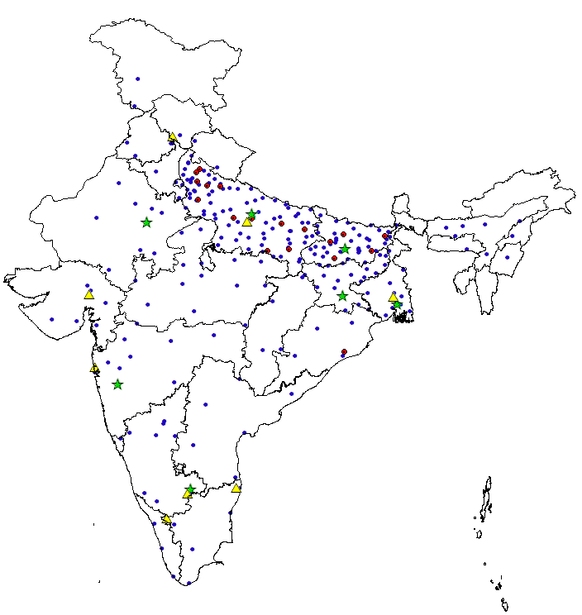




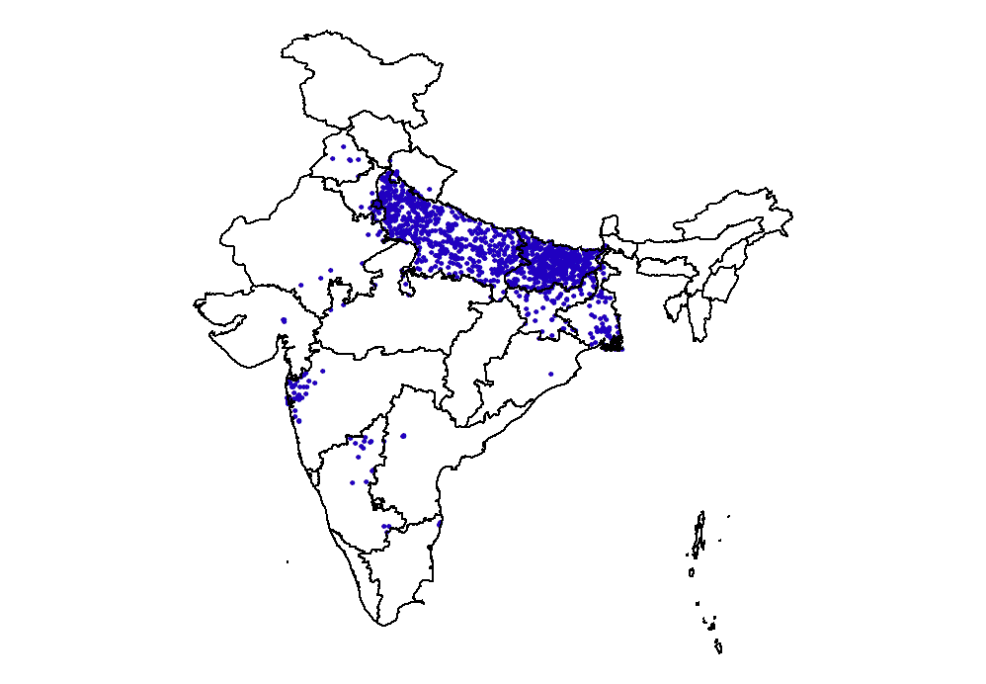
Polio Assets In India: WHO / UNICEF & Others
Medical Officers
Field Monitors
Strengths/Opportunities
Immunization
Training
Social mobilization
Monitoring
Advocacy
Accountability frameworks
Surveillance
Network & systems
Laboratories
Data management
Operational
Offices (state and district level)
Vehicles
IT systems
Overall
Credibility & acceptance on the ground
System familiarity
Microplanning
964
Pan-India
375
48
123
789
6349
Sub Regional Staff
District Mobilization Coordinators
Block
Mobilization coordinators
Community Mobilization Coordinators
7300+ SMNet Manpower in states of UP, Bihar & WB
Notes:
Polio assets and infrastructure includes three primary organization in India (WHO/UNICEF & others) of which only WHO-India, NPSP has the multilayered structure in place covering the whole country manned by medical officers as nodal program officers in liaison with Govt. counterparts. .

Slide 4
Polio Network : Scope of Work
Transitioning health areas
Strengthening RI systems
( MCV - 1 & 2)
New Vaccine Introduction/ Scale-up
(MR - vaccine)
Measles Elimination and Rubella/CRS Control goal
AEFI Surveillance
Maternal and Neonatal Tetanus Elimination
Vaccine Preventable Disease surveillance
Other Emergencies and Disease outbreak response: Kala Azar, Ebola
Maintaining polio-free status & implementing endgame strategy
Notes:
Measles elimination and Rubella/ CRS control strategies are being supported by Polio funded network

Slide 5
Key Lessons from Polio for RI & MR
Strong Government ownership & accountability
Meticulous planning & implementation
High risk approach
Capacity building of vaccinators on operation & communication
Robust communication strategy for demand generation
Real time monitoring & use of generated data
Research based innovations
Seamless partnership
Notes:
The lesions and best practices learned from Polio eradication experience in India are being used in both routine immunization and measles-rubella activities in the country.

Slide 6
Strengthening Routine Immunization, India- Why?
Full immunization coverage - India
1 out of every 3 children not fully vaccinated
~ 9 million children remain partially vaccinated/unvaccinated annually
Slow rate of increase in immunization coverage over past few years
States with uneven immunization services identified
Major reasons for partially vaccinated/unvaccinated children –
lack of awareness & fear of AEFI
Last case of polio due to WPV was on 13 Jan 2011
Percent Full immunization coverage,12-23 months
RSOC 2013-14
65%
< 50%
50% to 60%
60% to 70%
70% to 80%
> = 80%
Notes:
Overall increase in full immunization coverage
Full Immunization increased from 14 million children to 15 million, increase coverage of 1 million children since 2009;
Drop out From DPT2 to 3: around 10 %; OPV2 to 3: 9 points

Slide 7

Measles-Rubella Initiative, India: Context
MCV1 - JRF estimates
~19% of the global measles death burden in India (~27,000 estimated deaths annually)
6.4 mn children do not receive MCV1 annually
MCV2 admin coverage sub-optimal: ~ 60% (HMIS)
Wide age range (9 months <10 Years), phased MCV2 campaigns covering 119 m between 2010 & 2013
Outbreak based, laboratory supported Measles Rubella surveillance established
Committed to measles elimination & rubella/CRS control by 2020
MCV1 by state – 2014*
< 75%
75% to 80%
80% to 85%
85% to 90%
> = 90%
* Data source form WHO-UNICEF JRF (Joint Reporting Format), for 2014
Notes:
India has the maximum share of children not receiving MCV1 in the world including 19% of estimated measles deaths.
India has introduced MCV2 through both campaigns and routine immunization through a differential approach in 14 and 22 states respectively.
MCV 2 in routine immunization is sub-optimal and needs to be enhanced a lot
The country has plans to conduct a wide age range MR vaccination campaigns flowed by introduction in the routine immunization program
WHO India , NPSP supports both MR surveillance and MCV campaigns across all the states in the country

Slide 8
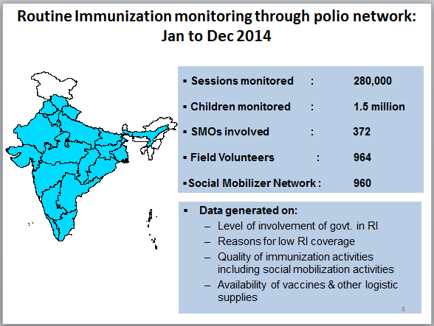
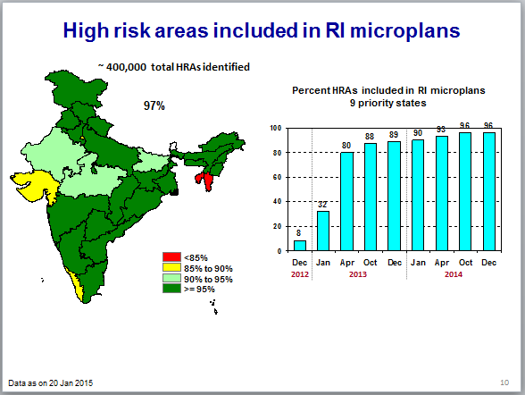
Intensification of routine immunization
Intensified
RI monitoring
Capacity building of frontline workers
Advocacy & Integrated
communication
Tagging of HRAs to RI
session sites
Accountability
through
Task Forces
Notes:
Routine immunization strengthening in the country, is supported by WHO-India, NPSP on all the key thematic areas of operation using the WHO-India, NPSP field network, using the high risk areas approach.

Slide 9

Community Based Monitoring of Routine Immunization in High Burden States, India
Percentage MCV1 coverage (12-23 months)
N:
244,729
206,844
107,407
99,362*
* Bihar data as of Jul 2015
Data Source : RI House to House monitoring data
Notes:
Based on the routine RI monitoring conducted through community visits by WHO-NPSP monitors, MCV -1 coverage shows an improvement.

Slide 10
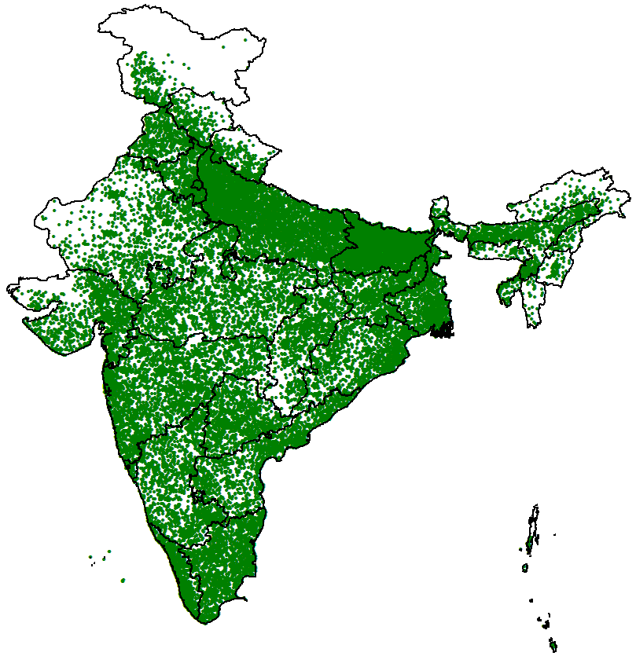
Use of AFP surveillance network for MR surveillance
N = 41,581
Private & government sectors, modern & traditional systems of medicine incorporated
Reporting site
No. of Reporting Sites
* data as on August 2015
Notes:
The existing Polio surveillance net-work including reporting-units and informing-units form both private and government health system are spread across the country (~ 42,000). The same surveillance network is now being used to established, sustain and strengthen measles-rubella surveillance system in the country

Slide 11

Support of Polio Network in Measles Rubella Initiative
MRI supported by polio network
Strengthening RI systems
( incl. MCV - 1 & 2)
New Vaccine Introduction/ Scale-up
(MR - vaccine)
Laboratory supported MR surveillance
AEFI Surveillance
Notes:
Measles elimination and Rubella/ CRS control strategies are being supported by Polio funded network

Slide 12
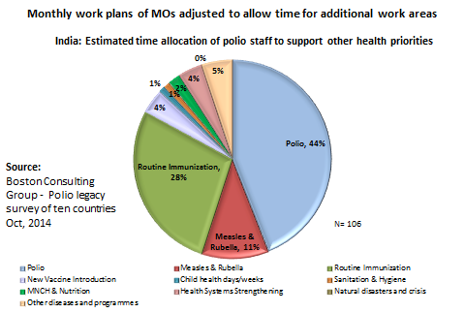
Managing New Responsibilities in the Field
Field staff re-distributed (reorganized)
  12 to 15% increase in MO positions in states with low RI coverage by shifting positions from Uttar Pradesh and Bihar
ToRs of MOs revised to include additional responsibilities
Capacity building of all MOs done to help adjust to new roles & responsibilities

Slide 13
Way Forward: Measles and Rubella
Intensify efforts to enhance both MCV1 and MCV2 in RI
Laboratory based measles-rubella surveillance platform strengthened
Country likely to introduce rubella vaccine and conduct MR campaigns
MR vaccine to replace both MCV1 and MCV 2 in routine immunization
Plan to conduct India Expert Advisory Group-MR in last quarter of 2015
Plan to transition MR surveillance to case-based
Initiate seroprevalence studies in selected states to assess susceptibility profile

Slide 14
Summary
Diversification of roles of polio funded personnel to other areas of work initiated
Alternative sources of funding, including from government, being explored to support long term sustainability
Support of measles rubella initiative (MRI) network required to achieve measles elimination and rubella control goal by 2020

Slide 15
Thank You

Slide 16
Key Lessons from Polio for RI & MR
Strong Government ownership & accountability
Meticulous planning & implementation
High risk approach
Capacity building of vaccinators on operation & communication
Robust communication strategy for demand generation
Real time monitoring & use of generated data
Research based innovations
Seamless partnership
Notes:
The lesions and best practices learned from Polio eradication experience in India are being used in both routine immunization and measles-rubella activities in the country.

Slide 17
Additional slides

Slide 18
Funding Sources for WHO NPSP
Funding sources for Biennium
  2012-2013
  Funding sources for 2014-15
  Includes support from GAVI HSS
  Includes support from BMGF for AEFI surveillance
Any funding shortfalls or withdrawal of support from polio network may delay the goal of achieving measles elimination & rubella control in India by 2020

Slide 19
NPSP will Support Measles-Rubella Vaccine Introduction
Measles-Rubella vaccination campaigns to be conducted in a phased manner across India, covering a wide age range target children, (9 months - <15 years)
 | Phase | No. of States | No. of Districts | Estimated Target Population (9 m<15 yrs) m
 | Phase 1 | 10 | 159 | 63
 | Phase 2 | 18 | 207 | 107
 | Phase 3 | 6 | 194 | 118
 | Phase 4 | 2 | 108 | 102
 | Total | 36 | 668 | 390

Slide 20
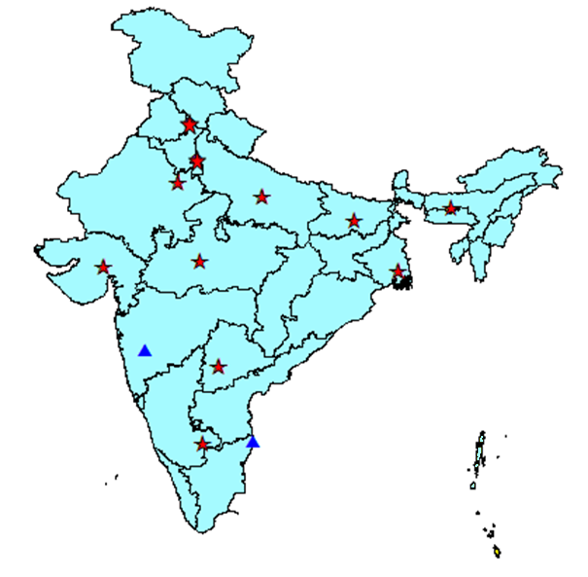
WHO Assisted, Laboratory Supported Measles-Rubella Surveillance System
Covering 100% of country population
Polio & Measles labs funded by Govt from 2014 onwards
Serological confirmation of suspected outbreaks using validated IgM Elisa
Genetic characterization of measles and rubella viruses to establish transmission chains in the states/distrcits of India
Quality assurance mechanisms in place
  Annual accreditation
  Annual proficiency test
11 - National laboratories
2 - Reference laboratories
Functioning MR surveillance in (36 states /UTs)
Notes:
Laboratory supported Measles-Rubella surveillance started in 2005 has been scaled up to cover the entire country backed by 13 WHO accredited M/R laboratory network , which is established based on the existing robust Polio Surveillance platform in the country

Slide 21
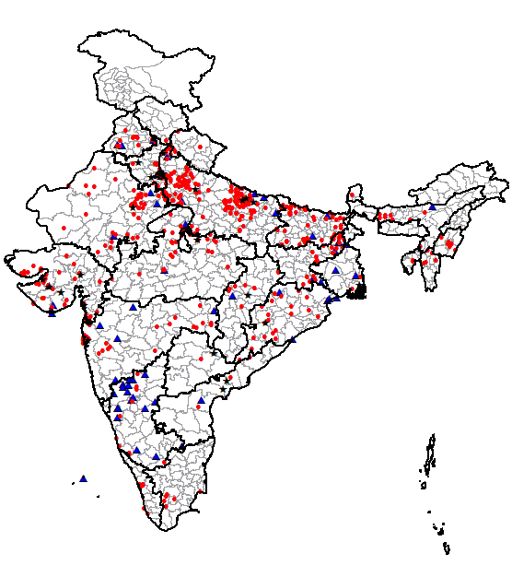
Serologically Confirmed Measles, Rubella and Mixed Outbreaks, India
(Basic epidemiology on measles and rubella transmission, used for strategic policy decision making in the country)
2015*-
628 outbreaks
Age-distribution & vaccination status in Measles cases, 2015*
529
72
27
Vaccinated
Measles outbreaks confirmed
Rubella outbreaks confirmed
Mixed outbreaks confirmed
Not vaccinated
Unknown
N - (both lab-confirmed and epi linked cases – 14,013
*data as on 21st July, 2015
# Outbreak confirmation for Measles: ≥ 2 cases IgM positive for measles, Similarly for Rubella
Notes:
The laboratory based surveillance system supported by WHO-India, NPSP is now generating basic epidemiology for the country on measles and rubella transmission, used for strategic policy decision making at the national level.

Slide 22
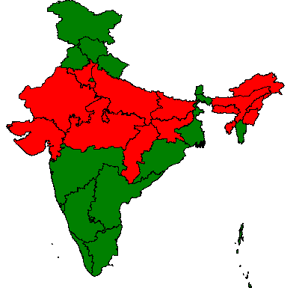
MCV-2 Vaccination Campaigns and Impact
Measles 2nd Dose Introduction (2010-2013)
- through campaigns
- through Routine Immunization
Cases from confirmed measles outbreaks
Reduction in Measles cases after SIAs based on surveillance data from the three campaign states
Measles catch-up campaign
Phase I
Phase II
Phase III
Capacity building workshops of health workers, medical officers and key program managers
Strengthening lab network
Case & outbreak investigation
Data analysis and use of data for action
~ 119 million children (9 months < 10 year) vaccinated through phased measles SIA campaigns with ~ 90%* reported coverage
(Supported by WHO-India NPSP and UNICEF)
*Cumulative MOH administrative MCV-2 campaign coverage data
Notes:
22
22
22
India conducted phased MCV2 campaigns in 14 high burden states targeting children 9 months to < 10 years, spanning across 2010-2013 with an administrative coverage of ~90% . Remaining states introduced 2nd dose measles in their RI program directly. This MCV2 SIA campaign was supported by WHO-India NPSP and UNICEF in the country. This SIA had an impact on measles transmission as evidenced through surveillance data from 3 states of Gujarat, Madhya Pradesh and Rajasthan , that showed a decline till 2013, which off course bas bounced back in 2014 &15 .

