Slide 1
Measles and Rubella Eradication
Alan R. Hinman, MD, MPH
With thanks to Steve Cochi, Walt Orenstein,
and Peter Strebel
2017 Measles & Rubella Initiative Partners Meeting
September 7-8, 2017

Slide 2
Outline of Presentation
Background for measles/rubella eradication
Issues relating to vertical and horizontal public health programs
Issues facing us now
What we need to do

Slide 3
Global measles deaths
Before measles vaccine >3 million deaths/year
2015 – 134,200 deaths
  ~15 deaths/hour
79% reduction in deaths 2000-2015
~20 million deaths prevented 2000-2015
Measles no longer a leading cause of childhood mortality

Slide 4
Eradication – Dahlem Conference 1997
Permanent reduction to zero of the worldwide incidence of infection caused by a specific agent as a result of deliberate efforts; intervention measures are no longer needed
Ottesen et al

Slide 5
Eradication - Strungmann Forum 2010
Global eradication – the worldwide absence of a specific disease agent in nature as a result of deliberate control efforts that may be discontinued where the agent is judged no longer to present a significant risk from extrinsic sources (e.g., smallpox).
Regional or national eradication – the absence of a specific disease agent in a defined geographic area as a result of deliberate control efforts that must be continued to prevent reestablished endemic transmission (e.g., polio, measles, rubella, guinea worm).
Cochi & Dowdle

Slide 6
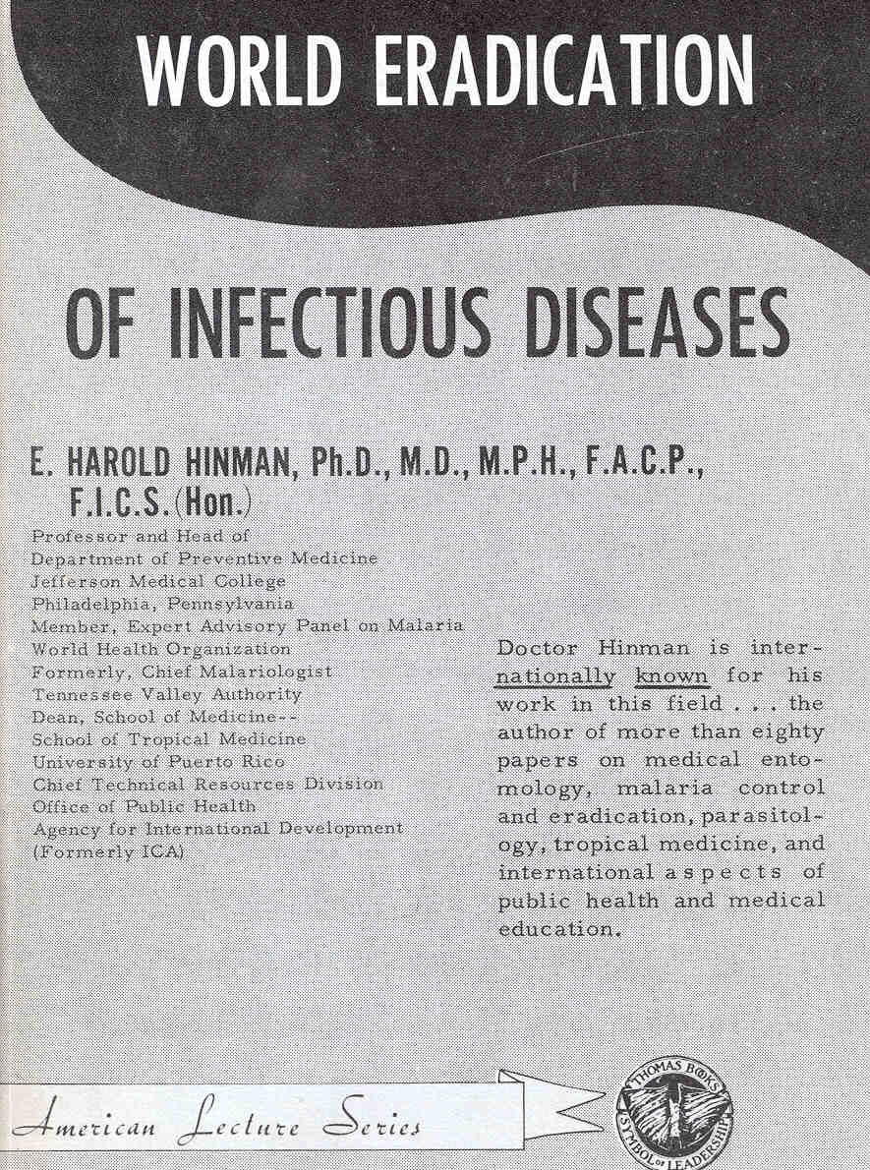

Slide 7
E H Hinman on Measles - 1966
“An eventual program of global eradication is forecasted. Hopefully, it will not be long delayed”

Slide 8
1980 International Conference on the Eradication of Infectious Diseases
“From a theoretical and technical point of view, measles can be eradicated from the world…Whether the financial, political and personnel resources necessary to achieve global eradication can be mobilized during the next several years remains in doubt.”
A Hinman

Slide 9
Hopkins, Koplan, Hinman, Lane - 1982
Establish “global measles eradication as a goal to be achieved by accelerated implementation of the World Health Organization’s Expanded Programme on Immunization.”

Slide 10
D A Henderson - 1982
“how realistic is this objective and what are the implicatons of such a programme being launched….?
“when measles transmission had been interrupted in all industrialised countries and, perhaps, ten to fifteen developing countries, the possibility of global measles eradication might usefully be examined”

Slide 11
Bill Foege - 1982
“Worldwide measles eradication is worthy of our best endeavors…
No measles case is inevitable.”

Slide 12
Measles and Rubella Elimination Goals by WHO Region
All 6 WHO Regions have measles elimination goals
Americas and Europe have rubella elimination goals
2015 2015
2000 2010
2015
2012
2020
2020
Notes:
World Health Organization
6 September, 2017
12
SEARO RC in Sept 2009 endorsed a resolution to mobilize support towards eliminate measles, 2010 RC meeting adopted the global 2015 measles targets (95% mortality reduction).
Note: EURO changed target to 2015, EMRO is in process of changing target to 2015

Slide 13
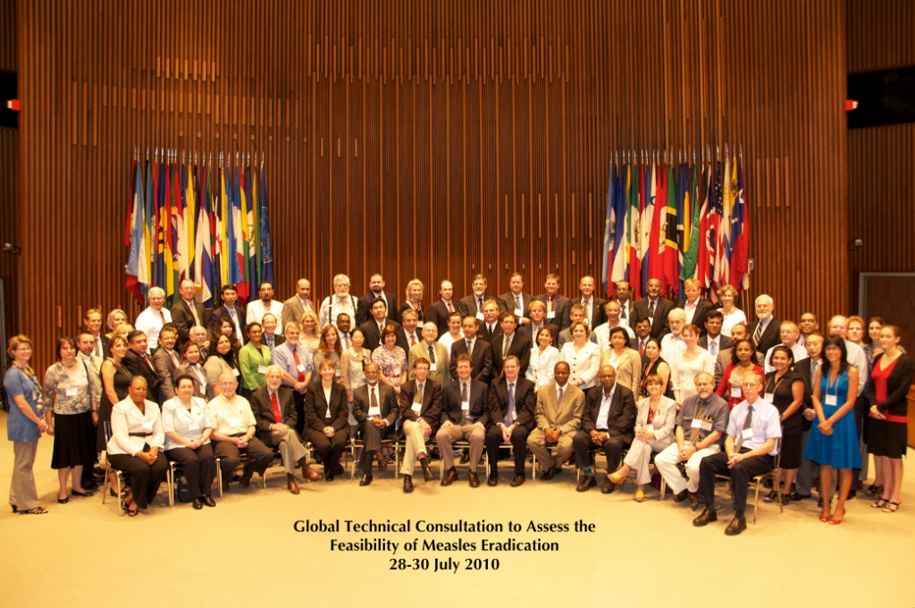
Feasibility of Measles Eradication
July 2010 – Global Consultation
  Measles can and should be eradicated
  In the context of strengthening immunization and primary health care systems
  Opportunity to accelerate rubella control and the prevention of congenital rubella syndrome
  Target date of 2020 feasible if measurable progress

Slide 14
International Task Force on Disease Eradication - 2016
“both measles and rubella eradication are technically feasible…
strengthened routine immunization services may be required”

Slide 15
Horizontal and Vertical Programs - 1965
“There are two apparently conflicting approaches to which countries should give careful consideration….The first, generally known as the “horizontal approach,” seeks to tackle the over-all health problems on a wide front and on a long-term basis through the creation of a system of permanent institutions commonly known as “general health services.” The second, or “vertical approach,” calls for solution of a given health problem by means of single-purpose machinery.”
Gonzalez

Slide 16
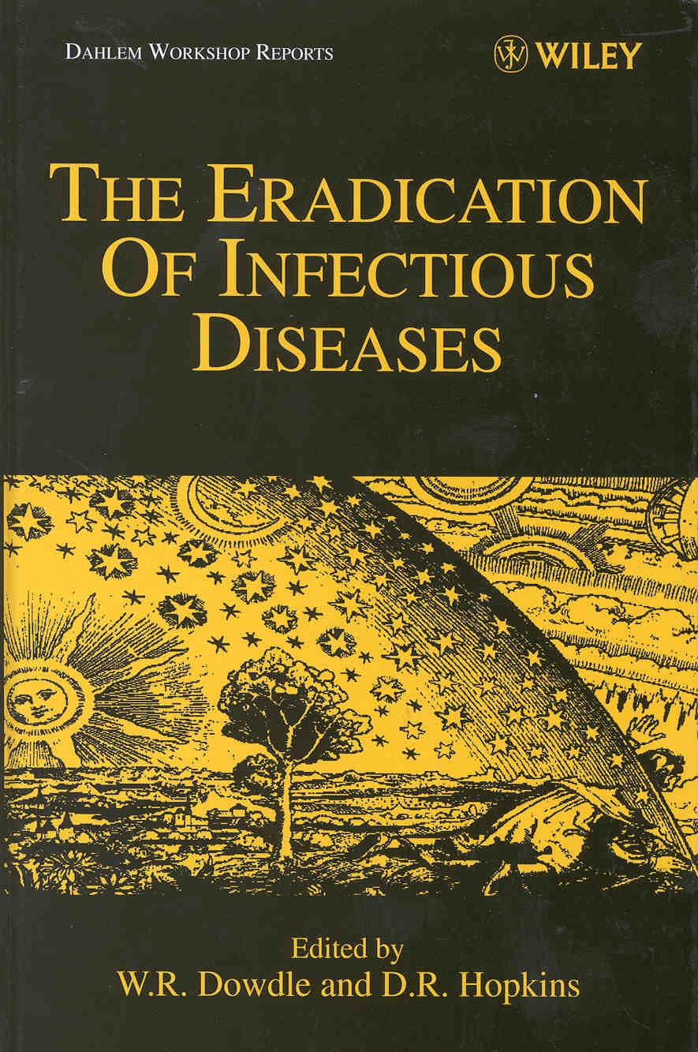

Slide 17
Dahlem Group Report
“Because of the close interrelationships between eradication programs and other health programs, eradication goals and activities should be expressed in the context of overall health services and explicit efforts should be taken to maximize the effectiveness of both the eradication and comprehensive health programs.”
Hall et al, Dahlem Conference, 1997

Slide 18
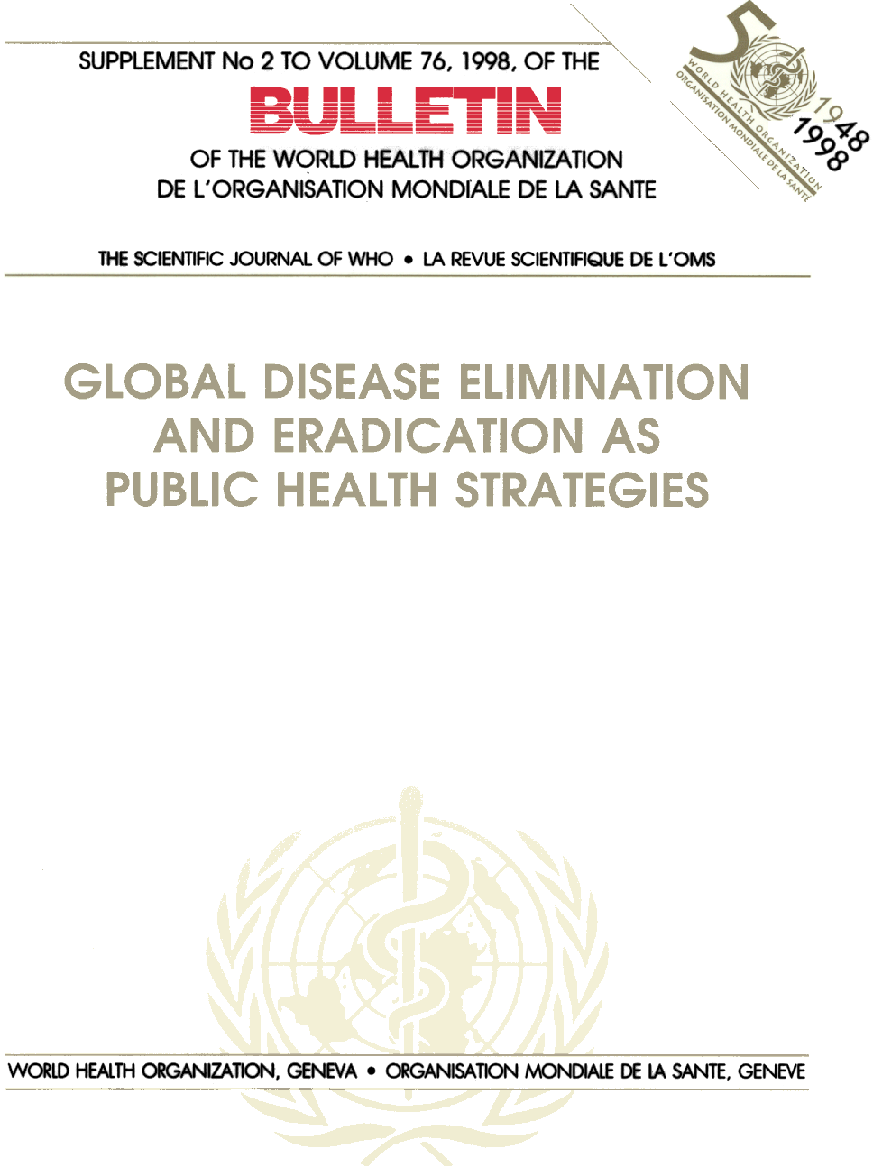

Slide 19
Actual and potential dangers of eradication for the health system and health development
Diversion of resources from existing support to basic services
Opportunities “forgone,” especially for countries for which the eradication effort is of low impact in terms of health outcomes
Atlanta Conference, 1998

Slide 20
Atlanta Conference Conclusions
Both targeted programs such as disease eradication and comprehensive health services development are important strategies to improve health
If an eradication program fails to strengthen infrastructure, it is a failure of planning and leadership, not inherently a failure of the program.

Slide 21
Diagonal Approaches – Frenk & Sepulveda
“diagonal approach stresses the importance of integration and coordination between vertical interventions, community based initiatives and health facilities or extension services”

Slide 22
Walt Orenstein on Diagonal Approaches
“In the United States, a focus on national elimination showed that to interrupt transmission in school children, with their high contact rates, very high immunity levels were needed. This led to the enactment and enforcement of comprehensive school immunization laws which not only covered measles but all vaccines recommended for those children….”

Slide 23
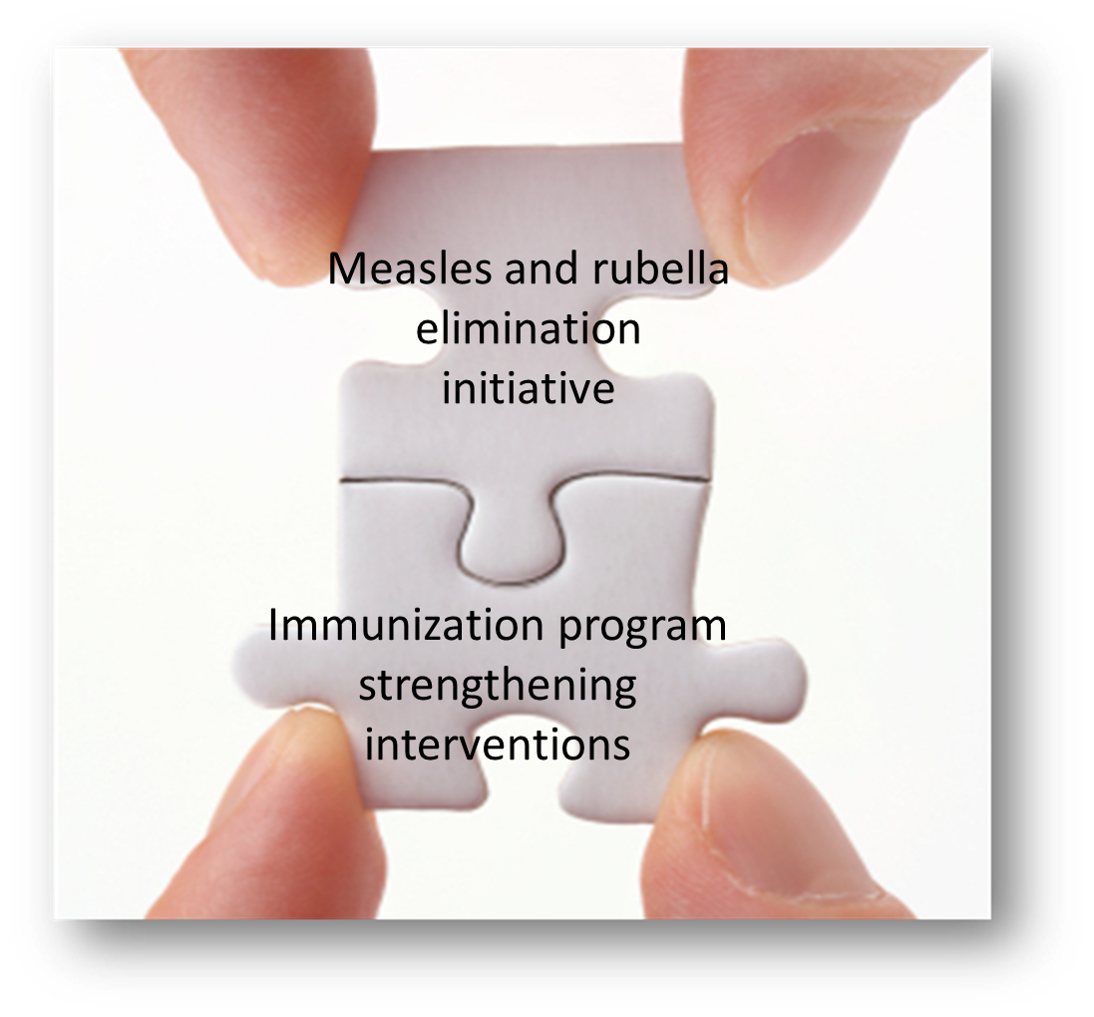


KEY STEP to build
immunization program capacity is to strategically link
disease-specific efforts
health system strengthening efforts
GVAP
measles and rubella elimination targets
GVAP
national and subnational vaccination coverage targets
Orenstein W.A. & Seib K (2016) Beyond vertical and horizontal programs: a diagonal approach to building national immunization programs through measles elimination, Expert Review of Vaccines, 15:7, 791-793
Sepúlveda J et al. Improvement of child survival in Mexico: the diagonal approach. Lancet 2006; 368: 2017–27

Slide 24

Possible Tactical Elements to Link
Measles/Rubella Elimination and Immunization Program Strengthening
Use MCV2 introduction to create new opportunities to receive vaccines & other child health interventions in 2nd year of life and beyond
Use planning for measles campaigns & measles risk assessments and to identify and target chronically underserved populations & geographies
CATCH UP
&
KEEP UP
REACH
the chronically
UNREACHED
Strengthen measles surveillance as a key component of outbreak-prone VPD surveillance; use measles outbreaks to target interventions to improve health systems
Use advocacy for measles elimination to support institutions, policies & practices needed to sustain high quality immunization programs
USE MEASLES
as an indicator of
health system
STRENGTH
STRENGTHEN
INSTITUTIONS,
POLICIES & PRACTICES
Notes:
We have given some thought to possible tactical elements that could be used in designing a diagonal approach to link a measles/rubella elimination initiative with immunization program strengthening interventions.
Four possible tactical elements in such a diagonal approach might include:
Catchup and keep up
Reach the chronically unreached
Use measles as an indicator of health system strength, and
Strengthen institutions, policies and practices
In the tactical element of catch-up and keep-up, a possible intervention might be to…
….

Slide 26
Disease Eradication in the 21st Century - 2010
“the challenge is to plan carefully so that targeted approaches and health systems development objectives are met in ways that maximize the positive synergies and minimize potential conflicts.”
A Hinman

Slide 27
ITFDE Conclusions 2016
“Because of the high contagiousness of measles, strengthened routine immunization services may be required in order to attain and maintain the unusually high immunization levels and prompt immunization of new birth cohorts that are needed for measles eradication, to a much greater extent than was necessary for smallpox or polio eradication.”

Slide 29
Maximizing Positive Synergies - WHO
“in a vicious circle, weak health systems have constrained the delivery capacity of the GHIs while the selective approach of the GHIs has also, in some cases, had the unintentional effect of further eroding the capacity of health systems”

Slide 30
Major issues facing the Measles/Rubella Initiative
Failure to meet GVAP goals
Incomplete implementation of the Global Measles and Rubella Strategic plan 2012-2020

Slide 32
Selected findings and recommendations from MidTerm Review - 1
Strengthening of immunization systems is critical…There must be a focus on how working to achieve measles and rubella eradication can help strengthen health systems in general and immunization systems in particular
We must re-orient the measles and rubella elimination program to increase emphasis on surveillance

Slide 33
Major issues facing the Measles/Rubella Initiative
Failure to meet GVAP goals
Incomplete implementation of the Global Measles and Rubella Strategic plan 2012-2020
GPEI transition

Slide 34
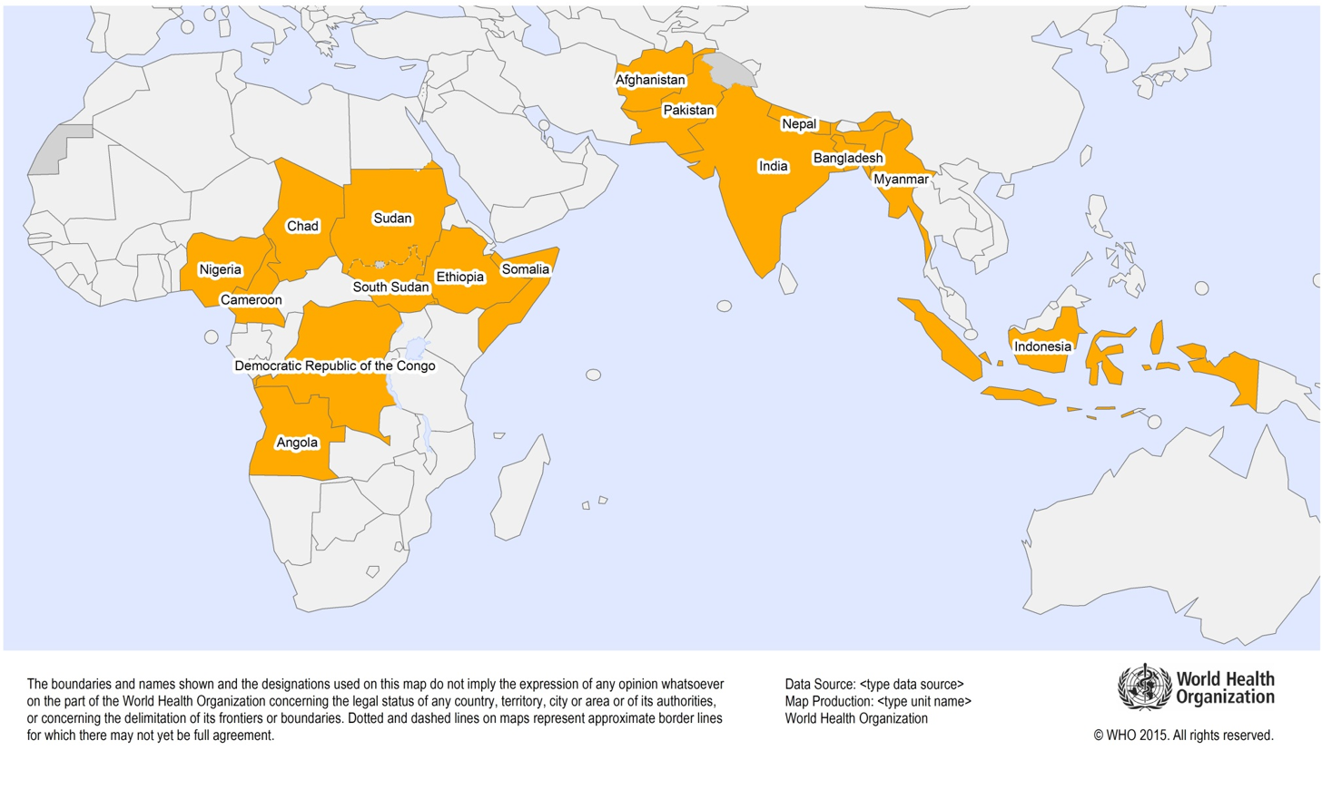
  16 priority countries for polio transition planning
  (represent 95% of GPEI assets)

Slide 35
The 16 Priority Countries also contain…
Most of the world’s unvaccinated and undervaccinated children
Most of the world’s measles cases and deaths
Most of the world’s rubella and CRS
Consequences of losing polio assets – risk that EPI progress in these countries and globally will be reversed

Slide 36
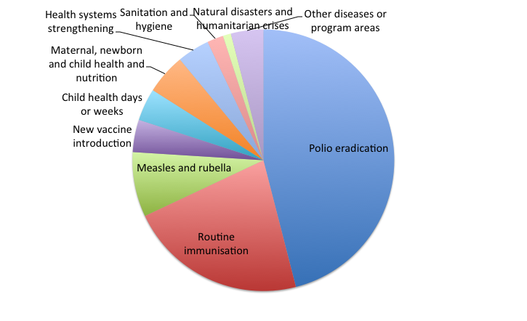
GPEI-funded staff already report spending more than half of their time on health priorities other than polio
4%
46%
8%
22%
% personnel time allocation
(self-reported)
9
Boston Consulting Group study in Afghanistan, Angola, Chad, DR Congo, Ethiopia, India, Nigeria, Pakistan, Somalia, South Sudan (Feb 2015)
36

Slide 37
86% of WHO immunization personnel in Africa are polio-funded
40% of WHO AFRO’s workforce is polio-funded
Polio funding plays a significant role in overall partner capacity in many regions and countries
WHO Example:
Example: Polio funds 70% of
WHO staff in DR Congo¹
38
126
3
88
Provinces
Kinshasa
# polio-funded personnel
Other
Total staff¹
1. 2013 DRC FRR data; excluding consultants
Source: GPEI FRR, WHO, UNICEF, BCG analysis

Slide 38
Major issues facing the Measles/Rubella Initiative
Failure to meet GVAP goals
Incomplete implementation of the Global Measles and Rubella Strategic plan 2012-2020
GPEI transition
Gavi transition/graduation

Slide 39
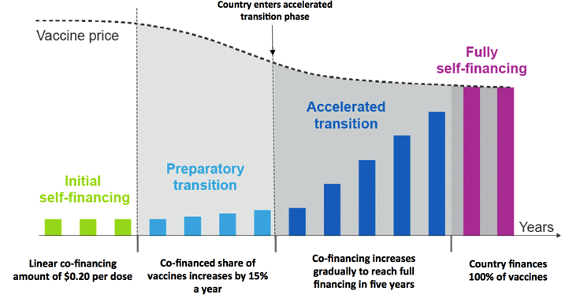
Gavi transition/graduation

Slide 40
Gavi transition/graduation
In 2016, 5 countries completed transition and are fully self-financing vaccines - Bhutan, Honduras, Mongolia, Sri Lanka, Ukraine
In 2016, 16 countries are in the accelerated transition phase – Angola, Armenia, Azerbaijan, Bolivia, Congo Rep., Cuba, Georgia, Guyana, Indonesia, Kiribati, Moldova, Nicaragua, Papua New Guinea, Timor Leste, Uzbekistan, Vietnam

Slide 41
Major issues facing the Measles/Rubella Initiative
Failure to meet GVAP goals
Incomplete implementation of the Global Measles and Rubella Strategic plan 2012-2020
GPEI transition
Gavi transition/graduation
Donor fatigue
Increase in nationalism/isolationism
Need to integrate services

Slide 42
Selected findings and recommendations from MidTerm Review - 2
Strengthening of immunization systems is critical
We must shift from SIAs to primary reliance on going services to deliver 2 doses of vaccine
Rubella doesn’t get the respect it deserves

Slide 43
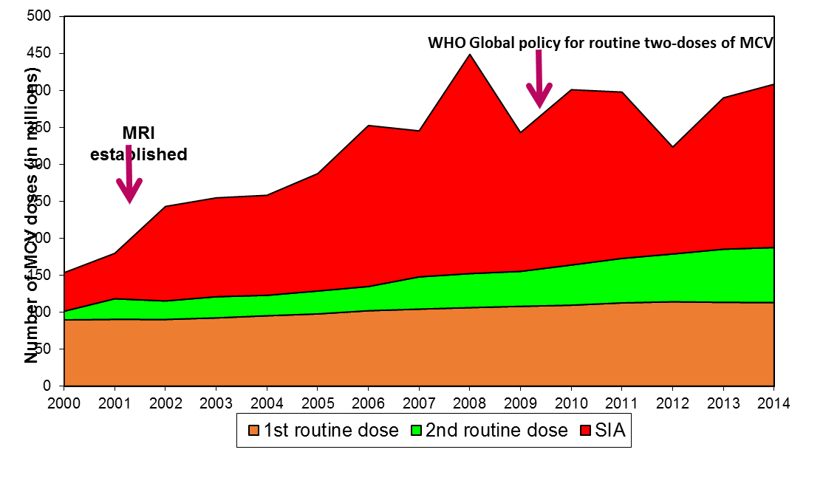
Role of SIAs
2.6 billion vaccinated in measles SIAs during 2000–2014
1st and 2nd routine dose: WHO/UNICEF coverage estimates, the World Population Prospects New York, 2015. SIA dose: WHO SIA database, March 2016 (provisional data)

Slide 44
Definitions
Supplement - something that completes or makes an addition
Supplementary - added or serving as a supplement
  Source: Merriam-Webster

Slide 45


Recent increase in countries using rubella vaccine
Countries with rubella vaccine in the national immunization programme, by year of vaccine introduction
17 countries introduced rubella vaccine during 2012-2015
17 countries planning introduction in 2016-2018
Introduced before 2012 (130 countries or 67%)
Introduced between 2012 and 2015 (17 countries or 8.8%)
Planned introductions in 2016-2018 (17 countries or 8.8%)
Not Available/ Not Introduced/ No Plans (30 countries or 15.4%)
Not applicable
Data source: WHO/IVB Database, as of 17 October 2016
Map production Immunization Vaccines and Biologicals (IVB),
World Health Organization
The boundaries and names shown and the designations used on this map do not imply the expression of any opinion whatsoever on the part of the World Health Organization concerning the legal status of any country, territory, city or area or of its authorities, or concerning the delimitation of its frontiers or boundaries. Dotted lines on maps represent approximate border lines for which there may not yet be full agreement. ©WHO 2016. All rights reserved.
Notes:
The reason global coverage with RCV is low is because 47 countries mainly in Sub-Saharan Africa and SE Asian (shaded here in grey) have yet to introduce rubella vaccine. This map shows recent progress with introduction of rubella vaccine – countries shaded in light green having introduced before 2012, and in dark green the 17 countries that introduced rubella vaccine during the period 2012 to 2015. In orange are 16 additional countries planning introduction of rubella vaccine during 2016-2018 with Gavi support.

Slide 46
Global rubella vaccination coverage still <50%
Rubella containing vaccine 1st Dose (RCV1) coverage* by WHO region, 1980-2015
46%
*coverage estimates for the 1rst dose of rubella containing vaccine are based on WHO and UNICEF estimates of coverage of measles containing vaccine.
Source: WHO/UNICEF coverage estimates 2015 revision. July 2016
Immunization Vaccines and Biologicals, (IVB), World Health Organization.
194 WHO Member States. Date of slide: 16 July 2016.
Notes:
This slide shows the secular trend in coverage with a dose of rubella containing vaccine among the global birth cohort. The first point to note is that while coverage has been increasing gradually over time, global coverage was only 46% in 2015. There are also large disparities in coverage across the WHO Regions with the AMR, EUR and WPR achieving over 90% and the AFR and SEAR still with coverage <20%.

Slide 47
What do we need to do?
Learn from GPEI
  Focus on surveillance to guide activities
  Embrace EPI
    Ensure M/R activities are part of EPI
    Strengthen ongoing services
    Use measles/rubella/CRS incidence as the primary indicator of success rather than coverage
  More formally integrate M/R and EPI in overall health system
Make most effective use of increased Gavi commitment to support measles and rubella

Slide 48
Conclusions
Measles and rubella/CRS can be eradicated
They should be eradicated
A target date should be established in 2020 (or before)
Eradication can only be accomplished in the context of
  strengthening ongoing immunization services
  strengthening surveillance so it can guide activities
Additional resources will be required to achieve the goal

