Slide 1

Update of Measles and Rubella Laboratory Network
in WPR
ACCELERATING PROGRESS TOWARDS MEASLES AND RUBELLA CONTROL AND ELIMINATION MEETING, 21-23 JUNE 2016, GENEVA, SWITZERLAND
Yan Zhang

Slide 2
Outline
  Brief Introduction of Epidemiology and Measles and Rubella LabNet (MRLN) in WPR
  Performance of MRLN in WPR
Challenge and Plan

Slide 3
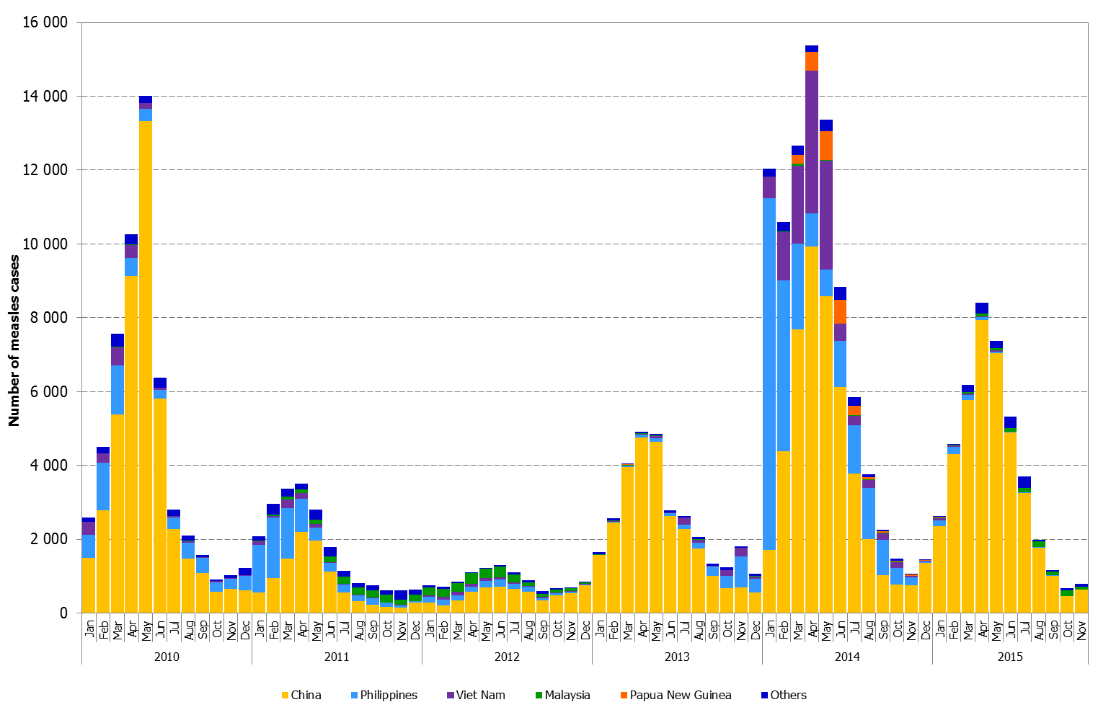
Measles Surveillance in WPRO
Confirmed measles cases by month of onset, 2010-2015
48,490
(27.0)
21,088
(11.7)
10,794
(5.9)
32,340
(17.7)
88,859
(48.3)
42,818
(24.9)
Source: Measles and rubella monthly country reports to WHO as of 20 December 2015
*Includes laboratory confirmed, epi-linked and clinically confirmed cases for 2010-2012

Slide 4
Progress Towards Measles Elimination in the Western Pacific Region
As of 2015
 | Category | Countries, Areas, Epidemiological Blocks
1 | Verified in March 2014 as having achieved elimination | Australia, Macao (China), Mongolia, Republic of Korea (n=4)
2 | Verified in March 2015 as having achieved elimination | Brunei Darussalam, Cambodia, Japan (n=3)
3 | Plan to submit verification report in March 2016 | New Zealand (n=1)
4 | May be ready for verification | Hong Kong (China), Singapore (n=2)
5 | Large outbreaks in 2013-2014 but limited temporally (<12 months) or geographically | Lao People’s Democratic Republic, Pacific Islands (n=2)
6 | Endemic or re-established endemic transmission | China, Malaysia, the Philippines, Viet Nam , Mongolia(n=5)

Slide 5
Rubella Cases
Western Pacific Region, 2000-2015
Number of Reported Rubella Cases
Source: WHO-UNICEF Joint Reporting Form (JRF) for Immunization data for 2000 to 2014
National measles and rubella monthly reports for 2015 (as of 20 January 2016)

Slide 6
The progress to Rubella Elimination
Australia, New Zealand, the Republic of Korea and Singapore are approaching to elimination of rubella
Japan developed and officially issued a national plan and strategy for rubella elimination in 2014 and determined 2020 as target year
Mongolia aims to eliminate rubella by 2020 and has started development of a National Strategy for Measles and Rubella Elimination 2016-2020
Cambodia will start development of a national plan and strategy for rubella elimination

Slide 7
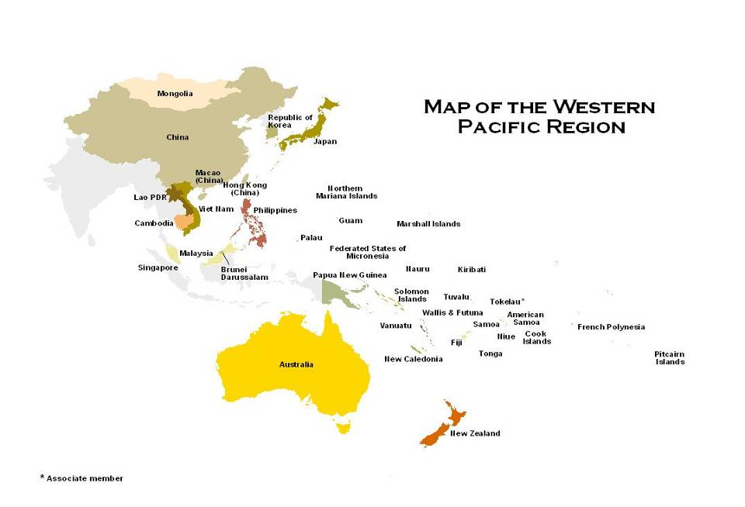
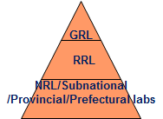
WPR Measles and Rubella Laboratory Network (2015)
+331 prefectural labs
Countries/areas: 37
Population: 1.6 billion
New sub-national labs
1 GSL
3 RRLs
17 National (14 fully functional)
31 provincial in China + 3 subnational labs in Vietnam(2) and Malaysia(1)
+ 331 prefectural
386 labs:1GSL,3 RRLs, 17NLs,3SNL,31 Prov L, 331 Prefecture Labs: 54% of Global

Slide 8
What do we do?
Laboratory Confirmation
Serology
Molecular detection
Virologic Surveillance
Virus Isolation
Genotyping
Quality Assurance
Training/Meeting
PT, Accreditation
  Network Laboratories: provide timely and reliable laboratory confirmation and virus Identification to support programme.
  Laboratory Network: strengthen cooperation among network laboratories and maintain
  high quality laboratory networks.
  Regional Coordination of Labnet: Coordinate with Internal EPI/ DCD/WPRO, WHO HQ , GSL, RRL, USCDC and other partners; Data management; Meetings/Trainings(RRL, NRL); Accreditation, Procurement and distribution of the reagents and supplies, Distribution of EQA panels and CDC molecular reagents, and et al.

Slide 9
Updates of Quality Assurance in MRLN, WPR
Accreditation: WHO-1GSL+3RRLs+17NLs+31PLs
  49/52 laboratories maintained fully accredited
  3 labs in PICs need to be assessed
IgM Proficiency Tests: AUS VIDRL-1GSL+2RRLs+16NLs+31PLs+3SNLs
  2014: 53 labs participated and all labs passed
  2015: 53 labs participated and all labs passed
Molecular Proficiency Tests: USA CDC
  2014: 4 labs (JPN, CHN, AUS, HOK) participated and passed.
  2015: 11 labs (JPN, CHN, AUS, HOK, MYS, MNG, NEZ, PHL, SGP, VNM (2)) participated and all labs passed
IgM Confirmatory Tests:
  Non-China labs: AUS VIDRL and HOK
    2014: 15/17 national labs participated and 14 labs have >90% concordance results for measles and rubella;
    2015: 9/17 national labs participated and all have>90% concordance results for MR but 1 lab has <90% concordance for measles. Other labs still ongoing-scheduled for shipment in 2016.
  China Labs: China NL+PL
    NL responsible for Provincial labs.
    PL responsible for prefectural labs

Slide 10
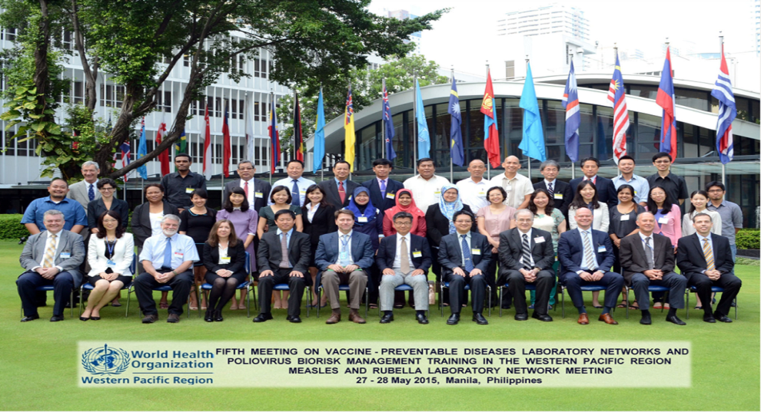
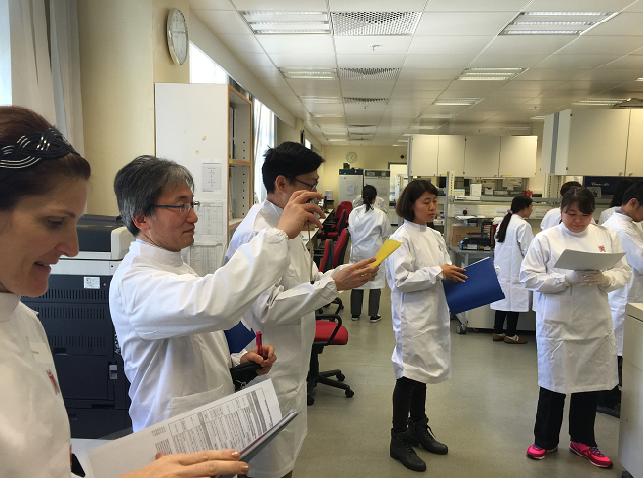
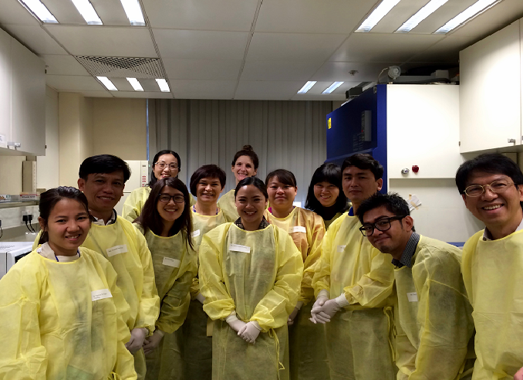
WHO Measles/Rubella Laboratory Trainings and Meetings, 2013-2016
Fourth Meeting on Vaccine Preventable Diseases Laboratory Networks in the Western Pacific Region, Manila Philippines,
11 to 15 March 2013
Hands-on Training Workshop on Cell Culture Techniques for the Laboratory Diagnosis of Polio/Enteroviruses and Measles/Rubella Viruses, Hong Kong SAR (China), 19 to 23 May 2014
Fifth Meeting on Vaccine Preventable Diseases Laboratory Networks and Polio Biorisk Management Training in the Western Pacific Region, Manila Philippines 27 to 30 May 2015
Sixth Regional hands-on Training Workshop on the Laboratory Diagnosis of Measles and Rubella, Hong Kong SAR, China,
29 February to 4 March 2016

Slide 11
WPR M&R Labnet Updates: 2015-2016
Meeting: 5th VPD Lab Net meeting, 25-26 May 2015, Manila
Training: Sixth Regional hands-on Training Workshop on the Laboratory Diagnosis of Measles and Rubella, Hong Kong SAR, China, 29 February to 4 March 2016
Onsite accreditation: 6 province in China: Hainan, chongqing, Tianjin, Jiangsu, Jilin, Innermogolia; 30 May-6 June 2016.

Slide 12
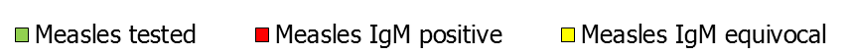
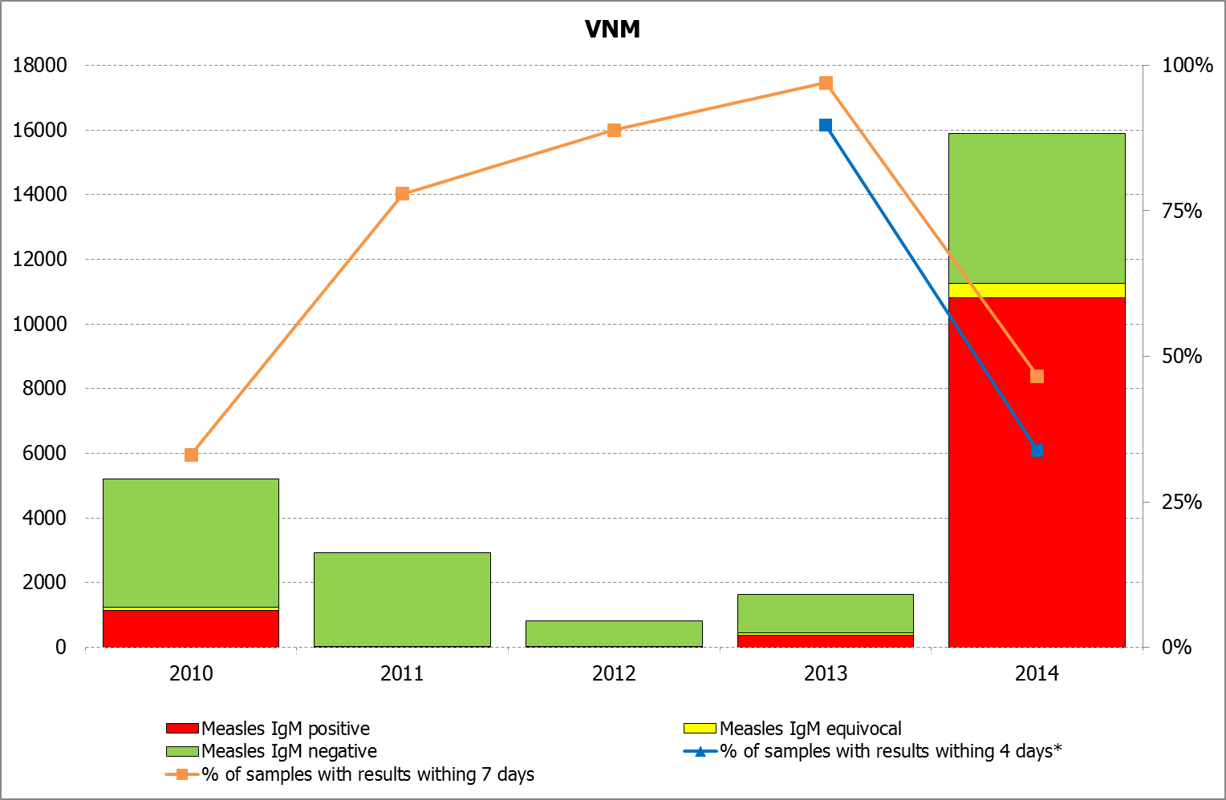
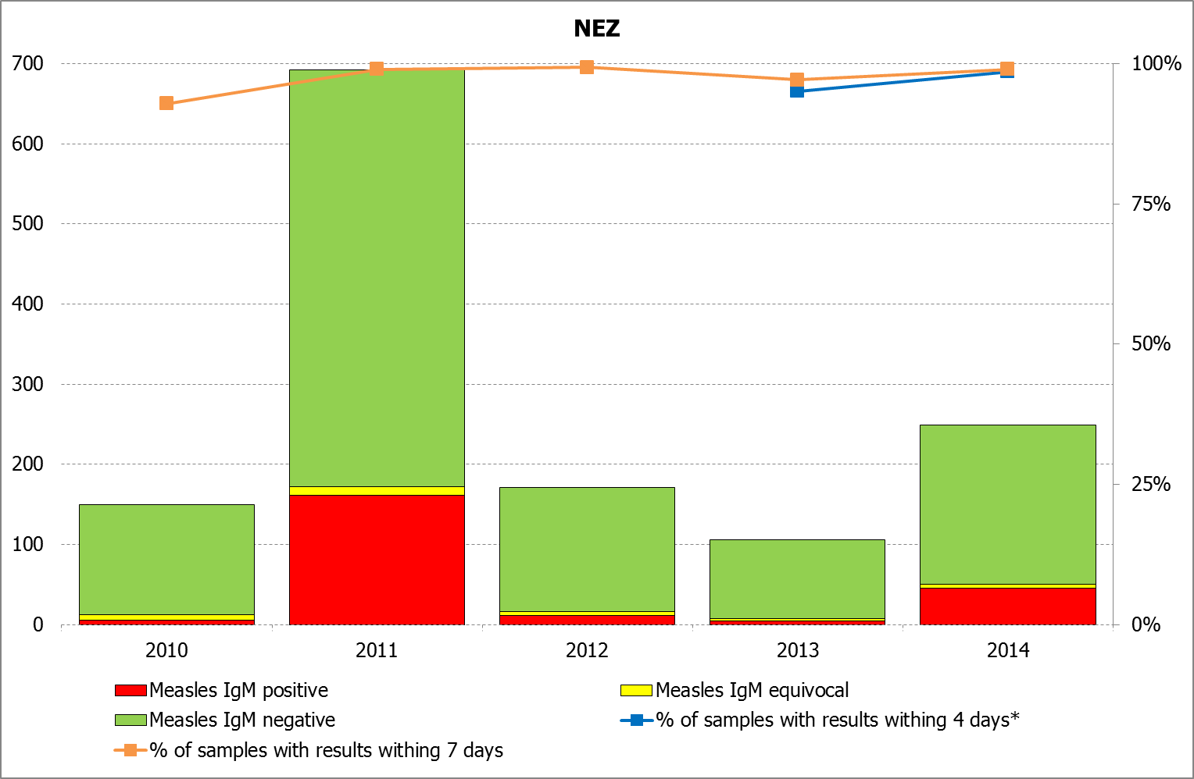
Laboratory workload and timeliness of report by country, WPR, 2010-2015
Source: Measles and rubella laboratory reports as of 20 May 2016
*Recommendation from the Fourth Meeting on Vaccine Preventable Diseases Laboratory Networks in the Western Pacific Region

Slide 13
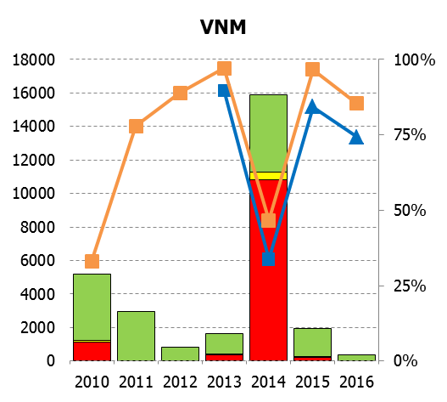
Laboratory workload and timeliness of report by country, WPR, 2010-2015
Source: Measles and rubella laboratory reports as of 20 May 2016
*Recommendation from the Fourth Meeting on Vaccine Preventable Diseases Laboratory Networks in the Western Pacific Region
** Data for 2015 are not yet available

Slide 14
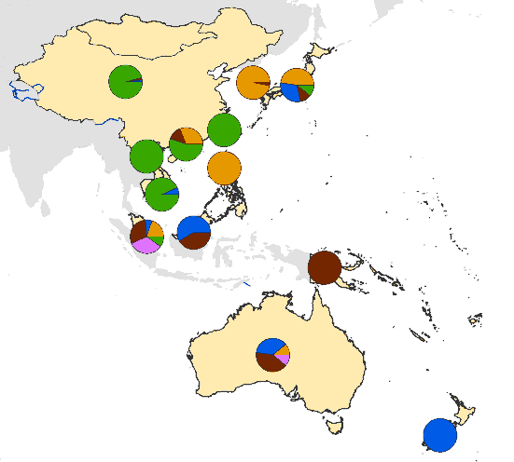
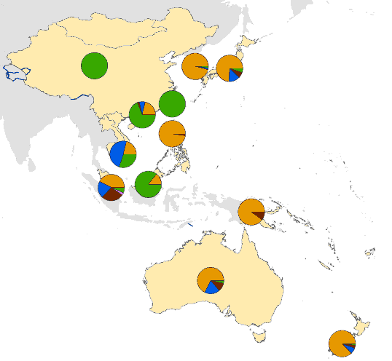
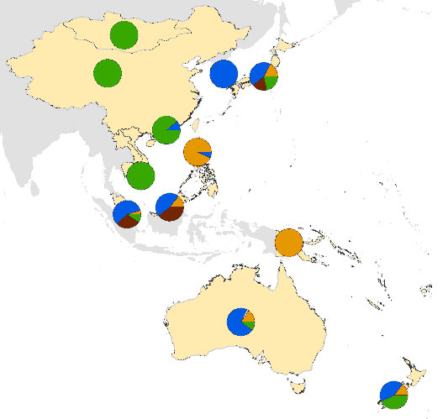
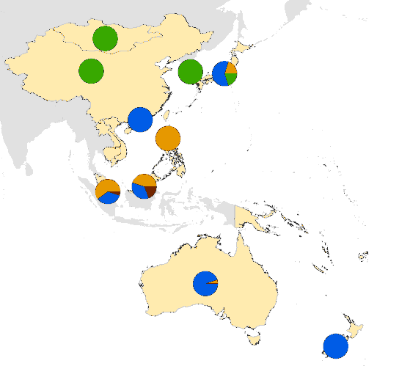
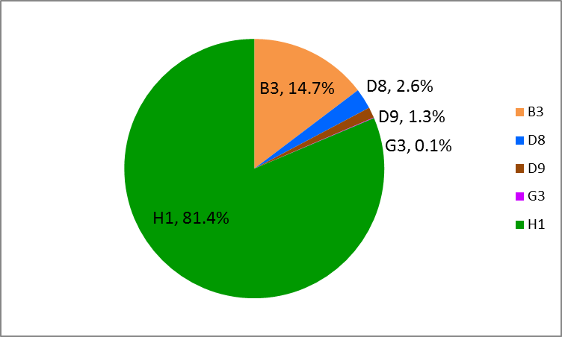
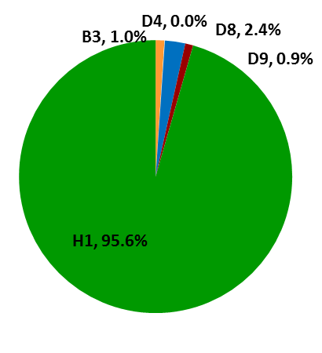
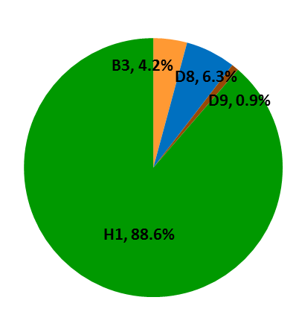
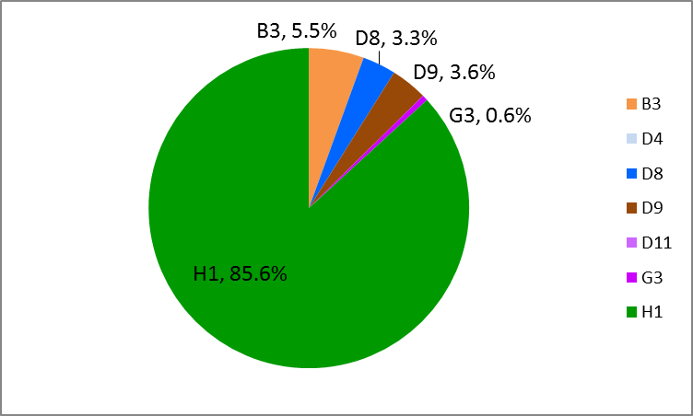
Measles virus genotype distribution in 2013-2016*, Western Pacific Region
B3
D4
D8
D9
D11
G3
H1
2013
2014
2015
2016
Sources: Includes all cases reported to the Western Pacific Regional Office by 20 May 2016 and the Measles Nucleotide Sequence online database (MeaNS).
The boundaries and names shown and the designations used on the maps do not imply the expression of any opinion whatsoever on the part of the World Health Organization concerning the legal status of any country, territory, city or area or of its authorities, or concerning the delimitation of its frontiers or boundaries. Dotted lines on maps represent approximate border lines for which there may not yet be full agreement.
© WHO Regional Office for the Western Pacific 2009. All rights reserved.

Slide 15
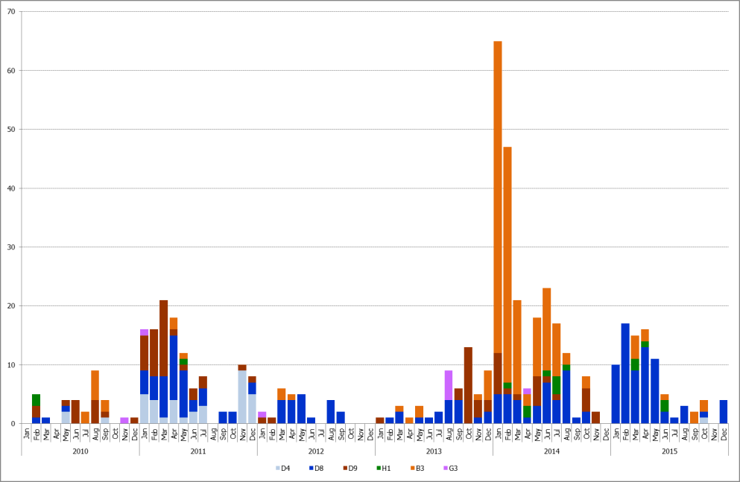
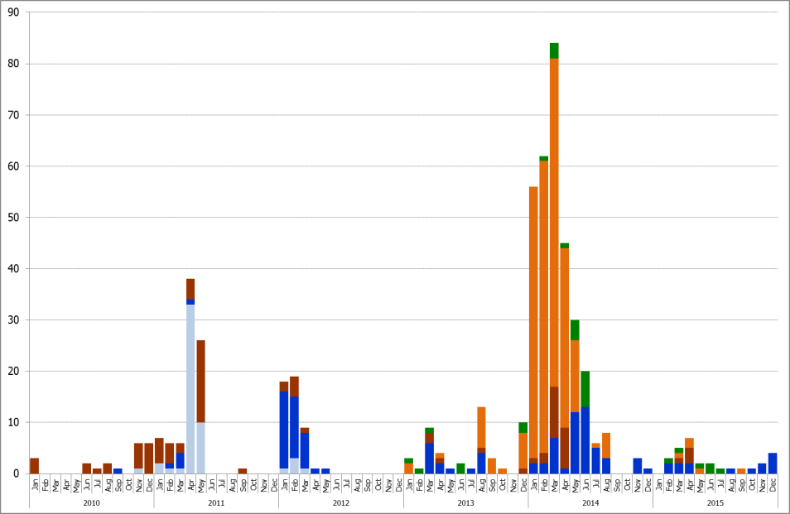
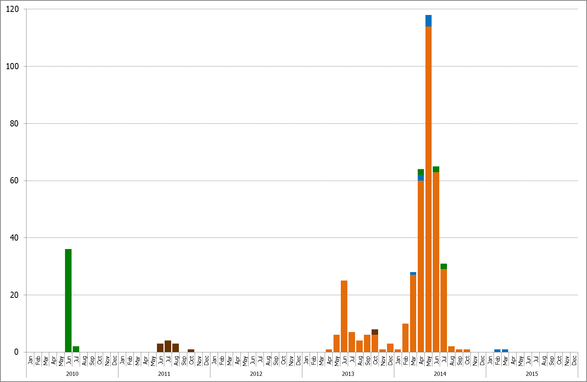
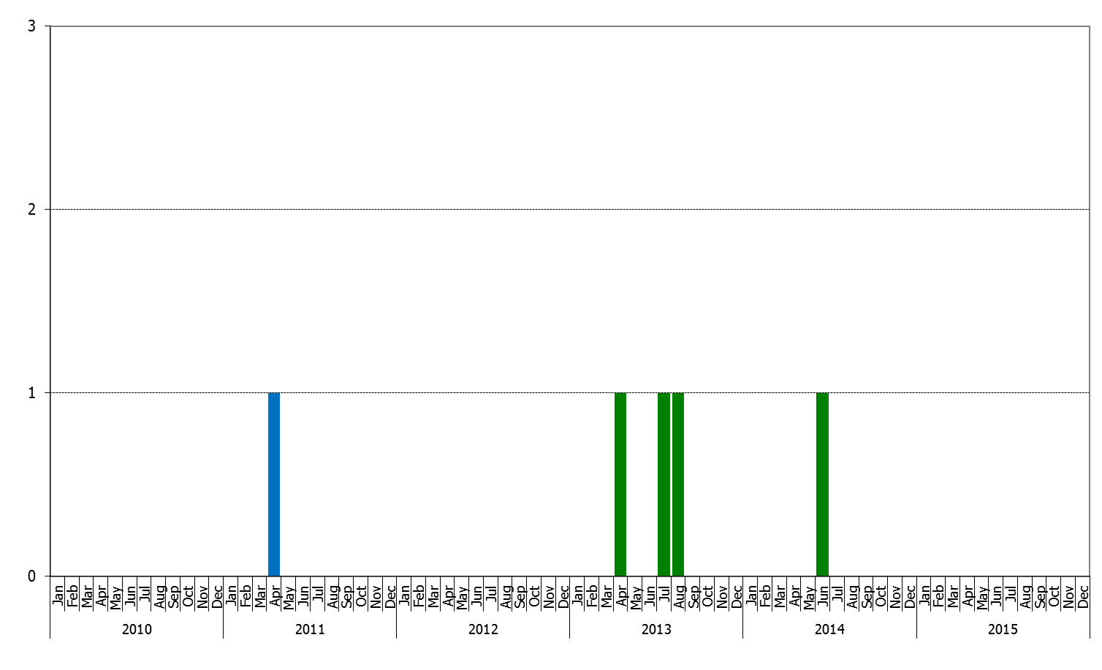
Monthly Detection of measles genotypes, 2010-2015
B3
D4
D8
D9
D11
G3
H1
Australia
Japan
D4, D8, D9 B3, D8, D9
D4, D9, D8 B3, D8, H1
Korea
Macao
H1, D9 B3, D8
Sources: Includes all cases reported to the Western Pacific Regional Office by 20 May 2016 and the Measles Nucleotide Sequence online database (MeaNS).

Slide 16
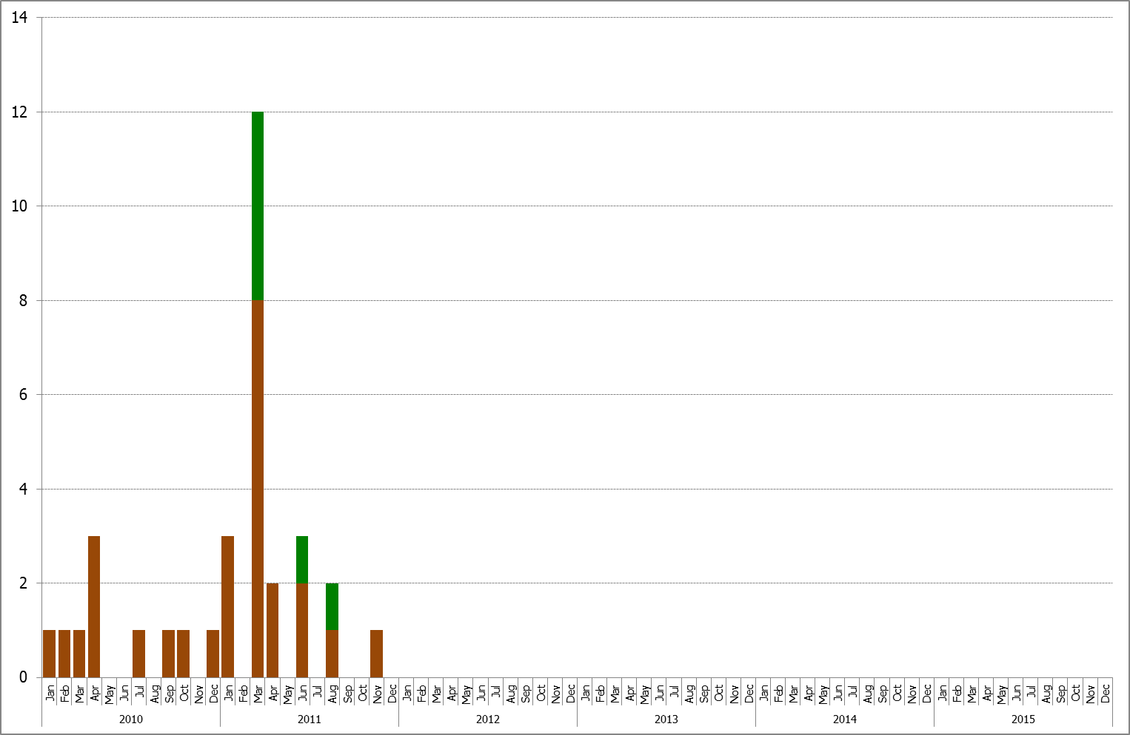
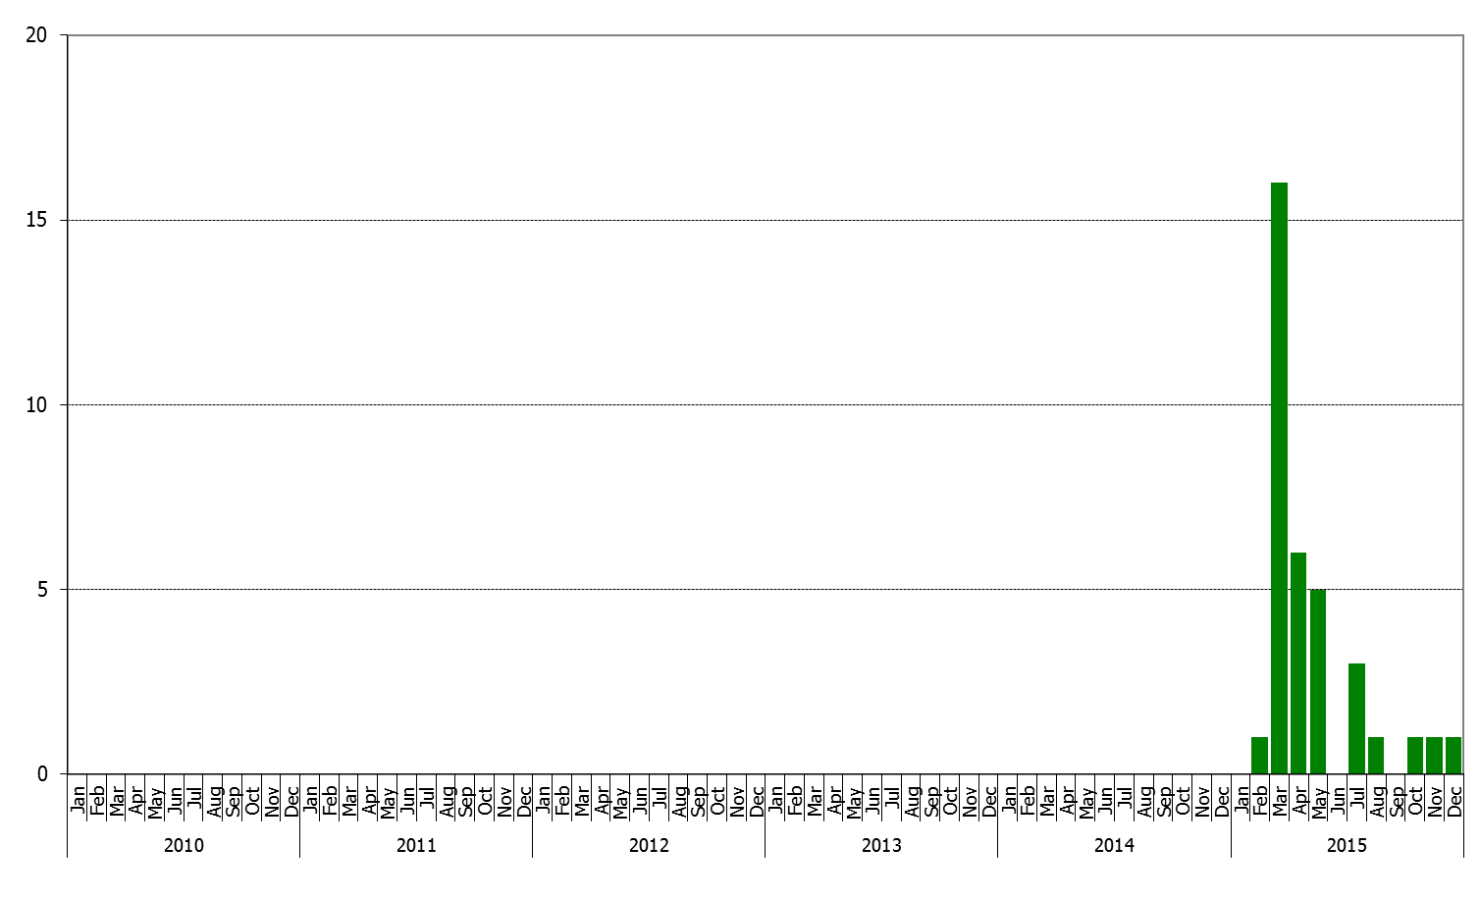
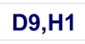
Monthly Detection of measles genotypes, 2010-2015
B3
D4
D8
D9
D11
G3
H1
Cambodia
Mongolia
For countries verified measles elimination, genotype evidence supports the interruption of endemic measles virus transmission (Mongolia re-introduction and endemic) .
Brunei: The last documented and proven measles case was reported in 2008.
Sources: Includes all cases reported to the Western Pacific Regional Office by 20 May 2016 and the Measles Nucleotide Sequence online database (MeaNS).

Slide 17
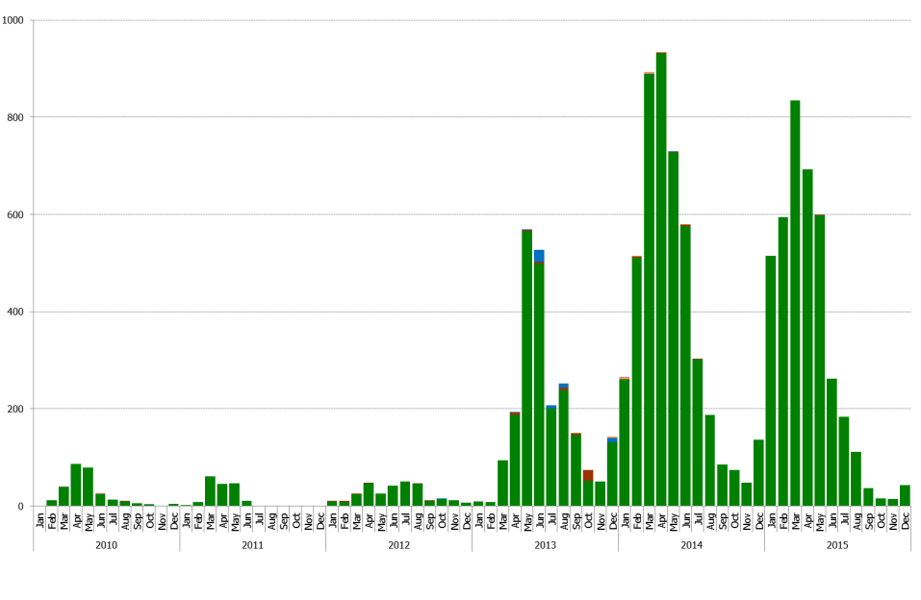
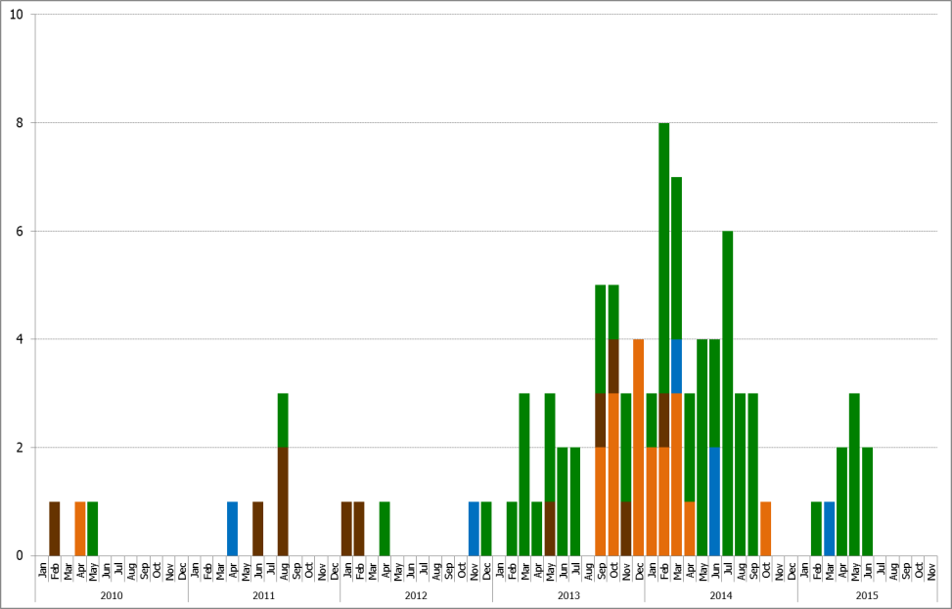
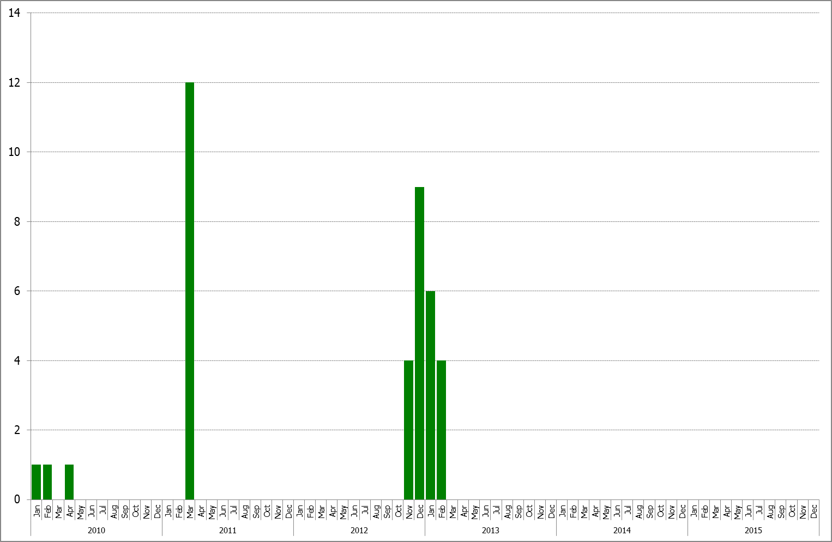
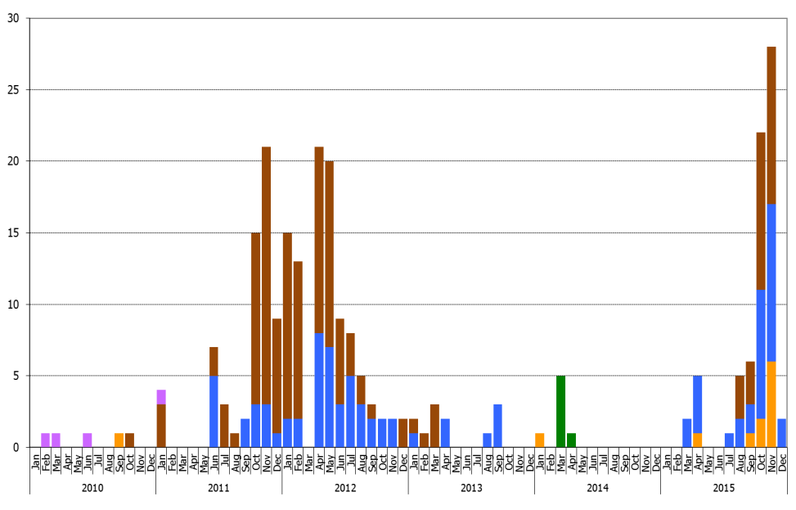
Monthly Detection of measles genotypes, 2010-2015
B3
D4
D8
D9
D11
G3
H1
China
Hongkong
Lao
Malaysia
Sources: Includes all cases reported to the Western Pacific Regional Office by 20 May 2016 and the Measles Nucleotide Sequence online database (MeaNS).

Slide 18
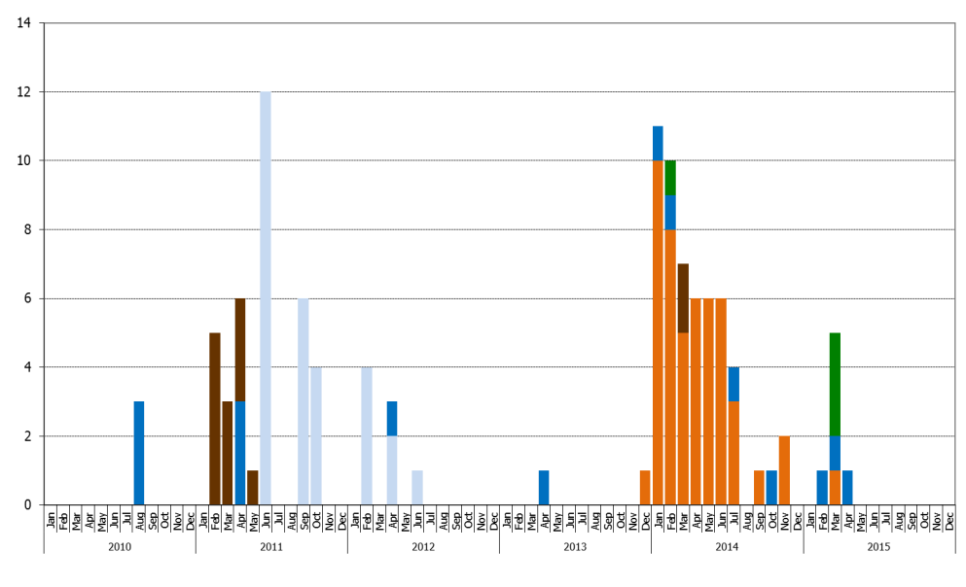
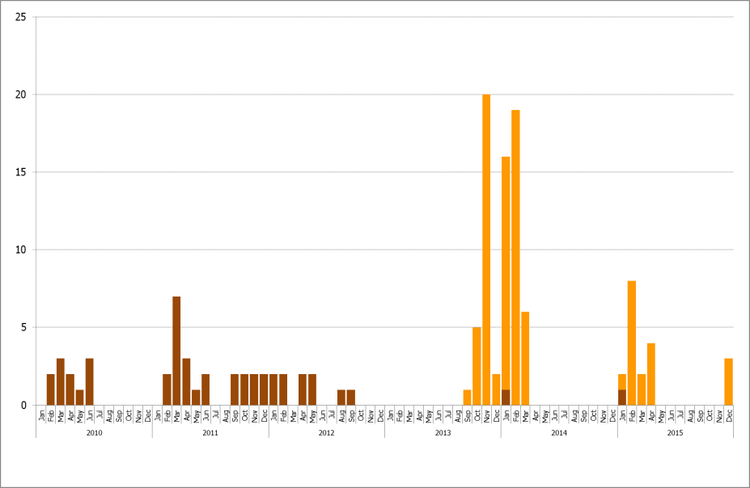
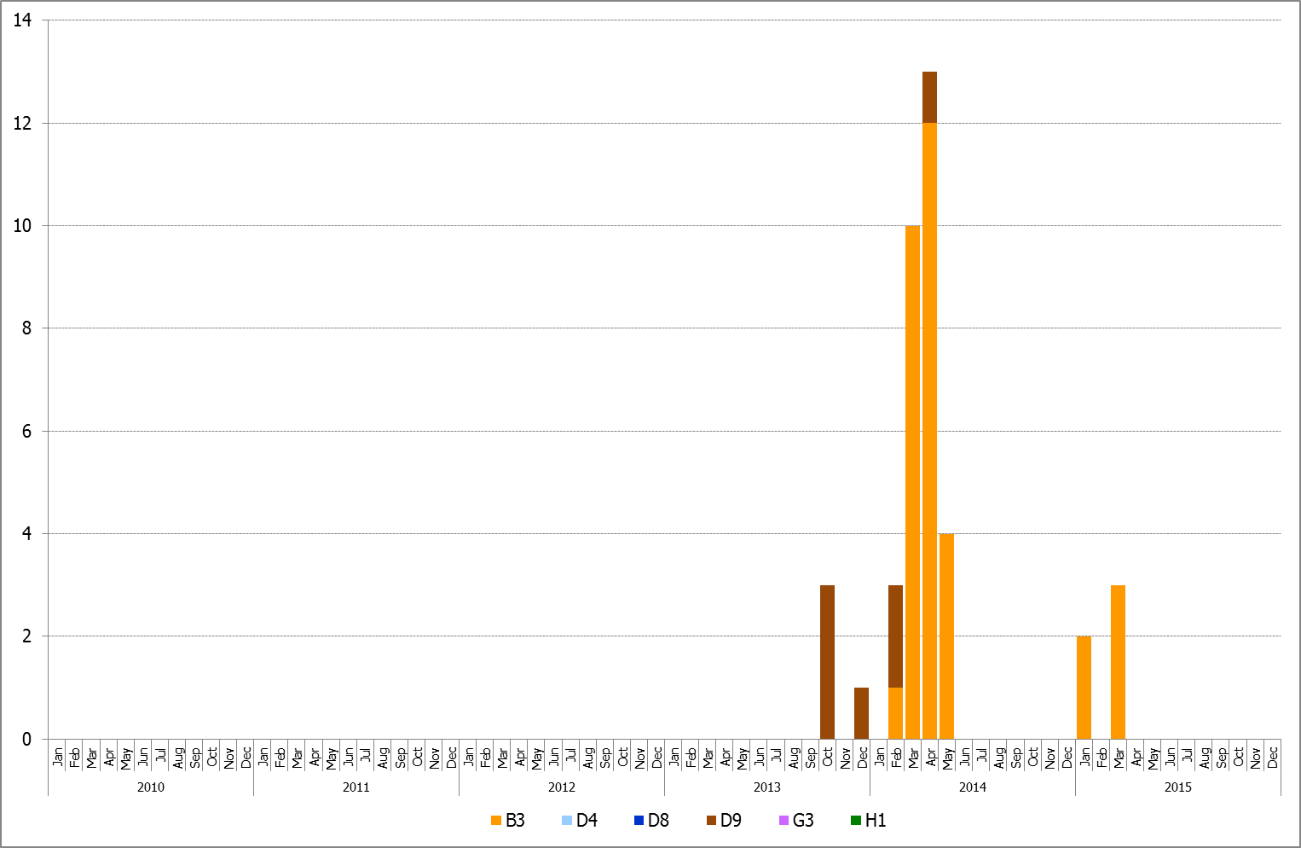
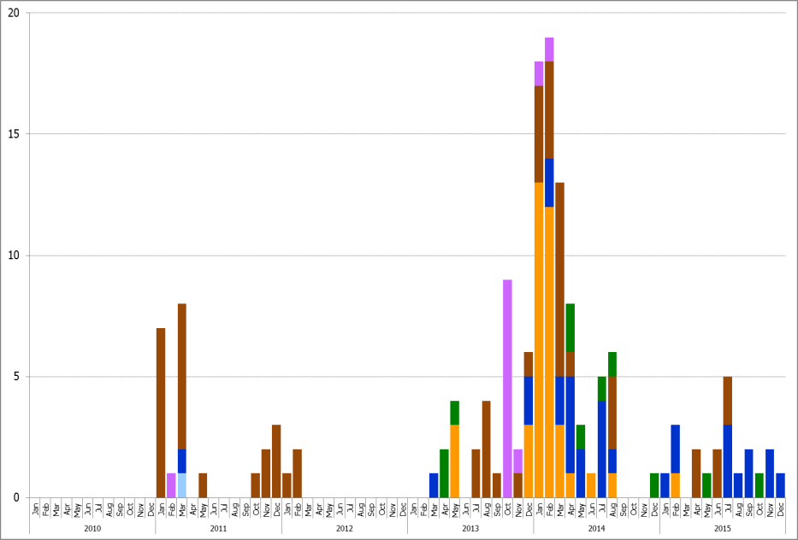
Monthly Detection of measles genotypes, 2010-2015
B3
D4
D8
D9
D11
G3
H1
New Zealand
Philippines
Papua New Guinea
Singapore
Sources: Includes all cases reported to the Western Pacific Regional Office by 20 May 2016 and the Measles Nucleotide Sequence online database (MeaNS).

Slide 19
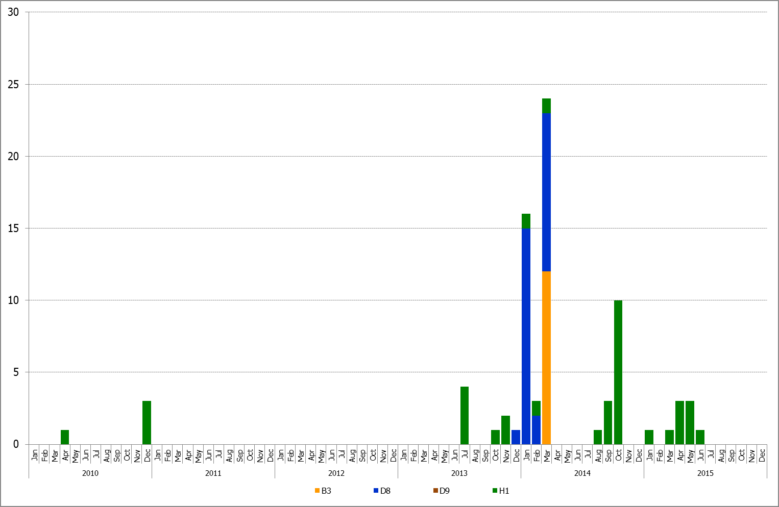
Monthly Detection of measles genotypes, 2010-2015
B3
D4
D8
D9
D11
G3
H1
Vietnam
Sources: Includes all cases reported to the Western Pacific Regional Office by 20 May 2016 and the Measles Nucleotide Sequence online database (MeaNS).

Slide 20
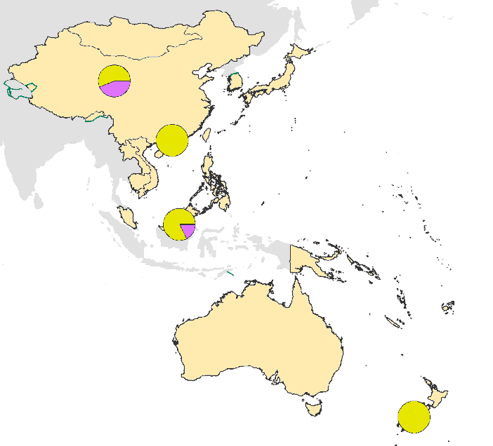
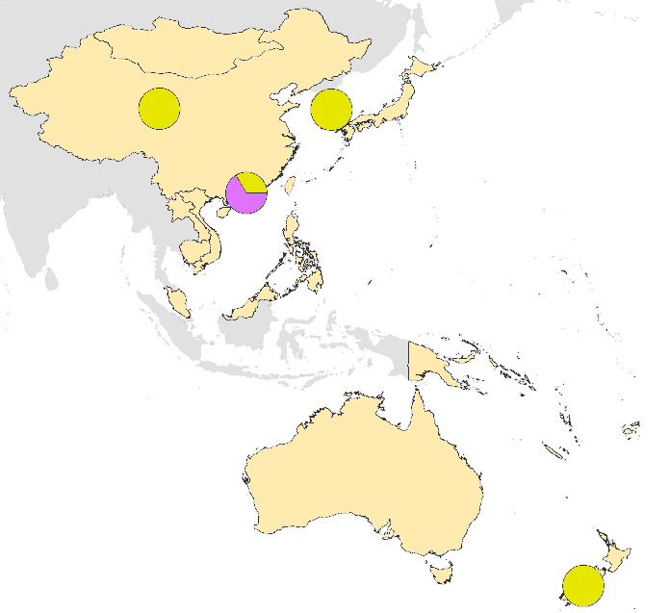
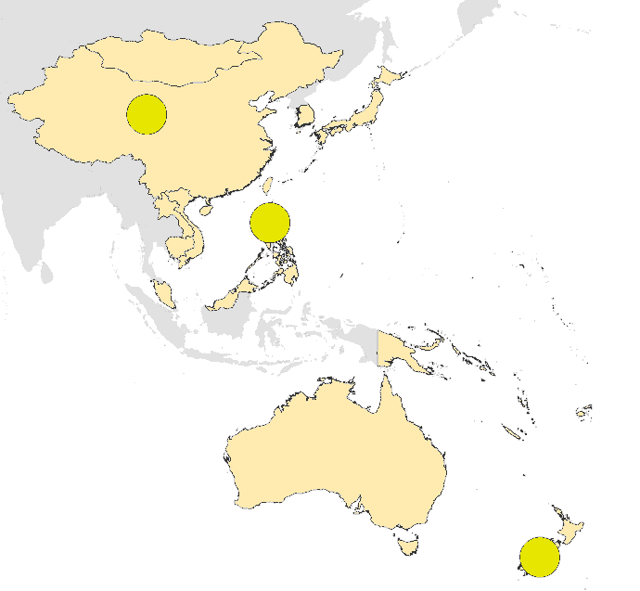
Rubella virus genotype distribution of cases with onset in 2013-2015, Western Pacific Region
2014
2015
2016
2B
1E
1J
Sources: Includes all cases reported to the Western Pacific Regional Office by 20 May 2016.

Slide 21

Measles genotype distribution in 2015 and 2016
Country | Lab confirmed cases | Samples for virus detection | No of isolates | No of +RT-PCR | Possible reason/solution for no report*
Lao PDR | 13 | 0 (486 serum samples) | 0 | 0 | 1.Work with EPI colleagues to get the samples; 2. Genotyping from serum
PNG | 57 | 0(196 serum samples) | 0 | 0 | 1.Work with EPI colleagues to get the samples; 2. Genotyping from serum
Viet Nam | 200 | 40(>2000 serum samples) | 0 | 0 | 1.Work with EPI colleagues to get more qualified throat samples; 2. Genotyping from serum
PHL | 669 | 67 | 10 | 20 | Genotype need to be reported. Get more and qualified throat samples.
Sources: Includes all cases reported to the Western Pacific Regional Office by 20 May 2016 and the Measles Nucleotide Sequence online database (MeaNS).

Slide 22
Difference in the number of genotypes reported, WPR, 2015
Country/area | MeaNS | Report to WPR | Difference
Australia | 89 | 51 | 38
Brunei Darussalam | 1 | 1 | 0
China | 2903 | 3905 | -1002
China, Hong Kong SAR | 12 | 9 | 3
Japan | 29 | 23 | 6
Malaysia | 4 | 71 | -67
Mongolia | 35 | 23 | 12
New Zealand | 10 | 8 | 2
Philippines | 19 | 15 | 4
Republic of Korea | 2 | 2 | 0
Singapore | 8 | 21* | -13
Viet Nam | 13 | 9 | 4
WPR | 3125 | 4138 | -1013
Source: MeaNS data as of 14 June 2016
Measles and rubella laboratory reports to WPR as of 20 May 2016
*Genotype reports from Singapore are from the surveillance reports

Slide 23
Achievements of Measles/Rubella LabNet
Highly proficient LabNet with strong quality assurance provided laboratory confirmation and genotyping evidence to the programme.
Most of labs have achieved the target indicator of timeliness of reporting (80% within 4 days) in 2015-2016.
For the countries verified measles elimination, genotype evidence supports the interruption of endemic measles virus transmission.
For Endemic countries and near to elimination countries, most of countries have genotyping data providing a good baseline for the genetic information.

Slide 24
Way forward for LabNet to achieve
Follow up with some NL for the timeliness of IgM reporting. PNG, KOR, VNM(2/4 labs)
  surge capacity building and outbreak response strategy (lessons from 2014)
Work with EPI colleagues to get viral samples and/or improve the quality of throat swab sample collection in some countries (VNM, PNG, LAO, PHL…)
Continually improve measles/rubella molecular detection AND REPORT: PHL, VNM, LAO…
Persistently Improve the Genotype information report to MeaNS
Rubella virologic surveillance and CRS surveillance should be strengthened.
Mongolia measles outbreak occurred after 1 year of measles elimination verification-workload and sample collection strategy…

Slide 25
WPR M&R Labnet Plan: 2016-2017
6th VPD Lab Net meeting, 12-15 Sep 2016, Manila
Onsite assessment/accreditation: SGP, VNM, MYS, 6 provincial labs in China, PNG, NEZ, KOR,GSL/RRL (Japan-NIID, AUS-VIDRL, China)
Desk accreditation for other network laboratories

Slide 26
Acknowledgement
David Featherstone
All MR Network Laboratories
  GSL: Katsuhiro Komase and team;
  RRL: HK PHLC: Janice Lo and team; VIDRL: Vicki and team; China CDC: Xu Wenbo and team
US CDC: Paul Rota and team, Joe Icenogle and team;
WHO HQ: Mick Mulders;
WPRO EPI team
WHO country EPI officers

Slide 27
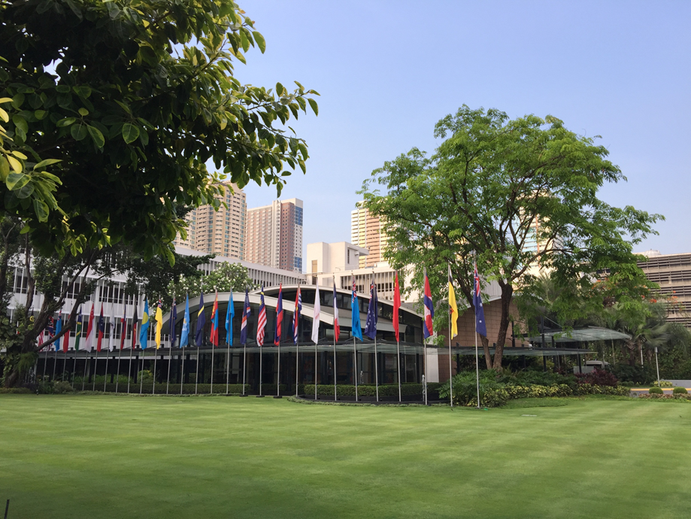
Thank you for your attention

