Slide 1
Regional updates:
Measles and Rubella Laboratory network in the South East Asia
The 14th Global Measles and Rubella Laboratory Network Meeting
Geneva, 21 June 2016
Sirima Pattamadilok
IVD WHO SEARO

Slide 2
Regional Measles and Rubella Goals
66th Meeting of the SEAR Regional Committee in September 2013 in New Delhi resolved to adopt the goal of measles elimination and rubella/CRS control in the South-East Asia Region by 2020
1655 days remaining

Slide 3
Reported Measles Cases and MCV1 and MCV2 Coverage SEAR, 2003–2015
Cases of measles reported to WHO and UNICEF through the Joint Reporting Form to Regional office for South-East Asia Region. Data are from WHO and UNICEF estimates for the South-East Asia Region..

Slide 4
Reported Rubella Cases and RCV* Coverage SEAR, 2003–2015
* RCV not introduced in DPR Korea, India, Indonesia
Cases of rubella reported to WHO and UNICEF through the Joint Reporting Form to Regional office for South-East Asia Region. Data are from WHO and UNICEF estimates for the South-East Asia Region..

Slide 5
Measles-Rubella Surveillance Indicators - 2015
Country | Proportion of all suspected measles and rubella cases that have had an adequate investigation initiated within 48 hours of notification | Discarded non-measles non-rubella incidence per 100,000 total population | Proportion of subnational administrative units reporting at least two discarded non-measles non-rubella cases per 100,000 total population | Proportion of sub-national surveillance units reporting to the national level on time
Bangladesh | 91 | 1.85 | 38 | 92
Bhutan | 83 | 0.67 | - | -
DPR Korea | 96 | 0.30 | - | 100
India | - | 0.38 | - | 92
Indonesia | 44 | 0.62 | - | 38
Maldives | 82 | 2.34 | - | 100
Myanmar | 57 | 0.39 | - | -
Nepal | 17 | 0.85 | 12 | 89
Sri Lanka | - | 4.00 | - | 100
Thailand | 30 | 0.58 | 9 | -
Timor Leste | 94 | 1.4 | - | 100
Of expected ~37,000 non-measles non rubella, only 9,800 reported-
26% capture rate
Not met
Close
Fully met
No data
Source: SEAR Weekly VPD bulletin and JRF as of 15 June 2016

Slide 6
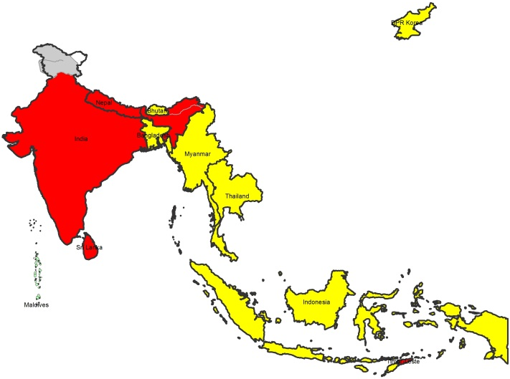
Measles-Rubella Surveillance 2015-
Incidence by country
Incidence per million → | Measles | Rubella
Bangladesh | 1.5 | 24.4
Bhutan | 14.5 | 0.0
DPRK | 0.0 | 0.0
India* | 19.9 | 38.5
Indonesia* | 3.2 | no data
Maldives | 0.0 | 0.0
Myanmar | 0.1 | 5.8
Nepal | 57.7 | 257.8
Sri Lanka | 74.8 | 4.8
Thaliand | 2.3 | no data
Timor-Leste | 38.6 | 8.3
SEAR | 15.9 | 38.7
Measles Incidence –
>5/million; <5 per million, zero cases
*Note: India and Indonesia are yet to fully expand the case-based surveillance nationwide.

Slide 7
SEAR seems to have countries in four different stages of population immunity
Countries with low/no transmission and immunity gap closed in all age groups : DPR Korea, Thailand and Maldives
Countries with very low incidence of measles cases but with resurgence : Sri Lanka and Bhutan
Countries that have progressed to close the immunity gap in children and young adults (up to the age of 14 years) but not in older population: Bangladesh, Myanmar, Nepal, and Timor-Leste
Countries with huge birth cohorts and yet to close the immunity gap even in children : India and Indonesia

Slide 8
Expansion of the SEAR Measles and Rubella Laboratory Network
Established QA system
2003
2014
2015
2020
8 Labs
37 Labs
39 Labs
45+ Labs

Slide 9
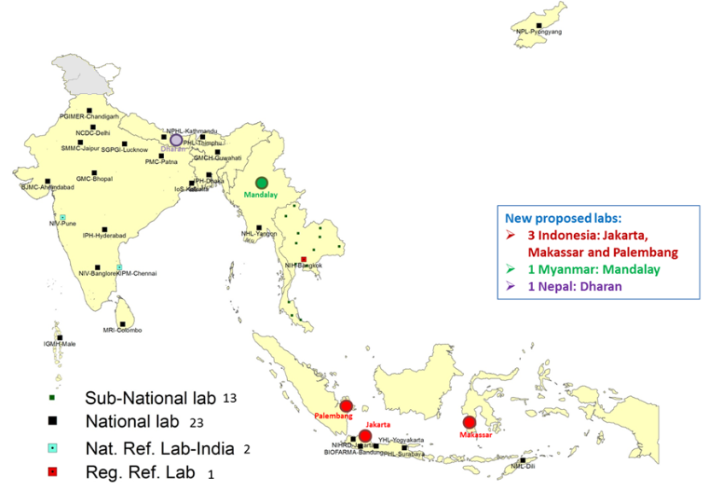
SEAR MR Laboratory Network, 2015: 39 Labs
1 India: ERC, Mumbai
The boundaries and names shown and the designations used in the maps in this document do not imply the expression of any opinion whatsoever on the part of the World Health Organization concerning the legal status of any country, territory, city or area or of its authorities, or concerning the delimitation of its frontiers or boundaries. Dotted lines on maps represent approximate border lines for which there may not yet be full agreement. © WHO 2015. All rights reserved
Notes:
At the present, the SEAR Measles and Rubella Laboratory Network has been expanded to a total of 39 laboratories. The network comprises one regional reference laboratory (RRL) at Thailand, two national reference laboratory (2NRL) of India, at least one national laboratory (NL) of each member states (8NL) except India (11NL) and Indonesia (4NL); and 13 sub-national laboratories (SNL) of Thailand. Moreover, Indonesia, Myanmar and Nepal have planned to increase more labs to support national case based surveillance; as above described. As of May 2015, there are 36 proficient laboratories out of 39 laboratories in the SEAR MR LabNet (Timor-Leste, Chandigarh, Delhi have yet to receive accreditation).

Slide 10
Laboratory capacity: 39 labs | Number
1. Serology | 16
2. Serology + Viral detection (Conventional & Real-time) | 8
3. Serology + Viral detection + isolation | 11
4. Serology + Viral detection + isolation + sequencing | 4

Slide 11
Number of Specimens Tested by the SEAR MR Lab Network, 2009-2015
Data as of 29 February 2016

Slide 12
Specimens Tested by SEAR MR Laboratory Network,
2012-2015
4027
4438
3013
3804
Indonesia
India
Data as of 31 Dec 2015

Slide 13
Results reported by the laboratory within 4 days of receiving the specimen for serology
Source: SEAR Annual EPI Reporting Form, 2016
* started since last quarter of 2015
** data from Monthly Lab Reporting

Slide 14
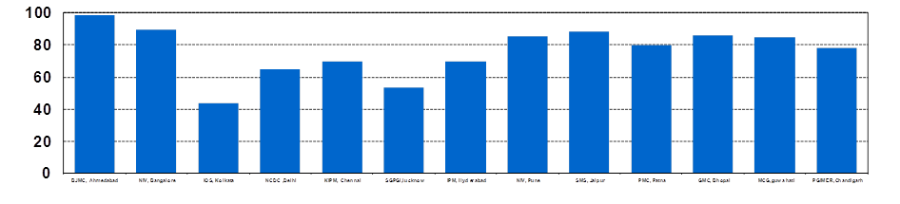
Timeliness of results reported to program, India
2015- 2016*
%
2015- Number of samples = 7,187
%
2016- Number of samples = 4,407
% Result reported within 4 days
*data as on April 2016
Note: Only Serum samples collected from outbreaks considered

Slide 15
Accuracy of measles and rubella IgM detection 2015-2016
Reference lab | Measles | Rubella
Thai NIH (RRL) | 94.3 - 100 | 90.9 - 100
Chennai (RL of India) | 94 - 100 | 89 - 100
Bio Farma, Bandung (RL of Indonesia) | 100% | 100%

Slide 16
Score on the WHO IgM proficiency test
2015
39 Labs | Result report | Scoring result
Measles | 95-100% (38 labs) | 95.5-100% (30 labs)
Rubella | 100% | 93.2-100% (31 labs)

Slide 17
Scoring result of Measles IgM of PT panel in SEAR
Country (Lab ID) | Scoring result |  | Summary | Cutting point
 | Part 1 | Part 2
Myanmar (081) | 20 | 10 | 97.7 | Batch
DPRK (139) | 20 | 9 | 95.5 | Batch, IQC
Bhutan (035) | 20 | 9.4 | 96.5 | IQC, Lately report
India-Chennai (080) | 20 | 10 | 97.7 | Cut off
India-Assam (Gauhati) (277) | 20 | 10 | 97.7 | IQC
India-Hyderabad (188) | 20 | 10 | 97.7 | Cut off
India-Jaipur (265) | 20 | 9 | 95.5 | Cut off, IQC
India-Patna (275) | 20 | 10 | 97.7 | Cut off
Indonesia-Bandung (028) | 19 | 11 | 96.2 | Interpretation result Bandung (Pos) → VIDRL (Neg)

Slide 18
Scoring result of Rubella IgM of PT panel in SEAR
Country | Scoring result |  | Summary | Cutting point
 | Part 1 | Part 2
Sri Lanka | 20 | 8 | 93.2 | RuM-IBL kit (kit validation criteria)
Myanmar | 20 | 10 | 97.7 | Batch
DPRK | 20 | 9 | 95.5 | Batch, IQC
Bhutan | 20 | 9.4 | 96.5 | IQC, Late report
India-Delhi | 20 | 10 | 97.7 | IQC RuM
India-Hyderabad | 20 | 10 | 97.7 | Cut off
India-Jaipur | 20 | 9 | 95.5 | Cut off, IQC
India-Patna | 20 | 10 | 97.7 | Cut off

Slide 19
Accreditation review 2013-2016
2013 | 2014 | 2015 | 2016 (as of May)
13 labs (score80-98%) | 13 labs (score80-94%) And one pending | 12 labs (score78-86%) And three provisionally | 13 labs (score85-92%) And two pending

Slide 20
Review results of Quality Laboratory in SEAR | Status
Serology testing results reported by the laboratory within 4 days of specimen receipt (Target: ≥ 80%) (turnaround time change from 7 days to 4 days by March 2014) | Partially (Yes: 8/11 co.)
2. IgM tests are performed on at least 50 specimens annually. | Yes
3. Accuracy of measles and rubella IgM detection (Target: ≥ 90%) | Yes
4. Score on the most recent WHO proficiency test ( Target: ≥ 90%) | Yes
5. Internal quality control (QC) procedures are implemented | Need to be addressed
6. Virus detection and genotyping results (where appropriate) are completed within 2 months of receipt of specimen and data reported to the WHO Regional Office (Target: ≥ 80%) | Need to be addressed
7. Score from the annual on-site review of laboratory operating procedures and practices (Target: ≥ 80% (NL) & ≥ 90% (RRL) | NL: Yes(32/38) RRL: Yes
Notes:
These is laboratory accreditation review indicators. The blue highlight is used for monitoring of high quality surveillance system.

Slide 21
Proficient* Laboratory Status in SEAR
(as of May 2016)
WHO accredited | Quality laboratory | Provisionally accredited | Pending
24 | 9 | 3 | 3
*A proficient laboratory is one that is WHO accredited and/or has an established quality assurance programme with oversight by a WHO accredited laboratory. Source: Framework for verifying elimination of measles and rubella. WER no. 9, 1st March 2013
Notes:
Provisionally accredited – Sri Lanka, Patna India and Sub National lab Thailand-Trant
Pending- Bangladesh, Jaipur India, Timor Leste
Quality Lab- 9 in thailand

Slide 22
To enhance Internal quality control
Opportunities for improvement
Actions
Supervision
In house control
West guard rule
In house calibration
Document control
GLP & Safety
CQI
Strengthen laboratory management skill and CQI (better we can do): The regional meeting was provided in Jakarta2014)
Build the lab assessors: The workshop on capacity building in measles and rubella laboratory accreditation in Bangkok 2015

Slide 23
The further step for internal quality control improvement
To implement the internal quality auditing process: The Regional workshop for strengthening capacity and internal quality assurance for the SEAR measles and rubella laboratory network in Bhutan, August 2016

Slide 24
To enhance the virus detection and genotyping result
Establishing molecular labs
Use the referral system in regional network to enhance submission of genotypes sequencing data in MeaNS and RubeNS
Encouragement of genotypes data sharing: Indonesia started submitting the nucleotides sequence data to MeaNS and RubeNS in June 2016

Slide 25
Establishing the molecular labs for viral genome detection and amplification in 2014-2016
2014: Provide molecular lab group training for 22 labs in 9 countries (Myanmar and Timor-Leste: not yet trained)
2015: Provide on site training for 3 labs:
  Sri Lanka: Conventional RT PCR
  Nepal: Conventional RT PCR
  Bangladesh: Conventional RT PCR
2016: Provide on site training for 2 labs:
  Myanmar: Conventional RT PCR and sequencing
  Bhutan: Conventional RT PCR and Real time PCR

Slide 26
Use the referral system in regional network to enhance submission of genotypes sequencing data in MeaNS and RubeNS
Initiated the referral system for genotypes sequencing as appropriate:
  India (7 labs): refer to NIV, Pune
  Indonesia (4 labs): refer to BioFarma, Bandung and NIHRD, Jakarta
  Nine countries (12 labs): refer to RRL, Thailand

Slide 27
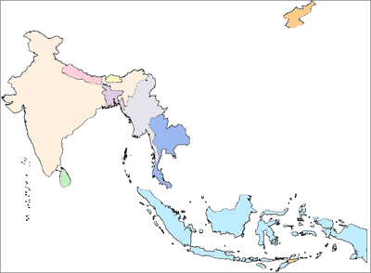
Measles genotypes circulating in SEAR between 2004-2016*
DPRK
D8, B3
Bhutan
 | 2004 | 2005 | 2006 | 2007 | 2008 | 2009 | 2010 | 2011 | 2012 | 2013 | 2014 | 2015 | 2016
Bangladesh |  |  |  |  |  |  |  |  |  |  | B3 | B3
Bhutan |  |  |  |  |  |  |  |  |  |  |  | D8,B3 | D8
DPRK
India | D4,D7, D8 | D4, D8 | D4, D8 | D4, D8, D7 | D4,D8 | D4,D8 | D4, D8 | D4, D8 | B3,D4, D8 | D4, D8 | B3, D4,D8 | B3,D4,D8 | D4,D8
Indonesia |  | D9 | D9 | D8 |  |  | D9 | D9,G3 | D9 | D8, D9
Maldives |  | D5
Myanmar |  |  |  | D5 |  |  | D9 | D9 | D9
Nepal | D4, D8 |  |  |  | D4 | D8 | D4, D8 | D4, D8 | D8 |  |  | D4,D8
Sri Lanka |  |  |  |  |  |  | D8 | D8 |  |  | B3 |  | B3
Thailand | D5 |  | D5 | D5 | D5, D9 | D9 |  | D8, D9 | D8, D9 | D8, D9 | B3 | H1 | H1
Timor Leste
D4, D8
Nepal
D4, D7,B3, D8
Myanmar
India
D5,D9
Bangladesh
B3
Thailand
D5,D8,D9,B3,H1
D8, B3
Sri Lanka
D5
Maldives
Indonesia
D8, D9,G3
-Non active
-Active
-New finding
Timor Leste
* Data as of 30 April 2016
Source: Measles RRL in SEAR, Nation Institute of Health, Thailand, MeaNS, WHO SharePoint and Intercountry Training on Molecular Technique for the SEAR Measles and Rubella Laboratory Network, Bangkok, Thailand, Feb 2014

Slide 28
Rubella genotype distribution in SEAR between 2005- 2016*
DPRK
 | 2005 | 2006 | 2007 | 2008 | 2009 | 2010 | 2011 | 2012 | 2013 | 2014 | 2015 | 2016
Bangladesh |  |  |  |  | 2B |  |  |  |  | 2B
Bhutan
DPRK
India |  |  | 2B | 2B | 2B
Indonesia |  |  |  | 1E | 1E | 1E | 1E | 1E, 2B | 1E, 2B
Maldives
Myanmar
Nepal |  |  |  | 2B | 2B | 2B |  | 2B
Sri Lanka |  |  |  | 1E, 2B |  |  | 2B | 2B
Thailand | 1E |  |  |  | 1E | 2B | 2B | 2B | 2B |  | 2B
Timor Leste
Bhutan
2B
Nepal
2B
2B
Myanmar
India
Bangladesh
Thailand
1E, 2B
1E, 2B
Sri Lanka
Maldives
Indonesia
1E,2B
Timor Leste
* Data as of 30 April 2016
Source: Measles RRL in SEAR, Nation Institute of Health, Thailand, RubeNS, WHO SharePoint and Intercountry Training on Molecular Technique for the SEAR Measles and Rubella Laboratory Network, Bangkok, Thailand, Feb 2014

Slide 29
The further step is for enhancing the use of molecular epidemiology data for identifying source of transmission

Slide 30
Estimated budget by tests
Test | Unit cost | Estimated # | Total cost (US$)
Measles IgM | 10US$ | 37,000 | 370,000.-
Rubella IgM | 10US$ | 25,900 (70% of Total) | 259,000.-
Conventional RT PCR | 90US$ | 1850 (5% of Total) | 166,500.-
Sequencing | 96US$ | 925 (50% of PCR) | 88,880.-
Real time | 85US$ | 600 (DPRK, Maldives and Thailand) | 51,000.-
Virus isolation | 40US$ | 925 (50% of PCR) | 37,000.-
 |  |  | 972,380.-

Slide 31
SEAR Measles and Rubella Labs
Regional Office Budget Projections for 2016
Budget Line | Annual Requirement* | Funding Available | Implementation 15 Jun 2016 | Funding Source | Funding Gap
Lab Staff
Scientist (50% staff time) | 123,250 | 123,250 | 61,625 | CDC-Polio | Nil
MO-Measles (10% staff time) | 20,200 | 15,500 | 7,750 | CDC-Measles | 4,700
Lab Technologist (Timor Leste) | 93,250 | 93,250 | 46,625 | WHO Flexi funds | Nil
Support Staff (50% staff time) | 11,250 | 8,625 | 4,312 | CDC-Measles | 2,625
Totals | 247,950 | 240,625 | 120,312 |  | 7,325
Lab Activities**
Technical Assistance | 52,000 | 52,000 | 46,024 | WHO Flexi funds | Nil
Supplies, Reagents & Equip | 722,250 | 289,200 55,250 | 41,078 110,249 19,916 | CDC-Measles WHO Flexi Funds UNF/MRI | 377,800 Nil Nil
Training, Meetings & Workshops | 220,000 | 59,800 | 2,559 7,500 8,136 | CDC-Measles UNF/MRI WHO Flexi funds | 60,200 100,000 Nil
Accreditation reviews / visits | 40,000 | 11,960 | 8,001 Nil 42,636 | CDC-Measles UNF/MRI WHO Flexi FUNDS | 8,040 20,000 Nil
Totals | 1,034,250 | 468,210 | 286,099 |  | 566,040 CDC-Msls - $ 446,040 UNF/MRI - $ 120,000
Grand Total (Staff + ACT) | 1,282,200 | 708,835 (55% of annual Req) | 406,411 (57% of Resources) (32% of Annual Req) |  | 573,365 (45% of Annual Req)
* Annual Requirement is drawn from donor proposals. Projected Requirement of USD 565,000 under PB 2016-17 for IVD Regional Office has not been considered for this summary. This is because the planned costs in the activity plans are understated due to budget space limitations
** Does not include USD 325,000 budgeted by countries in support of laboratory network, requested under UNF/MRI proposal for 2016

Slide 32
To support CRS surveillance system
Regional workshop on strengthening laboratory capacity for Rubella/Congenital Rubella Syndrome (CRS) surveillance in October 2015, Bangkok, Thailand
  To build capacity of labs to follow the new harmonized algorithm for lab-confirmation of CRS cases
  To strengthen coordination between lab-network and the surveillance teams so that complete lab-supported case-based CRS surveillance is functional in all countries in the region.

Slide 33
Verification Commissions and Committees
Regional Verification Commission Established in April 2016.
  First meeting planned on 1st week of August
All member states have a National Verification Committee (NVC).
  DPR Korea is in the process of establishing the National Verification Committee

Slide 34
Challenges
Quality assurance of the laboratories is an issue. To sustain the proficiency status of the huge number of the SEAR MR laboratory network require well plan and new strategic approach.
Need strong collaboration among laboratory and epidemiologist to conduct molecular epidemiology and use data to identify the source of virus as indigenous, imported or import-related
Laboratory support for case confirmation, genotyping and logistic still seen as responsibility of the WHO supported MR Laboratory network. Needs to be streamlined to respective national procurement systems.

Slide 35
Challenges
Hard to reach areas (Bhutan, Bangladesh, Nepal, Myanmar and Maldives) are required to use DBS collection and quality assurance should be addressed
Viral detection not done regularly
The test algorithm for Point-of-Care-Testing devices should be addressed as well as the costs for testing at the labs
Data reporting system
Sustainability for elimination phase: funding and staffing

Slide 36
Transformation required ……
Strengthening quality assurance system
  Implementation of internal auditing for all laboratories
  Lab-assessors capacity for independent accreditation review annually
  Random sampling by SEARO
Capacity building on molecular epidemiology to establish transmission pathways and genetic linkage
Country level implementation of laboratory supported CRS surveillance system
To provide technical support identifying alternate options for sample collection and ELISA diagnostic kits

Slide 37
Acknowledgements
National Reference Laboratories, National Laboratories and Sub-National Laboratories
Regional Reference Laboratory, Thai NIH
WHO-country office
US-CDC
PHE
Global Laboratory Coordinator

Slide 38


Dhanyavada
Dhanybhad
Dhon no baad
Istuti
Kaadinchhey la
Kamsa hamnida
Khob khun
Kyeizu tin ba de
Obrigada
Shukuriyaa
Terima kasih
Thank you
38

