Slide 1


Measles and Rubella IgM Proficiency Testing –
Panel 01502
Vicki Stambos
Accelerating Progress Towards Measles and Rubella Control and Elimination Meeting
Geneva, Switzerland, 21 – 23 June 2016
Vicki Stambos
The 13th Global Measles and Rubella Laboratory Network Meeting, Geneva, Switzerland, 29th June to 1st July 2015

Slide 2

Outline
Results of the measles and rubella proficiency test – Panel 01502 based on the revised and weighted PT score algorithm
Outcome of the web-based submission process
Feedback of new results submission procedure provided by participating laboratories (survey)

Slide 3
Panel 01502 composition
(n=20)
Antibody status | Number of samples
Measles IgM positive | 6
Rubella IgM positive | 6
Parvovirus B19 IgM positive | 1
Dengue IgM positive | 1
Measles/rubella IgM negative | 6

Slide 4

New PT score algorithm - Part 1:
 | Points per item | Maximum score (%)
Correct OD result and interpretation | 1 point/sample | 20/20 (100)
Incorrect results: Incorrect OD result and incorrect interpretation | Deduct 1 point/sample
Inconsistent results: Incorrect OD result and correct interpretation Correct OD result and incorrect interpretation | Deduct 1 point/sample Deduct 1 point/sample
Value: 75% of overall PT score

Slide 5
New PT score algorithm - Part 2:
 | Points per item | Total points (%)
Kit Data: Manufacturer Kit name Lot number Expiry date Cut-off value Positive control Negative control | 1 point 1 point 1 point 1 point 1 point 1 point 1 point | 7 points (58.3)
Kit validation criteria: If Siemens kit used - P/N OD control < 0.10 Individual P/P OD controls are within kit-specified range Individual P/P OD controls +/- 20% of mean P/P control If kit other than Siemens used – (Total of 3 points, (33.3%)) | 1 point 1 point 1 point | 3 points (33.3)
Use of In-house control | 1 point | 1 point (8.3)
TOTAL | 11 points | 11 points (100)
Timeliness of reporting: Results are required to be reported to VIDRL within 14 days from receipt of panel * | * 5% (0.55 point) will be deducted for each week (or part thereof) of late reporting
Value: 25% of overall PT score

Slide 6
Number of laboratories and results returned for panel 01502
Measles | AFR | AMR | EMR | EUR | SEAR | WPR | Total
No. of participating labs | 38 | 19 | 19 | 69ª | 39 | 53 | 237
No. of measles results returned | 38 | 19 | 19 | 70 | 39 | 53 | 238
Rubella
No. of participating labs | 38 | 18^{b} | 18^{c} | 69^{d} | 39 | 53 | 235
No. of rubella results returned | 38 | 18 | 18 | 72 | 39 | 53 | 238
ª One laboratory submitted 2 sets of results.
^{b} Excludes 1 laboratory that tested panel 01404 and submitted together with measles results for panel 01502.
^{c} Excludes 1 laboratory that tested for measles IgM and IgG, therefore insufficient
volume to test for rubella.
^{d} Three laboratories submitted 2 sets of results.
Data for results returned to VIDRL prior to 17th June 2016

Slide 7
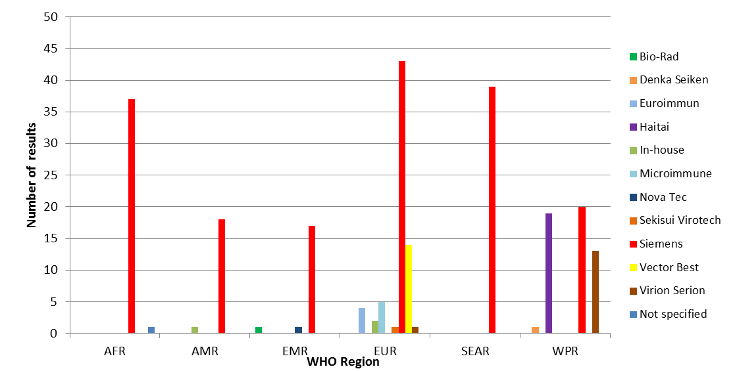
Measles IgM kits in use for panel 01502 by WHO region
10 commercially prepared kits

Slide 8
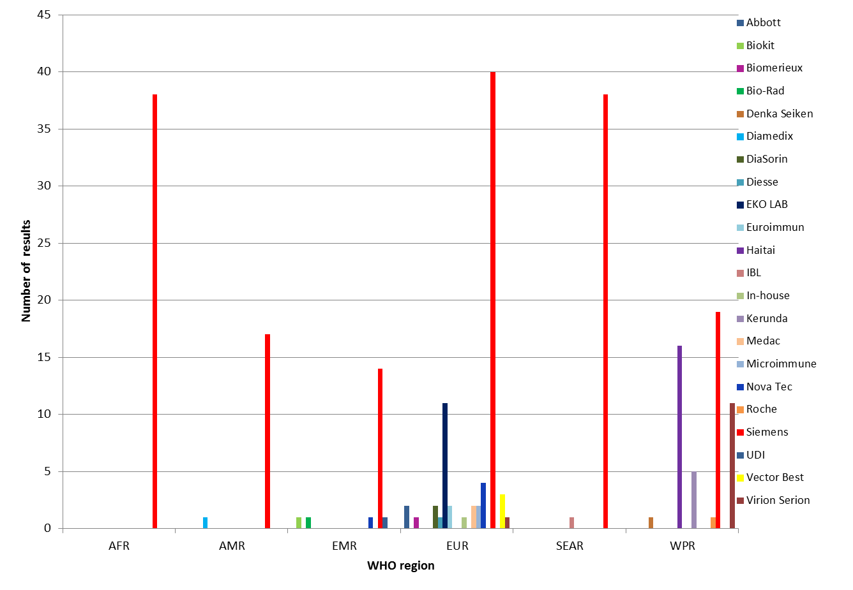
Rubella IgM kits in use for panel 01502 by WHO region
21 commercially prepared kits

Slide 9

Reporting kit details for panel 01502
Measles (n=238) | AFR | AMR | EMR | EUR | SEAR | WPR | Total (%)
Manufacturer | 37 | 19* | 19 | 70** | 39 | 53 | 237 (99)
Name | 37 | 18 | 19 | 68 | 39 | 53 | 234 (98)
Kit Lot No. | 37 | 19 | 19 | 69 | 39 | 53 | 236 (99)
Cut-off value | 22 | 14 | 16 | 56 | 35 | 50 | 193 (81)
Rubella (n=238) | AFR | AMR | EMR | EUR | SEAR | WPR | Total (%)
Manufacturer | 38 | 18 | 18 | 72* | 39 | 53 | 238 (100)
Name | 37 | 18 | 18 | 70 | 39 | 53 | 235 (99)
Kit Lot No. | 37 | 18 | 18 | 72 | 38 | 53 | 236 (99)
Cut-off value | 22 | 14 | 14 | 62 | 38 | 50 | 200 (84)
* One laboratory used in-house assay
** Two laboratories used in-house assays

Slide 10
Reporting QC data for panel 01502
Measles (n=238) | AFR | AMR | EMR | EUR | SEAR | WPR | Total (%)
Kit negative control | 38 | 19 | 19 | 70 | 39 | 53 | 238 (100)
Kit positive control | 38 | 19 | 19 | 70 | 39 | 53 | 238 (100)
In-house control | 29 | 11 | 13 | 47 | 35 | 42 | 177 (74)
Rubella (n=238) | AFR | AMR | EMR | EUR | SEAR | WPR | Total (%)
Kit negative control | 38 | 18 | 18 | 72 | 39 | 53 | 238 (100)
Kit positive control | 38 | 18 | 18 | 72 | 39 | 53 | 238 (100)
In-house control | 29 | 12 | 12 | 49 | 35 | 43 | 180 (76)

Slide 11
Expired kit details for panel 01502
 | AFR | AMR | EMR | EUR | SEAR | WPR | Total | Results obtained (Part 1)
Expired measles kits | 1 |  |  | 2 |  |  | 3 | 19/20 (1 lab) 20/20 (2 labs)
Expired rubella kits | 1 | 1 | 1 | 3 |  |  | 6 | 20/20 (6 labs)
Expiry date not stated | 1-measles |  |  |  |  |  | 1 | 20/20 (1 lab)
Valid tests
Measles: All valid tests
Rubella: All valid tests

Slide 12
Validation criteria – Measles – Panel 01502
Region | Valid test | Invalid test | Validation criteria unknown
AFRO n=38 | 37 | 1*
AMR n=19 | 19
EMR n=19 | 19
EUR n=70 | 62 | 1* | 7
SEAR n=39 | 39
WPR n=53 | 53
Total n=238 | 229 (96%) | 2 (1%) | 7 (3%)
*Individual kit P/P controls not within +/-20% of the mean kit P/P

Slide 13
Validation criteria – Rubella - Panel 01502
Region | Valid test | Invalid test | Validation criteria unknown
AFR n=38 | 37 | 1*
AMR n=18 | 18
EMR n= 18 | 18
EUR n=72 | 64 | 1** | 7
SEAR n=39 | 38 |  | 1
WPR n=53 | 52 |  | 1
Total n=238 | 227 (95%) | 2 (1%) | 9 (4%)
*Both P/P controls not within kit-specified upper and lower margins
**Both P/P controls not within kit-specified upper and lower margins, substrate diluted 1/100 instead of 1/10

Slide 14
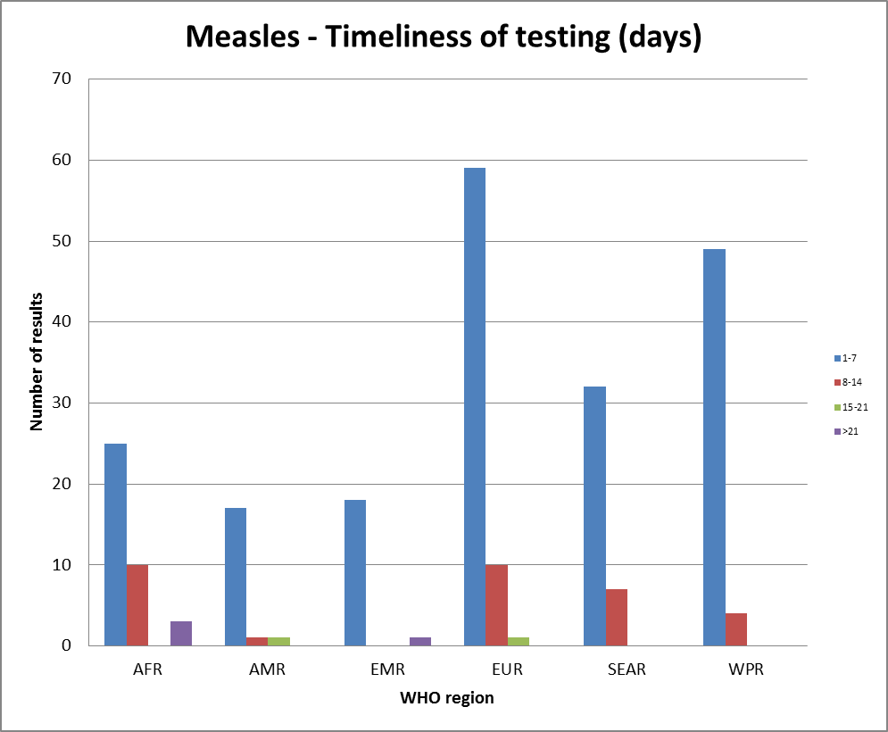
Measles - Timeliness of testing (days) – Panel 01502
≤14 days 92% 95% 95% 99% 100% 100%

Slide 15
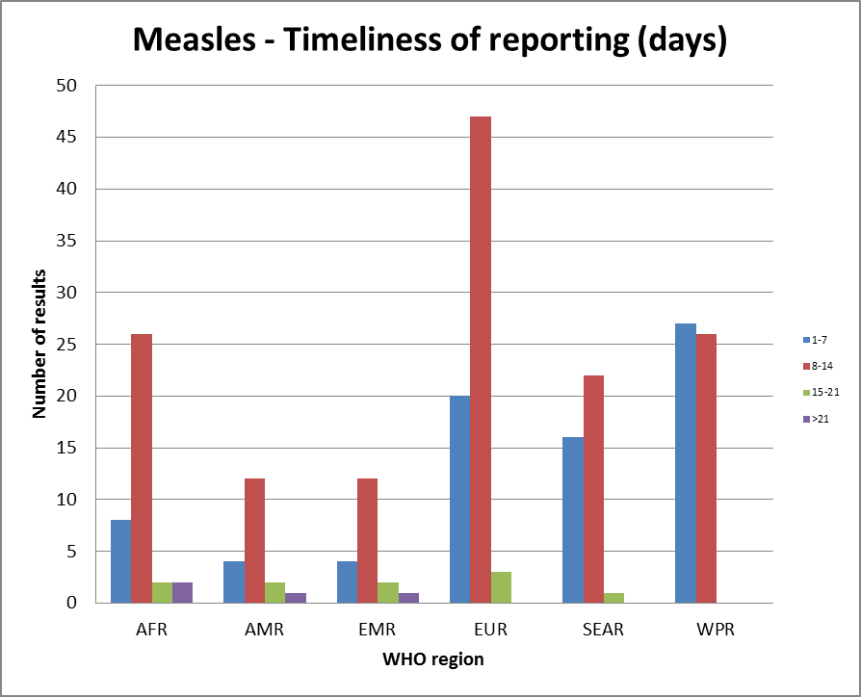
Measles - Timeliness of reporting (days) – Panel 01502
≤14 days 89% 84% 84% 96% 97% 100%

Slide 16
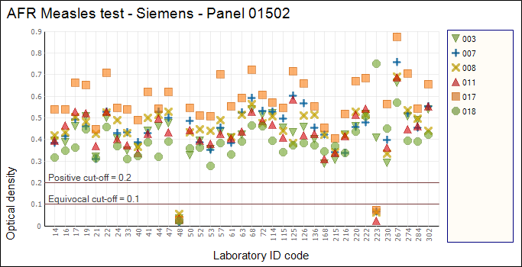

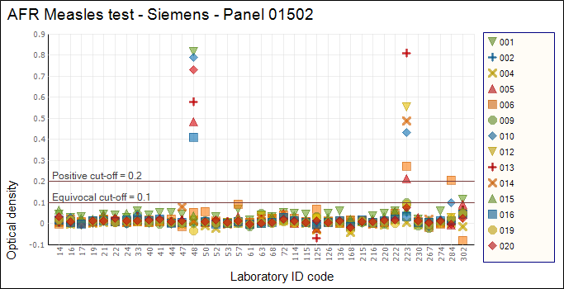
AFR Measles - Siemens
Lab ID 48: Rubella results reported on measles page and vice versa.
Lab ID 223: Lab reported condition of samples as ‘Inadequate’.
Lab ID 302: High OD values in control antigen wells observed for both measles and rubella test.
Lab ID 284: Kit used past expiry date.

Slide 17
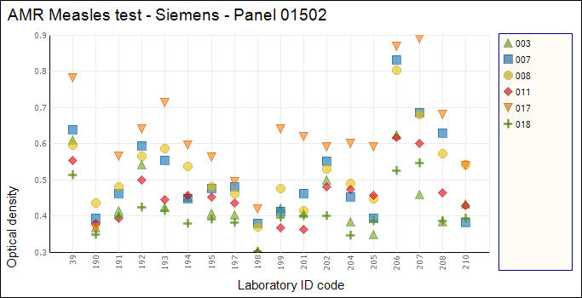
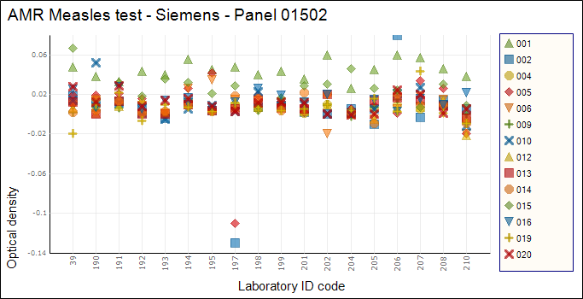
AMR Measles - Siemens
Lab 197: Tested panel 01404 for rubella and obtained correct results. Reason not specified.

Slide 18
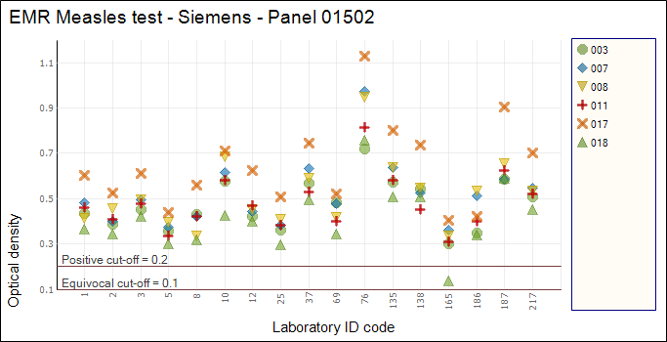
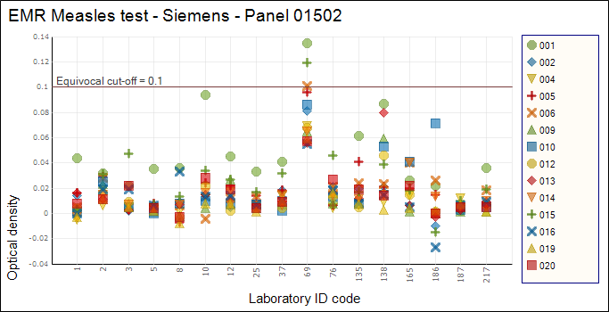

EMR Measles - Siemens
Lab ID 69: Samples 1, 6 and 15 had correct OD and interpretations on raw data files but transferred results incorrectly when reporting via the website.

Slide 19
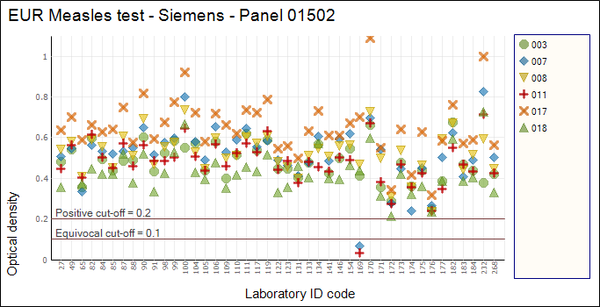
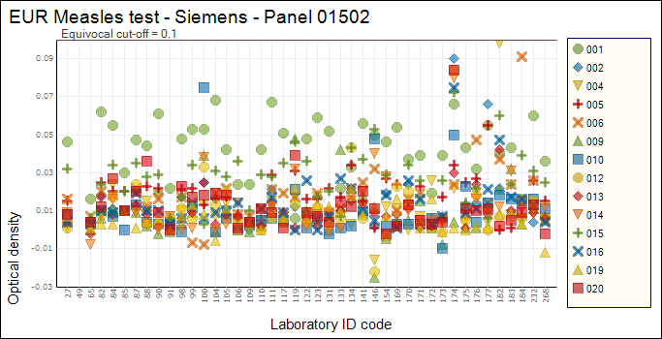
EUR Measles - Siemens
Lab ID 106 and 182: Kit used past expiry date.
Lab ID 172: Invalid test; individual P/P control OD values not within +/- 20% of the mean P/P.

Slide 20
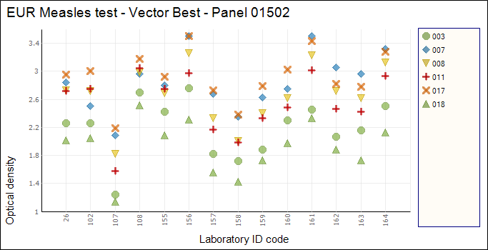
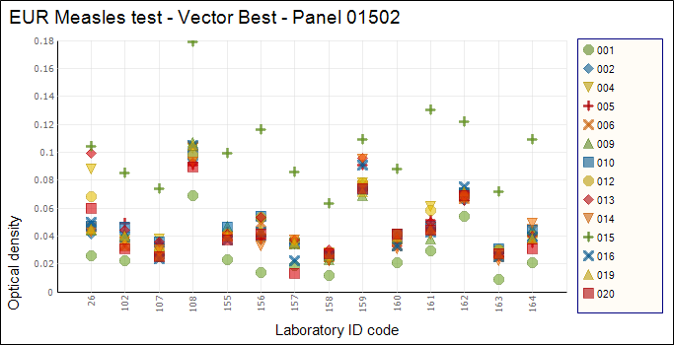
EUR Measles – Vector Best
Average cut-off = 0.289 , range = 0.251 – 0.328

Slide 21
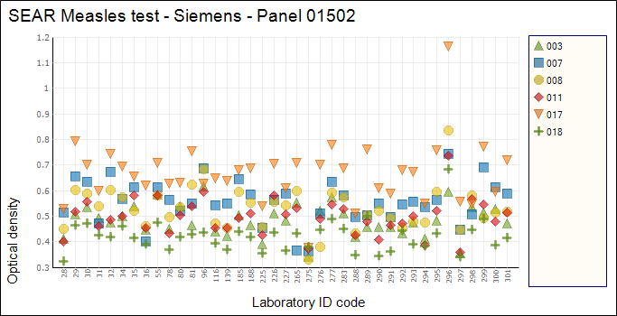

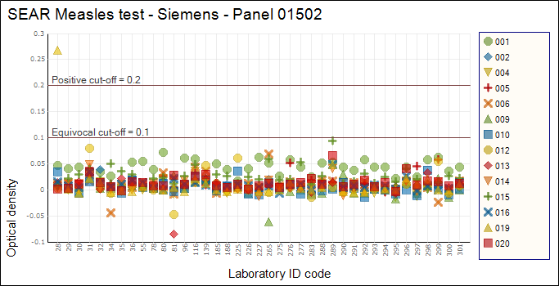
SEAR Measles – Siemens
Lab ID 296: Higher OD values than general consensus. Similar observation for rubella results.
Lab ID 28: Possible contamination of sample 19 from sample 18.

Slide 22
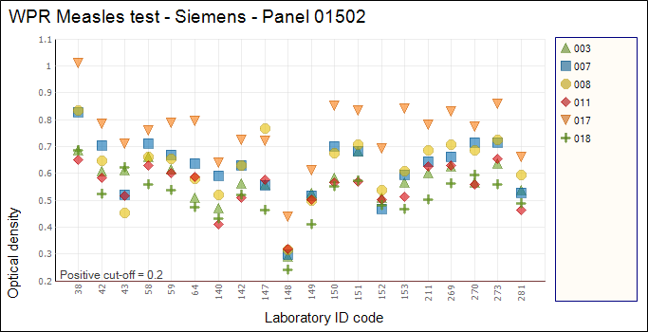
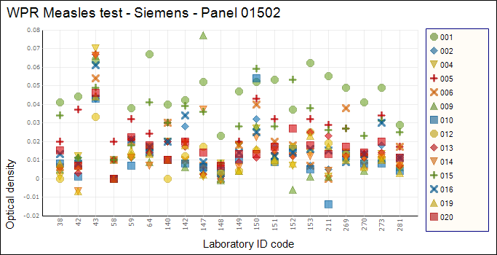
WPR Measles - Siemens
Lab ID 38: Lab reported that samples were stored at room temperature.
Lab ID 148: Lower OD values than general consensus. Similar observation with rubella test.

Slide 23
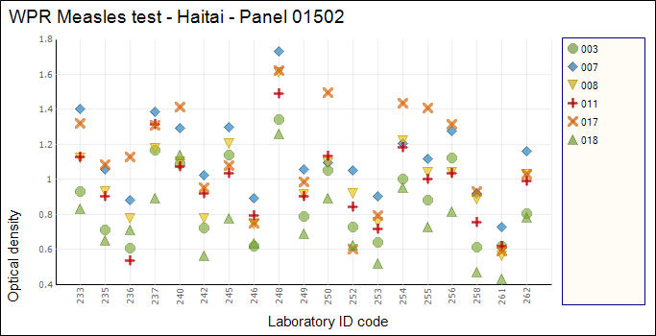
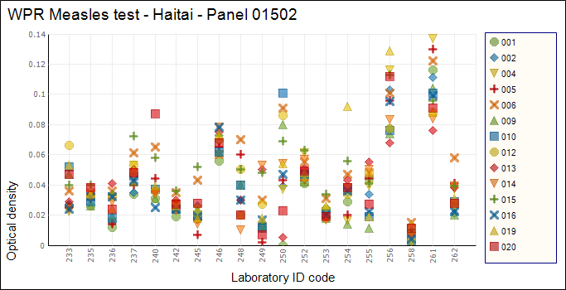
WPR Measles - Haitai
Average cut-off = 0.166, range = 0.147 – 0.233

Slide 24
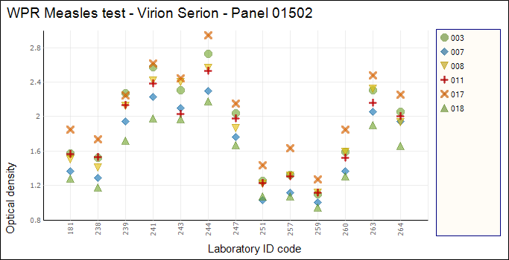
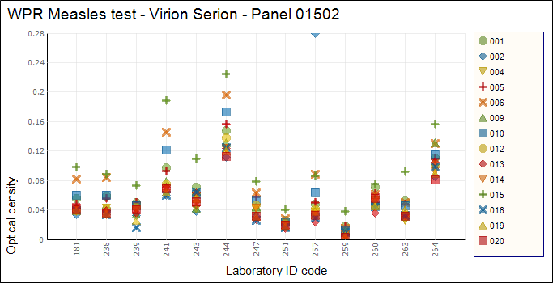
WPR Measles – Virion Serion
Average cut-off = 0.329, range = 0.182 – 0.570

Slide 25
Analysis of discrepant results for Measles IgM – Panel 01502
samples with discrepant results
Sample 011: 1 inconsistent result OD=0.337 reported as Negative.
P=Positive, N=Negative

Slide 26
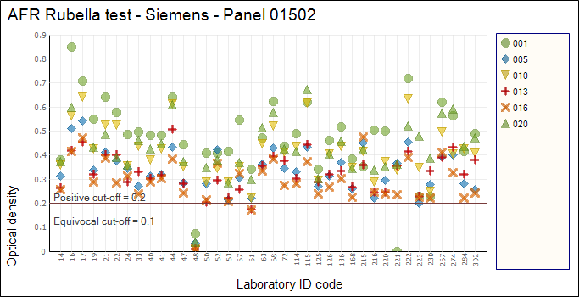
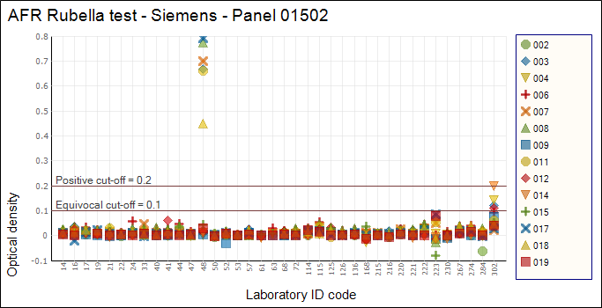
AFR Rubella - Siemens
Lab ID 48: Measles results reported on rubella page and vice versa.
Lab ID 61: Only tested samples that were negative for measles IgM.
Lab ID 221: Invalid test; individual kit P/P controls not within kit-specified lower and upper limits.
Lab ID 222: Kit used past expiry date.
Lab ID 223: Lab reported condition of samples as ‘Inadequate’.
Lab ID 302: High OD values in control antigen wells observed for both measles and rubella test.

Slide 27
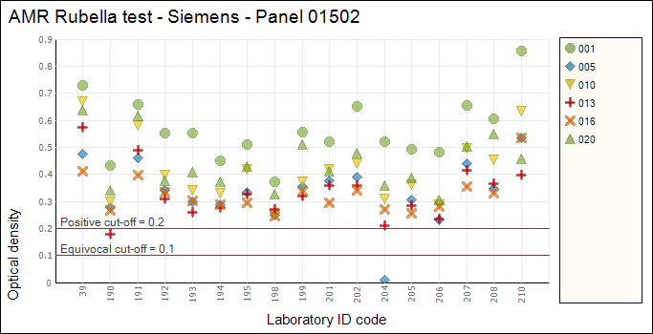
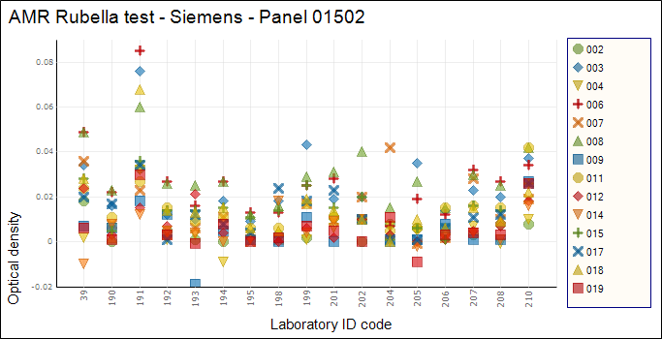
AMR Rubella - Siemens
Lab ID 190: Sample 13 incorrectly reported as negative, OD=0.18
Lab ID 195: Kit past expiry date.

Slide 28
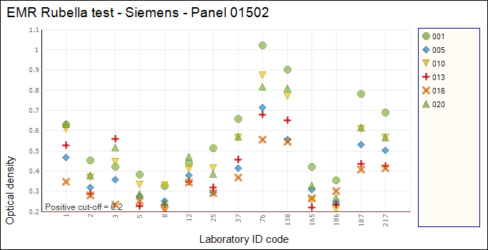
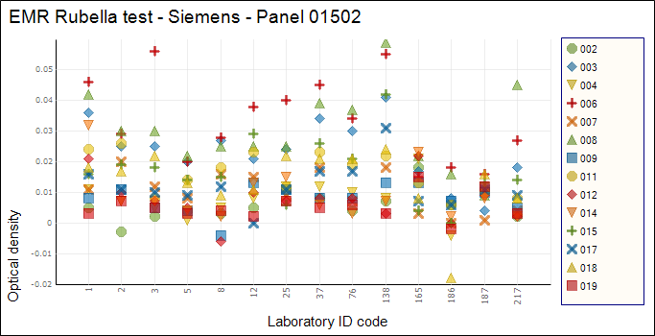
EMR Rubella - Siemens
Lab ID 37: Kit used past expiry date.

Slide 29
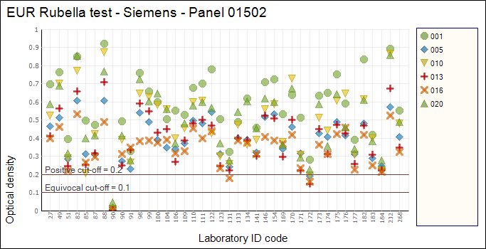
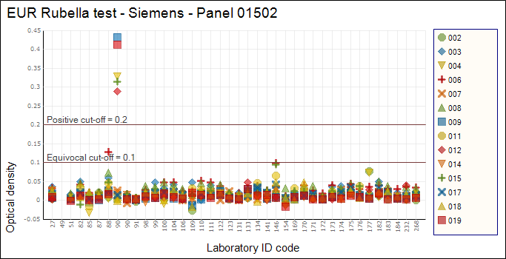
EUR Rubella - Siemens
Lab ID 90: First submission of rubella results <90%. Lab repeated test and subsequently reported results correctly. Lab reported mis-identification in the worksheet of the previous assay.
Lab ID 109: Test run invalid due to individual P/P control not within kit-specified upper and lower margins. Substrate incorrectly diluted 1/100 instead of 1/10.
Lab ID 172: Obtained equivocal results for 4 positive samples. Test met validation criteria.
Lab ID 182: Kit used past expiry date.

Slide 30
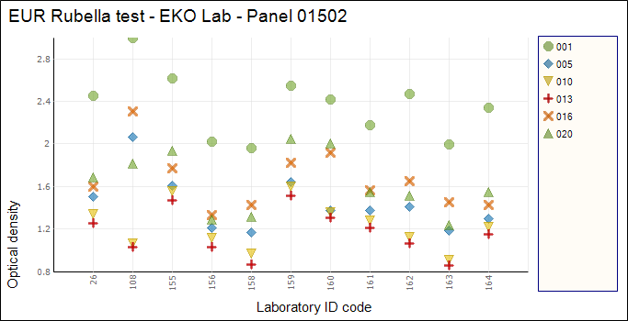
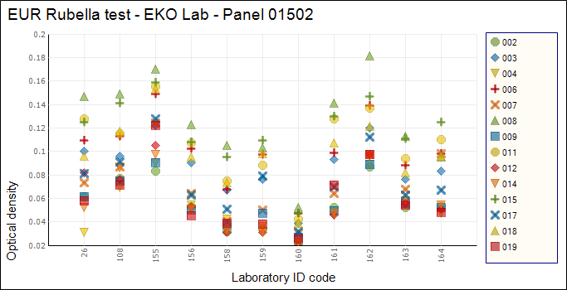
EUR Rubella – EKO Lab
Average cut-off = 0.288, range = 0.067 - 0.374

Slide 31
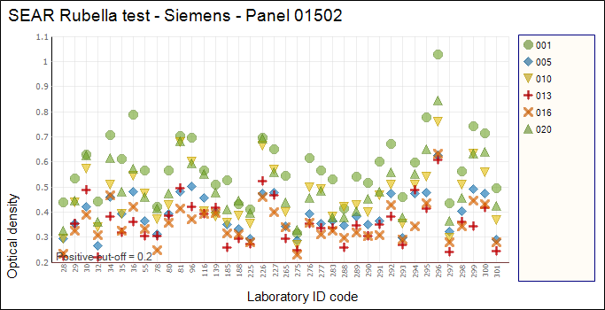
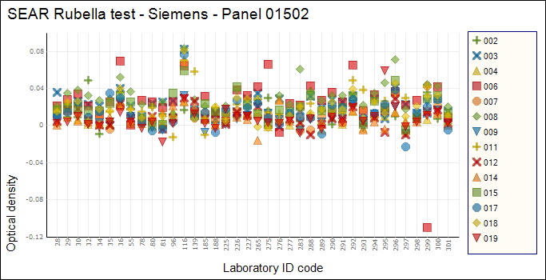
SEAR Rubella – Siemens
Lab ID 296: Higher OD values than general consensus. Similar observation for measles results.

Slide 32
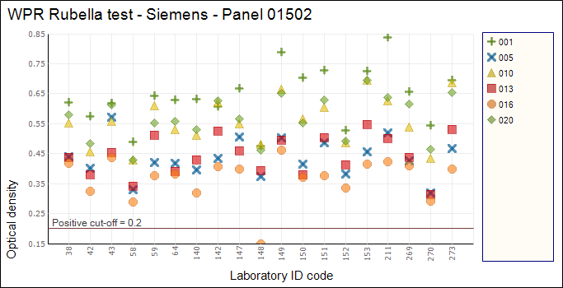
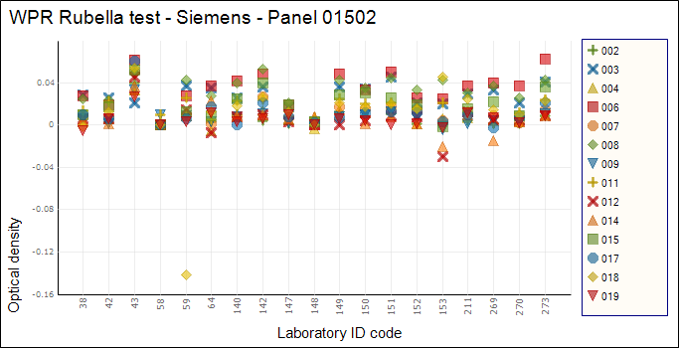
WPR Rubella - Siemens
Lab ID 38: Lab reported that samples were stored at room temperature.
Lab ID 148: Lower OD values than general consensus. Similar observation with measles test.

Slide 33
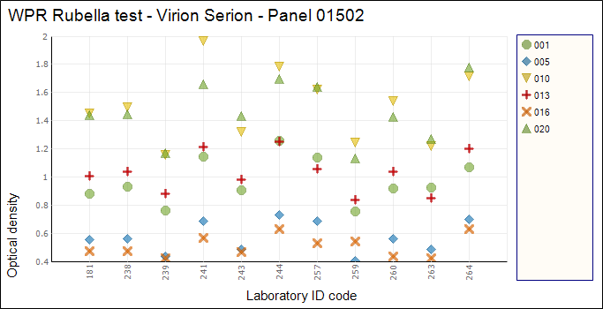
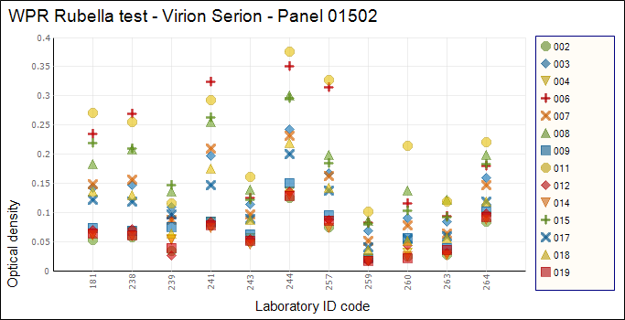
WPR Rubella – Virion Serion
Average cut-off = 0.379, range = 0.267 – 0.560

Slide 34
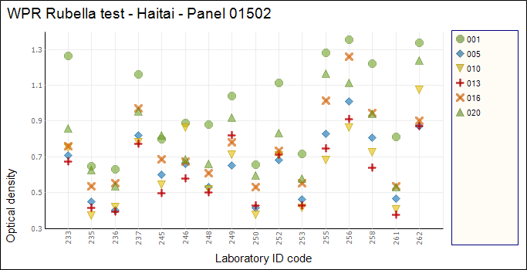
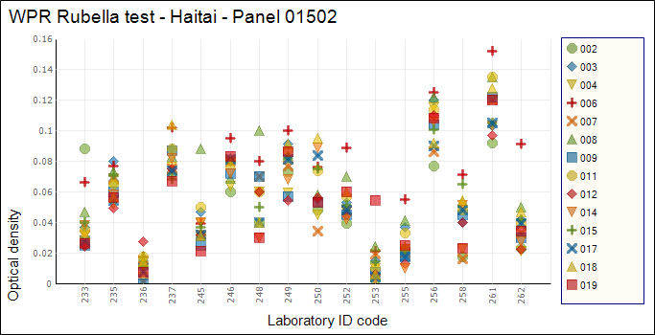
WPR Rubella – Haitai
Average cut-off = 0.348, range = 0.165 – 0.633

Slide 35
Analysis of discrepant results for Rubella IgM – Panel 01502
19 samples with discrepant results
Sample 005: 4 inconsistent results using Siemens kits, OD=>0.2 reported as Negative.
P=Positive, N=Negative

Slide 36
Part 1(75% of overall score) - Correct results by region – Measles Panel 01502
Correct results | AFR | AMR | EMR | EUR | SEAR | WPR | Total
5/5ª |  |  |  | 1 |  |  | 1
8/20 | 1 |  |  |  |  |  | 1
10/20 | 1 |  |  |  |  |  | 1
18/20 |  | 1 |  | 1 |  |  | 2
18/18 ^{b} | 1 |  |  |  |  |  | 1
19/20 | 3 |  | 1 | 1 | 1 |  | 6
20/20 | 32 | 18 | 18 | 67 | 38 | 53 | 226
Total results submitted | 38 | 19 | 19 | 70 | 39 | 53 | 238
ª Used as a supplementary assay for the positive samples.
^{b} Results were provided for 18 samples only.
100% score (5/5, 18/18 and 20/20) achieved for part 1: 228/238 (96%) results

Slide 37
Part 2 (25% of overall score)– Points achieved for correct data by region – Measles Panel 01502
Points | AFR | AMR | EMR | EUR | SEAR | WPR | Total
7/11 | 1 |  |  | 3 |  |  | 4
8/11 | 1 | 1 |  | 4 |  |  | 6
9/11 | 7 | 1 | 2 | 3 | 2 | 2 | 17
10/11 | 11 | 9 | 4 | 28 | 6 | 10 | 68
11/11 | 18 | 8 | 13 | 32 | 31 | 41 | 143
Total results submitted | 38 | 19 | 19 | 70 | 39 | 53 | 238
Data excludes timeliness of reporting.
11/11 score achieved for part 2: 143/238 (60%) results

Slide 38

Late to report (days) by WHO region
Late to report (days) | AFR | AMR | EMR | EUR | SEAR | WPR | Total
1-7 | 2 | 2 | 2 | 3 | 1 |  | 10
8-14 |  |  |  |  |  |  | 0
15-21 |  | 1 |  |  |  |  | 1
22-28 |  |  |  |  |  |  | 0
29-35 |  |  |  |  |  |  | 0
36-49 |  |  | 1 |  |  |  | 1
50-56 | 2 |  |  |  |  |  | 2
Total | 4 | 3 | 3 | 3 | 1 | 0 | 14

Slide 39
Overall final score by WHO region – Measles Panel 01502

Slide 40
Part 1(75% of overall score) - Correct results by region – Rubella Panel 01502
Correct results | AFR | AMR | EMR | EUR | SEAR | WPR | Total
6/6ª |  |  |  | 1 |  |  | 1
8/20 | 1 |  |  | 1 |  |  | 2
9/20 |  |  |  | 1 |  |  | 1
12/14^{b} | 1 |  |  |  |  |  | 1
14/14 ^{b} | 1 |  |  |  |  |  | 1
16/20 | 1 |  |  | 1 |  |  | 2
18/20 |  |  | 1 |  |  |  | 1
18/18^{c} | 1 |  |  |  |  |  | 1
19/20 | 3 | 3 |  | 4 |  | 1 | 11
20/20 | 30 | 15 | 17 | 64 | 39 | 52 | 217
Total results submitted | 38 | 18 | 18 | 72 | 39 | 53 | 238
ª Supplementary assay used for the positive samples.
^{b} Samples that tested positive for measles were not included for rubella testing.
^{c} Results were provided for 18 samples only.
100% score (6/6, 14/14, 18/18 and 20/20) achieved for part 1: 220/238 (92%) results

Slide 41
Part 2 (25% of overall score)– Points achieved for correct data by region – Rubella Panel 01502
Points* | AFR | AMR | EMR | EUR | SEAR | WPR | Total
7/11 |  |  |  | 3 |  |  | 3
8/11 | 1 |  |  | 4 | 1 |  | 6
9/11 | 7 | 1 | 2 | 4 | 1 | 2 | 17
10/11 | 13 | 10 | 5 | 27 | 2 | 9 | 66
11/11 | 17 | 7 | 11 | 34 | 35 | 42 | 146
Total results submitted | 38 | 18 | 18 | 72 | 39 | 53 | 238
Data excludes timeliness of reporting.
11/11 score achieved for part 2: 146/238 (61%) results

Slide 42
Late to report (days) by WHO region
Late to report (days) | AFR | AMR | EMR | EUR | SEAR | WPR | Total
1-7 | 2 | 2 | 2 | 3 | 1 |  | 10
8-14 |  |  |  |  |  |  | 0
15-21 |  | 1 |  |  |  |  | 1
22-28 |  |  |  |  |  |  | 0
29-35 |  |  |  |  |  |  | 0
36-49 |  |  | 1 |  |  |  | 1
50-56 | 2 |  |  |  |  |  | 2
Total | 4 | 3 | 3 | 3 | 1 | 0 | 14

Slide 43
Overall final score by WHO region – Rubella Panel 01502
EUR: 1 lab achieved <90% and subsequently performed repeat PT and obtained pass score. Lab reported mis-identification in the worksheet of first test run
EUR: 1 lab tested samples using 2 assays and achieved <90% using in-house assay and >90% using a commercial kit.

Slide 44
Summary proficiency test comparison– Global
Panel 01404 and 01502
 | Measles results |  | Rubella results
 | 01404 | 01502 | 01404 | 01502
Expired kits used | 7 | 3 | 6 | 6
Kit manufacturer reported | 100% | 99% | 100% | 100%
Kit lot number reported | 98% | 99% | 98% | 99%
Cut-off value reported | 67% | 81% | 72% | 84%
Test valid (known criteria) | 93% | 96% | 90% | 95%
Validation criteria not stated | 6% | 3% | 8% | 4%
Test results 100% correct | 90% | Part 1: 96% Overall: 56% | 94% | Part 1: 92% Overall: 55%
Test results ≥90% (pass) | 99% | Part 1: 99% Overall: 98% | 99% | Part 1: 97% Overall: 96%
Panel tested within 14 days | 96% | 97% | 96% | 97%
Results reported to VIDRL within 14 days | 85% | 94% | 84% | 94%

Slide 45

Conclusions:
Fewer measles and rubella results submitted achieved a perfect overall score - largely due to <100% score achieved in part 2.
Measles and rubella results were consistent with previous year’s results if comparing with results obtained in Part 1only.
Increased proportion of results submitted within 14 days compared with previous year.
Increased data reported for kit cut-off value compared with previous year for both measles and rubella test.
Approximately 75% of laboratories submitted data for in-house control for measles and rubella.

Slide 46
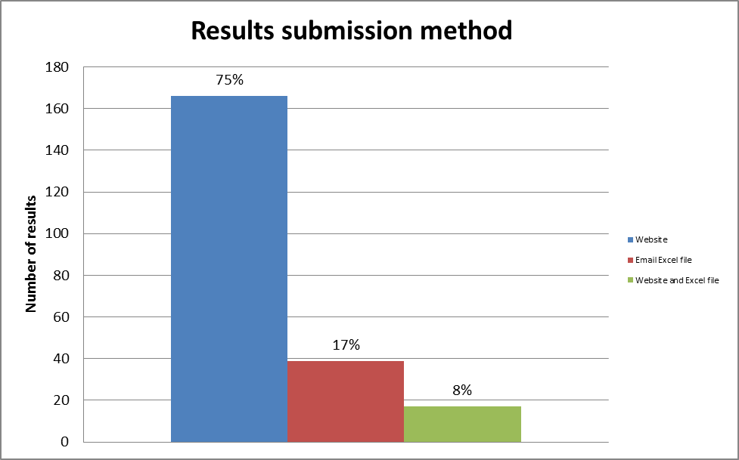

Results submission method, globally
Data as at 24th April 2016.

Slide 47
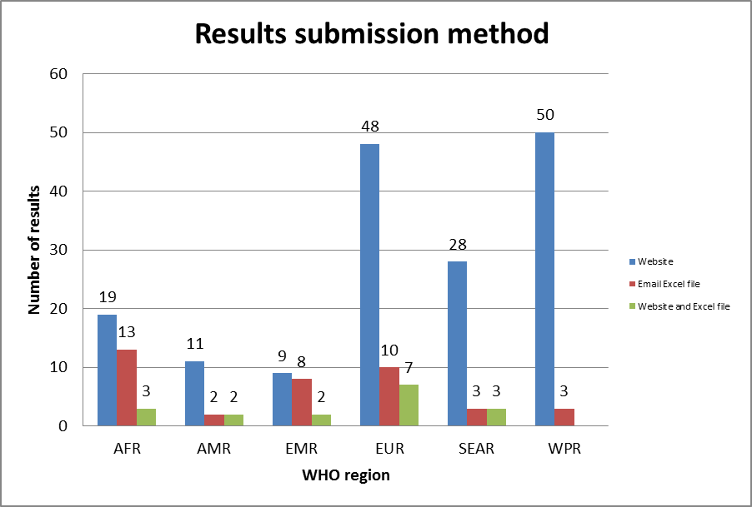
Results submission method by WHO region

Slide 48

Survey: Measles/rubella PT results submission via website
In April 2016, a survey was conducted (using SurveyMonkey) to obtain feedback from participants.
Survey comprised 7 questions.
Survey conducted anonymously and in English language only.
Survey available to respond for 17 days. A reminder was sent 1 day prior to closing date.
Survey link sent to email addresses (n=256) 19th April – every email address on our WHO measles/rubella PT results database including some duplicate labs.
Also, survey in Word document format was emailed to laboratories (n=40) that provided results for PT 01502 panel in Excel version format only, in case labs were ‘internet-challenged’.

Slide 49
Survey: Response
Survey link: 110 respondents
Word format emailed: 15 respondents
Total: 125 respondents
235 results for PT 01502 submitted by Survey closing date
% Response of participants that had submitted results for PT 01502 = 125/235 = 53%
Additional 5 respondents indicated (via email) that they were unable to reply to the Word document or open the survey link

Slide 50
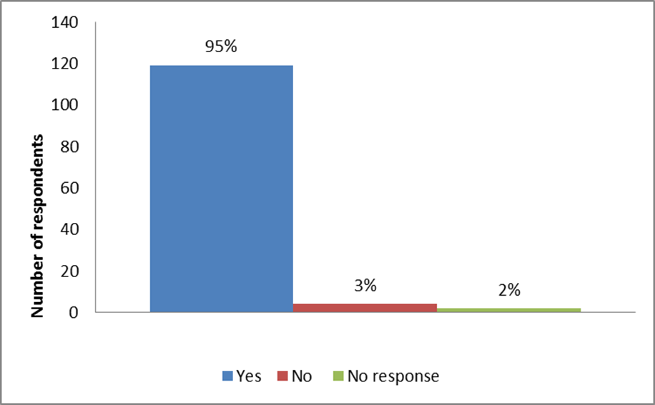

Q1: Have you submitted results for proficiency panel 01502?
n=125

Slide 51
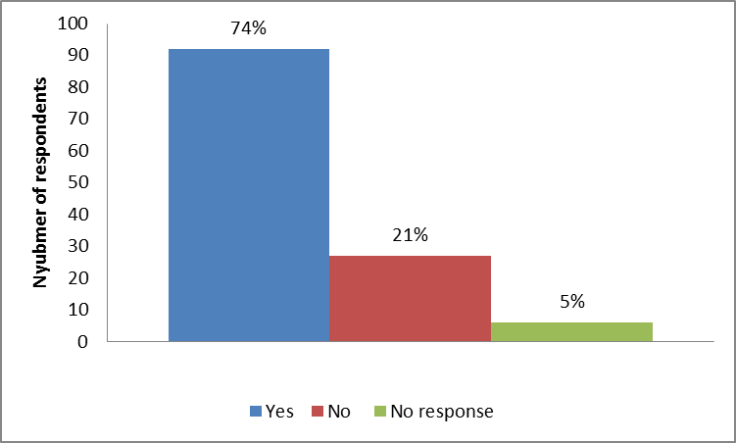
Q2: Have you submitted results for proficiency panel 01502 via the VIDRL website?
n=125
If answered No, further survey participation was not required.

Slide 52
Reason for not submitting PT results via the website
Reason/Explanation | No. of respondents (n=27)
Unable to login to website | 11
Not aware of website | 5
Login OK but browser issues encountered on reporting pages therefore, unable to submit results | 5
Challenges with internet during submission process* | 4
Submitted results to RRL directly via email | 1
No explanation given | 1
*Corrupt forms due to Gravity Forms that automatically update their plugins and prevented results submission (2 days offline), since then a code has been added; website relocated to a new host server (2 days offline)

Slide 53
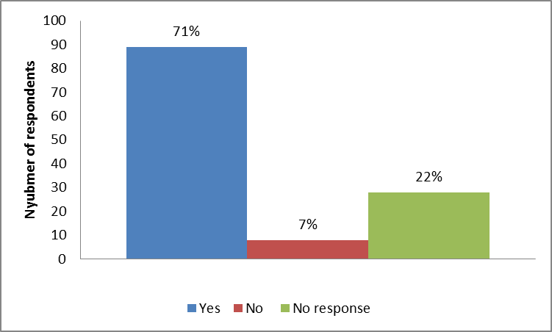
Q3: Were you satisfied with the login procedure?
84/92 participants that submitted results via the website were satisfied with the login procedure
8/92 participants that submitted results were not satisfied with login procedure
4 participants that did not submit results via the website were satisfied with the login procedure but experienced internet challenges eg. Page not loading.

Slide 54
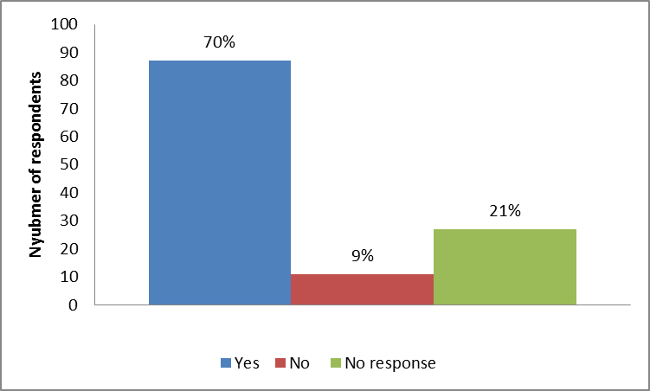
Q4: Were you able to navigate the report pages with ease?
9/11 respondents that answered ‘No’ submitted via the website
Respondents with no response (n=27) did not submit results via the website

Slide 55
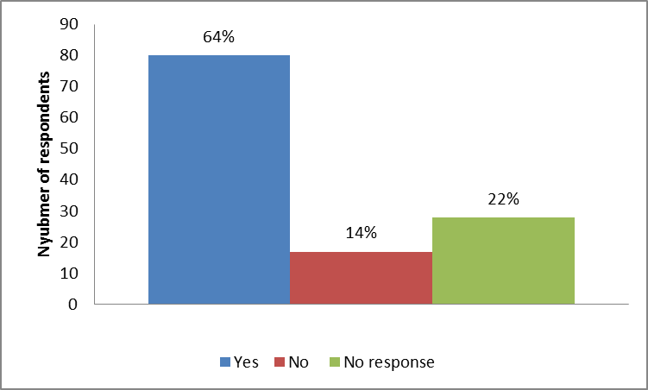
Q5: Were you able to enter data and results without problems?
16/17 respondents that encountered problems submitted via the website
23/28 respondents without a response did not submit results via the website.

Slide 56

Q6: Were adequate information and instructions provided for the results submission process?
13/14 respondents indicating inadequate information and instructions submitted via the website. Remaining 1 did not submit via the website

Slide 57
Q7: How can the submission process be improved?
Comments: | No. of respondents | Action taken
Easier login procedure | 8 | Ensure valid email address; familiarity
Reporting tables not user-friendly for kits other than Siemens | 5 | Non-Siemens table available
Technical issues – eg. Unable to ‘save and continue later’, incorrect data retrieved if saved temporarily | 4 | Changes made to rectify ‘Save and continue later’ function. Character encoding updated to accept and display any language or special character.
Instructions inadequate/not accessible unless logged in | 3 | Documents will be available on website
Confirmation of results when submitted/received at VIDRL | 3 | In progress
Function on report page to automatically calculate OD data from raw OD values suggested to minimise transcription error* | 3 | ?Website version 3
Copy/paste function suggested to minimise transcription error* | 2 | ?Website version 3
Upload results file instead of individual entry of data to minimise* transcription error | 2 | ?Website version 3
Information for availability of a website | 1 | Increased awareness of website

Slide 58

*Alternative option for submission of test results
Consider an ‘Upload’ option for submission of results via a csv/xls file
Steps:
User can select ‘Download’ csv or xlsx template from VIDRL website
Populate template with results for submission
Then ‘Upload’ back to VIDRL site which checks the template for parsing errors and allows user to continue with submission procedure.
Time constraints prevented development of this method as an alternative pathway for test results submission.
?Possible consideration for version 3

Slide 59

Challenges
Provide further assistance to laboratories that are unable to login to the website
Replenishment of serum supplies – IgM positive for:
measles, rubella and parvovirus.
Our currently available stocks will not allow preparation of a PT panel for 2017.
All contributions of sera will be greatly appreciated!

Slide 60
Acknowledgements
Serology Infectious Diseases Laboratory Staff, VIDRL
WHO measles and rubella network laboratories for PT and survey participation
Dr Mick Mulders, WHO global coordinator
WHO Measles and rubella regional laboratory coordinators
Dallas Wilson, Information Technology, VIDRL
All laboratories that have donated sera for the proficiency
panels

