Slide 1
MeaNS, RubeNS and a global update
Kevin Brown
Virus Reference Department
National Infection Service
22 June 2016

Slide 2
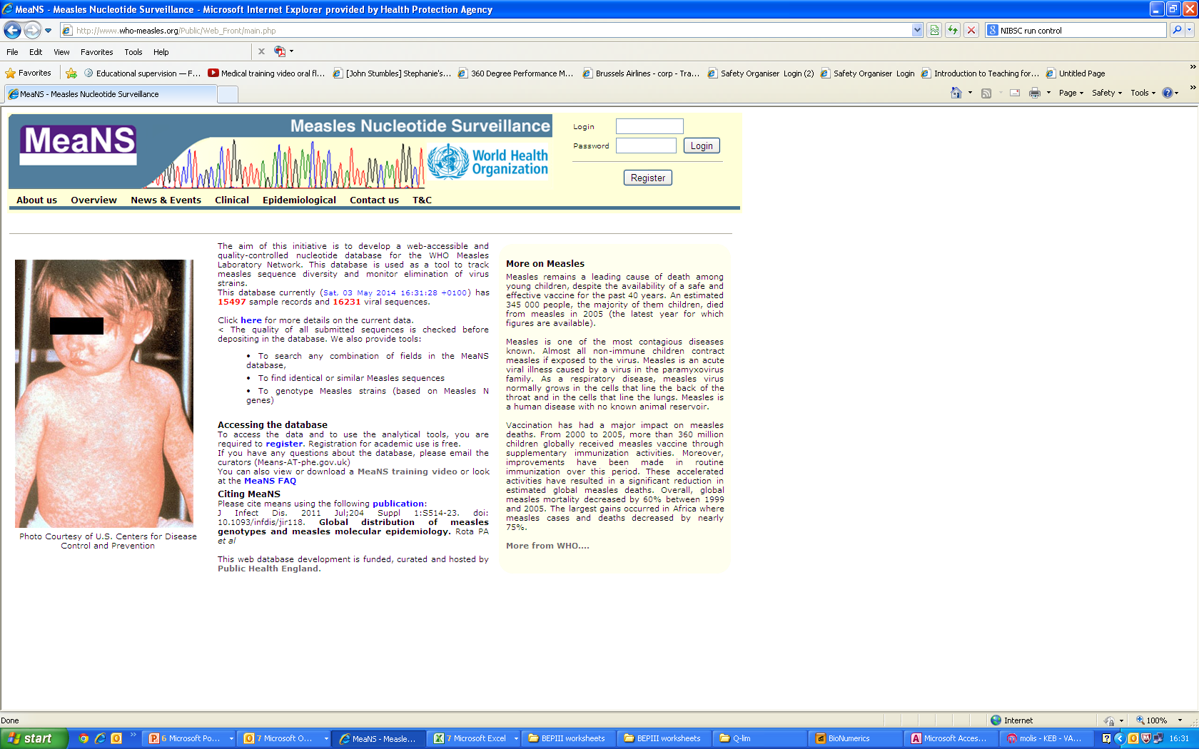
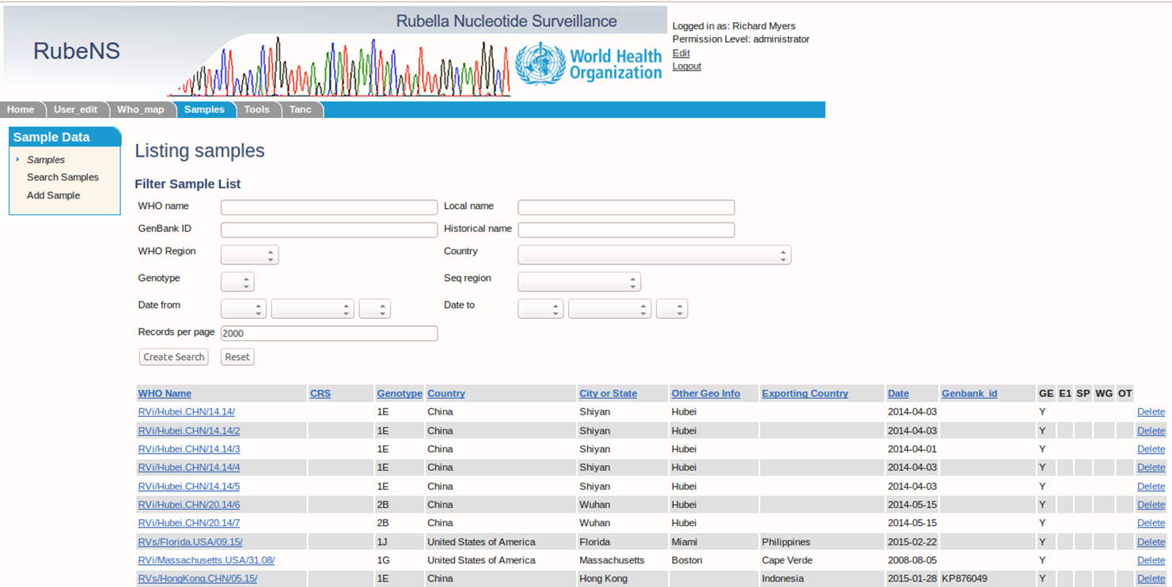
www.who-measles.org or www.who-rubella.org

Slide 3
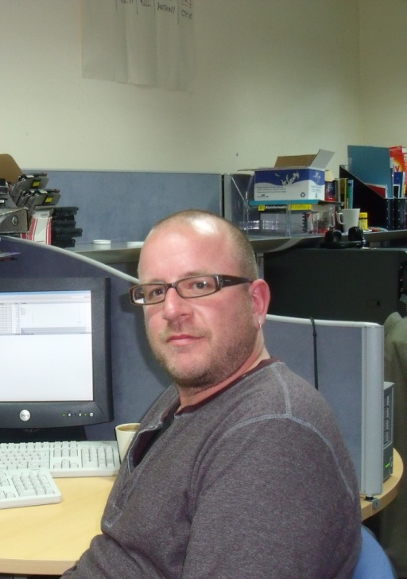

MeaNS/RubeNS
Bioinformatician
Richard Myers – new post in 2015
Currently no-one in post
Will be appointing to 2 posts
Candidates selected and offers made
David Williams: start August 2016

Slide 4
MeaNS and RubeNS – June 2016
MeaNS
  28978 Sample Records
  29822 Viral Sequences
RubeNS
  1590 Viral Sequences
4
Manual for the laboratory diagnosis of measles and rubella virus infection
WHO – EPI, WHO/IVB/07.01: 2nd edition 2007

Slide 5
MeaNS Submissions

Slide 6
MeaNS Vaccine Sequences
There continues to be submission of MeV vaccine sequences to MeaNS
    31 since the start of 2014
This is not what MeaNS was designed for and it would be better if people stopped doing this.
There is a message to this effect, but still being ignored
MeaNS genotypes sequences on entry so it would be possible to prevent submission of genotype A sequence, accompanied by a message that asking the submitter to contact us if there is good reason to submit – is it needed?
6
Manual for the laboratory diagnosis of measles and rubella virus infection
WHO – EPI, WHO/IVB/07.01: 2nd edition 2007

Slide 7
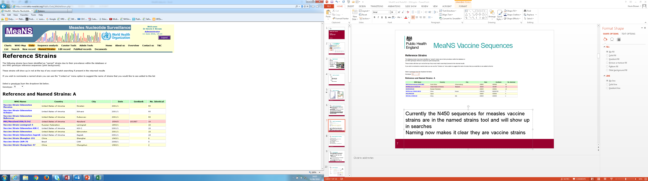
MeaNS Vaccine Sequences
Currently the N450 sequences for measles vaccine strains are in the named strains tool and will show up in searches
Naming now makes it clear they are vaccine strains
7
Manual for the laboratory diagnosis of measles and rubella virus infection
WHO – EPI, WHO/IVB/07.01: 2nd edition 2007

Slide 8
WHO naming
Sequences are stored according to WHO name
Cannot have two different sequences with same WHO name
Use naming convention as in WER
WER 2 March 2012, No 9, vol 87 pp73-80
ie MVs/Newcastle under Lyne.GBR\16.16\
No commas, underscores, city or state (not both), no \1 if first sequence
(When submitting to MeaNS or RubeNS no need to include genotype in the name)
MeaNS will generate the name if you have the relevant information
You cannot edit the WHO name once submitted. If there is a major error and it needs to be changed please send e-mail to MeaNS, with the justification.
However:
There are several different ways of generating Epi week in different countries.
Additional epi data (ie week of onset instead of sample data) is not a justification of changing the name

Slide 9
New sequence checking
When sequences are submitted:
New tool that will compare sequence to reference sequences
Identify which coding region of the virus
Then submit to the relevant fields
If more than 1 field (ie total N, or whole genome)
will populate all the relavent fields
Currently in the trial database
Will be imported into live database when bioinformatician in place

Slide 10
Batch update – WHO submission sheet
It appears many labs are still using the old WHO submission sheet:
This can be used for submitting sequences to MeaNS/RubeNS
Need to paste the sequence into the spreadsheet.
Please do not send sequences as a separate .fas file

Slide 11
MeaNS submission by region
11
Manual for the laboratory diagnosis of measles and rubella virus infection
WHO – EPI, WHO/IVB/07.01: 2nd edition 2007

Slide 12
MeaNS by genotype
12
Manual for the laboratory diagnosis of measles and rubella virus infection
WHO – EPI, WHO/IVB/07.01: 2nd edition 2007

Slide 13
MeaNS Genotype Diversity
13
Manual for the laboratory diagnosis of measles and rubella virus infection
WHO – EPI, WHO/IVB/07.01: 2nd edition 2007

Slide 14
MeaNS Genotype Diversity
14
Manual for the laboratory diagnosis of measles and rubella virus infection
WHO – EPI, WHO/IVB/07.01: 2nd edition 2007

Slide 15
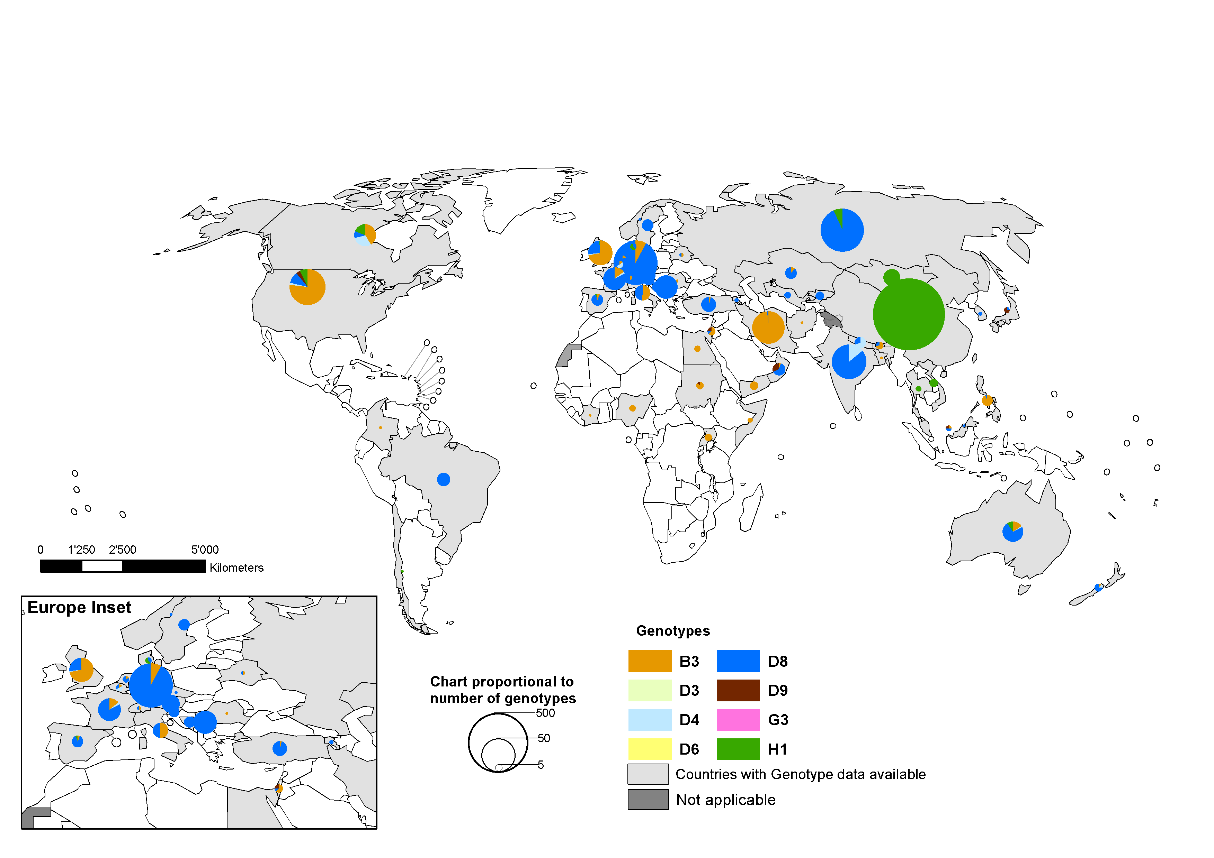

Distribution of measles genotypes
year 2015
Data in HQ as of 7 March 2016
Note: Pie chart proportional to the number of sequenced viruses:
China data has been adjusted by size (total genotyped = 2862).

Slide 16
MeaNS Genotype Diversity
Genotype data in MeaNS appears to show a reduction in the number of genotypes
At a WHO regional level:
D8 and B3 dominate for most regions
H1 skews the distribution in WPR
Impact of sampling bias:
Some countries submitting all data
Some countries only unique sequences
Some countries not sequencing at all
16
Manual for the laboratory diagnosis of measles and rubella virus infection
WHO – EPI, WHO/IVB/07.01: 2nd edition 2007

Slide 17
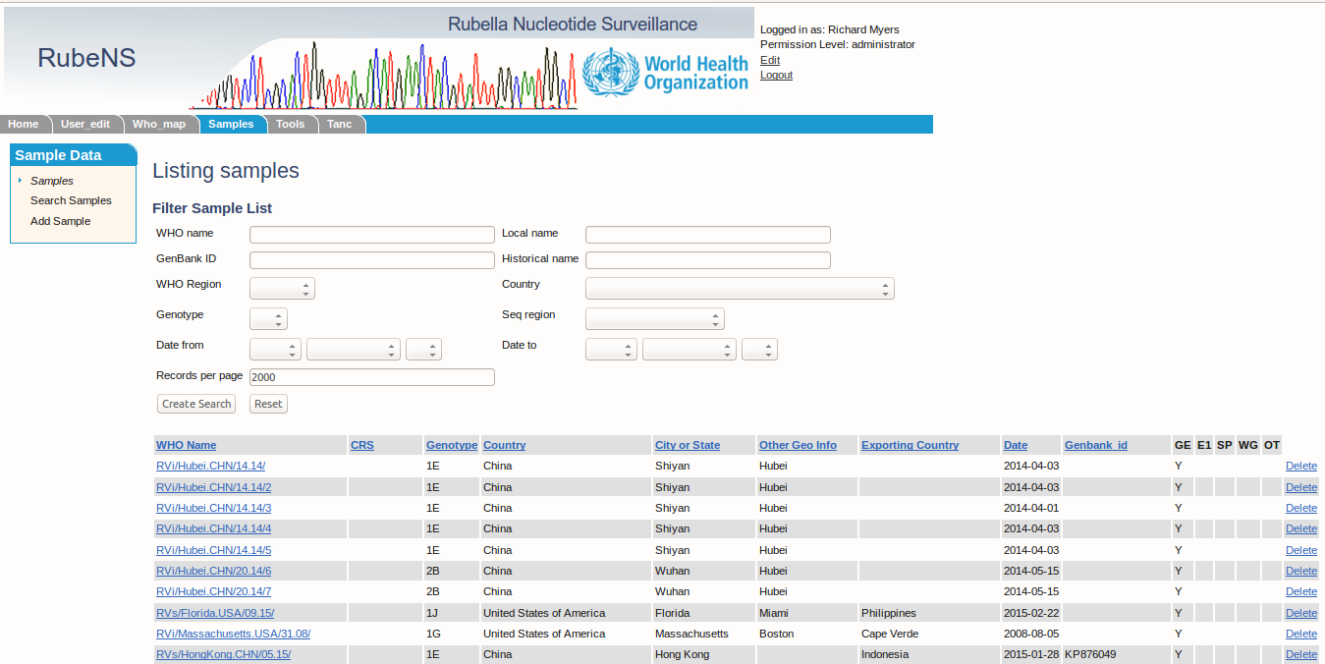
RubeNS Website
Site is being used
Submissions are limited
17
Manual for the laboratory diagnosis of measles and rubella virus infection
WHO – EPI, WHO/IVB/07.01: 2nd edition 2007

Slide 18
RubeNS Submissions
Number of submission is increasing, but…..
18
Manual for the laboratory diagnosis of measles and rubella virus infection
WHO – EPI, WHO/IVB/07.01: 2nd edition 2007

Slide 19
RubeNS Submissions
…majority coming from only one or two countries
19
Manual for the laboratory diagnosis of measles and rubella virus infection
WHO – EPI, WHO/IVB/07.01: 2nd edition 2007

Slide 20
RubeNS genotypes

Slide 21
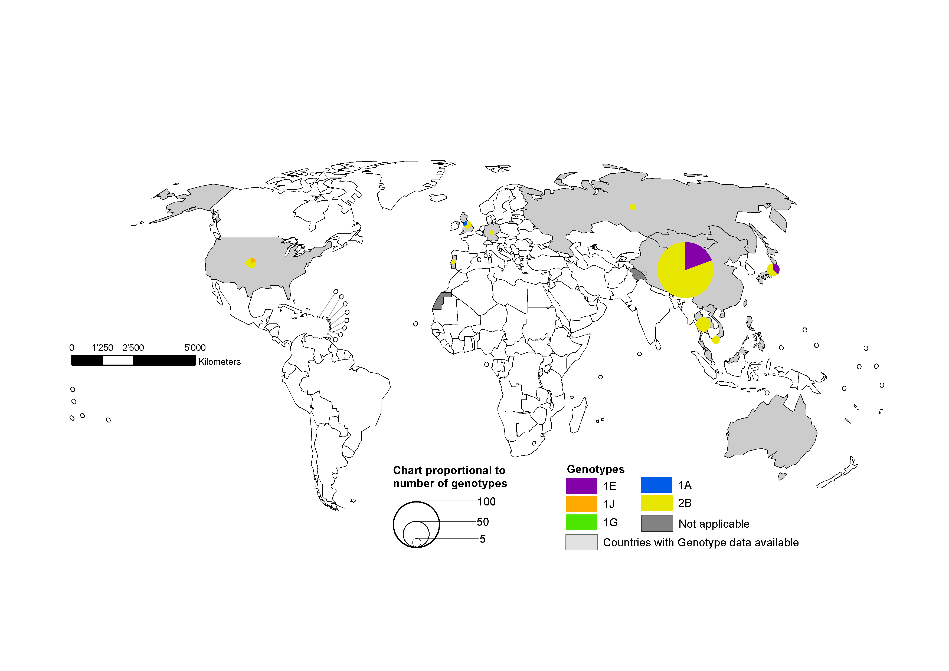
Distribution of rubella genotypes
year 2015
Data in HQ as of 7 March 2016
Note: Pie chart proportional to the number of sequenced viruses:
China data has been adjusted by size (total genotyped = 255).

Slide 22
MeaNS and RubeNS
Invaluable tools for monitoring transmissions
Valuable tools for documenting importations/monitoring loss of endemic viruses within countries
Large repository of data
Can monitor the ‘disappearance’ of some measles genotypes
Data is very heavily samples biased
Even more sampling bias in RubeNS
Talk on measles diversity on Thursday (S7 31)
MeaNS/RubenS steering committee on Friday am
All suggestions for ways to increase submissions especially for rubella sequences welcome

Slide 23
Steering committee
Joe Icenogle/Kevin Brown - Chairs
Josephine Bwogi
Judith Hübschen
Patcha Incomserb
Katsuhiro Komase
Mick Mulders
Paul Rota
Sabine Santibanez
Sergey Shulga
Sheilagh Smit
Makota Takeda
Henda Triki
Wenbo Xu
Zhen Zhu

