Slide 1
Whole Genome sequencing for measles ; A case study in Brazil
Alberto Severini , Marilda Siqueira , David Brown

Slide 2
Aims
To describe the control programme and surveillance of measles in Brasil.
Describe the recent outbreaks in Ceara and Pernambuco, nos and timing of cases ,measles genotyping and sampling frame.
NGS methods , results and interpretation

Slide 3
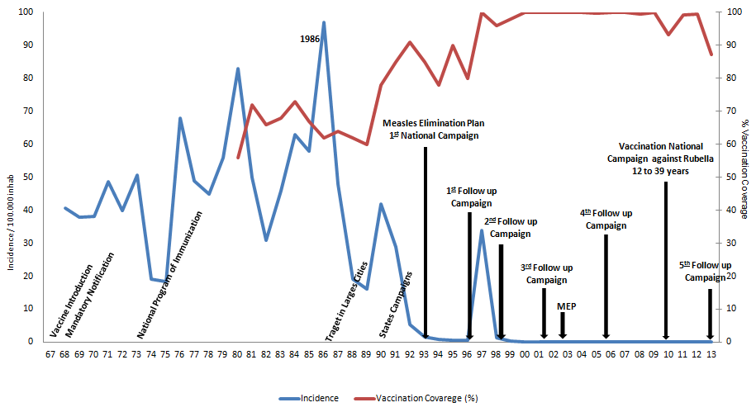
Measles: Control Strategies and Incidence,
Brazil - 1968 to 2013*
Source: MoH
Note: * Data updated on 01/13/2014.

Slide 4
Pattern of Measles Confirmed Cases, Brasil: 2010-2012
2010 n=68
2011 n=43
Pará
3 cases (D4)
PI - 01 case (G3)
Paraíba
57cases (B3)
BA - 01 case (D4)
DF - 01 case (D4)
MG- 01 case (D4)
RS
08 cases (B3)
RJ- 04 cases (D4)
SP - 27 cases (D4)
MS - 01 case (D4)
RS- 07 cases (D4)
PE – 01 case (D4)
SP – 01 case (D8)
2012 n=2
Source: MoH
.

Slide 5

Pattern of confirmed Measles Cases, Brasil - 2013
N= 220
CE – 01 caso (D8)
PB – 09 casos (D8)
PE – 200 casos (D8)
DF – 01 caso (B3)
MG – 02 casos (D8)
ES – 01 caso (D8)
SP – 05 casos (D8 e D4)
SC – 01 caso (D8)
Fonte: UVRI/CGDT/DEVIT/SVS/MS.

Slide 6
Pattern of confirmed Measles cases, Brasil - 2014
N= 876
CE – 840 casos (D8)
PE – 26 casos (D8)
RJ – 03 casos (D8)
SP – 07 casos (D8 e B3)
Fonte: UVRI/CGDT/DEVIT/SVS/MS.

Slide 7
Casos Confirmados de Sarampo, Brasil - 2015*
RR – 01 caso
N= 214
CE – 211 casos (D8)
SP – 2 casos
Fonte: UVRI/CGDT/DEVIT/SVS/MS.

Slide 8
Number of confirmed measles cases by epidemiological week, selected states
Brazil, 2013-2015*
2013
2014
2015
Number of cases
Source: Country reports to FGL-IM/PAHO.
*Data as of 04 February 2016
.
Notes:
A partir del 19 de marzo de 2013 Brasil inicia un brote de sarampion en Pernambuco, que dura 51 semanas y que ocasiona 226 casos y una defuncion en 24 municipios. Posteriormente se disemina a 9 estados, con pequenos brotes, pero principalmente a Ceará a partir de la semana 51 de 2013.

Slide 9
Epidemics/outbreaks of Measles in Brasil, 2013-2015
Pernambuco
Population 9.3 million
Data de Exantema: 1º caso confirmado 19/03/2013 e o último caso 14/03/2014(52 weeks)
Confirmed cases: 226
Critério de Confirmação:
Laboratory: 204 (90%)
Samples for PCR
Ceará
Population 8.8million.
Data de Exantema: 1º caso confirmado 25/12/2013 e o Último caso 06/07/2015(79weeks )
OVERLAP 11 weeks
Confirmed cases: 1.052
Critério de Confirmação:
Laboratory: 909 (86%)
Samples collected for PCR
Clinical samples with ct<30 and good volume sent for WGS.

Slide 10
Comments/Questions
All strains Genotyped D8, two types 1 bp difference.
Lack of clear epidemiological links between chains of transmission in all of the different cities and towns involved.
After several years in the elimination phase , do these outbreaks represent sustained transmission of measles or more than 1 introduction?

Slide 11
Molecular epidemiology
We used extended sequencing in the attempt to determine if the Pernambuco and Ceará outbreaks were caused by two distinct importation.
We sequenced the MF-NCR region, which was shown to be hypervariable
We compared the Brazilian sequences with similar sequences isolated in an UK outbreak
25 isolates from Ceará
31 isolates from Pernambuco

Slide 12
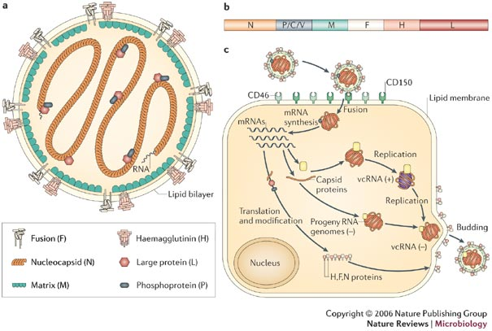
Measles genome
WHO genotyping N target 450 nt
M/F UTR target
1366 nt
Alternate genotyping target:
H ORF, 1854 nt
Moss & Griffin, 2006
Whole genome sequencing
15894 nt

Slide 13
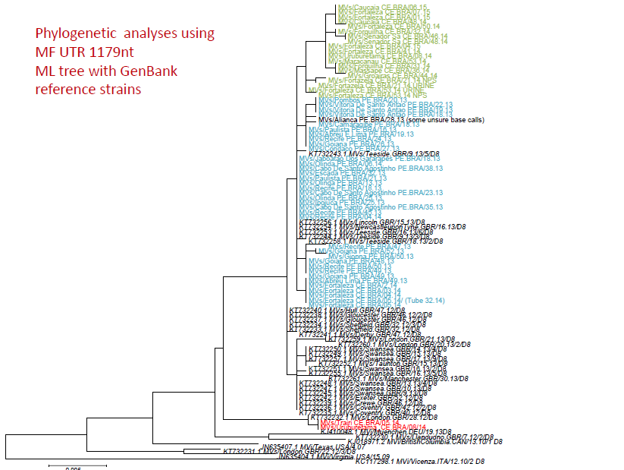
Ceará
Pernambuco

Slide 14
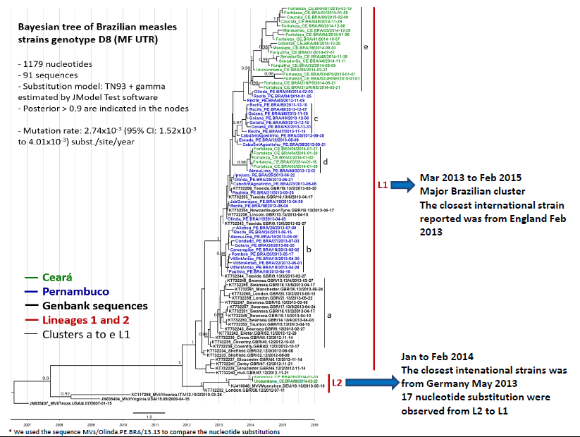
t

Slide 15
Conclusions
Extended sequencing shows that the original strain introduced in Brazil was similar to the strain circulating in the UK.
Most of the sequences from Ceará are on a distinct branch, but the topology of the tree favours the hypothesis of only one importation
Collection of more virus specimens from the Pernambuco and outbreak would have provided a better resolution of the outbreak
We encourage collection of as many NP specimens as possible from every outbreak.

Slide 16
ACKNOWLEDGEMENTS
NRL/FIOCRUZ
Xenia Lemos; Suellen Soares, Paola Silva.
MoH/Brazil
Flavia Caselli Pacheco; Giselle Siqueira; Marli Costa; Fabiano Marques
MR Lab Net Brazil
NML Canada
Robin Thorington; Joanne Hiebert;Helene Schulz
PAHO
Gloria Rey

